Slide 1

Planning for Year Three in the LCAP
An Opportunity for Continuous Improvement
California Department of Education – April 14, 2026

Slide 2
Acronyms
LCAP—Local Control and Accountability Plan ​
LCFF—Local Control Funding Formula
LEAs—Local Educational Agencies (School districts, county offices of education, and charter schools)​
COE—County office of education
CAASPP — California Assessment of Student Performance and Progress

Slide 3

Purpose
This webinar will provide strategies for local educational agencies (LEAs) to consider when planning for Year 3 of the current local control and accountability plan (LCAP) cycle. We will provide strategies and tools which enable LEAs to demonstrate how actions within the LCAP have been implemented and are being effective, which will enable LEAs to set the stage for success when transitioning to the next three-year LCAP cycle.

Slide 4


Agenda
The LCAP Cycle and the Importance of Year 3
Principles of Evaluation
Monitoring Implementation Fidelity
Determining Effectiveness or Ineffectiveness
Responding to Analysis

Slide 5


The LCAP Cycle and the Importance of Year Three
Foundations for Understanding

Slide 6
What is The LCAP Cycle?
For school districts and county offices of education, the LCAP is a three-year plan that is updated on or before July 1 of each year.
Charter schools may align the LCAP timeline to the term of the charter schools' budget.

Slide 7
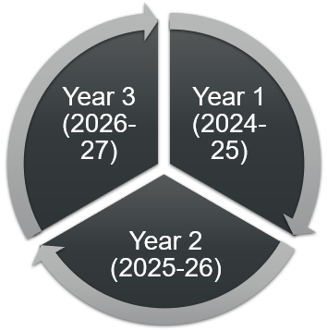
Current LCAP Cycle:
School districts and COEs

Slide 8
Current LCAP Cycle: Typical Charter School

Slide 9
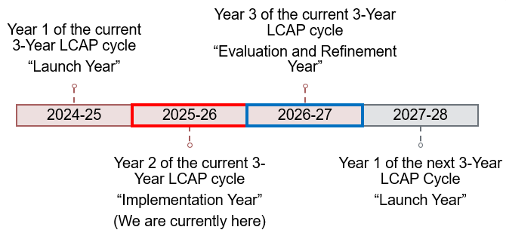
Current Three-Year LCAP Timeline
*see Appendix A for descriptive text

Slide 10
The Importance of Year 3
Beginning with the development of the 2024–25 LCAP, the LEA must change actions that have not proven effective over a three-year period (LCAP template and instructions, page 16).
For most actions in the LCAP the three-year period for evaluating effectiveness will end with the 2026–27 LCAP.
  In most cases, actions deemed ineffective at the end of the 2026–27 LCAP must be changed in the 2027–28 LCAP.
  For actions that have been identified as ineffective, the LEA must identify the ineffective action, the reasons for the ineffectiveness, and how changes to the action will result in a new or strengthened approach in the 2027–28 LCAP.

Slide 11
Opportunity in Year 3
Year 3 provides an LEA with an opportunity to evaluate its implementation and progress thus far and make course corrections prior to implementing the final year of the plan.
  Identifying the difference that actions and services have made for students and the system and making necessary adjustments reinforces accountability and drives continuous improvement.

Slide 12
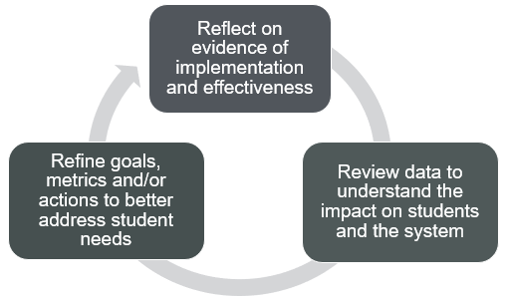
Reflection and Refinement
*see Appendix B for descriptive text

Slide 13



Principles of Evaluation
A Framework for Determining Impact

Slide 14
The Framework
Define the Problem
Identify Success Metrics
Collect Data
Compare Against Baselines
Monitor Implementation Fidelity
Examine Equity
Determine the Return on Investment (ROI)
Create a Continuous Improvement Loop

Slide 15
1. Define the Problem
Before evaluating goals and actions in the LCAP an LEA must clarify the problem(s) that it is seeking to address.
We must ask the following questions:
  What problem are we trying to solve?
  What change do we expect to see?
  Why do we think this strategy will cause that change?
This is often referred to as a “Theory of Action”

Slide 16
Theory of Action
A theory of action is a clear, logical explanation of how and why a particular strategy or set of actions is expected to lead to the outcomes you want.
Think of it as the cause‑and‑effect roadmap behind an initiative.

Slide 17
Why a Theory of Action Matters
A strong theory of action helps teams:
  Stay focused on the actual problem they’re trying to solve
  Ensure their activities are connected to desired outcomes
  Identify what to measure (both implementation and results)
  Spot weak assumptions before time and resources are spent
  Build shared understanding among staff and stakeholders
In short: a theory of action keeps strategy from becoming “random acts of improvement.”

Slide 18
Components of a Strong Theory of Action
A high-quality theory of action includes four elements:
The problem or need: what issue are we trying to address?
The strategy/inputs: what actions or interventions are we implementing?
The mechanism (the “because”): why should this strategy lead to the outcome? What’s the research or logic connecting them?
The expected outcomes: what short term, intermediate, and long-term results do we expect?

Slide 19
Simple Theory of Action Template
If we ____ (identify actions/strategies),
then ____ (identify the immediate changes in adult practice or student experience),
which will lead to ____ (identify the desired student outcomes),
because ____ (identify the research‑based rationale connecting strategy → change → outcome).

Slide 20
Sample Theory of Action
If we provide teachers with evidence‑based literacy training and weekly coaching,
then they will use structured reading instruction consistently and accurately,
which will lead to improved foundational reading skills for students in grades K–3 as measured by the LEAs early literacy assessment,
because systematic, explicit instruction in phonics and phonemic awareness is shown to improve early literacy outcomes.

Slide 21
Theory of Action vs. Logic Model
Concept | Purpose
Theory of Action (conceptual) | Explains why the strategy should work (i.e., the reasoning).
Logic Model (operational) | Describes what will happen operationally (e.g., inputs, activities, outputs, outcomes).

Slide 22
Sample Logic Model (1)
Logic Model Element | Metrics
If we provide targeted tutoring in reading comprehension 2 sessions per week for 10 weeks to identified students… | Implementation metric(s): Percentage of identified students receiving all 20 sessions; percentage of tutors trained in program model; attendance rate in tutoring sessions
Then tutors will deliver consistent, structured lessons aligned to reading comprehension strategies… | Implementation metric(s): fidelity checklist completion; observation data; tutor logs
Sample courtesy of Riverside County Office of Education

Slide 23
Sample Logic Model (2)
Logic Model Element | Metrics
So that students will increase their ability to comprehend and analyze text at their grade level… | Effectiveness metric(s): identified student growth on interim reading comprehension assessments; progress monitoring data
To achieve an average improvement of 1.5 reading levels as measured by the end-of-semester reading assessment. | Outcome metric(s): end of semester reading assessment data; percentage of identified students meeting or exceeding growth target
Sample courtesy of Riverside County Office of Education

Slide 24

In order to learn how to do something well, you have to fail sometimes. In order to fail, there has to be a measurement system.
Steve Jobs

Slide 25
2. Identify Success Metrics (1)
Once the problem has been defined the next step is to identify success metrics. These metrics are two-fold:
  Leading indicators (early signals): These tell you quickly whether implementation is on track, such as
    Participation rates
    Fidelity of implementation
    Engagement measures
    Interim assessments
    Attendance/behavior early shifts
  Leading indicators help you adjust before a strategy fails.

Slide 26
2. Identify Success Metrics (2)
(Continued)
  Lagging indicators (outcomes): These reflect the long-term results:
    Academic achievement
    Graduation or completion rates
    College/career measures
    Long-term attendance/behavior trends
  A strategy is “working” when both implementation AND outcomes improve.

Slide 27
Measuring and Reporting Results In the LCAP Template
Metric # | Metric | Baseline | Year 1 Outcome | Year 2 Outcome | Target for Year 3 Outcome | Current Difference from Baseline
[Metric #] | [Insert metric here] | [Insert baseline here] | [Insert outcome here] | [Insert outcome here] | [Insert target outcome here] | [Insert current difference from baseline here]

Slide 28
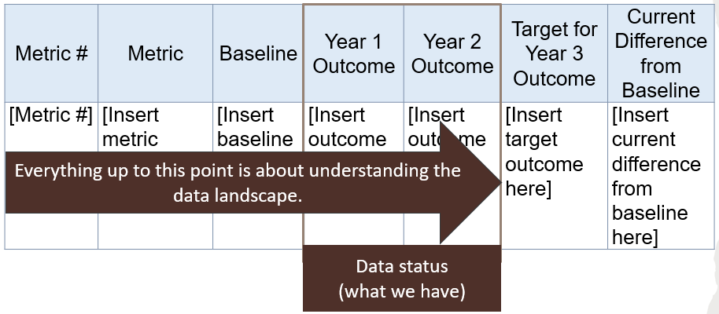
Understanding the Data Landscape
*see Appendix C for descriptive text

Slide 29
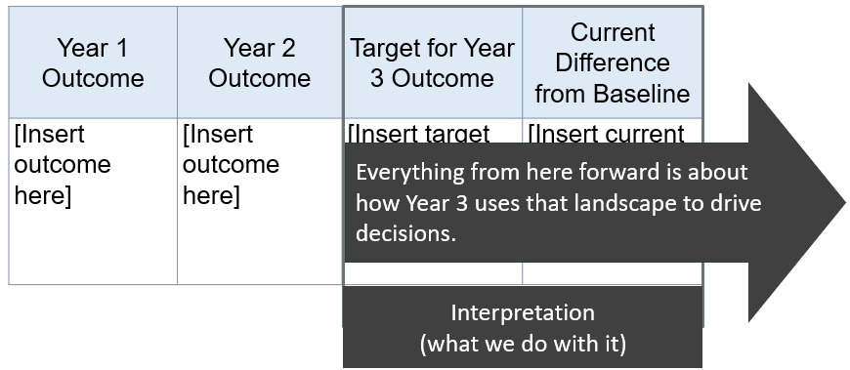
Interpreting the Data
*see Appendix D for descriptive text

Slide 30
Example of a Metric (1)
Metric | Baseline | Year 1 Outcome | Year 2 Outcome | Target for Year 3 Outcome | Current Difference from Baseline
Percentage of correct responses on the Interim District Common Assessment (Math) reported by student groups Source: District Common Assessment Performance (Math)

Slide 31
3. Collect Data in Multiple Ways
Benchmarks and Assessments
Qualitative Data
Benchmarks and assessments
State/national exams
Progress monitoring
Attendance, discipline, course-taking
Program usage data
Classroom observations
Focus groups (students, families, staff)
Teacher feedback
Student work analysis
Implementation audits
Qualitative data often explains why something is or isn’t working.

Slide 32
4. Compare Against Baselines or Control Conditions
A strategy might look good… until you compare it to:
  Previous years
  Similar student groups
  Schools not using the strategy
  State or national trends
Control or comparison data helps avoid misleading conclusions.

Slide 33
Example of A Metric (2)
Metric | Baseline | Year 1 Outcome | Year 2 Outcome | Target for Year 3 Outcome | Current Difference from Baseline
Percentage of correct responses on the Interim District Common Assessment (Math) reported by student groups Source: District Common Assessment Performance (Math) | All Students (All): 70% Low Income (LI): 63% African American (AA): 60% American Indian (AI): 64% (2023-24) | All: 72% LI: 61% AA: 65% AI: 66%

Slide 34



5. Monitor Implementation Fidelity
Identifying Current Implementation and Progress

Slide 35
Determining the Impact
Within the LCAP, LEAs are required to reflect on the previous year(s) and make determinations in a number of areas:
  Implementation
  Material differences
  Effectiveness or ineffectiveness
  Changes
This is captured within the Goal Analysis portions of the LCAP.

Slide 36
Goal Analysis for 2025–26

Slide 37
Prompt 1: Implementation
A description of overall implementation, including any substantive differences in planned actions and actual implementation of these actions, and any relevant challenges and successes experienced with implementation.
[Respond here]

Slide 38
Prompt 1: Instructions
Instructions:
  Describe the overall implementation of the actions to achieve the articulated goal.
    Include a discussion of relevant challenges and successes experienced with the implementation process.
    This must include any instance where the LEA did not implement a planned action or implemented a planned action in a manner that differs substantively from how it was described in the adopted LCAP.

Slide 39
Implementation vs. Effectiveness
Implementation tells us whether we did the thing.
Effectiveness tells us whether doing the thing made a difference.

Slide 40
Metrics:
Implementation v. Effectiveness
Implementation metrics measure how well a particular program, process, or intervention is being put into place.
  These metrics focus on whether the intended activities and strategies are being carried out as planned.
Effectiveness metrics, on the other hand, assess the impact and outcomes of a program or intervention. They focus on measuring the degree to which the desired goals and objectives are being achieved and whether the program is producing its intended results.

Slide 41
The Five Core Dimensions of Implementation Fidelity (1)
Researchers commonly measure implementation fidelity across five dimensions:
Adherence – Are educators implementing the required components?
Dosage/Exposure – Are students receiving the amount of instruction or intervention intended (minutes, frequency)?
Quality of Delivery – Is the instruction delivered effectively and aligned with expectations?

Slide 42
The Five Core Dimensions of Implementation Fidelity (2)
(Continued)
Participant Responsiveness – Are students engaged and participating as intended?
Program Differentiation – Is the strategy distinguishable from other practices? (i.e., not blended beyond recognition)
Generally, a strong implementation fidelity system measures at least three of these; a great one measures all five.

Slide 43
Possible Ways to Measure Fidelity of Implementation
Implementation Checklists
Classroom Observations
Artifacts and Work Samples
Usage Data
Surveys and Interviews
Coaching Logs & Professional Learning Community (PLC) Notes

Slide 44
A. Implementation Checklists (Teacher Self Report)
Simple checklists aligned with the strategy’s required components.
Examples:
  “Did I teach the lesson using ___ framework?”
  “Did I implement all steps of the behavior protocol?”
  “Did I provide the required number of minutes?”
Pros: Easy, fast, scalable
Limitations: Self-report bias

Slide 45
B. Classroom Observations (External or Internal)
Observers use a rubric aligned to the strategy’s key components.
Include:
  “Look-fors”
  Rating scales (0 = Not observed, 1 = Partial, 2 = Full)
  Notes on quality
Pros: More objective, captures quality
Limitations: Resource-intensive

Slide 46
C. Artifacts and Work Samples
Collect:
  Lesson plans
  Student work
  Video recordings
  Teacher logs
  Assessment evidence
These help validate whether the strategy is present in actual practice.
Pros: Tangible evidence
Limitations: Analysis time varies

Slide 47
D. Usage Data (for Digital or Structured Programs)
Pull reports showing:
  Minutes logged
  Lesson completion
  Frequency of access
  Mastery levels
This is especially powerful for:
  Intervention programs
  Adaptive software
  Online curriculum components
Pros: Automated, objective
Limitations: Doesn’t show instructional quality

Slide 48
E. Surveys and Interviews
Capture teacher and student experiences.
Ask about:
  Training adequacy
  Material usability
  Student engagement
  Barriers to implementation
Pros: Great for understanding context
Limitations: Perception-based

Slide 49
F. Coaching Logs & Notes
Coaches document:
  What they observed
  What was modeled
  What feedback was given
  Teacher progress over time
Pros: Continuous, growth-oriented
Limitations: Requires consistent coaching structure

Slide 50
What does “Good” Fidelity Look Like?
Most organizations use a scale like this:
  High fidelity = 80%+ of components implemented
  Moderate fidelity = 60–79%
  Low fidelity = <60%
Why 80%? Because research shows most programs lose effectiveness below that threshold.

Slide 51
Sample: A Simple Fidelity Measurement System (1)
For a literacy initiative:
1. Checklist (Weekly)
  Teacher self-score on key practices
  Time spent on each instructional block
2. Observation (Monthly)
  Short 10–15 minute walk-throughs using a rubric

Slide 52
Sample: A Simple Fidelity Measurement System (2)
3. Student Engagement Data
  Quick sample of student work
  Turn‑and‑talk participation checks
  Reading frequency logs
4. Professional Learning Communities Reflection
  What went well?
  What barriers exist?
  What support is needed?
Combining these gives a full picture—not just whether teachers tried the strategy, but whether students experienced it.

Slide 53
Key Principle
Measure Both Implementation and Impact
  High student outcomes with low fidelity = the strategy might not matter.
  Low outcomes with low fidelity = fix implementation first.
  High fidelity with low outcomes = time to rethink or replace the strategy.
You need both to make accurate decisions.

Slide 54
Tool: Fidelity Of Implementation Rubric
The Fidelity Of Implementation (FOI) Rubric is a simple, scalable tool that can assist a classroom teacher, a school, or an LEA in determining the fidelity of its implementation.
This tool is not endorsed by the California Department of Education, nor is its use required. It is simply provided as a means to collect and evaluate fidelity of implementation data.
Please email LCFF@cde.ca.gov and request the tool.

Slide 55
Now Back to Principles of Evaluation
A Framework for Determining Impact

Slide 56
6. Examine Equity
Look at the Impact Across Student Groups
A strategy is only truly working if it works equitably.
Check outcomes for:
  Grade levels
  Racial/ethnic groups
  English learners
  Students with disabilities
  Foster/homeless youth
  Socioeconomic groups
A strategy that raises overall scores but increases gaps is not “working” systemically.

Slide 57
Equity at the Heart of the LCAP
“The process of developing and annually updating the LCAP supports comprehensive strategic planning, particularly to address and reduce disparities in opportunities and outcomes between student groups indicated by the California School Dashboard (California Education Code [EC] Section 52064[e][1]).”
  LCAP Template Instructions page 1

Slide 58
Example of A Metric (3)
Metric | Baseline | Year 1 Outcome | Year 2 Outcome | Target for Year 3 Outcome | Current Difference from Baseline
Percentage of correct responses on the Interim District Common Assessment (Math) reported by student groups Source: District Common Assessment Performance (Math) | All Students (All): 70% Low Income (LI): 63% African American (AA): 60% American Indian (AI): 64% (2023-24) | All: 72% LI: 61% AA: 65% AI: 66% | All: 74% LI: 64% AA: 66% AI: 68% | All: 76% LI: 69% AA: 70% AI: 72% | All: 4% LI: 1% AA: 6% AI: 4%

Slide 59
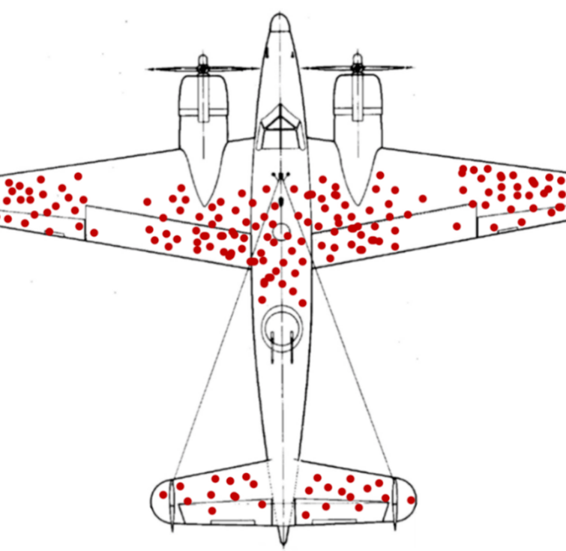
Beware!
Watch out for “survivorship bias.”
  Survivorship bias “is the logical error of concentrating on the people or things that made it past some selection process and overlooking those that did not, typically because of their lack of visibility.”

Slide 60

Who or what isn’t showing up in the data?

Slide 61
7. Determine the ROI
Ask:
  Do the benefits justify the cost (money, staff time, PD hours)?
  Is this the most effective strategy compared to alternatives?
  Are there cheaper or simpler methods yielding equal or better results?
Education resources are limited—ROI matters.

Slide 62
Prompt 2: Material Differences
An explanation of material differences between Budgeted Expenditures and Estimated Actual Expenditures and/or Planned Percentages of Improved Services and Estimated Actual Percentages of Improved Services.
[Respond here]

Slide 63
Prompt 2: Instructions
Instructions:
  Explain material differences between Budgeted Expenditures and Estimated Actual Expenditures and between the Planned Percentages of Improved Services and Estimated Actual Percentages of Improved Services, as applicable. Minor variances in expenditures or percentages do not need to be addressed, and a dollar-for-dollar accounting is not required.

Slide 64
2025-26 Annual Update Table
Last Year's Goal # | Last Year's Action # | Prior Action/Service Title | Contributed to Increased or Improved Services? | Last Year's Planned Expenditures (Total Funds) | Estimated Actual Expenditures (Input Total Funds)
[Input goal number] | [Input action number] | [Input action title] | [Input contributing to increased or improved services] | $ - | $ -
[Input goal number] | [Input action number] | [Input action title] | [Input contributing to increased or improved services] | $ - | $ -

Slide 65
8. Create a Continuous Improvement Loop
Successful systems don’t treat evaluation as a one-time event.
They:
  Implement
  Monitor
  Adjust
  Re-evaluate
  Scale or discontinue
The goal isn’t judgment—it’s learning.
Reflect
Review
Refine

Slide 66



Determining Effectiveness or Ineffectiveness
Identifying Whether a Strategy Has Been Effective

Slide 67
Prompt 3: Effectiveness or Ineffectiveness
A description of the effectiveness or ineffectiveness of the specific actions to date in making progress toward the goal.
[Respond here]

Slide 68
Prompt 3: Abridged Instructions
Instructions:
  Describe the effectiveness or ineffectiveness of the specific actions in making progress toward the goal during the three-year LCAP cycle. “Effectiveness” means the degree to which the actions were successful in producing the desired result and “ineffectiveness” means that the actions did not produce any significant or desired result.
  Beginning with the development of the 2024–25 LCAP, the LEA must change actions that have not proven effective over a three-year period.

Slide 69
Was this Action Effective?
Effectiveness = Did the strategy/action produce the intended outcomes—for the students it was designed to support—beyond what would have happened otherwise?
To answer that, we need seven components:
  Comparison of Outcomes Against Clear, Predefined Goals
  Multiple Data Sources (Triangulation)
  Comparison Against a Baseline
  Whether Improvements Occurred Across Student Groups
  Examine Implementation Fidelity
  Analyze Return on Investment
  Evidence of Sustainability

Slide 70
1. Comparison of Outcomes Against Clear, Predefined Goals
A strategy can't be judged without knowing:
  What was supposed to improve?
  By how much?
  For which students?
  In what timeframe?
Sample measurable goal:
  Reduce chronic absenteeism by 20% among targeted students by spring.
If outcomes don’t match the goals, the strategy likely wasn’t effective.

Slide 71
Example of A Metric (4)
Metric | Baseline | Year 1 Outcome | Year 2 Outcome | Target for Year 3 Outcome | Current Difference from Baseline
Percentage of correct responses on the Interim District Common Assessment (Math) reported by student groups Source: District Common Assessment Performance (Math) | All Students (All): 70% Low Income (LI): 63% African American (AA): 60% American Indian (AI): 64% (2023-24) | All: 72% LI: 61% AA: 65% AI: 66% | All: 74% LI: 64% AA: 66% AI: 68% | All: 76% LI: 69% AA: 70% AI: 72% | All: 4% LI: 1% AA: 6% AI: 4%

Slide 72
2. Multiple Data Sources (Triangulation)
As has already been mentioned, LEAs should look at several types of evidence—never just one.
  Quantitative Outcomes
    State assessments, benchmark or interim assessments, attendance and discipline data, etc.
  Qualitative Evidence
    Classroom observations, student focus groups, teacher feedback, family feedback, etc.
Qualitative data helps explain why the numbers look the way they do.

Slide 73
3. Compare Against a Baseline or Counterfactual (1)
To understand effectiveness, ask:
  “How do we know this improvement wouldn’t have happened anyway?”
Ways to compare:
  Before vs. After (Baseline Comparison)
    Compare current results to prior years
    Check whether trends improved more rapidly after the strategy was introduced

Slide 74
3. Compare Against a Baseline or Counterfactual (2)
(Continued)
  Across Groups (Comparison Groups)
    Compare participating classrooms/schools to similar ones not using the strategy
    Compare targeted students to non-targeted peers
  Against State or District Trends
    If your scores increased 3% but everyone else increased 7%, your strategy may not be the driver of improvement.
This avoids false conclusions.

Slide 75
4. Check Whether Improvements Occurred Across Student Groups
A strategy is truly effective only if:
  Gains are equitable
  Gaps narrow
  Impact is reliable across subgroups
Look at:
  Race/ethnicity, English learner status, students with disabilities, socioeconomic groups, foster/homeless youth, grade levels, etc.
If overall averages rose but gaps widened, the strategy is not systemically effective.

Slide 76
Example of A Metric (5)
Metric | Baseline | Year 1 Outcome | Year 2 Outcome | Target for Year 3 Outcome | Current Difference from Baseline
Percentage of correct responses on the Interim District Common Assessment (Math) reported by student groups Source: District Common Assessment Performance (Math) | All Students (All): 70% Low Income (LI): 63% African American (AA): 60% American Indian (AI): 64% (2023-24) | All: 72% LI: 61% AA: 65% AI: 66% | All: 74% LI: 64% AA: 66% AI: 68% | All: 76% LI: 69% AA: 70% AI: 72% | All: 4% LI: 1% AA: 6% AI: 4%

Slide 77
5. Examine Implementation Fidelity and Dosage
You can’t evaluate effectiveness without knowing:
  Was the strategy actually used as intended?
  Did students get the right amount of exposure?
  Was quality consistent?
Low fidelity = low confidence in results
High fidelity + weak outcomes = ineffective strategy
High fidelity + strong outcomes = likely effective
Evaluating both implementation and impact is essential.

Slide 78
6. Analyze Return on Investment (Impact vs. Cost)
Even a strategy that “works” may not be worth it.
Ask:
  Did the level of improvement justify the time, staffing, and financial investment?
  Are there cheaper or simpler alternatives with similar outcomes?
This is critical for district-level decisions.

Slide 79
7. Look for Evidence of Sustainability
A strategy is more likely effective if:
  Results persist over multiple cycles
  Staff capacity increases
  Practices spread naturally
  Implementation becomes easier over time
Short‑term spikes that disappear may indicate novelty effects, not true effectiveness.

Slide 80
Tool: Strategy Effectiveness Rubric
The Strategy Effectiveness Rubric provides one approach to answering the question “Was this strategy/action effective?”
This tool is not endorsed by the California Department of Education, nor is its use required. It is simply provided as one way an LEA may assess the effectiveness of its strategies/actions.
Please email LCFF@cde.ca.gov and request the tool.

Slide 81

The Path Foward
Responding to Analysis

Slide 82
Responsible Responses to Analysis
If strategies/actions are effective, continue the actions while continuing to monitor outcomes
If strategies/actions are ineffective, three responsible responses are suggested:
  Modify the action
  Refine the metric
  Discontinue or replace the action
Rationalizing the continuation of an ineffective action is not a responsible response

Slide 83
Prompt 4: Changes
A description of any changes made to the planned goal, metrics, target outcomes, or actions for the coming year that resulted from reflections on prior practice.
[Respond here]

Slide 84
Prompt 4: Abridged Instructions
Instructions:
  Describe any changes made to this goal, expected outcomes, metrics, or actions to achieve this goal as a result of this analysis and analysis of the data provided in the Dashboard or other local data, as applicable.​

Slide 85
When Might Action Be Required?
Immediate Action May Be Required If | Strategic Year 3 Monitoring May Be Appropriate If
Obvious ineffectiveness: No progress after 2 years Clear harm to students Funding is wasted with no discernable outcomes | Emerging trends show: Mixed signals from Year 1-Year 2 Implementation is moderate or low Year 3 outcomes will confirm if the action is effective

Slide 86
Modify the Action
It may be appropriate to modify the action when
  Implementation was strong
  The theory of action was sound
  Outcomes fell short
Examples:
  Adjust dosage, intensity, or target population
  Strengthen alignment to root cause
  Add complementary supports

Slide 87
Refine the Metric
It may be appropriate to refine the metric when
  The action addressed the right problem
  This outcome was reasonable
  The metric failed to capture meaningful change
In this instance revising a metric is not lowering expectations, it is improving measurement validity.

Slide 88
Discontinue or Replace
It may be appropriate to discontinue or replace an action when
  Implementation was solid
  Data show no meaningful progress
  Other strategies show stronger evidence

Slide 89

LEAs should continually evaluate the hard choices they make about the use of limited resources to meet student and community needs to ensure opportunities and outcomes are improved for all students.
LCAP Template Instructions, Page 1

Slide 90




Conclusion
Year 3 provides LEAs with the opportunity to evaluate implementation and progress thus far and to make course corrections prior to implementing the final year of the plan, which drives continuous improvement for students.
We hope today’s learning will assist you in your journey.

Slide 91


Thank you for all you do for your families and students!
Local Agency Systems Support Office
LCFF@cde.ca.gov

Slide 92
Appendix A - Slide 9
Timeline going from left to right with the following LCAP years: 2024-25, 2025-26, 2026-27, 2027-28.
Verbiage for each LCAP year:
  2024-25: Year 1 of the current 3-Year LCAP cycle “Launch Year”
  2025-26: Year 2 of the current 3-Year LCAP cycle “Implementation Year” (We are currently here)
  2026-27: Year 3 of the current 3-Year LCAP cycle “Evaluation and Refinement Year”
  2027-28: Year 1 of the next 3-Year “Launch Year”

Slide 93
Appendix B – Slide 12
3 rectangles with verbiage in a circular process starting with:
  Reflect on evidence of implementation and effectiveness
  Review data to understand the impact on students and the system
  Refine goals, metrics and/or actions to better address the student needs
A grey arrow starts from the first rectangle and continues through all rectangles.

Slide 94
Appendix C – Slide 28
Table with a header row with 7 columns and one row below header row.
Headers are as follows: Metric #, Metric, Baseline, Year 1 Outcome, Year 2 Outcome, Target for Year 3 Outcome, Current Difference from Baseline
The row has the following verbiage in the cells to point out what information must be entered: [Metric #], [Insert metric here], [Insert baseline here], [Insert outcome], [Insert outcome for Year 2], [Insert target outcome here], [Insert current difference from baseline here]
There is a brown arrow starting from the first column (Metric #) and extends to the fifth column (Year 2 Outcome) with the following verbiage: “Everything up to this point is about understanding the data landscape.”
Year 1 Outcome and Year 2 Outcome are outlined with a rectangle and with a brown solid rectangle with the following verbiage: “Data Status (what we have)”

Slide 95
Appendix D – Slide 29
Table with a header row with 4 columns and 1 row below the header row.
Headers are as follows: Year 1 Outcome, Year 2 Outcome, Target for Year 3 Outcome, Current Difference from Baseline
The row has the following verbiage in the cells to point out what information must be entered: [Insert outcome here], [Insert outcome here], [Insert target outcome here], [Insert current difference from baseline here]
There is a dark gray arrow starting from the third column (Target for Year 3 Outcome) and extends to the fourth column (Current Difference from Baseline) with the following verbiage: “Everything from here forward is about how Year 3 uses that landscape to drive decisions.”
The third and fourth columns are outlined with a dark gray rectangle and with a dark gray solid rectangle with the following verbiage: “Interpretation (what we do with it)”

