Slide 1
Tuesday @ 2 School Nutrition
Town Hall
May 27, 2025
Opportunities for All Branch (OFAB)
California Department of Education (CDE)

Slide 2

Town Hall at a Glance
District Spotlights
Standardized Recipes
Federal & State Updates
Operational Reminders
Resources & Other Announcements

Slide 3
District Spotlights

Slide 4
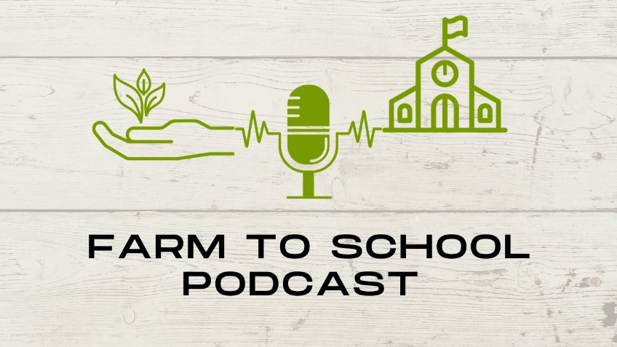
District Spotlight: Fort Bragg Nutrition Podcast
Oregon State University's Farm to School podcast featured Fort Bragg School District and the Noyo Food Forest.
'That's where the magic happens, when you have a cafeteria....and a school garden or education on where your food comes from. You have two operations and they both work together.' - Host Rick Sherman
Listen to the podcast at https://extension.oregonstate.edu/podcast/farm-school-podcast/noyo-food-forest.

Slide 5
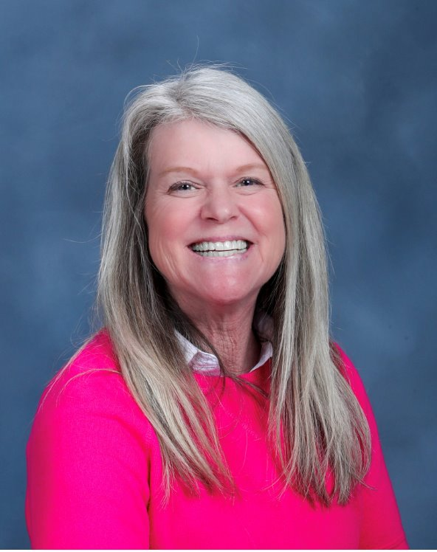
2025 California Classified School
Employees of the Year
Melissa Erman, Nutrition Operations Supervisor
Huntington Beach Union High School District
Photo Credit: Orange County Department of Education

Slide 6
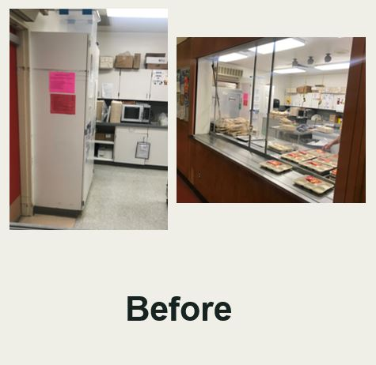
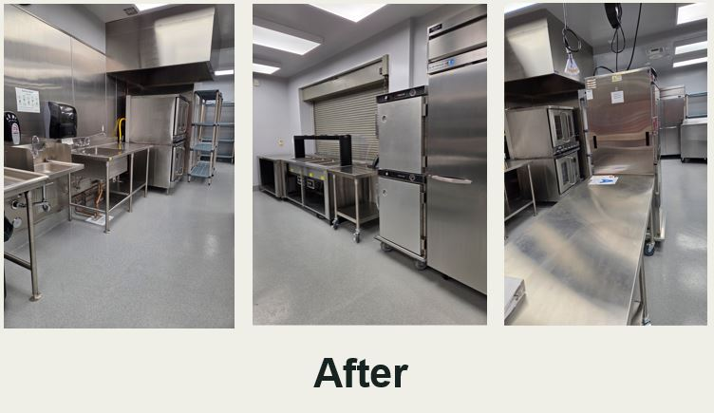
Kitchen Infrastructure and Training Funds in Action - Adobe Bluffs Elementary School

Slide 7
Standardized Recipes

Slide 8

Climate-Friendly Plant-Based Recipes
Forty standardized recipes from California schools
Recipes are ethnically diverse, student-tested and approved
Features recipes like Cauliflower Alfredo Pasta, Crispy Teriyaki Tofu, Chana Masala Bowls, and Fiesta Crunch Wraps

Slide 9
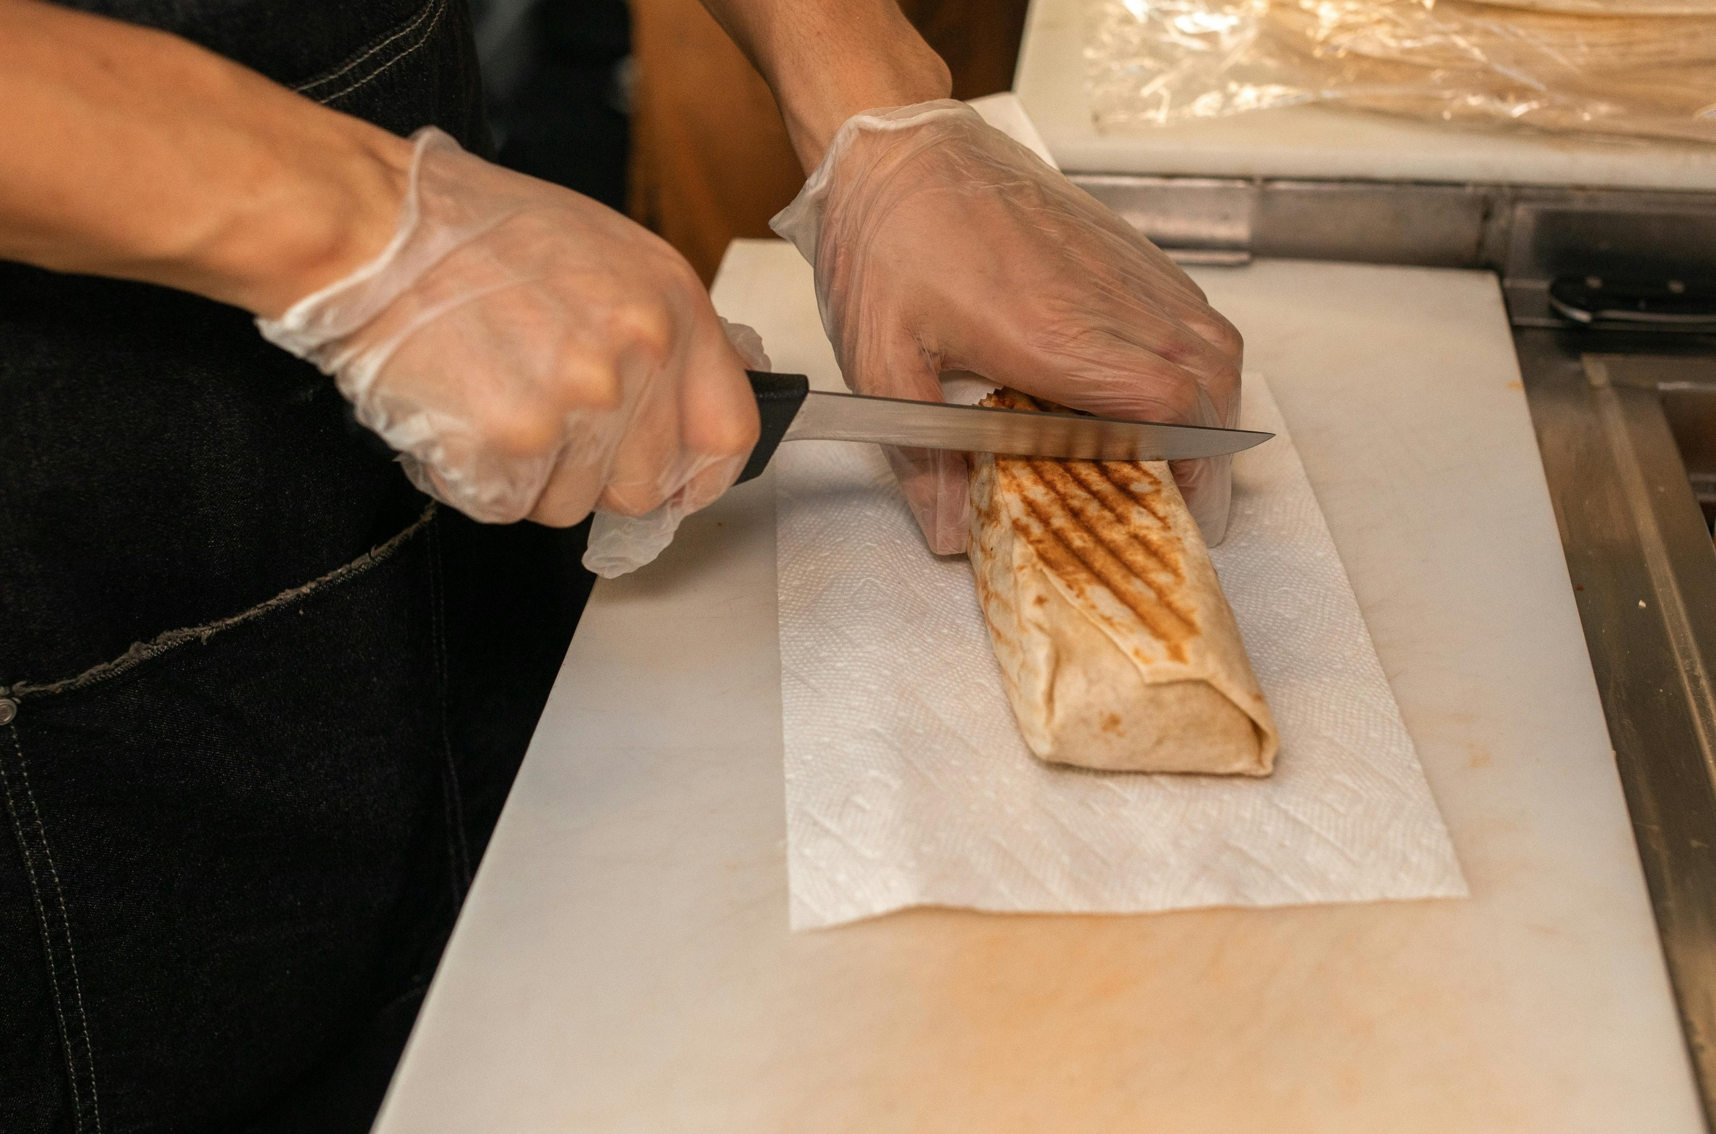
Standardized Recipe: Thai Bean Wrap
Banta Elementary School District
Features sweet Thai beans, topped with Thai slaw, Sun Butter sauce, all wrapped up
Download Climate-Friendly Plant-Based Recipes for Schools - https://foe.org/resources/climate-friendly-plant-based-recipes-for-schools/

Slide 10

Photo Contest: Celebrating California's School Meals
Goal: Highlight the quality, delicious school meals that are served every day, and the staff that prepare them.
The entry period is open through Monday, November 3, 2025.
Winners will be recognized for their efforts!
There are seven categories:
  Sow, Grow, and Show with Farm to School
  Mealtime Memories
  Cafeteria Creations
  Mealtime Legends
  Behind the Counter
  Super Selfies
  Offer Versus Serve

Slide 11
Federal Updates

Slide 12
State Updates

Slide 13
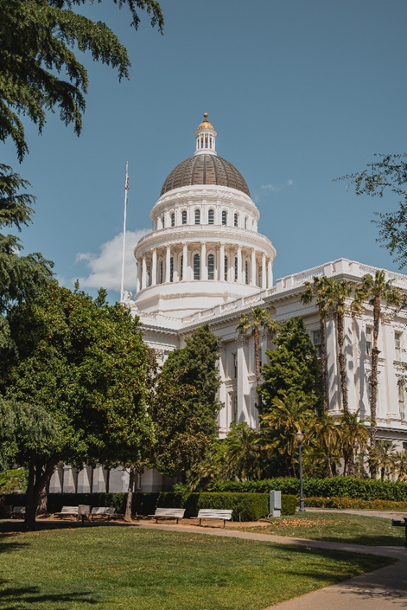
Proposed State Budget
Includes the following:
Universal Meals
SUN Bucks
2025 Kitchen Infrastructure and Training (KIT) competitive grant
2022 KIT encumbrance and reporting extension

Slide 14
Non-Disability Fluid Milk Substitutes
School Food Authorities (SFAs) have discretion to offer fluid milk substitutes for medical and special dietary needs (including accommodations for religious or moral convictions) when:
Product meets nutrient standard requirements.
Parent or guardian completes, signs and returns a Parental Request for Fluid Milk Substitution for School-Age Children form (SNP 26).
If providing fluid milk substitutions for non-disability reasons, SFAs are required to notify the CDE of their decision to do so by submitting a signed Fluid Milk Substitutions Notification form (SNP 05).

Slide 15
Parental Requests for Fluid Milk Substitutions
CA Code of Regulations, Title 5, Section 15560 requires SFAs to use the CDE's Parental Request for a Fluid Milk Substitution for School-Age Children form (SNP 26).
The SNP 26 is only required for documenting non-disability related fluid milk substitute requests.
Effective April 1, 2025, SFAs must utilize the SNP 26 to collect these types of requests, rather than similar forms developed by the SFA.

Slide 16
Piggybacking and Buy American

Slide 17
Steps for the SFA Originating the Contract (1)
Conduct the bid process in compliance with federal, state, and local procurement regulations.
Include a clear piggyback clause in the solicitation and contract. Things to consider:
  Setting a dollar value
  Limiting the number of additional parties that may be added
  Requiring permission to join your contract

Slide 18
Steps for the SFA Originating the Contract (2)
Keep all procurement records, including solicitation documents, evaluation criteria, scoring sheets, executed contract and any amendments.
Properly manage the contract in accordance with federal, state and local procurement regulations for the duration of the contract.

Slide 19
Steps for SFAs Wanting to Piggyback onto a Contract (1)
Make sure the original solicitation and contract include a clear piggyback clause (obtain, discuss, reach out to the SFA).
Confirm if there are any specific limitations (e.g., dollar value or the number of additional parties that may be added) and make sure joining the contract will not create a material change.

Slide 20
Steps for SFAs Wanting to Piggyback onto a Contract (2)
Review to ensure the contract was properly procured in compliance with federal, state, and local procurement regulations (keep records on-file).
Periodic check-in on the original contract for any changes or amendments.
Monitor vendor performance in accordance with terms and conditions of the original contract.

Slide 21

Procurement Training and Resources
Check out the CDE Course Catalog.
Explore Child Nutrition Information and Payment (CNIPS) Download Forms.
Visit the Procurement in Child Nutrition Programs webpage at https://www.cde.ca.gov/ls/nu/pr/.
Future procurement training at this year’s California School Nutrition Association conference!
Questions email NSDProcurementReview@cde.ca.gov.

Slide 22
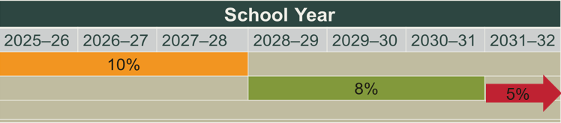
Buy American: New Threshold
Non-domestic food purchases cannot exceed 10 percent of total food purchases*.
Exceptions must be counted towards the 10 percent cap of non-domestic purchases.
*U.S. Department of Agriculture (USDA) Foods are not included in these calculations or the cap.

Slide 23
Buy American Exceptions
Limited exceptions:
  The product is listed on the Federal Acquisition Regulations (FAR) Nonavailable Articles list.
  The product is not produced or manufactured in the U.S. in sufficient and reasonably available quantities of a satisfactory quality.
  Competitive bids reveal the costs of a domestic product are significantly higher than the non-domestic product.
  Note: Purchases from these categories count towards the 10 percent cap.

Slide 24
Buy American Reporting (1)
Exception: If the product is listed on the FAR Nonavailable Articles list.
Documentation Requirements: No exception documentation required.
Cap: Purchases count towards 10 percent cap.

Slide 25
Buy American Reporting (2)
Exception: If the product is not produced or manufactured in the U.S. in sufficient and reasonably available quantities of a satisfactory quality and the product is not listed on the FAR list.
Exception: Competitive bids reveal the costs of a domestic product are significantly higher than the non-domestic product.
Documentation Requirements: Exception documentation required.
Cap: Purchases count towards 10 percent cap.

Slide 26
Optional Exceptions Tracking Form
Optional template used to track costs and exceptions related to non-domestic food purchases.
The form provides:
  An overview
  Tracking non-domestic purchases, associated exceptions, and associated costs
  Calculating non-domestic costs as a percentage of total commercial food costs
CNIPS Download Forms: PRU 10 – Buy American Exceptions Tracker

Slide 27
Buy American Accommodation Request
School Year 2025–26
USDA Policy Memorandum SP-09-2025 authorizes the CDE to approve temporary accommodations.
Submission: Use the link in the Buy American Accommodation Plan for School Year 2025–26 listserv.
Timeline: Requests may be submitted until Tuesday, June 30, 2026.
Rolling Basis: Apply as soon as you anticipate exceeding the cap; the accommodation request is not retroactive.
For questions email NSDBuyAmericanProvision@cde.ca.gov.

Slide 28
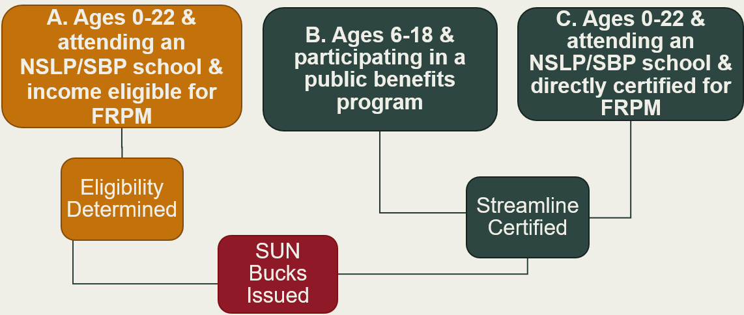
Eligibility ABCs
Full Text Description For SUN Bucks Eligibility Image

Slide 29

SUN Bucks Updates (1)
The end of eligibility period is now September 2, 2025.
The Spanish Universal Benefits Application (UBA) template was shared with local educational agencies (LEAs) on May 19, 2025, via listserv. If your LEA did not receive the email, reach out to SummerEBT@cde.ca.gov.

Slide 30
SUN Bucks Updates (2)
The Education Data Collection System is not yet open for the Supplemental SUN Bucks Collection.
  Further guidance on submitting SUN Bucks eligibility data to the Education Data Collection System is forthcoming from the California Longitudinal Pupil Achievement Data System (CALPADS) Office.

Slide 31
SUN Bucks Updates (3)
The May revise budget proposes to include funding for LEAs to do SUN Bucks/UBA-related work.
  The proposed budget needs to be finalized and signed.
  Anticipate a reimbursement model based on records to be submitted to CDE.

Slide 32

SUN Bucks Updates (4)
Save the Date!
  SUN Bucks webinar
  Thursday, June 5, 2025 at 2 p.m.
    Further information on verification
    Outreach materials
  Registration information coming soon

Slide 33
SUN Bucks Frequently Asked Questions (1)
Q: Can UBAs be collected electronically?
A: Yes, UBAs can be collected electronically. Wet signatures are not required. If an LEA chooses to collect UBAs electronically, paper applications must also be made available.

Slide 34
SUN Bucks Frequently Asked Questions (2)
Q: When can LEAs begin collecting UBAs/SUN Bucks applications from newly enrolled students?
A: LEAs can begin collecting UBAs/SUN Bucks applications from newly enrolled students at the start of that year's summer operational period. For 2025, this date is July 1, 2025.

Slide 35
SUN Bucks Frequently Asked Questions (3)
Q: Can household income ranges be collected on the UBA or must the income be listed as a specific number?
A: Household income ranges cannot be collected on the UBA. The total household income must be listed as a specific number that the LEA will then compare against that school year's income eligibility scales.

Slide 36
Frequently Asked Questions (4)
Q: What should an LEA do if the address listed on a UBA is different than the address listed in CALPADS?
A: LEAs should update the student's address in CALPADS using the address provided on the UBA.

Slide 37
SUN Bucks Resources (1)
June 5, 2025 SUN Bucks Webinar: Registration for this webinar is no longer available.
CDE SUN Bucks web page: https://www.cde.ca.gov/ls/nu/sunbucks.asp
California Department of Social Services (CDSS) SUN Bucks web page: https://cdss.ca.gov/sun-bucks
CDE UBA web page: https://www.cde.ca.gov/ls/nu/universalbenefitsapp.asp

Slide 38
SUN Bucks Resources (2)
CDE CALPADS Flash: https://www.cde.ca.gov/ds/sp/cl/calpadsupdflash279.asp
CDE SUN Bucks Inbox (LEA inquiries only): SummerEBT@cde.ca.gov
SUN Bucks Helpline (household inquiries): (877) 328-9677

Slide 39
Seamless Summer Option (1)
Reminder: Submit Seamless Summer Option (SSO) site applications in CNIPS.
SSO site applications must be reviewed and approved prior to the start of summer meal service. Site application approval cannot be backdated; late submissions may result in delayed approval or missed reimbursement.
Information listed in SSO site applications must reflect operations at that specific site (meal service dates, times, etc.). Information from site applications is posted in various summer meal finder web pages/apps.

Slide 40
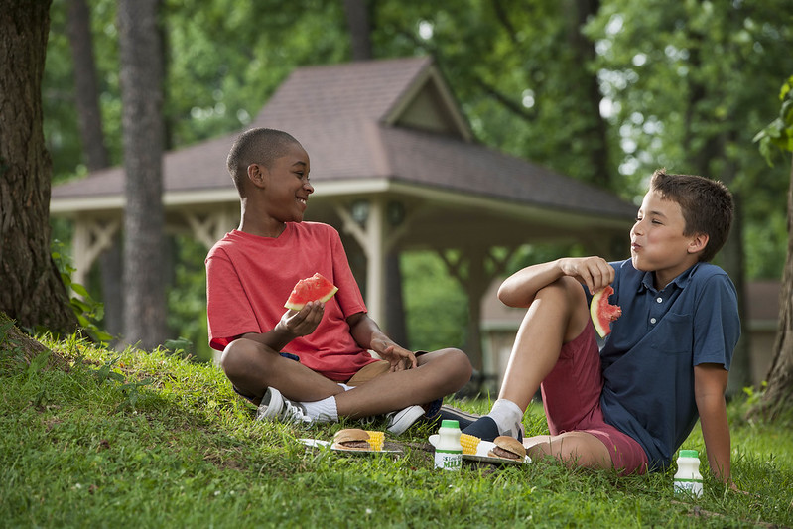
Seamless Summer Option (2)
Access the following resources:
  Form ID SSO 9 Seamless Summer Site Application Job Aid in the School Nutrition Program (SNP) Download Forms section in CNIPS
  SSO Training in the Nutrition Services Division (NSD) Learning Management Site
For help with your SSO site applications, email SSFO@cde.ca.gov.

Slide 41
Find a Summer Meals Site Near You!
The California Meals for Kids Mobile App (updated daily starting June 1) is available in the app store for all iOS, Android or Microsoft devices or online at https://www.cde.ca.gov/re/mo/cameals.asp.
The CDE Summer Meal Service Site web page (updated weekly) is available online at https://www.cde.ca.gov/ds/sh/sn/summersites25.asp.
All LEAs are required to conduct outreach for Summer Meal sites.

Slide 42
Summer Excessive Heat and Poor Air Quality Waivers (1)
On May 13, 2025, the USDA approved the use of two statewide waivers for summer meal program operators in good standing to provide meals in a non-congregate setting due to excessive heat and/or poor air quality.
Waivers are effective May 1, 2025 – September 30, 2025.

Slide 43
Summer Excessive Heat and Poor Air Quality Waivers (2)
Excessive Heat Waiver: May operate outdoor sites, without access to a temperature controlled indoor alternative sites, as non-congregate sites only on days when the National Weather Service has issued a heat advisory, excessive heat warning or excessive heat watch.

Slide 44
Summer Excessive Heat and Poor Air Quality Waivers (3)
Poor Air Quality Waiver: May operate outdoor sites, without indoor alternative sites, as non-congregate sites only when the Air Quality Index for the site's zip code is at a purple flag or higher.
Must use the www.airnow.gov website must be used to determine poor air quality.

Slide 45
Summer Excessive Heat and Poor Air Quality Waivers (4)
Operators using these waivers must not change me.al service times less than 24 hours in advance of the scheduled meal service.
Operators using these waivers must:
Indicate changes in meal service to attendees.
Alert the community of changes.

Slide 46
Summer Excessive Heat and Poor Air Quality Waivers (5)
To utilize these waivers, update your summer meal site application:
  For SSO site applications, the information is found at question #28.
  For Summer Foods Service Program (SFSP) site applications, the information is found at question #81.
More information is available on the Excessive Heat and Poor Air Quality Waivers for Summer Meal Programs listserv at https://www.cde.ca.gov/ls/nu/nutritionwhatsnew.asp.

Slide 47
Operational Reminders

Slide 48
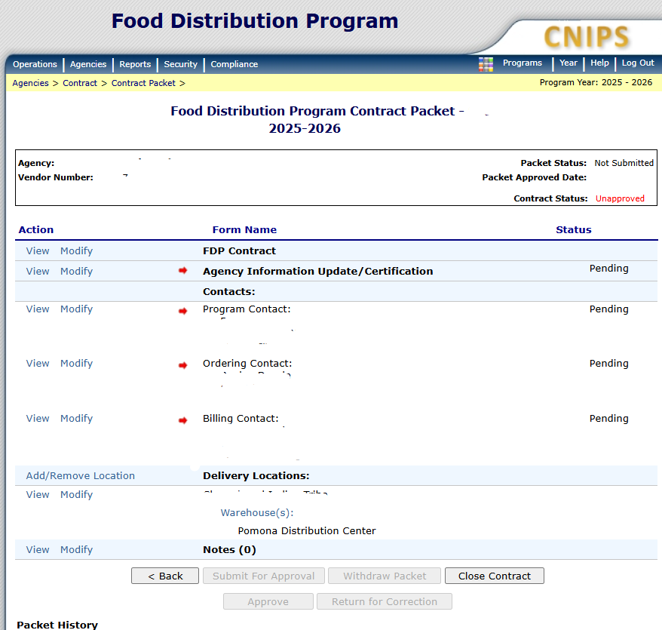
Food Distribution Program
Annual Contract Packet Update
Annual Food Distribution Program (FDP) Contract Packet Update
Required for all FDP agencies
Due Thursday, July 31, 2025
Questions email the FDP fooddistribution@cde.ca.gov

Slide 49
Important Operational Dates:
Next 30-90 Days (1)
Action | Date
Submit Summer 2025: SSO applications* | 30 days prior to the start of meal service
Submit Summer 2025: SFSP applications* | May 15th or 30 days prior to the start of operations
Advertise Availability of Summer Meals | Prior to the end of the School Year (SY)
Site Visit for New Summer Meal Sites (SFSP only) | First week of operations
*Applications must be approved prior to the start of meal service.

Slide 50
Important Operational Dates:
Next 30-90 Days (2)
Action | Date
Community Eligibility Provision Applications Due | June 30, 2025
Provision 2 Applications Due | June 30, 2025
Request Food Safety Inspections (x2) | End of SY 2024–25
Distribution Center Allocation A orders Due | July 7, 2025
FDP Contract Packet Update | July 31, 2025

Slide 51
Grant Reporting
Action | Date
KIT 2021 | June 30, 2025
KIT 2022* | June 30, 2025
School Food Best Practices | June 30, 2025
*The reporting tool will be released in early June while the proposed reporting and encumbrance extension is under consideration.

Slide 52
Resources and Other Announcements

Slide 53

Farm to Summer Celebration Week
Dates: June 16-20, 2025
Theme: Summer Foods Around the World
Earn Recognition:
  Pre- and Post-survey
  Taste, Teach, and Connect

Slide 54
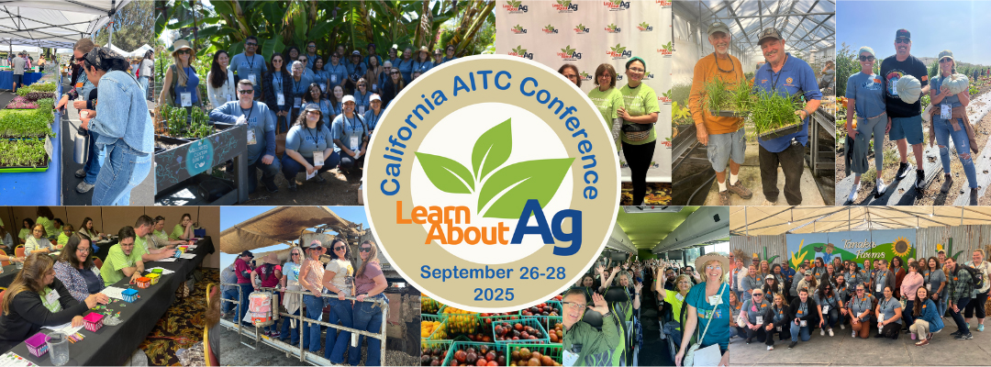
CA Agriculture in the Classroom Conference
Educators learn how to incorporate food into curricula.
The conference will be held September 26-28, 2025, in Sacramento.
Register on the CA Agriculture and Classroom Conference website at https://learnaboutag.org/programs/conference/.

Slide 55

Culinary Arts Trainings: Mediterranean Menus of Flavor
Training information coming soon!
San Diego - July 31, 2025
Sacramento - August 5, 2025
Bakersfield - August 7, 2025
Fresno - August 12, 2025
Oakland - August 14, 2025
Time: 8:00 a.m. - 12:30 p.m.

Slide 56
Nutrition Services Division Learning Management Site: Account Setup Reminder!
For food service and food service management company staff only:
Instructions are available in CNIPS Download Forms.
  LMS Reg 001 – Learning Management System (LMS) Account Self-Registration Access for Child Nutrition Program (CNP) Operators Job Aid
  LMS Reg 002 - LMS Account Self-Registration and Access Set-up Slides for CNP Operators
If you have questions regarding this topic, contact us at NSDLearning@cde.ca.gov.

Slide 57
Tuesday @ 2 Town Hall Schedule
Held on the fourth Tuesday of the month
Month | Format | Date
June | State Update and Guest Speaker | June 24, 2025
July | No Town Hall | N/A
August | State Update | August 26, 2025

Slide 58
Professional Standards Crediting Information
Key Area: Administration (3000)
Training Topic: Program Management (3200)
Learning Objective: Manage Staff Work Including Scheduling (3210)
Instructional Hours 1.5 hours

Slide 59
Full Text Description For SUN Bucks Eligibility Image (1)
The Eligibility ABCs slide provides a visual illustration of the ways in which children are eligible for SUN Bucks benefits. There are three groups (boxes) at the top of the image labeled A, B and C. Group A is a dark orange color on the left side of the image and states, “A. Ages 0-22 & attending an NSLP/SBP school & income eligible for FRMP” Below this group is a line connecting to a dark orange box with “Eligibility Determined” stated in the box. There is a line below the Eligibility Determined box connecting to a dark read box with “SUN Bucks Issues.” Group B is a dark green box that states, “B. Ages 6-18 & participating in a public benefits program.” Full text description continues to the next slide.

Slide 60
Full Text Description For SUN Bucks Eligibility Image (2)
Group C is a dark green box and states, “C. Ages 0-22 & attending an NSLP/SBP school & directly certified for FRMP.” Both Group B and C have lines connecting to a dark green box with “Streamline Certified” written in it. The dark green Streamline Certified box has a line connecting to the same dark red box SUN Bucks Issued mentioned earlier.
Return to SUN Bucks Eligibility Image Slide

Slide 61
0

