Slide 1
Tuesday at 2 School Nutrition Town Hall
April 28, 2026
Nutrition Services Division (NSD)
California Department of Education (CDE)

Slide 2

Town Hall at a Glance
District Spotlights
Federal & State Updates
Guest Speaker
Operational Reminders
Resources & Other Announcements

Slide 3
School Nutrition Program Spotlights

Slide 4

Columbia Elementary School District-Highlighting Local Foods
Hosted a Farm to Fork Spaghetti Feed
Offered an experience to feature locally sourced beef, produce, and wheat.
Served meals banquet style with interactive displays, farmer highlights, and educational resources.

Slide 5
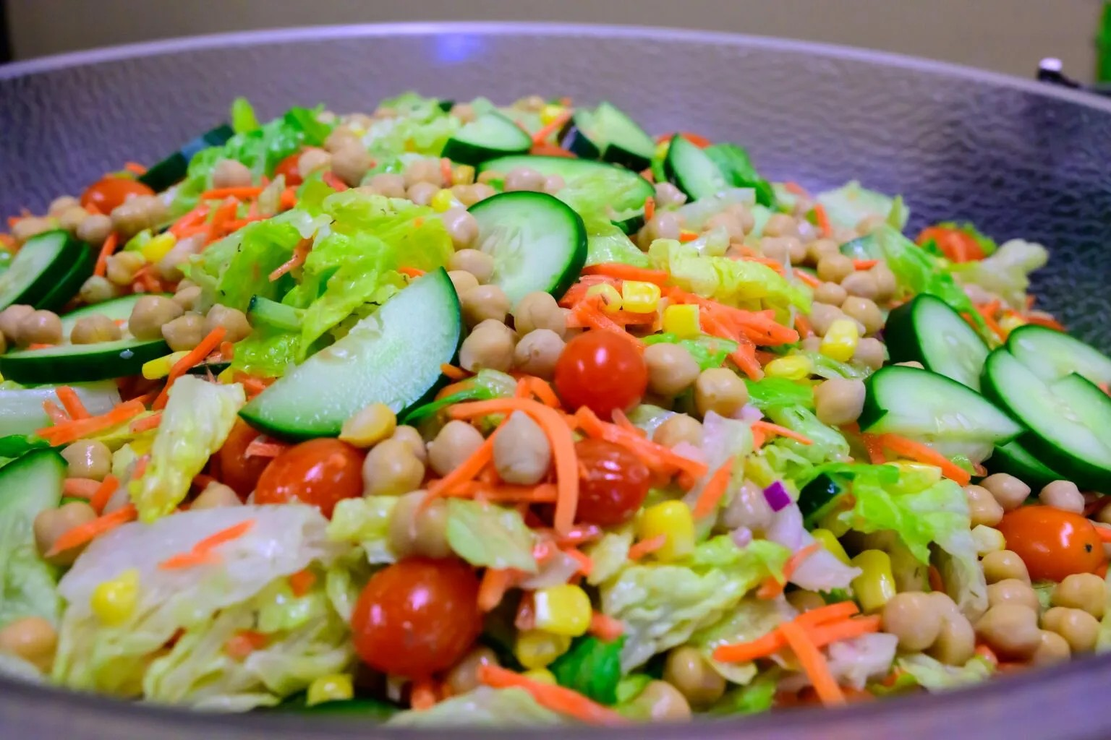
Fresno Unified School District (USD) -
Good Food Leader: Silver Status
Recognized the district's food sources within 50 miles
Met program's nutrition target
Implemented community health and nutrition education
Purchased reduced sugar products
Read the article Fresno USD Celebrates Good Food Leader: Silver Status at https://goodfoodpurchasing.org/fresnousd-silver-celebration/
Fresno USD’s Chickpea
Lunch Salad

Slide 6

Let’s Celebrate!
Friday May 1, 2026
Recognizing our school nutrition culinary professionals and their "superpowers" in nourishing students, supporting learning, and making a difference for every child.

Slide 7
Federal Updates

Slide 8
2026 Appropriations Act:
Effect of Child Nutrition Programs
SP05-2026, CACFP 03-2026, SFSP 03-2026
Child Nutrition Program (CNP) Flexibility/Prohibition | Dates
Extends the flexibility in the School Breakfast Program (SBP) only to offer vegetables in place of the fruits requirement; no vegetable subgroups required | July 1, 2025 – June 30, 2026 (School Years [SY] 2025–26 and 2026–27)
Continues the prohibition on procuring poultry products and seafood from the People's Republic of China. | Extends through September 30, 2026
Continues the direction that School Food Authorities (SFAs) with a negative cafeteria fund balance, as of June 30, 2025, must comply with the Paid Lunch Equity (PLE) pricing requirements. SFAs with a zero or positive balance are exempt. | SY 2026–2027 (PLE applies only to SFAs that charge for reimbursable meals)

Slide 9
2026 Appropriations Act: Resources
U.S. Department of Agriculture (USDA) Policy Memo 2026 Appropriations Act: Effect of Child Nutrition Programs SP05-2026, CACFP 03-2026, SFSP 03-2026 on USDA Food and Nutrition Service web page at https://www.fns.usda.gov/schoolmeals/appropriations-act-effect-cnp2026
CDE PLE Guidance web page at https://www.cde.ca.gov/ls/nu/sn/mbsnp022021.asp

Slide 10
2026 Appropriations Act: Questions
Crediting vegetables at breakfast email SNPinfo@cde.ca.gov.
Prohibition on poultry and seafood from China email NSDProcurementReview@cde.ca.gov.
PLE requirements email the Resource Management Unit at SNPCafeFundQuestions@cde.ca.gov.

Slide 11
State Updates

Slide 12
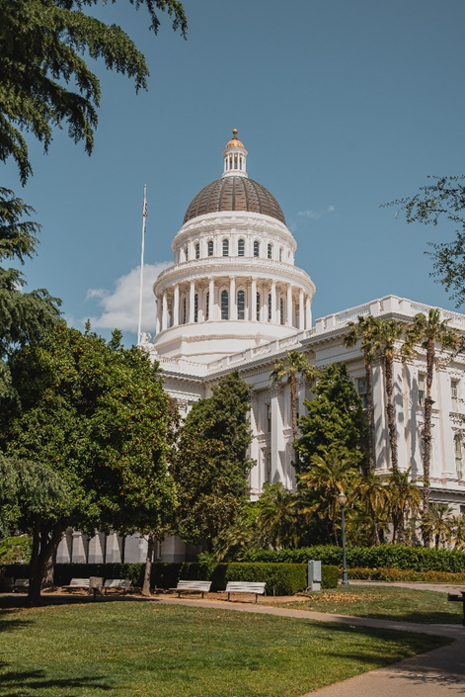
May Budget Revise
State law requires the Governor to revise their proposed budget for the upcoming state fiscal year by May 14.

Slide 13
State Bills Proposed
Senate Bill 1058 (McNerney) School districts: contracting: purchases for child nutrition programs
Assembly Bill 675 (Aguiar-Curry) Office of Farm to Fork: California Farm to School Program
Assembly Bill 2244 (Gabriel) Non-Ultraprocessed Certified Food Standard

Slide 14
Summer Excessive Heat and Poor Air Quality Waivers (1)
On April 3, 2026, the USDA approved CDE's two waivers for summer meal program operators in good standing.
On case-by-case bases, CDE can approve summer meal operators to provide meals in a non-congregate setting due to excessive heat and/or poor air quality.
Waivers are effective from May 1, 2026 – September 30, 2026.

Slide 15
Summer Excessive Heat and Poor Air Quality Waivers (2)
Excessive Heat Waiver:
With prior CDE approval, outdoor summer meal sites without access to temperature controlled indoor alternative sites may operate as non-congregate only on days when the National Weather Service has issued a heat advisory, excessive heat warning, or excess heat watch.

Slide 16
Summer Excessive Heat and Poor Air Quality Waivers (3)
Poor Air Quality Waiver:
With prior CDE approval, outdoor sites without access to indoor alternative sites may operate as non-congregate only on days when the Air Quality Index (AQI) for the site’s zip code is at a purple flag or higher.
Must use the www.airnow.gov website to determine if the site AQI meets purple or higher.

Slide 17
Summer Excessive Heat and Poor Air Quality Waivers (4)
Operators using these waivers must NOT:
Change meal service times less than 24 hours in advance of the scheduled meal service
Operators using these waivers must:
Indicate changes in meal service to attendees
Alert the community of changes
Notify the CDE of each excessive heat or poor air quality incident
Maintain all documentation and make available upon CDE request

Slide 18
Summer Excessive Heat and Poor Air Quality Waivers (5)
To use these waivers, operators must receive CDE approval in the Child Nutrition Information and Payment System (CNIPS) summer meal site application(s):
  For Seamless Summer Option (SSO) site applications, question #29.
  For Summer Foods Service Program (SFSP) site applications, question #82.
Please review the Excessive Heat and Poor Air Quality Waivers for Summer Meal Programs listserv at https://www.cde.ca.gov/ls/nu/heatandpoorairquality.asp

Slide 19
2026 SUN Bucks Verification (1)
April 1st was the deadline for local educational agencies (LEA) with Community Eligibility Provision (CEP) and Provision 2 (P2) sites to select three percent of approved Universal Benefits Applications (UBA) received between September 3, 2025 and April 1, 2026 for verification.
2026 SUN Bucks verification guidance can be found here:
  SUN Bucks webpage: https://www.cde.ca.gov/ls/nu/sunbucks.asp
  2026 SUN Bucks Verification Fact Sheet: https://www.cde.ca.gov/ls/nu/documents/sunbucksfactsheet26.docx
  Guide to Conducting Verification for SUN Bucks 2026: https://www.cde.ca.gov/ls/nu/documents/verificationguide26.pptx

Slide 20
2026 SUN Bucks Verification (2)
CEP and P2 (non-base year) schools must collect UBAs for SUN Bucks eligibility purposes.
Federal regulations require verification of these applications.
UBA verification is separate from National School Lunch Program (NSLP) meal application verification.
Schools operating NSLP/SBP using standard meal counting and claiming do not collect UBAs or conduct UBA verification.

Slide 21
2026 SUN Bucks Eligibility Records
All LEAs operating the NSLP/SBP will have 2026 SUN Bucks eligibility records to upload to the Supplemental SUN Bucks Collection in the Education Data Collection System (EDCS).
These will include records with start dates between July 1, 2025 and August 31, 2026 derived from:
    Approved NSLP Meal Applications (standard meal counting and claiming sites and P2 [base year] sites)
    Approved UBAs (CEP sites and P2 [non-base year] sites)
    Local Direct Certification (all sites)
    Extended Benefits (all sites)

Slide 22

2026 SUN Bucks UBAs (1)
LEAs are responsible for ensuring UBAs are processed accurately, even when using a vendor.
Some vendors cannot process UBAs and determine SUN Bucks eligibility and only have the capability to collect the raw application data.

Slide 23
2026 SUN Bucks UBAs (2)
LEAs should:
  Verify their vendor’s functionality and limitations on UBA processing.
  Ensure that eligibility determinations are being made correctly.
  If the vendor cannot process applications appropriately, manually evaluate eligibility using the Income Eligibility Guidelines https://www.cde.ca.gov/ls/nu/rs/scales2526.asp.
Important Reminders:
  Only UBAs that result in a free or reduced-price status are eligible for SUN Bucks (UBAs certified as paid are not eligible).

Slide 24
SUN Bucks LEA Funding
For funding allocation purposes, LEAs must:
  Upload approved UBA records received between July 1, 2025 and April 30, 2026 to the EDCS by April 30, 2026 at 5:00 p.m., and
  Exclude from the April upload the three percent of approved UBAs selected as part of the 2026 SUN Bucks verification sample, until verification has been complete and the SUN Bucks eligibility determination has been certified.
LEA funding is contingent upon USDA approval of California's 2026 SUN Bucks Plan for Operations Management (POM).

Slide 25
School Year 2026–2027
Indirect Cost Rates Now Available!!
California Education Code Section 38101(c) limits an LEA’s nonprofit school food service program indirect cost rate:
  Lesser of the LEA’s approved rate OR the statewide average rate
Additional information is available at the CDE Indirect Cost Rates web page at https://www.cde.ca.gov/fg/ac/ic/

Slide 26
Friends of the Earth
Amanda Hixson, Climate-Friendly School Food Program Manager
Kat Soltanmorad, RDN, Director of Food and Nutrition Services Tahoe Truckee USD

Slide 27
Operational Reminders

Slide 28
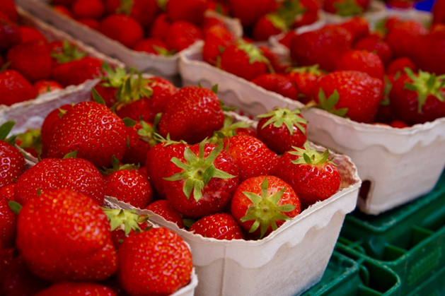
Department of Defense (DoD) Fresh Entitlement Reminder
Deadline: Use your entitlement in the Fresh Fruits and Vegetables Order Receipt System (FFAVORS) by Tuesday, May 12, 2026.
Unspent balances will be transferred to the State Account.
After the transfer, schools collectively use the State Account until funds are depleted.

Slide 29
Micropurchases (1)
Micropurchases – are small informal purchases where the aggregate amount of the procurement transaction does not exceed the micropurchase threshold.
Threshold: $15,000 or $50,000 with self-certification.
  Management Bulletin CNP-01-2024 https://www.cde.ca.gov/ls/nu/sn/mbcnp012024.asp
Regulation Update
  Micropurchase definition is per transaction, not per vendor.

Slide 30
Micropurchases (2)
SFAs may use micropurchases to increase the number purchases of products from local farms and other suppliers.
Example: An SFA with a threshold of $50,000 may purchase $50,000 of local strawberries more than once from the same farmer.
Key requirements:
  Each transaction must be at or under micropurchase threshold.
  Price must be reasonable.
  Purchases should be distributed equitably among vendors.
  LEAs must document the history of each procurement and retain documentation.

Slide 31
Prepare P2 or CEP Applications
Applications Due: June 30, 2026
Determine if any sites need to apply or reapply for CEP or P2:
  Current cycle is expiring
  Standard meal counting and claiming sites have an identified student percentage (ISP) of 40 percent or higher
  Sites have been added or merged within an existing CEP group, or student population has changed at CEP or P2 sites
Contact SNP Specialist to discuss options or answer questions now, so applications can be submitted on time

Slide 32
Important Operational Reminders (1)
Action | Date
Use FFAVORS entitlement | Tuesday, May 12, 2026
Submit Summer 2026: SSO applications* | Submit 30 calendar days prior to start of meal service.
Submit Summer 2026: SFSP applications* | No more than 30 calendar days prior to meal service or Friday, May 15, 2026, whichever comes first.
Year-round schools must submit P2 applications and P2 extension requests to NSD with all supporting documentation | Monday, June 1, 2026
*Applications must be approved prior to the start of meal service.

Slide 33
Important Operational Reminders (2)
Action | Date
CEP applications, P2 applications and P2 extension requests must be submitted to NSD with all supporting documentation | Tuesday, June 30, 2026
Complete Kitchen Infrastructure and Training (KIT) 2022 Final Report | Tuesday, June 30, 2026
Request Food Safety Inspections (x2) for SY 2025–26 | End of SY 2025–26
Complete SY 2025-26 Food Safety Inspections Survey in CNIPS | July 2026, complete in the 2026-27 CNIPS program year

Slide 34
Resources and Other Announcements

Slide 35
2025 KIT and Retention & Recruitment (R&R) Grants
Applications for both grants have closed and all applications have been scored.
NSD is finalizing the grant awards and will send Grant Award Notifications and funding results once available.
Funding should be available to LEAs by July 2026.

Slide 36
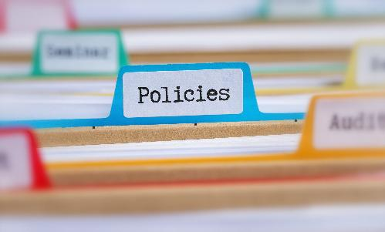
Local School Wellness Policy (LSWP)
Reminder: LSWP policy guidance assigns the responsibility to establish, maintain, and update the LSWP to the LEA.
  Title 7 Code of Federal Regulations (CFR) Section 210.31
Questions? Contact the LSWP team at LSWP@cde.ca.gov
Learn more with NSD’s online courses on Building the LSWP and LSWP Requirements

Slide 37
Farm to Summer Celebration 2025-Awardees (1)
Calistoga Joint Unified School District (USD)
Capistrano USD
Colton Joint USD
Delhi USD
Fresno Unified School District (SD)
Galt Joint Union Elementary SD
Healdsburg USD
Hesperia Unified SD Nutrition Services
Kern High SD
Linden USD
Little Lake City SD
Lodi USD
Manteca USD
Morongo USD
Murrieta Valley USD

Slide 38
Farm to Summer Celebration 2025-Awardees (2)
Natomas USD
Ontario-Montclair SD
Palmdale Elementary SD
Pittsburg Unified School District Edible Garden
Redlands USD
San Bernardino City USD
San Diego Unified Sandi Coast Cafe (Farm to School)
San Luis Coastal USD
Santa Cruz City Schools
Sausalito Marin City SD
Upland USD
Vista USD
Yucaipa-Calimesa Joint USD

Slide 39

Farm to Summer Celebration Week
Dates: June 15–19, 2026
Theme: From Seed to Plate: The Story of Our Food
Earn Recognition:
  Pre- and Post-survey
  Taste, Teach, and Connect

Slide 40
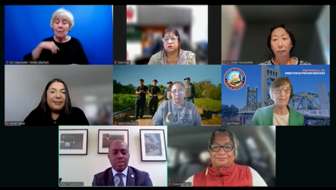
Webinar: Celebrating Women Advancing Sustainable School Meals
2026 Women's History Month Theme: Women Leading the Way for Sustainability
State Superintendent of Public Instruction Tony Thurmond hosted a webinar titled: Celebrating Women Advancing Sustainable School Meals

Slide 41
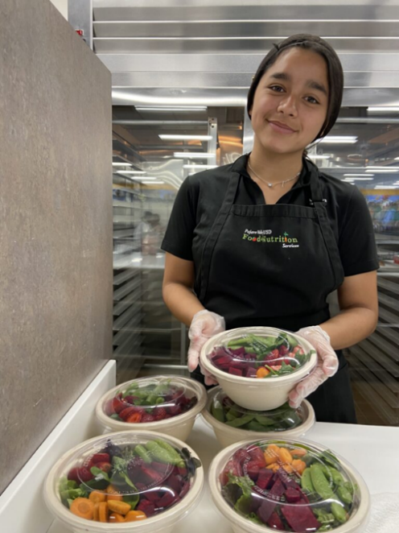
Recording Available: A Farmer's Guide to Working with California Schools
CDE webinar presented live during the Community Alliance with Family Farmers (CAFF) Small Farmers Conference earlier this year
Learn from Food Service Directors:
  Building relationships with farmers
  Purchasing methods
  Establishing food safety requirements
Watch the webinar recording on NSD Learning Site by searching for the title

Slide 42
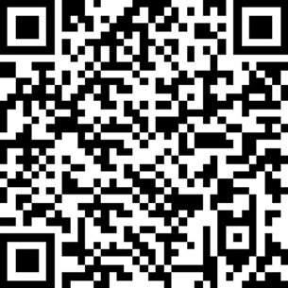
Input Requested: CA Universal Meal Implementation Survey
Voluntary survey to assess the implementation of CA Universal Meals
Survey Deadline Extended: Friday, May 1, 2026
  Time: 30-45 minutes to complete
  PDF of Questions: FSD UM Survey, CNIPS Download Forms
Access the survey by web link or QR code: https://ucanr.co1.qualtrics.com/jfe/form/SV_6tacwBLGBNoGZ1k
Questions: Contact Wendi Gosliner, Principal Investigator at SchoolMealsStudy@ucanr.edu

Slide 43

New Resources Available:
Dietary Guidelines for Americans 2025–2030
Eat Real Food Toolkit
Posters & Graphics
Sample newsletters and website and social media posts
Resources available on the Eat Real Food Toolkit web page at https://www.fns.usda.gov/cnpp/dietary-guidelines-americans/eatrealfood-toolkit

Slide 44
Food Smarts – Free Trainings
Training | Date/Time
Food Smarts Facilitator Training | May 20 & June 3, 2026, 10 a.m. - 12 p.m.
Capacitación Para Educadores de Food Smarts, Español | May 21 & June 4, 2026, 9 a.m. - 11 a.m.
Register at: CalFresh Upcoming Training and Events
Questions: CFHLStatewideTraining@leahspantry.org

Slide 45
USDA Grants Supporting Farm to School
Regional Food Systems Partnership (Public and private)
  Plan and develop or implement and expand local or regional food systems
Farmers Market Promotion Program
  Promotes direct-to-consumer activities, including direct producer-to-institutional markets
Local Food Promotion Program
  Supports local and regional food business enterprises that are intermediaries in indirect producer to consumer marketing, such as food hubs.
25 percent cash or in-kind is required
Apply at www.grants.gov by Friday, June 5, 2026.

Slide 46
Tuesday at 2 Town Hall Schedule
Held on the fourth Tuesday of the month
Date | Topic
May 26, 2026 | Town Hall updates and mini training
June 23, 2026 | Town Hall updates and guest speaker
July 2026 | No Town Hall

Slide 47
Professional Standards Crediting Information
Key Area: Administration (3000)
Training Topic: Program Management (3200)
Learning Objective: Manage Staff Work Including Scheduling (3210)
Instructional Hours: 1.5 hours

Slide 48
THIS INSTITUTION IS AN
EQUAL OPPORTUNITY PROVIDER.

