Slide 1
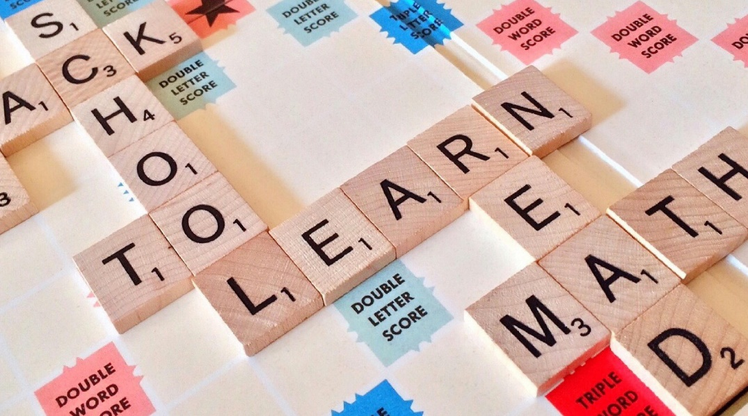
Tuesday @ 2
School Nutrition Town Hall
August 27, 2024
California Department of Education
Nutrition Services Division

Slide 2

Town Hall at a Glance
District Spotlights & Award Recognition
Federal Updates
State Updates
Reminders
Funding Updates
Other Announcements

Slide 3
District Spotlight: Napa Valley Unified School District
The Press Democrat featured Napa Valley Unified School District (USD) in an article that highlighted the impacts of Universal Meals and the resulting increase in number of meals served in the district.
School Year (SY) | Number of Meals Served
2021–22 | 1.5 million
2022–23 | 2.2 million
2023–24 | 2.4 million

Slide 4
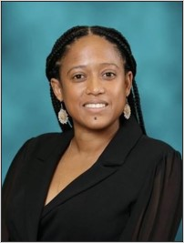
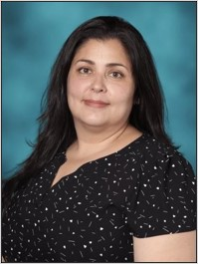
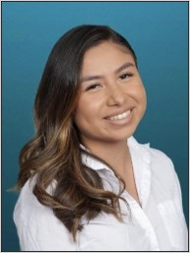
District Spotlight: Mission Preparatory, Inc.
Fresh Fruit and Vegetable Program (FFVP) Grantee
Dra. Cynthia Jerez
Executive Director
Beatriz Franco
Compliance and
Operations Specialist
Cindy Quintanilla Acosta
Director of Finance and Community Operations

Slide 5
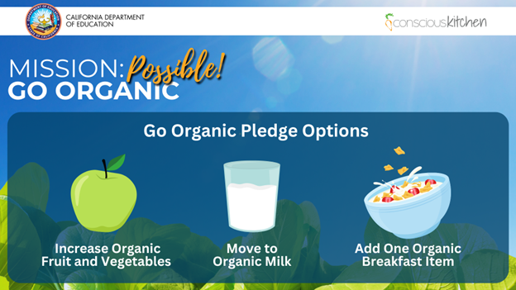
Mission: Possible! Go Organic!

Slide 6
Upcoming Celebrations
Dates | Celebrations
The Month of September | California Food Literacy Month
The Month of October | National Farm to School Month
October 10, 2024 | California Crunch Day
October 12, 2024 | National Farmer's Day
October 14-18, 2024 | National School Lunch Week

Slide 7

Turnip the Beet Awards for
Summer 2024
Recognizes summer meal programs serving high quality summer meals
Nominations due to the California Department of Education (CDE) by August 30, 2024

Slide 8

California Green Ribbon
Schools (CA-GRS)
Recognition Program
The CA-GRS program honors excellence in whole-school sustainability.
Awardees receive CDE recognition and an award plaque.
Applications are due Monday, November 4, 2024.
For CA-GRS information or to request an application visit the CDE CA-GRS web page at https://www.cde.ca.gov/ls/fa/sf/greenribbonprog.asp.

Slide 9

Healthy School Food Pathway
Fellowship 2025
Natalie Vandenburgh
Senior Coordinator of Fellowship
Chef Ann Foundation

Slide 10
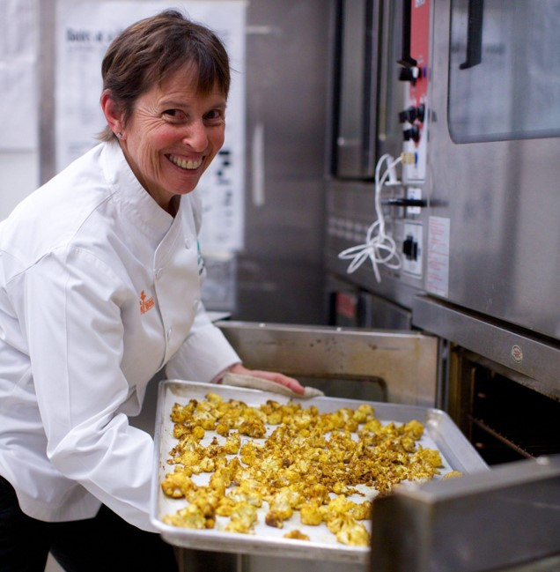
MISSION
Ensure that school food professionals have the resources, funding and support they need to provide fresh, healthy, delicious, cook from scratch meals that support the health of children and our planet.

Slide 11
APPROACH
Our programs support districts in transitioning their school meal programs from highly-processed heat-and-serve school food to self-operated scratch-cook programs through training, technical assistance, professional development, and implementation grants.

Slide 12
IMPACT
Our programs have reached over 14,000 schools and 3.4 million children in all 50 states.

Slide 13
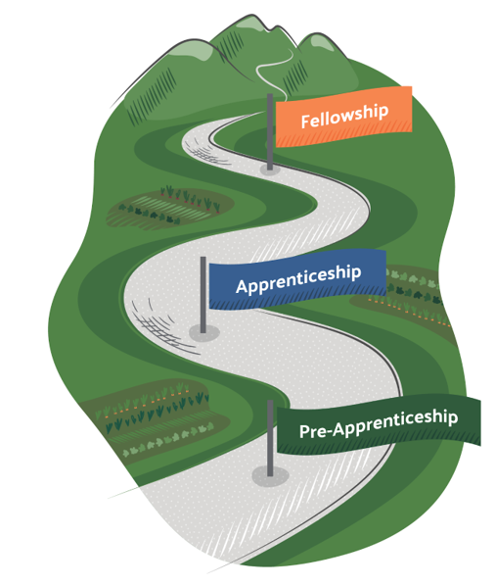
Healthy School Food Pathway
Maximizing Impact Through Workforce Development

Slide 14
What is the Fellowship?
A registered apprenticeship program designed to cultivate the next generation of diverse school food leaders who can successfully operate scratch-cooked school meal programs and advocate for:
  Healthy school meals
  Efficient scratch cooking operations
  Climate-positive food system solutions
  An equity-driven, valued workforce

Slide 15
Who is the Ideal Fellow?
A current school food professional who is:
In a mid- to upper-level position in their department
Looking to grow their career and increase scratch cooking
Ready for a challenging and rewarding opportunity

Slide 16
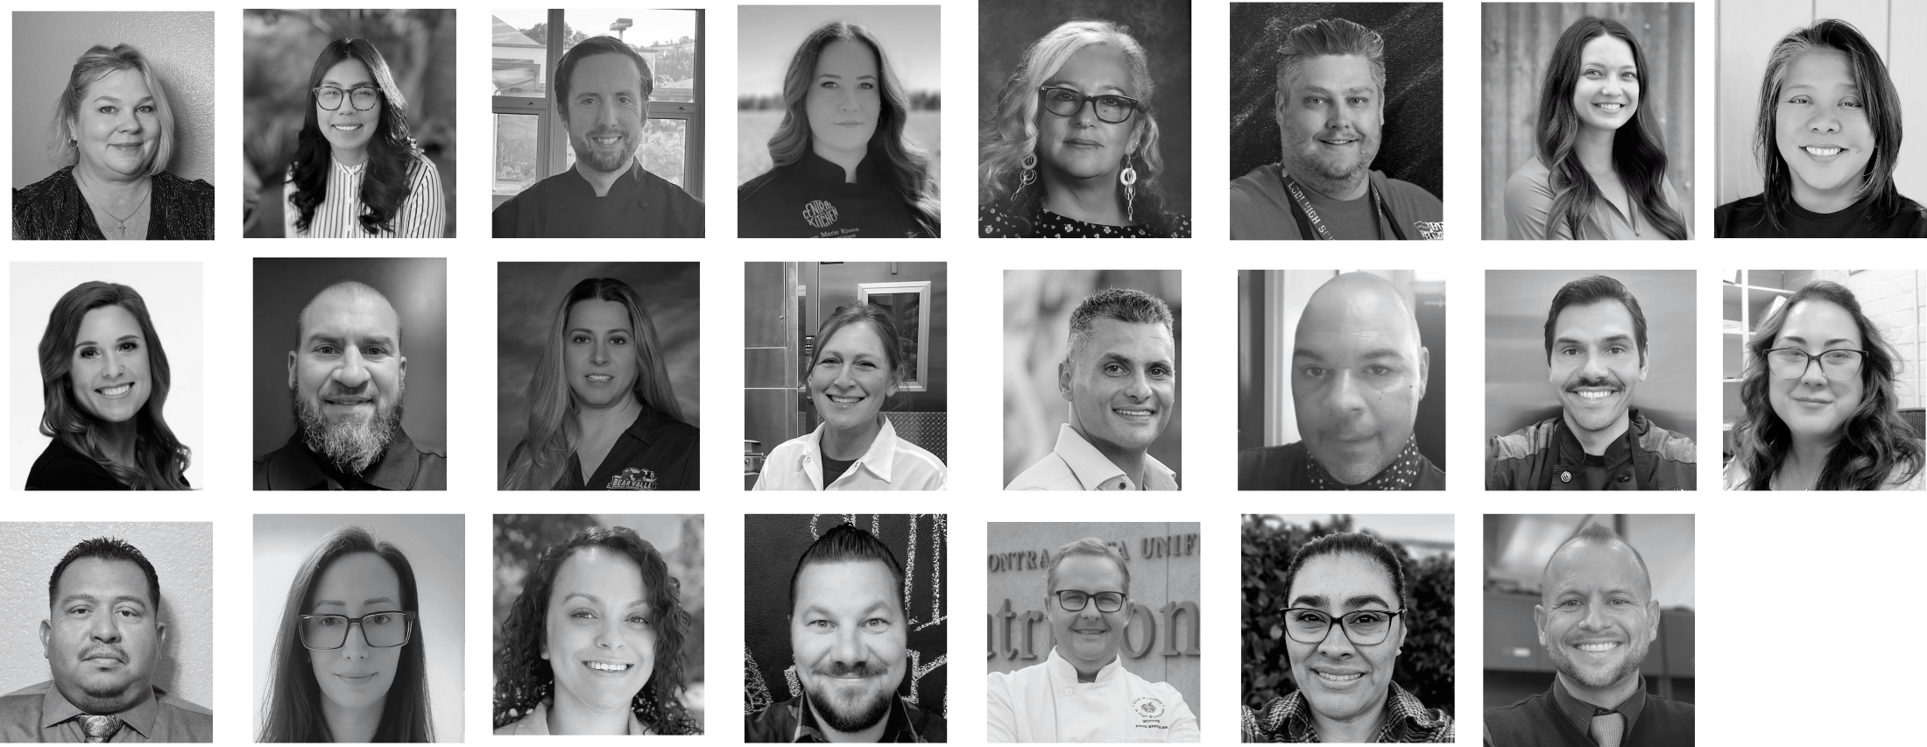
Meet the 2023 & 2024 California Fellows

Slide 17
How does the Fellowship help you grow as a leader?
With a cohort of ~24 other like-minded school food professionals from across the country, you’ll master 16 key learning competencies via:
Weekly virtual live learning sessions on Zoom
Five on-site experiential learning trips
Asynchronous coursework
Group policy project
On-the-job capstone project

Slide 18
When does the Fellowship take place?
The fellowship time period is from January 2025 - January 2026.
Weekly virtual learning sessions take place on Zoom from 3 p.m. to 6 p.m. Pacific Time on most Tuesdays.
Five in-person trips are taken (three in spring/summer, two in fall/winter).
Applications for the 2025 cohort are open now - apply by September 12th at 10:59 p.m. Pacific Daylight Time.

Slide 19
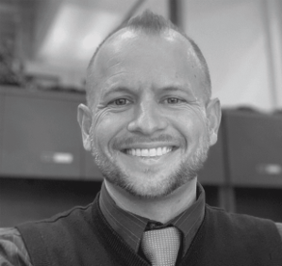
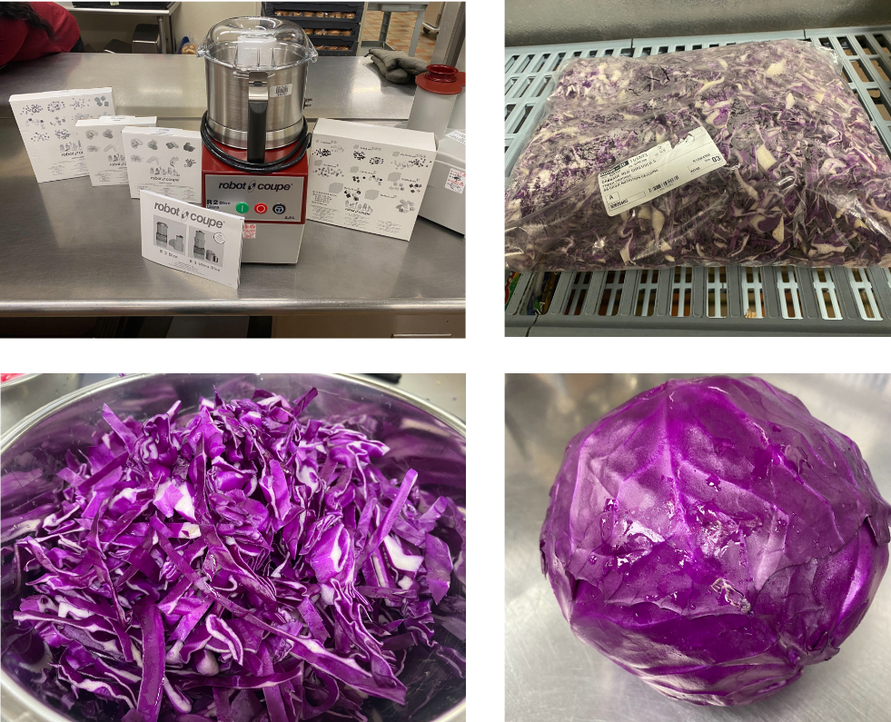
Success Stories (1)
Whole Food:
Quality You Can Taste!
Warren Ryan
San Bernardino City USD

Slide 20
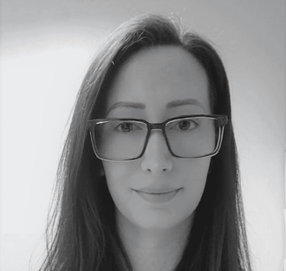
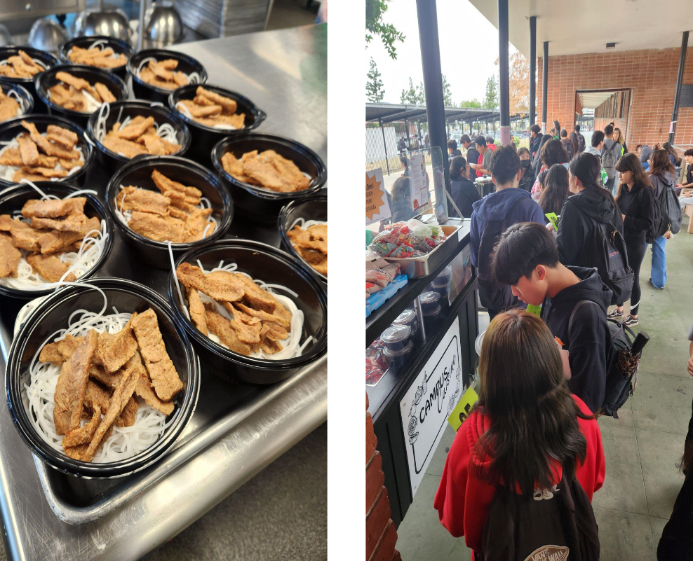
Success Stories (2)
Nom Nom Cart for Student Customization
Brittney Rodriguez
Hacienda La Puente USD

Slide 21
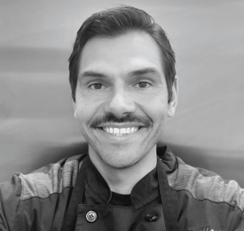
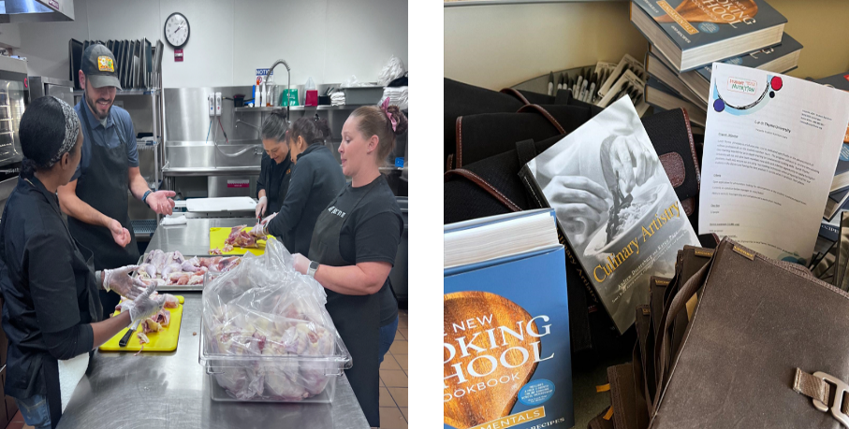
Success Stories (3)
Read more about Richie’s exciting new role as director at Redwood City School District on the Chef Ann Foundation Fellowship blog at https://www.chefannfoundation.org/blog/inaugural-fellowship-graduate-becomes-first-time-director/.
Richie Wilim
Vacaville USD

Slide 22
Questions
If you have questions about the Healthy School Food Pathway Fellowship email: fellowship@chefannfoundation.org

Slide 23
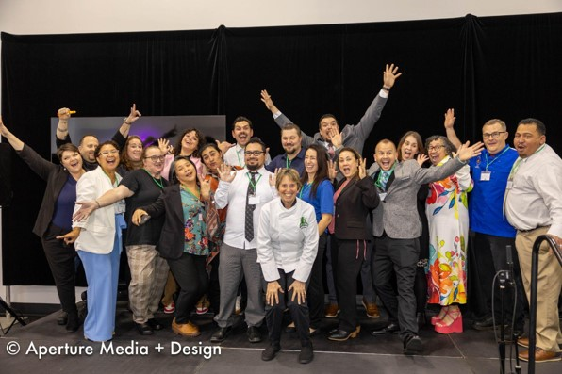
Apply for the Chef Ann Foundation Today!
Thank you!
Apply by September 12th at https://chefannfoundation.org/fellowship.

Slide 24
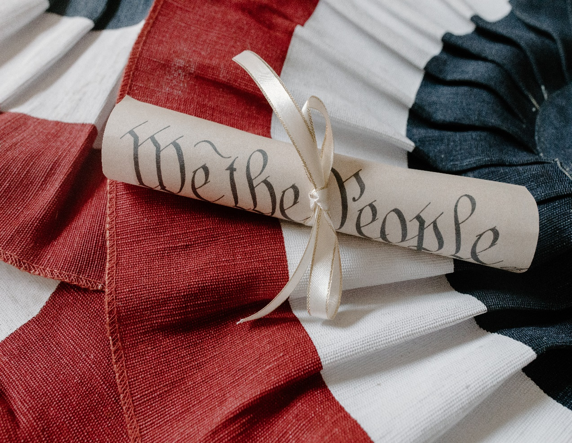
Federal Updates

Slide 25
Final Rule Flexibilities: Are you ready?
As a reminder, July 1, 2024, brought some new flexibilities of the following supports for:
  Vegetarian diets and dietary preferences.
  Local fresh foods through geographic preference and Buy American.
  Other areas such as professional standards support.
For more information on the final rule, visit the Child Nutrition Programs: Meal Patterns Consistent with the 2020–2025 Dietary Guidelines on the School Nutrition Standards web page at https://www.fns.usda.gov/cn/school-nutrition-standards-updates.

Slide 26
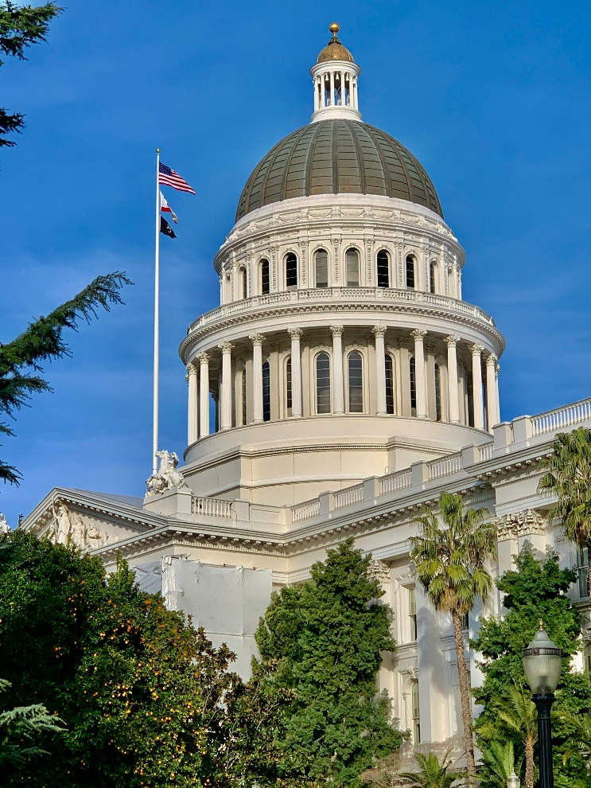
State Updates

Slide 27

Back to School Reminders (1)
New Requirement!
Monthly direct certification matching through the California Longitudinal Pupil Achievement Data System (CALPADS) for ALL public schools, county offices of education and charter schools.

Slide 28
Back to School Reminders (2)
Establish individual child eligibility
  Community Eligibility Provision (CEP)/Provision 2 (P2) Non-Base Year: Conduct Direct Certification
  P2 Establishing New Base Year: Conduct Direct Certification AND Collect National School Lunch Program (NSLP) Meal Applications
  Standard Counting and Claiming: Conduct Direct Certification AND Collect NSLP Meal Applications

Slide 29
Back to School Reminders (3)
2. Notification to the public and families
Send a public media release notifying the public of the availability of school meals and send letters to households.
  Standard counting and claiming sites: include information on applying for free and reduced-price meal (FRPM) benefits and federal Income Eligibility Guidelines.
  Provision sites: notify public and families that meals will be available at no cost.

Slide 30
Back to School Reminders (4)
3. Update the Child Nutrition Information and Payment System (CNIPS)
  Ensure that site applications are up-to-date and current.
  Update contacts- this is who will receive listservs.
  Complete prior to claiming deadlines – no application approval means you cannot submit.
  Timely submissions are important.

Slide 31
Back to School Reminders (5)
Food Safety Inspections
  Request two food safety inspections from the local environmental health department.
  Document the request for food safety inspections in CNIPS.
  Retain documentation for CDE review.

Slide 32
Food Distribution Program Administrative Fee Suspension for SY 2024–25
Continued suspension of $0.90 per case or case equivalent administrative fee for the following:
  Direct delivery products.
  Bulk foods to processors.
Fee suspension is temporary in SY 2024–25.
  School food authorities (SFAs) are encouraged to budget for these fees in future years.

Slide 33

2024 Sun Bucks Update (1)
Phase II Sun Bucks cards being mailed now to students identified as eligible for the first time after March 29, 2024.
Over 5.2 million cards have been mailed to date.

Slide 34
2024 Sun Bucks Update (2)
Children can continue to qualify for 2024 Sun Bucks through August 31, 2024.
Required Local Educational Agency (LEA) Action:
  Receive a NSLP application or alternative income form by August 31, 2024.
  Process application and submit the FRPM program record to the CALPADS.

Slide 35
2024 Sun Bucks Update (3)
Newly eligible children will receive Sun Bucks cards throughout the fall.
CALPADS data is pulled monthly through the end of 2024.
    August 31
    September 30
    October 31
    November 27
    December 31

Slide 36

Sun Bucks Customer Service
Family Inquiries and Support:
  PIN setup and card replacements
  Address changes
  Eligibility questions
  Escalations
1-877-328-9677

Slide 37
Important Operational Dates:
Next 30 to 90 days (1)
Action | Date
2023–24 FFVP Final Report | August 30, 2024
2024–25 FFVP Mandatory Online Trainings | September 13, 2024
Request Food Safety Inspections (x 2) and update in CNIPS | August-October 2024

Slide 38
Important Operational Dates:
Next 30 to 90 days (2)
Action | Date
Complete annual updates | July-October 2024
Use all carryover pounds for U.S. Department of Agriculture (USDA) Foods | October 31, 2024

Slide 39

Funding Updates

Slide 40
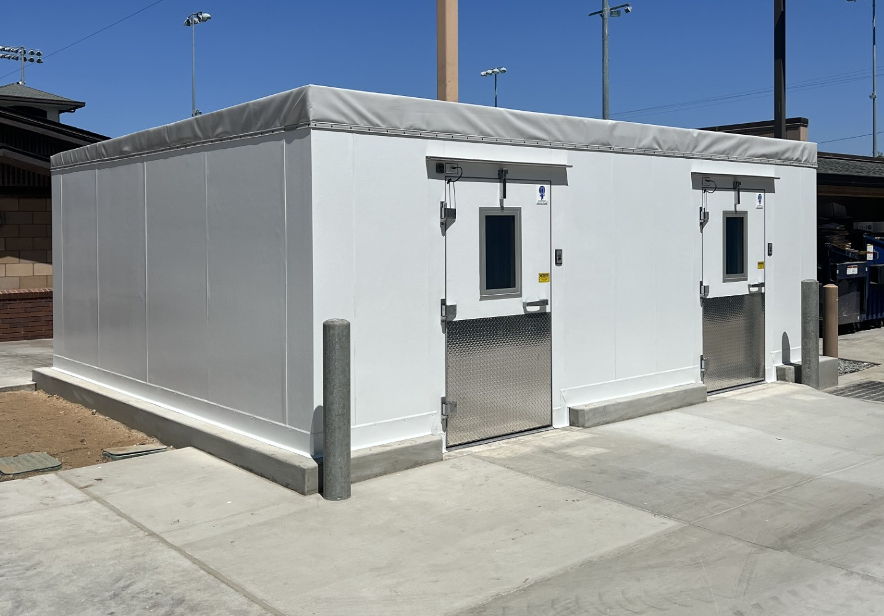
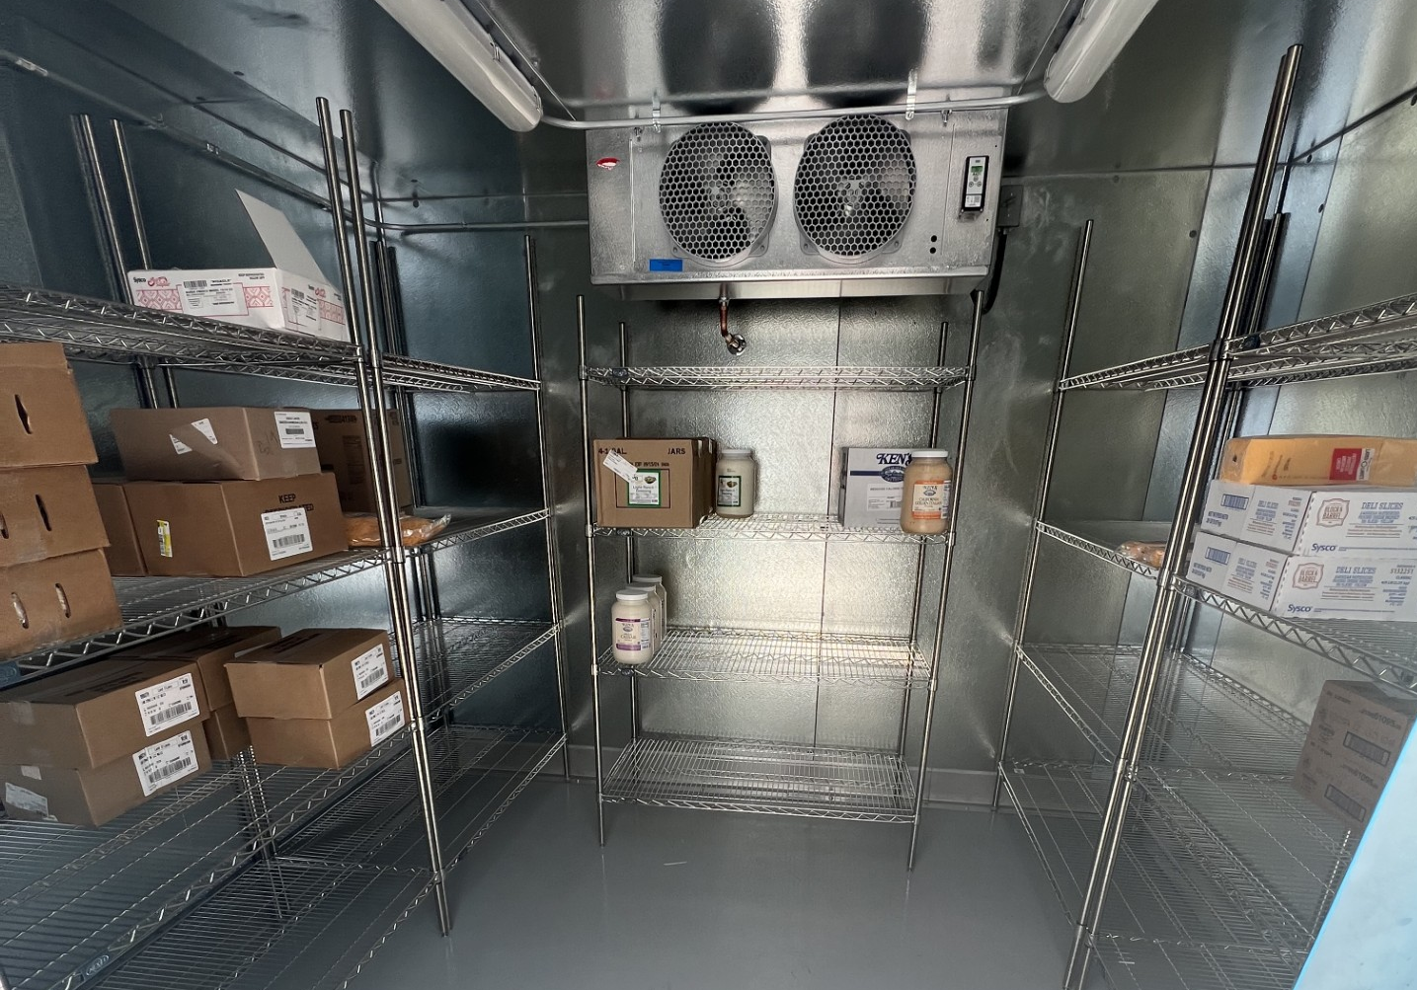
Equipment Assistance Grant: Coronado USD
Charity Campbell, Director Child Nutrition Services, shares "I can't thank you enough for the funds. These walk-ins will allow for more efficient deliveries, organization, and inventory. These were crucial to our operations, and we are so thankful!"
Exterior walk-in Interior walk-in

Slide 41
Grant Funds Overview (1)
Grant | Timeline
Payment request sent to the State Controller’s Office (SCO) for the first set of Commercial Dishwasher Grant (CDG) grantees who submitted their e-signed Grant Award Notification (GAN). | July 23, 2024
Payment request sent to the SCO for the second set of CDG grantees who submitted their e-signed GAN. | August 2, 2024

Slide 42
Grant Funds Overview (2)
Grant | Timeline
FFVP Grantees Announcement for SY 2024–25 was released | August 6, 2024
Local Food for Schools deadline to expend any unused funds | November 29, 2024

Slide 43

Resources & Other Announcements

Slide 44
Introduction to School Nutrition Program Administration Training
3-Day in-person training
Date: October 30-November 1, 2024
Location: Corona Norco USD, Learning Center South
Registration information will be shared via listserv

Slide 45
Administrative Review Prereview Training
The training is required for SFAs with SY 2024–25 School Nutrition Program (SNP) Administrative Review (AR).
SNP AR Prereview Training (PRT) will prepare the SFAs for the SNP AR.
The live webinar is scheduled on September 17 through 18, 2024.
Registration is required to obtain access to the live PRT webinar.
Registration links are available from the Webinar Registration: Mandatory Prereview Training Webinar listserv.

Slide 46
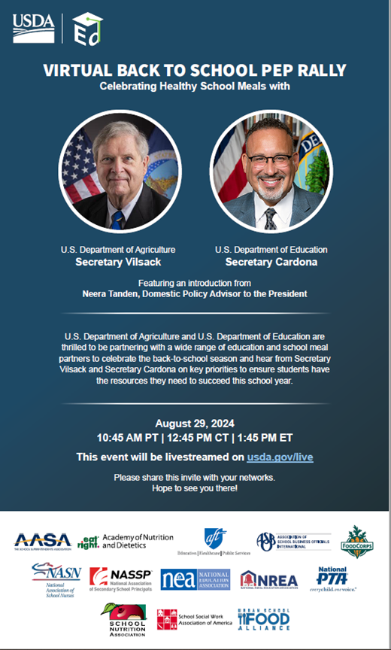
USDA Virtual Back to School Pep Rally: Celebrating Healthy School Meals
What: Pep rally to celebrate Back to School!
  Tom Vilsack, Secretary
  Miguel Cardona, U.S. Department of Education Secretary
When: August 29, 2024, at 10:45 a.m.
Where: Livestream the pep rally at https://www.usda.gov/media/live

Slide 47
USDA: Reducing Added Sugars in School Meals Webinar
When: September 12, 2024, noon to 1 p.m.
What: Strategies to reduce added sugars while improving quality and incorporating local tastes, opportunities to hear best practices, and new resources!
Where: Register via WebEx link provided in the chat.

Slide 48
USDA: Reducing Added Sugars at Breakfast
This new resource helps school nutrition professionals:
  Determine added sugars in foods and drinks.
  Provides menu planning tips.
  Updated to include new added sugar limits.
  Other tips for reducing added sugar in recipes.
Download Reducing Added Sugars at Breakfast on the USDA website at https://www.fns.usda.gov/tn/sbp/reducing-added-sugars.

Slide 49
Webinar: Institute of Child Nutrition (ICN)
Strategies for Improving Lunch Line Efficiency
What: Learn new strategies to improve lunch line efficiency in student queues and communication among school nutrition staff to ensure a smooth lunch service.
When: August 29, 2024, noon to 1 p.m.
Where: Register on the ICN Strategies, Training, Action Plans and Resources (STAR) web page at https://theicn.docebosaas.com/learn/courses/417/star-strategies-for-improving-lunch-line-efficiency-august-29th-2024-3pm-est.

Slide 50
New Resources: Culinary Institute of Child Nutrition (CICN)
Check out the new Culinary Quick Bites training series!
  Culinary Quick Bites offers 15-minute trainings.
  Each on-site lesson includes a lesson objective, facilitator guide, instructional video, and activity.
  Topics include knife skills, developing flavor, basic food prep skills, and basic cooking techniques.
Access the CICN series at https://theicn.org/cicn/culinary-quick-bites-series/.

Slide 51
Resources: CICN Back to School Toolbox
New resources to help you prepare for the school year!
Resources include:
  Back to School Checklist
  Good and Best Practices
  Important Back to School Trainings, and more!
Access these courses and more on the ICN website at https://theicn.org/info/backtoschool/.

Slide 52
Tuesday @ 2pm Town Hall Schedule
Held on the fourth Tuesday of the month
Month | Format | Date
September | State Update and Guest Speaker | 9/24/24
October | State Update | 10/22/24
November | No Town Hall | N/A

Slide 53
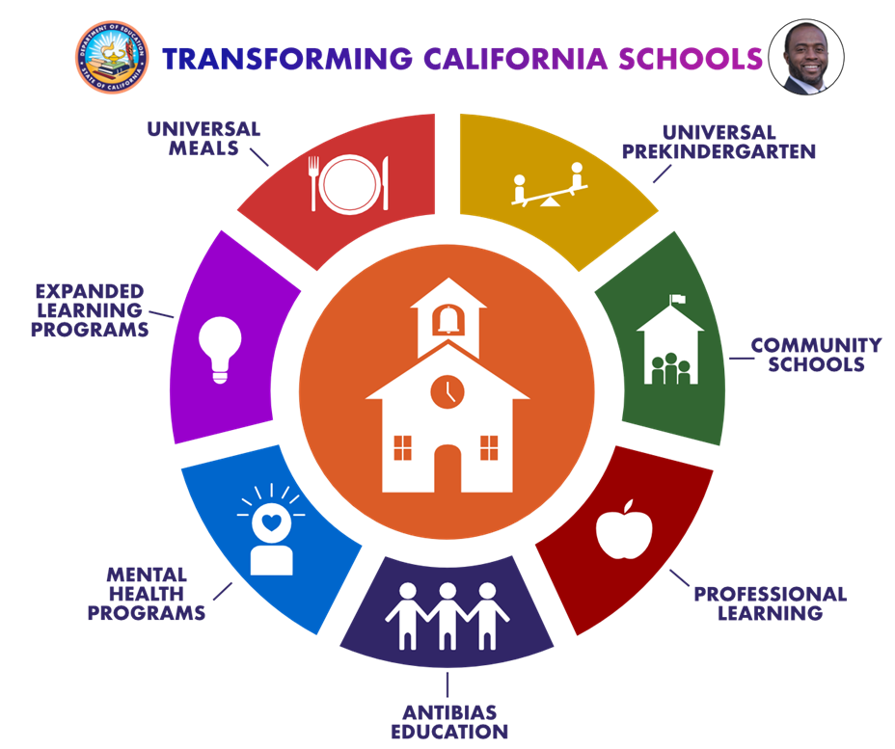
Thank you!
Next Town Hall:
September 24, 2024
This institution is an equal opportunity provider.

