Slide 1
Tuesday @ 2 School Nutrition Town Hall
February 25, 2025

Slide 2

Town Hall at a Glance
District Spotlight
Federal & State Updates
Operational Reminders
Grant Announcements
Guest Speaker-Local School Wellness Policy
Resources & Other Announcements

Slide 3
District Spotlights

Slide 4
CA Healthy Meals Incentives Recognition Awardees
Evergreen School District (SD), San Jose, CA - Innovation in the Cultural Diversity of School Meals
Little Lake City School District, Santa Fe Springs, CA - Breakfast Trailblazer
Newman-Crows Landing Unified School District (USD), Newman, CA -Innovative School Lunch Makeover, Innovation in Nutrition Education & Innovation in the Preparation of School Meals
San Ysidro SD, San Ysidro, CA - Small or Rural School Food Authority Breakfast Trailblazer

Slide 5
Healthy School Food Pathways
2025 Fellowship Cohort
Albert Tse (San Francisco USD)
Amber Green (Marysville Joint USD)
Christina Lane (Washington USD)
Dwayne Dionne (Alhambra USD)
Gianmario Oddli (Morgan Hill USD)
Jamie Anderson (Banta USD)
Jeane Pacheco (Lodi USD)
Kamilah Williams (Menifee USD)
Maly Pra (Dublin USD)
Michelle Diaz (Gridley USD)
Nicholas Svoboda (Galt Joint Union Elementary SD)
Patience Boulais (Ocean View SD)
Sepon Istepanyan (Live Oak USD)

Slide 6
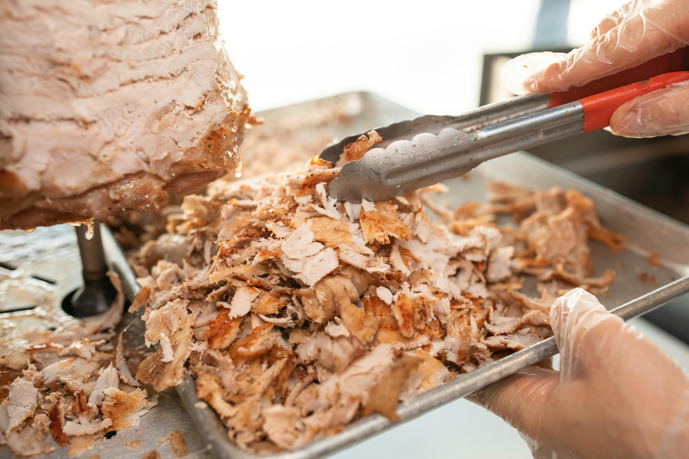
Standardized Recipe: Beef Birria Bowl
Los Angeles USD
Features shredded beef, brown rice, seasoned pinto beans; topped with pico de gallo; served with a lemon wedge and tortilla chips
Available in Child Nutrition Information and Payment System (CNIPS) Applications Download Forms

Slide 7
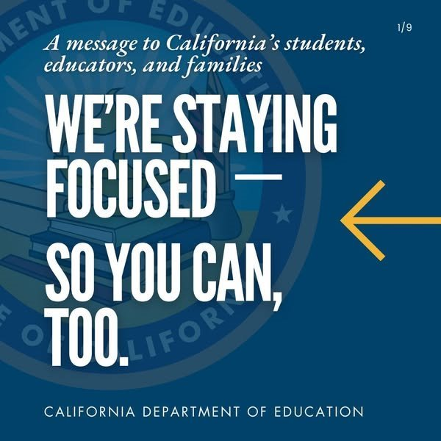
Federal Updates

Slide 8
Summer Food Service Program (SFSP) 2025 Reimbursement Rates
Rates are effective from January 1, to December 31, 2025.
Meal Type | Rural or Self-Prep | All Other Site Types
Breakfast | $3.09 | $3.03
Lunch or Supper | $5.40 | $5.32
Snacks | $1.28 | $1.25

Slide 9
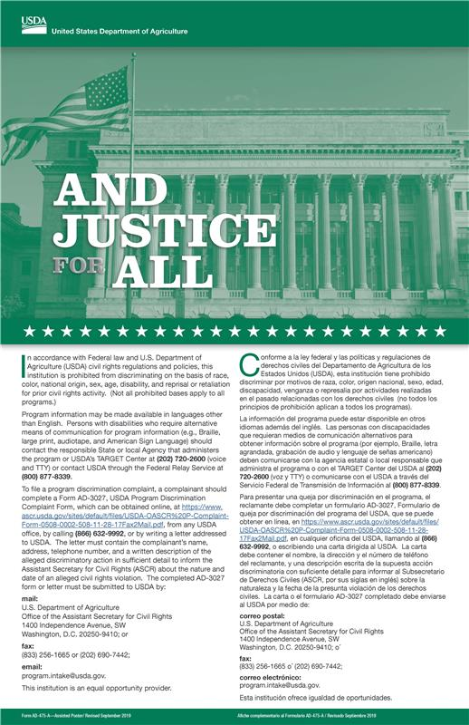
Update on And Justice for All Posters
And Justice For All Posters (AJFA):
AJFA Posters have been removed from the U.S. Department of Agriculture’s (USDA) webpage.
California Department of Education (CDE) does not currently have any AJFA posters to send to school food authorities (SFAs).
SFAs should continue to display any AJFA posters dated 2019 or 2022.
SFAs should remove posters featuring the Statue of Liberty.

Slide 10
State Updates

Slide 11


California Code of Regulations Updates
Effective April 1, 2025 (1)
Related Management Bulletins will be forthcoming.
Amended–Title 5, California Code of Regulations (5 CCR) Section 15562: Meals Eligible for Reimbursement
  To be eligible for state meal reimbursement, meals provided must be eligible for federal reimbursement.
  Added Registered Dietitians (RD) to the list of professionals that can approve food component substitutions for medical reasons.

Slide 12
California Code of Regulations Updates
Effective April 1, 2025 (2)
New Section–5 CCR Section 15560: Fluid Milk Substitutes
  Fluid milk substitutes must meet the same nutritional requirements as fluid milk.
  For a Disability: Allows a Medical Statement to Request Special Meals and/or Accommodations form for a fluid milk substitute to be signed by an RD or State of California licensed physician, physician assistant, or nurse practitioner.

Slide 13
California Code of Regulations Updates
Effective April 1, 2025 (3)
New Section–5 CCR Section 15560: Fluid Milk Substitutes, continued:
Non-disability: Allows fluid milk substitutes to be provided once a completed Parental Request for a Fluid Milk Substitute for School-Age Children form is provided.
SFAs must inform the CDE if providing fluid milk substitutes for non-disability reasons.

Slide 14
California Code of Regulations Updates
Effective April 1, 2025 (4)
Amended–5 CCR Sections 15575-15578 Competitive Foods
Section 15575 Definitions for Foods:
Expanded the definition of entrée to include a grain only, whole-grain rich entrée served in the School Breakfast Program (SBP).
  California's SBP grain only entrée requirements are stricter than the federal requirements.
  NOTE: Any grain in a competitive entrée must be whole grain-rich.

Slide 15
California Code of Regulations Updates
Effective April 1, 2025 (5)
Section 15576 Definitions for Beverages
Updated the definition for Electrolyte Replacement Beverages to include a calorie limit per serving size to align with USDA regulations.
Added a definition for Flavored Water to align with California Education Code.
Updated fluid milk limits for added sugars to align with USDA regulations.
NOTE: California is stricter and only allows nonfat flavored milk as a competitive beverage.
Updated nondairy milk limits for fat and added sugar.

Slide 16
California Code of Regulations Updates
Effective April 1, 2025 (6)
Section 15577 Food and Beverages Restrictions
Updated snack and entrée nutrition standards to align with the California Education Code and USDA regulations.
NOTE: California law and regulations still require that trans fat be analyzed for competitive food compliance.
All applicable resources effected by these changes will be updated to reflect these changes.

Slide 17
Ultra Processed Foods
By October 1, 2025, provide recommendations for adopting higher standards for healthy school meals than those contained in the 2020-2025 Dietary Guidelines for Americans.
  Statewide survey for all food service directors (April)
  Key informant interviews (May)
    Schools
    Industry

Slide 18
Sun Bucks Universal Benefits Application
The Universal Benefits Application (UBA) template will be released by the end of February.
Schools operating Community Eligibility Provision or Provision 2 in non-base years will need to make UBAs available for families to apply for SUN Bucks benefits for summer 2025.
  Alternative Income Forms cannot be used for SUN Bucks eligibility determinations.
Children can only be determined eligible if directly certified or have an approved UBA or National School Lunch Program (NSLP) meal application on file with the school.

Slide 19
Operational Reminders

Slide 20
USDA Foods Ordering and Timelines for School Year (SY) 2025–26
Preplanners and Surveys are due Monday, March 3, 2025.
The Food Distribution Program (FDP) compiles all orders into truckload quantities and finalizes orders to the USDA.
Contact FoodDistibution@cde.ca.gov.

Slide 21
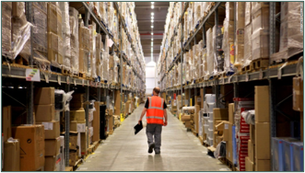
Balances at Processors
Check balances at current processors
Compare usage to what you diverted last year
Review SY 2024–25 diversions
Ask about available California excess pounds

Slide 22
FDP Knowledge Check (1)
What is Thursday, May 1, 2025, known for?
Chocolate parfait day
National fruit compote day
The day by which you should use your entitlement in the Fresh Fruits and Vegetables Order Receipt System (FFAVORS)
All of the above

Slide 23
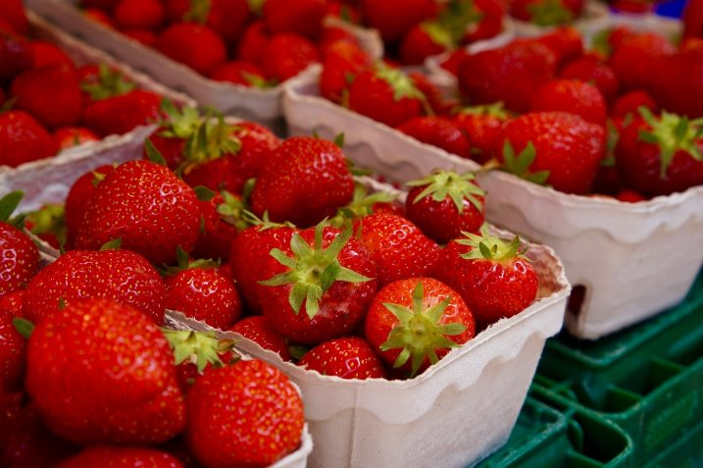
FDP Knowledge Check (2)
d) All of the above...but what we really want you to remember is to use your entitlement in FFAVORS by Thursday, May 1, 2025.

Slide 24

Cooperative Agreements or Piggyback Contracts Survey
Asks for number of cooperative and piggyback contracts
Counts as a contract review for all SFAs that use the contract
Survey due date is Friday, March 28, 2025

Slide 25
Knowledge Check: Ramadan Waiver (1)
Is it too late to opt in to the non-congregate Ramadan waiver?
Yes
No

Slide 26
Knowledge Check: Ramadan Waiver (2)
Is it too late to opt in to the non-congregate Ramadan waiver?
b) No, there is still time to apply!
For more information visit the CDE Waiver for Non-congregate Meals During Ramadan web page at https://www.cde.ca.gov/ls/nu/ramadanwaivermeals.asp [Please note: the wavier period has closed]

Slide 27
Seamless Summer Option (SSO) & SFSP Applications Open
Program operators can now submit SSO and SFSP applications for summer 2025.
  SSO site applications must be approved before summer operations begin, and
  SFSP applications must be submitted by Thursday, May 15th or 30 days prior to the start of summer operations, whichever comes first.

Slide 28
Important Operational Dates:
Next 30-90 Days (1)
Action | Date
Submit the USDA Foods Pre-Planner or Survey | March 3, 2025
Cooperative Agreements or Piggyback Contracts Survey | March 28, 2025
Use your entitlement in the FFAVORS | May 1, 2025

Slide 29
Important Operational Dates:
Next 30-90 Days (2)
Action | Date
Submit Summer 2025: SSO applications | Submitted and approved prior to the start of operations
Submit Summer 2025: SFSP applications | May 15th or 30 days prior to the start of operations

Slide 30
Grant Announcements

Slide 31
School Breakfast Program and Summer Meals Program Start-up and Expansion Grants
Funding Amount: $1.017 million available with awards up to $15,000 per school site
Due Date: 4 p.m., Monday, March 17, 2025
Eligible Agencies: Public school districts, county offices of education, and directly funded charter schools
Note: School sites may be awarded no more than once every three years
More information available on the School Breakfast and Summer Meal Grants web page at https://www.cde.ca.gov/ls/nu/sn/sbsfgrant.asp

Slide 32
Fresh Fruit and Vegetable Program (FFVP) Grant
Funding Amount: Per student award between $50 to $75
Due Date: 4 p.m., Thursday, March 20, 2025
Eligible Agencies: Public school districts, county offices of education, charter schools, private schools, or residential child care institutions operating the NSLP
Note: SFAs may apply on behalf of elementary school sites that have at least 50 percent or more of its students eligible for free or reduced-price meals
More information available on the FFVP Request for Applications web page at http://www.cde.ca.gov/fg/fo/r9/ffvp25rfa.asp

Slide 33
FFVP Try Agriculture Samples with Tastes and Education (TASTE) Grant
Funding Amount: $1,886,442
Eligible Agencies: The FFVP TASTE Incentive is available exclusively to SY 2025–26 FFVP grantees
Allowable Expenses: Taste tests of local produce and nutrition and/or agricultural-based education materials
Due Date: 4 p.m., Monday, March 20, 2025
More information available on the TASTE Incentive Grant web page at http://www.cde.ca.gov/fg/fo/r9/ffvp25rfa.asp

Slide 34
Local School Wellness Policy
Wellness and Community Activities
Jennifer Davis, Director of Nutrition Services
Kern High School District

Slide 35
Resources and Other Announcements

Slide 36
Join the CA Local School Wellness Policy Collaborative Newsletter
Receive alerts about upcoming trainings, new and refreshed resources, and more!
Sign up to receive updates by joining the CA Local School Wellness Policy Collaborative newsletter at https://healthyeating.us10.list-manage.com/subscribe?u=53977a2d4e0c4ee1c6f32ad4b&id=127223b69a.

Slide 37

March Celebrations (1)
If 3's are E's and 7's are L's:
Wh3n do3s Nationa7 Schoo7 Breakfast W33k B3gin and 3nd?
BONUS Question: What is the theme?

Slide 38

March Celebrations (2)
Wh3n do3s Nationa7 Schoo7 Breakfast W33k B3gin and 3nd?
March 3-7, 2025
BONUS Question: What is the theme?
"Clue In to School Breakfast"

Slide 39
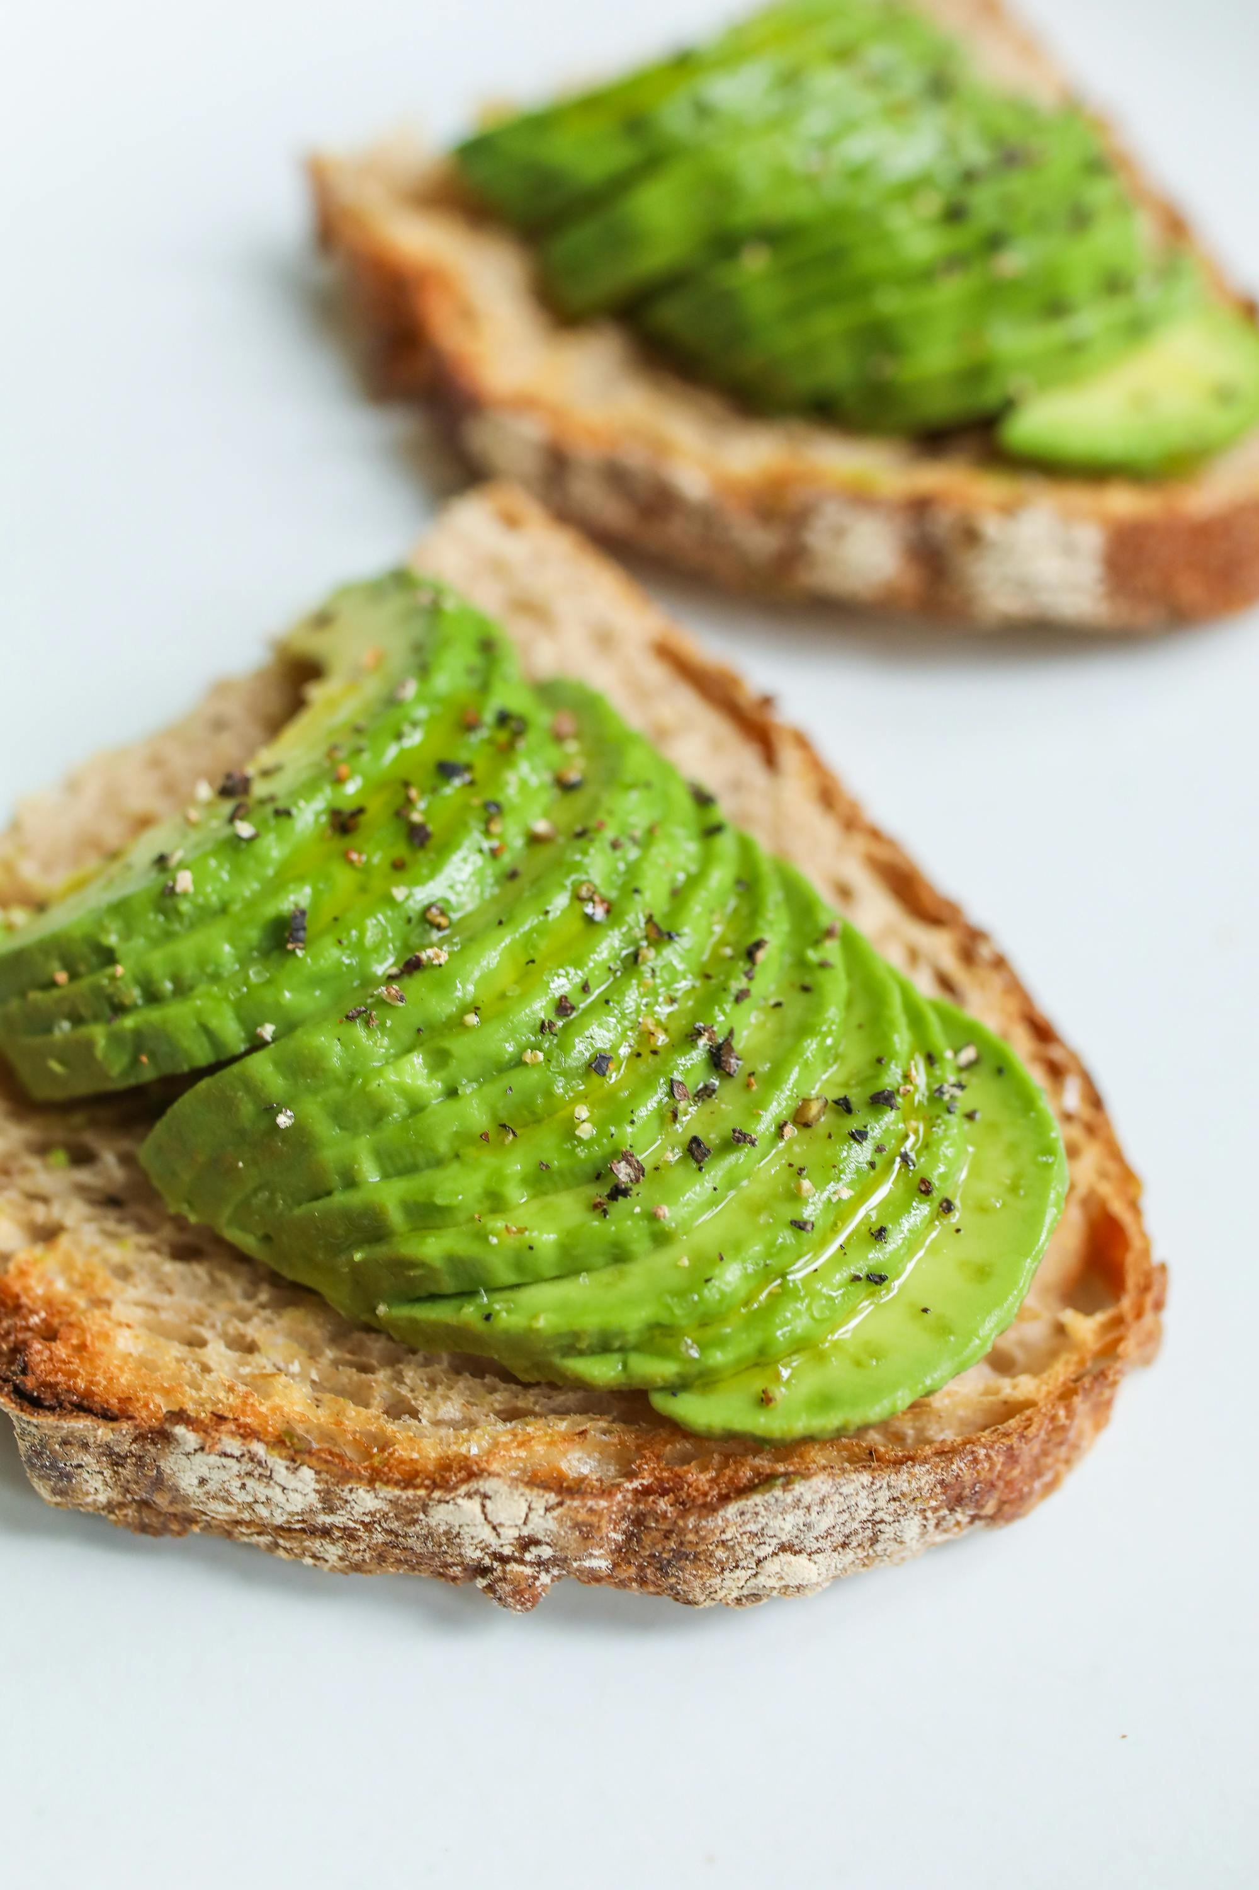
March Celebrations (3)
What other nutrition celebration is in March and lasts all month?
Hint: This year's theme is Food Connects Us, and one component of this month's celebration always includes Registered Dietitian Nutritionist Day!

Slide 40

March Celebrations (4)
What other nutrition celebration is in March and lasts all month?
  National Nutrition Month®

Slide 41

Earth Day 2025 is April 22nd:
Eliminating Single-Use Plastics
Work towards eliminating single-use plastics by making one plastic-free action or eliminating all single-use plastics for one day.
Learn more about Plastic Free Lunch on the Cafeteria Culture.org website at https://www.cafeteriaculture.org/plastic-free-lunch.html

Slide 42
Child Nutrition Advisory Council (CNAC) Recruitment
Recruiting the following CNAC member positions:
Child Care Food Program Sponsor
Classroom Teacher
Consultant Position
Curriculum Coordinator
Lay Person
School Administrator
Send questions to the CNAC team at CNAC@cde.ca.gov.
School Board Member
High School Student
Applications will be posted soon
Applications due March 28, 2025
Learn more on the CNAC web page at https://www.cde.ca.gov/ls/nu/he/cnac.asp

Slide 43
Reminder: Soft Launch of the Nutrition Services Division (NSD) Learning Site (1)
Reminding you of the soft launch of CDE NSD's new Learning Site for:
  For Child Nutrition Program (CNP) Operators with CNIPS ID
    Directors, managers, full and part-time staff
    Food Service Management Company staff
  To satisfy mandatory trainings, professional standards requirement, and additional trainings to support the successful administration of your CNPs

Slide 44
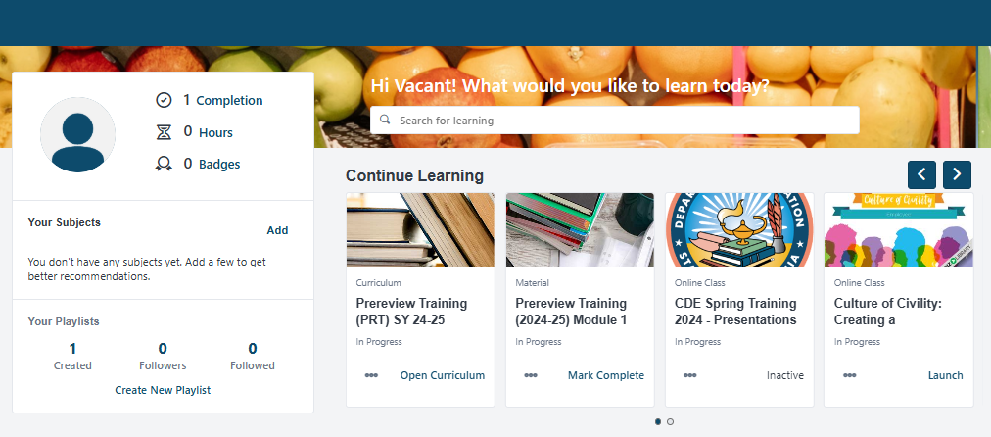
Reminder: Soft Launch of
NSD Learning Site (2)
Self-registration is required to access site
What to expect next:
  Upcoming self-registration webinar and guided tour webinars
Wednesday, February 26, 2025, at 1 p.m.
Wednesday, March 5, 2025, at 1 p.m.
  Updates via Listserv and Town Hall reminders
For questions or support, contact us at NSDLearning@cde.ca.gov

Slide 45
Tuesday @ 2 Town Hall Schedule
Held on the fourth Tuesday of the month
Month | Format | Date
March | State Update | March 25, 2025
April | State Update and Guest Speaker | April 22, 2025
May | State Update | May 27, 2025

Slide 46
Professional Standards Crediting Information
Key Area: Administration (3000)
Training Topic: Program Management (3200)
Learning Objective: Manage Staff Work Including Scheduling (3210)
Instructional Hours 1.5 hours

Slide 47
THIS INSTITUTION IS AN
EQUAL OPPORTUNITY PROVIDER.

