Slide 1

Tuesday @ 2
School Nutrition Town Hall
June 25, 2024
California Department of Education
Nutrition Services Division

Slide 2
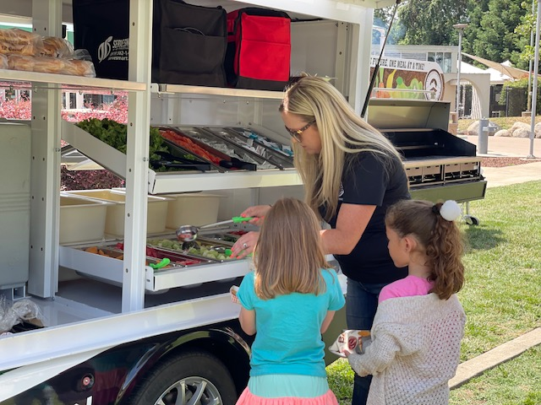
Town Hall at a Glance
District Spotlights & Award Recognition
Federal Updates
State Updates
Reminders
Funding Updates
Other Announcements

Slide 3

District Spotlight: Azusa Unified School District’s Mini Farmers Market
The June 2024 Served Digizine highlights Azusa Unified School District's (USD) commitment to working with local farmers and the Farm to School program.
Azusa USD partners with local farmers to provide nutrition education at each elementary school!

Slide 4
CA Healthy Meals Incentives Initiative: Recognition Awardees
Congratulations CA awardees:
    Centralia Elementary School District
    Newman-Crows Landing USD
Healthy Meals Incentives (HMI) applications are accepted on a rolling basis through June 30, 2025.
Send your request for California Department of Education (CDE) letters of support to HMILetterOfSupport@cde.ca.gov.

Slide 5

Green Ribbon Schools (GRS) Award Program
California’s 2024 National U.S. Department of Education Green Ribbon Schools (ED-GRS) honorees include:
Cabrillo USD
Trabuco Elementary, Saddleback Valley USD
Claremont USD
Pacific Ridge School
Rio School District
Find the California’s GRS Award application on the CDE GRS web page at https://www.cde.ca.gov/ls/fa/sf/greenribbonprog.asp.

Slide 6
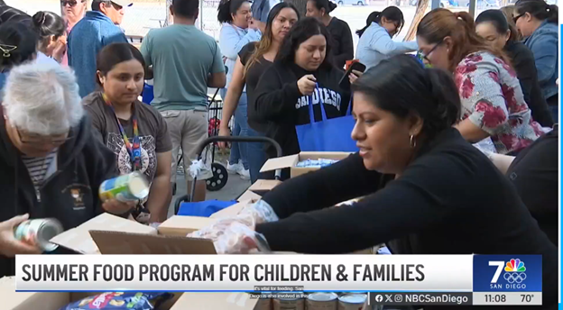
District Spotlight: San Diego USD
San Diego USD's Summer Meals program was highlighted on their local NBC Channel 7 news.
San Diego USD is offering summer meals at various sites throughout San Diego.
Partnering with the Feeding San Diego School Pantry Program to offer fresh produce and pantry items.

Slide 7
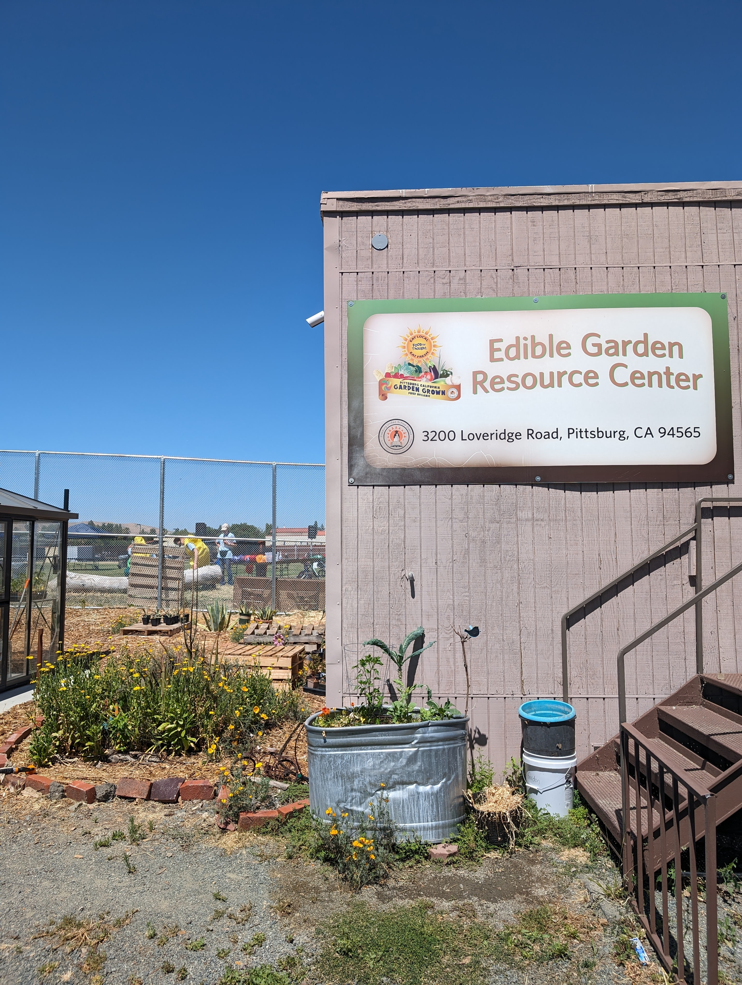
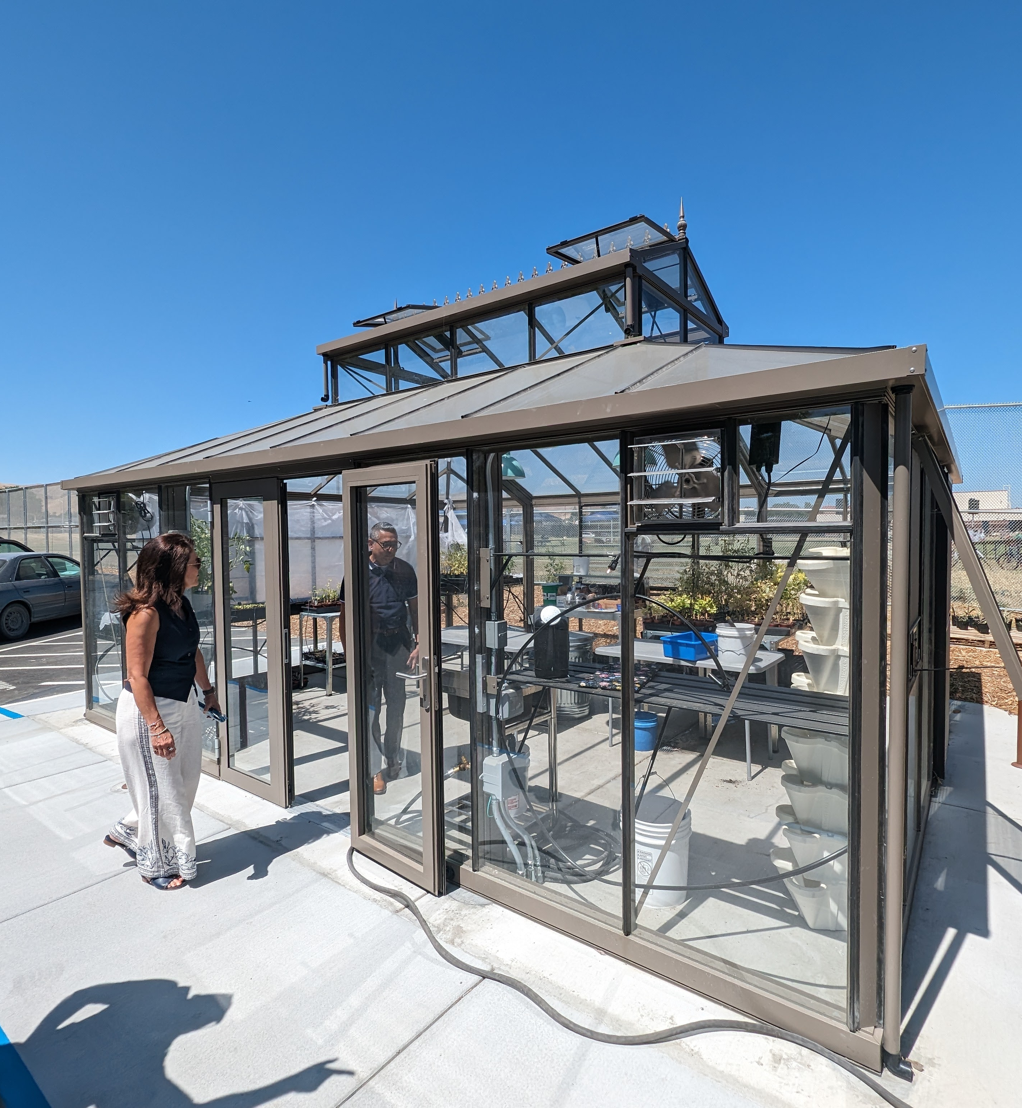
Summer Meals Kickoff -Pittsburg USD

Slide 8

Turnip the Beet Awards for
Summer 2024
Recognizes high quality summer meals
Nominations due to the California Department of Education (CDE) by August 30, 2024

Slide 9

Farm to Summer Celebration Week
Teach, Taste, Share the week of June 17-21st
Each Farm to Summer Celebration Week Program Operator receives the following for participating in the event:
  An online badge and certificate
  Recognition on an upcoming Townhall, listserv, and the CDE website
Complete the post-survey electronically at https://surveys3.cde.ca.gov/go/f2summerpostsurvey2024.asp
Thank you for participating!

Slide 10
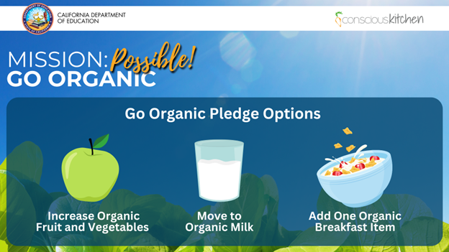
Mission: Possible! Go Organic!

Slide 11

Federal Updates

Slide 12
Traceability of Fresh Produce
U.S. Department of Agriculture (USDA) guidance for recall of fresh produce.
Trace to supplier and to whom and when served:
  Maintain purchase records and supplier contact info.
  Label produce and avoid comingling.
  Retain shipping documents to secondary locations.
  Document use on production records.

Slide 13
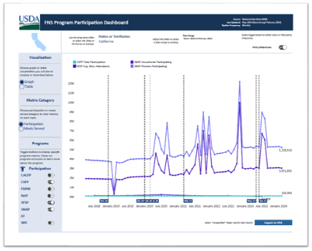
USDA Food and Nutrition Service (FNS)
Program Participation Dashboard
Check out the FNS's interactive dashboard!
Features state, territory and national level data for FNS nutrition programs.

Slide 14
Webinar - School Meals Just Got Healthier: Navigating the New USDA School Nutrition Standards
Webinar topics:
  USDA school nutrition standards
  Resources and tools to support implementation
Date: June 27, 2024, noon-1:15 p.m.
Watch the Institute of Child Nutrition’s, School Meals Just Got Healthier: Navigating the New USDA School Nutrition Standards webinar recording at https://theicn.docebosaas.com/pages/40/school-nutrition-dashboard.

Slide 15
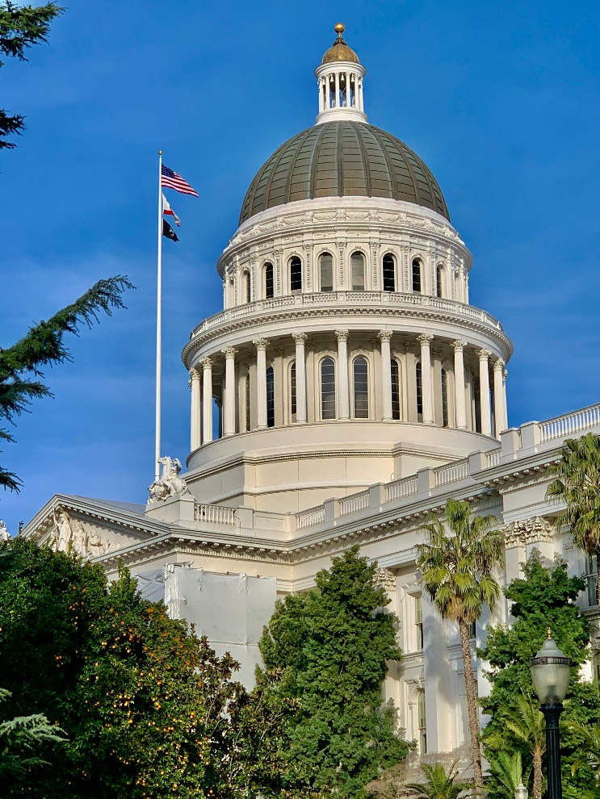
State Updates

Slide 16
Summer Feeding Reminders
Update Child Nutrition Information and Payment System (CNIPS) site applications in CNIPS.
Non-congregate feeding only available in rural areas:
  Have an approved site application in CNIPS
  Program integrity checklist submitted with procedures and training for staff

Slide 17
Excessive Heat and Poor Air Quality Waivers for Summer Meals (1)
Impacted sites eligible for:
  Non-congregate meal service – regardless if site is rural or not
  Parent and guardian meal pickup
  Meal service time flexibility

Slide 18
Excessive Heat and Poor Air Quality Waivers for Summer Meals (2)
Excessive Heat: The National Weather Service has issued a heat advisory, excessive heat warning or an excessive heat watch
and
The outdoor feeding site does not have a temperature controlled alternative indoor site.

Slide 19
Excessive Heat and Poor Air Quality Waivers for Summer Meals (3)
Poor air quality: Airnow.gov indicates an air quality index flag of purple or higher for the zip code in which the site is located
and
The outdoor feeding site does not have access to an alternative indoor site.

Slide 20
Excessive Heat and Poor Air Quality Waivers for Summer Meals (4)
Sites using these waivers must:
    Not change meal service time less than 24 hours in advance
    Put up a printed notice at site indicating change in meal service
    Alert the community
    Comply with all other program requirements

Slide 21
Excessive Heat and Poor Air Quality Waivers for Summer Meals (5)
How to apply:
Request this waiver using CNIPS site applications for:
  Seamless Summer Option or SSO: Question #26
  Summer Food Service Program or SFSP: Question #94

Slide 22
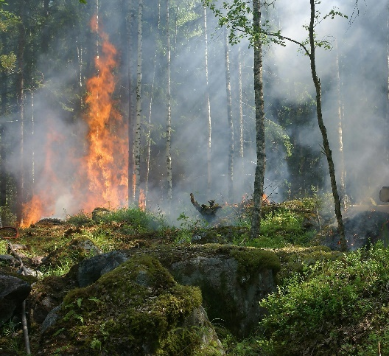

Disaster Preparedness Reminders
State or Federally Declared Disaster​
  Disaster Response – Child Nutrition Programs Management Bulletin CNP-01-2023​
Unanticipated School Closures and Flexibilities

Slide 23

2024 Summer EBT
(S-EBT or SUN Bucks)(1)
SUN Bucks cards being mailed to households now
Estimated SUN Bucks delivery date:
  Last Name A - D: June 2024
  Last name E - L: July 2024
  Last Name M - Z: August 2024

Slide 24
2024 Summer EBT
(S-EBT or SUN Bucks) (2)
Children can continue to qualify for SUN Bucks through August 31, 2024.
  Submit a meal application or alternative income form, or
  Newly identified via direct certification
Those identified as eligible during summer will receive SUN Bucks cards Fall 2024.

Slide 25
S-EBT Customer Service Support
Call Center is Live Now
  PIN setup and card replacements
  Address changes
  Eligibility questions
  Escalations
1-877-328-9677

Slide 26
Food Distribution Program (FDP) Reminders
FDP Contract Packet Annual Update
  Due July 31, 2024
Distribution Center Allocation A orders due
Check inventory balances at processors
Questions: Send an email to fooddistribution@cde.ca.gov

Slide 27
School Nutrition Programs Administrative Reviews in 2024–25
The list of the School Food Authorities (SFA) with 2024–25 School Nutrition Program (SNP) Administrative Reviews (AR) will be available on the Nutrition Services Division web page at the end of June.
A listserv announcing the SNP AR schedule will be sent to the SFAs.
All SFAs scheduled for the SNP AR are required to complete the mandatory SNP AR Prereview Training.

Slide 28
Important Operational Dates:
Next 30 to 90 days (1)
Action | Date
Site Visit for New Summer Sites | First week of operations
Community Eligibility Provision or CEP/Provision 2 Application Deadline | June 30, 2024
Request Food Safety Inspections (x 2) | End of School Year

Slide 29
Important Operational Dates:
Next 30 to 90 days (2)
Action | Date
SNP Annual Updates | Beginning July
FDP Contract Packet due | July 31, 2024
Update student data in the California Longitudinal Pupil Achievement Data System (CALPADS) for S-EBT determination | August 31, 2024

Slide 30

Funding Updates

Slide 31
Local Food for Schools (LFS)
Distributed the initial 80% of funds to County Offices of Education on May 10, 2024
Second quarter report of expenditures were due on May 15, 2024 – 46 reports not yet received
Third quarter report of expenditures reporting tool to be released on June 26, 2024
  Due by July 24, 2024
Questions email the LFS team at LFSGrant@cde.ca.gov

Slide 32
Grant Funds Overview (1)
Grant | Timeline
School Breakfast and Summer Expansion Grants funding results posted | June 3, 2024
Commercial Dishwasher Grant funding results posted | June 6, 2024

Slide 33
Grant Funds Overview (2)
Grant | Timeline
2021 Kitchen Infrastructure and Training (KIT) Final Report | June 30, 2024 (Proposed trailer bill: new due date June 30, 2025)
2022 KIT Final Report | June 30, 2025

Slide 34
Tuesday @ 2pm Town Hall Schedule
Held on the fourth Tuesday of the month
Month | Format | Date
July | State Update | 7/23/24
August | State Update and Guest Speaker | 8/27/24
September | State Update | 9/24/24

Slide 35

Thank you!
Next Town Hall:
July 23, 2024
This institution is an equal opportunity provider.

