Slide 1
Tuesday at 2 School Nutrition Town Hall
March 24, 2026
Nutrition Services Division (NSD)
California Department of Education (CDE)

Slide 2
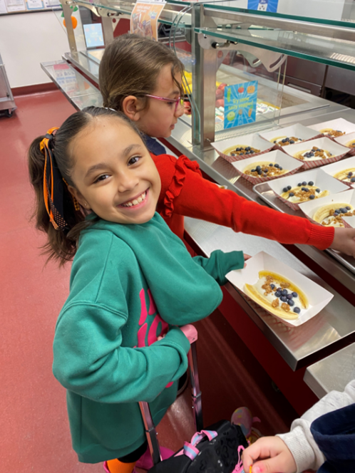
Town Hall at a Glance
District Spotlights
Federal & State Updates
Guest Speaker
Operational Reminders
Resources & Other Announcements

Slide 3
School Nutrition Program Spotlight

Slide 4
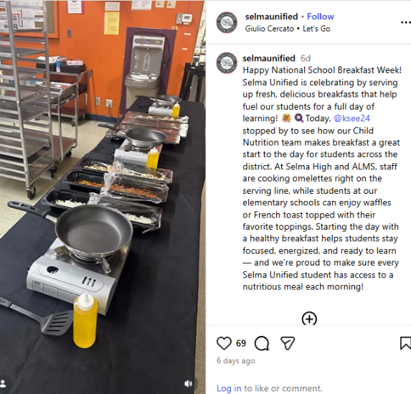
National School Breakfast Week-Spotlight (1)
Selma Unified School District (USD)
Celebrated National School Breakfast Week featuring:
  Omelet Bar and
  Waffles and French Toast with their favorite toppings
Check out Selma USD's Instagram post at https://www.instagram.com/reel/DVhvoynE7nB/

Slide 5
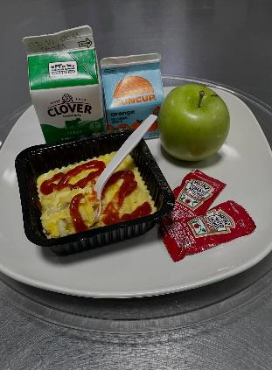
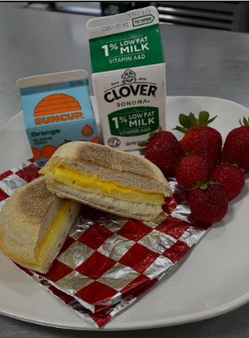
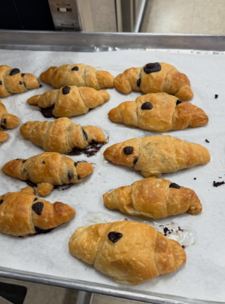
National School Breakfast Week-Spotlight
Monterey Peninsula Unified School District
Homemade Potato Frittata
Egg and Cheese Sandwiches
Locally-made Chocolate Croissants

Slide 6
Federal Updates

Slide 7
Upcoming 2025–2026 School Food Authority (SFA) Survey Participation
What: U.S. Department of Agriculture (USDA) Food and Nutrition Service (FNS) is conducting a survey of all SFAs operating the National School Lunch Program (NSLP) focusing on key challenges, including school food procurement and program administration for School Year (SY) 2025–26.
When: School Food Service Directors will be emailed on Monday, March 30, 2026.
Questions: Email FNS staff at CNSurveys@usda.gov.

Slide 8
State Updates

Slide 9
State Meal Mandate - Update
CDE Management Bulletin (MB) SNP-05-2026 California State Meal Mandate reissued with minor revisions.
Policy now clarifies the requirements for NSLP and School Breakfast Program (SBP) meals to comply with both federal and applicable state meal pattern requirements.
Specific meal pattern requirements can be found in the CDE MB SNP-14-2025 Updates to School Nutrition Program Standards.
Access these MBs on the CDE School Nutrition Programs Management Bulletins web page at https://www.cde.ca.gov/ls/nu/sn/mb.asp.

Slide 10
Reimbursement for Off-Site Meal Consumption
CDE MB SNP-06-2026 Reimbursement for Off-Site Meal Consumption released.
USDA reissued guidance on when NSLP and SBP meals can be served and consumed off site and claimed for reimbursement.
No action is required and guidance did not change.

Slide 11
SUN Bucks Updates
2026 SUN Bucks Implementation webinar recording online at https://www.youtube.com/watch?v=302gOjyC_EU.
This webinar focuses on various aspects of the 2026 program including eligibility, implementation, and data sharing.
Any local educational agency (LEA) staff that are involved with the administration and support of SUN Bucks will benefit from viewing this webinar.
California's 2026 SUN Bucks Plan of Operations and Management is pending USDA review and approval.

Slide 12
NEW – Food Service Management Company Request for Proposal & Contract Template
Food Service Management Company (FSMC) Request for Proposals and Model Fixed-price Contract template:
Available in the Child Nutrition Information and Payment System (CNIPS), download forms, Form ID PRU-07
New Certificate of Compliance and updated language for the Buy American and California Agricultural Preference Requirements
Updated regulations for SFA and FSMC responsibilities
Questions email the School Food Service Contracts Unit at SFSContracts@cde.ca.gov

Slide 13
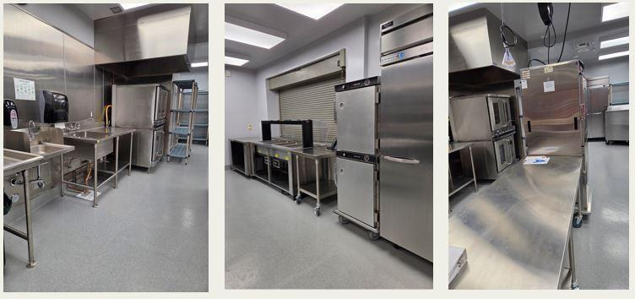
2022 Kitchen Infrastructure and Training (KIT)
Final Report –Coming Soon!
Direct email from Surveys@cde.ca.gov
One person per LEA will receive the custom link
All recipients must complete this report
Due: Tuesday, June 30, 2026
  Prior submissions do not fulfill reporting requirement
Questions: KITFunds@cde.ca.gov

Slide 14
2025 KIT & Retention & Recruitment Grants
Applications for both grants have closed and all applications have been scored.
NSD is finalizing the grant awards and will send Grant Award Notifications and funding results out once available.

Slide 15
Community Eligibility Provision and Provision 2
Rebecca Schupp, Supervisor II

Slide 16
Provisions Overview (1)
Federal provisions, Community Eligibility Provision (CEP) and Provision 2 (P2), are meal counting and collection alternatives that reduce administrative burdens for SFAs operating the School Nutrition Programs (SNPs):
Reduces administrative costs and paperwork for schools
Maximizes federal reimbursement for the SNPs
Increases efficiency during meal services

Slide 17
Provisions Overview (2)
Public schools, charter schools, and county offices of education must adopt a federal provision at any schools with an identified student percentage (ISP) at 40% or higher
  ISP = number of directly certified (DC) students/total enrollment
SFAs can choose CEP or P2 to satisfy this requirement
Other SFA types, such as private schools, have the option to adopt CEP or P2

Slide 18
CEP vs. P2 (1)
 | CEP | P2
Eligibility | Sites or groups of sites must have an ISP of at least 25% to be eligible | No minimum eligibility criteria, all sites eligible
Required Socioeconomic Data | Only uses DC and enrollment data from the prior year to calculate the ISP | Uses DC and meal application eligibility data and meal counts during the base year

Slide 19
CEP vs. P2 (2)
Action | CEP | P2
Application | Must submit full application with enrollment and DC data to CDE by June 30th | Must complete mandatory online training and submit application by June 30th (June 1st for year-round schools); SFA will be subject to base year review
Sites/Groupings | May apply as individual sites or as groups | Must apply and establish base year percentages at site or district level
Cycle Length | 4-year cycle | 4-year cycle, with options to extend if eligible

Slide 20
SFAs Operating CEP & P2 (1)
If currently approved to operate CEP or P2 and cycles are expiring, you must reapply or return to standard counting and claiming in SY 2026–27.
  All SFAs with expiring cycles have been contacted by SNP Specialists.
If student population or sites have changed, you may be required to reapply/re-base mid-cycle.

Slide 21
SFAs Operating CEP & P2 (2)
SFAs may be required to reapply or re-base if:
Approved to operate CEP and sites have been added, removed, or combined within existing CEP groups.
Approved P2 sites have added or removed grade levels, sites have merged, or if student population changes.
Reach out to SNP Specialist to discuss if reapplying for CEP or P2 is required. SFAs that fail to reapply/re-base before the application deadline will be required to return to standard counting and claiming.

Slide 22
Federal DC Impacts
House of Representatives or H.R. 1 will eventually result in a decrease in DC for CalFresh and Medi-Cal.
  Funding cuts and eligibility changes expected to roll out overtime but have not been fully implemented yet.
  SY 2025–26 could be the last year SFAs capture some CalFresh and Medi-Cal students through DC.
NSD recommends all existing CEP sponsors calculate ISP based on April 1 data.
  If ISP has remained the same or increased, it is recommended to reapply for CEP and lock in another 4-year cycle.

Slide 23
Important Dates
Date | Required Action
April 1, 2026 | Calculate ISP for all sites and existing groups and determine if applying or reapplying for CEP or P2 is necessary. Note: CEP applications used enrollment and DC data as of April 1, for SFAs pulling DC data from California Longitudinal Pupil Achievement Data System (CALPADS) this file will usually be available between the 5th and 10th of the month but will still be reflective of April 1.
June 1, 2026 | Year-round schools must submit P2 applications and P2 extension requests to NSD with all supporting documentation
June 30, 2026 | CEP applications, P2 applications and P2 extension requests must be submitted to NSD with all supporting documentation

Slide 24
CEP & P2 Resources & Contact Information
If applying for CEP or P2 for the first time, considering switching to a different provision, or your SFA needs to re-base, review the following resources and contact your SNP Specialist:
CDE Community Eligibility Provision web page at https://www.cde.ca.gov/ls/nu/sn/cep.asp
CDE Provision 2 web page at https://www.cde.ca.gov/ls/nu/sn/provisions.asp
CEP and P2 trainings available on NSD Learning Site, enter "CEP" or "Provision 2" in the search field
Contact: Questions email the team at SNPInfo@cde.ca.gov

Slide 25
Operational Reminders

Slide 26

Reminder: Food Safety Inspections
SFAs are required to obtain two food safety inspections at each site from the local environmental health department.
Group homes are exempt from obtaining food safety inspections but still must complete the food safety inspection survey in CNIPS.
2025–26 food safety inspection surveys will open in CNIPS in July for the 2026–27 program year.

Slide 27
Summer 2026 Operations (1)
Program Operators can begin submitting Seamless Summer Option (SSO) and Summer Food Service Program (SFSP) applications for summer 2026.
SSO site applications must be approved before summer operations begin.
SFSP applications must be submitted by Friday, May 15 or 30 days prior to the start of summer operations, whichever comes first. SFSP applications must be approved before meal service can begin.

Slide 28
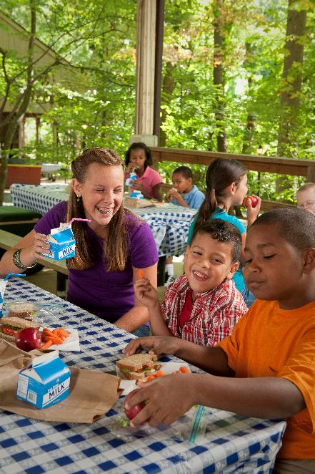
Summer 2026 Operations (2)
Work with district administrators to identify summer programming and meal service needs.
Schools offering summer school and serving only enrolled students may continue operating under the SNPs.
SFAs planning community feeding, serving only Expanded Learning Opportunity Program students, or providing rural non-congregate meal service should apply for SSO/SFSP.

Slide 29
Rural Non-congregate Meal Service in Summer Meal Programs (1)
Non-congregate Meal Service webinar is now available in the NSD Learning Site by searching non-congregate.
Program Integrity Plans are due by Wednesday, April 1, 2026.
The Program Integrity Plan template and Job Aid is available in the Download Forms section of CNIPS.
  In the SNP Module, see Form IDs SSO 2 and SSO 2a.
  In the Summer Food Service Program Module, see Form IDs SFSP 36 and SFSP 36a.

Slide 30
Rural Non-congregate Meal Service in Summer Meal Programs (2)
No Kid Hungry 2026 Summer Webinar Series begins Wednesday, March 25, 2026, at 12 p.m.
Learn about the basics of rural non-congregate meal service, menu building, community engagement, delivery models, and outreach
Register for the No Kid Hungry 2026 Webinar Series. The webinar has passed.

Slide 31
Rural Non-congregate Meal Service in Summer Meal Programs (3)
Who: No Kid Hungry California is offering grant funding to expand summer meals
What: Funding is available for schools and community organizations that are serving rural communities and expanding non-congregate feeding models
Grant amount: Varies, average award is $5,000 - $15,000
Applications due: Wednesday, April 15, 2026

Slide 32
Important Operational Reminders (1)
Action | Date
Calculate ISP for all sites and existing groups and determine if applying or reapplying for CEP or P2 is necessary. | Wednesday, April 1, 2026
Submit Summer 2026: SSO applications* | 30 calendar days prior to the start of meal service
Submit Summer 2026: SFSP applications* | Friday, May 15, 2026
*Applications must be approved prior to the start of meal service.

Slide 33
Important Operational Reminders (2)
Action | Date
Year-round schools must submit P2 applications and P2 extension requests to NSD with all supporting documentation | Monday, June 1, 2026
CEP applications, P2 applications and P2 extension requests must be submitted to NSD with all supporting documentation | Tuesday, June 30, 2026
Complete KIT 2022 Final Report | Tuesday, June 30, 2026
Request Food Safety Inspections (x2) | End of SY 2025–26

Slide 34
Resources and Other Announcements

Slide 35
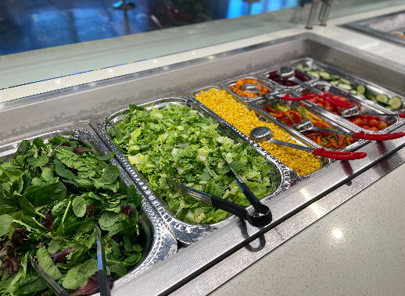
Funding Opportunity: Salad Bars to Schools Equipment Grant Program
What: Provides schools funding to support salad bars.
Who: K-12 schools participating in the NSLP
How: Apply on the Salad Bars to School Equipment Grant web page at https://www.thelunchbox.org/apply-for-a-grant/salad-bars-to-schools/
Due: Applications close on Tuesday, March 31, 2026
Questions: saladbargrant@chefannfoundation.org

Slide 36
Input Requested: CA Universal Meal Implementation Survey
Voluntary survey to assess the implementation of CA Universal Meals
  Similar to the March 2023 survey
Survey Deadline: Monday, April 6, 2026
  Time: ~30-45 minutes to complete
  PDF of Questions: FSD UM Survey, CNIPS Download Forms
Survey Link: https://ucanr.co1.qualtrics.com/jfe/form/SV_6tacwBLGBNoGZ1k
Questions: Contact Wendi Gosliner, Principal Investigator at SchoolMealsStudy@ucanr.edu

Slide 37

Mark Your Calendar: Celebrate School Nutrition Culinary Professionals
School Nutrition Employee Week April 27- May 1, 2026
School Lunch Hero Day is Friday, May 1, 2026
Share your photos with us email Town Hall staff at NSDTownHalls@cde.ca.gov

Slide 38
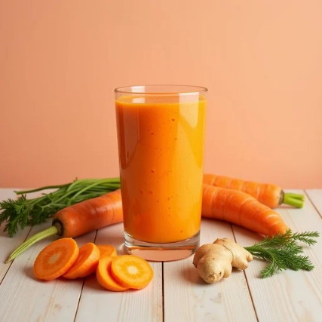
California Flavors: Fresh Recipes for the Future of School Meals
Features 12 new recipes, such as a Mango Carrot Lassi, Korean Street Toast, and Oven-Baked Pancit
Reflects the rich cultural diversity of California students
Highlights California grown fruits and vegetables, and introduces students to flavors from around the world
Access these recipes on the California Food for California Kids webpage at https://www.californiafoodforcaliforniakids.org/california-flavors-sabores-de-california

Slide 39
Available Now: Competitive Foods and Beverages Online Trainings
Five Competitive Foods and Beverages trainings are now available on the NSD Learning Site.
Search 'Competitive Foods'
Questions on accessing the NSD Learning Site email NSDLearning@cde.ca.gov.

Slide 40
Tuesday at 2 Town Hall Schedule
Held on the fourth Tuesday of the month
Date | Topic
April 28, 2026 | Town Hall updates and guest speaker
May 26, 2026 | Town Hall updates and guest speaker

Slide 41
Professional Standards Crediting Information
Key Area: Administration (3000)
Training Topic: Program Management (3200)
Learning Objective: Manage Staff Work Including Scheduling (3210)
Instructional Hours: 1.5 hours

Slide 42
THIS INSTITUTION IS AN
EQUAL OPPORTUNITY PROVIDER.

