Slide 1

Tuesday @ 2
School Nutrition Town Hall
December 12, 2023
California Department of Education
Nutrition Services Division

Slide 2

Town Hall At-A-Glance
District Spotlights
Operational Reminders
State and Federal Updates
Funding Updates
Important Dates
Resources & Other Announcements

Slide 3
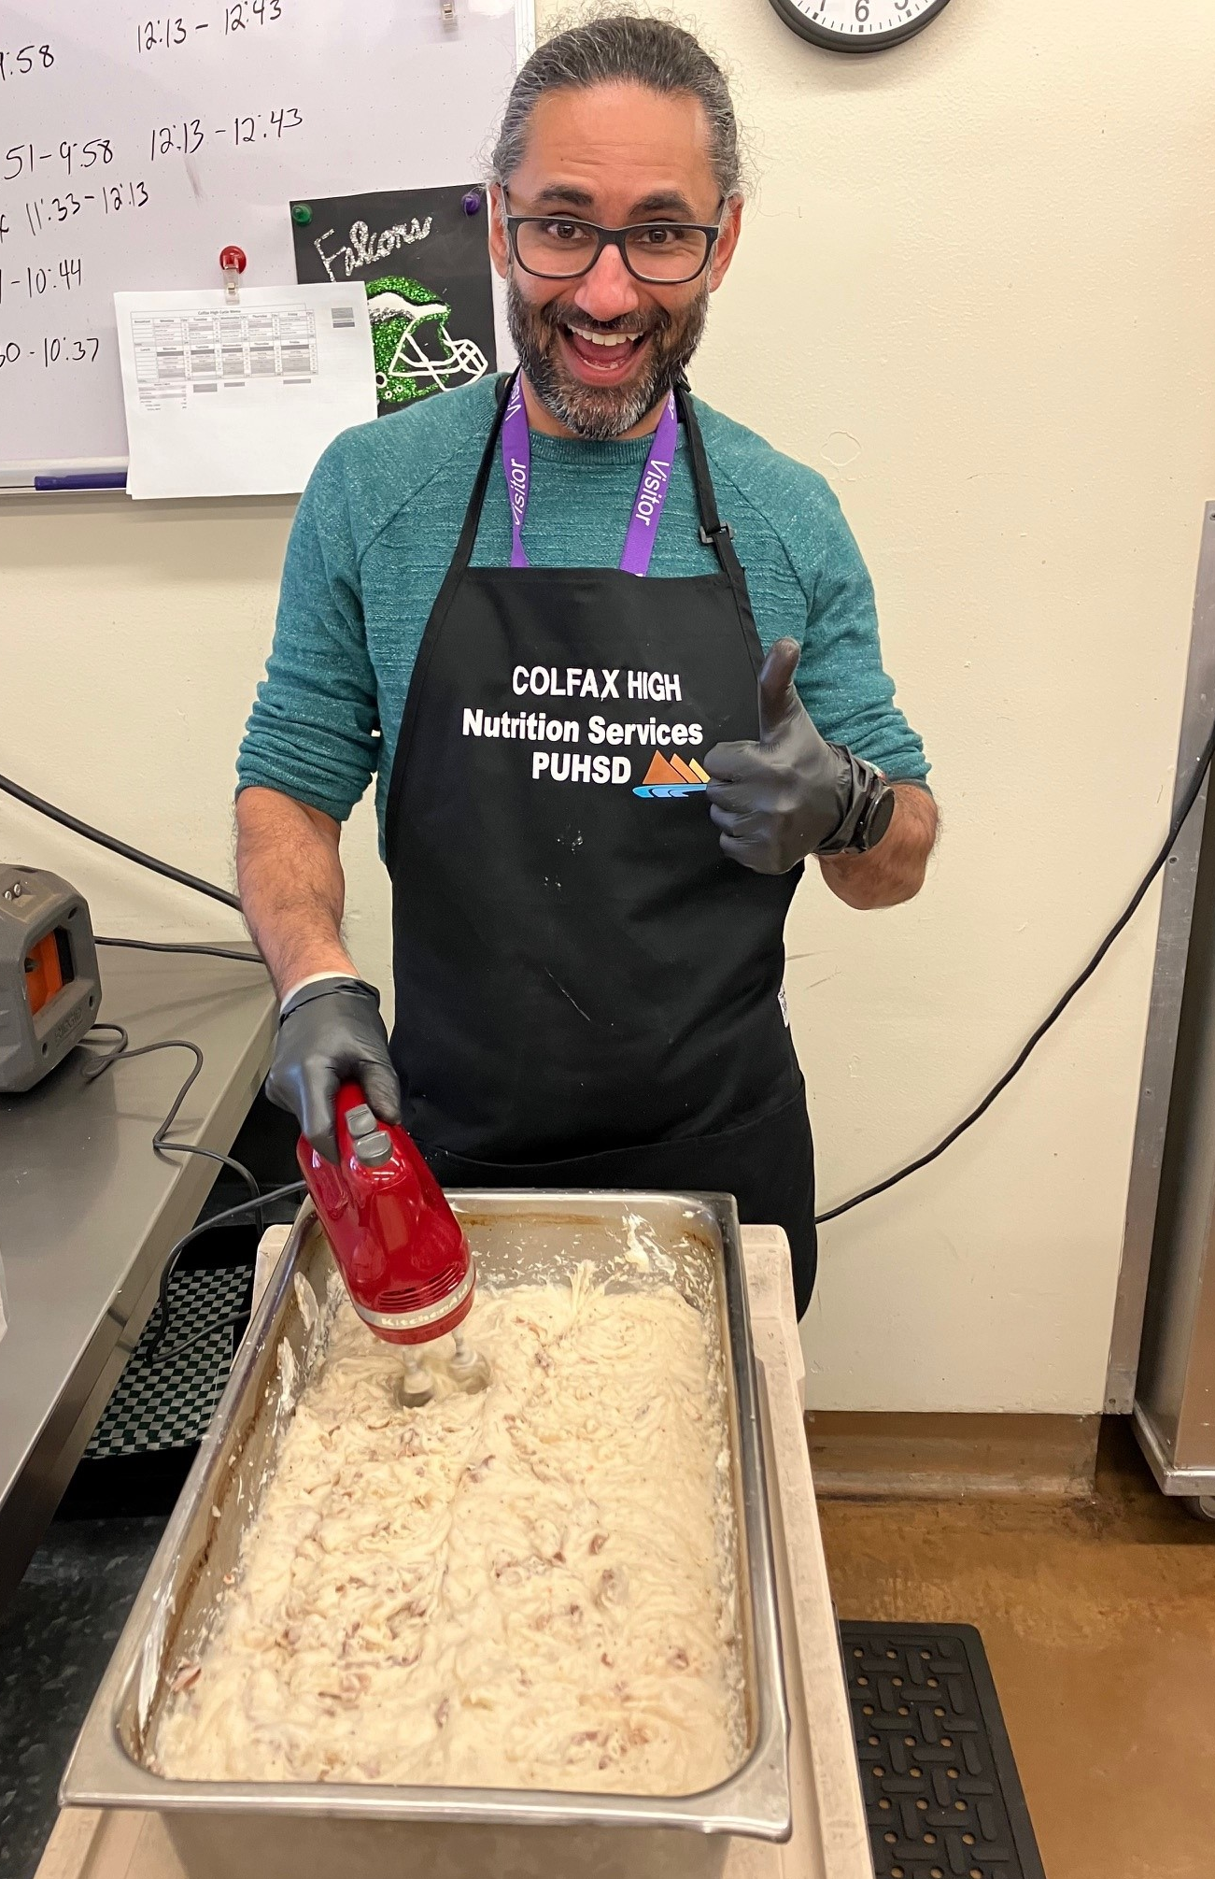
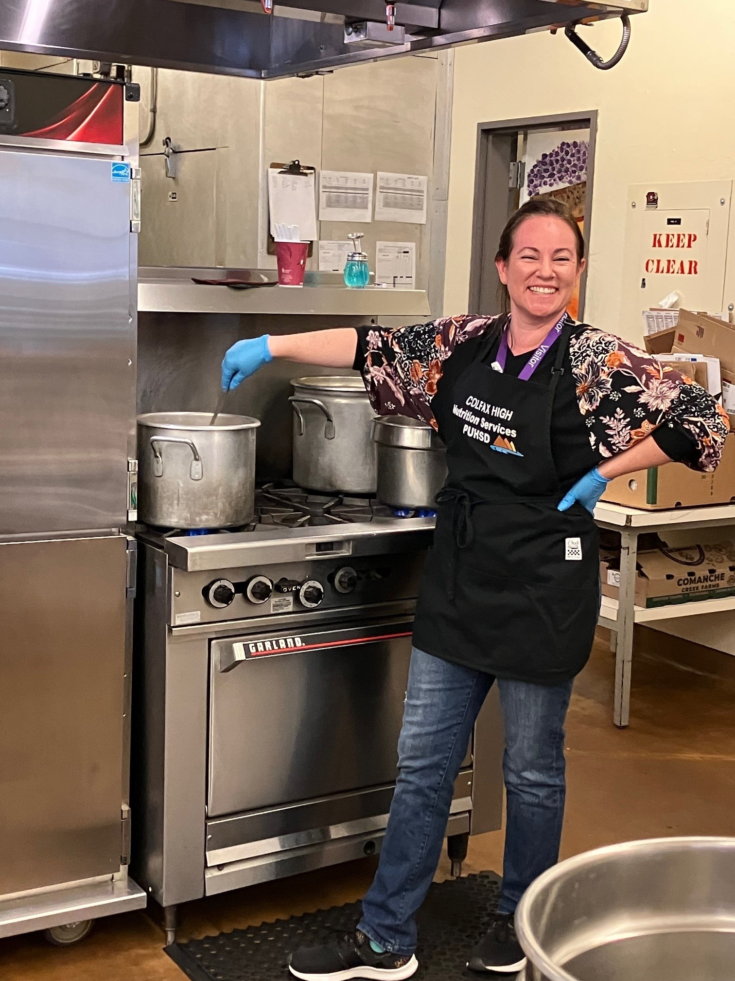
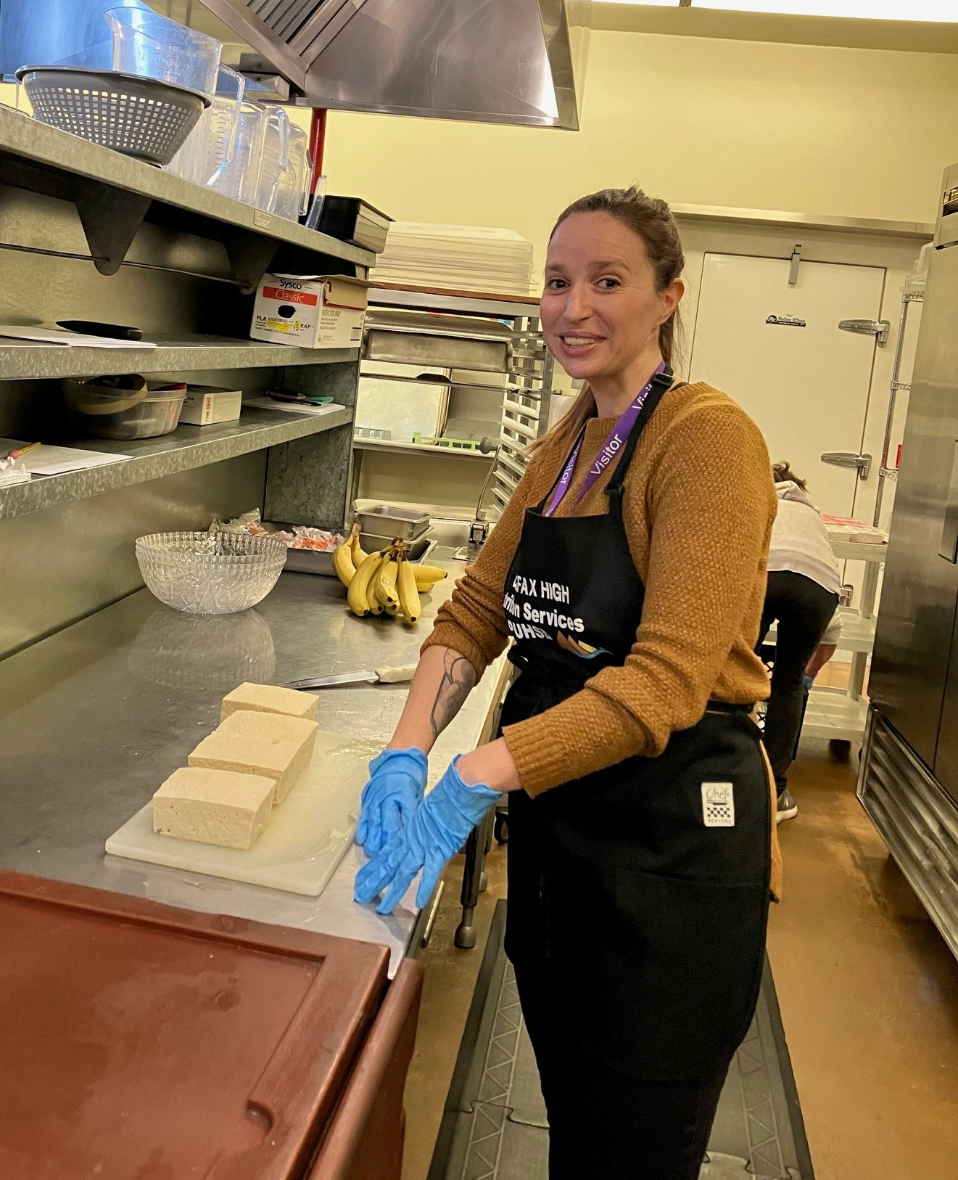
Turkey Day at Colfax High

Slide 4
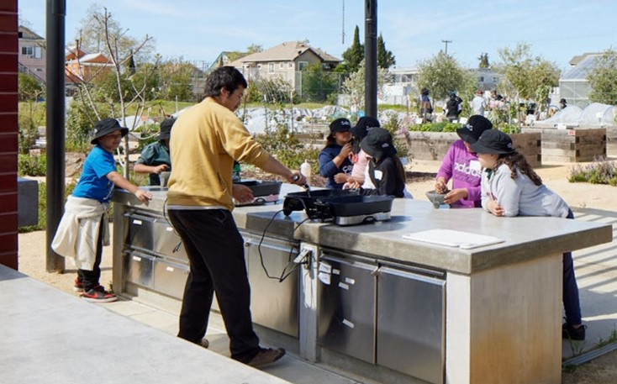
In the News: Farm to School
Nevada County Food Policy Council to focus on local foods in schools, hospitals: Small rural school districts in Nevada county collaborate with their Food Policy Council to expand farm-to-institution sales to provide scratch-cooked meals made with local foods.
Oakland schools’ new central kitchen includes a demonstration garden, classroom, and a greenhouse that supplies starter plants for 60 school gardens.

Slide 5
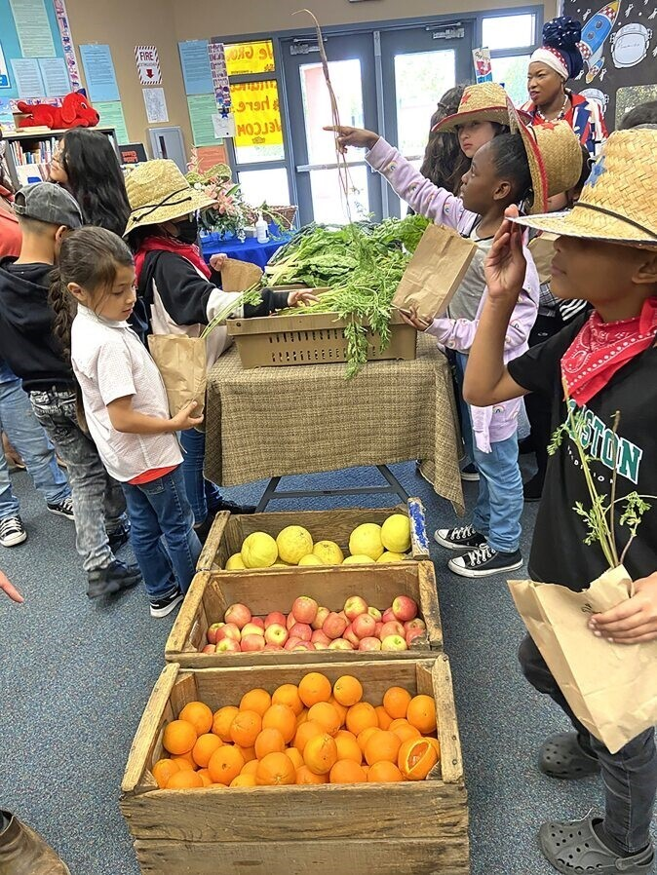
District Spotlight: Rialto Unified School District (USD)
U.S. Department of Agriculture's (USDA) Success Stories
Growing Thriving Child Nutrition Programs in Rialto, CA

Slide 6
Important Operational Dates:
Next 30 to 60 days
Action | Date
Submit Seamless Summer Option (SSO) Holiday Meal Service Site Applications | Before Meal Operations Begin
USDA Foods Preference Survey | November–January
Changing Participation Avenue for the Receipt of USDA Foods | December 15
Food Service Management Company (FSMC) Documents Due | January 5, 2024
Verification Report Due | January 16, 2024

Slide 7
Holiday Meal Service
Holiday meals may be offered under:
Child Nutrition Program | School Break Period Required to Offer Holiday Meals:
SSO | More than 10 school days
Summer Food Service Program (SFSP) | 15 or more school days
ALL SITES must meet area eligibility requirements
Holidays are not counted towards the school break period
Submit SSO applications BEFORE service begins
Connect with your assigned analyst for questions on holiday meal service

Slide 8

School Year (SY) 2023–24 Verification Reporting
January 16, 2024: Verification Reporting
NO Exemptions from Verification Reporting

Slide 9
Change of Participation for Receipt of USDA Foods for SY 2024–25
Deadline is December 15, 2023
Email a letter of intent to FoodDistribution@cde.ca.gov
Include:
  Agency name and vendor number
  Contact name and phone number
  Selected participation avenue for SY 2024–25

Slide 10
Contracting Reminders
Vended meal contract
FSMC
Consulting services
Procurement agent
  Management Bulletin SNP-09-2018 Distinguishing an FSMC From A Vendor available on the California Department of Education (CDE) School Nutrition web page at https://www.cde.ca.gov/ls/nu/sn/mbsnp092018.asp

Slide 11
Meal Vendor (or Vended Meal Provider)
Services include:
Providing meals
Purchasing food and supplies
Preparing meals
Services cannot include:
Providing labor to serve meals
Operating “Point of Service”
Preparing claims for submission
Provide program oversight

Slide 12
FSMC vs. Consultant
FSMC Services:
Menu planning
Purchasing
Submitting claims
Preparing and/or serving meals
Operating the POS system
Managing any aspect of the day-to-day operation
Consultant Services:
Provide professional/technical support and recommendations
Does not oversee daily program operations

Slide 13
Procurement Agent
Authorized to procure on client's behalf
Fiduciary relationship of trust
Contractually required to conduct competitive procurements with client’s interest in mind

Slide 14
Contracts Review
FSMC:
Performs daily operations and/or claims
Must use a formal procurement
Must have CDE pre-approval
Meal vendor, consulting, and purchasing:
No daily operations and/or claims
Must follow procurement method for dollar amount
Does not require CDE approval

Slide 15
Bid Splitting Not Allowed
Bid splitting is intentionally dividing purchasing to avoid getting price quotes or going out to bid using a more formal procurement method.
Public Contract Code 20116 and Title 2, Code of Federal Regulations (CFR), Section 200.318(d)

Slide 16
Bid Splitting Examples
Goods Example
10 Refrigerators at $3,000 each
Purchase 1 fridge per month = bid splitting
Should obtain quotes for all 10 refrigerators and purchase at one time
Services Example
Consulting and purchasing agent services needed
Should not separate services to avoid using a formal procurement method if the services are available together

Slide 17
Procurement and Contracting Questions
CDE is available to help with your questions and has many resources available.
Procurement questions: NSDprocurementreview@cde.ca.gov
FSMC questions: SFSContracts@cde.ca.gov

Slide 18
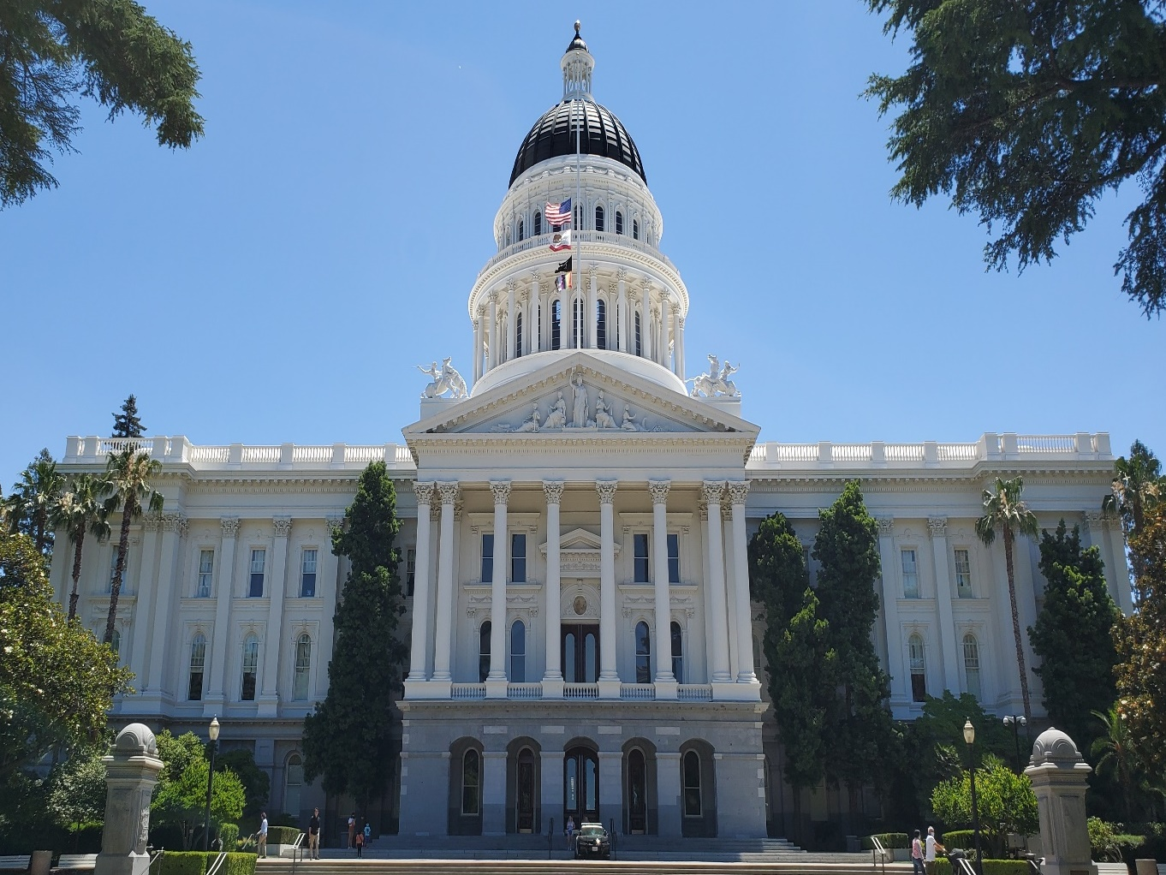
State Updates

Slide 19
Buy American Provision
Senate Bill (SB) 490
Effective January 1, 2024 through January 1, 2029
Applies to local educational agencies (LEA) who receive over $1,000,000 in federal meal reimbursement annually
Requires LEAs to only purchase agricultural food products grown, packaged and processed domestically unless the LEA can document:
  Domestic bid or price is 25% higher than the non-domestic price
  Domestic quality is inferior
  Domestic product is available in insufficient quantities
Does not apply to contracts already in place on January 1, 2024

Slide 20
SB 1383 Short-Lived Climate Pollutants: Organic Waste Methane Emissions Reduction
Current:
Effective January 1, 2022, Kindergarten through Grade 12 (K-12) public school districts, charter schools, and county offices of education are required to recycle organic waste either by subscribing to service or self-haul/back-haul.
As of January 1, 2024:
K-12 public school district sites with an on-site food facility are required to recover edible food.

Slide 21
Assembly Bill (AB) 1200: Safer Food Packaging and Cookware Act (1)
Per- and poly-fluoroalkyl substances (PFAS) and alternatives in food packaging (paper and paperboard)
January 1, 2023: Prohibited the distribution, sale, and offering for sale any food packaging containing regulated PFAS
Example products: Food or beverage containers, take-out food containers, unit product boxes, liners, wrappers, serving vessels, eating utensils, straws, food boxes, and disposable plates, bowls, or trays.

Slide 22
AB 1200: Safer Food Packaging and Cookware Act (2)
Definition of Food Packaging:
A nondurable package, packaging component, or food service ware that is intended to contain, serve, store, handle, protect, or market food, foodstuffs, or beverages, and is comprised, in substantial part, of paper, paperboard, or other materials originally derived from plant fibers.

Slide 23
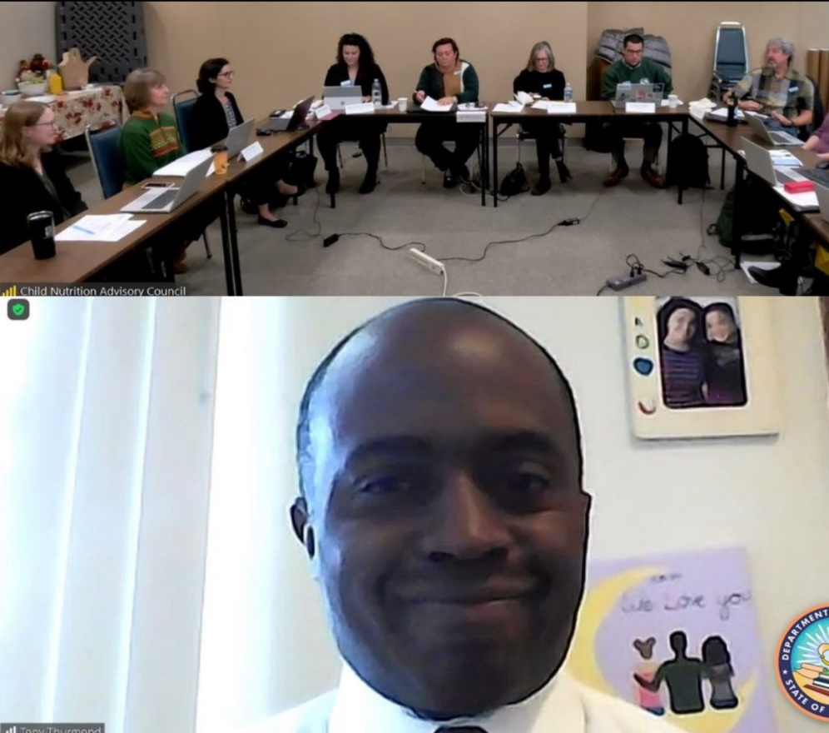
Child Nutrition Advisory Council (CNAC) Welcomed Tony Thurmond State Superintendent of Public Instruction (SSPI)

Slide 24
CNAC Recruitment (1)
Mission: To advise the SSPI in areas of health, wellness, and nutrition for all students in California’s kindergarten through grade twelve public schools.
Positions under recruitment:
  Child Care Food Program Sponsor
  Classroom Teacher
  Curriculum Coordinator
  Food Service Director
  Food Service Supervisor/Manager
  Lay Person
  Nutrition Education Specialist
  Parent–Teacher Association (PTA) or Organization (PTO) Representative

Slide 25

CNAC Recruitment (2)
Term (3-years):
  January 1, 2024, through December 31, 2026
Recruitment application is now available on the CNAC web page under Member Application Information at https://www.cde.ca.gov/ls/nu/he/cnac.asp
NEW: Application deadline extended to January 26, 2024

Slide 26

Federal Updates

Slide 27
USDA Policy Memo SP 02-2024,
CACFP 02-2024, SFSP 02-2024 (1)
Revised: Crediting Tofu and Soy Yogurt Products
Released 11/29/2023
Extends tofu definition in 7 CFR 210.2 to SFSP
Tofu must be recognizable as a meat substitute to credit
  Reminder: Tofu incorporated into items to add texture or improve nutrition, such as in smoothies, sauces, and baked desserts, does not credit toward the meats/meat alternates component

Slide 28
USDA Policy Memo SP 02-2024,
CACFP 02-2024, SFSP 02-2024 (2)
Item | 1.0 Ounce Equivalent of Meat Alternate
Commercially Prepared Tofu | ¼ Cup or 2.2 ounces by weight Must contain at least 5 gm protein
Soy Yogurt | ½ Cup, or 4.0 ounces by weight
Reference Child Nutrition labels or use a Product Formulation Statement from the manufacturer

Slide 29
USDA Policy Memo TA 01-2024 Crediting Traditional Indigenous Foods in Child Nutrition Programs (CNP)
Offers guidance on incorporating traditional indigenous foods to meet CNP meal pattern requirements
Expands the Food Buying Guide crediting list of similar traditional Indigenous foods
Covers traditional foods that do not credit towards the meal pattern requirements (e.g., acorns or maple syrup)
Try traditional foods during taste tests or educational programs

Slide 30

2023 Farm to School Census
Complete your Farm to School (F2S) Census now!
Please complete your census whether you conduct any F2S activities or not.
The information may be used to show the need for future funding.
Due date: December 31, 2023

Slide 31

Funding Updates

Slide 32
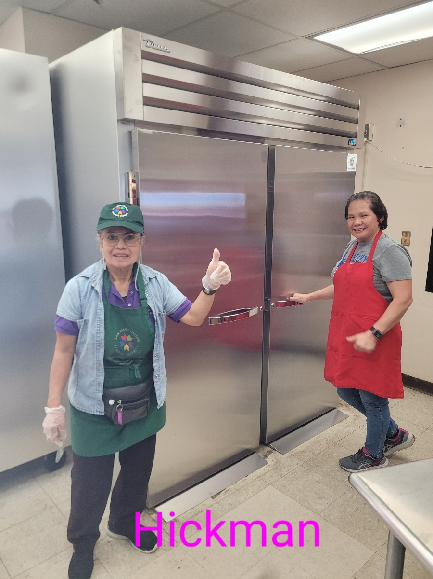
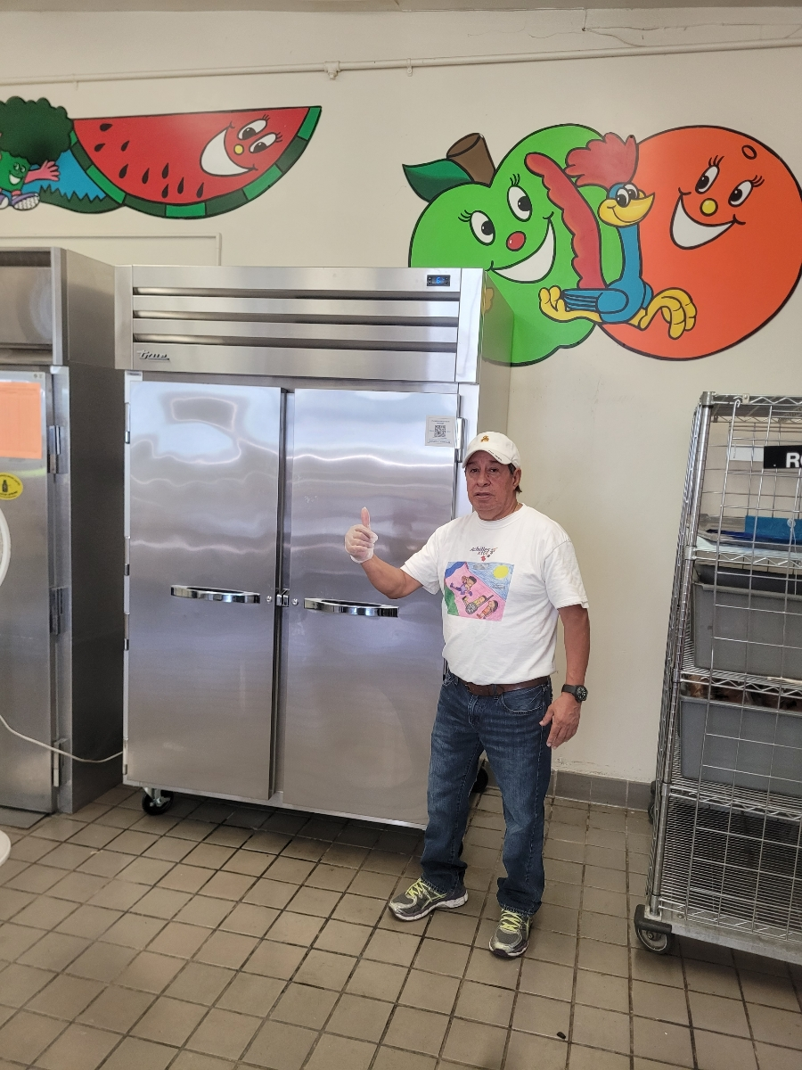
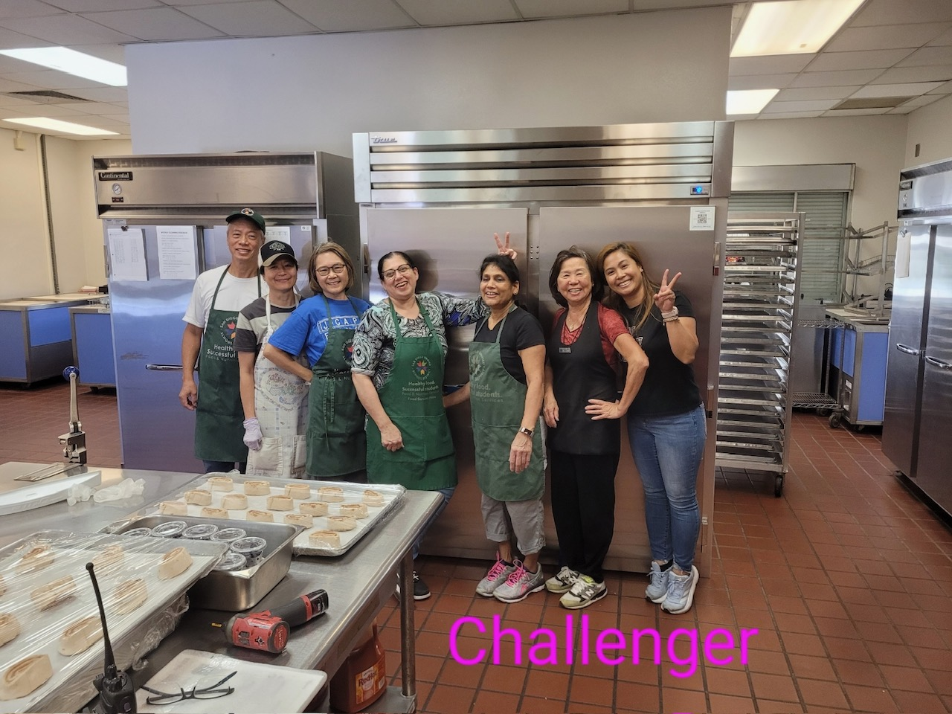
Kitchen Infrastructure and Training (KIT) Funds in Action
San Diego USD shared some pictures of their recent KIT fund purchases!

Slide 33
Grant Funds Overview
Grant | Timeline
2023–24 Fresh Fruit and Vegetable Program (FFVP) Second Allocation Grant Award Notification Was Posted | November 9, 2023
Local Food for Schools Funding Disbursed | January 2024*
2024–25 FFVP Request for Applications (RFA) Will Be Released | January 2024
School Breakfast Startup Grant RFA Released | January 2024
Supply Chain Assistance Funds Disbursed (Round Four) | February 2024*
*Updated since last Town Hall

Slide 34
USDA Farm to School Grant
FY 2024 RFA is Open
Awards:
  Up to $500K
Applications due:
  January 12, 2024
Grant purpose:
  Increase availability of local food in schools and to help students connect food
Eligible applicants include:
  Non-profits, with or without 501(c)(3) status
  Independent school districts
  City, township, County, State governments
  Native American Tribal governments

Slide 35
Healthy Meals Incentives (HMI) Recognition Awards
Informational Webinar: December 13, 2023, at 8 to 9 a.m.
Apply now: Applications are accepted on an ongoing basis through June 30, 2025
Eligibility: Breakfast Trailblazer (All and Small and/or Rural school food authorities [SFA]); Lunch Trailblazer (All and Small and/or Rural SFA); Innovative School Lunch Makeover, Innovation in the Cultural Diversity of School Meals, Innovation in the Preparation of School Meals, Innovation in Nutrition Education
Questions: awards@healthymealsincentives.org

Slide 36
Partnerships for Local Agriculture and Nutrition Transformation in Schools (PLANTS) RFA is Open
Awards (8):
  $500,000 to $600,000
Applications due:
  January 22, 2024
Grant purpose:
  Groups of local partners will transform school food supply chains with systemic and equity driven approaches.
Eligible applicants include:
  - SFAs
  - Food producers
  - Food distributors
  - Food Aggregators
  - Nonprofits
  - Local government agencies
      - Indian Tribal Organizations

Slide 37
Supporting Community Agriculture and Local Education Systems (SCALES) Grant RFA is Open
Grant purpose:
  To build partnerships to increase local procurement in school meal programs.
Awards (35):
  Up to $150,000
Applications due:
  January 26, 2024
Eligible applicants include:
  Rural School Food Authorities

Slide 38

Resources & Other Announcements

Slide 39
California Healthy School Food Pathway Pre-Apprenticeship Program
Apply Now!
Deadline:
  February 12, 2024
Program start date:
  April 1, 2014
Seven-week course:
  Four School Food Institute sources:
    20 hours
  Two virtual learning sessions:
    3 hours
  On-the-job learning:
    84 hours (12 hours/week)

Slide 40

The Great Kindness Challenge (GKC)
The GKC week is January 22–26, 2024
The theme for the 13th Annual GKC Week is Create Kindness
Sign up for free resources on the GKC website
Become a Kindness Certified School and receive a GKC certificate and digital GKC badge!

Slide 41
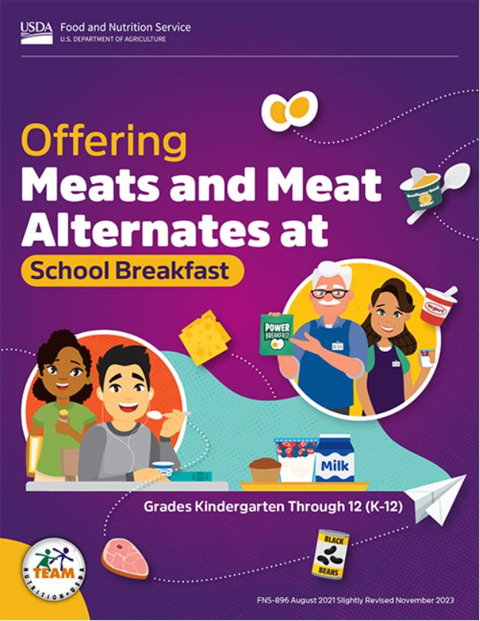
USDA Team Nutrition Resources
Updated resources:
  Offering Meats and Meat Alternates at School Breakfast
  Offering Smoothies as Part of Reimbursable School Meals
  Serving School Meals to Preschoolers

Slide 42
Tuesday @ 2pm Town Hall Schedule
Held on the fourth Tuesday of the month
Month | Format | Date
January | State Update and Guest Speaker | 1/23/24
February | State Update | 2/27/24
March | State Update and Guest Speaker | 3/26/24

Slide 43
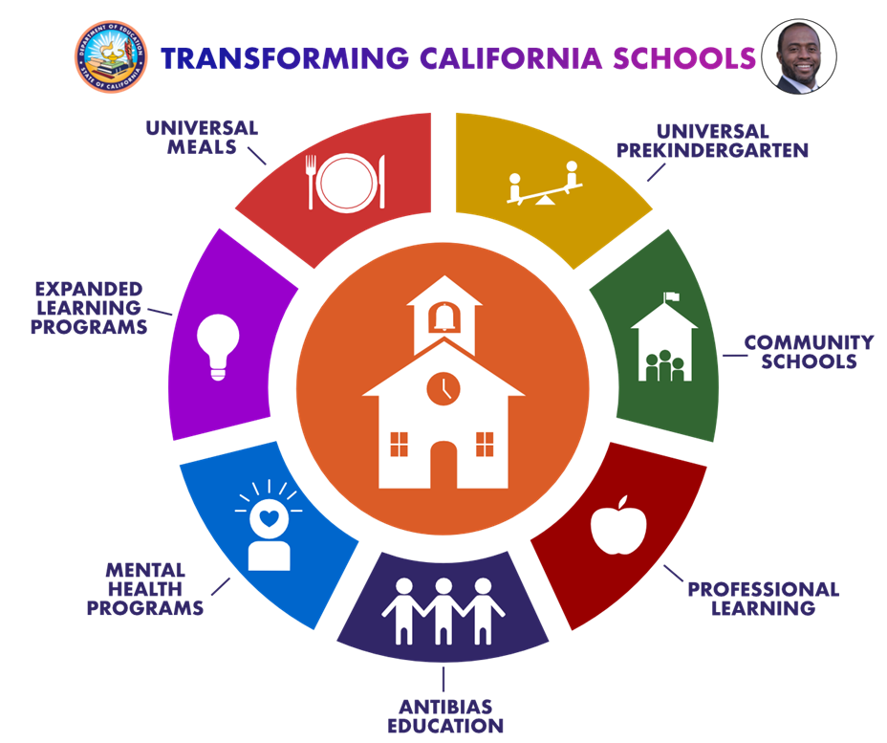
Thank you!
Next Town Hall:
January 23, 2024
This institution is an equal opportunity provider

