Slide 1

Tuesday @ 2
School Nutrition Town Hall
May 2023
California Department of Education
Nutrition Services Division

Slide 2

Welcome
Housekeeping:
  Lines muted
  Links in chat
  Live caption option
  Q&A for questions

Slide 3
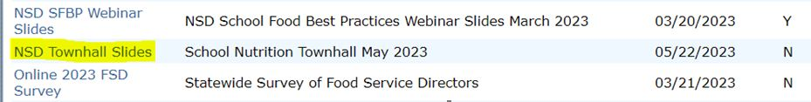
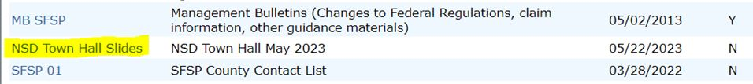
Reminder: Town Hall Slides Available Now
Program Operators can download slides on the Child Nutrition Information Payment System (CNIPS) Download Forms: “NSD Townhall Slides” and SFSP module
SNP Module:
SFSP Module:

Slide 4
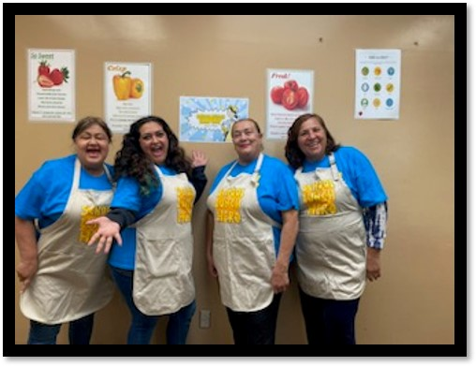
Town Hall-At a Glance
Celebrations
Federal Updates
State Updates
Funding
Summer Meals
Procurement Review
Important Dates
Training

Slide 5

Celebrations

Slide 6
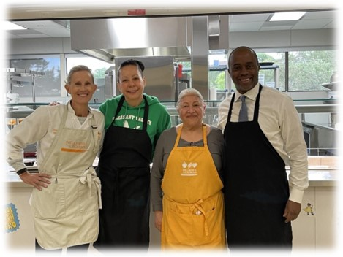
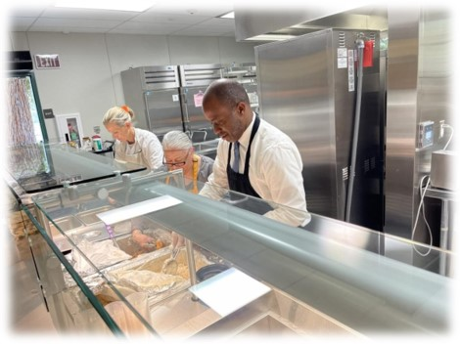
Honoring School Lunch Heroes
Novato Unified School District (USD)

Slide 7


Congratulations to CA Hunger Heroes:
Fausat Rahman-Davies and Becky Rix

Slide 8
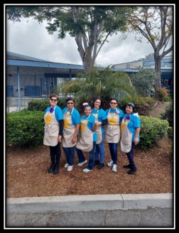

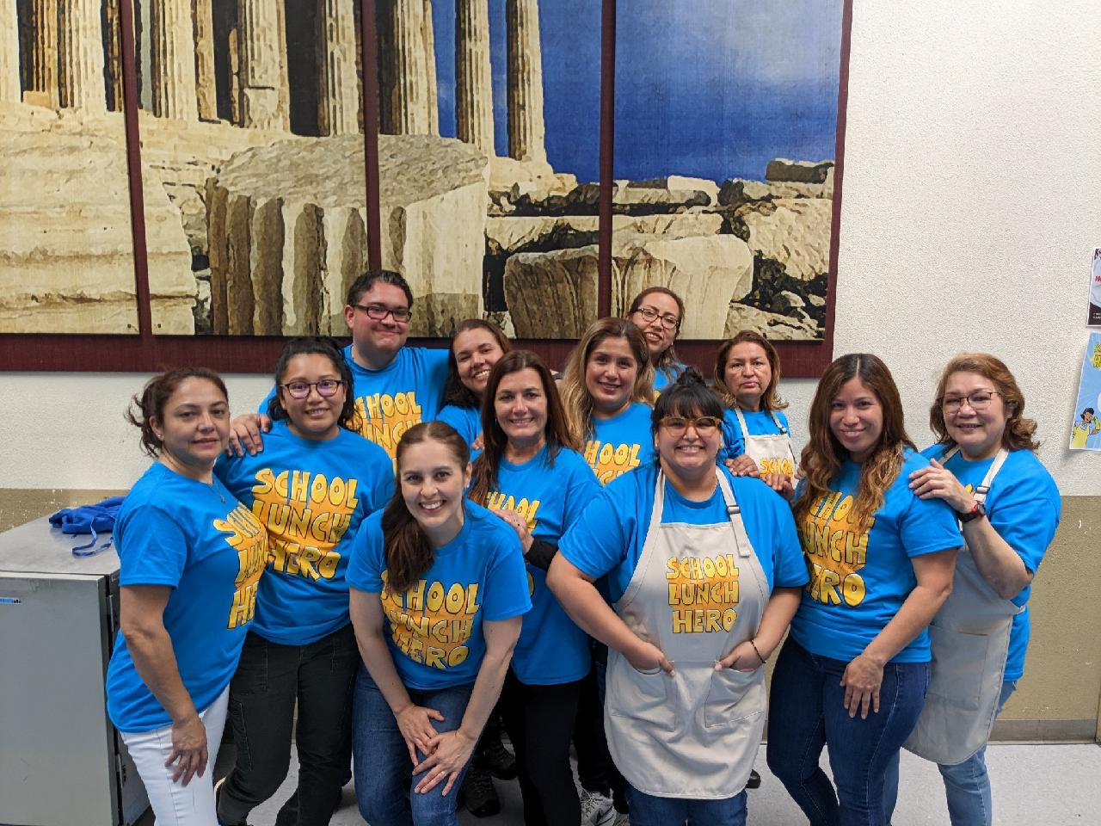
School Lunch Hero Day: Sweetwater Union High School District

Slide 9

School Lunch Hero Day:
San Marino USD

Slide 10
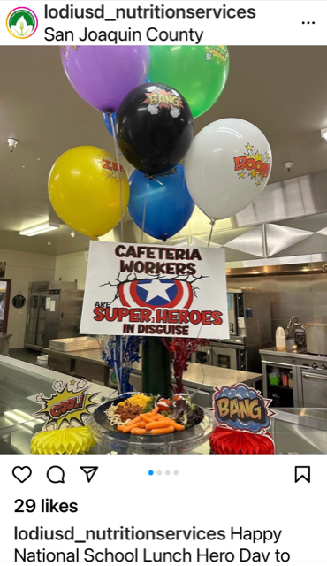
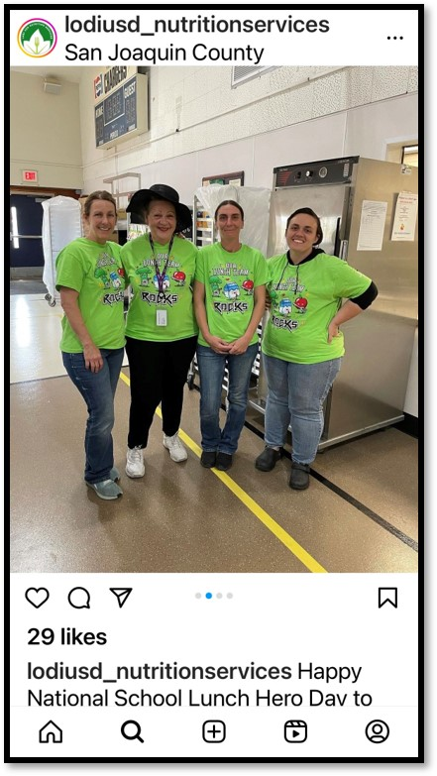
School Lunch Hero Day:
Lodi USD

Slide 11
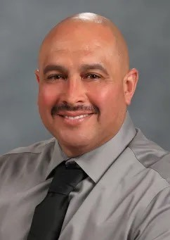
2023 California Classified School Employees of the Year
Jaime Carranza
Senior Warehouseman
Anaheim Union High School District

Slide 12
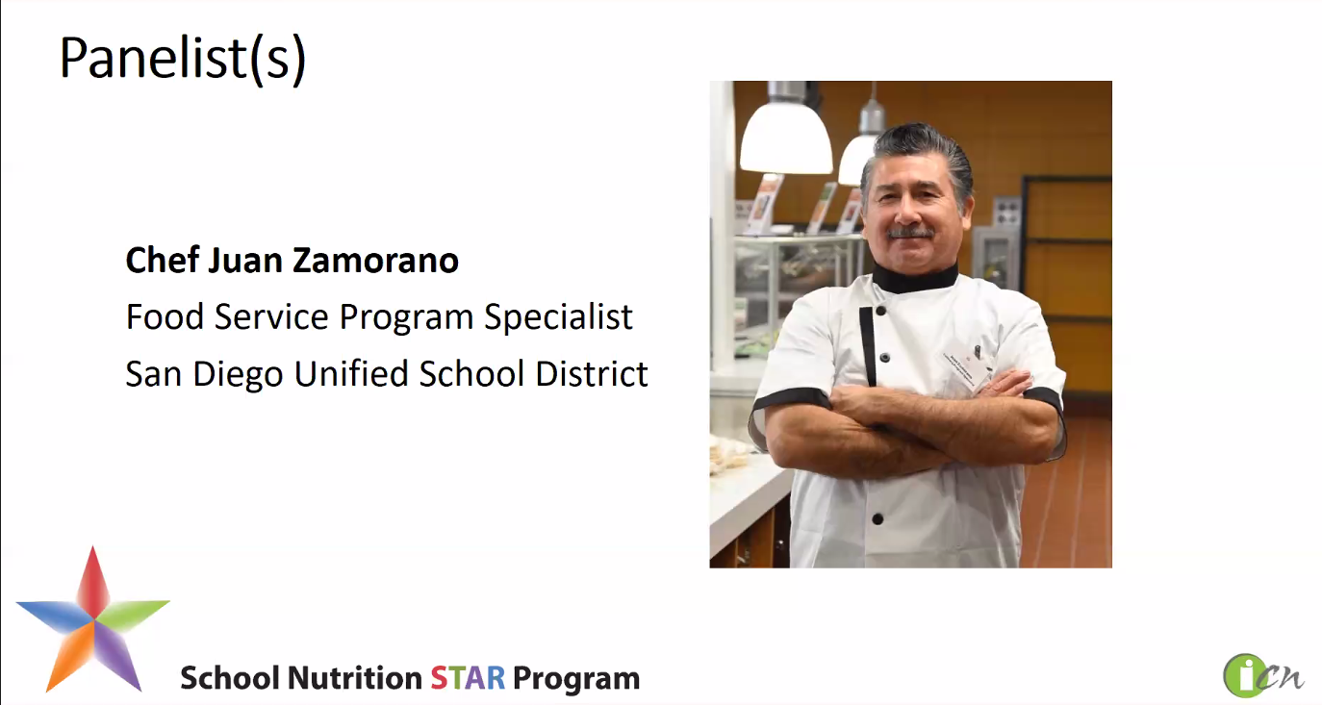
San Diego USD
Strategies for Increasing Scratch Cooking

Slide 13
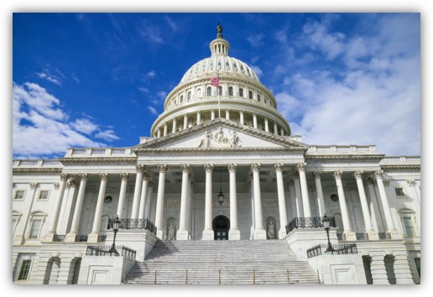
Federal Updates

Slide 14
Reminder: National School Lunch Program (NSLP) Sodium Limits Change
Sodium Target and Date | Grades K-5 | Grades 6-8 | Grades 9-12
Target 1A Effective July 1, 2023 | ≤ 1,110 mg | ≤ 1,225 mg | ≤ 1,280 mg
Target 1 Ends June 30, 2023 | ≤ 1,230 mg | ≤ 1,360 mg | ≤ 1,420 mg
Averaged over the course of the week
Sodium limits for breakfast remain at Target 1 for SY 2023-2024

Slide 15
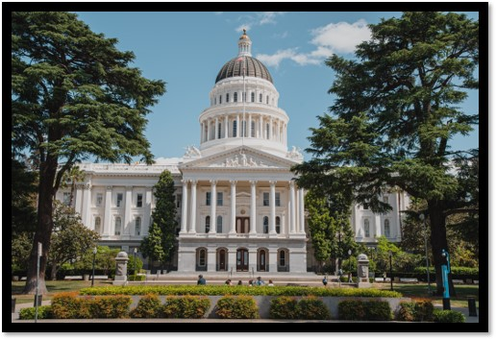
State Updates

Slide 16
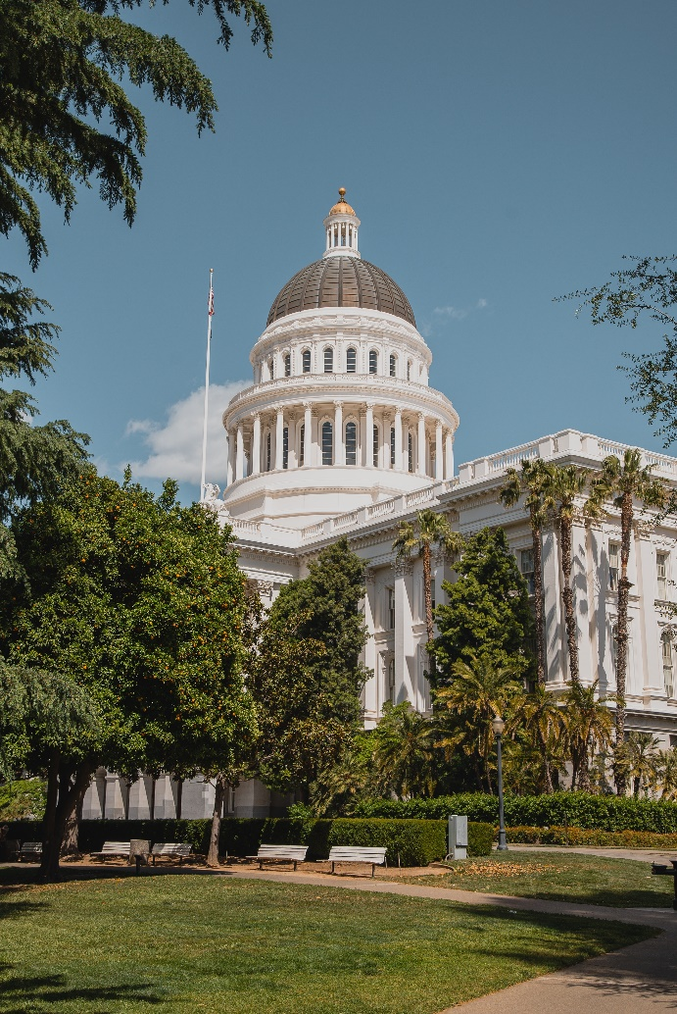
State Budget: May Revise and Trailer Bill
Proposition 98 Funding
Kitchen Infrastructure and Training (KIT)

Slide 17
2021 KIT Mid-Term Report
Due: Friday, June 9, 2023
Goal:
  Gauge how funds are being used to support school meal operations,
  Identify unspent funds, and
  Obtain success stories and pictures

Slide 18

Farm to Summer Celebration Week and Pre-Survey
Week of: June 19-23, 2023
Theme: Create Your Own Farmstand
Complete
  Pre- and Post-survey
  Taste, Teach, and Connect
Earn Recognition: One in a Melon Certificate
Questions: Farm2School@cde.ca.gov

Slide 19
Summer Food Service Program (SFSP) Final Rule: Streamlining Program Requirements and Improving Integrity

Slide 20
SFSP Final Rule (1)
First Week Site Visits
  Program operators must conduct a site visit within the first two weeks of operation for new sites
  Site visit for new sites may occur at the same time as the review of food service operations required within the first four weeks of operations

Slide 21
SFSP Final Rule (2)
Meal Service Times
  Removes existing meal service time restrictions
  Clarifies that breakfast must be served at or close to the beginning of the day and not after lunch or supper
  Requires that one hour must elapse between the end of one meal service and start of another (except residential camps)

Slide 22
SFSP Final Rule (3)
Off-site Meal Consumption "Traveling Apple"
  Allows children to take one item off-site:
    One fruit OR one vegetable OR one grain item
  Must follow all applicable state and local laws
  State agency approval not required

Slide 23
SFSP Final Rule (4)
Offer versus Serve
  Only School Food Authority sponsors may utilize Offer Versus Serve when using the SFSP meal pattern

Slide 24
SFSP Final Rule (5)
New Definition:
  Site Supervisor: individual on site for the duration of the meal service, who has been trained by the sponsor, and is responsible for all administrative and management activities at the site

Slide 25
SFSP Final Rule (6)
New Definition:
  Unanticipated School Closure: any period from October through April (or any time of the year in an area with a continuous school calendar) during which children who are not in school due to a natural disaster, building repair, court order or labor-management disputes

Slide 26
SFSP Final Rule (7)
New Definitions:
  Vended Site: serves unitized meals, with or without milk, that were procured through a formal agreement or contract
  Self-Preparation Site: prepares the majority of meals that will be served at its site or receives meals that are prepared at its sponsors’ central kitchen. The site does not contract with a food service management company for unitized meals, with or without milk, or for management services.

Slide 27
SFSP Final Rule (8)
Reimbursement:
  State agency must disapprove claim within 30 calendar days, provide an explanation, and state how the claim must be revised
  Provides sponsor the right to appeal

Slide 28

Seamless Summer Site Applications
Applications are now open
Must submit prior to start of operations
No retroactive approvals

Slide 29

Feeding Options for Summer 2023
State Meal Mandate requirements
School Nutrition Program (SNP) vs Seamless Summer Option (SSO) operations
Area eligibility requirements
Site types

Slide 30
State Meal Mandate
Public School Districts, County Offices of Education and Charter Schools must:
  Provide a nutritionally adequate breakfast AND lunch each school day
  Meals must meet NSLP and School Breakfast Program (SBP) meal pattern requirements
  Meals must be offered during Summer School

Slide 31
Summer School Feeding Options (1)
National School Lunch and School Breakfast Program
Or
2. Seamless Summer Feeding Option (SSO)

Slide 32
Summer School Feeding Options (2)
NSLP and SBP
  Follow the same meal counting and claiming processes as during the regular school year
  Meals served qualify for Universal Meals reimbursement
  Option if you intend to feed only summer school students

Slide 33
Summer School Feeding Options (3)
Seamless Summer Feeding Option (SSO)
  Must operate as an OPEN site
  Must meet Area Eligibility Requirements
    Use school or census data
  Cannot operate as Closed-Enrolled or Restricted-Open

Slide 34
Summer School Feeding Options (4)
Seamless Summer Feeding Option (SSO)
  Cannot operate as a Closed-Enrolled site in order to limit participation to summer school students
  Must utilize NSLP/SBP if you only intend to feed summer school students

Slide 35

Summer Pop-Quiz!
What options do schools have to serve meals to summer school students?
NSLP and SBP
SSO Open Site
SSO Closed-Enrolled Site
All of the Above
A & B

Slide 36
Answer: Summer Pop-Quiz!
What options do schools have to serve meals to summer school students?
A & B
Schools may serve meals to summer school students through the NSLP and SBP or SSO Open Site options.

Slide 37
U.S. Department of Agriculture (USDA) Foods for the SFSP
$1,000 minimum for SFSP self-prep sponsors
Submit SFSP Sponsor Agreement for USDA Foods
  CNIPS SFSP module Download Forms; Form ID#20
  Email completed form to FoodDistribution@cde.ca.gov
Update the Food Distribution Program (FDP) Contract packet in CNIPS
Check out the USDA Foods Available Lists in CNIPS

Slide 38
Local Agency Procurement Review (LAPR)

Slide 39
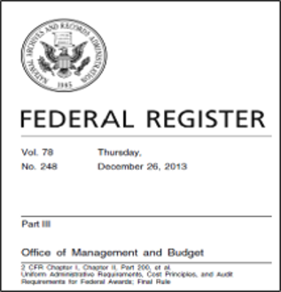
Purpose of Review
SNP Operator purchases must comply with all federal procurement regulations.
Federal regulations require state agencies to monitor SNP Operator’s procurement practices.

Slide 40
Frequency of Review
A minimum of once every eight years:
  School food authorities (SFA) that contract with a food service management company (FSMC), Residential Child Care Institutions, private schools, and camps.
  Public school districts, charter schools, and county offices of education operating without an FSMC contract.

Slide 41
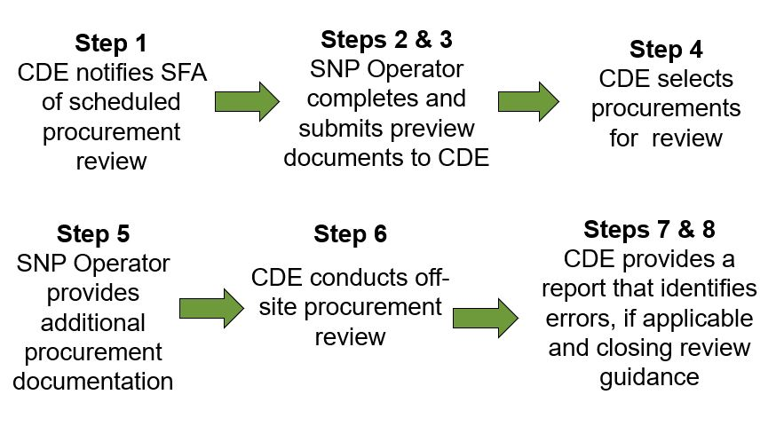
Overview of California Department of Education (CDE) Off-site Review Steps

Slide 42
Phase 1: Prereview

Slide 43
Step 1: Notification of Review
CDE notifies SNP Operators in May by email that they are selected for an off-site procurement review.
The email will include:
  A list of documents to be submitted
  Due date and the email address to send documents
  Link to resources to assist with the procurement review

Slide 44
Step 2: SNP Operator Completes the SFA Procurement Table
Complete the SFA Procurement Table (fillable spreadsheet)
  List each procurement separately on the table
    For micropurchases, the aggregate (total) is listed for each vendor
    For small purchase and formal purchase methods, list each contract or procurement separately
Complete the Vendor Paid List (summary of expenditures) from the prior school year
  CNIPS Download Forms PRU-02 instructions

Slide 45
Step 3: SNP Operator Submits Documents to CDE
By stated due date on email, submit documents to NSDProcurementReview@cde.ca.gov:
  Non-Child Nutrition Program cooperative or group purchasing agreements, if applicable
  Written Code of Conduct
  Written Procurement Procedures
  SFA Procurement Table PRU-01
  Vendor Paid List (summary of expenditures) from prior school year
  Initial Documents Checklist

Slide 46
Phase 2: Review

Slide 47
Step 4: CDE Selects Procurements
Procurements selected for a detailed review are based on a list of established priorities:
  Only one response received to solicitation
  Group purchasing, group buying, or third-party contracts
  Highest-priced contracts
  Procurements that exceed applicable threshold (e.g., small purchase method used for a $275,000 procurement)

Slide 48

Step 5: SNP Operator Submits Documents to CDE
SNP Operators will have 10 business days to submit:
Receipts and invoices
Solicitation documents
Bidder responses
Contracts
Price/Cost analysis documentation

Slide 49
Step 6: CDE Conducts Offsite Review
General Procurement: Code of Conduct and Procurement Procedures
Micropurchases
Small purchases
Formal procurements
FSMC contracts
Processing contracts

Slide 50
Phase 3: Closing

Slide 51
Step 7: CDE Provides Technical Assistance Report to SNP Operator
The report will include the following:
Executive Summary Email
Technical Assistance review report
Acknowledgement Form
FSMC Base Year Review Email (if applicable)
FSMC Renewal Year Review Email (if applicable)

Slide 52

Step 8: Closing Review Guidance
Once the CDE has received your signed Acknowledgment Form, the review is closed.

Slide 53
Procurement Resource Unit (PRU) Forms
Download Forms section of the CNIPS:
  PRU-01: SFA Procurement Table
  PRU-01a: SFA Procurement Table Guide
  PRU-02: Vendor Paid List
  PRU-03: List of Documents that may be required for review
  PRU-08: Code of Conduct Checklist
  PRU-08a: Code of Conduct Reference Sample
  PRU-08b: Procurement Procedure Reference Sample

Slide 54
PRU Training and Resources
Course Catalog Trainings
  Procurement Guidance Webinars
Resources
  USDA Food and Nutrition Service School Meals Policy web page
  CDE Procurement in Child Nutrition Programs web page
  Title 2, Code of Federal Regulations (2 CFR), Part 200, Subpart D
  Title 7, Code of Federal Regulations, sections 210.16 and 210.21
Notes:
[Next Slide]

Slide 55

Q&A/Recap

Slide 56
Important Operational Dates:
Next 30 days (1)
Action | Date
SFSP Application Deadline | May 15th (or 30 days prior to operations, whichever comes first)
SSO Application | Prior to Start of Meal Service
Notification for scheduled Local Agency Procurement Review | Notifications in early June
Site Visit for New Summer Sites | 1st week of operations (may combine with review visit required in first 4 weeks)
Food Safety Inspections (x 2) | End of SY

Slide 57
Important Operational Dates:
Next 60 days
Action | Date
Community Eligibility Provision (CEP) Application Deadline for SY 2023-24 | June 30
Provision 2 Application Deadline for SY 2023-24 | June 30
Local School Wellness Policy Triennial Assessment, if applicable | June 30
Submit annual FDP CNIPS contract for SY 2023–24 | No later than July 31 (submitting before end of SY 2022–23 is preferred)

Slide 58
Polling Question:
Planning for SY 2023-24 Introduction to School Nutrition Program Administration (ISNPA) Training
When is the best time to provide an in-person three-day ISNPA training in Sacramento for new Food Service Directors? (check all that apply)
March
April
May
June
July
October

Slide 59
Tuesday @ 2pm Town Hall Schedule
Held on the fourth Tuesday of the month
Month | Format | Date
June | State Update | 06/27/23
July | State Update and Guest Speaker | 07/25/23
August | State Update | 08/22/23

Slide 60

Thank you!
Next Town Hall:
June 27, 2023
This institution is an equal opportunity provider

