Slide 1
Tuesday at 2 School Nutrition Town Hall
May 26, 2026
Nutrition Services Division (NSD)
California Department of Education (CDE)

Slide 2

Town Hall at a Glance
District Spotlights
Federal & State Updates
Guest Speaker
Operational Reminders
Resources & Other Announcements

Slide 3
School Nutrition Program Spotlights

Slide 4

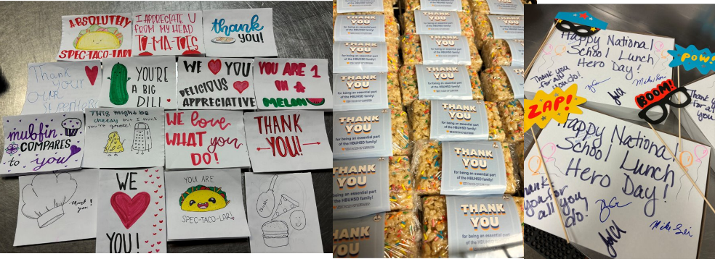
District Spotlight – School Lunch Hero Day
Huntington Beach Union High School District
Brentwood Union Elementary School District

Slide 5
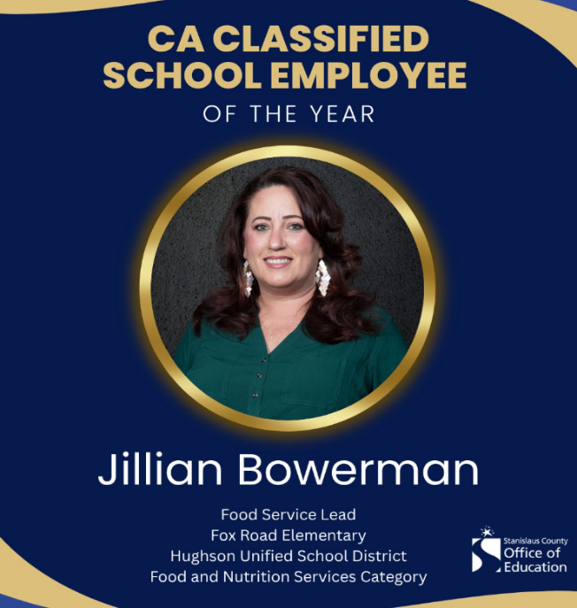
CA Classified School Employee of the Year: Food Service
Congratulations Jillian Bowerman
Food Service Lead at Fox Road Elementary in Hughson Unified School District (USD)

Slide 6
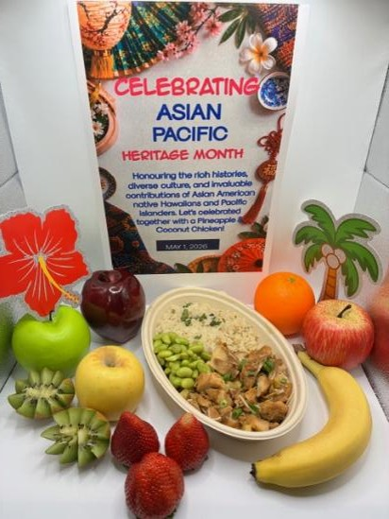

New Haven USD Celebrates Asian American & Pacific Islander Heritage Month
New Haven USD Board: Heritage Months
Offers foods that correlate with the celebration
Bottom Photo: Example posters
Right Photo: Featured menu item of Island Pineapple Chicken and Rice

Slide 7
Federal Updates

Slide 8
U.S. Department of Agriculture (USDA) Reorganization
Reorganization and relocation of staff to hubs and program compliance locations across the U.S.
Renames the Food and Nutrition Service (FNS) to the Food and Nutrition Administration
No disruption to services

Slide 9
Final Rule & Comment Period: Whole Milk for Healthy Kids Act (1)
Final Rule: Effective June 8, 2026, allows the discretion of school food authorities (SFA) to serve reduced-fat (2 percent) and whole milk in the National School Lunch Program (NSLP), School Breakfast Program (SBP), NSLP Afterschool Snack Program, preschool meal pattern, Special Milk Program, and the Child and Adult Care Food Program.
Age Group | Fluid Milk Type | Milk Variety
1 year | Whole | Unflavored
2-5 years | Whole, reduced-fat, low-fat, or fat-free | Unflavored
6 and older | Whole, reduced-fat, low-fat, or fat-free | Flavored or Unflavored

Slide 10
Final Rule & Comment Period: Whole Milk for Healthy Kids Act (2)
Excludes the saturated fat content of fluid milk when calculating the weekly average calculations for the NSLP and SBP.
No changes to the added sugar product-based limits.
May sell unflavored and flavored reduced-fat (2 percent) and whole milk items as a compliant competitive beverage, known as Smart Snacks in Schools.*
*Note: California Education Code Section 49431.5 does not permit whole or 2 percent milk to be sold as a competitive beverage by public school districts and county offices of education.

Slide 11
Final Rule & Comment Period: Whole Milk for Healthy Kids Act (3)
Public Comment: Ends June 8, 2026
Submit comments by one of the following methods:
  Online: https://www.regulations.gov/document/FNS-2026-0067-0001
  Mail: Send comments to School Meals Policy Division, Food and Nutrition Service, 1320 Braddock Place, Alexandria, VA 22314
Review the Federal Register: Expanding Fluid Milk Options in Child Nutrition Programs final rule at https://www.federalregister.gov/documents/2026/05/08/2026-09212/expanding-fluid-milk-options-in-child-nutrition-programs#p-115

Slide 12
Resource Updates (1)
The following resources are now updated to align with fluid milk substitution requirements in the NSLP enacted through the Whole Milk for Healthy Kids Act of 2025.
Management Bulletin (MB) SNP-11-2026, Final Rule: Fluid Milk Substitutions
MB SNP-10-2026, Modifications to Accommodate Disabilities
Disability Modifications Including Food Allergies web page
Accommodating Special Dietary Needs Quick Reference Guide found in the Download Forms section of the Child Nutrition Information and Payment System (CNIPS)

Slide 13
Resource Updates (2)
SNP 05 Notification of Decision to Offer Fluid Milk Substitutes in the School Nutrition Programs (SNP) form found on the SNP Forms web page at https://www.cde.ca.gov/ls/nu/sn/fm.asp, as well as in the Download Forms section of CNIPS
SNP 26 Parental Request for Fluid Milk Substitution for School-Age Children form found in the Download Forms section of CNIPS
CNP 925 Medical Statement to Request Special Meals and/or Accommodations form found on the School Nutrition Programs Forms web page at https://www.cde.ca.gov/ls/nu/sn/fm.asp, as well as in the Download Forms section of CNIPS
Questions contact the School Nutrition Programs Unit at SNPINFO@cde.ca.gov

Slide 14
Discontinuation of FNS Instruction 113-1
On March 3, 2026, the USDA FNS released a memorandum titled Modifying the FNS Instruction 113‑1: Civil Rights Compliance and Enforcement – Nutrition Programs and Activities.
The FNS is updating FNS Instruction 113‑1, a guidance document regarding civil rights.
While the instruction is being updated, please discontinue citing it.
Please note that all civil rights and nondiscrimination laws and regulations remain in full effect.

Slide 15
Nondiscrimination Statement
Continue to display the current nondiscrimination statement on all program materials such as brochures, coupons, electronic benefit cards, menus, and flyers.
Documents one page or less in length (i.e., menus and flyers), the short version may be used: “This institution is an equal opportunity provider.”
The full version of the statement must be used on eligibility materials, public notifications, websites, and any other program materials longer than one page.
The current full version is available on the CDE USDA Nondiscrimination Statement web page at https://www.cde.ca.gov/ls/nu/cr/crfactsheet.asp

Slide 16
Protected Classes
Race
Color
National Origin
Religion
Sex
Disability
Age
Marital status
Family/parental status
Income derived from a public assistance program
Political beliefs
Reprisal or retaliation for prior civil rights activity

Slide 17
State Updates

Slide 18
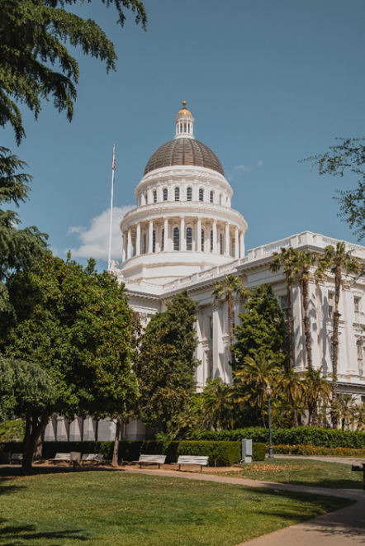
May Budget Revise
Proposes the following:
Fully fund universal school meals
Cost of living adjustment and increased funding for Local Control Funding Formula
Kitchen Infrastructure and Training (KIT) funds

Slide 19
Find a Summer Meals Site Near You!
The California Meals for Kids Mobile App (updated daily starting June 1) is available in the app store for all iOS, Android or Microsoft devices or online at https://www.cde.ca.gov/re/mo/cameals.asp.
The CDE Summer Meal Service Site web page (updated weekly) is available online at https://www.cde.ca.gov/ds/sh/sn/summersites26.asp.
All local educational agencies (LEA) are required to conduct outreach for Summer Meal sites.

Slide 20
SUN Bucks Updates (1)
California's 2026 SUN Bucks Plan of Operations and Management (POM) has been approved by the USDA.
SUN Bucks cards will be sent in alphabetical order by last name.
Phase 1 of SUN Bucks card mailing includes streamline certified students.
  These cards should begin arriving in June.
Phase 2 of SUN Bucks card mailing includes students determined to be income eligible based on approved NSLP meal applications, approved Universal Benefits Applications (UBA)s, local direct certification, or extended benefits.
  These cards should begin arriving in July/August.

Slide 21
SUN Bucks Updates (2)
The Education Data Collection System (EDCS) is open for 2026 SUN Bucks eligibility data submissions through Wednesday, September 30.
LEAs should continue to upload any newly identified 2026 SUN Bucks records monthly. These records are derived from:
  Approved NSLP meal applications
  Approved Universal Benefits Applications (UBA)
  Local direct certification
  Extended benefits
For timely benefit issuance, we encourage the prompt upload of records.

Slide 22

SUN Bucks Updates (3)
Reminder: Parents/guardians with questions about the status of their child(ren)'s SUN Bucks cards should be directed to call the SUN Bucks helpline at (877) 328-9677.
LEAs with programmatic questions can email SummerEBT@cde.ca.gov.
LEAs with technical questions regarding EDCS can email EducationDataCollection@cde.ca.gov.

Slide 23
SUN Bucks Updates (4)
The 2026 SUN Bucks UBA Processing and Verification Report will launch in September for applicable LEAs to complete and submit.
The report is intended for use only by LEAs with at least one Community Eligibility Provision (CEP) and/or Provision 2 (P2) site.
This report supports SUN Bucks program oversight and LEA funding apportionments.
LEAs completing this report must still complete the SFA Verification Collection Report in CNIPS when it opens in November.

Slide 24
Disaster Planning and Flexibilities
SFAs experiencing unanticipated school closures can apply for non-congregate meal service waivers through June 30, 2026:
  NSLP/SBP at any closed school sites also offering virtual instruction.
  Seamless Summer Option (SSO) at area eligible schools or community sites when school is closed with no virtual instruction
CDE Disaster Guidance for Child Nutrition Programs web page https://www.cde.ca.gov/ls/nu/disasterguidance.asp

Slide 25
Expanded Capital Expenditure Approved List
Contains CDE approved equipment for SFAs to purchase for meal service
Updates include prep tables, serving counters, kiosks, sneeze guards, and cafeteria tables and chairs
  Must be used exclusively for school food service
  Separate CDE approval is not required if on the list
  Must follow federal, state, and local procurement requirements
CDE Capital Expenditure Approved List webpage https://www.cde.ca.gov/ls/nu/sn/capexpapprovedlist.asp

Slide 26
Local Agency Procurement Review - Schedule Coming Soon
Schedule to be announced for the SFAs receiving a Local Agency Procurement Review (LAPR) in School Year (SY) 2026–27
Live training opportunities to prepare for LAPR are coming in August
Online LAPR training is available in the Learning Management System
Questions about the LAPR contact NSDProcurementReview@cde.ca.gov

Slide 27
2025 KIT and Retention and Recruitment Grants Recipients Announced
2025 KIT and Retention and Recruitment (R&R) Grant funding results available at https://www.cde.ca.gov/fg/fo/r9/kit25result.asp
Grant Award Notifications (GAN) sent early May through Adobe Sign
Once GANs are signed, SFAs should receive funding within 6-8 weeks

Slide 28
2025 KIT & R&R Next Steps
2025 KIT grantees will receive 50% initially, 25% after completing mandatory progress report, and final 25% after completing final report
R&R grantees will receive 90% initially, 10% after completing final report
All funds must be encumbered by Friday, June 30, 2028
Information on KIT and R&R available at https://www.cde.ca.gov/ls/nu/sn/kit2025.asp

Slide 29
Ultraprocessed Foods
Jessie Gouck, Equity and Strategic Alignment Section Manager
Nutrition Education and Physical Activity Branch
California Department of Public Health

Slide 30
Assembly Bill 1264:
Real Foods, Healthy Kids Act
Jessie Gouck
Nutrition and Physical Activity Branch
California Department of Public Health
May 26, 2026

Slide 31
California’s recent precautionary approach to food
California Food Safety Act (Assembly Bill (AB) 418, 2023)
California School Food Safety Act (AB 2316, 2024)
Executive Order N-1-25
Real Food, Healthy Kids Act (AB 1264, 2025)

Slide 32
AB 1264
From the bill language, the intent is:
to reduce the consumption of ultraprocessed foods by the children of California, and to encourage schools and school districts to promote and provide healthier options in school meals, and
to prioritize the inclusion of agricultural and whole food products in school meals.
Real Food, Healthy Kids Act
California was the first state in the nation to create a statutory definition for ultraprocessed food

Slide 33
What does AB 1264 do?
Defines ultraprocessed food
Requires California Department of Public Health (CDPH) to adopt regulations that define two additional groups of foods:
  Ultraprocessed foods of concern (UPFOC)
  Restricted school foods (RSF)
Requires school food vendors to report what foods they make available for sale to schools; must phase out sale of UPFOC and RSF to schools
  CDPH to provide training and technical assistance (TA)
Requires schools to ultimately phase out service/sale of UPFOC and RSF
  CDPH to provide training and TA
What does CDPH have to do?
What do local schools have to do?
What do school food vendors have to do?

Slide 34
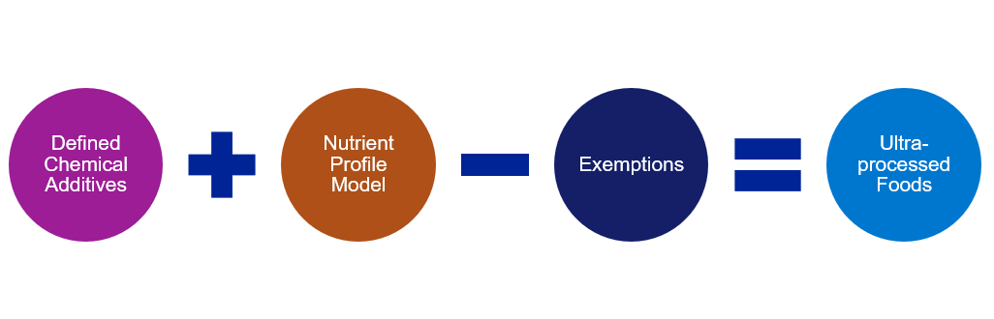
Definitions: Ultraprocessed Foods

Slide 35
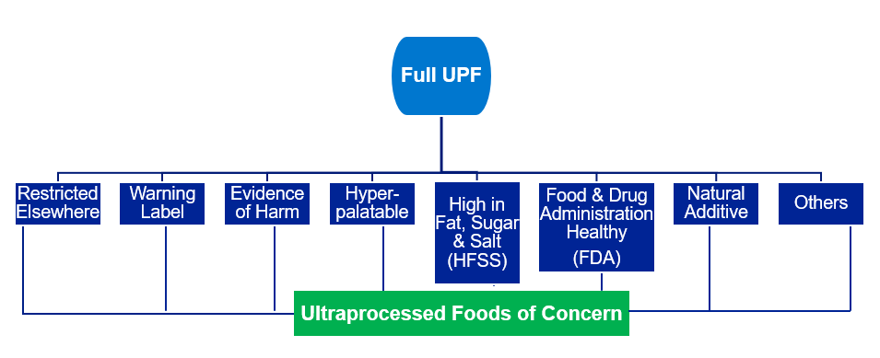
Definitions: UPF of Concern

Slide 36
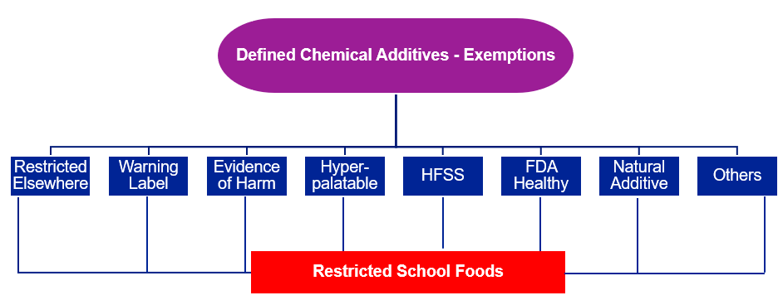
Definitions: Restricted School Foods

Slide 37
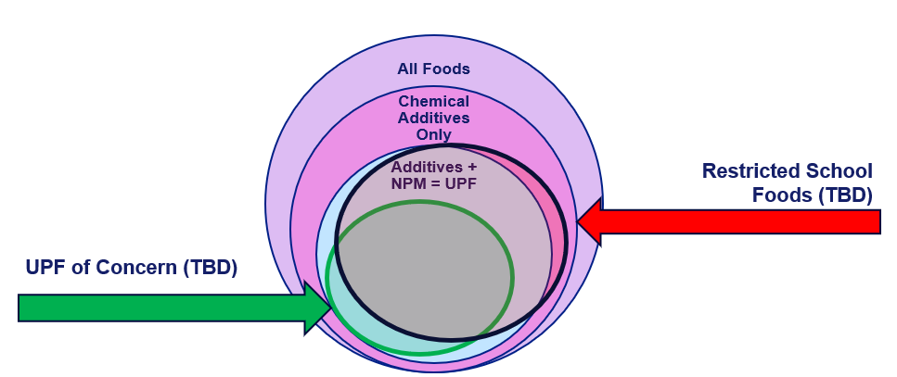
Example: not to scale or representative

Slide 38

AB 1264: What is next
AB 1264, known as the Real Foods, Healthy Kids Act, went into effect January 1, 2026; funding in the May Revision of the Governor’s Budget but no funding until July 1
CDPH will begin the work to define the regulatory process to define UPF of Concern and Restricted School Foods:
  Review evidence and criteria related to UPF and definitions
  Engage partners
  Open for public comment
Once defined, begin support to school food vendors and professionals
Begin data collection
Ongoing efforts include annual reports on progress and potential updates to the definitions based on the state of the science

Slide 39
Engagement Opportunities
Public Input Opportunities
  Voluntary: initial public input survey (i.e. what should be considered when defining UPFOC and RSF?)
  Required: all elements of the Administrative Procedures Act (draft of regulations/definitions, open for comment)
Named consultants
  Office of Environmental Health Hazard Assessment
  California Dept of Education (CDE)
  California Dept of Food and Agriculture (CDFA)
  University of California
  School Food Authorities
  School Nutrition Program Directors and Managers
What we know and what is still to be determined

Slide 40
What if I want to engage?
Everyone will be able to provide public input at each opportunity
Specific consultants will be selected to support legislatively mandated requirements
  Process of engagement still to be determined (TBD)
CDPH will continue to engage with CDE to help disseminate information and communicate as relevant
Request to be on our email listserv for future communications

Slide 41
Timeline for implementation
CDPH:
  2026-2027: begin the regulatory process; must adopt sub-definitions by June 1, 2028
  2026 and beyond: work across sectors with partners (CDE, CDFA, local schools, other interested parties)
  2026-2027: develop a system for food vendors to report into
  2027: begin providing training and TA to schools and food vendors
  2028: report annually on progress
School Food Vendors:
  2027: begin reporting on foods sold to schools (annually for six years)
  2032: can no longer sell specified foods/beverages to schools
Schools:
  2035: no longer serve specified foods in National School Lunch Program (NSLP), School Breakfast Program (SBP), or competitive foods

Slide 42
Important points to consider
Schools already work very hard to balance nutritional needs of students and their food budgets.
Equally as important as removing unhealthy foods is ensuring access to good quality, affordable healthy food.
Working across sectors to continue to support healthy food systems that include pathways for school food procurement is an essential component for success.
Continuing conversations about other supportive opportunities like school kitchen investments and California (CA) grown products are vital.

Slide 43
Contact Information
If you are interested in being informed of public input opportunities related to AB 1264 implementation email CDPH staff at Nutrition@cdph.ca.gov.

Slide 44
Resources
“How does CA AB 1264 categorize foods?” Center For the Science in the Public Interest web page at https://www.cspi.org/resource/how-does-ca-ab-1264-categorize-foods
Assembly Bill (AB) 1264 California Legislative Information

Slide 45
Operational Reminders

Slide 46
Food Distribution Program (FDP)
End of Year Reminders
Update the FDP Contract Packet for SY 2026–27
  Completed in CNIPS
  Due Friday, July 31, 2026
Check Inventory Balances at Processors
  Use before Sweeps at end of October
  Ensure carryover balances are accurate after transfer to SY 2026–27
Questions email the FDP at fooddistribution@cde.ca.gov

Slide 47
Important Operational Reminders (1)
Action | Date
Submit Summer 2026: SSO applications* | Submit 30 calendar days prior to start of meal service.
Year-round schools must submit P2 applications and P2 extension requests to NSD with all supporting documentation | Monday, June 1, 2026
CEP applications, P2 applications and P2 extension requests must be submitted to NSD with all supporting documentation | Tuesday, June 30, 2026
*Applications must be approved prior to the start of meal service.

Slide 48
Important Operational Reminders (2)
Action | Date
Complete Kitchen Infrastructure and Training (KIT) 2022 Final Report | Tuesday, June 30, 2026
FDP Contract Packet for SY 2026–27 in CNIPS | Friday, July 31, 2026
Request Food Safety Inspections (x2) for SY 2025–26 | End of SY 2025–26
Complete SY 2025–26 Food Safety Inspections Survey in CNIPS | July 2026, complete in the 2026–27 CNIPS program year

Slide 49
Resources and Other Announcements

Slide 50

Reminder: Farm to Summer Celebration Week
Dates: June 15–19, 2026
Theme: From Seed to Plate: The Story of Our Food
Earn Recognition:
  Pre- and Post-survey
  Taste, Teach, and Connect
Farm to Summer Celebration web page: https://www.cde.ca.gov/ls/nu/he/f2summercelebrationwk.asp

Slide 51
Free Virtual Training Opportunities for CalFresh Healthy Living Partners
Training Topic | Training Date and Time
Trauma-Informed Care in Community & School Gardens | June 16 & June 30, 2026, 10-12 p.m.
Clifton Strengths: Leveraging Your Strengths Basics | June 17, 2026, 10-12 p.m.
Clifton Strengths: Leveraging Your Strengths Deep Dive | June 23, 2026, 10-12 p.m.
The Systems Approaches for Healthy Communities (SAHC) Self-Paced Course | Course must be completed by November 30, 2026

Slide 52
Tuesday at 2 Town Hall Schedule
Held on the fourth Tuesday of the month
Date | Topic
June 23, 2026 | Town Hall updates Guest Speaker: Urban School Food Alliance
July 2026 | No Town Hall
August 25, 2026 | Town Hall updates Mini-training: Budget agreements

Slide 53
Professional Standards Crediting Information
Key Area: Administration (3000)
Training Topic: Program Management (3200)
Learning Objective: Manage Staff Work Including Scheduling (3210)
Instructional Hours: 1.5 hours

Slide 54
0

