Slide 1
Annual Outcome-Based Data for Evaluations and
Continuous Quality Improvement Report Webinar
October 2022

Slide 2
Goals of the Webinar
The goals of the webinar are to provide grantees information on:
  Why the data is collected
  Description of the report
  Report due date
  Submission process
  Submission status
  Common issues with uploading and reporting issues
  Resources for grantees

Slide 3
Why Does the Expanded Learning Division (EXLD) Collect the Data? (1)
The Outcome Data section is the first part of the Annual Outcome-Based Data Report
  The reported student and attendance data in this section is part of the biennial report, that is submitted to the California State Legislature, on expanded learning programs in California.

Slide 4
Why Does the EXLD Collect the Data? (2)
The Continuous Quality Improvement (CQI) section is the second part of the report
  California Education Code sections 8427 and 8484 requires all state and federally-funded expanded learning programs serving elementary, middle, and high school students in California to submit evidence of a data-driven, program quality improvement process.

Slide 5
What is in the Report? Templates (1)
There are two templates for the report:
  After School Programs Evaluation (ASPEVAL), for After School Education and Safety (ASES) and 21st Century Community Learning Centers (CCLC) grantees.
  After School Safety and Enrichment for Teens (ASSETs), for 21st Century High School ASSETs grantees.

Slide 6
What is in the Report? Templates (2)
As mentioned earlier, there are two sections to the report:
  Outcome Data for Evaluation
  CQI

Slide 7
Report Due Date
The report is due each year in the fall. Please refer to the CDE web pages each year for the due date.
Once the reports are submitted, EXLD staff will start downloading and reviewing the data for each report.

Slide 8
Submission Process
An email with the submission instructions and reporting templates is sent to all grantees
The report must be submitted via the California Department of Education's exFiles File Transfer System, https://www3.cde.ca.gov/exfiles/index.aspx?pid=87.
This report is NOT submitted in the After School Support Information System (ASSIST) or via email.

Slide 9
Submission Status
Grantees will NOT be notified or receive a receipt of submission
  However, if there are any issues with the report, EXLD staff will contact the uploader or the grantee by using the Grant Contacts in ASSIST.

Slide 10
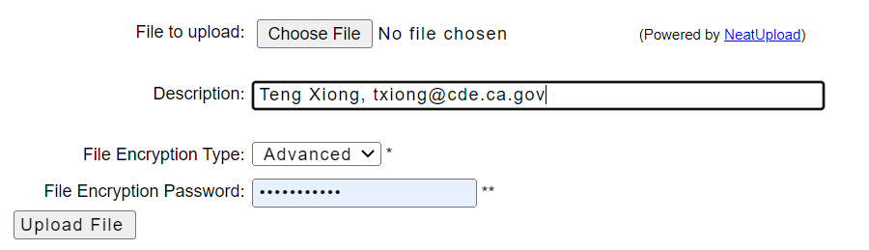
Common Issues: File Encryption Password Field (1)
A successful upload does not necessarily mean EXLD staff can download the report
There are pre-populated characters in the File Encryption Password field.

Slide 11
Common Issues: File Encryption Password Field (2)
The pre-populated characters must be deleted first, then the uploader must type or copy and paste the File Encryption Password, that is provided in the instruction email, prior to clicking the "Upload File" button.
EXLD staff will use the same File Encryption Password to download. The uploader or grantee will be contacted if there are any issues with the password.

Slide 12
Common Issues: File Encryption Password Field (3)
It is important to note that if there are multiple reports to be uploaded, the person inputting the reports must delete the characters in the File Encryption Password Field and then
re-type and copy and paste the File Encryption Password each time, for each report, prior to clicking the “Upload File” button.

Slide 13
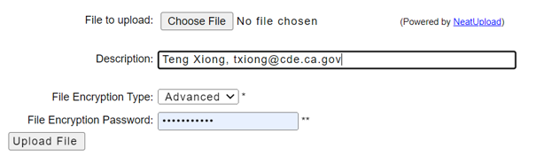
Common Issues: Description Field
The Description Field should include the name and email of the person uploading the report. If there are any issues with the report, EXLD will use this contact information to communicate any problems with the report submission.

Slide 14
Common Issues: File Name
If there are any issues with the report and there is no contact information in the Description Field (see slide 13), the File Name of the report is important when trying to identify the grantee.
Please use the following naming convention for the report:
  Grantee Name, FY, report type
  Ex. XYZ Unified 2021-22 ASPEVAL or XYZ Unified 2021-22 ASSETs

Slide 15
Common Issues: ASPEVAL Reports (1)
If a local educational agency (LEA), county office of education, district, charter school, or city municipality is the grantee for an ASES grant, then only one ASPEVAL report needs to be submitted.
If an LEA or city municipality is the grantee for an ASES grant and/or a 21st CCLC grant(s) in multiple cohorts (ex. Cohort 11 or 12), then only one ASPEVAL report needs to be submitted.

Slide 16
Common Issues: ASPEVAL Reports (2)
If an LEA is the grantee for an ASES grant and a Community-Based Organization (CBO) is the grantee for a 21st CCLC grant for the same or some of the same sites in the ASES grant, then there needs to be two separate ASPEVAL reports submitted:
One ASPEVAL report for the LEA's ASES grant
One ASPEVAL report for the CBO's 21st CCLC grant

Slide 17
Common Issues: ASPEVAL Reports (3)
If an umbrella or charter school organization has multiple ASES and/or 21st CCLC grants and the grantee name listed is different for each of those grants, then a separate ASPEVAL report is needed for each grant.
Example: XYZ Charter Organization will show as an ASES grant – XYZ Charter Elementary, ASES grant – XYZ Charter Middle School, or 21st CCLC grant – XYZ Charter Organization

Slide 18
Common Issues: ASPEVAL Reports (4)
If a CBO has multiple 21st CCLC grants in different cohorts (i.e., Cohort 11 or 12), they only need to submit one ASPEVAL report for the sites in those grants.

Slide 19
Common Issues: ASPEVAL Reports (5)
If a CBO is the after school provider for a grantee who has an ASES or 21st CCLC grant and they are submitting the report for those grantees, please make sure to review the information in slides 15, 16, and 17.

Slide 20
Common Issues: ASSETs Reports
If an LEA or CBO is the grantee for multiple ASSETs grants in different cohorts (i.e., Cohort 11 and 12), they only need to submit one ASSETs report for the sites in those grants.

Slide 21
Common Issues: Report Format
Please upload the reports (ASPEVAL and ASSETs) in Excel format. Do not save or upload the report as a PDF file.
EXLD staff needs to clean data (for formatting issues) and compile the data into a larger Excel spreadsheet.

Slide 22
Common Issues: Zipping a File
Please do not zip a file before submitting.
The exFiles File Transfer System will automatically zip the Excel file after entering the File Encryption Password and clicking the “Upload File” button.

Slide 23
Common Issues: Password Protected Files
Please do not password protect the Excel file. This will cause a delay in completing the data review process.

Slide 24
Common Issues: ASSIST Contacts
If the Description Field does not have at least an email and there is an issue with the report, EXLD staff uses ASSIST to search for the Grant Contacts, if the file name has the correct naming convention.
Please make sure that Grant Contacts are up-to-date in ASSIST

Slide 25
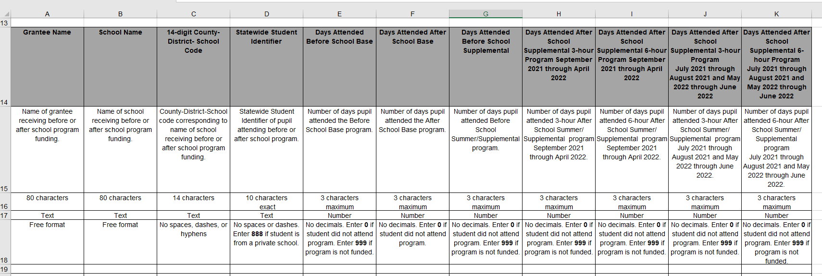
Reporting Issues: ASPEVAL Reports (1)
Reporting Template

Slide 26
Reporting Issues: ASPEVAL Reports (2)
Attendance Columns
Columns H (three-hour) and I (six-hour) for Supplemental September–April (i.e., FY 2021-22 is September 2021–April 2022)
This is only for ASES and/or 21st CCLC grantees that have Supplemental funding and ran either a three-hour program or six-hour program during the school year (weekends, vacations, or breaks).

Slide 27
Reporting Issues: ASPEVAL Reports (3)
Attendance Columns
Columns J (three-hour) and K (six-hour) Supplemental (i.e., FY 2021-22: July 2021-August 2021 and May 2022-June 2022).
This is only for ASES and/or 21st CCLC grantees that have Supplemental funding and ran either a three-hour or six-hour program during the summer.

Slide 28
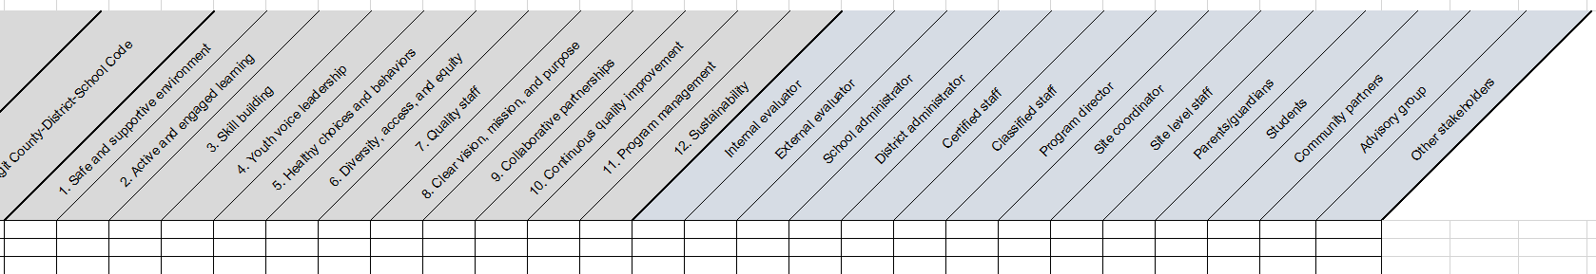
Reporting Issues: CQI Section (1)
CQI Columns

Slide 29
Reporting Issues: CQI Section (2)
Data Cells
When submitting CQI data for a school site, please do not leave any cells in that row blank.
If not working on a Quality Standard or a particular stakeholder was not involved in the program, please put in a zero.

Slide 30
Resources
Annual Outcome and CQI Frequently Asked Questions web page
https://www.cde.ca.gov/ls/ex/evalfaq.asp
Annual Outcome (ASES and 21st CCLC) instruction web page
https://www.cde.ca.gov/ls/ex/aobdandcqiinstrucem.asp
Annual Outcome (ASSETs) instruction web page
https://www.cde.ca.gov/ls/ex/aobdandcqiinstrucassets.asp

Slide 31
Questions
Please contact the ASPEVAL Help Desk for any questions on the report via email at aspeval@cde.ca.gov.

Slide 32
Thank you!

