Slide 1

Tuesday @ 2
School Nutrition Town Hall
January 28, 2025
California Department of Education
Nutrition Services Division

Slide 2
Reminder: Disaster Guidance (1)
School food authorities (SFAs) experiencing unanticipated school closures can apply for non-congregate feeding waiver:
National School Lunch Program (NSLP)/ School Breakfast Program (SBP) at any closed sites also offering virtual instruction
Seamless Summer Option (SSO) at area eligible sites when school is closed with no virtual instruction

Slide 3
Reminder: Disaster Guidance (2)
Under state declared disaster:
Late claims – Nutrition Services Division (NSD) can approve SFAs experiencing a disaster to submit claims beyond the 60-day submission requirement without using the one-time exception for late submissions.
Prop 98 disaster claims - School districts and County Offices of Education (COEs) can submit a claim for reimbursement to help offset fixed expenses.

Slide 4
Reminder: Disaster Guidance (3)
SFAs directly impacted by Los Angeles wildfires:
The U.S. Department of Agriculture (USDA) has granted NSD the authority to waive meal pattern requirements on a case-by-case basis.
SFAs must apply and be approved to utilize this flexibility.
Any questions on disaster guidance or flexibilities can be directed to School Nutrition Program (SNP) Specialists

Slide 5

Town Hall at a Glance
District Spotlight
Focus Quality
Federal & State Updates
Reminders
Funding Updates
Learning Management System
Resources & Other Announcements

Slide 6
Town Hall Resolutions
Focusing on quality programs
Sharing a standardized recipe each month
Featuring guest speakers every other month
Testing your knowledge
Highlighting new training opportunities

Slide 7

Columbia Elementary School District’s Quest for QUALITY
Q - Quest for local products
U - Unique offerings
A - Amazing vendor relations
L - Learning new recipes and techniques
I - Inventive menu items
T - Teamwork
Y - Yielding a brighter future

Slide 8
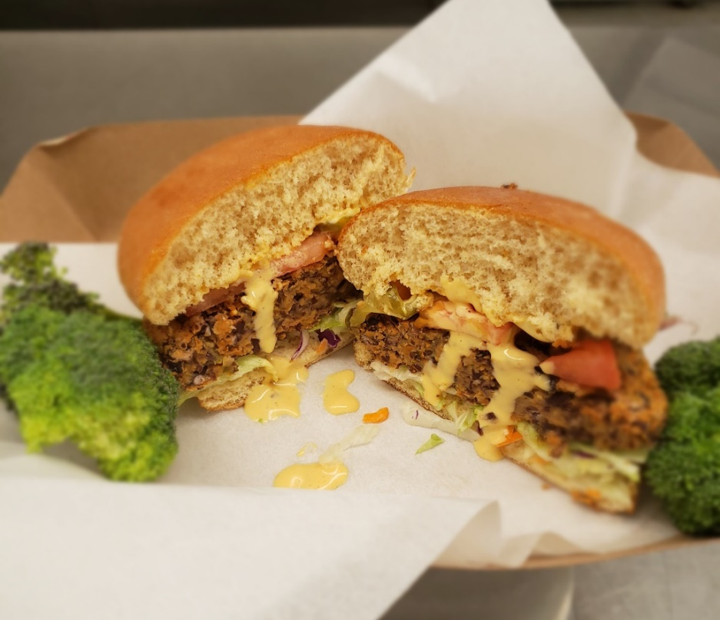
Standardized Recipe:
Black Bean Burger
Elk Grove Unified School District
Plant-based option
Features black beans, red bell pepper, onions, sweet potatoes and various seasonings
Available in Child Nutrition Information and Payment System (CNIPS) Applications Download Forms.

Slide 9
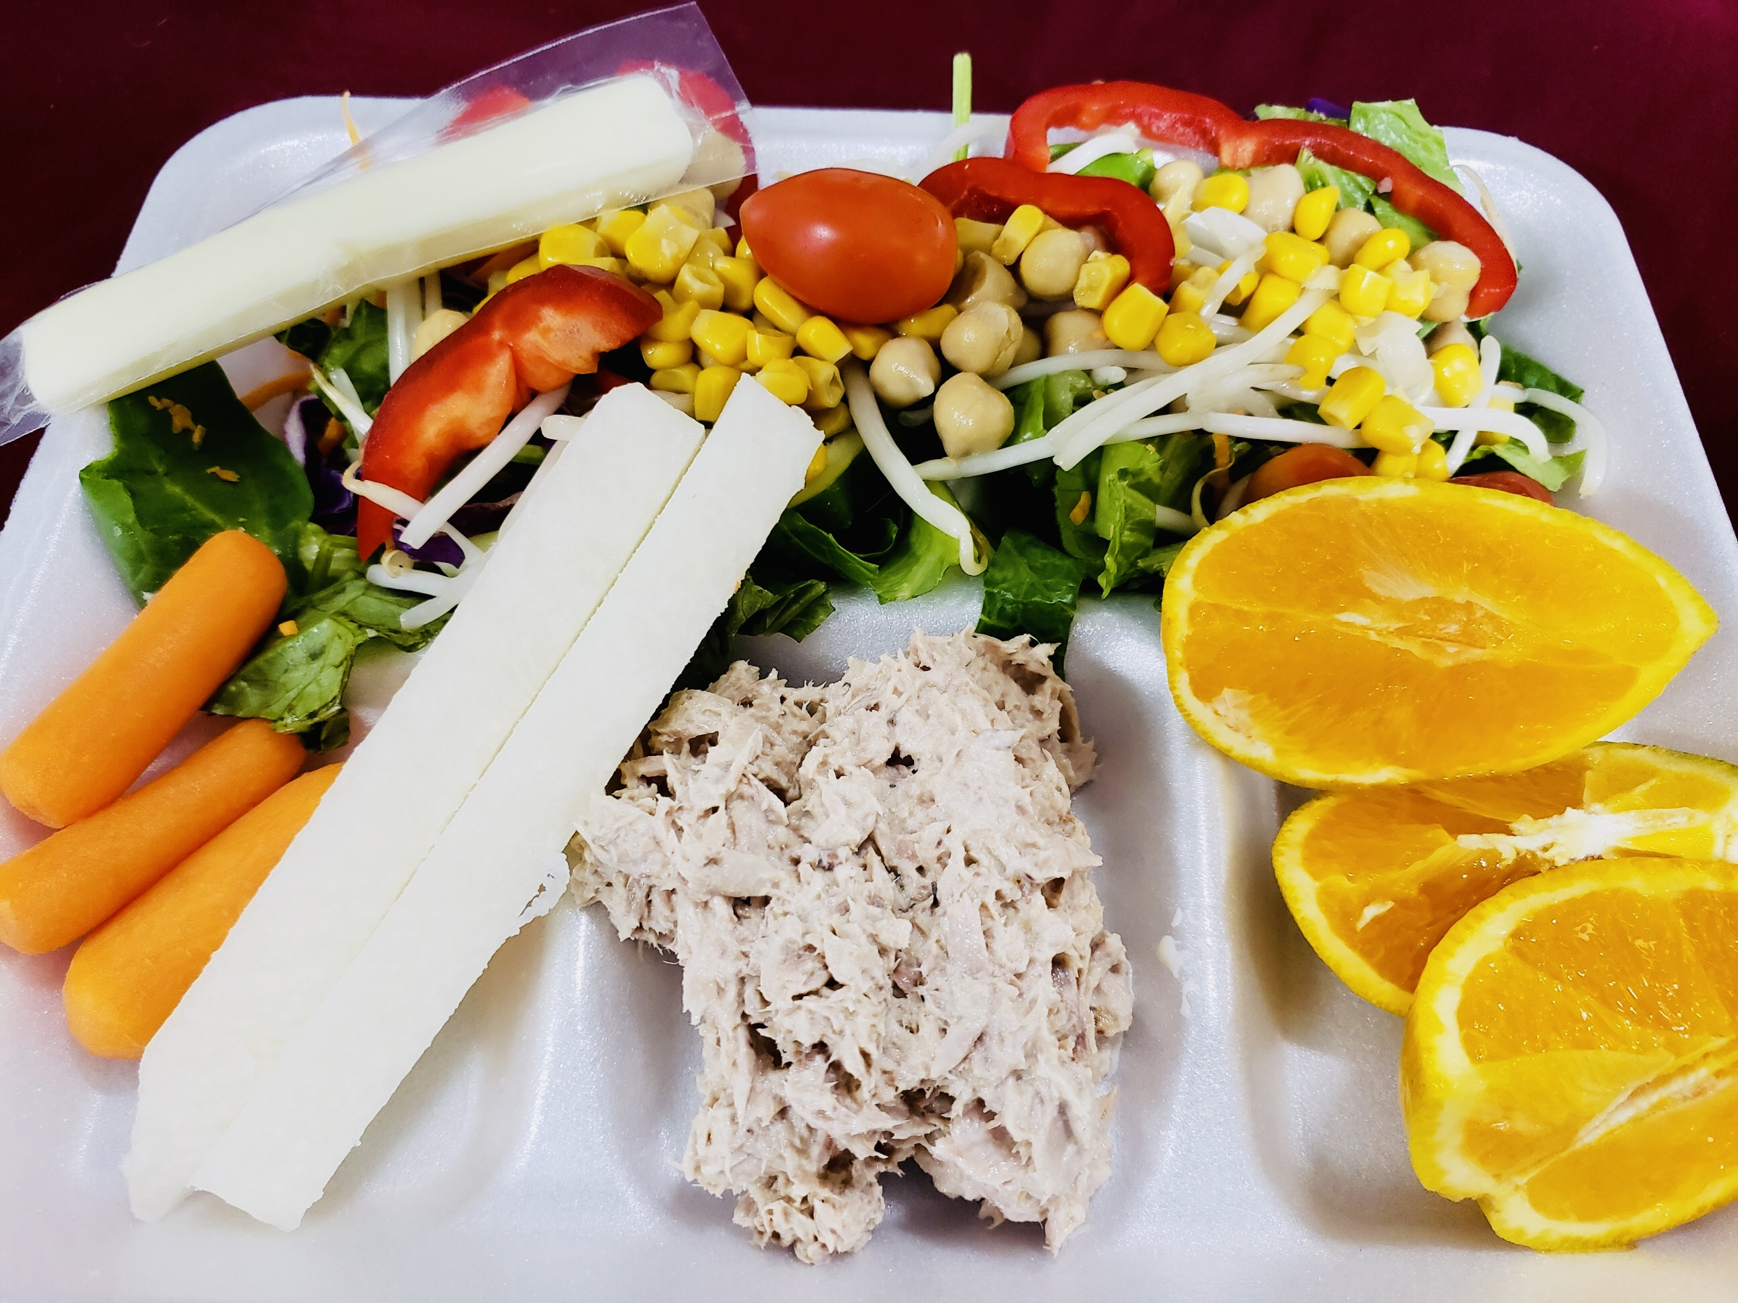
Meal Quality

Slide 10
School Nutrition Program's Ramadan Waiver
CDE has authority to approve meal service flexibilities for students fasting during Ramadan.
SFAs must request pre-approval through online survey: Waiver for Non-congregate Meals During Ramadan Opt-in Survey at https://surveys3.cde.ca.gov/go/w-nm-ramadan.asp. [Please note: the Opt-in is no longer open]
Flexibilities can only be used during Ramadan (tentatively starting February 28, 2025).
Flexibilities include non-congregate meal service, meal service time flexibilities, and waives offer versus serve.

Slide 11
Public Comment Request for Information
Topic: Grain-Based Desserts and High-Protein Yogurt Crediting in Child Nutrition Programs
Why: Public comments help inform future policymaking, guidance, and technical assistance related to grain-based desserts and high-protein yogurt
Due date: March 26, 2025
Submit public comment on the Federal Register website

Slide 12
Final Rule: Food Labeling: Nutrient
Content Claims; Definition of Term "Healthy"
On December 19, 2024, the Food and Drug Administration (FDA) announced the release of a new final rule updating the "healthy" claim manufacturers may voluntarily use on packages. To meet the criteria a food product must:
contain a certain amount of food from at least one of the food groups or subgroups, such as fruits, vegetables, grains, fat-free and low-fat dairy and protein foods, recommended by the Dietary Guidelines for Americans, and
meet specific limits for added sugars, saturated fat, and sodium.

Slide 13
FDA Bans Food, Drug & Cosmetic (FD&C) Red Number 3
Manufacturers have until January 15, 2027, to reformulate food products to eliminate Red Dye Number 3.
21 Code of Federal Regulations Part 71
CA requirements: As of January 1, 2027, the California Food Safety Act, will prohibit the manufacture, sale or provision (delivering, distribution, holding and offering) of food products that contain brominated vegetable oil, potassium bromate, propylparaben, and Red Dye Number 3.
Health and Safety Code Section 109025

Slide 14
Update: Restriction of Certain Food Dyes and Ingredients in School Meals
California School Food Safety Act (amends California Education Code sections 49431, 49431.2, 49431.5, 49501.5, and 49531)
Effective December 31, 2027:
  Amends definition of nutritionally adequate breakfast and lunch, to meals that do not contain any of the following substances: Blue 1 (CAS3844-45-9), Blue 2 (CAS 860-22-0), Green 3 (CAS 2353-45-9), Red 40 (CAS 25956-17-6), Yellow 5 (CAS 1934-21-0), Yellow 6 (CAS 2783-94-0) and
  Prohibits the same additives in competitive foods sold in elementary, middle, and high schools.

Slide 15
Final Rule - Child Nutrition Programs:
Meal Patterns Consistent With the 2020-2025 Dietary Guidelines for Americans (DGAs)

Slide 16
Final Rule Overview
Final rule updates can be categorized in four main areas:
Nutrition standards (added sugars, including flavored milk and sodium)
Menu planning flexibilities that support vegetarian diets and other dietary preferences.
Local and domestic foods
Other operations

Slide 17
Added Sugars: Two-phased Approach (1)
Effective Date | New Added Sugar Requirement
Phase 1 July 1, 2025 School Year (SY) 2025-26 | Product-based limits for: Breakfast cereals: No more than 6 grams (g) per dry ounce (oz) Yogurt 12 g per 6 oz (2g per oz) Flavored Milk 10 g or less per 8 fluid oz 15 g per 12 fluid oz when sold as a competitive food in middle and high schools

Slide 18
Added Sugars: Two-phased Approach (2)
Effective Date | New Added Sugar Requirement
Phase 2 July 1, 2027 SY 2027-28 | Weekly limit of no more than 10% of total calories for SBP and the NSLP.

Slide 19
Sodium
No changes until June 30, 2027, for both NSLP/SBP.
      NSLP current Sodium Target 1A
      SBP Sodium Target 1
Beginning July 1, 2027 (SY 2027–28), schools must implement sodium limits.
      NSLP: 15 percent reduction
      SBP: 10 percent reduction

Slide 20
What two dietary specifications have new limits with the new final rule? (1)
Added sugar
Sodium
Calories
Saturated Fat

Slide 21
What two dietary specifications have new limits with the new final rule? (2)
The ANSWER is...
Added sugar
Sodium

Slide 22
California Department of Education Resources
Final Rule updates will continue to be made on a rolling basis.
    Web pages:
      NSLP and SBP Meal Pattern
      Milk Requirements in Child Nutrition Programs
      Procurement and Farm to School
    Listservs: Nutrition What's New web page at https://www.cde.ca.gov/ls/nu/nutritionwhatsnew.asp
    Management Bulletins: https://www.cde.ca.gov/ls/nu/lr/

Slide 23
Other Resources
Training and resources are available at:
  USDA Updates to School Nutrition Standards web page at https://www.fns.usda.gov/cn/school-nutrition-standards-updates
  Team Nutrition web page at https://www.fns.usda.gov/tn/team-nutrition
  Institute of Child Nutrition at https://theicn.docebosaas.com/learn#courselist

Slide 24

Resource Update: Offering Meat and Meat Alternates at School Breakfast Training Guide
The training guide shows School Nutrition Professionals how to offer meats and meat alternates at school breakfast.
The guide includes new updates resulting from final rule for grains, meats/meat alternates, or a combination of both at breakfast.
Access this resource on the Team Nutrition website at https://www.fns.usda.gov/tn/offering-meats-and-meat-alternates-school-breakfast.

Slide 25
Training: USDA Team Nutrition
The Road to Successful Menu Planning for School Meals
This series will help you prepare to implement the requirements contained in the new final rule, Child Nutrition Programs Consistent With the 2020–2025 Dietary Guidelines for Americans.
  New Series Training Opportunity: Identifying Top Sources of Added Sugars and Simple Swaps
View this training and others at https://www.fns.usda.gov/tn/offering-meats-and-meat-alternates-school-breakfast.

Slide 26
Webinar: How to Transition to Scratch Cooking in Schools – First Steps
The Institute of Child Nutrition is hosting a webinar titled How to Transition to Scratch Cooking in Schools – First Steps.
The webinar will be held, February 6, 2025 from 12 to 1 p.m.
Register on the Institute of Child Nutrition Training website under the iLearn Training tab at https://theicn.docebosaas.com/pages/40/school-nutrition-dashboard.

Slide 27
Administrative Review Findings: Meal Component and Quantities (1)
Five most common findings in this compliance area in SY 2023–24:
Missing Meal Component(s)
Incomplete or Missing Menu Production Records
Shortage in the daily/ weekly Whole Grain Requirement
Shortage in the daily/ weekly Vegetable Requirement
Not offering a milk variety/ an allowable milk variety
Reminder: Missing Meal Components may result in fiscal action.

Slide 28
Administrative Review Findings: Meal Component and Quantities (2)
Resources:
Administrative Review Questions
  Contact your assigned Child Nutrition Assistant or Child Nutrition Consultant
  CNIPS Download Forms - Form ID: Caseload
Access the 2024–25 School Year Administrative Review Schedule on the CDE web page at https://www.cde.ca.gov/ls/nu/ar/arsnp.asp or phone 800-952-5609

Slide 29
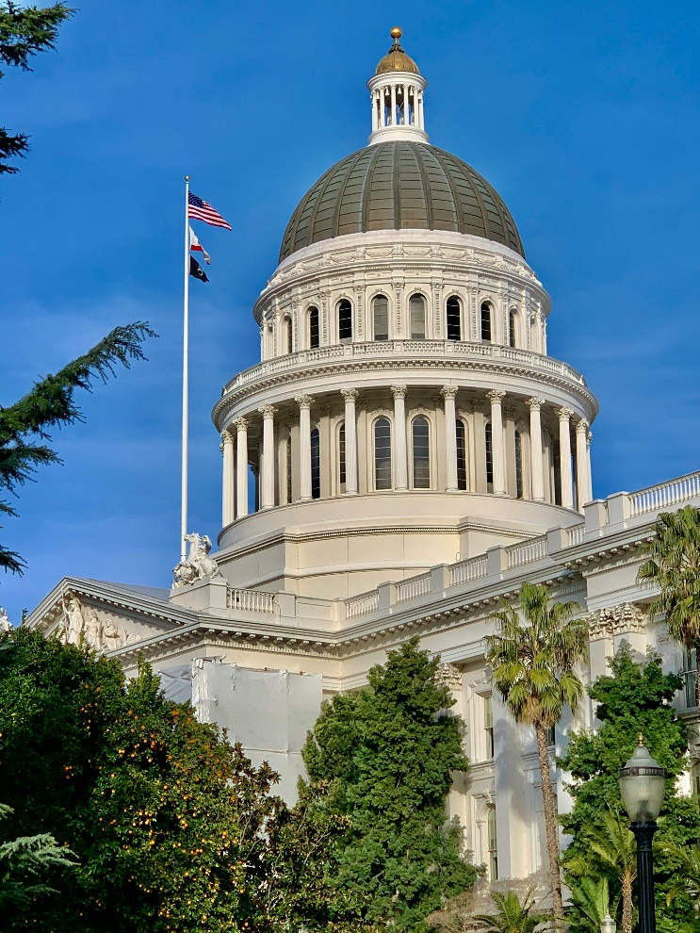
State Updates

Slide 30
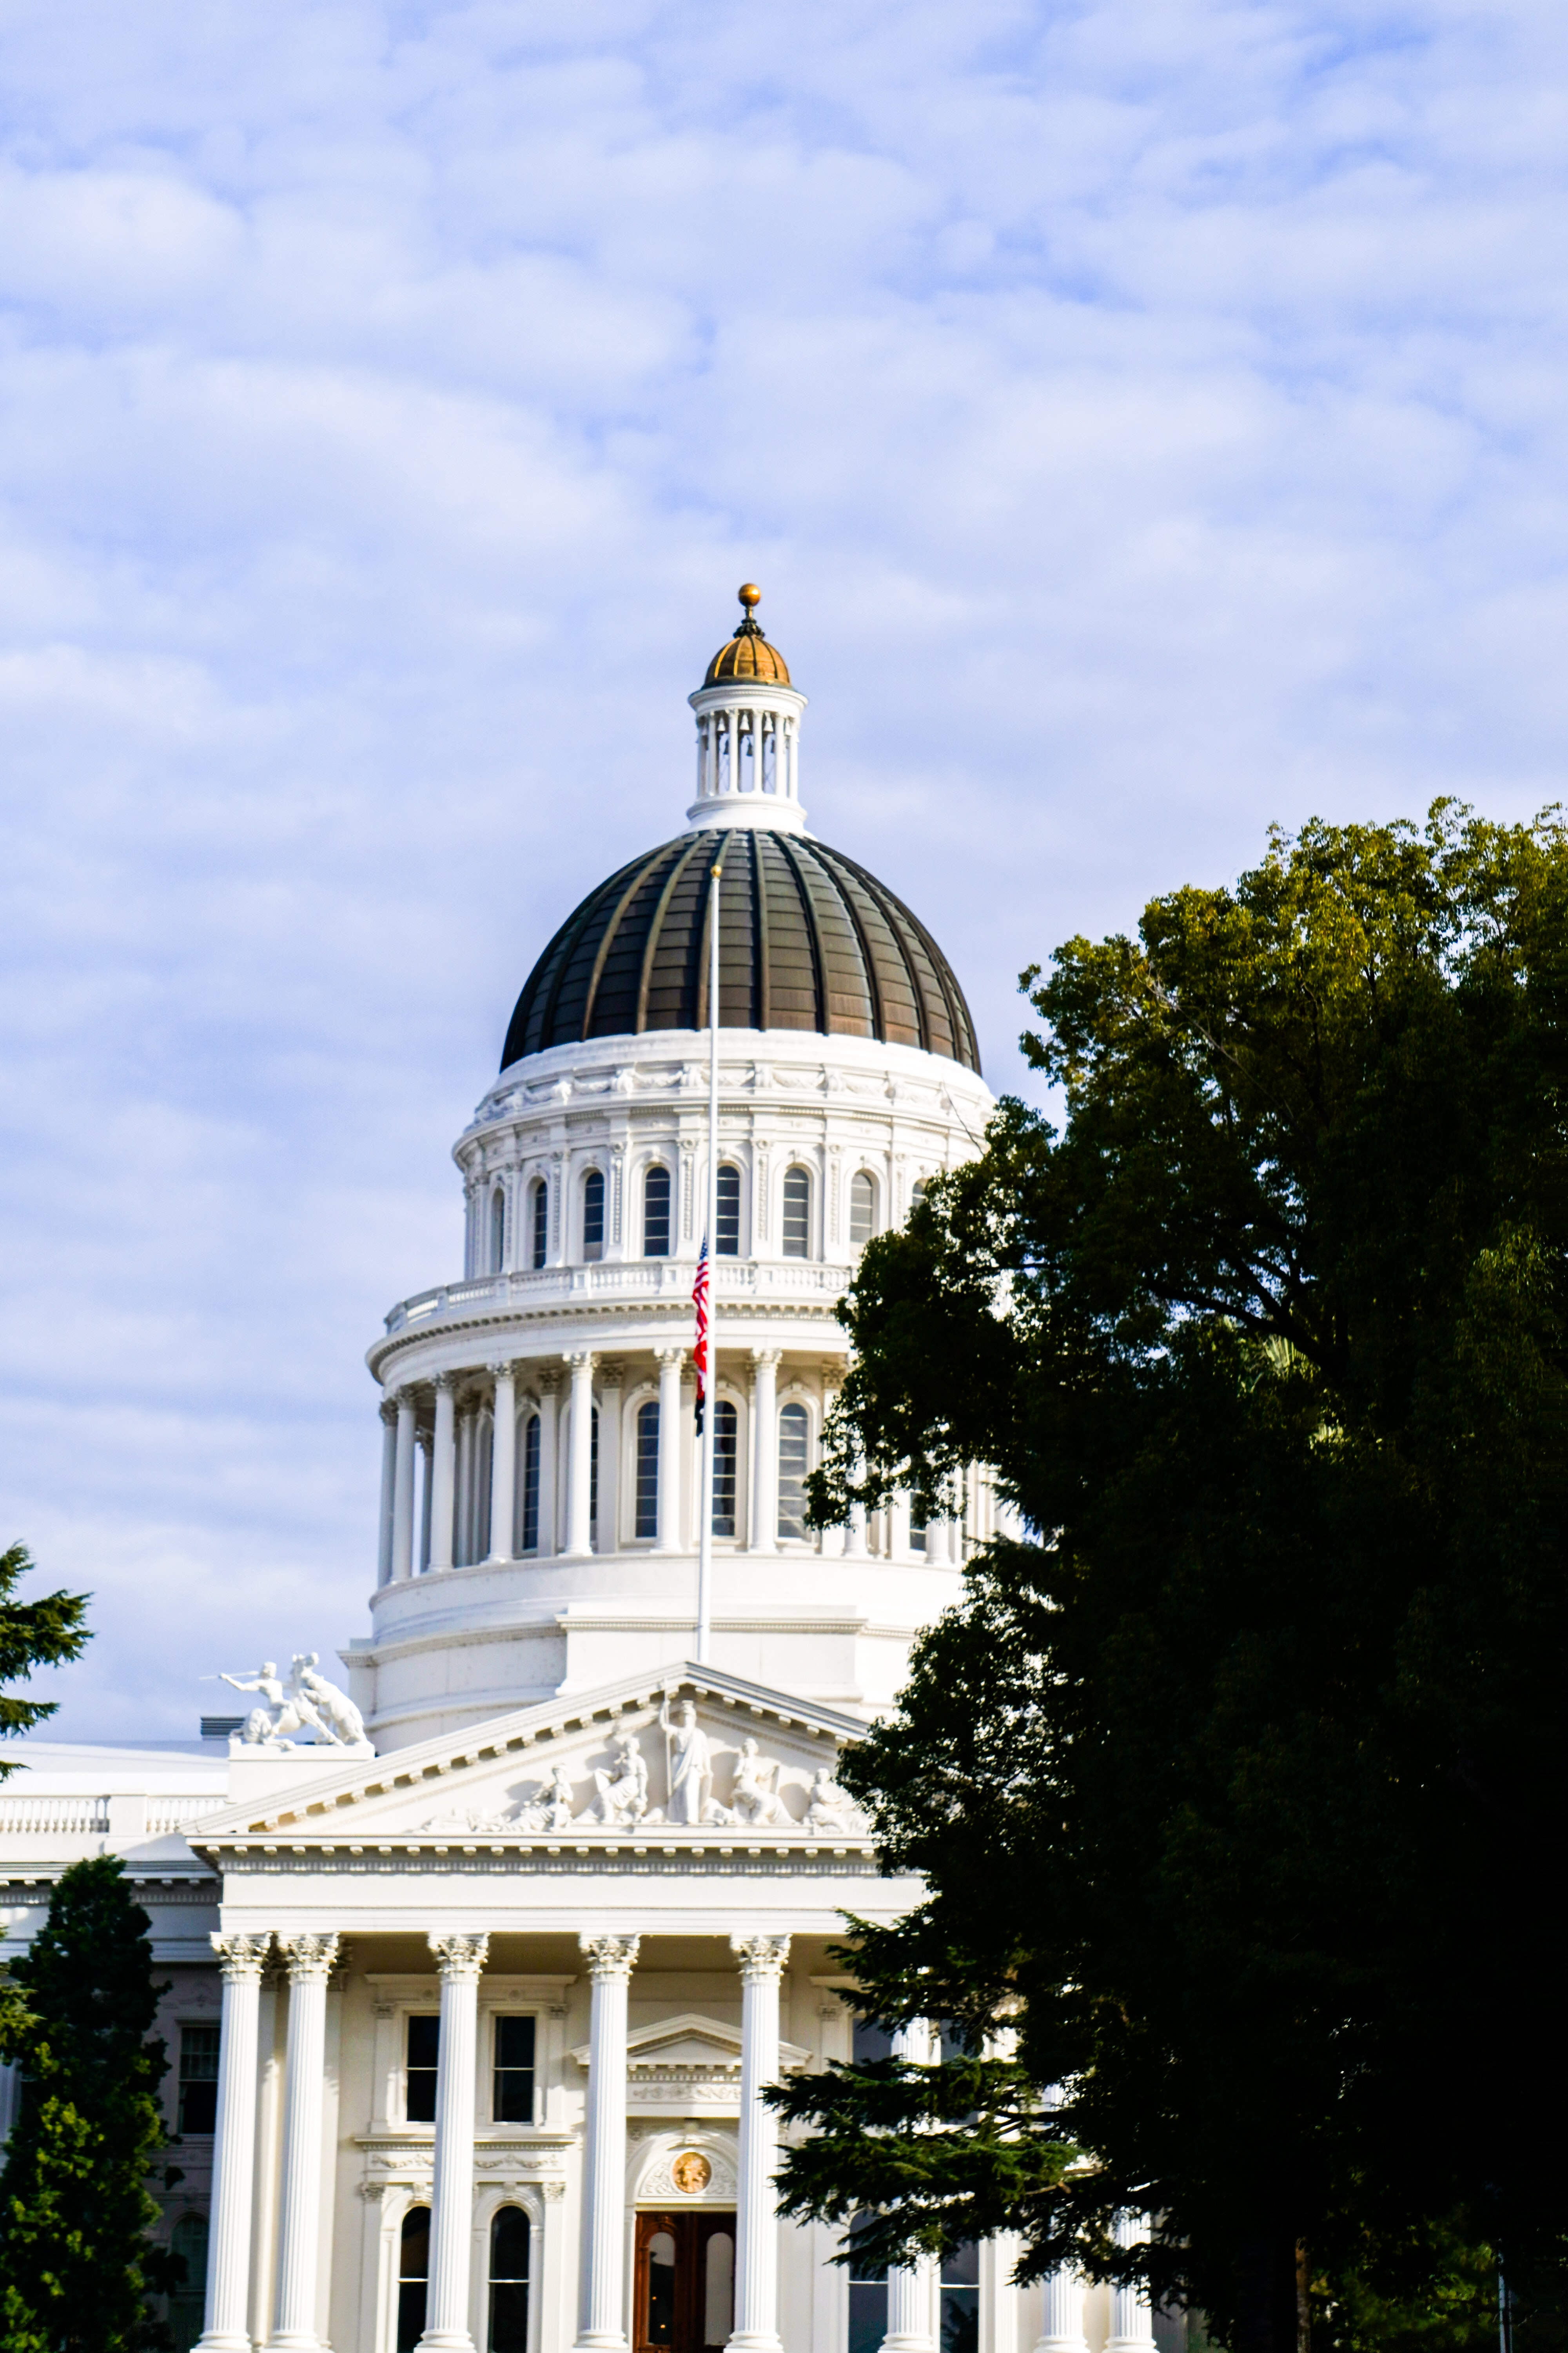
Governor's Proposed Budget
2025–26 Governor’s Proposed Budget was released January 10, 2025
May Revise is due on May 14, 2025

Slide 31
Executive Order: N-1-25
Ultra-Processed Foods
Assigns tasks to multiple state agencies.
The California Department of Education (CDE) and the State Board of Education must identify and provide recommendations to the Governor for areas where California may adopt higher standards for healthy school meals than the recent Final Rule and beyond California's current standards.
Costs, logistics and other factors will be considered.

Slide 32
Obligation to Protect
Immigrant Families
Schools should be safe havens for all California students and families.
California laws empower schools to welcome all students and reassure them of their educational rights and opportunities.
Resources:
  News Release: State Superintendent of Public Instruction (SSPI) Supports Senate Bill 48 to Keep U.S. Immigration and Customs Enforcement (ICE) Off School Campuses
  Guidance: Promoting a Safe and Secure Learning Environment for All: Guidance and Model Policies to Assist California’s K-12 Schools in Responding to Immigration Issues

Slide 33
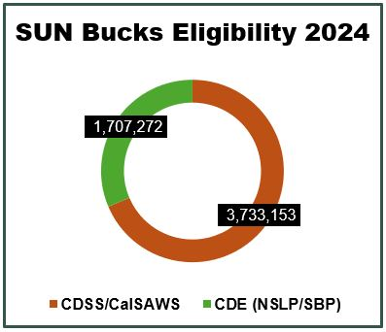
SUN Bucks: 2024
5,588,236 SUN Bucks cards
$670,573,478 total value in benefits

Slide 34
SUN Bucks: 2025
CDE is releasing a new Universal Benefits Application (UBA) to be used when determining SUN Bucks eligibility.
UBAs will be available for Provision schools (Community Eligibility Provision/Provision 2) to make SUN Bucks eligibility determinations for non-directly certified students.

Slide 35

USDA Foods Updates

Slide 36
USDA Foods Ordering and Timelines for SY 2025–26 (1)
Preplanner and Surveys
  Distribute February 1, 2025
  Due March 1, 2025
Consider your needs for the coming School Year
  Check balances at Processors – what did you actually use versus what you diverted.
  If you had pounds swept in the past year, consider adjusting your requests for the coming year.

Slide 37
USDA Foods Ordering and Timelines for SY 2025–26 (2)
Surveys are sent from Food Distribution Program (FDP) Ordering Coordinators through CNIPS to:
  State Co-op and Advance Order agencies
Surveys are sent from FDP Ordering Coordinators directly to:
  Private Co-op Lead Districts
  Large Direct Ship agencies

Slide 38
USDA Foods Available List
SY 2025–26 (1)
New Items
  Fresh Honeycrisp Apples, 111895
  Frozen Black Bean Burger Patties, 111860
  Frozen Cooked Pulled Chicken, 111881
Items Removed
  Apples, Braeburn, Fresh, 40 lb. case, 100523
  Flour, Bakers Hard Wheat, 50 lb. bag, 100413

Slide 39
USDA Foods Available List (2)
Specification Changes
Beef, Patties, Cooked, 2.0 M/MA, Frozen, Item Code 110711, this product is now soy-free
For more information visit the USDA Foods Available web page at https://www.fns.usda.gov/usda-fis/usda-foods-available

Slide 40

Product Information Sheets & USDA Foods Database Survey
Voluntary survey to collect feedback on USDA Foods in Schools Product Information Sheets and USDA Foods Databases.
Survey will help identify potential opportunities for improvement and ensure product information is being presented in the best possible way.
Due by April 18, 2025

Slide 41
Department of Defense (DoD) Fresh Updates
New Southern California DoD Fresh Prime Vendor
  Valley Produce Company
DoD Fresh Receipting Requirements
  Within two calendar days after delivery

Slide 42

Funding Updates

Slide 43
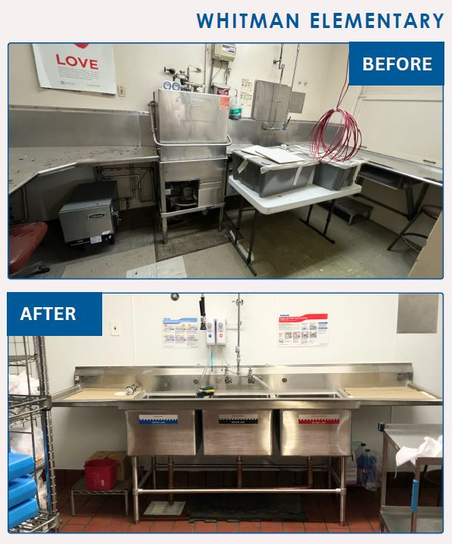
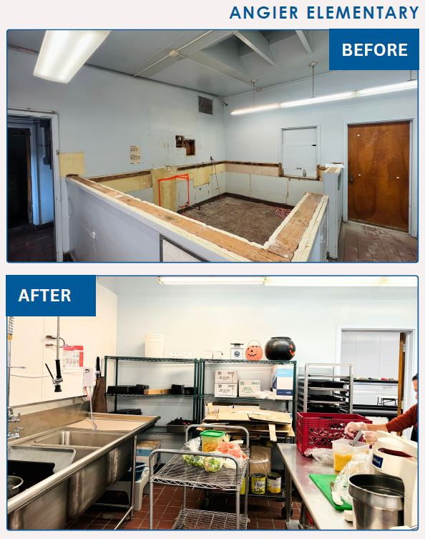
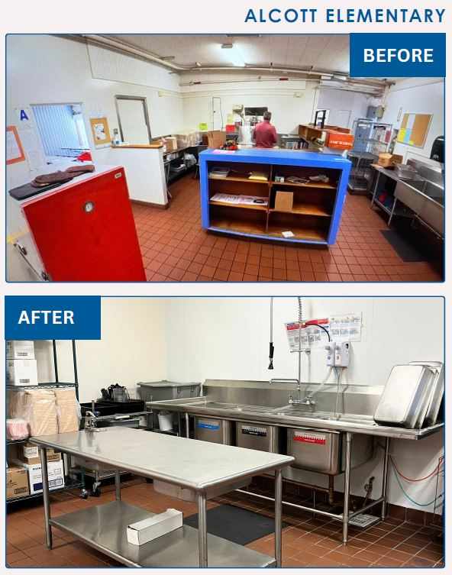
Kitchen Infrastructure and
Training in Action:
San Diego Unified School District

Slide 44
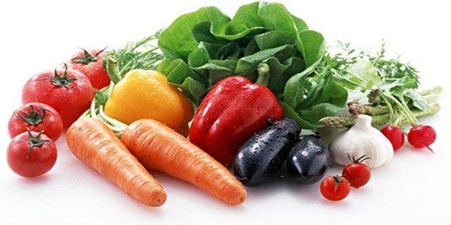
Local Food for Schools SY 2023–24
All Local Food for Schools (LFS) funds from the current opportunity should have been expended by November 29, 2024.
  If you have not fully expended your LFS funds, look for a communication from your analyst.
  Any unspent dollars below the 80 percent prepayment must be returned to the CDE.
  Information on the final mandatory report will be emailed in early spring.

Slide 45
School Breakfast Program and Summer Meals Program
Start-up and Expansion Grants
SY 2025–26 applications are now available!
Competitive grants up to $15,000 per school site.
Information on the grant and eligibility requirements are available at https://www.cde.ca.gov/ls/nu/sn/sbsfgrant.asp
Applications must be submitted online by 4 p.m., Monday, March 17, 2025.

Slide 46

Resources & Other Announcements

Slide 47
NEW: Soft Launch of
NSD Learning Site (1)
Announcing soft launch of CDE NSD's new Learning Site for:
  For Child Nutrition Program (CNP) Operators with CNIPS ID
    Directors, managers, full and part-time staff
    Food Service Management Company staff
  To fulfill your Professional Standards annual training requirements

Slide 48
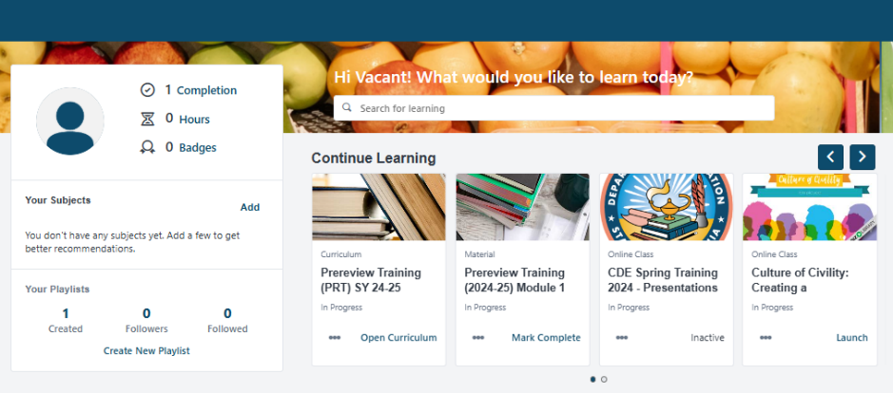
NEW: Soft Launch of
NSD Learning Site (2)
Self-registration is required to access the NSD Learning Site
What to expect next:
  Upcoming webinars
    Registration walk-through and guided tour
  Updates via Listserv and Town Hall reminders

Slide 49
Training Opportunities
Friends of the Earth is hosting two learning cohorts March 2025 through June 2026
  Opportunity #1: Organic Farm to School Procurement Peer Support Group. Learn more at www.foe.org/organic-cohort-form
  Opportunity #2: Plant-Based Elementary School Menus Peer Support Group. Learn more at www.foe.org/plant-based-cohort-form
Apply by February 21, 2025

Slide 50
Child Nutrition Advisory Council (CNAC)
CNAC Mission: To advise in the areas of health, wellness, and nutrition for all students in California’s K-12 public schools.
CNAC members recently appointed:
  Yaz Widatalla, Food Service Director, New Haven Unified School District (USD)
  Anne Wilson, Food Service Supervisor/Manager, San Luis Coastal USD
  Amber Green, Nutrition Education Specialist, Marysville Joint USD
  Rachel Rothman, Parent–Teacher Association or Organization Representative, San Diego USD
  Maulik Dhakal, Student Member, Los Altos High School

Slide 51

National Nutrition Month ® 2025
March is National Nutrition Month®
2025’s theme is Food Connects Us
Resources: National Nutrition Month® web page at https://www.eatright.org/about-national-nutrition-month

Slide 52

National School Breakfast Week (NSBW)
NSBW: March 3–7, 2025
Theme: Clue In to School Breakfast
Resources: School Nutrition Association’s National School Breakfast Week web page at https://schoolnutrition.org/about-school-meals/national-school-breakfast-week/

Slide 53
Tuesday @ 2pm Town Hall Schedule
Held on the fourth Tuesday of the month
Month | Format | Date
February | State Update and Guest Speaker | 2/25/25
March | State Update | 3/25/25
April | State Update and Guest Speaker | 4/22/25

Slide 54
Thank you!
Professional Standards Crediting Information
  Key Area: Administration (3000)
  Training Topic: Program Management (3200)
  Learning Objective: Manage Staff Work Including Scheduling (3210)
  Instructional Hours 1.5 hours
This institution is an equal opportunity provider.

