Slide 1
Tuesday at 2 School Nutrition Town Hall
June 23, 2026
Nutrition Services Division (NSD)
California Department of Education (CDE)

Slide 2
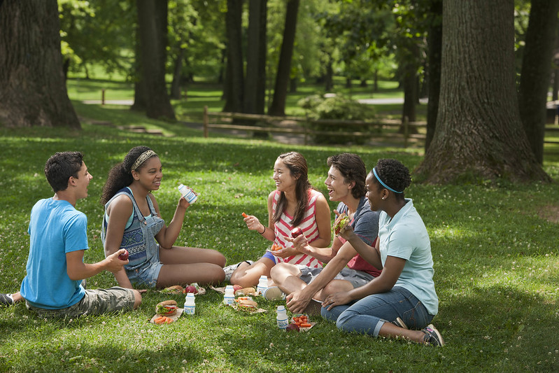
Town Hall at a Glance
District Spotlights
Federal & State Updates
Guest Speaker
Operational Reminders
Resources & Other Announcements

Slide 3
School Nutrition Program Spotlights

Slide 4
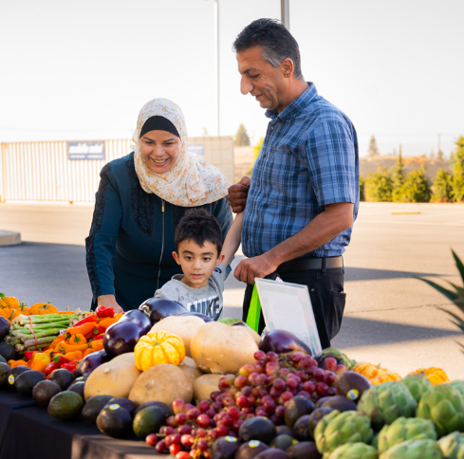
District Spotlight – Modesto City Elementary School District
Offering a traveling farmers market at summer meal sites each Wednesday; market offers free produce and nutrition education
Participated in CDE's Farm to Summer Celebration on June 17th by offering summer squash to children
Learn more about this topic on the Modesto City School News web page at https://www.mcs4kids.com/news

Slide 5
Federal Updates

Slide 6
Final Rule: Expanding Fluid Milk Options in Child Nutrition Programs (1)
U.S. Department of Agriculture (USDA) released SP 08-2026, CACFP 04-2026 Expanding Fluid Milk Options in Child Nutrition Programs (CNPs)
Effective June 8, 2026, allows the discretion of school food authorities (SFA) to serve reduced-fat (two (2) percent) and whole milk in the following School Nutrition Programs (SNP):
National School Lunch Program (NSLP)
School Breakfast Program (SBP)
NSLP Afterschool Snack Program
Special Milk Program

Slide 7
Final Rule: Expanding Fluid Milk Options in Child Nutrition Programs (2)
Allowable fluid milk options by age group for all SNPs:
Age Group | Fluid Milk Type | Milk Variety
1 year | Whole | Unflavored
2-5 years | Whole, reduced-fat, low-fat, or fat-free | Unflavored
6 and older | Whole, reduced-fat, low-fat, or fat-free | Flavored or Unflavored

Slide 8
Final Rule: Expanding Fluid Milk Options in Child Nutrition Programs (3)
Comingling Grade Levels
Local Educational Agencies (LEA) serving Transitional Kindergarten students only, or comingling with preschool students, or comingling with Kindergarten (K) through 5th grade students:
  can serve either the preschool or K-5 meal pattern for breakfast or lunch
  must follow the respective meal pattern, which includes the type of milk offered.
LEAs serving preschool children separately from other age groups, must follow the preschool meal pattern and may only be served unflavored milk.
Management bulletin updates in progress (SNP 02-2019)

Slide 9
Final Rule: Expanding Fluid Milk Options in Child Nutrition Programs (4)
Nutrient Analysis:
  Excludes the saturated fat content of fluid milk when calculating the weekly average of percent of calories from saturated fat for the NSLP and SBP.
Competitive Foods
  Allows the sale of unflavored and flavored reduced-fat (2 percent) and whole milk under federal Smart Snacks in Schools regulations
  California Education Code (EC) Section 49431.5 does not permit whole or 2 percent milk as a competitive beverage and therefore it is not an allowable competitive food public, noncharter school districts and county offices of education.

Slide 10
Guidance Updates
Updating Guidance and Materials:
  Management bulletin updates are in progress
  Impacted web pages have added banner notifications to alert you that updates are in progress
  Trainings will be updated on a rolling basis
Questions: Email the SNP Unit at SNPINFO@cde.ca.gov

Slide 11
State Updates

Slide 12
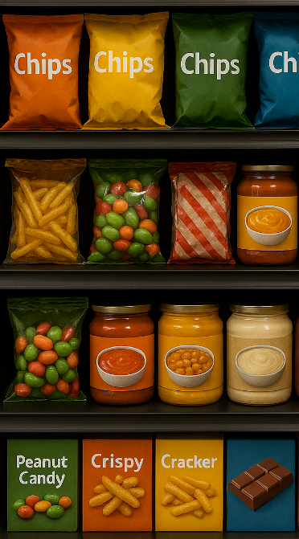
Restrictions of Certain Food Dyes and Ingredients (1)
California Food Safety Act:
Effective January 1, 2027, and prohibits the manufacture, sale or provision (delivering, distribution, holding and offering) of food products that contain brominated vegetable oil, potassium bromate, propylparaben, and Red Dye Number 3.
Health and Safety Code Section 109025

Slide 13
Restrictions of Certain Food Dyes and Ingredients (2)
California School Food Safety Act: amends EC sections 49431, 49431.2, 49431.5, 49501.5, and 49531)
  Effective December 31, 2027, amends the definition of nutritionally adequate breakfast and lunch, to meals that do not contain any of the following substances: Blue 1, Blue 2, Green 3, Red 40, Yellow 5, Yellow 6) and
  Prohibits the same additives in competitive foods sold in elementary, middle, and high schools.

Slide 14
Changes to Product Labeling
California Food and Agricultural Code Section 82001
Beginning July 1, 2026: Food manufacturers, processors, or retailers must label food items to display a date label and include uniform terms for quality or safety dates on a food item as follows:
  Quality: “BEST if Used by” or “BEST if Used Frozen by” and for items too small to fit the term use "BB", this includes beverages as defined by California Public Resources Code Section 14504
  Safety: “USE by” or “USE by or Freeze by” and for items too small to fit the term use "UB"

Slide 15
Community Eligibility Provision (CEP) and Provision 2 (P2) Applications Due
Applications due Tuesday, June 30, 2026
SFAs that miss the application deadline must return to standard counting and claiming for the 2026–27 school year (SY)
SFAs may be required to apply or reapply for CEP or P2:
  Current CEP or P2 cycle expires this year
  Standard counting and claiming sites now have an identified student percentage (ISP) of 40 percent or higher (sites/groups with ISP of 25 percent eligible but not required)
  Sites have been added or merged within an existing CEP group, or student population has changed at CEP or P2 sites

Slide 16
SY 2026–27 Annual Updates
Early July: 2026–27 Annual Updates in the Child Nutrition Information and Payment System (CNIPS) open
  Listserv with instructions and resources will be sent at that time
Applications must be approved before meal claims can be submitted for reimbursement
Reminder: SFAs serving summer school meals under NSLP/SBP will:
  Input June meal service data and claims in the 2025–26 program year
  Input July/August data in the 2026–27 program year

Slide 17

Summer Meal Program Reminders
Update CNIPS site applications when operations change at any approved summer feeding site.
Data in CNIPS is posted to summer feeding site websites and the California Meals for Kids mobile app, so meal service times and days must be accurate.

Slide 18
Find a Summer Meals Site Near You!
The California Meals for Kids Mobile App (updated daily starting June 1) is available in the app store for all iOS, Android or Microsoft devices or online at https://www.cde.ca.gov/re/mo/cameals.asp.
The CDE Summer Meal Service Site web page (updated weekly) is available online at https://www.cde.ca.gov/ds/sh/sn/summersites26.asp.
All LEAs are required to conduct outreach for
Summer Meal sites.

Slide 19
SUN Bucks Updates (1)
SUN Bucks cards are being mailed in alphabetical order by last name.
Phase 1 of SUN Bucks card mailing includes streamline certified students.
  These cards should have begun arriving in June.
Phase 2 of SUN Bucks card mailing includes students determined to be income eligible based on approved NSLP meal applications, approved Universal Benefits Applications (UBA), local direct certification, or extended benefits.
  These cards should begin arriving in July/August.

Slide 20
SUN Bucks Updates (2)
The Education Data Collection System (EDCS) is open for 2026 SUN Bucks eligibility data submissions through Wednesday, September 30, 2026.
LEAs should continue to upload any newly identified 2026 SUN Bucks records monthly. These records are derived from:
  Approved NSLP meal applications
  Approved UBA
  Local direct certification
  Extended benefits
For timely benefit issuance, we encourage the prompt upload of records.

Slide 21

SUN Bucks Updates (3)
Reminder: Parents/guardians with questions about the status of their child(ren)'s SUN Bucks cards should be directed to call the SUN Bucks helpline at (877) 328-9677.
LEAs with programmatic questions can email SummerEBT@cde.ca.gov.
LEAs with technical questions regarding EDCS can email EducationDataCollection@cde.ca.gov.

Slide 22
SUN Bucks Updates (4)
September: The 2026 SUN Bucks UBA Processing and Verification Report will launch for LEAs to complete and submit, as applicable.
The report:
  Is intended for use only by LEAs with at least one CEP and/or P2 site.
  Supports SUN Bucks program oversight and LEA funding apportionments.
LEAs completing this report must still complete the NSLP SFA Verification Collection Report in CNIPS when it opens in November for NSLP meal application verification purposes.

Slide 23
School Nutrition Program
Procurement Tools and Resources
Jill Kidd, M.S., R.D.
Director of Procurement and Business Innovation Initiatives
Urban School Food Alliance

Slide 24
Urban School Food Alliance Procurement Resources & Contact Information
Access the Urban School Food Alliance Procurement resources and contact information on the Transforming School Meals website at https://bit.ly/m/USFA?r=qr

Slide 25
Operational Reminders

Slide 26
Final Reminder: 2022 Kitchen Infrastructure and Training (KIT) Final Report
Due: Tuesday, June 30, 2026
Application link provided via direct email from Surveys@cde.ca.gov
  One person per LEA received the custom link
All 2022 KIT funds recipients must complete this report
  Prior submissions do not fulfill reporting requirement
Questions: email KITFunds@cde.ca.gov
  Note: Questions about the 2025 KIT and Recruitment and Retention grants should be sent to KIT2025@cde.ca.gov

Slide 27
SNP Administrative Reviews
SY 2026–27 is the fourth year of the current five-year SNP administrative review (AR) cycle
  The list of SFAs scheduled for an SNP AR in SY 2026–27 will be available on the Review Schedule tab of the CDE SNP AR web page at https://www.cde.ca.gov/ls/nu/ar/arsnp.asp by the end of June
The live prereview training webinar is highly recommended
  Registration will be distributed via listserv
  Slides will be available on the NSD Learning Site

Slide 28
Test Your Knowledge
What annual task must all Food Distribution Program (FDP) recipient agencies do before July 31?
Hint:
It involves the Child Nutrition Information Payment System or CNIPS.

Slide 29
Test Your Knowledge: Answer
What annual task must all Food Distribution Program participants do before July 31?
Answer:
Update and submit the SY 2026–27 FDP contract packet in CNIPS.
Questions: Email the FDP at fooddistribution@cde.ca.gov

Slide 30
Important Operational Reminders (1)
Action | Date
Submit Summer 2026: Seamless Summer Option applications* | Submit 30 calendar days prior to start of meal service.
Complete KIT 2022 Final Report | Tuesday, June 30, 2026
CEP applications, P2 applications and P2 extension requests must be submitted to NSD with all supporting documentation | Tuesday, June 30, 2026
*Applications must be approved prior to the start of meal service.

Slide 31
Important Operational Reminders (2)
Action | Date
FDP Contract Packet for SY 2026–27 in CNIPS | Friday, July 31, 2026
Complete SY 2025–26 Food Safety Inspections Survey in CNIPS | July 2026, complete in the 2026–27 CNIPS program year
Annual Updates for SY 2026–27 in CNIPS | CNIPS opens early July
Upload newly identified 2026 SUN Bucks records into the EDCS | Monthly, through September 30, 2026

Slide 32
Resources and Other Announcements

Slide 33

Farm to Summer Celebration Week Wrap-Up
Dates: June 15–19, 2026
Theme: From Seed to Plate: The Story of Our Food
Earn Recognition:
  Pre- and Post-survey
  Taste, Teach, and Connect
Action: Complete the post-survey (forthcoming)

Slide 34

California Agriculture in the Classroom
Regional Mini-Conferences featuring hands-on workshops and resources to promote cafeteria to classroom
Conference Dates and Locations:
  September 12, 2026, Santa Rosa
  September 26, 2026, Modesto
  October 10, 2026, Escondido
Information and Registration: Visit the 2026 California Agriculture in the Classroom Regional Conference web page at https://learnaboutag.org/programs/conference/

Slide 35

California Farm to School Summit
Celebrate Farm to School Month at the California Farm to School Summit this fall!
Date: October 15, 2026
Where: Soil Born Farms, Sacramento, CA
Learn more and pre-register at https://cafarmtoschoolsummit.com

Slide 36
Tuesday at 2 Town Hall Schedule
Held on the fourth Tuesday of the month
Date | Topic
July 2026 | No Town Hall
August 25, 2026 | Town Hall updates Mini-training: Budget agreements

Slide 37
Professional Standards Crediting Information
Key Area: Administration (3000)
Training Topic: Program Management (3200)
Learning Objective: Manage Staff Work Including Scheduling (3210)
Instructional Hours: 1.5 hours

Slide 38
0

