Slide 1
California Department of Education School Nutrition Program Online
Prereview Training
Module 6: Part 2, General Program Compliance
Schools and Residential Child Care
Institutions with day students
Course Number 123
2021–22
Notes:
Welcome to the California Department of Education School Nutrition Program Prereview Online Training for Schools and Residential Child Care Institutions with day students. Course Number 123, Module 6, Part 2: General Program Compliance, 2021–22
[Next Slide]

Slide 2
Objectives
Provide information on the required documentation needed for the administrative review (AR) of General Program Compliance
Review common findings
Strategies to avoid findings
Notes:
Objectives
The objectives of this module are to:​
Provide information on the required documentation needed for the administrative review, or AR, of General Program Compliance
Review common findings, and ​
Provide strategies to avoid findings
[Next Slide]

Slide 3
General Program Compliance
General Area
Water Availability
Food Safety, Storage, and Buy American
Reporting and Recordkeeping
School Breakfast Program (SBP) and Summer Food Service Programs (SFSP) Outreach
Findings or noncompliance may result in withholding of funds.
Notes:
General Program Compliance – General Area
The general areas of review are equally important as the critical areas of review. The general areas of review discussed in this module include:
Water Availability
Food Safety, Storage, and the Buy American Provision
Reporting and Recordkeeping, and
School Breakfast Program, or SBP, and Summer Food Service Program, or SFSP, Outreach
Although fiscal action is not required for the general areas of review, the California Department of Education, or CDE, may withhold funds for noncompliance with program requirements.
Let’s begin by going over the requirements for water availability.
[Next Slide]

Slide 4
Water Availability (1)
Assess if children have access to water during the lunch meal services
Assess if water is available in food service areas where reimbursable meals are served
Assess if children have access to water when breakfast is served in the cafeteria
Evaluate that water is not promoted as an alternative selection to fluid milk
Notes:
Water Availability
The goal of the water review is to:
Assess if children have access to water during the lunch meal services,
Assess the availability of water in food service areas where reimbursable meals are served,
Assess water availability to the SBP when breakfast is served in the cafeteria, and
Evaluate that water is not promoted as an alternative selection to fluid milk.
[Next Slide]

Slide 5
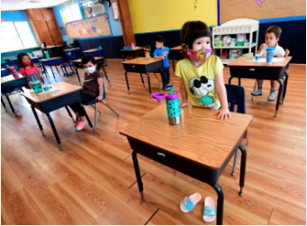
Water Availability (2)
COVID-19
During COVID-19, school food authorities (SFA) are not required to provide water with noncongregate meals.
SFAs are required to provide water if lunch is served in the classroom or the cafeteria
For more information refer to USDA Policy Memo SP 15-2021, which is in the Referenced Resources below.
Notes:
COVID-19
During COVID-19, school food authorities, or SFAs, are not required to provide water with noncongregate meals.
However, when lunch is served in the classroom or the cafeteria, SFAs are required to provide water.
For more information on water requirements during COVID-19, please refer to the U.S. Department of Agriculture, or USDA, Policy Memorandum SP 15-2021, which is in the Referenced Resources below.
[Next Slide]

Slide 6

Water Availability (3)
Review Requirements
The reviewer will validate compliance with water requirements:
  When lunches are served in the
  cafeteria or the classroom
  When breakfast is served in the
  cafeteria
If SFA is serving noncongregate meals, the water requirement does not apply
Notes:
Review Requirements
The reviewer will validate compliance with water requirements when lunches are served in the cafeteria or the classroom, and when breakfast is served in the cafeteria.
If the SFA is serving noncongregate meals, the water requirement does not apply.
Now, let’s look at food safety and storage.
[Next Slide]

Slide 7
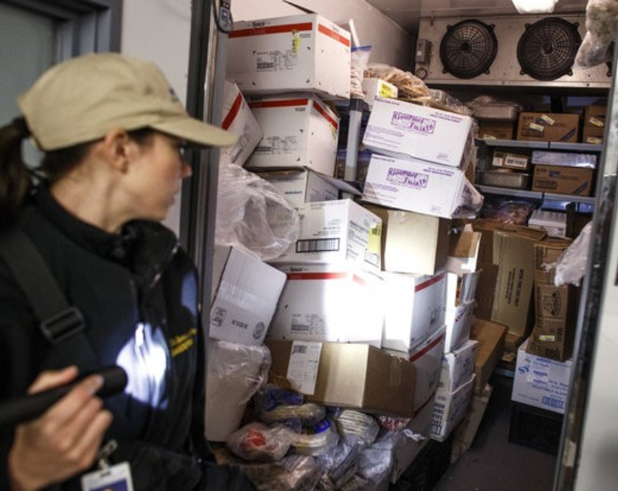
Food Safety and Storage (1)
Evaluate the selected schools for compliance with food safety and storage requirements.
Review facilities where food is stored, prepared, or served for the purpose of the School Nutrition Programs (SNP).
Notes:
Food Safety and Storage
The purpose of this section is to evaluate the selected schools for compliance with food safety and storage requirements. This will include a review of any facility where food is stored, prepared, or served for the purpose of the School Nutrition Programs, or SNPs.
[Next Slide]

Slide 8
Food Safety and Storage (2)
Required Documents
The following documents must be available for review:
Two food safety inspections or requests for each site
Current food safety inspection report
  Public view, date, and findings
Health permit
Notes:
Required Documents
To ensure compliance with food safety and storage requirements, the following documents must be available for review:
Two food safety inspection reports per site, or a request to complete them. If the SFA is unable to obtain two food safety inspections, documentation must be provided to show that two health inspections were requested from the local environmental health department.
A copy of the most recent food safety inspection report must be displayed in public view. The displayed document must reflect the inspection dates and the local environmental health department’s findings, if any.
A health permit must also be obtained for each site preparing or serving food. Ensure that the health permit is kept valid by following the local environmental health department requirements.
[Next Slide]

Slide 9

Food Safety and Storage (3)
Required Documents
Certification in food safety for one person at each site
Food safety plan or Hazard Analysis Critical Control Point (HACCP)
Temperature logs for storage areas, refrigerators, and freezers
Notes:
The SFA must also have a certification for food safety for at least one person at each site.
The food safety plan or Hazard Analysis Critical Control Point, also known as HACCP, must be in place, and
Temperature logs for food storage areas, refrigerators, and freezers must also be available for review.
[Next Slide]

Slide 10
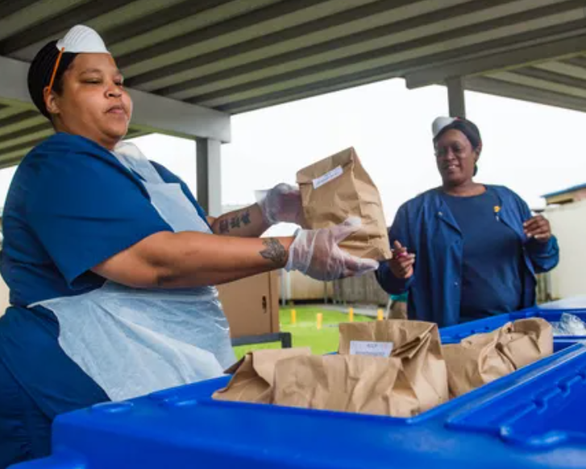
Food Safety and Storage (4)
Common Findings
HACCP plan missing at each site
Refrigerator and freezer temperature logs missing
Food safety inspections not requested
Food inspection reports not posted in public view
Notes:
Common Findings
The following is a list of the most common findings reviewers have found in previous ARs:
The HACCP plan is missing at each site
Refrigerator and freezer temperature logs are missing
Food safety inspections were not requested, and
Food inspection reports are not posted in public view
[Next Slide]

Slide 11
Food Safety and Storage (5)
Strategies to Avoid Findings
Maintain and implement HACCP plan at each site
Maintain temperature logs for refrigerators and freezers
Monitor and record food temperatures daily
Request two food safety inspections for each site
Post food inspection reports in public view
Ensure at least one person at each site is food safety certified
Notes:
Strategies to Avoid Findings
To avoid these common findings in food safety and storage, the district should:
Maintain and implement a HACCP plan at each site
Maintain temperature logs for refrigerators and freezers
Monitor and record food temperatures daily
Request two food safety inspections for each site
Post food inspection reports in public view, and
Ensure that at least one person at each site is food safety certified
Now, let’s review the Buy American Provision!
[Next Slide]

Slide 12
Buy American Provision (1)
Foods purchased must be produced or processed in the United States or territories
Products must consist of over 51 percent domestically grown commodities
Contracts and solicitations must contain Buy American Provision language
Notes:
Buy American Provision
The Buy American Provision requires each SFA to purchase food that is produced or processed domestically. Domestically processed foods must contain over 51 percent, by weight or volume, domestic agricultural commodities. Contracts and solicitations must contain Buy American Provision language.
To ensure contractor compliance, the SFAs, in their solicitations and contracts, must obtain a certification statement of Buy American from vendors or manufacturers.
[Next Slide]

Slide 13

Buy American Provision (2)
Exceptions must be documented for cost or lack of availability
Procurement procedures must include Buy American Provision language
Notes:
There are limited exceptions to the Buy American Provision, which allow for the purchase of products not meeting the domestically produced or processed in the United States requirement. Nondomestic items may be purchased due to lower purchasing price or lack of domestic availability. Documentation must be maintained to support the purchase of nondomestic items.
To ensure compliance with Buy American regulations, procurement procedures must include Buy American Provision language.
[Next Slide]

Slide 14
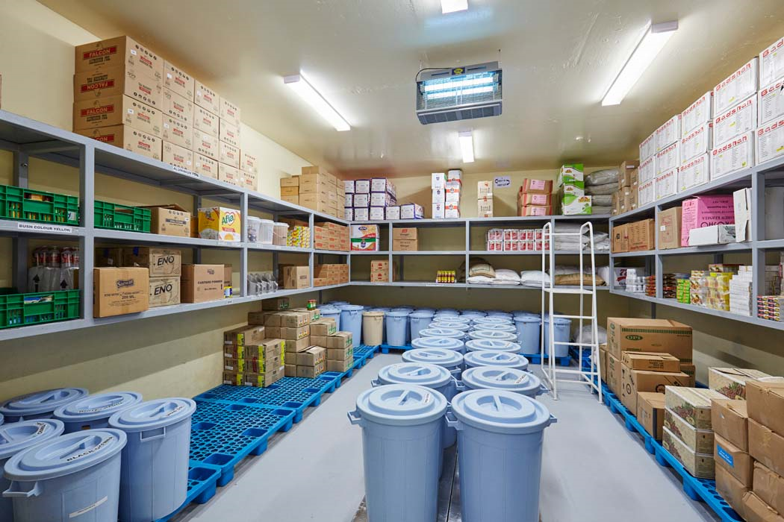
Buy American Provision (3)
Storage Facility Review
Review of on and off-site storage facilities to assess if the foods received by the SFA are over 51 percent domestic.
On-site storage facilities include:
  Freezers
  Refrigerators
  Dry goods storage
Notes:
Storage Facility Review
To determine compliance with the Buy American Provision, the reviewer will conduct a review of on and off-site storage facilities and select a variety of agricultural food components to assess if the foods received by the SFA are over 51 percent domestically produced or processed.
On-site storage facilities may include school freezers, refrigerators, dry good storage rooms, and other areas.
[Next Slide]

Slide 15

Buy American Provision (4)
Storage Facility Review
Off-site storage facilities include:
  SFA-contracted warehouse
  Self-operated warehouse
Notes:
Off-site storage facilities would include SFA-contracted or self-operated warehouses.
[Next Slide]

Slide 16
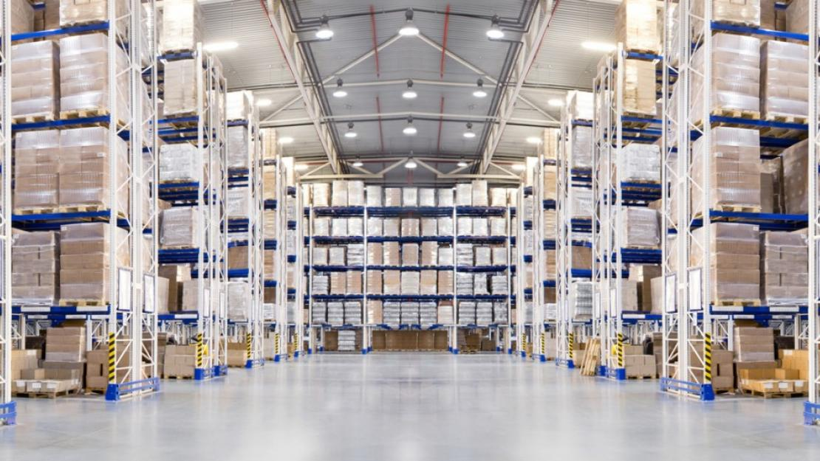
Buy American Provision (5)
Storage Facility Review
SFAs will be required to upload documents to CNIPS items listed on their menus and recipes to evaluate if at least 51 percent of the product was produced and processed domestically.
Notes:
During COVID-19, the review will be conducted remotely. SFAs will be required to upload to CNIPS items listed on their menus and recipes to evaluate if at least 51 percent of the product was produced and processed domestically.
[Next Slide]

Slide 17
Buy American Provision (6)
Food Component Categories
Canned vegetables and vegetable juice
Frozen vegetables and vegetable juice
Canned fruit and fruit juice
Frozen fruit and fruit juice
Frozen meat and entrée items
Refrigerated foods (produce, dairy, etc.)
Bakery, pasta, and miscellaneous (flour, cornmeal, etc.)
Notes:
Food Component Categories
The CDE is required to look at labels from two to three items from several food component categories to determine if they were purchased, produced, and processed in the United States or its territories.
The food component categories that are reviewed include:
•Canned vegetables and vegetable juice
•Frozen vegetables and vegetable juice
•Canned fruit and fruit juice
•Frozen fruit and fruit juice
•Frozen meat and entrée items
•Refrigerated foods (such as produce or dairy), and
•Bakery, pasta, and other miscellaneous items (such as flour and cornmeal)
[Next Slide]

Slide 18
Buy American Provision (7)
Required Documents
Documentation from vendor or manufacturer for items that are not clearly labeled over 51 percent domestically produced or processed
Cost comparison between domestic item and purchased item
Documentation showing lack of availability
Justification for not providing domestically produced alternative items
Notes:
Required Documents
If the reviewer determines the SFA has nondomestic agricultural food components, additional documentation will be needed to ensure compliance. Exceptions for availability may include:
Documentation from vendors or manufacturers for items that are not clearly labeled over 51 percent domestically produced or processed
Cost comparison between the domestic item and purchased item
Documentation showing lack of availability, or
Justification for not providing domestically produced alternative items
[Next Slide]

Slide 19

Buy American Provision (8)
Common Findings
Commodities or products are nondomestic
Products are less than 51 percent domestic
Products are not clearly labeled as domestic
Lack of documentation to support exceptions
Notes:
Common Findings
Now that we have reviewed the AR process for the Buy American Provision, let’s review common findings.
Common Buy American findings include:
Commodities or products are nondomestic
Products are less than 51 percent domestic
Products are not clearly labeled as domestic, and
Lack of documentation to support exceptions
Let’s review strategies to help prevent these common findings from occurring.
[Next Slide]

Slide 20
Buy American Provision (9)
Strategies to Avoid Findings
Obtain a certification statement from vendors or manufacturers that they will follow the Buy American Provision
Include the Buy American Provision language in all solicitations and contracts
Maintain documentation for exceptions for cost and availability
Notes:
Strategies to Avoid Findings
To avoid findings in the Buy American area of the AR:
Obtain a certification statement from vendors or manufacturers that they will follow the Buy American Provision
Include the Buy American Provision language in all solicitations and contracts
Maintain documentation for exceptions for cost and availability
[Next Slide]

Slide 21
Buy American Provision (10)
Strategies to Avoid Findings
Monitor food deliveries for compliance
Document all communications
Develop and implement policies and procedures for monitoring and ensuring compliance
Notes:
Monitor food deliveries for compliance
Document all communications, and
Develop and implement policies and procedures for monitoring and ensuring compliance
Next we will discuss resources.
[Next Slide]

Slide 22
Buy American Provision (11)
Resources
CNIPS Download Forms
PRU10a – Buy American Provision Exception Documentation Instructions
PRU10b – Buy American Certification and Nondomestic Log for Micropurchases
Procurement in SNP web page. Links are provided in the Referenced Resources below.
Notes:
Resources
There are USDA resources to assist in the documentation of the Buy American Provision requirements. These resources are available in the CNIPS download forms section under:
PRU10a – Buy American Provision Exception Documentation Instructions, and
PRU10b – Buy American Certification and Nondomestic Log for Micropurchases
The CDE developed a web page to outline procurement requirements for the SNPs. Links are provided in the Referenced Resources below.
Now, let’s move on to reporting and recordkeeping requirements.
[Next Slide]

Slide 23
Reporting and Recordkeeping (1)
Records must be maintained for three years plus the current fiscal year or until three years after all audit or AR findings are resolved
Reimbursement claims
Eligibility records
Point-of-service meal counts
Menu and food production records
Cafeteria fiscal records
Notes:
Reporting and Recordkeeping
All reports and records must be maintained for three years plus the current fiscal year or until three years after all audit or AR findings are resolved. These include:
Reimbursement claims and any documents to back up the claim
Eligibility records
Point-of-service meal counts
Menu and food production records, and
Cafeteria fiscal records
[Next Slide]

Slide 24
Reporting and Recordkeeping (2)
For alternative claiming methods such as Provisions, including Community Eligibility Provision (CEP)
Keep base-year records for three years plus the current fiscal year after provision base-year is discontinued
All extensions and Identified Student Percentage changes
Notes:
If the district is operating an alternative claiming method such as Provisions, including the Community Eligibility Provision, or CEP, records must be retained for three years after the submission of the last claim for reimbursement using provisions’ base-year and CEP data, including all extensions and Identified Student Percentage changes.
[Next Slide]

Slide 25
Reporting and Recordkeeping (3)
Reports submitted in a timely manner
  Verification
  Safety inspections
  Claims
Records and reports must be maintained for three years plus the current fiscal year or until three years after all audit or AR findings are resolved
Failure to maintain program records could result in significant fiscal findings
Notes:
During the AR, the reviewer will ensure reports required by the CDE, such as verification, safety inspections, and claims are submitted in a timely manner.
Records and reports must be maintained for three years plus the current fiscal year. If there are audit or AR findings, records and reports must be maintained for three years after all audit or AR findings are resolved.
Although reporting and recordkeeping is a general area of review, failure to maintain program records could result in significant fiscal findings.
[Next Slide]

Slide 26
Reporting and Recordkeeping (4)
Common Findings
Records not maintained for the required time period
Records not maintained for the duration of the provision claiming option (including the Community Eligibility Provision)
Reports not submitted in a timely manner
Notes:
Common Findings
Common review findings include:
Records were not maintained for the required time period
Records were not maintained for the duration of the provision claiming option, including CEP, and
Records were not submitted in a timely manner
[Next Slide]

Slide 27
Reporting and Recordkeeping (5)
Strategies to Avoid Findings
Develop system to maintain records
Develop and maintain a written plan and procedure
Maintain a calendar of due dates and allow time to compile and complete required information
Notes:
Strategies to Avoid Findings
To avoid findings in this area:
Develop a system to maintain records which may include departments outside of food service or vendors
Develop and maintain a written plan and procedure and make it available to staff if a key person leaves the SFA, and
Maintain a calendar of due dates and allow sufficient time to compile and complete the required information to ensure reports are submitted in a timely manner
Next, let’s review the last general area topic of SBP and SFSP Outreach.
[Next Slide]

Slide 28
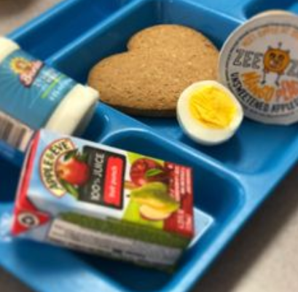
SBP and SFSP Outreach (1)
School Breakfast Program
SFAs must inform families of:
Availability of breakfast offered under the SBP
Prior to or at the beginning of the school year
Multiple outreach methods recommended
Notes:
SBP and SFSP Outreach – School Breakfast Program
SFAs must inform families of the availability of breakfast offered under the SBP.
Outreach should occur at the beginning of each school year, when free and reduced-price meal applications are sent to households. In addition, schools should send reminders regarding the availability of the SBP multiple times throughout the school year through multiple outreach methods.
[Next Slide]

Slide 29

SBP and SFSP Outreach (2)
Summer Food Service Program
SFA’s must notify the community of availability and locations of SFSP meals in the area, even if the SFA is not operating the SFSP.
Outreach must be completed prior to the end of the school year
Notes:
Summer Food Service Program
SFA’s must notify the community of availability and locations of SFSP meals in the area, even if the SFA is not operating the SFSP.
The outreach for summer meals must be completed prior to the end of the school year to ensure that families are informed of the availability and locations.
[Next Slide]

Slide 30
SBP and SFSP Outreach (3)
Required Documents
SBP outreach documents
  Breakfast menus
SFSP outreach documents
  Public media release
  Letters to households
  Notifications made by phone or other venues
Notes:
Required Documents
To ensure SBP and SFSP outreach are conducted in accordance with the requirements, place the following documents in the toolbox or upload them to CNIPS if the review is conducted remotely:
SBP outreach documents, such as breakfast menus; and
SFSP outreach documents, which may include: a public media release, letters to households, or notifications made by phone or other venues
Next, we will look at common findings for this section.
[Next Slide]

Slide 31

SBP and SFSP Outreach (4)
Common Findings
Availability of breakfast not sufficiently communicated to households
Availability of summer meals not advertised to the community
Notes:
Common Findings
Common findings for SBP and SFSP outreach are:
Availability of breakfast not sufficiently communicated to households, and
Availability of summer meals not advertised to the community
[Next Slide]

Slide 32
SBP and SFSP Outreach (5)
Strategies to Avoid Findings
Develop tracking tool for breakfast outreach activities
Notify the community of the availability of summer meals before the end of the school year
Notes:
Strategies to Avoid Findings
Finally, to avoid outreach findings:
Develop a tracking tool for breakfast outreach activities, and
Notify the community of the availability of summer meals before the end of the school year
We have now successfully reviewed each general area of compliance.
[Next Slide]

Slide 33

You have completed Module 6!
Notes:
Congratulations!
This concludes Module 6, Part 2 of the General Areas of Compliance. In this module we reviewed the general areas of Water Availability; Food Safety, Storage, and Buy American; Reporting and Recordkeeping; and School Breakfast and Summer Food Service Programs Outreach.

Slide 34
Prereview Online Training
Completion (1)
Complete Module 6 assessment questions ​
Complete all modules applicable to SFA ​
  Module 1–6 are required for all SFAs​
  Module 7 – if participating in Other Federal Programs, such as Afterschool Snacks, Seamless Summer Option, or Fresh Fruits and Vegetables
  Module 8 – if participating in a Special Provision Option​
Notes:
Please select Next to begin a series of assessment questions on the information that was just reviewed in Module 6.
If the SFA does not operate any other federal program or use alternative claiming methods such as provisions or CEP, the SNP Prereview Training is complete. However, if the SFA participates in any other federal programs such as Afterschool Snacks, Seamless Summer Option, or Fresh Fruits and Vegetables please complete Module 7. If the SFA is using alternative claiming methods such as provisions or CEP, please complete Module 8.
[Next Slide]

Slide 35
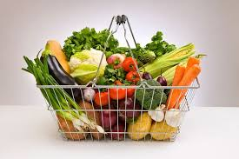
Prereview Online Training
Completion (2)
Complete brief evaluation and attestation statement once all applicable modules are completed​
Notes:
Once the assessment questions are completed, continue to the next applicable module. If all required modules are complete, select Next to complete a short evaluation and an attestation statement, which will document the completion of the CDE Prereview Training.
Do not complete the evaluation or attestation statement until all required modules have been reviewed.
[Next Slide]

Slide 36
Prereview Attestation Statement
Complete Attestation statement
  Must be completed by an authorized agency representative
Print Attestation statement
Select Submit to document participation
Please Note: You will not be able to return to the Attestation once Submit is selected.
Notes:
Prereview Attestation Statement
The attestation statement must be completed by an authorized agency representative.
Remember to print the attestation statement for your records.
Be sure to select Submit to document your participation.
Please note that you will not be able to return to the attestation once you have selected Submit.
[Next Slide]

Slide 37
Today’s Professional Standards
Instructional Time: 0.75 hours
Key Area: 3000 Administration
Training Topic: 3200 Program Management
Learning Objective: 3260 AR preparation
This institution is an equal opportunity provider.
Notes:
Thank you for your participation.
If you have questions about the content of the training modules, please contact your Nutrition Services Division Field Services Unit representative. For completing this course, you can credit 45 minutes of professional standards instructional time to key area 3000 Administration for the training topic of 3200 Program Management. The Learning Objective is 3260, AR preparation.
This institution is an equal opportunity provider.

