Slide 1
Roles and Responsibilities Beyond Actions to Reorganize School Districts
School District Organization Meeting, April 2022
Presented by Lindsay Valle
School Facilities and Transportation Services Division

Slide 2
Disclaimer
Advice/opinions offered in this presentation and by our staff today are not legal opinions nor do they necessarily represent official positions of the California Department of Education (CDE). Such advice/opinions are exemplary and are not binding on local educational agencies or other entities. Except for statutes, regulations, and court decisions that may be referenced herein, compliance is not mandatory.
(Education Code [EC] Section 33308.5)

Slide 3
Content Overview
Parties with School District Organization Responsibilities
Role of the County Board of Supervisors
COE-County Board of Supervisors Relationship
Role of the County Committee
County Office of Education Support
Transfer of County Committee Duties
Role of County Superintendent
SB 442 Changes to EC 5020

Slide 4
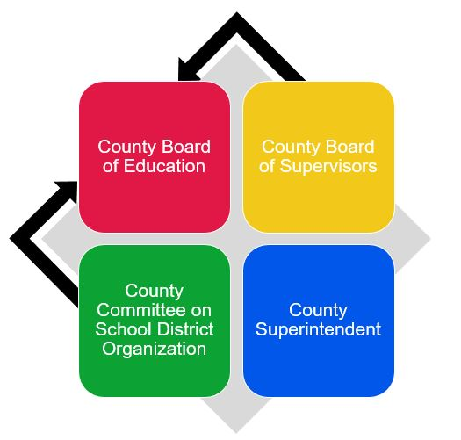
Responsible Parties

Slide 5

Role of the County Board of Supervisors
The county board of supervisors has a number of responsibilities related to school district organization.
Responsibilities may have transferred to the County Board of Education (EC 1043 and 1080).
COE staff should understand what responsibilities have transferred; this information should be found in resolutions adopted by the county boards of education and supervisors.

Slide 6

COE – County Board of Supervisors Relationship
Regardless of the fiscal independence of a COE, the County Superintendent should understand the relationship between the COE and county board of supervisors.
Past practice, previous understandings or agreements, or insufficient knowledge of pertinent issues may result in confusion regarding responsibilities.

Slide 7
Role of the County Committee
Appointments to vacant County Committee positions
Responsibilities for changing board of education election methods:
  Creating or abolishing trustee areas
  Increasing or decreasing the number of governing board members
  Rearranging trustee areas
  Alternative methods of electing governing board members
  Establishing or abolishing common governing boards
  Rearranging trustee areas based on federal decennial census

Slide 8
Role of the County Office of Education
Provide legal counsel or services to the County Committee, if necessary (EC 4011)
Provide reimbursement of travel expenses for County Committee members, who serve without compensation (EC 4010)

Slide 9

Transfer of County Committee Duties
At the request of either the County Board of Education or the County Committee, the State Board of Education (SBE) may transfer authority of the County Committee to the County Board of Education. (EC 4020 et seq.)

Slide 10
Role of the County Superintendent
Serve as Secretary of the County Committee
Call Elections
Call, Conduct, Notice, and Provide Support for County Committee Meetings and Public Hearings
District and Community Liaison
Boundary Responsibilities
Other District Organization Issues

Slide 11
County Committee Elections/Vacancies
If district organization duties have not been transferred to the County Board of Education, the County Superintendent calls an annual meeting of school district governing board representatives for purposes of electing County Committee members. (EC 4005)
The County Superintendent secures candidates for the election, prepares ballots (including by-mail ballots), and conducts this election to fill vacancies due to term expirations.

Slide 12

Other County Committee Secretary Functions
Calls elections on district organization issues
Meeting support
Appointments to vacant County Committee positions when County Committee cannot make appointment

Slide 13
District and Community Liaison
As executive secretary to the County Committee, the County Superintendent is the “face” of district organization to districts and the community.
This can include provision of:
  Information, coordination, and guidance.
  Procedural advance and counseling.
  Information and assistance for meetings and briefings.
  Coordination of media and community relations (EC 35700.1)

Slide 14

Boundary Responsibilities
County Superintendent ascertains whether district boundary records are correct. (EC 2600)
County Superintendent maintains a “full and correct transcript of the boundaries.”
County Superintendent provides corrected district boundaries to the U.S. Census via CDE.
County Superintendent maintains trustee area boundaries. (EC 5031)

Slide 15
Other District Organization Issues
The County Superintendent may provide information to school districts and the community regarding:
  The California Voting Rights Act (CVRA)
  Need and process for establishment of a by-trustee-area method of election
  Information regarding filling district governing board vacancies and reducing size of board
  Process to request waivers from the SBE regarding CVRA and reorganization matters

Slide 16
SB 442 Changes to EC Section 5020
Senate Bill 442 (2021) became operative January 1, 2022
As a result of SB 442, an election to establish trustee areas is no longer required if the County Committee resolution approving the change contains a declaration that the change is being done in furtherance of the purposes of the California Voting Rights Act of 2001 (Chapter 1.5 (commencing with Section 14025) of Division 14 of the Elections Code)

Slide 17
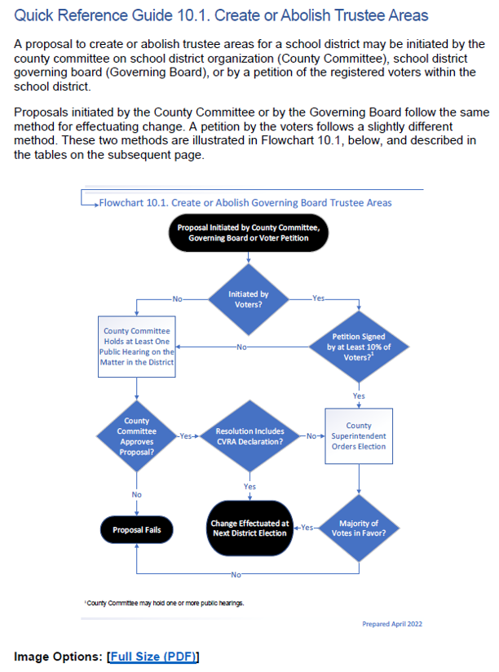
Resources
Quick Reference Guide 10.1 (PDF) reflects the change due to SB 442 (2021)
Chapter 10 of the SDO Handbook will soon be updated to reflect SB 442

Slide 18
Questions???
SDO@cde.ca.gov

