Slide 1
2022-2023 Civil Rights Review Training
for Methods of Administration
Presented by the Civil Rights Review Program
Notes:
Welcome to the Civil Rights Review training for the 2022-2023 review cycle.
In this presentation, we will discuss the purpose of the Civil Rights Review, legal authority, selection process, review process components, and the Protected Characteristics.

Slide 2
Civil Rights Review
The U.S. Department of Education, Office of Civil Rights (OCR) requires all state agencies to conduct compliance reviews to ensure students’ equal access to Career and Technical Education (CTE) programs and activities, regardless of race, color, national origin, sex, or disability.
Our Mission
The California Department of Education (CDE) has the regulatory responsibility to ensure that all students have equal access to CTE programs in California public secondary schools.
Notes:
Slide Title: Civil Rights Review
The U.S. Department of Education, Office of Civil Rights (OCR) requires all state agencies to conduct compliance reviews to ensure students’ equal access to Career and Technical Education (CTE) programs and activities, regardless of the protected characteristics of race, color, national origin, sex, or disability.
Our Mission
The California Department of Education (CDE) has the regulatory responsibility to ensure that all students have equal access to CTE programs in California public secondary schools.

Slide 3
Objectives
Review the following:
  Legislation
  Procedures for school site selection
  Processes of conducting a Civil Rights Review (CRR)
  Areas of observation and documentation provided as evidence
Notes:
Slide Title: Objectives
Our objective for this presentation is to review the following:
the legislation
the procedures for school site selection
the processes of conducting a Civil Rights Review (CRR)
the areas of observation and documentation provided as evidence

Slide 4
Table of Contents
Civil Rights Laws, Regulations & Guidelines
MOA & Civil Rights Compliance
LEA Selections
Pre-Review
In-Review
Resolution
FAQs
Facilities Measuring Tips
Resources
Notes:
Slide Title: Table of Contents
The table of contents outline the areas covered in this training. Each item underlined offers you a link to that section. You can also navigate back to the table of contents from the title slide.
Table of Contents
Civil Rights Laws, Regulations & Guidelines
MOA & Civil Rights Compliance
Selection Process
Pre-Review
In-Review
Resolution
FAQs
Facilities Measuring Tips
Resources

Slide 5

Civil Rights Laws, Regulations, & Guidelines
Click here to return to the Table of Contents
Notes:
Section Title: Civil Rights Laws, Regulations, & Guidelines
The next slide is a brief overview of the of the Civil Rights laws, regulations, and guidelines.

Slide 6

Federal Laws and Regulations
U.S. Department of Education implemented regulations:
Title VI of the Civil Rights Act of 1964 (Title VI), 42 USC section 2000(d), 34 CFR Part 100
Notes:
Slide Title: Federal Laws and Regulations
U.S. Department of Education implemented regulations which provides the authority to conduct the Civil Rights Reviews,
Please watch this video on Title VI of the Civil Rights Act of 1964...
Video Link: https://www.youtube.com/watch?v=NIGQe15IZlo
•Title VI of the Civil Rights Act of 1964
Prohibits discrimination, exclusion from participation, and the denial of benefits based on race, color, and national origin in all programs or activities receiving federal financial assistance.

Slide 7
Title IX of the Educational Amendments of 1972
34 CFR Part 106
Prohibits discrimination based on sex (sexual harassment) in all educational programs or activities receiving federal financial assistance.
  Key Issues: recruitment, admissions, and counseling; financial assistance; athletics; sex-based harassment; treatment of pregnant and parenting students; discipline; single-sex education; and employment. Also, a recipient may not retaliate against any person for opposing an unlawful educational practice or policy, or made charges, testified or participated in any complaint action under Title IX.
Notes:
Slide Title: Title IX of the Educational Amendments of 1972 (Title IX)
Title IX remains a critical federal civil rights law which prohibits discrimination on the basis of sex (including sexual harassment) in all schools that receive federal financial assistance. Some key issue areas in which agencies have Title IX obligations include: recruitment, admissions, and counseling; financial assistance; athletics; sex-based harassment, which encompasses sexual assault and other forms of sexual violence; treatment of pregnant and parenting students; treatment of LGBTQ+ students; discipline; single-sex education; and employment. Also, a recipient may not retaliate against any person for opposing an unlawful educational practice or policy, or made charges, testified or participated in any complaint action under Title IX.

Slide 8
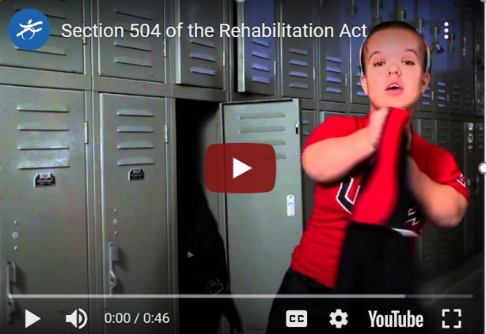
Section 504 of the Rehabilitation Act of 1974
Notes:
Slide Title: Section 504 of the Rehabilitation Act of 1974 (Section 504), 29 USC section 794, 34 CFR Part 104
Here is a short video on the impact of Section 504 of the Rehabilitation Act of 1974
Video Link: https://www.youtube.com/watch?v=XM3VKnGbAPE
As this student in the video illustrates,
•Section 504 of the Rehabilitation Act of 1974
Prohibits discrimination based on disability in programs, services and activities receiving federal financial assistance. All students with disabilities are covered by Section 504 regardless of their eligibility for special education and related services under the Individuals with Disabilities Education Act (IDEA).

Slide 9
Federal Laws and Regulations
U.S. Department of Education implemented regulations (continued):
Guidelines for Eliminating Discrimination and Denial of Services on the Basis of Race, Color, & National Origin, Sex & Handicap in Vocational Education Programs, 34 CFR Part 100 Appendix B
U.S. Department of Justice implemented regulation:
Title II of the Americans with Disabilities Act of 1990 (ADA), 42 USC section 12101, 28 CFR Part 35
Notes:
Slide Title: Federal Laws and Regulations
U.S. Department of Education implemented regulations (continued):
•Guidelines for Eliminating Discrimination and Denial of Services on the Basis of Race, Color, & National Origin, Sex & Handicap in Vocational Education Programs detail the responsibilities of recipients of federal funds and that offer or administer vocational education programs (career and technical education programs and programs of study).
U.S. Department of Justice implemented regulation:
•Title II of the Americans with Disabilities Act of 1990
Prohibits discrimination in state & local government service, regardless of whether or not programs receive federal financial assistance. Public school students are covered by the Title II regardless of their eligibility for special education & related services under the IDEA.

Slide 10
MOA & Civil Rights Compliance
Click here to return to the Table of Contents
Notes:
Section Title: MOA & Civil Rights Compliance
The following slides will provide a brief overview of the Methods of Administration & the Civil Rights Compliance program

Slide 11
MOA & Civil Rights Compliance
What is MOA?
The Methods of Administration (MOA) is a national level compliance review program. OCR oversees 68 State Agencies within the United States required to conduct annual compliance reviews at the secondary and postsecondary levels.
Civil Rights Compliance
Collect & analyze civil rights information & data; Conduct annual compliance reviews; Provide compliance assistance upon request; and Periodically report activities & findings to OCR.
Notes:
Slide Title: MOA & Civil Rights Compliance
What is MOA?
The Methods of Administration (MOA) is a national level compliance review program. OCR oversees 68 State Agencies within the United States required to conduct annual compliance reviews at the secondary and postsecondary levels.
Civil Rights Compliance
The California Department of Education (CDE) is required to adopt a civil rights compliance program to identify, remedy, and/or prevent discrimination in CTE programs offered and/or administered by LEAs. To implement and meet the state's MOA obligations, the CDE collects & analyzes civil rights information & data; conducts annual compliance reviews; provides compliance assistance upon request; and periodically reports activities and findings to the U.S. Department of Education, Office for Civil Rights (OCR).

Slide 12
Compliance Review Procedures
Selection
Data Requests
Data Review/Analysis
Pre-Review
Initial Contact from Program Reviewer
LEA Preparations
In-Review
Entrance Meeting
Interviews
School Site Selections
Notice of Selection
Uploading on CMT
Facilities Review
Resolution
Letter of Findings
Compliance Assistance
CMT Account
Voluntary Compliance Plan
Exit Meeting
Notes:
Slide Title: Compliance Review Procedures
There are several Federal Laws and regulations where LEAs must demonstrate compliance. This flowchart outlines CDE's compliance review procedure. Under each section, there is a process to ensure the most comprehensive civil rights review. In the coming slides we will go a bit more in depth into each area of the review procedures. Starting with selection, moving into the pre-review to in-review process. Lastly the resolution process where we will discuss findings, and a voluntary compliance plan.

Slide 13
LEA Selections
Click here to return to the Table of Contents
Notes:
Section Title: LEA Selections
The following slides will provide a brief overview of CDE's selection criteria process.

Slide 14

LEA Selection Criteria
LEAs which have approved CTE programs and receive federal financial assistance through the state are candidates for the Civil Rights Reviews.
LEAs are selected for Civil Rights Reviews by a ranking criteria approved by the OCR.
Notes:
Slide Title: LEA Selection Criteria
The following criteria are used by the CDE to select LEAs for Civil Rights Reviews:
LEAs which have approved CTE programs and receive federal financial assistance through the state are candidates for the Civil Rights Reviews.
LEAs are selected for Civil Rights reviews by the following ranking criteria approved by the OCR.

Slide 15
LEA Site Selection
Multiple measures are used to address underrepresentation in CTE programs:
Student Enrollment Data by sex, race, disability, English learners & special education.
Ranking point value assigned based on the measures.
Ranking point values are scored & compared.
Schools with the highest overall score are automatically identified for a review.
Time since last CRRs or lack of review.
Notes:
Slide Title: LEA Site Selection
There are multiple measures used to address underrepresentation in CTE programs. CDE obtains the enrollment data LEAs entered into CALPADS two school year cycles prior. Comparisons by sex, race, English learners, special education, and disability status are made between the school’s general student population and the school’s CTE student population. These figures are used to determine the percentage of variance among the groups. Ranking point values are scored & compared based on those measures.
Schools with the highest points scored overall are automatically identified for review. Once schools are identified, we factor in the time since last civil rights review or lack of review to make the site selections.

Slide 16

Notice of Selections
Notification of Selection Letters are emailed to District & School Site Administrators.
Notice Letters require selected LEAs to: Designate a minimum of one (1) CRR Coordinator, who will serve as the primary point of contact before, during, & after the review. Complete the CRR General Information Request form by the date specified. Provide legible copies of floor/building plans for the entire school site.
Notes:
Slide Title: Notice of Selections
Notification of Selection Letters are sent to the LEAs. The letter requires the LEA to do the following:
Designate a minimum of one (1) CRR Coordinator, who will serve as the primary point of contact before, during, and after the review.
Complete the CRR General Information Request form by the date specified. The information provided assists the CDE to consider local factors associated with a LEA when scheduling the Civil Rights Review. The timely completion of the form assists the CDE in scheduling the onsite Civil Rights Review without any potential conflicts. Completed forms must be emailed to OEOCRR@cde.ca.gov.
Provide legible copies of floor/building plans for the entire school site. The plans must identify all buildings & facilities accessible to CTE students.

Slide 17

Notification of Review Dates
The LEA is notified of their review dates & assigned program reviewer via email.
Email attachments may include, but are not limited to: Notification of Review Dates Letter CRR Program Instrument Review Guide
Notes:
Slide Title: Notification of Review Dates
Based on the information provided by the site on the General Information Request Form, dates are selected for the review.
Once a schedule is finalized, the LEA is notified of their review dates & assigned program reviewer via email.
Email attachments may include, but are not limited to:
•Notification of Review Dates Letter
•CRR Program Instrument
•Review Guide

Slide 18
Request for Schedule Changes
Rescheduling of reviews is only allowed when unforeseen circumstances or emergencies arise.
To request a schedule change: CRR Coordinator must provide written justification for the request. The Program Reviewer will review the CRR schedule and propose new dates. The LEA will be informed of the outcome in writing, via e-mail. If approved, schedule changes will update on CMT.
Notes:
Slide Title: Request for Schedule Change
Rescheduling of a review is only allowed when unforeseen circumstances or emergencies arise.
To request a schedule change:
The CRR Coordinator must provide written justification for the request.
The Program Reviewer will review the CRR schedule and propose new dates.
The LEA will be informed of the outcome in writing via e-mail.
If approved, schedule changes will be updated on CMT.

Slide 19
Pre-Review
Click here to return to the Table of Contents
Notes:
Section Title: Pre-Review
The following slides will provide a brief overview of the Pre-review.

Slide 20

CRR Monitoring Dimensions
The monitoring process is composed of three categories of evidence:
Documentation
School & district publications, rules, policies, & procedures.
Observation
CTE classrooms & site facilities.
Interviews
Admin staff, CTE teachers, pupils, & relevant parties.
Notes:
Slide Title: CRR Monitoring Dimensions
The CRR Monitoring process is composed of three (3) categories of evidence
Documentation refers to the actual materials (i.e., school and district publications, rules, policies, procedures, annual notification, handbooks, flyers, etc.) provided in CMT.
Observation refers to the inspection of CTE classrooms and site facilities.
Interviews with administrative staff, CTE teachers, pupils, and relevant parties, are conducted by the Reviewer to better understand the implementation of policies and/or procedures within the LEA.

Slide 21
Areas of Review
Administrative
Site Location & Eligibility Criteria
Recruitment
Admissions
Student Financial Assistance
Career Counseling Programs
Services for Students with Disabilities
Accessibility
Comparable Facilities
Work-Study, Cooperative Education, Job Placement
Employment
Notes:
Slide Title: Areas of Review
The following areas are reviewed using the U.S Department of Education and U.S Department of Justice current federal legislation:
Administrative
Site Location & Eligibility Criteria
Recruitment
Admissions
Student Financial Assistance
Career Counseling Programs
Services for Students with Disabilities
Accessibility
Comparable Facilities
Work-Study, Cooperative Education, Job Placement
Employment
It is highly suggested that the CRR Coordinator develop a CRR team to allow the delegation of parts of the review to those responsible. Suggested members may include, but are not limited to, those who hold the following responsibilities as coordinators and directors of; student services, counseling, Title IX, 504, Title II, Human Resources, English learners, CTE, special education, and administrative staff familiar with policies and procedures for personnel and students.

Slide 22
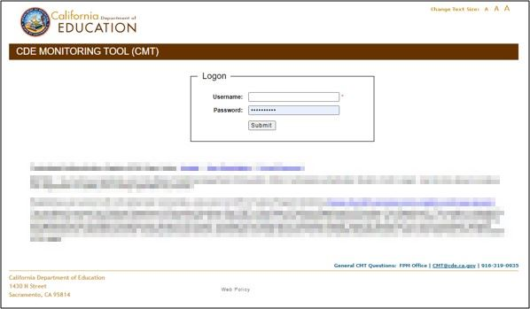
CRR Coordinator Responsibilities
Create a CDE Monitoring Tool (CMT) account Review the Civil Rights Program Instrument Attend CMT & CRR training Assist with the scheduling of staff interviews Upload documents into CMT Maintain communication with the program reviewer
Notes:
Slide Title: CRR Coordinator Responsibilities
In order to participate in the civil rights review & avoid findings of noncompliance, assigned CRR coordinators are required to do the following:
Create a CDE Monitoring Tool (CMT) account. CMT is a web-based system that allows Agencies to upload evidence in response to state and federal requirements during the monitoring process.
Review the Civil Rights Program Instrument – a guide that contains the legal requirements and provides detailed descriptions of acceptable evidence to be uploaded.
Attend CMT & CRR training – There is a YouTube recorded training and a user manual posted on the CMT Web Page.
Assist with the scheduling of staff interviews
Upload documents into CMT at least 90 days prior to start of the review - Communication about the items uploaded, will take place via email; not in CMT.
Maintain communications with the program reviewer - If the LEA's CRR coordinator does not communicate with or is not responsive to the assigned reviewer, the reviewer will be unable to determine compliance. This would ultimately result in a finding of noncompliance.

Slide 23
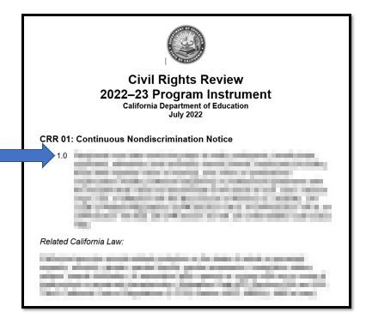
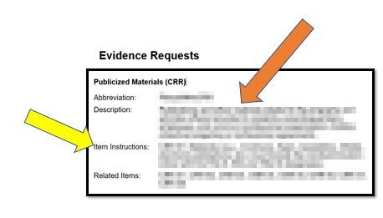
Civil Rights Review Instrument
Notes:
Slide Title: Civil Rights Review Instrument
One main resource available to you is the Civil Rights Review Instrument. The blue arrow directs you to the legal requirements. The orange arrow indicates the description of what the evidence must include, and the yellow arrow points to the Item Instructions, which are examples of the different types of acceptable evidence to upload into CMT. This useful instrument will be made available in the FPM Box.

Slide 24
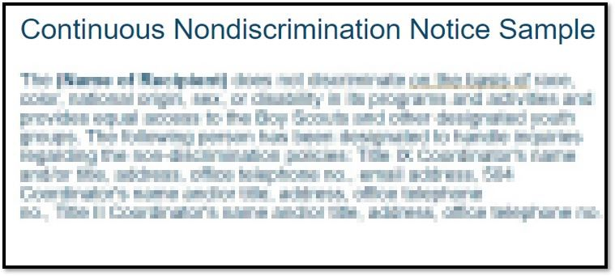
Types of Evidence Requests
Handbooks
Catalogs
Job Announcements & Job Applications
Flyers, Brochures, Posters
Websites, Social Media
Announcements
School/Local Newspaper,
Newsletters, Bulletins
Notes:
Slide Title: Types of Evidence Requests
One of the most common types of evidence requests is the Continuous Nondiscrimination Notice.
The Continuous Nondiscrimination Notice – must be placed in many places, including, but not limited to... The Student/Parent or legal guardian, and employee handbooks, Course Catalogs, job announcements and applications, flyers, brochures, websites, posters, announcements, applications for admissions, annual notifications, newsletters, school newspapers, local newspapers etc.,
Pictured here is a sample of the Continuous Nondiscrimination Notice.

Slide 25
Coordinators' Contact Information
The contact information for the Title IX, 504, and Title II Coordinators shall include the following:
  Name
  Title
  Office Address
  Telephone Number
  Email Address (Title IX)
Notes:
Slide Title: Coordinators' Contact Information
The Agency's Title IX , 504 , & Title II Coordinators contact information must be advertised in the Agency's Continuous Nondiscrimination Notice. The language at minimum shall include:
Name(s),
Title(s),
Office Address(es), and
Telephone number(s).
In addition, Title IX requires that the email address for the Title IX Coordinator be included. It is a best practice to include the email address of the 504 and Title II Coordinators to allow an additional method of communication and for consistency.
Agencies may have more than one Title IX Coordinator, 504 Coordinator and/or Title II Coordinator.
Be sure to review your Agency’s board policies and administrative regulations for your governing board’s compliance designees to ensure the correct administrators are being publicized to (a) employees, (b) parents & guardians and (c) pupils. If the correct designation is not in the Agency’s policies and regulations, a finding of noncompliance will issued.

Slide 26
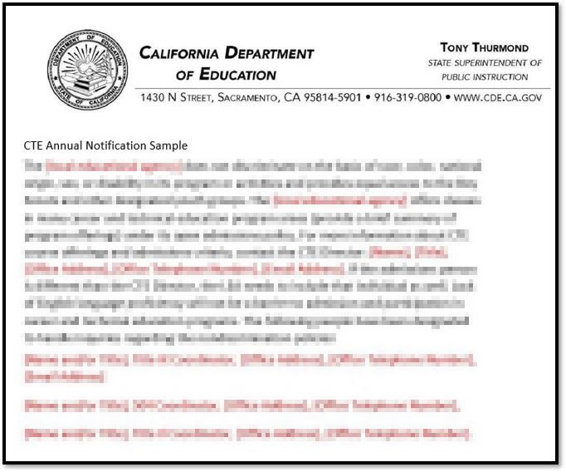
Types of Evidence Requests
CTE Annual Notification
Notes:
Slide Title: CTE Annual Notification Sample
The CTE Annual Notification
The CTE Annual Notification is similar to Nondiscrimination Notification as it contains the protected statuses and the contact information for all the coordinators; However, as you can see by the red lettering , the CTE annual notification must contain the CTE director contact information and a brief summary of the CTE programs offered. It is required to be:
Published prior to the beginning of each school year reaching students, parents/legal guardians, employees, and the general public; and,
If the service area contains a community of national origin minority persons with limited English language skills, the CTE Annual Notification must be disseminated to that community in its language and state that recipients will take steps to assure that the lack of English language skills will not be a barrier to admission and participation in the recipient’s CTE programs.

Slide 27
Types of Evidence Requests
  Title IX
  Title IX coordinator(s) job description
  Training materials received by/provided to Title IX coordinators, investigators, decision-makers, other persons who facilitate the information resolution process
  Sample Written Notice to complainant and respondent
  Sample Written Determination to complainant and respondent
Notes:
Slide Title: Types of Evidence Requests
Along with providing the Title IX coordinator contact information on the CTE Annual Notification, job descriptions for each coordinator must be uploaded:
Title IX Coordinator(s) job description shall include these responsibilities as outlined by Title IX:
Coordinates & monitors the district's Title IX compliance, as well as state civil rights requirements regarding discrimination & harassment based on sex;
Oversees prevention efforts of Title IX violations;
Implements the district's nondiscrimination complaint procedures;
Investigates complaints alleging discrimination based on sex, including sexual harassment.
Title IX requires personnel participating in the grievance process to receive training as specified in the regulations. LEAs must provide copies of the training materials for those acting as Title IX coordinator(s), investigators, decision-makers and other person(s) who facilitate the informal resolution process. Some examples of training materials are PowerPoints, documents, handouts, module outlines, screenshots of materials on 3rd party portals (weblinks are not accepted).
Under the Title IX final rule, LEAs are required to provide a written notice upon receipt of a Title IX complaint to parties who are known. A Written Determination letter regarding responsibility is required upon the conclusion of the investigation. Even if no Title IX complaints have been received, LEAs must provide samples of their Written Notice & Written Determination letters for complainants and respondents.
Uniform Complaint Procedures letters do not meet the requirement under Title IX Final Rule.

Slide 28
Types of Evidence Requests
Demographic Information Categorized by CTE Program
CTE Program staff & students
Limited English language students
Students with disabilities
Students by sex
Students enrolled in & off campus CTE classes
Notes:
Slide Title: Types of Evidence Requests
LEAs will be required to provide the following documents as specified by the evidence request:
Demographic information for the current school year categorized by CTE program.
•CTE Program staff and students
•Limited English language students
•Students with disabilities
•Students by sex
•Students enrolled in off campus CTE classes
Demographic information needs to be provided on LEA letterhead and signed by the site's Principal or appropriate administrator.
To reduce redundancy, the demographic information categorized by CTE may be combined into a chart, table or spreadsheet.
Please do not to include any personally identifiable information in the uploads.

Slide 29
Types of Evidence Requests
Services to Students with Disabilities
  List of auxiliary aides/adaptive equipment
  Student Individual Education Plans (IEPs)
  Student 504 Plans
Notes:
Slide Title: Types of Evidence Requests
More Evidence Requests
For Services to Students with Disabilities: Please list Auxiliary Aides/Adaptive Equipment;
Consistent with updated guidance we are requiring an Individual Education Plan and 504 Plans with the personally identified information redacted.

Slide 30
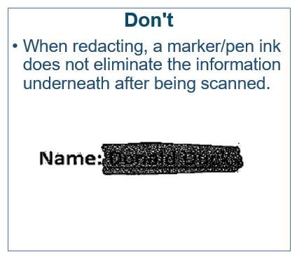
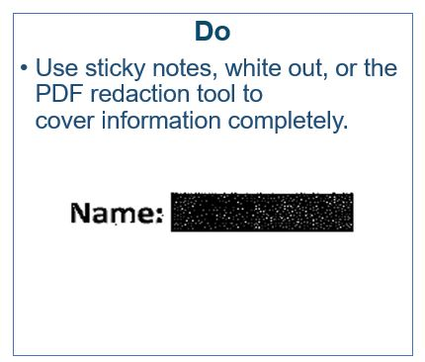
Evidence Redaction Tip
Notes:
Slide Title: Evidence Redaction Tip
In the instances where you will need to redact any personally identifiable information., for example when reporting complaint information or demographic information, be sure to follow our second example where the redaction was done using the redaction tool in Adobe/PDF. Sticky notes and white out are also good methods for redacting. However, simply marking out the name with a Sharpie, as shown in the first picture, would not fully redact the personal information. You can still make out the name of the person. Which, in this case, appears to be Donald Duck.

Slide 31
In-Review
Click here to return to the Table of Contents
Notes:
Section Title: In-Review
Overview of the Civil Rights In-Review; entrance meeting, interviews, facility walkthrough and exit meeting.

Slide 32

In-Review
Entrance Meeting:
A meeting coordinated between the program reviewer and the LEA’s assigned CRR Coordinator (main point of contact) for introductions and a brief overview of the civil rights review’s purpose and process.
Review of Documents:
The program reviewer continues to review of uploaded evidence in CMT.
Interviews With:
District and School level staff Students (on-site only)
Notes:
Slide Title: In-Review
The program reviewer will provide the CRR coordinator with an interview schedule and a list of recommended attendees for the entrance meeting which will include at minimum: Superintendent, Assistant Superintendent, HR Director, Principal, CTE Director, Special Education/IEP Director, Student Services Director, Title IX/504 Coordinator(s), and District Grounds/Facility Director.
The purpose of the entrance meeting is for introductions and for the program reviewer to provide a brief overview of the civil rights review purpose and process.
The interviews are an opportunity to learn about the LEA's practices to see whether legal requirements are being implemented. For on-site reviews, a program reviewer may include interviews with students to learn about their experiences and perceptions of the practices implemented at the school.
The program reviewer continues a review of uploaded evidence on CMT, provides feedback, and requests any additional documentation to ensure areas of investigation are in compliance.

Slide 33
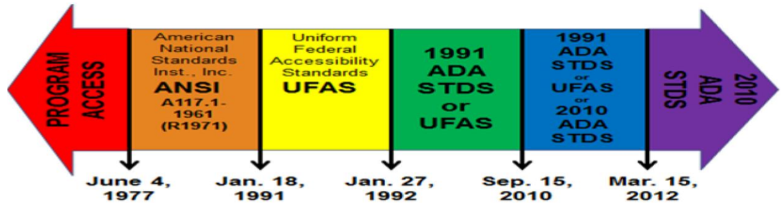
Determining Accessibility Standards
Construction dates matter for determining which standards apply.
Depending on the dates of construction and alteration, LEAs must use the applicable accessibility standards to comply with Section 504.
Notes:
Slide Title: Determining Accessibility Review
All agencies are responsible for compliance with Section 504 and Title II. During the review, an inspection of the school site's physical facilities will be conducted. Please note that construction dates matter for determining which standards apply. Depending on the dates of construction and alteration, LEAs must use the applicable accessibility standards to comply with Section 504.
This arrow chart may be used to determine which accessibility standard(s) apply(ies) based on dates when facility(ies) were first constructed or altered. The standards include ANSI, UFAS, the 1991 ADA and the 2010 ADA Standards.
Program Access – dates through June 3, 1977
ANSI Dates from June 4, 1977 – January 17, 1991
UFAS January 18, 1991 – January 26, 1992
1991 Standards or UFAS January 27, 1992 – September 14, 2010
1991 Standards or UFAS or 2010 ADA Standards – September 15, 2010 – March 14, 2012
2010 ADA Standards: March 15, 2012 and forward
For example, the cafeteria was built in 1959, and completely remodeled in February of 1988. According to the arrow chart, the American National Standard Institute (ANSI) would apply.

Slide 34
The Physical Facilities Accessibility Review or Walkthrough
The following areas will be reviewed:
Entrance/Exit CTE classrooms, labs, & workshops Reception counters Alarm Restrooms | Egress Desk Height Stadium/Fields Elevators/Lifts Path of travel Parking Lots Library | Auditoriums, gyms, locker rooms Signage International Symbol of Accessibility Proximity of classroom, shops & labs Water Fountains Cafeteria
Notes:
Slide Title: The Physical Facilities Accessibility Review or Walkthrough
This slide indicates the areas in which you can expect a facilities walkthrough. A review will be conducted of all facilities and locations accessed by CTE students .

Slide 35

Facilities Measuring Tips
Click here to return to the Table of Contents
Notes:
Slide Title: An ADA Inspection
This video includes some measuring tips for LEAs undergoing an online review. Please note that all lengths (i.e., height, width, depth) are measured in inches. This gives a general overview of what to expect during the facilities walk through. Keep in mind, this video does not cover all areas assessed for ADA and there are a few mentioned in the video, that we do not include in our assessment.
Video Link: https://www.youtube.com/watch?v=z_ajvgyZhQI

Slide 36

Common Areas of Non-Compliance
Door(s) at Entrance(s) and Exits(s):
Door push force: Measure in pounds
Signage(s):
Height of accessible signage: Measure from the floor to the centerline of sign
Height of characters of signage
Toilet/Restrooms
Height of mirror: from floor to reflecting edge of mirror
Height of soap dispenser: from floor to operable part of dispenser(s)
Height of paper towel dispenser: from floor to operable part of dispenser(s)
Notes:
Slide Title: Common Areas of Non-Compliance
Common compliance findings from past reviews.
When measuring the push force of doors, this should be gauged at 5 pounds or less, unless it is a fire door, or an exterior hinged door in which case the max is 15 pounds.
For Signage, be sure to measure the height of the International Symbol of Accessibility (ISA) signage, measure from the ground floor to the center line.
For ISA parking signs, measure from the ground to the base of the sign.
For toilets and restrooms measure the following:
Height of mirror from floor to reflecting bottom edge
Height of soap dispenser: from floor to operable part of dispenser(s)
Height of paper towel dispenser: from floor to operable part of dispenser(s)

Slide 37
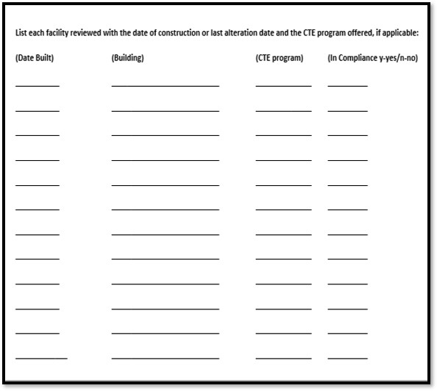
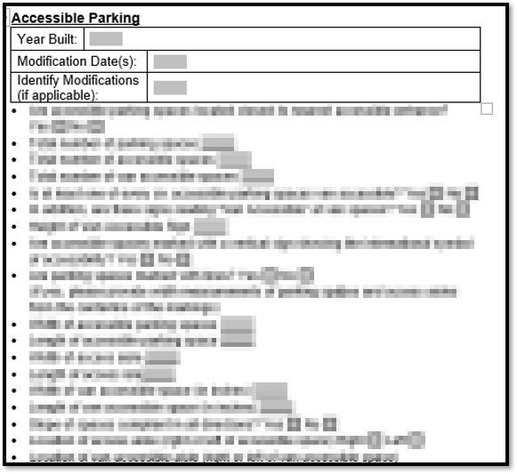
Accessibility Checklist
& Facilities Packet
Notes:
Slide Title: Accessibility Checklist & Facilities Packet
All measurements are to be recorded in the Facilities Review Packet.
The image to the left is a screenshot of the Accessible Facilities Checklist.
LEAs are required to complete and submit an Accessible Facilities Checklist prior to the review. LEAs will need to fill in the original build dates and dates of any and all alterations to buildings accessed by students.
The image to the right is a screenshot of the Facilities Packet:
For an on-site review, the program reviewer with the assistance of an LEA staff person as identified by the site CRR coordinator, will conduct the facilities review. For on-line reviews, the LEA will be required to complete and submit the Facilities Review Package according to the timeline provided by the program reviewer. The person conducting the inspection is responsible for completing a self-assessment for each school which is a part of this civil rights review.

Slide 38
Exit Meeting
Exit Meeting – a meeting for the program reviewer to present findings to be issued in the Letter of Findings and to answer questions regarding the review.
Notes:
Slide Title: Exit Meeting
Once your Program Reviewer has conducted the facilities walk through and reviewed all documents provided into evidence, an exit meeting will be conducted on the last day of the review to discuss potential findings, observations, and the resolution period.
It is strongly suggested to include the following attendees:
LEA's superintendent, site principal, CRR coordinator, HR Director, Student Services Director, and District Grounds/Facility Director.

Slide 39
Resolution
Click here to return to the Table of Contents
Notes:
Section Title: Resolution
This section provides an overview of the Civil Rights resolution period which includes the Letter of Findings, the Voluntary Compliance Plan and how your reviewer will assist you in meeting federal compliance.

Slide 40
Letter of Findings (LOF)
What is a Letter of Findings?
  A summary review of the LEA's policies and practices.
  The LOF documents the following: citation(s) and a narrative explanation of applicable regulations and guidelines; areas reviewed in compliance; findings of noncompliance; and needed corrective actions, if applicable.
  LOFs are sent 30-60 days after the exit meeting.
Notes:
Slide Title: Letter of Findings
The Letter of Findings or LOF is a summary review of the LEA's policies and practices issued to the school's principal and superintendent. The LOF documents the following: citation(s) and a narrative explanation of applicable regulations and guidelines; areas reviewed that are in compliance; findings of noncompliance; and needed corrective actions, if applicable. LOFs are sent 30-60 days after the exit meeting.

Slide 41

Voluntary Compliance Plan (VCP)
What is a VCP?
Purpose & Time Frames
Voluntary Compliance per MOA
VCP Approval/Rejection Process
VCP Resolution Process
Notes:
Slide Title: Voluntary Compliance Plan
Voluntary Compliance Plan (VCP) is an outline of the findings as written in the LOF with a specific description(s) of corrective actions.
The VCP is a voluntary agreement between the CDE and the LEA. The purpose is to convey the steps needed to resolve violations of noncompliance found during the review.
The LOF will include a VCP form that shall be completed and submitted to the CDE within 60 days from the date of the LOF via email. The VCP shall include the LEA's plan for the corrections, the person(s) tasked with the responsibility to complete the action, the timeframe for completion, and signatures of person(s) within the district with the authority to make the plan binding, usually the site principal and Superintendent.
The submitted VCP is evaluated by the program reviewer to be approved or rejected. The corrective actions must be approved by the CDE and be consistent with the guidelines, applicable regulations, and accessibility standards, and should include a month and year of anticipated completion.
If the VCP is approved, the CDE will issue a Notice of Acceptance letter. This letter informs the LEA, their VCP submission for that district/school site review has been accepted.
If the VCP is rejected, the CDE will issue a Notice of Rejection letter with mention of reason(s) for not being accepted and a due date for resubmission.
Once the VCP is resubmitted and approved with all completed corrective action(s), a Notice of Resolution will be issued to indicate all areas of noncompliance have been resolved and the review is closed.

Slide 42
Frequently Asked Questions (FAQs)
Click here to return to the Table of Contents
Notes:
Section Title: Frequently Asked Questions

Slide 43
FAQ
What is the LEA list for secondary education?
How often are schools selected for a CRR review?
The LEA is a charter high school utilizing different high schools in the county to offer their CTE programs. Should the LEA be removed from the review?
Should EL be removed as one of the selection criteria for middle schools?
Notes:
Slide Title: FAQ
1.) What is the LEA List for secondary education?
The LEA list for secondary education includes (1) alternative schools and programs of choice; (2) adult education programs; (3) charter middle and high schools; (4) community day schools; (5) continuation high schools; (6) county community schools; (7) diploma plus schools; (8) magnet middle and high schools; and (9) traditional middle and high schools.
2.) How often are schools selected for a CRR review?
CDE's targeting plan, approved by the federal Office for Civil Rights 1) identifies the information & procedures used to select LEAs for review and 2) lists the LEAs within the state of California that offers one or more CTE programs. This list of secondary education schools is then divided into a five (5) year rotation & categorized alphabetically.
3.) The LEA is a charter high school utilizing different high schools in the county to offer their CTE programs. Should the LEA be removed from the review?
No. If the LEA is home to several career & technical education programs, & utilizes various facilities, the LEA still qualifies for a review. If it isn’t feasible to conduct the review in one week, due to the size of the program, the review may be extended
4.) Should English Learners be removed as one of the selection criteria for middle schools?
No. The MOA Plan submitted to OCR in July 2020 includes English Learner enrollment data as a criteria for review. Unless updated, EL will remain a criteria for review.

Slide 44
FAQ
A middle school site was selected due to disproportions in English Learners (EL) CTE enrollment. The LEA has indicated that the middle school's EL students have federally mandated elective classes & are unable to take CTE classes as a result. Does this disqualify them from a CRR review, or are they required to undergo the review?
Should the LEA be held accountable for data keyed into CALPADS?
What if the LEA states they do not have a CTE program?
Notes:
Slide Title: FAQ
5. A middle school site was selected due to disproportions in English Learners (EL) CTE enrollment. The LEA has indicated that the middle school's EL students have federally mandated elective classes & are unable to take CTE classes as a result. Does this disqualify them from a CRR review, or are they required to undergo the review?
No. This does not disqualify the LEA from a CRR as we are federally required to review schools based on EL enrollment. The program reviewer may ask further questions & investigate the structure of the program. The review may result in no findings; however, the LEA is responsible for explaining the disproportion in enrollment. If the school has a CTE program, the review will need to be conducted.
6.) Should the LEA be held accountable their self-reported data in CALPADS?
Yes. The LEA must be held accountable for the self-reported data. If they have structured themselves outside of what their CDS code allotted, then they are responsible for the outcome - i.e. additional reviews, incorrect selections, etc. If they are reporting CTE classes that are not being offered at their site, the LEA must provide a reasonable explanation.
LEAs that are not in agreement with the data used and would like to be re-evaluated may re-submit their data. Submissions should represent the most up-to-date enrollment information. The data must include 1) total CTE student enrollment, and total school enrollment 2) Total CTE reported courses, and 3) CTE program student enrollment for the selected protected class group.
7.) What if the LEA states they do not have a CTE program?
If the LEA does not have a CTE program, they may request to be removed from the CRR schedule. The LEA is to email the following documents to our office inbox with a cc to their Program Reviewer along with their request to be removed:
School's academic planner/course catalog listing all courses offered for the school year under review.
An official letter signed by the school principal indicating the reason for the request along with an explanation for the course coding and self-reported data.

Slide 45
Resources
Click here to return to the Table of Contents
Notes:
Section Title: Resources

Slide 46
Resources
Office of Equal Opportunity, Civil Rights Review Page:
https://www.cde.ca.gov/re/di/eo/cterights.asp
U.S. Department of Education, OCR Resources:
https://www2.ed.gov/about/offices/list/ocr/frontpage/faq/readingroom.html
https://www2.ed.gov/policy/rights/guid/ocr/title-ix-coordinators.html
https://www2.ed.gov/about/offices/list/ocr/504faq.html#safeguards
https://www2.ed.gov/about/offices/list/oela/english-learner-toolkit/index.html
https://www2.ed.gov/about/offices/list/ocr/frontpage/pro-students/sex-pr.html
Program Accessibility:
https://www.ansi.org/
https://www.access-board.gov/aba/ufas.html
https://www.ada.gov/1991ADAstandards_index.htm
https://www.ada.gov/2010ADAstandards_index.htm
Notes:
Slide Title: Resources
Resources links for your reference.

Slide 47
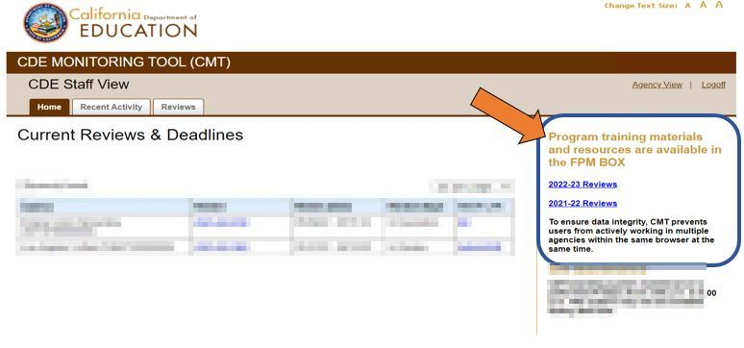
CMT Link To FPM Box
Notes:
Slide Title: CMT Link to FPM Box
Once logged into the CDE Monitoring Tool, please note the FPM Box feature. Below is the link for your convenience.
https://cde.app.box.com/v/fpmtraining2223

Slide 48
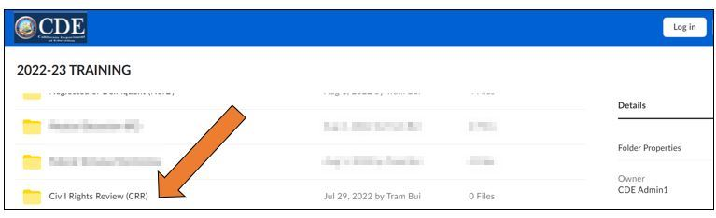
Helpful Tips: FPM Box
Notes:
Slide Title: Helpful Tips: FPM Box
Once inside the FPM Box you will find the Civil Rights Review (CRR) folder. This folder contains several documents and samples which will assist you with your Civil Rights Review. Please use the samples that have been posted as they will assist you in receiving fewer findings of noncompliance or perhaps no findings at all.
This PowerPoint presentation, as well as an in depth version titled 2022-23 Civil Rights Review Training for MOA, FAQs, the 2022-23 Civil Rights Review Program Instrument and several other resources will be placed in the FPM Box.

Slide 49
Contact Information
Civil Rights Program Office
Office of Equal Opportunity
CA Department of Education
1430 N Street, Suite 4206
Sacramento, CA 95814
Email: OEOCRR@cde.ca.gov
Notes:
Slide Title: Contact Information
This is the office’s main contact information, with our office's email address.

Slide 50
Thank you
Notes:
Slide Title: Thank you

