Slide 1
This webinar will begin shortly.
There will be no audio until the webinar begins at 10:00 AM.
Thank you for your patience.

Slide 2
Webinar on COVID-19 Guidance for
Early Learning and Care Contractors
Early Learning and Care Division and
Fiscal and Administrative Services Division
Date: June 18, 2021
Time: 10:00 AM – 11:00 AM

Slide 3

Welcome and Introductions

Slide 4
Meeting Agenda
Introduction and Welcome
Policy Updates
Transition-related Guidance
Program Quality Implementation (PQI) Update
Fiscal Updates
Appeals
Questions
Closing

Slide 5
Budget Update
Legislative version of the budget (Assembly Bill 128) currently on the Governor's desk
Negotiations ongoing with the Governor and the Legislature
The California Department of Education (CDE) is waiting for the budget to become law. As a result, full guidance around the following is not yet available:
  Reimbursement Rates
  Distance Learning
  Hold Harmless
  Family Fees

Slide 6
Transition-Related Guidance
Joint transition guidance from the CDE and the California Department of Social Services (CDSS)
Initial transition guidance released on June 16:
  Funding Terms and Conditions and Program Requirements
  12-Month Eligibility
  Licensing
  Fiscal Year 2021–22 Contracts
  Consultant Directories
Upcoming Guidance

Slide 7
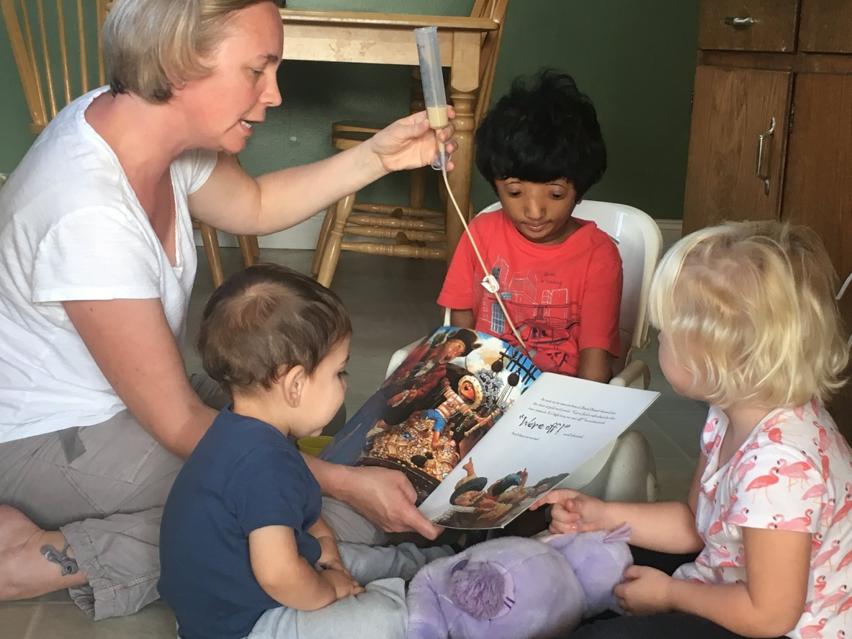
Program Quality Implementation (PQI) Update
“You are Our Heroes” participation
Emails and phone calls
End-of-year data
Consultant caseloads
Photo Credit: Jacobson Family Child Care; Camarillo, CA

Slide 8
Fiscal Updates – Reserve Accounts
2020–21 Reserve Accounts
  Calculation for all Reserve Accounts remain unchanged
  All Reserve Account Activity Reports will be available in the Child Development Provider Accounting Reporting Information System (CPARIS)
2021–22 Reserve Account Updates
  No need to spend Reserve Account funds by June 30, 2021
  Transition Trailer Bill language has potential changes to Reserves:
    Both Preschool and Child Development Contractors will be allowed Reserve Accounts equal to 15 percent of the sum of applicable Maximum Reimbursable Amounts or $2,000; whichever is greater
    Removes the 10 percent professional development requirement for Direct Service Reserve Accounts
  If changes are made in 2021–22, they will not impact 2020–21

Slide 9
Fiscal Updates – Emergency Childcare Augmentations
Alternative Payment (CAPP) contractors were emailed around April 9 regarding a FY 2020–21 augmentation/amendment for Emergency Childcare
By today, CAPP contractors will receive an email about an Advanced Apportionment for these Emergency Childcare funds
  Represents 40.8 percent of the funds received in the recent augmentation
  Ensures contractors have cash on hand to timely reimburse providers in order to continue currently enrolled Emergency Childcare families
  Ensures contractors have cash on hand to timely reimburse providers for the enrollment of new Emergency Childcare families

Slide 10
Fiscal Updates – Analyst Assignments
Current Fiscal Analyst Assignments have been updated
  Child Development and Nutrition Fiscal Services (CDNFS) Fiscal Apportionment Analyst Directory: https://www.cde.ca.gov/fg/aa/cd/faad.asp
  Visible in CPARIS
2021–22 Fiscal Analyst Assignments
  Only one fiscal analyst during the first quarter of 2021–22
  After the first quarter, CDNFS analyst assignments for CDE and CDSS contracts will be visible in CPARIS as well on our department web pages

Slide 11
Parent Appeals
No change to the California State Preschool Program (CSPP) appeal process
Parents can continue to submit a CSPP appeal to ELCDAppeals@cde.ca.gov or by fax at 916-323-6853

Slide 12

Questions
Photo Credit: Lighthouse for Children CDC; Fresno, CA

Slide 13
Resources
The ELCD COVID-19 Guidance web page
  https://www.cde.ca.gov/sp/cd/re/elcdcovid19.asp
  Webinar slides, MBs, Frequently Asked Questions (FAQs)
The ELCD Emergency email inbox
  ELCDEmergency@cde.ca.gov
The PQI Office Regional Consultants
  https://www.cde.ca.gov/sp/cd/ci/assignments.asp
  Consultants are most easily reached by email
  or by phone at 916-322-6233

Slide 14

Closing
Photo Credit: Lighthouse for Children CDC; Fresno, CA

