Slide 1
California Preschool Data Collection (CAPSDAC) Demonstration and Q&A
Applied Data Research and Evaluation Office (ADRE)
California Department of Education (CDE)
Date: June 11, 2024
Time: 10 a.m. – 11:30 a.m.

Slide 2
Agenda
CAPSDAC Data Submission Information Survey
CAPSDAC Staff Roles
CAPSDAC Classroom Language Characteristics
CAPSDAC: Statewide Educator Identifier (SEID) FAQs
Preschool County-District-School (CDS) Codes and Pre-populated California State Preschool Program (CSPP) Sites in CAPSDAC
CAPSDAC Demonstration
Question and Answer

Slide 3
CAPSDAC Data Submission Information Survey
The CAPSDAC Support Team has launched a survey to collect information from LEAs that operate a CSPP on anticipated data submission practices for the CAPSDAC
This survey has items including:
  How agencies plan to submit the Monthly Data Submissions to the CAPSDAC (Manual Input, Electronic File Upload, Copy Forward)
  If using Electronic File Upload and using a software vendor, which software vendor your agency uses
  Preferred technical assistance
  Role of staff that will be responsible for submitting the CAPSDAC Monthly Data Submission
This survey must be completed by Friday, June 14, 2024
  https://surveys3.cde.ca.gov/go/capsdacdatasubmission.asp

Slide 4
CAPSDAC Staff Role Updates − Teacher
For the CAPSDAC Monthly Data Submission, in the Staff Records, only enter data for staff meeting one of the following definitions:
  Teacher: The teacher means a person with the appropriate permit or credential issued by the California Commission on Teacher Credentialing (CTC) who is designated as an instructor and is responsible for the management, curriculum implementation, and daily operations of a specific classroom. This individual oversees the educational activities, supports other classroom staff, and ensures that the learning environment meets established standards and goals.

Slide 5
CAPSDAC Staff Role Updates − Aide
In addition to Staff classified as Teachers, please also report Aides:
  Aide: An individual specifically designated to assist within a classroom. This aide provides direct support to the classroom teacher and students, contributing to the educational and developmental goals of the classroom. The assigned aide may help with instructional activities, classroom management, and addressing the needs of individual students, ensuring a conducive learning environment.
Only teachers and aides funded by CSPP must be included in the CAPSDAC Monthly Data Submission

Slide 6
CAPSDAC Classroom Language Characteristics
To align with identified Staff Roles, the Classroom Languages Used and Languages Proficient have been updated to:
  Language(s) Used – Teacher(s)
  Language(s) Proficient – Teacher(s)
  Language(s) Used – Aide(s)
  Language(s) Proficient – Aide(s)
Only consider the language characteristics of Teachers and Aides entered in the CAPSDAC Monthly Data Submission
All corresponding documentation will be update accordingly; please ensure you are using templates with updated headers

Slide 7
SEID FAQs
Where can I find the SEID for staff within our LEA?
  The SEID is typically accessed by authorized personnel within the LEAs Human Resources (HR) department through the CTC SEID Lookup Tool within the Educator Credentialing System (ECS), https://ecsorganizations.ctc.ca.gov/Account/Login?ReturnUrl=%2FSEIDLookup.
Do all staff members need to have SEIDs?
  No, not all staff members are issued SEIDs by the CTC. SEIDs are issued by CTC to all certificated staff (teaching and non-teaching) that have a valid application or hold a valid certificate, permit or credential maintained by CTC. Certificated staff are individuals that provide educational services including teachers, administrators, counselors, librarians, nurses, speech therapists, and others.
  You can find further information regarding the SEID and access on the SEID FAQ page of the CTC, https://www.ctc.ca.gov/credentials/assignment-resources/SEID-FAQs.

Slide 8
Preschool CDS Codes
LEA operated CSPP have been issued CDS codes. They will be accessible on the CAPSDAC system.
  There is no action needed on the part of the LEA.
New LEA operated CSPP sites will need to obtain a CDS code.
  Additional guidance will be released on this process.

Slide 9
Pre-populated CSPP Sites in CAPSDAC (1)
CAPSDAC users will be able to download their LEA's Site List along with the corresponding CDS codes directly from the system. This feature is accessible through a report titled "Information (including CDS Code) for each preschool site within this LEA."
Users will have the flexibility to select sites when manually adding records for the monthly submission. The overview window will automatically populate the selected site's name and corresponding CDS code, ensuring accuracy and efficiency in data entry.

Slide 10
Pre-populated CSPP Sites in CAPSDAC (2)
The user's LEA Site List in CAPSDAC, along with the corresponding CDS codes, is prepopulated based on the site information currently in the Child Development Management Information System (CDMIS).
  LEA Action Needed: LEAs will need to review their current site information in CDMIS for any inaccuracies and ensure that all sites are up-to-date.
    If the information is incorrect in CDMIS, it will also be incorrect in the prepopulated sites with CDS codes in CAPSDAC, which can lead to errors and delays in data submission.
    Also, the CDE will compare the CDMIS site list and the CDS preschool list to consolidate. If corrections are needed the CDE will make the corrections and inform contractors and their PQI consultants.

Slide 11
CAPSDAC Accounts
CAPSDAC user accounts will be created for LEAs in the last two weeks of June.
Two accounts will be created for each LEA:
  The Executive Director will have an LEAAdmin account.
  The Program Director will also have an LEAAdmin account.
  Both the Executive Director and the Program Director will be able to create AppUser accounts for LEA-designated personnel.
  After receiving an email regarding account creation with a default password, users will need to create a new password during their initial login.
  Once your account is established, we recommend reviewing every site listed for accuracy.

Slide 12
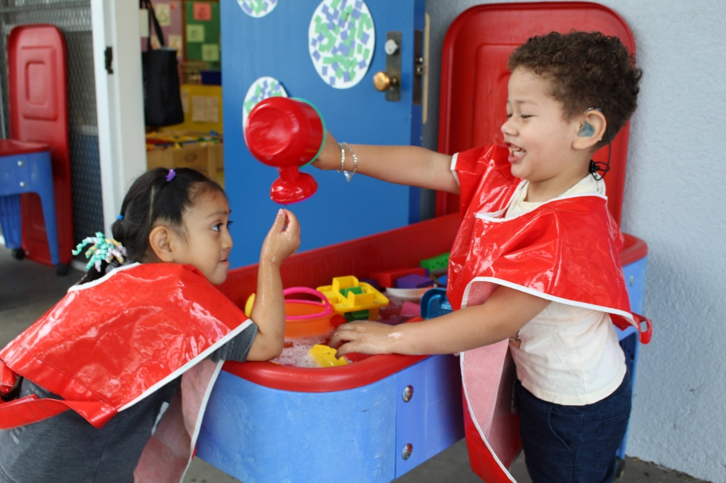
CAPSDAC 1.0 – Demonstration
Live Demonstration:
During this portion of the webinar, a staff member will share their web browser to showcase the CAPSDAC Online Portal and the Manual Entry, Copy Forward, and Electronic File Data Submission options.
Photo Credit: Breed St. Elementary, Deaf & Hard of Hearing Program

Slide 13

Questions and Answers
Photo Credit: Kidango Decoto Center; Union City, CA

Slide 14
Thank you!

