Slide 1
Child Development Management Information System (CDMIS) Webinar
Applied Data Research and Evaluation Office , Early Education Division, California Department of Education
July 15, 2025, 2 to 3:30 p.m.

Slide 2
Agenda
CDMIS Monthly Population Report (801A) Update Reminder
  Update to Family, Child, and Provider Fields in Fiscal Year (FY) 2025–26
  What's New in the 801A Report Interface?
801A Electronic File Upload: Updated Template Walkthrough
Updated Reporting Schedule for April, May and June 2025 801A Reports
Reporting Schedule for FY 2025–26
Temporary CDMIS Site Closure Announcement
Resources and Contact Information
Questions and Answers

Slide 3
Update to Family Fields in
FY 2025–26 801A
New Fields:
  Head-of-Household Address 1, Head-of-Household Address 2, Head-of-Household City, Head-of-Household State
  California Work Opportunity and Responsibility to Kids (CalWORKs) Recipient
  Reason for Needing Service

Slide 4
Update to Family Fields in
FY 2025–26 801A (2)
Removed Fields:
  Temporary Assistance for Needy Families (TANF)/CalWORKS Cash Aid Recipient?
  Family Income Greater Than 85 Percent of the State Median Income
  Reason for Receiving Child Care

Slide 5
Update to Child Fields in FY 2025–26 801A
New Fields:
  Is Child Receiving Extended Learning and Care?
  Child's Eligibility
  Is Child Enrolled in a Department of Social Services Program?
  Is Child Enrolled in a Head Start Program?
Removed Fields:
  Child's Primary Language
  Child is an English Learner
Updated Fields:
  Child's Gender
  Child has an Individualized Education Program (IEP) or Individualized Family Service Plan (IFSP)

Slide 6
Update to Provider Fields in FY 2025–26 801A
New Fields:
  Is this Provider License-Exempt? and Provider License Number
  Provider Address 1, Provider Address 2, Provider City, Provider State
Removed Fields:
  Provider Federal Employer Identification Number (FEIN) or Social Security Number (SSN)
  Program Code 1, Program Code 2, Program Code 3
  Attendance Status 2 and Attendance Status 3
Updated Fields:
  Type of Childcare
  Attendance Status

Slide 7
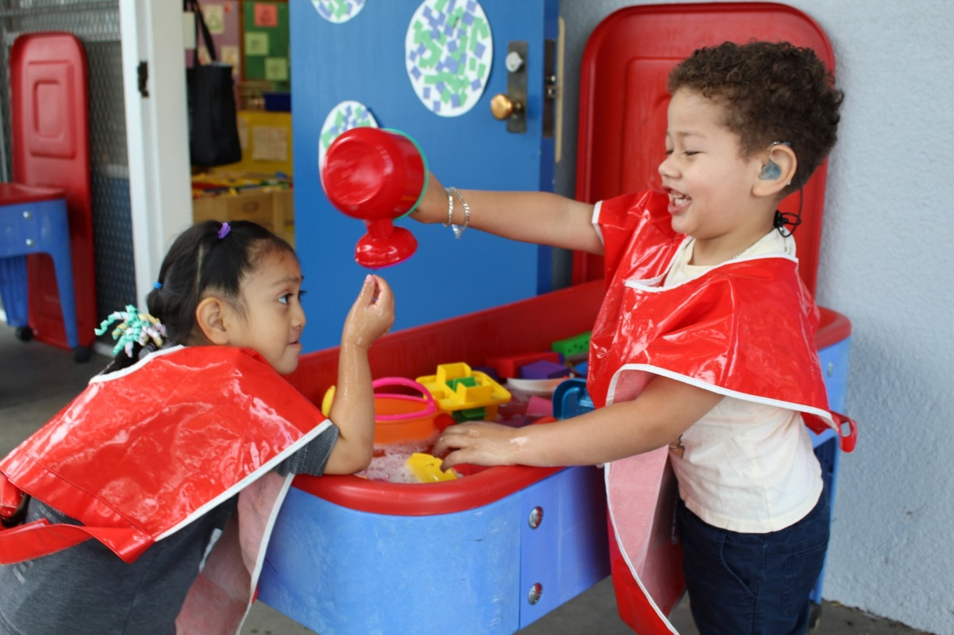
What’s New in the 801A Report Interface?
Live Demonstration:
A team member will share their screen to walk through recent changes to the 801A report’s manual entry screen, including layout updates, new fields, and revised data entry guidance.
Photo Credit: Breed St. Elementary, Deaf & Hard of Hearing Program

Slide 8
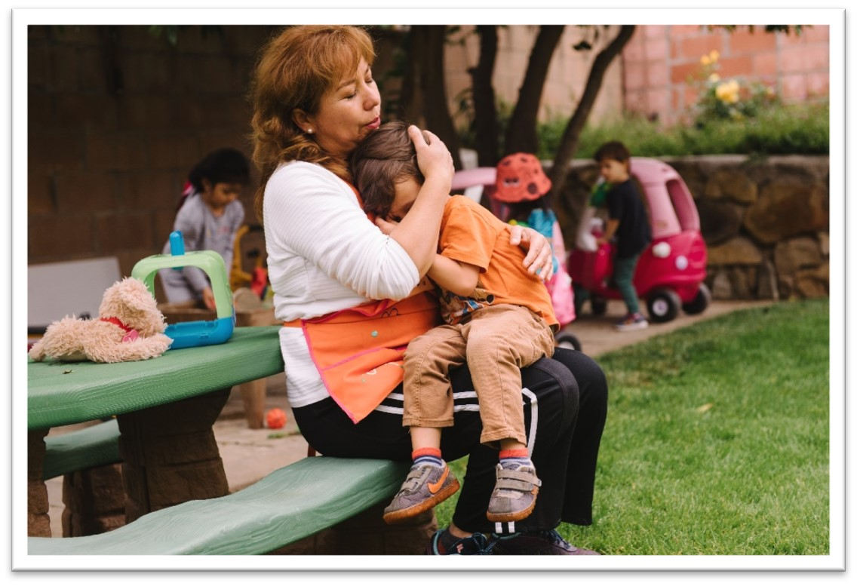
801A Electronic File Upload: Updated Template Walkthrough
Live Demonstration:
A team member will share their screen to review the updates made to the 801A Electronic File Template and demonstrate how to use the file to upload child enrollment records into the system.
Photo Credit: Trauma Informed Care Module

Slide 9
Updated Reporting Schedule for April, May, and June 2025 801A Reports
Report Period | Report Due Date | Report Lock Date (Updated)
April 2025 801A | May 20, 2025 | July 31, 2025
May 2025 801A | June 20, 2025 | July 31, 2025
June 2025 801A | July 21, 2025 | July 31, 2025

Slide 10
801A Reporting Schedule for FY 2025–26
801A Report Period | Report Due Date | Report Lock Date
July 2025 | August 20, 2025 | January 20, 2026
August 2025 | September 22, 2025 | January 20, 2026
September 2025 | October 20, 2025 | January 20, 2026
October 2025 | November 20, 2025 | April 20, 2026
November 2025 | December 22, 2025 | April 20, 2026
December 2025 | January 20, 2026 | April 20, 2026
January 2026 | February 20, 2026 | July 21, 2026
February 2026 | March 20, 2026 | July 21, 2026
March 2026 | April 20, 2026 | July 21, 2026
April 2026 | May 20, 2026 | October 20, 2026
May 2026 | June 22, 2026 | October 20, 2026
June 2026 | July 21, 2026 | October 20, 2026

Slide 11
Temporary CDMIS Site Closure Announcement
To make the updated 801A Report changes for FY 2025–26 in the CDMIS, the CDMIS will be shut down and will not be available to users from 4:00 p.m. on July 31, 2025, through August 3, 2025.
The CDMIS will be available again by 8:00 a.m. on August 4, 2025.
If there are any changes to this schedule, we will notify all active CDMIS users by email as soon as possible.

Slide 12
Resources and Contact Information
CDMIS Technical Assistance Inbox:
  CDMIS@cde.ca.gov
CDMIS Support Web Page:
  https://www.cde.ca.gov/sp/cd/ci/main.asp
CDMIS Site:
  https://www4.cde.ca.gov/cdmis
12

Slide 13

Questions and Answers
Photo Credit: Kidango Decoto Center; Union City, CA

Slide 14
Thank you!

