Slide 1
California Preschool Data Collection (CAPSDAC) Contractor Training Webinar
Applied Data Research and Evaluation Office
California Department of Education (CDE)
Date: December 11, 2025
Time: 10:00am – 11:30 a.m.

Slide 2
Agenda
CAPSDAC 2.0 Data Domains and Fields Updates
Beta 2 Testing Announcement
Upcoming Webinar Schedule
CAPSDAC Resources
Question and Answer Session

Slide 3
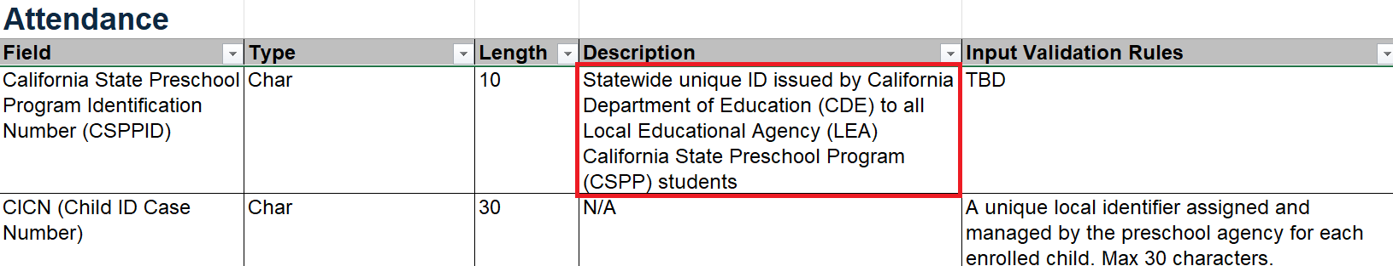
CAPSDAC 2.0 Data Domains and Fields Updates (1):
Attendance Domain Definition
Updated the California State Preschool Program Identification number (CSPPID) variable description in the ‘Attendance’ domain to align with the definition used across the other tabs in the CAPSDAC Data Domains and Fields document.

Slide 4
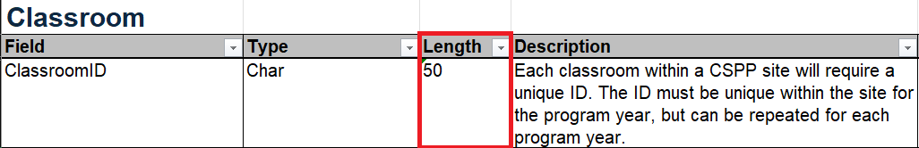
CAPSDAC 2.0 Data Domains and Fields Updates (2):
ClassroomID Character Limit Update
Updated ‘ClassroomID’ input validation rules maximum character count to 50 to align with CAPSDAC 1.0 across Classroom (CLRM), Classroom Enrollment (CLEN), and Staff Classroom Enrollment (SCLR).

Slide 5
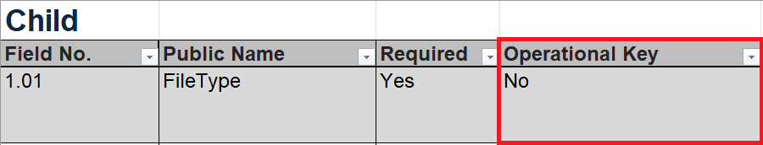
CAPSDAC 2.0 Data Domains and Fields Updates (3): Operational Keys
Added the Operational Key variable to each domain to support consistent identification and alignment across records.
  Operational Key Definition: The set of fields that identify the record or records via batch to be processed depending on the type of processing associated with the record type

Slide 6
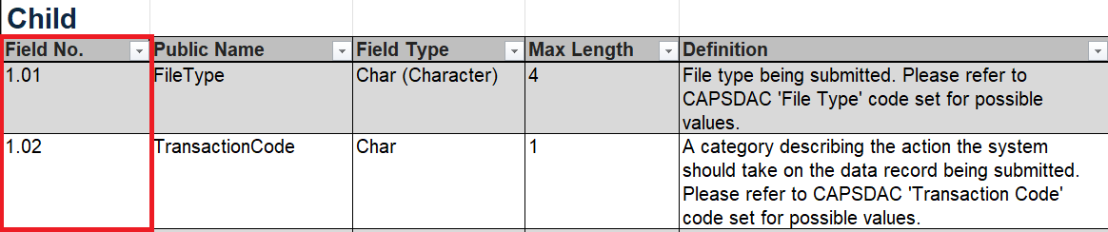
CAPSDAC 2.0 Data Domains and Fields Updates (4): Field Numbers
Aligned the CAPSDAC Data Domains and Fields document with CALPADS by adding a Field Number column at the start of each domain to match the CALPADS File Specifications.

Slide 7
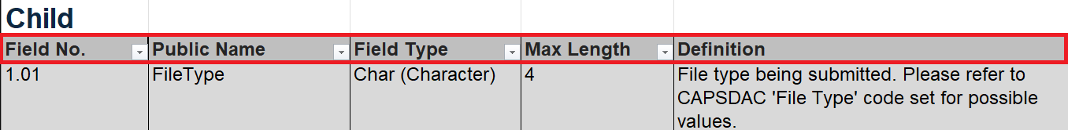
CAPSDAC 2.0 Data Domains and Fields Updates (5): Field Titles
Updated field titles in the CAPSDAC Data Domains and Fields document to align with the CALPADS File Specifications for improved consistency across documentation.

Slide 8
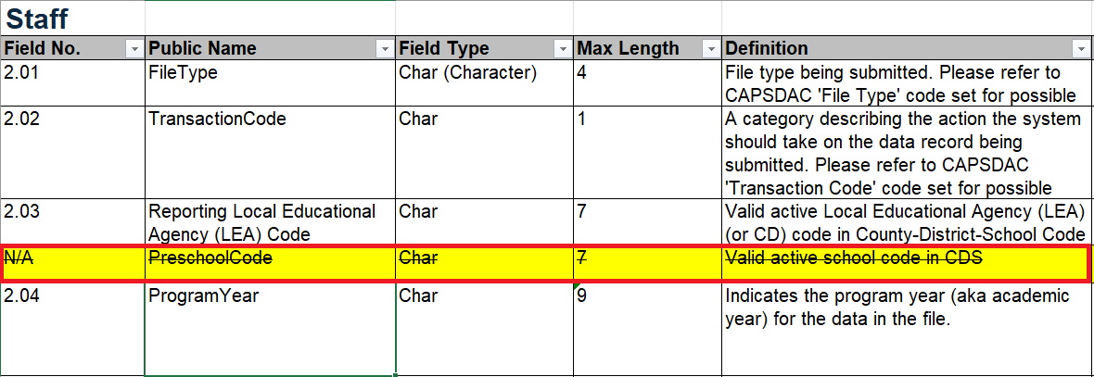
CAPSDAC 2.0 Data Domains and Fields Updates (6):
Staff Domain – Preschool CDS Code
Updated the CAPSDAC Data Domains and Fields document by removing the ‘PreschoolCode’ field from the Staff domain, with this change expected to be rolled out to the test environment sometime next week.

Slide 9
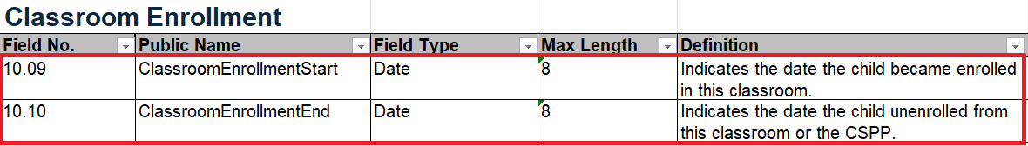
CAPSDAC 2.0 Data Domains and Fields Updates (7):
Classroom Enrollment Dates
Updated the CAPSDAC Data Domains and Fields document by adding Classroom Enrollment Start Date and Classroom Enrollment End Date fields to the Classroom Enrollment domain with this change expected to be rolled out to the test environment sometime next week.

Slide 10
Beta 2 User Testing Announcement
Timeline
  Start: February 20, 2026
  End: May 14, 2026
  Duration: ~ 3 months
What Users Will Do
  Test manual data entry
  Continue testing electronic file upload
Access
  Call for Beta 2 testing volunteers
  If you are Beta 1 testing volunteers, you will continue have the access to CAPSDAC Bata 2 release
  If you do not have the access to Beta 1 and wish to test Beta 2, please email CAPSDAC@cde.ca.gov by February 9, 2026

Slide 11
Upcoming Webinar Schedule
January 6, 2026 (Tentative)
February 3, 2026 (Tentative)
March 17, 2026 (Tentative)

Slide 12
CAPSDAC Resources
Resources
CAPSDAC Online Portal: https://www.capsdac.org/
CDE CAPSDAC Support web page: https://www.cde.ca.gov/sp/cd/ci/capsdacsupportlanding.asp
CAPSDAC Customer Support Training PowerPoint Slide Deck and Training Video have been posted on the CDE CAPSDAC Customer Support Resource Page: https://www.cde.ca.gov/sp/cd/ci/capsdacportalsupport.asp
Individual or small group training can be provided by the CDE CAPSDAC Support Team upon requests

Slide 13

Question and Answer Session
Photo Credit: Kidango Decoto Center; Union City, CA

Slide 14
Thank you!

