Slide 1
Webinar on COVID-19 Guidance for
Early Learning and Care Contractors
Early Learning and Care Division and
Fiscal and Administrative Services Division
Date: March 19, 2021
Time: 10:00 AM – 11:00 AM

Slide 2

Welcome and Introductions

Slide 3
Meeting Agenda
Introduction and Director's Welcome
Policy Update
Fiscal Update
Program Quality Implementation Update
Overview of Vaccination Public Information Notice and Cohort Guidance with California Department of Social Services (CDSS)
Questions
Closing

Slide 4
Upcoming Guidance
Extension of Emergency Childcare Services, and New Enrollments in Emergency Childcare Services for Essential Workers and At-Risk Populations
Reimbursement and Data Collection Requirements for Alternative Payment Programs and Providers; Non-Operational Days for Closures Related COVID-19
Reopening and Reimbursement Requirements for Direct Service Contractors; Non-Operational Days for Closures Related to COVID-19

Slide 5
American Rescue Plan Act (ARPA)
On March 11, 2021, President Biden signed the American Rescue Plan Act.
The Center for Law and Social Policy (CLASP) estimates California will receive $3.8 billion
Funds must be obligated by the end of September 2023; liquidated by the end of September 2024
States may use funds to help:
  low-income families afford childcare
  provide childcare assistance to essential workers regardless of income
  help providers reopen and cover past pandemic-related expenses
  pay operating costs

Slide 6
Fiscal Update: Status of Coronavirus Response and Relief Supplemental Appropriations Act (CRRSA)
In early February 2021, California was awarded $964 million in federal Child Care and Development Fund (CCDF).
Assembly Bill (AB) 82 appropriated $402 million in fiscal year (FY) 2020–21 for the following:
  Extension of Emergency Childcare
  New Emergency Childcare Enrollments
  $525 Per-Child Stipends
The State Controller's Office (SCO) has not made these funds available to the California Department of Education (CDE)

Slide 7
Fiscal Update: Alternative Payment Amendment
Combined Amendment to be sent in early or mid-April
A single Alternative Payment (CAPP) amendment will contain:
  $76 million Emergency Childcare Extension (CRRSA)
  $80 million New Slots for Emergency Childcare (CRRSA)
  $21.486 million New Slots (Prop 64)
  Any Non-Op Reimbursements (CARES)
  Additional Augmentations for Paying at Maximum Certified Hours (CARES)
  Extend period of performance for all CAPP contracts

Slide 8
Fiscal Update: Stipend Allocations
Flat-rate stipend amount of $525 per child enrolled in a subsidized program will be issued in April
Eligible Contract types: CalWORKs Stage 2 (C2AP) and 3 (C3AP), Alternative Payment Program (CAPP), Migrant Alternative Payment Program (CMAP), General Childcare (CCTR), Children with Severe Disabilities (CHAN), Migrant Childcare (CMIG), California State Preschool (CSPP), and Family Childcare Home Networks (CFCC)
Stipend allocations are based on November 2020 enrollment
Contractors will be provided with a 5 percent administrative cost allocation

Slide 9
Fiscal Update: Stipend Allocation Guidance
The CDE will release more detailed guidance in the upcoming week
Use of stipend funds may include:
  Hazardous pay for employees, if contractors follow relative federal regulations
  Mental health services
  Salaries and benefits
  Equipment and supplies
  Any allowable expense that would be reimbursable under an agency’s existing child development contract to address COVID-19 costs or to ensure the programs are able to remain open or reopen

Slide 10
Program Quality Implementation Update
FY 2020–21 Program Self-Evaluation (PSE)
  The management bulletin will be released soon
  The PSE will be submitted to the CDE in the form of a multiple-choice survey
  Training will be provided on completing the PSE – tentative date Wednesday, April 14, at 10:00 a.m.
  Due date for the PSE is Tuesday, June 1, 2021

Slide 11
Program Quality Implementation Update (2)
Program Self-Evaluation (PSE) Web Page will contain:
PSE Management Bulletin
Link to the multiple-choice survey
List of the multiple-choice questions
Environment Rating Scale (ERS) Self-Certification During a Pandemic
Frequently Asked Questions

Slide 12
Federal Disaster Relief Grant
One-time funding: Supplemental Disaster Relief Act of 2019 (Public Law-116-20)
2018 FEMA-declared disasters in affected ZIP code areas (fires)
Total Amount $2,596,560
Licensed and non-licensed providers can apply for between $1,000 - $25,000
Non-COVID-19 related - will not pay for costs paid for by Federal Emergency Management Assistance (FEMA) or insurance
Request for applications available at: https://www.cde.ca.gov/fg/fo/r2/disasterreliefrfa.asp [Link no longer available]

Slide 13
Vaccinations – Childcare Sector
Vaccination prioritization under phase 1B for “Education Workers,” which includes the Childcare Sector, are currently eligible to access and receive a COVID-19 vaccine.
Child Care Licensing Program released Provider Information Notice (PIN) for Child Care Providers (CCP) PIN 21-06-CCP with information and Frequently Asked Questions regarding vaccines for childcare workers.
A resource Toolkit (one-page) outlining availability of vaccine clinics is on the licensing COVID-19 Resource webpage.

Slide 14
Vaccinations – Childcare Sector (2)
Child Care vaccine codes help to open access in areas of need determined by the California Healthy Places Index (HPI)
These individualized accessibility codes allow for direct access via the California My Turn website
Codes will be distributed to providers via partner agencies:
  Child Care Resource and Referral Offices (Local R&Rs)
  Child Care Providers United

Slide 15
Vaccinations – Child Care Sector (3)
Vaccine accessibility codes are just one of many avenues for access. Accessibility for all via My Turn is improving each day.
For the latest information on California vaccination efforts, visit the state vaccine website or contact your local Public Health Department.
CCLD Licensing COVID-19 Inbox
  cclcovid19info@dss.ca.gov

Slide 16
Vaccinations – Childcare Sector (4)
Find the Vaccine Toolkit and other resources by visiting the Child Care Licensing Program on the COVID-19 Resource web page

Slide 17
Updated Cohort Guidance
Providers located in counties in the widespread (purple) risk level must follow the Guidance for Small Cohorts/Groups of Children and Youth
For all other tiers, please follow the COVID-19 Child Care Industry Guidance for group size
  Children should remain in groups as small as possible and keep the same children and staff together in the same group
Cohorts should be six (6) feet apart from each other
If a local ordinance requires providers to provide care within smaller groups, providers must follow the stricter local requirement

Slide 18
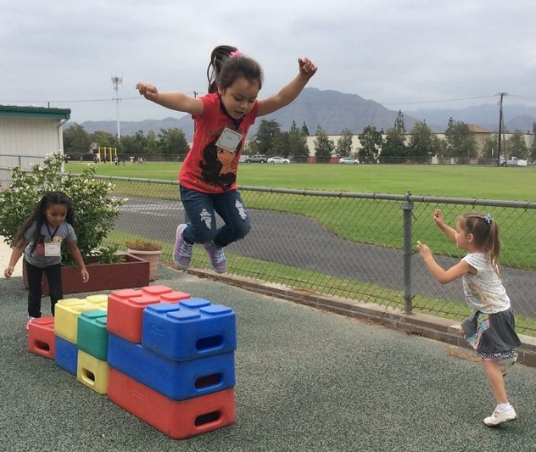
Questions
Photo Credit: UPS Preschool at CSU Channel Islands; Camarillo, CA

Slide 19
Resources
The ELCD COVID-19 Guidance web page
  https://www.cde.ca.gov/sp/cd/re/elcdcovid19.asp
    Webinar slides, MBs, Frequently Asked Questions (FAQs)
The ELCD Emergency email inbox
  ELCDEmergency@cde.ca.gov
The PQI Office Regional Consultants
  https://www.cde.ca.gov/sp/cd/ci/assignments.asp
    Consultants are most easily reached by email
    or by phone at (916) 322-6233

Slide 20
Resources (2)
The Child Care Licensing Program website ‘COVID-19 Resource Page’
  https://www.cdss.ca.gov/inforesources/cdss-programs/community-care-licensing/child-care-licensing/covid-19-child-care-resources
  Health and Safety COVID-19 Inbox
  cclcovid19info@dss.ca.gov

Slide 21

Closing
Photo Credit: American River College Child Development Center; Sacramento, CA

