Slide 1

Paving the Way for English Learners with the California English Learner Roadmap
Presentation for School, District, and County Leadership
California Department of Education (CDE)
English Learner Support Division
Updated February 2019
Notes:
[Handouts required: either the CA EL Roadmap printable document or the CA EL Roadmap Policy. Both are available at https://www.cde.ca.gov/sp/ml/rmpolicy.asp. If using the CA EL Roadmap Policy, participants will also need access to internet-capable devices so that they can access the CA EL Roadmap elements at https://www.cde.ca.gov/sp/ml/rmprincipleone.asp and the Crosswalk to the Local Control and Accountability Plan at https://www.cde.ca.gov/sp/ml/rmprinciplepriority.asp . This information is included in the printable document so no separate handout is required if using that document. Finally, copies of the Self-Reflection available at https://www.cde.ca.gov/sp/ml/rmresources.asp are needed]
[Other needs: speakers and internet connection to play included videos. Chart paper and markers are recommended for group discussions]
[Total presentation time: 2 hours and 30 minutes. This presentation can be extended with optional embedded extensions indicated in presenter talking points if time allows]
[1 minute]
My name is __________[name] and I am a ______________ [title] at __________ [affiliation].
This presentation is titled, “Paving the Way for English Learners with the California English Learner Roadmap.” The information in this presentation comes from the English Learner Support Division at the California Department of Education.
Today I will provide an overview of and updates on the California English Learner Roadmap.
[Click to advance to next slide]

Slide 2
Outcomes
To understand the context of the English Learner (EL) Roadmap Policy
To become familiar with the policy and its principles
To understand how the EL Roadmap Policy connects to the Local Control and Accountability Plan (LCAP)
To understand the development process, organization, and purpose of the Guidance Document and Web-based Resources
To reflect on your role in the implementation process and assess your local educational agency’s (LEA’s) progress and next steps
Notes:
[2 minutes]
The outcomes for this session are:
To understand the context of the English Learner, or EL, Roadmap Policy
To become familiar with the policy and its principles
To understand how the EL Roadmap Policy connects to the Local Control and Accountability Plan, or LCAP
To understand the development process, organization, and purpose of the Guidance Document and Web-based Resources
To reflect on your role in the implementation process and assess your local educational agency’s, or LEA’s, progress and next steps
[Click to advance to next slide]

Slide 3

Welcome!
Please take a moment to share with your table group:
  Your name and role
  Why is learning about the EL Roadmap important to your work?
Notes:
[6 minutes]
Please take a moment to introduce yourself to the other people at your table and discuss why learning about the EL Roadmap is important to your work.
[Click to advance to next slide]

Slide 4
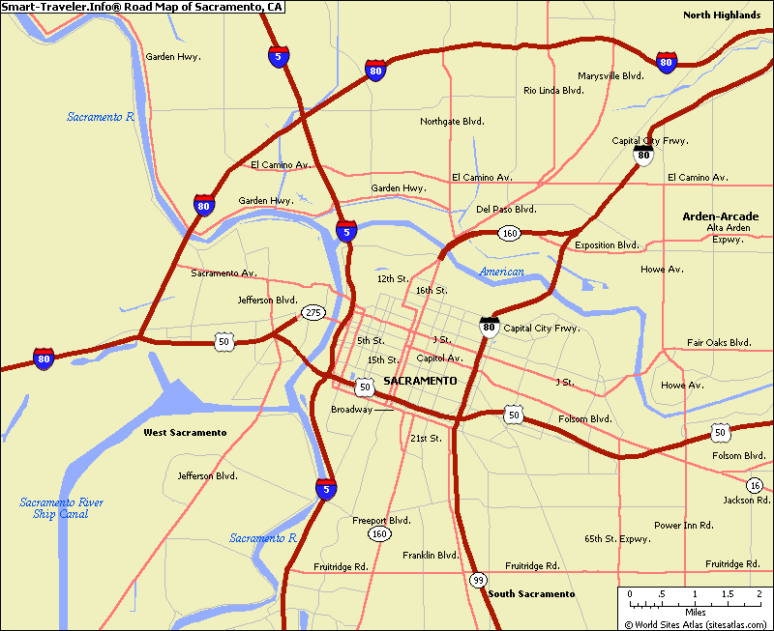
Why a Roadmap?
Over 1.2 million English learners in California’s schools
Systems of support
Helps schools meet new state and federal standards
Helps equip students with twenty-first century skills
Notes:
[2 minutes]
Let’s discuss why we need the EL Roadmap.
In the 2017–18 school year, California had more than 1.2 million students who were classified as English learners. That is one in every four public school students statewide.
We need to provide systems of support to English learners, schools, and parents so that English learners have access to the curriculum and feel supported at school. We must provide the support needed to ensure that English learners have the same opportunities as English-only students.
We are all on the road of continuous improvement. The California EL Roadmap is a map to get there.
The California EL Roadmap Policy not only helps schools and districts meet the academic standards, it also helps them equip students with the twenty-first century skills necessary to succeed in college and career, and prepares them to participate in our global society.
[Click to advance to next slide]

Slide 5
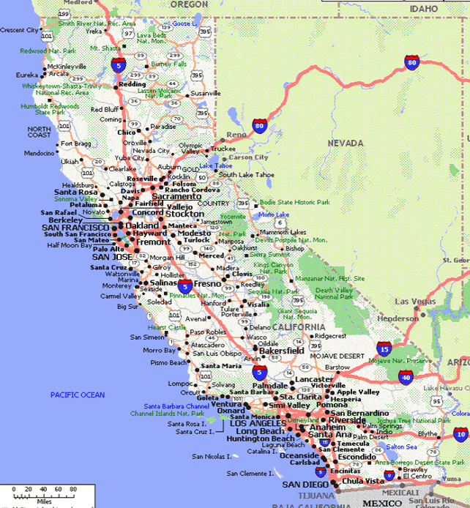
EL Roadmap Purpose
Desire for more aspirational, inspirational vision
EL Roadmap needed to “move the needle” in EL programs and services
Definite need for a guidance document, tools, crosswalks to other documents and legal citations, and to the LCAP
Notes:
[2 minutes]
With all of the recent changes in programs and services for English learners, it was time to develop a cohesive direction and a common aspirational, inspirational vision.
The goal was to pull from current research and practice to set a course for innovation in serving English learners, thus “moving the needle” on EL programs and services.
The goal was to create these resources in collaboration with the field, including the guidance document, tools, and crosswalks to other documents and legal citations, including the LCAP.
[Click to advance to next slide]

Slide 6

Historical Perspective
New English Language Development (ELD) Standards Adopted
CA State Seal of Biliteracy established
Era of English-only research, policy, and accountability
2012
CA EL Roadmap Policy approved
Lau v. Nichols
1990s
National Literacy Panel on
Language Minority
Children and Youth
Every Student Succeeds Act
1974
Castañeda v. Pickard
1981
2017
2006
2015
2010
1976
CA Common Core State Standards (CCSS)
2001
2016
CA Bilingual-
Bicultural Act
CA Education for a Global Economy Initiative (Proposition 58) passed
1998
No Child Left Behind
Proposition
227
2014
Era of building programs, practices, and approaches
The CA English Language Arts/ ELD Framework is adopted
Notes:
[6 minutes]
This image shows a timeline of events in EL education.
In 1974, the court case Lau v. Nichols established that not providing specific language support to English learners violated their civil rights. The 1974 decision paved the way for the 1976 California Bilingual-Bicultural Act, which made bilingual education a right for English learners.
These two developments ushered in the era of building bilingual programs, practices, and supports.
In 1981, the United States Court of Appeals, 5th Circuit, heard an appeal and ruled in favor of the Castañedas, establishing a three pronged approach for assessing bilingual programs. The criteria are:
The bilingual education program must be “based on sound educational theory,”
The program must be “implemented effectively with resources for personnel, instructional materials, and space,” and
After a trial period, the program must be proven effective in overcoming language barriers.
In the 1990s, pushback to bilingual education ushered in an era of English-only research, policy, and accountability. This culminated in 1998 with the passage of Proposition 227, also known as the English in Public Schools Initiative, which stated that instruction to English learners must be provided overwhelmingly in English.
In 2001, No Child Left Behind came into effect and, along with Proposition 227, lead to English-only research, policy, and accountability.
In 2006, the tide began to turn when the National Literacy Panel on Language Minority Children and Youth released its report, finding that literacy in the home language corresponds to literacy in English for English learners.
In 2010, the California Common Core State Standards, or CCSS, were adopted. In 2012, the new English Language Development, or ELD, Standards and the State Seal of Biliteracy were both adopted. This was followed by the California English Language Arts, or ELA,/ELD Framework in 2014 and the Every Student Succeeds Act in 2015.
In November of 2016, the California Education for a Global Economy, or California Ed.G.E., Initiative was passed by 73 percent of voters in California. This initiative repealed parts of Education Code established by Proposition 227, including the requirement that instruction for English learners must be overwhelmingly in English, thus making way for more multilingual programs.
Finally, in 2017, the California EL Roadmap Policy was approved, which brings us to the present day when the California EL Roadmap guidance document is available and the policy is in its implementation phase.
[Click to advance to next slide]

Slide 7
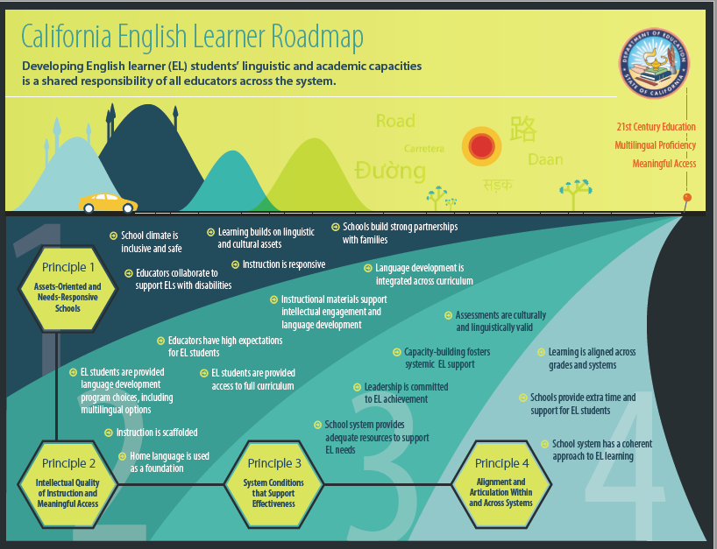
The CA EL Roadmap Defined
The California English Learner Roadmap: Strengthening Comprehensive Educational Policies, Programs, and Practices for English Learners (CA EL Roadmap)
  State Board Policy
  Guidance Document
  Web-based Resources
Notes:
[5 minutes]
The California EL Roadmap Policy, approved by the State Board of Education on July 12, 2017, updates policy for educating English learners.
This policy brings California’s policy for educating English learners in line with current research and with the California Way.
The California Way builds on a collaborative team approach to positive education change and is now attracting national attention as an alternative to test-driven reform. The California Way rests on the belief that educators want to excel, trusts them to improve when given the proper supports, and provides local schools and districts with the leeway and flexibility to deploy resources so they can improve. The California Way engages students, parents, and communities as part of a collaborative decision-making process around how to fund and implement these improvement efforts, and provides supplemental resources to ensure that California's English learners, foster youths, and students in poverty have the learning supports they need. The California EL Roadmap Policy is consistent with this guiding vision.
Along with the policy, members of the EL Roadmap workgroup worked with the CDE and the writer, Professor Kenji Hakuta, to inform a guidance document that incorporates the policy itself and provides Web-based Resources for use in local planning.
The California English Learner Roadmap: Strengthening Comprehensive Policies, Programs, and Practices for English Learners, or California EL Roadmap, is the product of the California EL Roadmap project and includes the California State Board of Education EL Roadmap Policy, the guidance document, and the Web-based Resources.
[Click to advance to next slide]

Slide 8











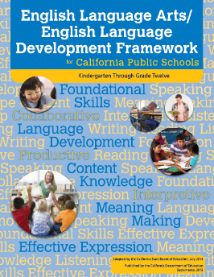

The CA EL Roadmap and the California Way
Field Input
Legal Foundations
Notes:
[5 minutes]
When creating the California EL Roadmap, the process was informed by a variety of programs, priorities, and input.
The CDE and the writer took into account:
The deliberations and input of the EL Roadmap Workgroup, a group of experienced educators and experts in their fields who contributed to this process, input from the field, and the legal foundations.
The EL Roadmap Policy was also built to be consistent with the initiatives put forward by Tom Torlakson, the State Superintendent of Public Instruction at the time, including:
Global California 2030, the State Seal of Biliteracy, Blueprints 1.0 and 2.0, Greatness by Design, Integrating the CA ELD Standards into K–12 Mathematics and Science Teaching and Learning, the California ELD Standards, the ELA/ELD Framework, and the California Common Core State Standards.
Taken together, this is the California Way.
[Click to advance to next slide]

Slide 9

Vision
English learners fully and meaningfully access and participate in a twenty-first century education from early childhood through grade twelve that results in their attaining high levels of English proficiency, mastery of grade level standards, and opportunities to develop proficiency in multiple languages.
Notes:
[2 minutes]
The California EL Roadmap articulates an inspirational and aspirational vision for educating English learners.
The vision is:
“English learners fully and meaningfully access and participate in a twenty-first century education from early childhood through grade twelve that results in their attaining high levels of English proficiency, mastery of grade level standards, and opportunities to develop proficiency in multiple languages.”
[Click to advance to next slide]

Slide 10

Mission
California schools affirm, welcome, and respond to a diverse range of English learner strengths, needs, and identities. California schools prepare graduates with the linguistic, academic, and social skills and competencies they require for college, career, and civic participation in a global, diverse, and multilingual world, thus ensuring a thriving future for California.
Notes:
[2 minutes]
The mission stated in the EL Roadmap Policy is:
“California schools affirm, welcome, and respond to a diverse range of EL strengths, needs, and identities. California schools prepare graduates with the linguistic, academic, and social skills and competencies they require for college, career, and civic participation in a global, diverse, and multilingual world, thus ensuring a thriving future for California.”
[Click to advance to next slide]

Slide 11
Four Interrelated Principles
Principle One: Assets-Oriented and Needs-Responsive Schools
Principle Two: Intellectual Quality of Instruction and Meaningful Access
Principle Three: System Conditions that Support Effectiveness
Principle Four: Alignment and Articulation Within and Across Systems
Notes:
[2 minutes]
The four interrelated principles are:
Principle One: Assets-Oriented and Needs-Responsive Schools,
Principle Two: Intellectual Quality of Instruction and Meaningful Access,
Principle Three: System Conditions that Support Effectiveness, and
Principle Four: Alignment and Articulation Within and Across Systems.
[Click to advance to next slide]

Slide 12


Principles to Elements
PRINCIPLE
Element
Element
Element
Actionable Steps
Element
Notes:
[2 minutes]
[If using the CA EL Roadmap document, point participants to where the principles are further broken down into elements in the Four Interrelated Principles section of the document. If using the policy, participants will need to access the elements online at https://www.cde.ca.gov/sp/el/rm/principleone.asp or you will need to print out the information available on the page for each principle]
The inspirational, aspirational vision of the CA EL Roadmap is broken down into four principles that together form the path that will make the vision a reality.
The CA EL Roadmap further breaks down the four principles into elements that make up each principle. The elements are the actionable steps that can be taken to implement the principle.
Together, the elements form the principle.
[Click to advance to next slide]

Slide 13
The Four Principles
Video available at https://youtu.be/YXfmPRsEYMs?list=PLzAV3ARcMmw1l-hX2vpb6RSbDSYt8mvPE
Notes:
[5 minutes]
This video, created by the California Association for Bilingual Education, or CABE, provides an overview of the four interrelated EL Roadmap principles.
Dr. Laurie Olsen, the co-chair of the EL Roadmap Workgroup, provides this information.
[Play embedded video or play from YouTube at https://youtu.be/YXfmPRsEYMs?list=PLzAV3ARcMmw1l-hX2vpb6RSbDSYt8mvPE]
[Click to advance to next slide]

Slide 14
Principle One: Assets-Oriented and Needs-Responsive Schools
Pre-schools and schools are responsive to different English learner strengths, needs, and identities and support the socio-emotional health and development of English learners. Programs value and build upon the cultural and linguistic assets students bring to their education in safe and affirming school climates. Educators value and build strong family, community, and school partnerships.
Please look over the elements under principle one and briefly discuss:
If you were engaged in a continuous improvement cycle, how would you decide what to focus on within this principle? What data would you use? What would your focus be?
Notes:
[10 minutes]
[To shorten the timeframe of this presentation, you can also have participants choose one principle to focus on for this activity or assign principles by table, rather than having all participants discuss all four principles]
The policy contains four principles.
Principle one is:
Pre-schools and schools are responsive to different EL strengths, needs, and identities and support the socio-emotional health and development of English learners. Programs value and build upon the cultural and linguistic assets students bring to their education in safe and affirming school climates. Educators value and build strong family, community, and school partnerships
Please look over the elements under principle one and briefly discuss:
If you were engaged in a continuous improvement cycle, how would you decide what to focus on within this principle? What data would you use? What would your focus be?
[Click to advance to next slide]

Slide 15
Principle Two: Intellectual Quality of Instruction and Meaningful Access
English learners engage in intellectually rich, developmentally appropriate learning experiences that foster high levels of English proficiency. These experiences integrate language development, literacy, and content learning as well as provide access for comprehension and participation through native language instruction and scaffolding. English learners have meaningful access to a full standards-based and relevant curriculum and the opportunity to develop proficiency in English and other languages.
Please look over the elements under principle two and briefly discuss:
If you were engaged in a continuous improvement cycle, how would you decide what to focus on within this principle? What data would you use? What would your focus be?
Notes:
[10 minutes]
[To shorten the timeframe of this presentation, you can also have participants choose one principle to focus on for this activity or assign principles by table, rather than having all participants discuss all four principles]
Principle two is:
English learners engage in intellectually rich, developmentally appropriate learning experiences that foster high levels of English proficiency. These experiences integrate language development, literacy, and content learning as well as provide access for comprehension and participation through native language instruction and scaffolding. English learners have meaningful access to a full standards-based and relevant curriculum and the opportunity to develop proficiency in English and other languages.
Please look over the elements under principle two and briefly discuss:
If you were engaged in a continuous improvement cycle, how would you decide what to focus on within this principle? What data would you use? What would your focus be?
[Click to advance to next slide]

Slide 16
Principle Three: System Conditions that Support Effectiveness
Each level of the school system (state, county, district, school, pre-school) has leaders and educators who are knowledgeable of and responsive to the strengths and needs of English learners and their communities, and who utilize valid assessment and other data systems that inform instruction and continuous improvement. Each level of the school system provides resources and tiered support to ensure strong programs and build the capacity of teachers and staff to leverage the strengths and meet the needs of English learners.
Please look over the elements under principle three and briefly discuss:
If you were engaged in a continuous improvement cycle, how would you decide what to focus on within this principle? What data would you use? What would your focus be?
Notes:
[10 minutes]
[To shorten the timeframe of this presentation, you can also have participants choose one principle to focus on for this activity or assign principles by table, rather than having all participants discuss all four principles]
Principle three is:
Each level of the school system (state, county, district, school, pre-school) has leaders and educators who are knowledgeable of and responsive to the strengths and needs of English learners and their communities, and who utilize valid assessment and other data systems that inform instruction and continuous improvement. Each level of the school system provides resources and tiered support to ensure strong programs and build the capacity of teachers and staff to leverage the strengths and meet the needs of English learners.
Please look over the elements under principle three and briefly discuss:
If you were engaged in a continuous improvement cycle, how would you decide what to focus on within this principle? What data would you use? What would your focus be?
[Click to advance to next slide]

Slide 17
Principle Four: Alignment and
Articulation Within and Across Systems
English learners experience a coherent, articulated, and aligned set of practices and pathways across grade levels and educational segments, beginning with a strong foundation in early childhood and appropriate identification of strengths and needs, continuing through to reclassification, graduation, higher education, and career opportunities. These pathways foster the skills, language(s), literacy, and knowledge students need for college- and career-readiness and participation in a global, diverse, multilingual twenty-first century world.
Please look over the elements under principle four and briefly discuss:
If you were engaged in a continuous improvement cycle, how would you decide what to focus on within this principle? What data would you use? What would your focus be?
Notes:
[10 minutes]
[To shorten the timeframe of this presentation, you can also have participants choose one principle to focus on for this activity or assign principles by table, rather than having all participants discuss all four principles]
Principle four is:
English learners experience a coherent, articulated, and aligned set of practices and pathways across grade levels and educational segments, beginning with a strong foundation in early childhood and appropriate identification of strengths and needs, continuing through to reclassification, graduation, higher education, and career opportunities. These pathways foster the skills, language(s), literacy, and knowledge students need for college- and career-readiness and participation in a global, diverse, multilingual twenty-first century world.
Please look over the elements under principle four and briefly discuss:
If you were engaged in a continuous improvement cycle, how would you decide what to focus on within this principle? What data would you use? What would your focus be?
[Click to advance to next slide]

Slide 18
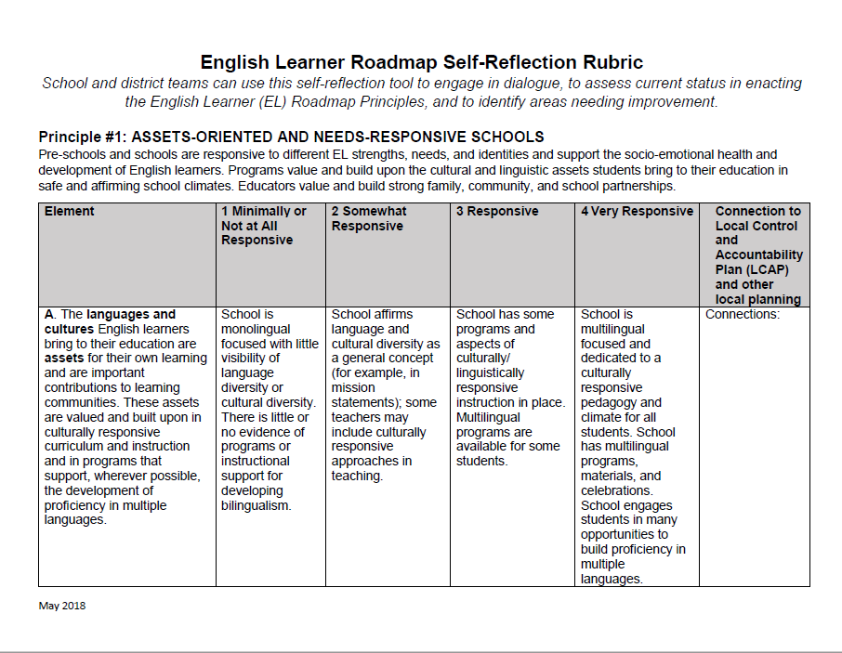
Self-Reflection Rubric Purpose
Purpose: Schools, districts, and programs are able to reflect on their EL policies, programs, and practices based on a clearly outlined rubric for the purpose of guiding and prioritizing planning and improvement.
Available on the CA EL Roadmap Resources Web page as a handout.
Notes:
[5 minutes]
We will now take a chunk of time to look deeper into how your LEA’s current practices align with the principles and elements of the CA EL Roadmap. Part of the goal of this work is to identify areas of growth that can be addressed through the LCAP process.
This activity will provide you with an opportunity to engage in some dialogue as a team and identify any areas that might need improvement.
The Self-Reflection Rubric is a tool that is available to LEAs as part of the Web-based Resources. A copy of the rubric is also available as a handout.
This rubric allows schools, districts, and programs to identify strengths and weaknesses in their EL policies, programs, and practices. While the California School Dashboard provides a snapshot of how an LEA is doing, it does not provide the full story. This tool allows LEAs to dig deeper into their EL policies, programs, and practices and provides a starting point as LEAs engage in a continuous improvement cycle to better embrace and support English learners.
[Click to advance to next slide]

Slide 19
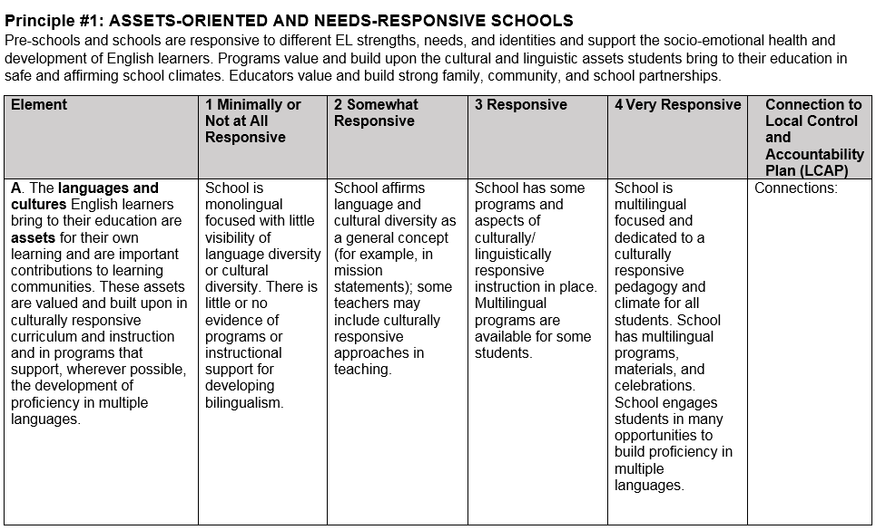
Self-Reflection Rubric
Notes:
[5 minutes]
You have the Self-Reflection Rubric as a handout. It is designed to look at each principle, element by element.
Take a moment to look at Principle 1, Element A. Starting from the left, each element is followed by a description of the level of implementation for the element.
The levels of implementation are:
1, meaning minimally or not at all responsive;
2, meaning somewhat responsive;
3, meaning responsive; or
4, meaning very responsive.
The right side of the rubric includes a place to make notes on how each element connects to the goals and activities in the LCAP.
[Click to advance to next slide]

Slide 20

Self-Reflection Activity
In teams:
Please focus on one principle
Read through that entire section of the rubric, marking where you think a particular school, district, or program is in each area from your perspective and role
Be prepared to share
10 minutes
Notes:
[12 minutes]
[Assign a principle to each table or have tables choose one principle to focus on for this activity. For longer sessions, you can have participants look at multiple principles and extend this activity]
In your team, please focus on one principle.
Read through that entire section of the rubric, marking where you think a particular school, district, or program is in each area from your perspective and role
Be prepared to share.
[Give groups 10 minutes to complete this task. The countdown timer begins with when you click to advance slide. It will turn red after 10 minutes.]
[Click to advance to the next slide]

Slide 21
Team Dialogue
Discuss reflections from your principle and corresponding elements with your table
What did you notice when you were using this rubric about the program, district, or school you focused on?
How might you use this with others?
How might you adapt this for different uses?
10 minutes
Notes:
[12 minutes]
[Consider providing chart paper to participants for this activity]
Now you will have 10 minutes total for team dialogue on your reflections for each principle and its elements. As you look at each area, take time to note the implications for the LCAP.
[Give teams 10 minutes to complete this task. The countdown timer begins with when you click to advance slide. It will turn red after 10 minutes.]
[If time allows, ask tables to share out highlights from their discussions]
[Click to advance to next slide]

Slide 22
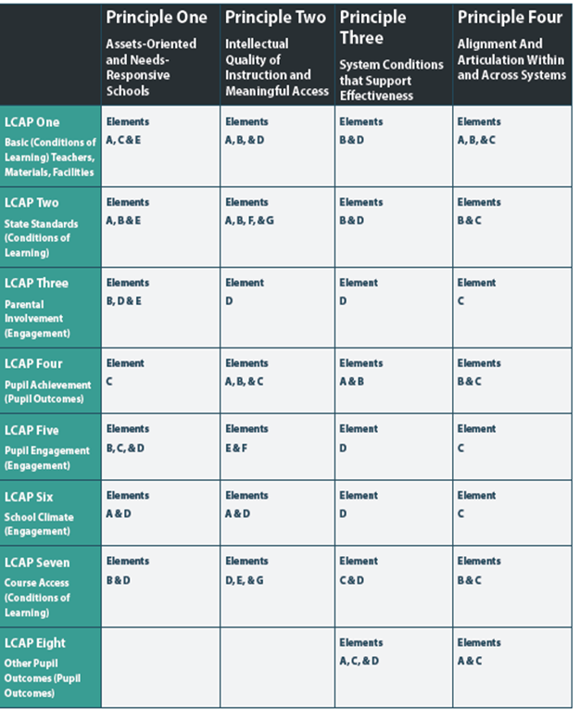
Local Control Accountability Plan
LEAs must write an LCAP
How do the Principles and Elements work within the LCAP?
Based on your discussion earlier with the rubric, what areas might you want to focus on in LCAP development?
See handout
Available at https://www.cde.ca.gov/sp/ml/rmresources.asp.
Notes:
[10 minutes]
Now, we will discuss how this policy affects local educational agencies’, or LEAs’, LCAPs.
LEAs must write an LCAP that addresses the LCAP state priorities.
The Crosswalk to LCAP is a document that helps LEAs address the principles and elements of the EL Roadmap policy while simultaneously addressing these state priorities.
Please take a moment to look over the Crosswalk to LCAP, either in the CA EL Roadmap or online.
[Give participants a minute to look over the Crosswalk to LCAP handout]
Now, please discuss:
How do the Principles and Elements work within the LCAP?
Based on your discussion earlier with the rubric, what areas might you want to focus on in LCAP development?
[Give participants a few minutes to discuss]
[Share out responses as time allows]
[Click to advance to next slide]

Slide 23
Closing Discussion
What are the implications for what we discussed today in your classroom, school, district, or county office?
  EL Roadmap Policy, principles, elements, Web-based Resources, and Guidance Document
What might your role be in sharing the EL Roadmap with district staff and stakeholders?
How can the EL Roadmap inform district decisions, LCAP development, and EL policy?
Notes:
[10 minutes]
Please discuss with your table:
What are the implications for what we discussed today in your classroom, school, district, or county office?
EL Roadmap Policy, Principles, Elements, Web-based Resources, and Guidance Document
What might your role be in sharing the EL Roadmap with district staff and stakeholders?
How can the EL Roadmap inform district decisions, LCAP development, and EL policy?
[Give time for participants to discuss in small groups]
[Share out responses as time allows]
[Click to advance to next slide]

Slide 24
Anaheim Union High School District’s
EL Roadmap Video
Video available at https://www.youtube.com/watch?v=VtqJCB6ssGk&feature=youtu.be
Notes:
[4 minutes]
To close this session, I will show a video clip that the Anaheim Union High School District Superintendent Michael Matsuda, a member of the EL Roadmap Workgroup, created with members of his staff and students from his district.
Please enjoy this inspirational video.
[Click to play video at https://www.youtube.com/watch?v=VtqJCB6ssGk&feature=youtu.be]
[Click to advance to next slide]

Slide 25
Resources
CDE EL Roadmap web page at https://www.cde.ca.gov/sp/ml/roadmap.asp
  Includes: the EL Roadmap Policy, the EL Roadmap Guidance Document, information on and examples of each principle in action, the Self-Reflection Rubric, Frequently Asked Questions, the EL Roadmap Webinar, this presentation and others, and more
California Association for Bilingual Education EL Roadmap videos at https://youtu.be/6_piqi-lBFw?list=PLzAV3ARcMmw1l-hX2vpb6RSbDSYt8mvPE
  Includes Introduction and Overview, Four Principles, and Call to Action videos
Notes:
[3 minutes]
There are many resources to support EL Roadmap implementation.
The CDE EL Roadmap web page, at https://www.cde.ca.gov/sp/ml/roadmap.asp, includes the EL Roadmap Policy, the EL Roadmap Guidance Document, information on and examples of each principle in action, the Self-Reflection Rubric, Frequently Asked Questions, the EL Roadmap Webinar, this presentation and others, and more.
Another resource is the California Association for Bilingual Education EL Roadmap videos at https://youtu.be/6_piqi-lBFw?list=PLzAV3ARcMmw1l-hX2vpb6RSbDSYt8mvPE. These videos include an Introduction and Overview video, a Four Principles video, and a Call to Action video.
[Click to advance to next slide]

Slide 26



Contact Information
For further information about the EL Roadmap, contact the Language Policy and Leadership Office in the English Learner Support Division at the CDE
  Phone: 916-319-0845
  Email: ELRoadmapProject@cde.ca.gov
  Follow the English Learner Support Division on Twitter: @MultilingualCA
Notes:
[1 minute]
For further information about the EL Roadmap, contact the Language Policy and Leadership Office in the English Learner Support Division at the California Department of Education by phone at 916-319-0845 or by email at ELRoadmapProject@cde.ca.gov.
For information, updates, and resources from the English Learner Support Division, follow @MultilingualCA on Twitter.
[Click to advance to next slide]

Slide 27

Thank you!
Notes:
[1 minute]
In conclusion, the EL Roadmap is ushering in a new era of education for English learners in the state of California that focuses on the whole child and emphasizes the importance of being bilingual, multilingual, and biliterate in our global society.
Keep your eyes open for observable changes in your community, schools, districts, county offices, and at the CDE.
Thank you so much for coming.
[End presentation]

