Slide 1
The California State Seal of Biliteracy
Multilingual Support Division
California Department of Education
November 8, 2023
Notes:
[Slides for the CDE State Seal of Biliteracy, or SSB, webinar]
[Complete presentation takes approximately 1 hour. Local educational agencies may choose to use all or a selection of these slides to inform district or school site staff, parents, students, and other interested parties about the SSB program.]
[Provide welcome and begin presentation]
[Click to advance to next slide]

Slide 2
Webinar Outcomes
To become familiar with:
The State Seal of Biliteracy (SSB) program’s purpose and importance
The newly updated requirements for earning the SSB
The process for tracking eligible students and keeping records
The process for requesting insignias
The available resources and where to find them
Best practices for raising awareness, equity, and building a path to biliteracy
Notes:
The outcomes for this webinar are to become familiar with:
The SSB program’s purpose and importance;
The newly updated requirements for earning the SSB;
The process for tracking eligible students and keeping records;
The process for requesting insignias;
The available resources and where to find them; and
Best practices for raising awareness, equity, and building a path to biliteracy,
Participants should feel prepared to start an SSB program or to strengthen an existing SSB program after viewing this webinar.
[Click to advance to next slide]

Slide 3
Overview
Notes:
First, I will provide an overview of the SSB program.
[Click to advance to next slide]

Slide 4
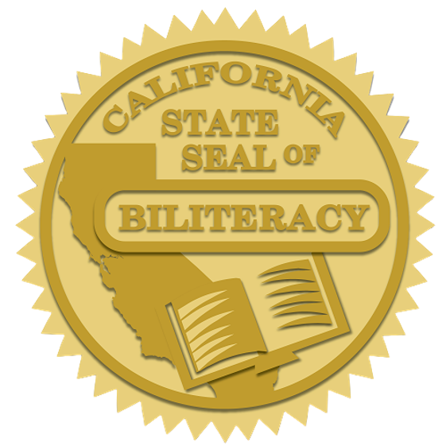
What is the State Seal of Biliteracy?
Recognition by the State Superintendent of Public Instruction for graduating high school students who have attained a high level of proficiency in speaking, reading, and writing in one or more languages in addition to English
A free program for students, schools, and districts available to public schools, direct-funded charter schools, and county offices of education
Notes:
What is the SSB?
The SSB is a program that offers recognition by the State Superintendent of Public Instruction for graduating high school students who have attained a high level of proficiency in speaking, reading, and writing in one or more languages in addition to English.
This recognition is marked by a gold seal that can be affixed to the diploma or transcript of a graduating senior who has met all of the SSB eligibility requirements. The seal is pictured on this slide and shows the state of California and an open book.
The SSB is a free program. By law, no fee may be charged to students, schools, or districts to participate in the program.
[Click to advance to next slide]

Slide 5
Purpose of the State Seal of Biliteracy
Recognize high school graduates who are biliterate or multiliterate
Encourage pupils to study languages
Provide employers and colleges with a method to identify people with language and biliteracy skills
Strengthen intergroup relationships
Affirm the value of diversity and honor the multiple cultures and languages of a community
Notes:
The SSB was established for a variety of reasons, including to encourage and recognize biliteracy and multiliteracy and the study of languages.
This program also provides a way for employers and colleges to identify students who have the twenty-first century skills of biliteracy or multiliteracy.
Finally, this program fosters an inclusive environment that strengthens intergroup relations, embraces multiculturalism, and affirms the value of linguistic diversity in the community.
The SSB’s purposes align with the vision of the English Learner Roadmap Policy, for English learners to fully and meaningfully access and participate in a twenty-first century education from early childhood through grade twelve that results in their attaining high levels of English proficiency, mastery of grade level standards, and opportunities to develop proficiency in multiple languages.
English learners and other multilingual learners are already on the path to the State Seal of Biliteracy with their home languages. Ensuring these students have opportunities to develop the home language along with English is an important part of growing the SSB and celebrating California’s linguistic diversity.
[Click to advance to next slide]

Slide 6
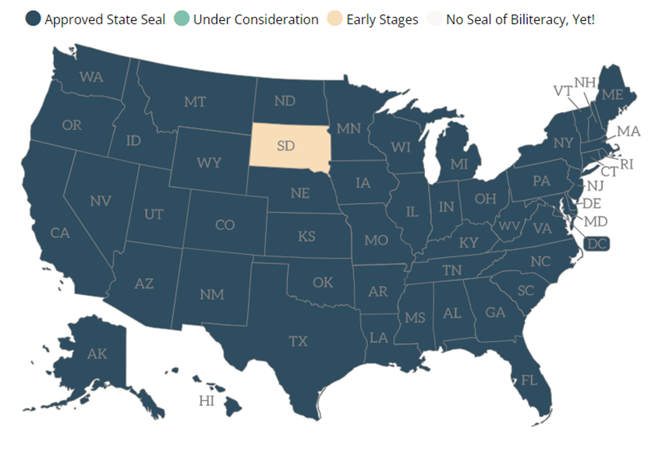
SSB Programs in the United States
Became effective January 1, 2012, per Assembly Bill 815.
California was the first state to adopt the SSB.
As of 2023, every state has an SSB program except for South Dakota, which is in the process of establishing one.
Image from Californians Together Seal of Biliteracy website at http://sealofbiliteracy.org
Notes:
Many other states in the United States also have SSB programs.
In California, the SSB became effective on January 1, 2012, per Assembly Bill 815.
California was the first state to adopt an SSB program. Since then, 48 other states and the District of Columbia have followed suit.
This map, from the Californians Together Seal of Biliteracy website at http://sealofbiliteracy.org, shows the states in dark blue that have already adopted an SSB program. The map shows every state shaded in dark blue other than one state, South Dakota. South Dakota is shaded in peach, showing that it is currently in the early stages of developing an SSB program. This means that soon, every state will have an SSB program.
The nationwide focus on the State Seal of Biliteracy is further strengthened with the U.S. Department of Education’s Raise the Bar: Lead the World Initiative. One of this initiative’s three key focus areas is creating pathways for global engagement. This includes providing every student with a pathway to multilingualism.
The link to the Raise the Bar: Lead the World web page is available on the links doc. It is included under the heading “Partner Resources.”
[Click to advance to next slide]

Slide 7
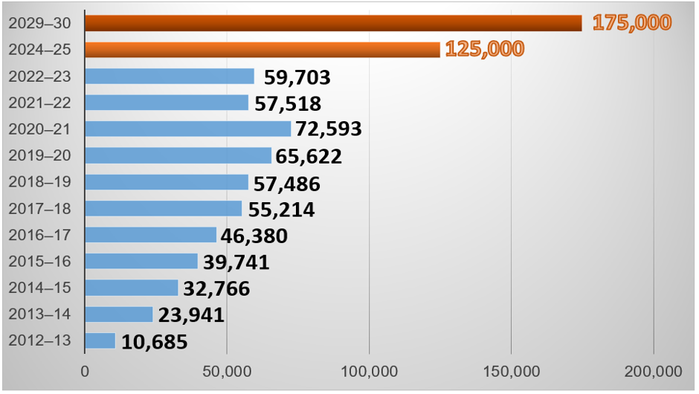
SSB Growth by Year
Total seals awarded since the program was established: 521,649
Notes:
The blue bars in this graph show the growth in the number of seals awarded annually since the program was established.
In the 2012-13 school year, 10,685 seals were awarded. In 2013-14, 23,941 seals were awarded. In 2014-15, 32,766. In 2015-16, 39,741. In 2016-17, 46,380. In 2017-18, 55,214. In 2018-19, 57,486. In 2019-20, 65,622. In 2020-21, 72,593. Finally, in 2021-22 we saw a decline in the number of seals awarded for the first time, to 57,518. This past year, we saw an increase again, to 59,703.
The top two rows in the bar graph, shaded in orange, show the goals from the Global CA 2030 Initiative.
To stay on track with the goals set forth in the Global California 2030 initiative, we will need to work hard from now until 2025 to achieve the target of 125,000 seals in 2024-25, and ultimately 175,000 seals by 2030.
The mission of Global California 2030 is to equip students with the world language skills to fully engage with the diverse cultures and heritages of California and the world, while also preparing them to succeed in the global economy.
Please see the link on your links document for the Global California 2030 Report, which provides additional information about these goals.
A total of 521,649 SSBs have been awarded in California since the program was established. That translates into a lot of students who are equipped with biliteracy or multiliteracy, contributing to their communities and to the economy.
While these numbers are exciting, it was disappointing to see the decline during the 2021-22 school year. The decline during 2021-22 is most likely attributable to the COVID-19 pandemic. However, it is an important call to action to ensure that all California students and families are aware of the SSB and its requirements and that all students, but especially those who bring the asset of a home language other than or in addition to English to California schools, have the opportunity to develop biliteracy or multiliteracy.
[Click to advance to next slide]

Slide 8
Local Participation Data
Data posted annually in the fall on the California Department of Education (CDE) SSB web page under the “Participation Data” tab.
Excel spreadsheet:
First tab: statewide data by county
Subsequent tabs: each county’s data (organized by local educational agency [LEA])
Notes:
In addition to general participation numbers, local participation data is also available.
The data is posted annually each fall on the CDE SSB web page under the “Participation Data” tab. The link to this web page is also available on your links doc.
The data is posted in an Excel spreadsheet.
The first tab includes statewide data organized by county.
Each subsequent tab provides a county’s data. The data on each county tab is organized by LEA.
This spreadsheet can be a valuable resource when starting an SSB program since you can find out which other LEAs offer the SSB in your county or in nearby counties and can collaborate with them when establishing a program.
[Click to advance to next slide]

Slide 9
Requirements
Notes:
Next, I will provide an overview of the SSB requirements.
[Click to advance to next slide]

Slide 10

Assembly Bill 370
Signed by Governor Newsom on October 7, 2023.
Amends the requirements for earning the SSB, starting with 2024 graduates.
All information in this webinar will reflect the new requirements, effective January 1, 2024.
Notes:
As many of you know, the requirements for the SSB have recently changed.
On October 7, 2023, Governor Newsom signed AB 370, which amends the SSB requirements starting with 2024 graduates.
The information in this webinar will reflect the new requirements, which are effective on January 1, 2024.
[Click to advance to next slide]

Slide 11

Overall Requirements
Demonstrate English proficiency
  How?
Demonstrate proficiency in another language in addition to English
  How?
Requirements are established in California Education Code (EC) Section 51461.
Notes:
To earn the SSB, students must demonstrate proficiency in English. The question is, how?
Students must also demonstrate proficiency in another language to earn the SSB. Again, the question is, how?
Today, I will clarify the new requirements for demonstrating proficiency in English and one or more languages in addition to English for the SSB.
The requirements are outlined in California Education Code, or EC, Section 51461. I will go over the requirements in the law and some of the frequently asked questions, or FAQs.
[Click to advance to next slide]

Slide 12


English Proficiency Requirements
Choose Either:
Coursework OR Assessment
Notes:
Students may choose to demonstrate their proficiency in English for the SSB through either coursework or an assessment.
This slide includes an image of a classroom with high school students and a test with a pencil.
[Click to advance to next slide]

Slide 13
English Proficiency
Coursework Options:
Completion of all English language arts (ELA) requirements for graduation with an overall grade point average (GPA) of 3.0 or above in those classes.
  Completion of one or more ELA courses at a public higher education institution or an independent institution of higher education…with a grade equivalent to a GPA of 3.0 or above may be used to satisfy one or more course requirements.
  (EC Section 51461[a][1][A])
Notes:
To demonstrate English proficiency though coursework, students must complete all English language arts, or ELA, requirements for graduation with an overall grade point average, or GPA, of 3.0 or above in those classes.
Per EC Section 51461(a)(1)(A), ELA courses completed at a public higher education institution or an independent institution of higher education with a grade equivalent to a GPA of 3.0 or above may be used to satisfy one or more of the course requirements.
This means that students can use courses taken through dual enrollment at a college or university while in high school towards the coursework option for demonstrating English proficiency.
[Click to advance to next slide]

Slide 14
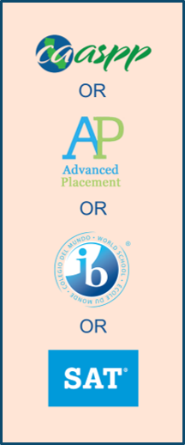
English Proficiency
Assessment Options (Choose One):
California Assessment of Student Performance and Progress (CAASPP) ELA, administered in grade 11, at or above “standard met” level;
English Advanced Placement (AP) with a score of 3 or higher;
English International Baccalaureate (IB) examination with a score of 4 or higher; or
Evidence-Based Reading and Writing section of the SAT with a score of 480 or higher.
(EC Section 51461[a][1][B]–[D])
Notes:
To demonstrate proficiency in English, students may also choose one of the assessment options instead of coursework.
These options are passing either:
The California Assessment of Student Performance and Progress, or CAASPP, for ELA, administered in grade 11, at or above the “standard met” level;
An English Advanced Placement, or AP, assessment with a score of 3 or higher;
An English International Baccalaureate, or IB, examination, with a score of 4 or higher; or
The Evidence-Based Reading and Writing section of the SAT with a score of 480 or higher.
These requirements are outlined in EC Section 51461(a)(1)(B)–(D)
This slide includes a visual representation of each of the assessment options, represented by the logo of each assessment: the CAASPP, AP, IB, or SAT.
Again, students may choose either coursework or one of these assessments to demonstrate their proficiency in English and do not need both to earn the SSB.
[Click to advance to next slide]

Slide 15
Highlighted Frequently Asked Question
(FAQ): CAASPP
Is passing the CAASPP required to show proficiency in English?
No. The CAASPP is one of the options available to demonstrate proficiency in English for the SSB.
Notes:
I also wanted to share a couple of Frequently Asked Questions, or FAQs, that relate to the English proficiency requirements.
A highlighted FAQ regarding the CAASPP is:
Is passing the CAASPP required to show proficiency in English?
No. The CAASPP is one of the options available to demonstrate proficiency in English for the SSB.
This is new, as the CAASPP was previously required for all students seeking the SSB.
[Click to advance to next slide]

Slide 16
Highlighted FAQ: AP
Which AP exam may be used to demonstrate proficiency in English for the SSB?
Students may demonstrate their proficiency in English for the SSB with either the AP English Language and Composition, AP English Literature and Composition, or AP Seminar exam.
Notes:
A highlighted FAQ for the AP is:
Which AP exam may be used to demonstrate proficiency in English for the SSB?
Students may demonstrate their proficiency in English for the SSB with either the AP English Language and Composition, AP English Literature and Composition, or AP Seminar exam.
[Click to advance to next slide]

Slide 17
Second Language Proficiency Requirements
Choose Either:
Coursework OR Assessment
Notes:
Students may choose to demonstrate their proficiency in English for the SSB through either coursework or an assessment.
This slide includes an image of a classroom with high school students and a test with a pencil.
[Click to advance to next slide]

Slide 18

Second Language Proficiency
Coursework Options:
Successful completion of a four-year course of study of content in a world language at a high school or higher level attaining an overall GPA of 3.0 or above in that course of study, and oral proficiency in the language comparable to that required to pass the AP, IB, or ACTFL Oral Proficiency Interview (OPI).
  Course of study could include:
    Courses completed in another country in a language other than English
    Courses completed at a college or university through dual enrollment
(EC Section 51461[a][2][B])
Notes:
To demonstrate proficiency in the second language though coursework, students must complete a four-year course of study of content in a world language at a high school or higher level with an overall GPA of 3.0 or above in that course of study.
In addition, students must also demonstrate oral proficiency in the language comparable to that required to pass the AP, IB, or ACTFL Oral Proficiency Interview, or OPI.
One or more courses in this course of study could be completed in another country in a language other than English or at a college or university through dual enrollment.
For either of these options, the school or district would need to verify the courses through a transcript.
These requirements can be found in EC Section 51461(a)(2)(B).
This slides is accompanied by an image representing the two parts of the coursework option: a transcript representing the coursework and speech bubbles representing oral proficiency.
[Click to advance to next slide]

Slide 19
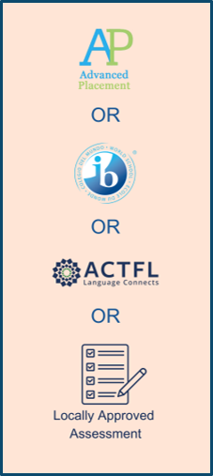
Second Language Proficiency
Assessment Options (Choose One):
World language AP examination with a score of 3 or higher;
World language IB examination with a score of 4 or higher;
ACTFL Writing Proficiency Test (WPT) and OPI with scores of intermediate mid or higher; or
Locally approved assessment in the language that meets the rigor of a four-year high school course of study in the world language.
(EC Section 51461[a][2][A] and [C]).
Notes:
Students may also choose to demonstrate proficiency in the second language through an assessment.
Per EC sections 51461(a)(2)(A) and (C), there are multiple assessment options.
They are, either:
Pass a world language AP examination with a score of 3 or higher;
Pass a world language IB examination with a score of 4 or higher;
Pass an ACTFL Writing Proficiency Test, or WPT, and OPI, with scores of intermediate mid or higher; or
Pass a locally-approved assessment in the world language that meets the rigor of a four-year high school course of study in the world language.
Students may choose one of these assessments from the options available at the school or district to demonstrate their proficiency in the second language.
This slide includes a visual representation of each of the assessment options, represented by the logo of each assessment: the AP, IB, ACTFL, or locally approved assessment (represented by an image of a test).
[Click to advance to next slide]

Slide 20
Highlighted FAQ:
Assessment Approval
How can LEAs certify their locally approved assessments to determine proficiency in a world language other than English for the SSB?
An LEA must certify that any world language proficiency assessment(s) it uses, other than those specified in EC Section 51461(a)(2)(A), meet the rigor of a four-year high school course of study and, at a minimum, assess speaking, reading, and writing in the language at the proficient level or higher (EC Section 51461[a][2][C]). LEAs may certify locally approved assessments when submitting the online Insignia Request Form annually.
Notes:
A highlighted FAQ regarding assessment approval is:
How can LEAs certify their locally approved assessments to determine proficiency in a world language other than English for the SSB?
An LEA must certify that any world language proficiency assessment(s) it uses, other than those specified in EC Section 51461(a)(2)(A), meet the rigor of a four-year high school course of study and, at a minimum, assess speaking, reading, and writing in the language at the proficient level or higher (EC Section 51461[a][2][C]). LEAs may certify locally approved assessments when submitting the online Insignia Request Form annually.
There is a question on the form asking about any locally approved assessments.
[Click to advance to next slide]

Slide 21
Highlighted FAQ: Local Assessments
Are there any assessments which districts have approved locally to assess world language proficiency in a language other than English for the SSB?
A list of locally approved world language proficiency assessments that LEAs have certified meet the rigor of a four-year high school course of study in the world language and assess speaking, reading, and writing in the language at the proficient level or higher is posted on the CDE SSB web page under the “Assessments” tab.
Notes:
Another highlighted FAQ regards local assessments:
Are there any assessments which districts have approved locally to assess world language proficiency in a language other than English for the SSB?
A list of locally approved world language proficiency assessments that LEAs have certified meet the rigor of a four-year high school course of study in the world language and assess speaking, reading, and writing in the language at the proficient level or higher is posted on the CDE SSB web page under the “Assessments” tab.
This list is created from submissions to the Insignia Request Form and will be updated annually.
[Click to advance to next slide]

Slide 22
Highlighted FAQ: World Language Coursework
If a student tests into a higher-level world language course and completes through year four of that language with a 3.0 GPA, would that student qualify for the SSB even if the student did not complete levels 1, 2, 3, and 4 in high school?
LEAs define the structure, organization, and successful completion of a four-year high school course of study in a world language. The LEA may establish comparable rigor scenarios for the "four-year high school course of study in a world language" consistent with EC Section 51461, including for students who place into higher level language courses. For example, if a student tests out of the first year of a four-year high school course of study or takes the first year of a four-year high school course of study while still in grade 8, but completes the rest of the four-year course, such student could qualify for the SSB provided they also satisfied the other criteria.
Notes:
Another highlighted FAQ regards world language coursework is:
If a student tests into a higher-level world language course and completes through year four of that language with a 3.0 GPA, would that student qualify for the SSB even if the student did not complete levels 1, 2, 3, and 4 in high school?
LEAs define the structure, organization, and successful completion of a four-year high school course of study in a world language. The LEA may establish comparable rigor scenarios for the "four-year high school course of study in a world language" consistent with EC Section 51461, including for students who place into higher level language courses. For example, if a student tests out of the first year of a four-year high school course of study or takes the first year of a four-year high school course of study while still in grade 8, but completes the rest of the four-year course, such student could qualify for the SSB provided they also satisfied the other criteria.
[Click to advance to next slide]

Slide 23
Highlighted FAQ: Oral Proficiency
How do LEAs assess oral proficiency for the SSB?
It is a local decision how to assess oral proficiency, but in order to earn the seal students must meet this requirement. The assessment you choose or create must meet the rigor of the oral portion of an AP or IB exam or the ACTFL OPI (EC Section 51461[a][2][B]).
The CDE is not asking LEAs to submit their oral proficiency assessments at this time but may do so in the future.
Notes:
The final highlighted FAQ in this area focuses on oral proficiency.
How do LEAs assess oral proficiency for the SSB?
It is a local decision how to assess oral proficiency, but in order to earn the seal students must meet this requirement. The assessment you choose or create must meet the rigor of the oral portion of an AP or IB exam or the ACTFL OPI (EC Section 51461[a][2][B]).
The CDE is not asking LEAs to submit their oral proficiency assessments at this time but may do so in the future.
[Click to advance to next slide]

Slide 24
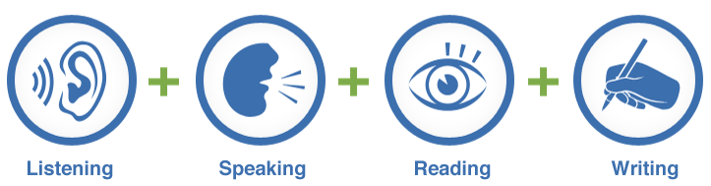
Assessment: Modalities of Communication
A pupil who seeks to qualify for the SSB through a language that is not characterized by listening, speaking, or reading, or for which there is no written system, shall pass an assessment on the modalities that characterize communication in that language at the proficient level or higher (EC Section 51461[a][2][C][ii]).
Notes:
The SSB can be awarded in any world language, including American Sign Language and indigenous languages. Students must demonstrate proficiency in all of the modalities of communication that exist in that language.
EC Section 51461(a)(2)(C)(ii) states:
A pupil who seeks to qualify for the SSB through a language that is not characterized by listening, speaking, or reading, or for which there is no written system, shall pass an assessment on the modalities that characterize communication in that language at the proficient level or higher.
In other words, students should be assessed on all of the ways of communicating that exist in the language. For example, students who seek to qualify for the seal in a language that does not have a written system need only pass an assessment that assesses speaking and listening.
[Click to advance to next slide]

Slide 25
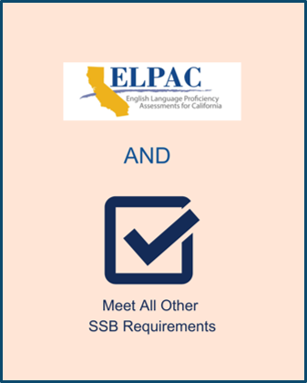
English Proficiency Requirements for
English Learners
Attain on oral composite score of level 4 on the English Language Proficiency Assessments for California (ELPAC)
(EC Section 51461[b][1])
AND
Meet all other requirements for earning the seal (EC Section 51461[b][2])
Notes:
In addition to the other English proficiency requirements, there is also an additional requirement for students who are currently classified as English learners at the time they are seeking the SSB.
Per EC Section 51461(b)(1), English learners must also attain on oral composite score of level 4 on the English Language Proficiency Assessments for California, or ELPAC, in addition to meeting all the other requirements for earning the SSB.
The ELPAC requirement only applies to students who are currently classified as English learners. If a student reclassified at any time prior to grade 12 when the SSB is being awarded, they do not need to meet this additional requirement.
This slide includes an image of the ELPAC logo and a check mark labeled “meet all other requirements.”
[Click to advance to next slide]

Slide 26
Highlighted FAQ: Requirements
Can the SSB be awarded prior to grade 12?
Yes. If a student meets all the requirements in EC Section 51461 prior to grade 12, the SSB may be awarded to that student as soon as the requirements are met. If the requirements are met prior to grade 12, the LEA may note that the seal has been awarded on the transcript and wait to affix the gold embossed seal to the diploma until the diploma is awarded at graduation.
Notes:
A final general FAQ for the requirements is:
Can the SSB be awarded prior to grade 12?
Yes. If a student meets all the requirements in EC Section 51461 prior to grade 12, the SSB may be awarded to that student as soon as the requirements are met. If the requirements are met prior to grade 12, the LEA may note that the seal has been awarded on the transcript and wait to affix the gold embossed seal to the diploma until the diploma is awarded at graduation.
[Click to advance to next slide]

Slide 27
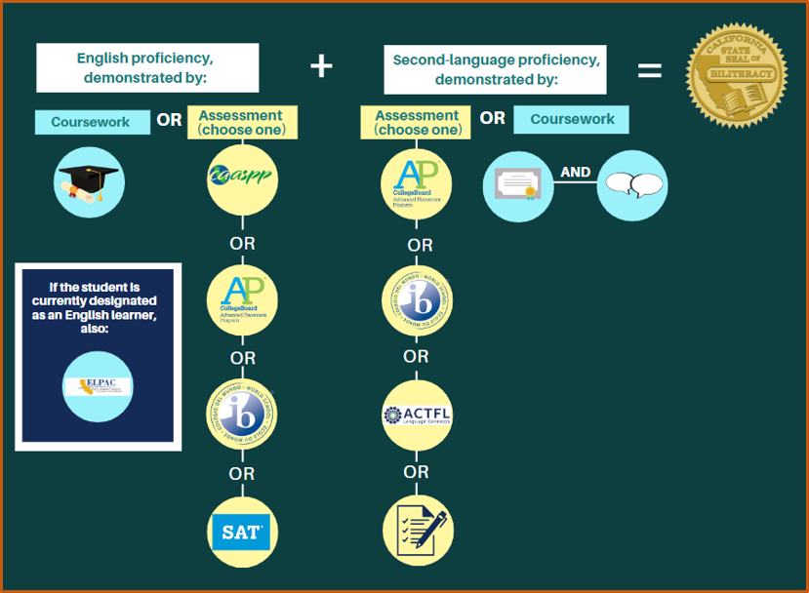
Requirements Review
Requirements poster available under the “Resources” tab on the CDE SSB web page at https://www.cde.ca.gov/sp/ml/sealofbiliteracy.asp.
Notes:
This visual demonstrates the requirements and different options for earning the seal. This is a simplified version of the SSB requirements poster available under the “Resources” tab on the CDE SSB web page. The link to this web page is provided on the links document.
Under the white heading, “English proficiency demonstrated by,” there are two subtitles, “coursework,” or “assessment (choose one).” As we discussed, the coursework option, represented here by a graduation cap and diploma, is all ELA courses required for graduation with a 3.0 GPA or above. As I mentioned, courses taken through dual enrollment at a college or university may also be used towards this requirement.
Under “Assessments,” it shows the logo for each of the ELA assessment options: CAASPP, AP, IB, or SAT.
Below that is the subheading, “If a student is currently designated as an English learner, also:” with an image of the ELPAC logo below. English learners must also demonstrate English proficiency by achieving an oral composite score of performance level four on the ELPAC.
The next white heading says, “Second-language proficiency, demonstrated by:”
Below that, are two subheadings that show the two options: “assessment (choose one)” or “coursework.”
Below the “assessment” heading are the choices, each represented by the assessment logo: AP, IB, and ACTFL. Additionally, the option to use a locally approved assessment is represented by the image of a test with a pen.
The other option for demonstrating second language proficiency is coursework. Below that heading is an image of a diploma and an image of speech bubbles. To demonstrate proficiency through coursework, students may complete a four-year high school course of study in the language with a 3.0 GPA or above. Students who seek to qualify for the seal through this method must also demonstrate oral proficiency in the language. As I mentioned, courses taken through dual enrollment at a college or university or in another country may also be used towards this requirement.
Together, when a student demonstrates English proficiency and second language proficiency, they qualify for the SSB. This is demonstrated by the image of the SSB insignia next to the equation “English proficiency + second language proficiency = SSB insignia.”
[Click to advance to next slide]

Slide 28
Logistics
Notes:
[Please note, these are the state processes. When providing this presentation locally, it is recommended to include the site, district, or county process as applicable]
Next, I will go over logistics for participating in the SSB program.
[Click to advance to next slide]

Slide 29
Requesting Seals
A school district, county office of education, or direct-funded charter school must submit the number of eligible students to the CDE on the Insignia Request Form to receive seals.
The online Insignia Request Form is available on the CDE SSB web page under the “Forms” tab.
No deadline; requests processed on an ongoing basis
Allow four weeks to process order, mail seals, and locally affix seals to diplomas or transcripts
Notes:
A school district, county office of education, or direct-funded charter school must complete the Insignia Request Form to participate in the program and receive seals.
This form is for LEA use and cannot be submitted directly by parents or students. Instead, parents or students should contact the school or district for information about how to determine if they or their child is eligible for the seal.
The Insignia Request Form is an online form that can be found on the CDE SSB web page. The link to this page is available on the link document. The CDE is no longer accepting paper request forms.
The CDE will process requests on an ongoing basis.
There is no deadline for submitting; however, when applying, allow four weeks to process the order, mail the seals, and to affix the seals to diplomas or transcripts locally.
You do not need to do anything in advance to let the CDE know you intend to participate in the SSB program. Submitting this form, usually in the spring once you have identified eligible students, is all that you need to do.
[Click to advance to next slide]

Slide 30
Insignia Request Form
Information Requested:
Role of individual completing the form
Contact information
Form type (new, corrected, or additional)
LEA details
  County
  District
  County-District-School (CDS) code
  Names of school(s) participating
Notes:
The online Insignia Request form can be completed by the District Superintendent, Charter School Administrator, or authorized designee.
The CDE is requesting the role and contact information for the person requesting seals on the LEA’s behalf and the LEA details including the county; district; County-School-District, or CDS, code; and the names of the school(s) participating.
[Click to advance to next slide]

Slide 31
Insignia Request Form (2)
Information Requested (continued):
Language(s) in which the seal is being awarded and number of seals awarded per language
Number of students qualifying for more than one SSB
Number of current and former English learners qualifying
Number of students with an individualized education program (IEP) earning the SSB
Any assessments other than those named in EC Section 51461(a)(2)(A) that were used to assess proficiency in a world language other than English for the SSB (locally approved world language proficiency assessments)
Notes:
The CDE also requests the languages in which students qualified, the number of seals awarded in each language, and the number of students qualifying in more than one language.
The CDE also requests the number of current or former English learners and students with individualized education programs, or IEPs, who qualified.
Finally, the CDE requests that LEAs submit information about any assessments other than those named in EC Section 51461(a)(2)(A) that were used to assess proficiency in a world language other than English for the SSB. These are also known as locally approved world language proficiency assessments.
The purpose of collecting this information is for the LEA to certify to the CDE that the assessment(s) used meet the criteria in the law. The CDE also uses this information to create the list of locally approved assessments annually.
LEAs may fill out this form for a single school or may request seals for multiple schools in the same district with a single form.
[Click to advance to next slide]

Slide 32

Record Keeping
Keep Records Of:
Students who earn the seal
How they fulfilled the requirements
Locally-approved assessments used
Oral proficiency assessments used
  For students qualifying through a four-year high school course of study in the language
Notes:
It is important for LEAs to keep records of their SSB program. EC Section 51464 states that a school district that participates in the program under this article shall maintain appropriate records in order to identify pupils who have earned an SSB.
Please keep records of:
Students who earn the seal,
How they fulfilled the requirements,
Locally-approved assessments that were used, and
Oral proficiency assessments used for students qualifying through a four-year high school course of study in the language.
Students may ask for verification that they earned the SSB from the school or district after graduation for higher education or employment, so having these records is important for students as well.
[Click to advance to next slide]

Slide 33
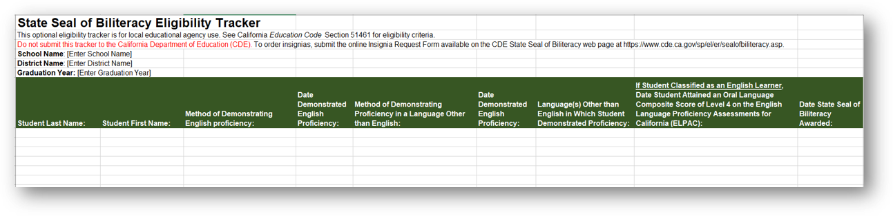
Record Keeping (2)
Optional Resource:
SSB Eligibility Tracker available on the CDE SSB web page under the “Requirements” tab.
Notes:
In order to facilitate the process of tracking eligible students, the CDE has provided interested parties with an eligibility tracker.
This is an optional resource that may be used or adapted as needed. This resource is for internal record keeping only. Please do not submit this form to the CDE but instead please use the online Insignia Request Form.
It is available on the CDE SSB web page under the “Requirements” tab. The link to this web page is available on your link document.
The optional SSB Eligibility Tracker is formatted as pictured here.
It includes spaces to enter the school and district name and the graduation year.
Below that, is a table with columns to enter the student’s name and how they fulfilled the requirements.
It includes a space to list how they demonstrated English proficiency, the date they demonstrated English proficiency, how they demonstrated proficiency in a language other than English, the date they demonstrated proficiency, and the language(s) in which the student demonstrated proficiency in addition to English.
It also includes an optional column to indicate when the student attained an oral language composite score of level 4 on the ELPAC.
Finally, it includes a column to list when the SSB was awarded.
LEAs are welcome to use this template, adapt it, or create their own system for tracking students. Some districts have used an online form to enter information for students who have met the requirements. A district might have each school enter students who meet the requirements using this form and then use the information submitted to order insignias on behalf of all participating schools and to keep records.
Again, how records are kept is a local decision.
[Click to advance to next slide]

Slide 34
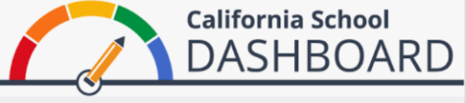
The SSB and the California Longitudinal Pupil Achievement Data System
LEAs indicate which students earned the SSB when exiting students in the California Longitudinal Pupil Achievement Data System.
Starting in 2018, the SSB was incorporated as one of the options an LEA may select for the College/Career Indicator for high schools. Students who earned the SSB will be reflected in the California School Dashboard.
Notes:
The SSB is also tracked using the California Longitudinal Pupil Achievement Data System, or CALPADS.
LEAs indicate which students earned the SSB when exiting students in CALPADS.
Starting in 2018, the SSB was incorporated as one of the options an LEA may select for the College/Career Indicator for high schools. Students who earned the SSB will be reflected in the California School Dashboard.
For more information on the California School Dashboard, visit the CDE California School Dashboard and System of Support web page. This link is available on your link document.
[Click to advance to next slide]

Slide 35
Equity and Raising Awareness
Notes:
Next, I will share some information and resources to ensure that the program is implemented equitably and that all students are aware of the SSB program.
[Click to advance to next slide]

Slide 36
Equity
The SSB may be awarded in any language, including indigenous languages, languages that do not have a written system, and American Sign Language (ASL).
The SSB should be available to all students, including students with IEPs, English learners, and students from other underserved populations.
See the CDE California Practitioners’ Guide for Educating English Learners with Disabilities.
Notes:
To ensure equity, the SSB may be awarded in any language, including indigenous languages, languages that do not have a written system, and American Sign Language, or ASL.
The SSB should be available to all students, including students with IEPs, English learners, and students from other underserved populations, including migratory students and students experiencing homelessness.
For more information about supporting English learners with disabilities, please see the CDE California Practitioners’ Guide for Educating English Learners with Disabilities. The link is available on the link document.
[Click to advance to next slide]

Slide 37
Highlighted FAQ: Students with Disabilities
Are the requirements for the SSB different for students who have an IEP?
For a student with an IEP, LEAs should defer to what is in the student’s IEP regarding testing. The decision to modify the SSB criteria would depend on the individual student and the decisions made by the student’s IEP team. The IEP team should review the student’s assessment plan and transition plan and determine what assessment(s) to use and what score on these assessments indicates proficiency in order to accurately measure the student’s biliteracy in light of the student’s IEP.
Notes:
An FAQ regarding students with disabilities is:
Are the requirements for the SSB different for students who have an IEP?
For a student with an IEP, LEAs should defer to what is in the student’s IEP regarding testing. The decision to modify the SSB criteria would depend on the individual student and the decisions made by the student’s IEP team. The IEP team should review the student’s assessment plan and transition plan and determine what assessment(s) to use and what score on these assessments indicates proficiency in order to accurately measure the student’s biliteracy in light of the student’s IEP.
[Click to advance to next slide]

Slide 38
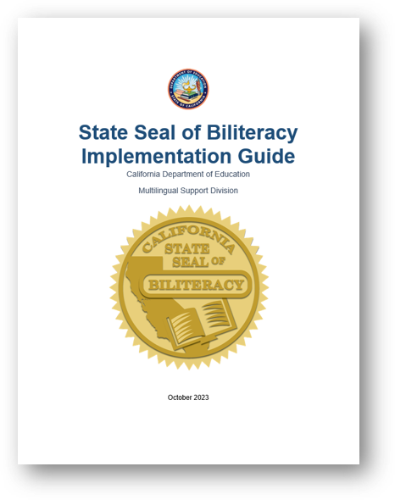
Highlighted Resource:
SSB Implementation Guide
Available under the “Resources” tab on the CDE SSB web page.
Includes all the information needed to start or strengthen an SSB program:
  Criteria
  Ordering process
  Best practices
  Self-Assessment Tool
  Sample handbook and website language
Notes:
If you are new to coordinating an SSB program or would like more resources and support, I would like to highlight the SSB Implementation Guide as a resource that can support you.
The SSB implementation Guide is available under the “Resources” tab on the SSB web page. The link to this page is on your link document.
The cover of this guide is pictured on the slide. The guide includes all the information needed to start or strengthen an SSB program including the criteria, ordering process, best practices, Self-Assessment Tool, and sample handbook and website language.
This guide includes everything I referenced in today’s webinar and more.
[Click to advance to next slide]

Slide 39
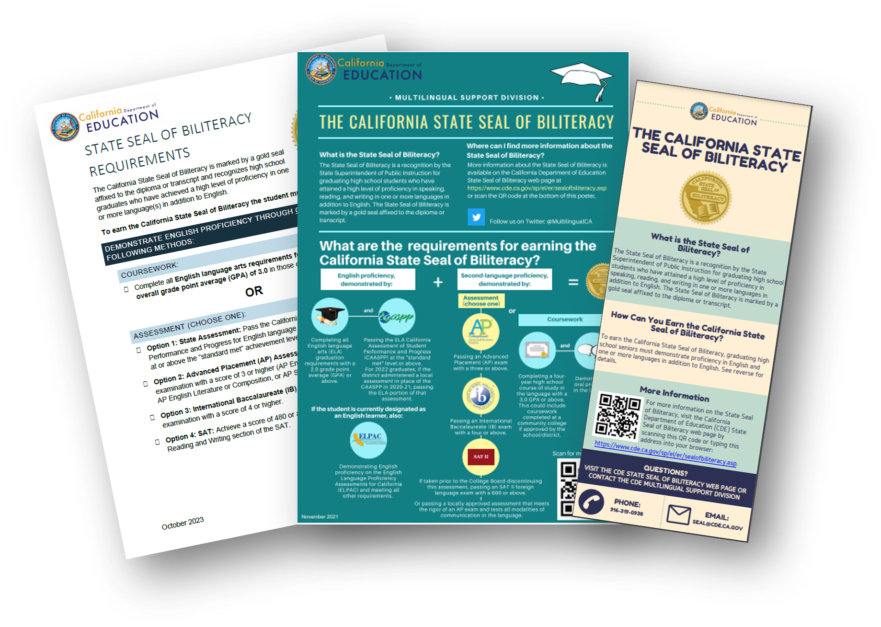
Raising Awareness Resources
Share information with students and families in grade 9 or before
Available on the CDE SSB web page under the “Resources” tab
  Requirements flyer (translations coming soon)
  Requirements poster (translations coming soon)
  Bookmark (translations coming soon)
  PowerPoint Presentation (coming soon)
  Flyer (translations coming soon)
  Sample handbook language (in the SSB Implementation Guide)
  Sample website language (in the SSB Implementation Guide)
Notes:
Raising awareness with students, families, and educators is key to implementing a new or strengthening an existing SSB program.
A variety of resources for raising awareness can be found on the CDE SSB web page under the “Resources” tab and also in the SSB Implementation Guide.
It is important to share information about the SSB with students in grade 9 or before. Information should also be shared with their families. Share information early and often to ensure that students have time to prepare to meet the requirements.
High schools may consider communicating with local feeder middle schools to get students excited about the seal and help them understand the requirements and paths to meeting them when they register for high school courses.
Some of the resources available are:
A requirements flyer that can be shared with students, families, teachers, and counselors. Counselors can also use this flyer to help students track their progress;
A requirements poster that can be posted in world language and English language development, or ELD, classrooms, counselor’s offices, bulletin boards, etc.;
A bookmark that can be provided to students;
This PowerPoint presentation which will be adapted for other audiences and posted to the website soon;
Sample handbook language, available in the SSB Implementation Guide, that LEAs can add to their handbooks; and
Sample website language, available in the SSB Implementation Guide, that LEAs can add to their websites.
The images of resources on this slide show the requirements flyer, the requirements poster, and the bookmark.
These resources are currently being translated and will be available in additional languages soon.
[Click to advance to next slide]

Slide 40
Ways to Raise Awareness
With Families:
Back to school nights
Open houses
Handbook
Letters and emails
School and district websites
Social media
English Learner Advisory Committee (ELAC), District English Learner Advisory Committee (DELAC), and other parent groups
Parent liaison
With Students:
World language classes
English language development classes
ELA or home room classes
Counseling appointments
Assemblies
Notes:
The resources highlighted on the previous slide can be used to raise awareness.
Some of the opportunities to use these resources to raise awareness with families are:
Back to school nights;
Open houses;
The handbook;
Letters and emails;
School and district websites;
Social media;
English Learner Advisory Committee, or ELAC, District English Learner Advisory Committees, or DELAC, and other parent groups; and
Parent liaisons.
Some of the opportunities to use these resources to raise awareness with students are:
World language classes,
ELD classes,
ELA or home room classes,
Counseling appointments, and
Assemblies.
Again, information should be shared early and often to ensure that students and families are fully aware of the SSB program and its requirements.
[Click to advance to next slide]

Slide 41
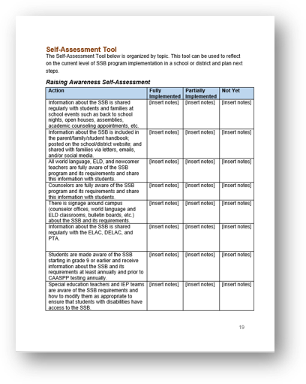
Highlighted Resource:
Self-Assessment Tool
Available in the SSB Implementation Guide
The Self-Assessment Tool covers:
  Raising awareness
  Processes
  Creating paths to biliteracy
Can be used for planning for new programs and to identify next steps for existing programs
Notes:
Finally, I would like to highlight one tool from the SSB Implementation Guide: the Self-Assessment Tool.
The Self-Assessment Tool covers:
Raising awareness,
Processes, and
Creating paths to biliteracy.
This tool can be used for planning for new programs and to identify next steps for existing programs.
The “Raising Awareness” section of the tool is pictured on this slide. It is a table that includes a column for actions with specific actions that an LEA can take to raise awareness (the text is too small to read in the image). Next to each action are columns labeled “fully implemented,” “partially implemented,” and “not yet.” These include space for LEAs to take notes of next steps or evidence.
I recommend using this tool with a school or district office staff to identify next steps and recommend ways to improve SSB programs and ensure all students have access to the SSB. If you come up with other ideas or practices that work well, please share them with me so I can continue to improve this resource!
[Click to advance to next slide]

Slide 42
Creating Paths to the Biliteracy and the SSB
Notes:
The final element I will cover today is creating paths to the biliteracy and the SSB.
[Click to advance to next slide]

Slide 43
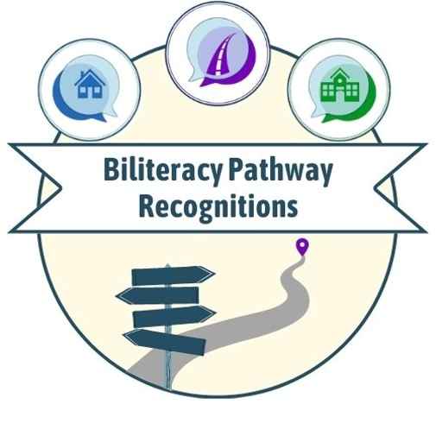
Biliteracy Pathway Recognitions
Purpose: To recognize preschool, kindergarten, elementary, and middle school students who have demonstrated progress toward proficiency in speaking, listening, reading, and writing in one or more languages in addition to English.
Notes:
The Biliteracy Pathway Recognition program was established in 2021.
The purpose of this program is to recognize preschool, kindergarten, elementary, and middle school students who have demonstrated progress toward proficiency in speaking, listening, reading, and writing in one or more languages in addition to English.
Just as the SSB recognizes high school graduates who have achieved a high level of literacy in one or more languages in addition to English, this program provides recognition for students who are on the path to biliteracy at key segments along their educational journey.
This slide includes an image of the Biliteracy Pathway Recognitions logo, which shows a path with a signpost and three speech bubbles above, one with a house, one with a road, and one with a school.
[Click to advance slide]

Slide 44
Three Biliteracy Pathway Recognitions
The three Biliteracy Pathway Recognitions available are:
The Biliteracy Program Participation Recognition;
The Home Language Development Recognition; and
The Biliteracy Attainment Recognition.
More information on the CDE Biliteracy Pathway Recognitions web page
Notes:
The three Biliteracy Pathway Recognitions available are:
1. The Biliteracy Program Participation Recognition (represented by an image of a school),
2. The Home Language Development Recognition (represented by an image of a house), and
3. The Biliteracy Attainment Recognition (represented by an image of a road).
LEAs may choose to award one or all of these recognitions. Since the requirements for the Biliteracy Pathway Recognitions are not established in law, the criteria are optional guidance and may be customized to fit the LEA’s program model(s) and the needs of students.
For more information on the Biliteracy Pathway Recognitions, please see the CDE Biliteracy Pathway Recognition web page. The link to this web page is available on your link doc.
[Click to advance slide]

Slide 45
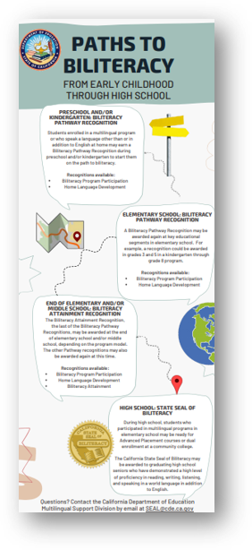
Creating Paths to Biliteracy
Multiple paths to biliteracy
  Home language proficiency
  World language coursework
  Multilingual program (dual language immersion, etc.)
  Schooling abroad
  Many more
Alignment and articulation with elementary and middle schools that feed into the high school (path from preschool–grade 12)
Notes:
There are multiple paths to the State Seal of Biliteracy.
A student that has a home language other than or in addition to English may continue to develop that language to a high level of proficiency and earn the SSB.
A student may also choose to complete world language coursework in high school or through dual enrollment at a community college to earn the seal.
Students who graduate from an elementary or middle school multilingual program, such as dual language immersion, may place into higher level courses in that language or take a qualifying assessment to earn the seal.
Similarly, students who completed schooling abroad in another language may have very high proficiency in the language and may earn the seal through an assessment or the coursework they completed in the other country.
These are just a few of the many paths to earning the SSB.
The bookmark pictured on this slide shows the Biliteracy Pathway Recognitions as a path to the SSB, starting with preschool and culminating in the SSB in grade 12. Recognitions may be awarded in preschool, elementary, and middle school to encourage students as they continue on the path to the SSB.
This bookmark is available on the CDE Biliteracy Pathway Recognitions web page along with other information and resources. The link is available on your link doc.
Alignment and articulation with elementary and middle schools that feed into the high school are vital to building a path to biliteracy from preschool through grade 12.
High schools can work with elementary and middle schools to identify students who may already be on the path to biliteracy and ensure these students receive the information and encouragement they need to earn the SSB.
It is especially important to reach out to English learners and other students who have a home language other than or in addition to English as these students are well on their way to biliteracy and may need encouragement to continue to develop the linguistic asset of the home language.
[Click to advance slide]

Slide 46
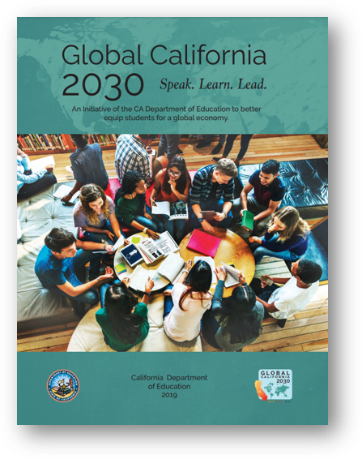
Global California 2030 Initiative
Sets ambitious goals to expand multiliteracy:
  By 2030: Half of all K–12 students participate in programs leading to proficiency in two or more languages
  By 2040: Three out of four students earn the SSB
Global California 2030 Report
Notes:
The importance of creating paths to biliteracy is reinforced by the Global California 2030 Initiative.
This initiative sets ambitious goals to expand multiliteracy, including:
By 2030: Half of all K–12 students participate in programs leading to proficiency in two or more languages, and
By 2040: Three out of four students earn the SSB.
The Global California 2030 Report articulates the goals of the initiative and is available as a PDF. The link is provided on your link doc.
To meet these goals and others articulated in the report, California must establish well articulated paths to biliteracy beginning in preschool that connect at each educational segment through grade 12 and beyond. The Biliteracy Pathway Recognitions are a first step toward creating these paths.
[Click to advance slide]

Slide 47

Questions and Answers
Notes:
[Optional time for questions and answers]
[Click to advance slide]

Slide 48
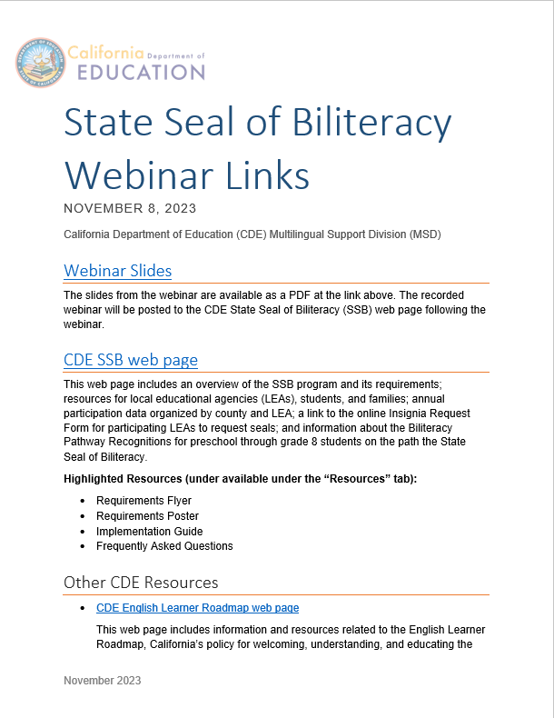
Resources
State Seal of Biliteracy webinar link document:
Posted with webinar slides (recorded webinar) on the CDE SSB web page at https://www.cde.ca.gov/sp/ml/
sealofbiliteracy.asp under the “Resources” tab
Notes:
As a reminder, the link document pictured on the slide is posted with the webinar recording on the CDE SSB web page at https://www.cde.ca.gov/sp/el/er/sealofbiliteracy.asp under the “Resources” tab.
This document has links to all the relevant resources that I referenced today.
[Click to advance slide]

Slide 49
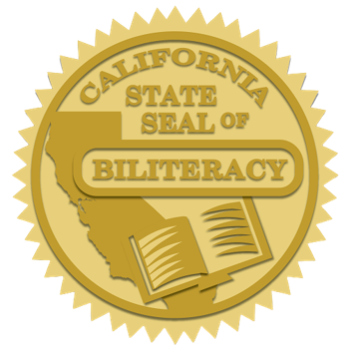
Thank You
Gina Garcia-Smith
Education Programs Consultant
Multilingual Support Division (MSD), California Department of Education (CDE)
SEAL@cde.ca.gov
916-319-0265 (direct line)
916-319-0938 (MSD main line)
Notes:
[Recommended to provide local SSB contact for the site or district as well]
Thank you for your interest in the SSB.
This important program helps prepare students with twenty-first century skills, encourage the study of languages, affirm cultural and linguistic identities, and build bridges between communities.
If you have any questions about the SSB, please contact Gina Garcia-Smith, Education Programs Consultant in the MSD at the CDE, by phone on her direct line at 916-319-0265 or through the main office at 916-319-0938.
You can also reach Gina by email at SEAL@cde.ca.gov.
Thank you for your time.
[Click to advance to next slide]

Slide 50
Long Description for Slide 7
This bar graph shows the growth in the number of SSBs awarded by school year.
2012-13: 10,685
2013-14: 23,941
2014-15: 32,766
2015-16: 39,741
2016-17: 46,380
2017-18: 55,214
2018-19: 57,486
2019-20: 65,622
2020-21: 2,593
2021-22: 57,518
2022-23: 59,703

Slide 51
Long Description for Slide 27
SSB visual shows “English proficiency demonstrated by,” there are two subtitles, “coursework,” or “assessment (choose one).” Under coursework is a graduation cap and scroll. Under "assessment" is the CAASPP, AP, IB, and SAT logos, each with "OR" between them. Below the cap is "If a student is currently designated as an English learner, Also: and the ELPAC logo. Below "second language proficiency, demonstrated by:" it says "assessment (choose one)" or "coursework." Under "Assessment is the AP, IB, and ACTFL logos and a checklist icon, each with "or" between them. Below "coursework" is a diploma and speech bubbles.

Slide 52
Long Description for Slide 33
Screenshot of the SSB Eligibility Tracker. It is an excel spreadsheet and includes space for the school name, district name, and graduation year. Below are columns to fill out for student last name, student first name, method of demonstrating English proficiency and date, method of demonstrating proficiency in a language other than English and date, language(s) in which student demonstrated proficiency, if student is current English learner date they achieved oral composite score of 4 on ELPAC, and date SSB was awarded.

