Slide 1
California Preschool Data Collection (CAPSDAC) 2.0 Training Webinar
Applied Data Research and Evaluation Office
California Department of Education (CDE)
Date: April 21, 2026
Time: 10:00 to 11:30 a.m.

Slide 2
Agenda
CAPSDAC 2.0 Features
CAPSDAC 2.0 User Manual Appendix A – Data Definitions
Beta Testing
In-person Training Sign Up
Update Site Information Into Child Development Management Information System (CDMIS)
Unique IDs
Certification & Timeline
Upcoming Webinars
Frequently Asked Questions ( FAQs)

Slide 3
Summary of Changes
Number of domains increasing from 3 to 10
Longitudinal system – no more unwanted data overrides!
California State Preschool Program ID (CSPPID) – A new state-wide identifier
Anomalies – what did I do wrong?
Reports and exports
Simplified monthly certification and new annual cycles
Certification process changes
User permissions – following Family Education Rights and Privacy Act (FERPA) rules

Slide 4
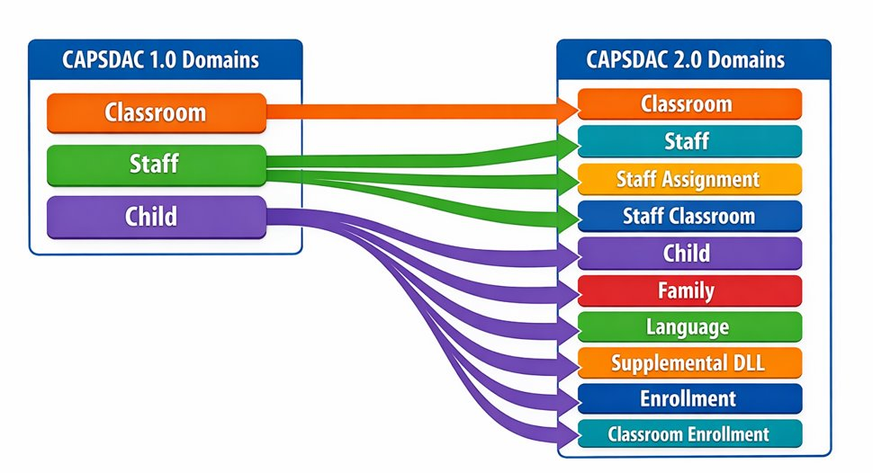
Domains Changes Between 1.0 and 2.0

Slide 5
Longitudinal System
Full set of data is entered once at the start of the school year.
Updates are only needed when things change.
Inserting/updating a record will not override everything else!

Slide 6
CSPPID
A new state-wide identifier for a child will be created called the CSPPID
This CSPPID will stay with a child, even if the child moves to a different Local Educational Agency (LEA).
LEA can perform a state-wide search to look for an existing CSPPID before requesting to generate a new one.

Slide 7
Anomalies
Three types of errors will need to be researched
Data discrepancies (DDs) – Validation errors that arise from conflicts between two data domains
Multiple ID errors (MIDs) – Potential duplicate CSPPID candidates
Statewide Student Identifier (SSID) sync errors – Unable to sync child data with CALPADS

Slide 8
Reports and Exports
Reports:
PowerBI reports give information in a user-friendly format
Embedded into the webpage for easy viewing
Can be downloaded or printed
Data exports:
Create data dumps in Comma Delimited (CSV) format with or without headers
Custom file names
Enter an email address to get notified when complete

Slide 9
User Permissions
LEA Admins can grant/restrict permissions to access their data
Permissions are granular to comply with FERPA regulations
Inquiry and Update permissions for each domain
Extracts permission
Reports permission
Certifier permission limits who can submit data certifications

Slide 10
Timeline
CAPSDAC 1.0 is being retired August 1, 2026, after the certification of the June 2026 data.
CAPSDAC 2.0 is launching July 1, 2026, for the 2026-27 school year! (Notice the one-month overlap)

Slide 11
CAPSDAC 2.0 User Manual Appendix A: Data Definitions
Available online at https://www.cde.ca.gov/sp/cd/capsdacchanges.asp
This document defines all the data fields in CAPSDAC 2.0.

Slide 12
Beta Testing
All current CAPSDAC 1.0 users have had accounts created for them to beta test CAPSDAC 2.0
Use your CAPSDAC 1.0 credential to log into CAPSDAC 2.0
URL: https://uat.staging.capsdac.org/
If additional staff members wish to take part in the beta testing, please ensure that CAPSDAC 1.0 accounts are created for them.

Slide 13
Upcoming In-Person Trainings
In-person at Fresno
  Tuesday, May 6, 2026 , from 9:00 am – 12:00 pm
In-person at Santa Clara
  Tuesday, June 16, 2026 , from 9:00 am – 12:00 pm

Slide 14
Update Site Information Into CDMIS
All preschool sites must be added and maintained in the Update Agency Information section of the CDMIS. This requirement applies to both center-based sites and family childcare homes.
Agencies should use this section to enter new site information and keep existing site details current.
After a new site is submitted and approved by the assigned Program Quality Implementation (PQI) Consultant, the information is fed into an internal site management system for County-District-School Code (CDS) review.
Once reviewed and approved, the site will be assigned its respective preschool CDS code.

Slide 15
Unique IDs
CDS codes (213 CDS codes will be different)
CSPPID (all kids will have new CSPPID starting July)

Slide 16
Certification Phases and First Certification (1)
Phase 1, July 2026: Classroom, Staff, Staff Assignment, Staff Classroom, Child, Family, Language, Supplemental Language, Enrollment, Classroom Enrollment
Phase 2, January 2027: Attendance and Education Program
Phase 3, 2030: Incident, Incident Result

Slide 17
Certification Phases and First Certification (2)
Certification Type | First Certification
Monthly (Phase 1 Enrollment, Attendance Phase 2) | Enrollment: August 2026 (July 2026 Data) Attendance: February 2027 (January 2027)
Fall (All other records) | December 2027 (Census Day Data 2027)
End of Year (All other records) | July 2027 (FY 2026–27 Data)

Slide 18
Certification Phases: Suggested Timeline (1)
The following three certification s offer a suggested timeline for submitting and certifying data. Information is not yet finalized and can be superseded by updated versions.

Slide 19
Certification Phases: Suggested Timeline (2)
CAPSDAC Submission | Primary Data Submitted | Official Submission Window | Recommended Date for Zero Errors | Certification Deadline | Amendment Window
Monthly (Prior month's data) | Enrollment Records Attendance Information | First day of the month through the last day of the month | Not Applicable | 15th of the month | Certification deadline date through the last day of the month

Slide 20
Certification Phases: Suggested Timeline (3)
CAPSDAC Submission | Primary Data Submitted | Official Submission Window | Recommended Date for Zero Errors | Certification Deadline | Amendment Window
Fall (Census Day data) | All Data Records Except Attendance and Enrollment | First Wednesday of October (Census Day) through late January Example: October 6, 2027 to January 22, 2028 | Two weeks prior to Certification Deadline Example: November 19, 2027 | Early/Mid December Example: December 10, 2027 | Certification Deadline through Late January Example: December 10, 2027 through January 21, 2028

Slide 21
Certification Phases: Suggested Timeline (4)
CAPSDAC Submission | Primary Data Submitted | Official Submission Window | Recommended Date for Zero Errors | Certification Deadline | Amendment Window
End of Year (Cumulative data) | All Data Records Except Attendance and Enrollment | Beginning of May through end of July Example: May 3, 2027 to July 30, 2027 | Two weeks prior to Certification Deadline Example: June 25, 2027 | Mid July Example: July 16, 2027 | Certification Deadline through End of July Example: July 19, 2027 through July 30, 2027

Slide 22
Upcoming Webinars/Office Hours
May 26, 2026 10 to 11:30a.m.
June 23, 2026 10 to 11:30a.m.

Slide 23
Resources and Documentation
CAPSDAC Support Webpage:
https://www.cde.ca.gov/sp/cd/ci/capsdacsupportlanding.asp
CAPSDAC Planning Resources for Upcoming Release:
https://www.cde.ca.gov/sp/cd/ci/capsdacchanges.asp
  CAPSDAC Data Domains and Fields
  CAPSDAC Code Sets
  CAPSDAC 2.0 File Upload Template
  CAPSDAC 2.0 User Manual Appendix B: Electronic file upload instructions

Slide 24

Question and Answer Session
Photo Credit: Kidango Decoto Center; Union City, CA

Slide 25
Thank you!

