Slide 1
Early Education Division Webinar
Early Education Division (EED)
and Fiscal and Administrative Services Division
Date: January 17, 2023
Time: 4:00 P.M. to 5:00 P.M.

Slide 2

Welcome and Introductions

Slide 3

Agenda
Welcome
January Governor's Proposed Budget Overview
  Universal Transitional Kindergarten (UTK)
  California State Preschool Program (CSPP)
  Other Investments
Upcoming Sessions
Question and Answers
Photo Credit: Kidango Decoto Center; Union City, CA

Slide 4

2023–24 Governor's
Proposed
Budget
Photo Credit: Tulare City School District; Tulare, CA

Slide 5
Governor's Proposed Budget: UTK
$690 million additional funds to implement the second year of Transitional Kindergarten (TK) expansion
$165 million additional funds to support the addition of one additional certified or classified staff
$550 million originally intended to be included in 2023–24 budget delayed until 2024–25.

Slide 6
Governor's Proposed Budget: CSPP
$116.3 million to cover cost of additional children needing exceptional needs adjustment factor as a requirement for serving children with disabilities increases to 7.5 percent of funded enrollment in 2023–24
$152.7 million to replace expiring federal funds currently supporting existing reimbursement rates
$763,000 to support the preschool Classroom Assessment Scoring System (CLASS)
Provides an 8.13 percent statutory Cost-of-Living Adjustment (COLA)

Slide 7
Governor's Proposed Budget: Other Items
Early Literacy
  $250 million to build upon existing Literacy Coaches and Reading Specialists Grant Program
  $1 million to create a Literacy Roadmap
Educator Workforce: Committed to continuing multi-year investments from previous years.
Universal school meals

Slide 8
ARPA Survey Reminder
Originally contractors were required to complete the American Rescue Plan Act (ARPA) survey for all sites to receive their $600 per-child stipend allocation.
CSPP Contractors who received or will be receiving ARPA funded benefits are required to submit a survey which allows the State to meet federal reporting requirements.
A second ARPA survey was released by the California Department of Social Services (CDSS) for purposes of collecting additional information from contractors.
CSPP Contractors MUST complete the 2nd ARPA survey, even if a response was previously submitted.

Slide 9
Upcoming Sessions
Webinar on Thursday, January 19, 2023, 10:00 a.m. - 11:30 a.m.
  Child Development Provider Accounting Reporting Information System (CPARIS) Contract Earnings Calculations Webinar
Technical Assistance Session on January 25, from 3:30 p.m. - 4:30 p.m. This session will focus on Management Bulletin (MB) 23-01 and the changes to eligibility and priority for CSPP
Webinar on Thursday, January 26, 2023, from 10:00 a.m. - 11:00 a.m.
  The CDE is in the final stages of approving the MB on serving children with disabilities (children with exceptional needs)
  The MB will include information on eligibility and priority, the set aside, and data collection, among others

Slide 10
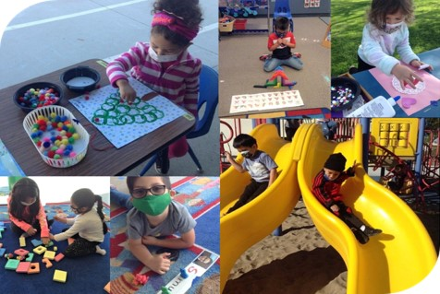
UPK Mixed Delivery Quality and Access Workgroup
The UPK Mixed Delivery Workgroup was established on December 1, 2022, and will meet from January 2023 until March 2024.The first meeting is January 26, 2023.
The workgroup will provide recommendations on increasing access and updating preschool standards
The workgroup is being convened by the CDE, in consultation with the Department of Social Services, and the State Board of Education. As part of a statewide collaborative effort, the CDE has welcomed the partnership of the California Commission on Teacher Credentialing (CTC).
Photo credit: UPS Preschool; Camarillo, CA

Slide 11

Questions
Photo credit: Photo Credit: Kidango Decoto Center; Union City, CA

Slide 12
Resources
PQI Office Regional Consultants
  https://www.cde.ca.gov/sp/cd/ci/assignments.asp
  Consultants are most easily reached by email
Early Education and Nutrition Fiscal Services (EENFS), Fiscal Apportionment Analyst Directory
  https://www.cde.ca.gov/fg/aa/cd/faad.asp
  Regulation Related Questions
  EEDTitle5@cde.ca.gov

Slide 13
Thank you

