Slide 1
This webinar will begin shortly. There will be no audio until the webinar begins at 10:00 AM. Thank you for your patience.

Slide 2
Early Education Division Webinar
Early Education Division and
Fiscal and Administrative Services Division
Date: January 21, 2022
Time: 10:00 AM – 11:00 AM

Slide 3
Welcome and Introductions

Slide 4
Meeting Agenda
Welcome
Budget Updates
Assembly Bill (AB) 1363
Reserve Account changes
Program Quality Implementation (PQI) Office Updates and Reminders
Continued Funding Application (CFA)
Request for Applications (RFA)
Opportunities to Support Workforce Development
Questions

Slide 5
Governor’s Budget
Photo Credit: Catholic Charities Treasure Island CDC; San Francisco, CA

Slide 6
Governor's Budget: Universal Transitional Kindergarten (UTK)
UTK
$640 million to expand eligibility for transitional kindergarten (TK), for all children turning five-years-old September 2 and February 2, beginning 2022–23.
$383 million to add an educator to every TK class
Expanded Learning (Includes Support for TK) Increases:
$3.4 billion for expanded learning rates and the Expanded Learning Opportunities Program (ELO-P)

Slide 7
Governor's Budget: California State Preschool Program (CSPP)
$309 million to increase CSPP adjustment factors to better support students with disabilities and dual language learners.
All students participating in CSPP will maintain continuous eligibility for 24 months (increased from 12 months).
After all eligible three- and four-year-old children are served, CSPP can serve eligible two-year-old children as last priority.

Slide 8
Governor's Budget: Inclusion
Children with an individualized education program (IEP) will be categorically eligible for CSPP.
New requirement for CSPP to serve at least 10 percent of children with IEP (similar to Head Start).
$500 million to support the Inclusive Early Education Expansion Program (IEEEP)
$2 million to incorporate early identification for learning disabilities into the state’s preschool assessment tools

Slide 9
Governor's Budget: Professional Development
$60 million to provide training for educators on effective use of assessment tools
$54.4 million to build upon the multi-year investments included in the 2021 Budget Act to support efforts to enhance schools’ ability to hire qualified teachers and substitutes

Slide 10
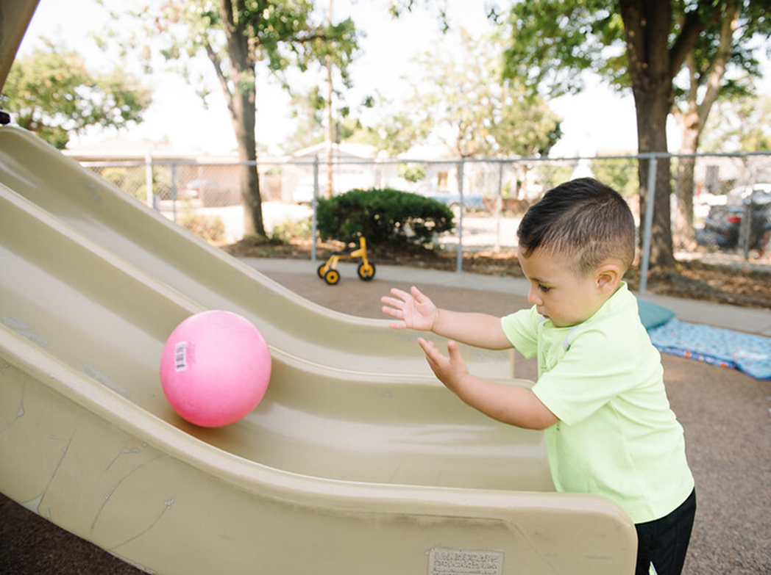
AB 1363 Update
Photo Credit: Kidango Decoto Center; Union City, CA

Slide 11
AB 1363 Updates
California Department of Education (CDE) Requirements
The CDE must develop:
A family language instrument,
A family language and interest interview
Criteria for CSPP contractors to accurately identify dual language learners (DLL) based on the family language instrument and the interest interview.
Requires data to be collected about dual language learners and the preschool program.
Next Steps
The CDE is required to develop guidance on implementation of this bill through a Management Bulletin (MB) on or before March 15, 2022.
This MB will notify and provide guidance to CSPP regarding the new requirements for how contractors must identify and collect data on children that are DLL.

Slide 12
American Rescue Plan Act (ARPA) Survey and Stipend Updates
American Rescue Plan Act funding distributed via:
Stipends based on March 2021 enrollment data
Rate Supplements based on September 2021 enrollment data
Rate Increases for non-local education agency (LEA) CSPP Contractors
ARPA Survey must be completed to receive ARPA funding.
The Early Education and Nutrition Fiscal Services (EENFS) office has been working with PQI to increase response rates.
ARPA Stipend Update
Have completed two rounds of stipend payments.
Round 3 data is being compiled now.

Slide 13
Reserve Account Changes
An email, titled Changes to Center-Based Reserves, was sent on December 13, 2021 informing contractors of changes in fiscal year (FY) 2021–2022.
Effective July 1, 2021, reserve accounts must be split into two accounts: one reserve for CSPP contracts and one reserve for all other California Department of Social Services (CDSS) center-based contracts.
Balances maintained in the CSPP Reserve may only be used for eligible CSPP expenditures.
Balances maintained in the Center-Based Reserve account for programs at CDSS may only be used for eligible expenditures for those programs.
In early January, Fiscal Analysts informed contractors with both reserve types of their FY 2021–22 beginning balances. Because reserve balances can change until the audit is processed or the year-end report revision deadline has passed, these reserve balances in FY 2021–22 remain preliminary.

Slide 14
Reserve Account Limits
The Preschool Reserve Account maximum limit will remain 15% of the sum of CSPP Contract Maximum Reimbursable Amounts (MRAs).
EC Section 8336 has also been amended to remove the requirement that 10 percent of the reservable amount must be utilized on professional development for the CSPP.

Slide 15
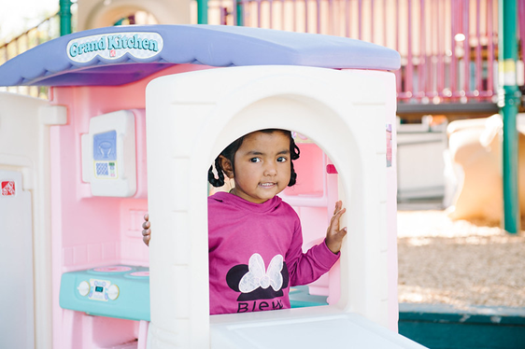
PQI Office Updates and Reminders
California State Preschool Program Closures:
COVID-19 Closures
Non-COVID-19 Emergency Closures
Distance Learning Requirements
Robla School District ECE Program; Sacramento, CA

Slide 16
FY 2022–23 CSPP CFA
Extension Requests:
CFA must be received on or before 5:00 p.m., January 31, 2022.
Methods to CFA Submission:
Electronic Submission
Option 1: Electronic CFA with a Digital Signature
Option 2: Scanned CFA with Wet Signature
Mail or In-Person Submission (Hard Copy)
Child Development Management Information System (CDMIS) Reminder:
Update CDMIS when there are any changes and/or updates to be made (e.g., site information).
If you have any questions and/or concerns, please email us at CFA@cde.ca.gov

Slide 17
FY 2021–22 CSPP RFA
$130 million in CSPP Expansion Funding
Available to Local Education Agencies (LEA):
Subcontracting
Family Childcare Home Education Network (FCCHEN)
Request for Applications:
Anticipated release of RFA
RFA Webinar
RFA Questions

Slide 18
Funding Opportunities to support Workforce Development
The Early Education Teacher Development Grant Program
Available to eligible LEAs, which include charter schools, school districts, and county offices of education.
The purpose of the grant:
(1) To increase the numbers of highly-qualified teachers available to serve in CSPP and TK. (2) Provide and elevate CSPP, TK, and kindergarten (K) teachers training in specific competencies.
February 2, 2022, by 5 p.m. - Mandatory Letter of Intent due to UPKWorkforceRFA@cde.ca.gov
Spring 2022 – Application released; technical assistance webinar to follow
The Universal Prekindergarten Teacher Pipeline Compendium

Slide 19
The California Preschool Learning Foundations (PLF)
$10 million in one-time funds to update by January 2024
Incorporate recent research in the field
Best practices to support dual language learners
Best practices to support children with disabilities
Adaptation of the Desired Results Development Profile (DRDP)
Direct Assessment of literacy and math
CDE participates in weekly meetings to keep this moving forward
Enhancing the alignment between preschool with the kindergarten to grade two standards

Slide 20
Questions
Photo Credit: Ford and Shannon TK; Richmond, CA

Slide 21
Resources
The EED COVID-19 Guidance web page
https://www.cde.ca.gov/sp/cd/re/elcdcovid19.asp
Webinar slides, MBs, Frequently Asked Questions (FAQs)
The EED Emergency email inbox
EEDEmergency@cde.ca.gov
The PQI Office Regional Consultants
https://www.cde.ca.gov/sp/cd/ci/assignments.asp
Consultants are most easily reached by email
or by phone at 916-322-6233

Slide 22
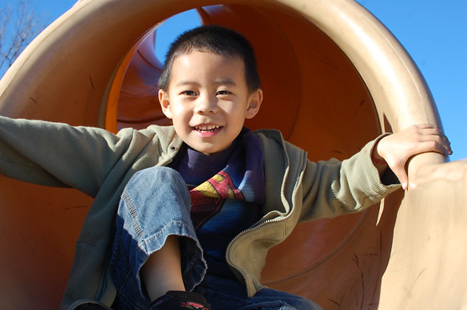
Closing
Photo Credit: Poplar Avenue School, Kindergarten, Oroville, CA

