Slide 1
Early Education Division Webinar
Early Education Division (EED)
Fiscal and Administrative Services Division (FASD)
Date: March 4, 2022
Time: 10:00 a.m. to 11:00 a.m.

Slide 2

Welcome and Introductions

Slide 3
Meeting Agenda
Budget Updates
Rate and Quality Workgroup
Assembly Bill (AB) 1363
Universal PreKindergarten Updates
Stipends and Child Development Provider Accounting Reporting Information System (CPARIS) Updates
California State Preschool Program (CSPP) Expansion Request for Applications and Training
Teacher Development Grant
Questions and Answers

Slide 4

Governor's Budget Updates
Trailer Bill Language released February 1, 2022
Budget Hearings are underway with the next hearing on March 8, 2022 at 9 A.M.
Frequently asked questions about the budget
Photo Credit: Tulare City School District; Tulare, CA

Slide 5
Rate and Quality Workgroup
Purpose: To assess the existing quality standards for childcare and development and preschool programs and the methodology for establishing reimbursement rates for those programs. The work group will provide recommendations relating to specified topics to the Joint Labor Management Committee, Department of Finance, and the Joint Legislative Budget Committee no later than August 15, 2022.
Meets Monthly
Next Meeting is March 11, 2022 from 8:30 A.M.-11:30 A.M.

Slide 6
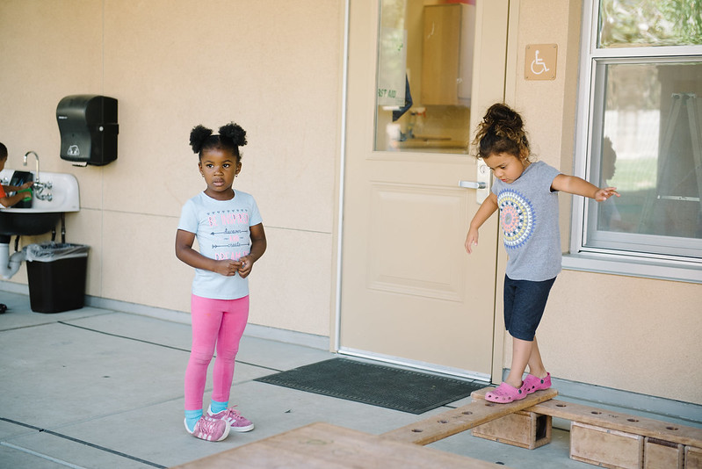
AB 1363 Preschool Dual Language Learners
Photo Credit: Lighthouse for Children CDC, Fresno CA

Slide 7
AB 1363 Requires Contractors to Conduct:
Family Language Instrument
Required by law to include:
  Language a child is exposed to in the home and community environment
  Language the child understands
  Language the child is able to speak
Family Language and Interest Interview
Required by law to include an inquiry and discussion about:
  Strengths and interests of the child
  Language background of the child
  Needs of parents, guardians, family members of the child to help support language and development of child

Slide 8
AB 1363 Data Collection
Contractors will be required to report:
  Child home language, language the child uses most, and family/guardian preferred language to receive verbal/written communication
  Race or ethnicity
  Language characteristics of program including but not limited to, whether the program uses the home language for instruction, such as DLL, or other program that supports the development of home languages.
  The language composition of the program staff.

Slide 9
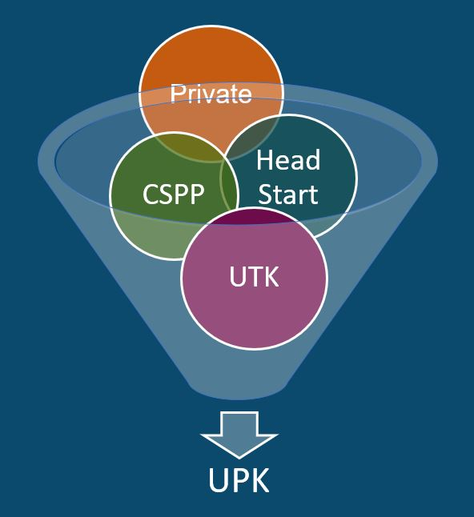
What is Universal PreKindergarten (UPK)?
UPK will bring together programs across early learning and K-12, relying heavily on Universal Transitional Kindergarten (UTK) and CSPP, as well as Head Start, community-based organizations (CBOs), and private preschool.
Universal means that by 2025–26,
regardless of background, race, zip code, immigration status, or income level – every child– has access to a quality learning experience the year before Kindergarten.

Slide 10
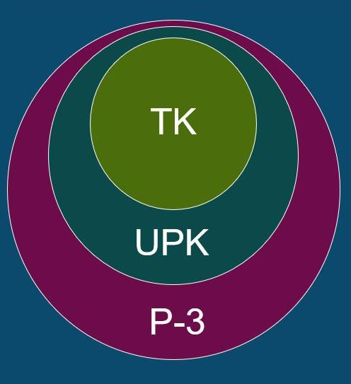
How Do Transitional Kindergarten (TK),
UPK, and Preschool through Grade 3 (P-3) Alignment Work Together?
TK is an integral program in the mixed delivery system for achieving UPK. It will be the only program that must serve any four-year-old child that wants to enroll by 2025–26.
UPK is a mixed-delivery system of UTK, CSPP, Head Start, expanded learning, private providers, and more. It provides every four-year-old child access to high quality learning the year before Kindergarten.
P-3 Connects UPK with Kindergarten, 1st, 2nd, and 3rd grade. It aligns developmentally informed best practices, UPK– 3rd grade.

Slide 11
UPK Template and Guidance
UPK Planning Template has required and recommended questions for local educational agencies (LEAs) to consider in UPK planning
  Outlines the data that will be required for submission to the CDE to meet the requirements of Education Code (EC) 8281.5 through a survey after June 30, 2022
Additional guidance corresponds to the template and introduces early education concepts, research, resources, programs, partnership opportunities, and policies
Both can be found at https://www.cde.ca.gov/ci/gs/em/

Slide 12
Stipends Update
American Rescue Plan Act (ARPA) Stipends based on March 2021 enrollment data
  ARPA Survey Response Required to receive ARPA funding
  Releasing stipends in rounds based on the completion of ARPA Survey.
  Third round of stipends should have been received by eligible contractors during the week of February 21.
72% of Preschool Contractors have received their stipend allocations to date.
Contact the ARPA Survey inbox at ARPASurvey@cde.ca.gov

Slide 13
Service County Enrollment Reporting
Management Bulletin (MB) 22-01 provided guidance to CSPP on the first stage of rate reform and requires enrollment reporting by service county beginning January 2022.
Child Development Provider Accounting Reporting Information System (CPARIS) has been updated to allow service county enrollment reporting.
The Early Education and Nutrition Fiscal Services (EENFS) conducted a webinar on February 24, 2022.
The CPARIS User Manual has been updated with CSPP-specific reporting instructions

Slide 14
Upcoming EED Trainings (1)
Overview of How to Implement a California State Preschool Program (CSPP) Contract
  Program Quality Implementation
    March 8th, 2022 from 1:00 P.M.-3:00 P.M.
  Fiscal and Administrative Services
    March 10th, 2022 from 9:00 A.M.-12:00 P.M.
  Child Development Management Information System
    March 10th, 2022 from 1:00 P.M.-3:00 P.M.

Slide 15
Upcoming EED Trainings (2)
Sustaining Program Quality Elements: Parent Involvement and Education and Health and Social Services
  March 24th, 2022 from 10:00 A.M.-12:00 P.M.
Additional trainings and details forthcoming

Slide 16
Fiscal Year (FY) 2021–22 CSPP Expansion Request for Applications (RFA)
$130 million in expansion funding available to local educational agencies
  Subcontracting
  Family Childcare Home Education Networks (FCCHEN)
The RFA was released on February 28, 2022
Instructional webinar on March 17, 2022
Applications due to the CDE by 5:00 P.M. on April 7, 2022

Slide 17
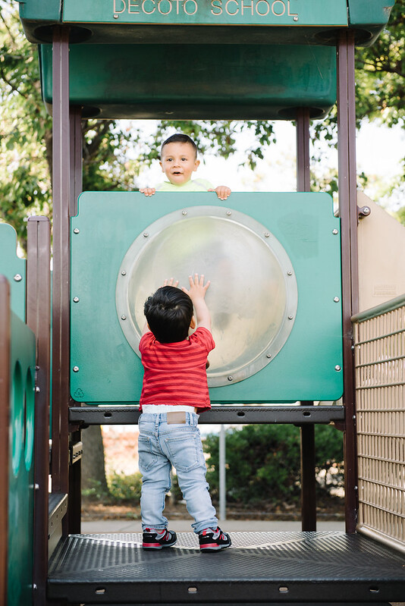
The Early Education Teacher Development Grant
To be released in early March
Will hold a technical assistance webinar afterwards
Questions? Email:
  UPKWorkforceRFA@cde.ca.gov
Photo Credit: Kidango Decoto Center; Union City, CA

Slide 18

Questions
Photo Credit: Kidango Decoto Center; Union City, CA

Slide 19
Resources
The EED COVID-19 Guidance web page
  https://www.cde.ca.gov/sp/cd/re/elcdcovid19.asp
  Webinar slides, MBs, Frequently Asked Questions (FAQs)
The EED Emergency email inbox
  EEDEmergency@cde.ca.gov
The PQI Office Regional Consultants
  https://www.cde.ca.gov/sp/cd/ci/assignments.asp
  Consultants are most easily reached by email
  or by phone at 916-322-6233

Slide 20
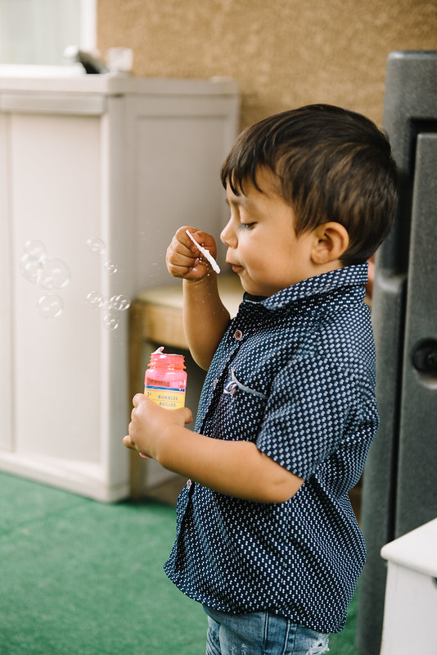
Closing
Photo Credit: Debra Manrique Family Child Care; Oxnard, CA

