Slide 1
Early Education Webinar
Early Education Division (EED)
Fiscal and Administrative Services Division (FASD)
Date: May 18, 2023
Time: 4:00 p.m. to 5:00 p.m.

Slide 2

Welcome and Introductions

Slide 3
Meeting Agenda
Welcome
Early Action Budget Items
Budget Process Timeline
Governor's May Revision
Legislative Budget Plans
Current Grants and Contracts Updates
Upcoming Events and Notifications
Question and Answer

Slide 4
Early Action Budget Items
Assembly Bill (AB) 100
  Allows for the California Department of Education (CDE) to use $5.3 million Proposition 98 (P98) General Fund (GF) and $4.4 million Non-P98 GF to support the extension of family fee waivers from July 1, 2023, to September 30, 2023.
Assembly Bill (AB) 110
  Includes statutory language to extend the current family fee waiver until September 30, 2023
  Authorizes the CDE to issue temporary rate increases to contractors that exceed the existing contract reimbursement rates

Slide 5
Plans for Early Action Allocations
Family Fee Waiver Allocations
  AB 110 provides additional funding authority to ensure contractors have sufficient funds to cover the cost of family fee waivers between July 1, 2023, and September 30, 2023.
  California State Preschool Program (CSPP) contractors will receive an allocation to cover the costs of the family fee waivers, and will be included as part of the CSPP Budget Act amendment, expected to be released in Fall 2023.
Temporary Rate Increases
  CDE is working on a methodology for allocating funds to CSPP contractors.
  CDE plans to issue one-time, lump-sum payments that will not be provided as an augmentation to the CSPP contract, but issued as an apportionment payment.

Slide 6

Budget Process Timeline
January 10: Governor's proposed budget released
Late May to Early June: Budget committee hearings
Late February: Budget subcommittee hearings began
February 1: Trailer Bill Language released
June 15: Budget Bill must be passed
May 12: May Revision released

Slide 7
State Fiscal Condition Weaker than Estimated in January
In January, the Governor's proposed budget for 2023–24 maintained funding for Early Education programs despite the projected $22.5 billion shortfall.
Since January, this shortfall has grown by $9.3 billion to $31.5 billion at the time of the May Revision.
Despite this, the Governor's May Revision budget proposal continues to recognize the importance of Early Education.

Slide 8
Governor's May Revision Proposals:
Universal Transitional Kindergarten (UTK)
Continues to support investments of UTK expansion, including:
  Revised costs for the first year of TK expansion:
    $357 million for expanding access to all children turning five years old between September 2 and February 2.
    $283 million for the first-year costs to for one additional certificated or classified staff person in every Transitional Kindergarten (TK) class.
  $597 million for the second-year costs (upcoming fiscal year) to expand access to all children turning five-years-old between September 2 and April 2.

Slide 9
Governor's May Revision Proposals:
Universal PreKindergarten Proposed Statutory Changes
January proposal included requirements for second adult in TK classroom; May Revise adds additional options for meeting new requirement, specifically:
  The adult has completed at least 6 units in early childhood education or child development or both.
  The adult has sufficient related experience as determined by the local educational agency.
Allowance for children with summer birthdays to enroll in Early Admittance TK
Allows returned UPK Planning and Implementation Grant funds to be allocated to the Early Education Teacher Development Grant

Slide 10
Governor's May Revision Proposals:
California State Preschool Program
Incorporates Early Action items, including waiving family fees until September 30, 2023, and temporary rate increases
Provides an 8.22 percent Cost of Living Adjustment (COLA)
Proposes to allow children who live in or whose parents work in a neighborhood meeting the requirements of CSPP neighborhood school eligibility to enroll at any CSPP site

Slide 11
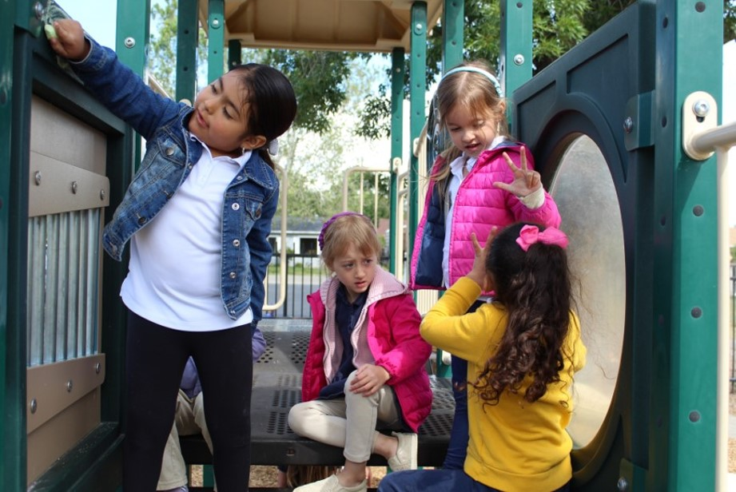
Governor's May Revision: Other Investments
Educator Workforce: Committed to continuing multi-year investments from previous years.
  Includes statutory amendments to allow for comparable California Teaching Credentials to be issued to any U.S. military servicemember or spouse
Universal school meals
Facilities
Expanded Learning Opportunities Program (ELO-P)
Photo Credit: Tree of Life, International Charter School; Anderson, CA

Slide 12
Legislative Plans
Senate Budget Plan (Proposed)
  Childcare/Preschool Rates: $800 million in new funding
  Family Fees: Overhaul of family fee structure
  Preschool and TK Facilities: Rejects the Governor’s reductions and delays to facilities programs and grants
  Workforce Investments: $1.1 billion to address workforce needs
  Teacher Residency Investment: $150 million to increase stipends
Assembly Budget Plan (Proposed)
  Increases childcare funding by 25.44 percent through an increased COLA

Slide 13
Current Grants and Contracts Updates
CSPP Quality Rating Improvement System (QRIS) Block Grant
  The funding application was released May 15
Early Education Teacher Development Grant (EETDG)
  First round of reporting April 2023
Preschool Learning Foundations (PLFs)
  Revision to include emphasis on diversity, equity, and inclusion
Desired Results Developmental Profiles (DRDP)
  Adaptions will align with changes to PLFs; participation welcome
Early Identification Tool (EIT)
  Legislative Report due on October 5, 2023

Slide 14
Upcoming Events and Notifications:
Annual Program Self-Evaluation
Management Bulletin 23-04: Fiscal Year 2022–23 Program Self-Evaluation (PSE) for California State Preschool Program (CSPP) Contractors
  To be completed via survey
  Due June 1, 2023, by 5:00 p.m.
  Fiscal Year 2022–23 PSE webpage: https://www.cde.ca.gov/sp/cd/ci/pseforms.asp

Slide 15
Upcoming Events and Notifications
Child Development Management Information System (CDMIS) Training Webinar
  May 24, 2023, 10:00 a.m. - 12:00 p.m.
Universal PreKindergarten (UPK) Mixed Delivery Quality and Access Workgroup Meeting
  May 25, 2023, 12:30 p.m. - 4:30 p.m.
Supporting Dual Language Learners in California State Preschool Programs Webinar
  June 13, 2023, 3 p.m. - 4:30 p.m.

Slide 16

Questions
Photo Credit: Kidango Decoto Center; Union City, CA

Slide 17
Resources
Program Quality Implementation (PQI) Office Regional Consultants Directory
  https://www.cde.ca.gov/sp/cd/ci/assignments.asp
  Consultants are most easily reached by email
Early Education and Nutrition Fiscal Services (EENFS), Fiscal Apportionment Analyst Directory
  https://www.cde.ca.gov/fg/aa/cd/faad.asp
  Regulation Related Questions
  EEDTitle5@cde.ca.gov

Slide 18

Closing
Photo Credit: Debra Manrique Family Child Care; Oxnard, CA

