Slide 1
Achieving Success in Positive Interactions, Relationships, and Environments Webinar
This webinar will begin shortly.
There will be no audio until the webinar begins at 2:30 p.m.
Thank you for your patience.

Slide 2
Leveraging the Achieving Success in Positive Interactions, Relationships, and Environments Grant to Support Classroom Assessment Scoring System Implementation
Early Education Division
Date: October 8, 2024
Time: 2:30 – 4:00 p.m.

Slide 3
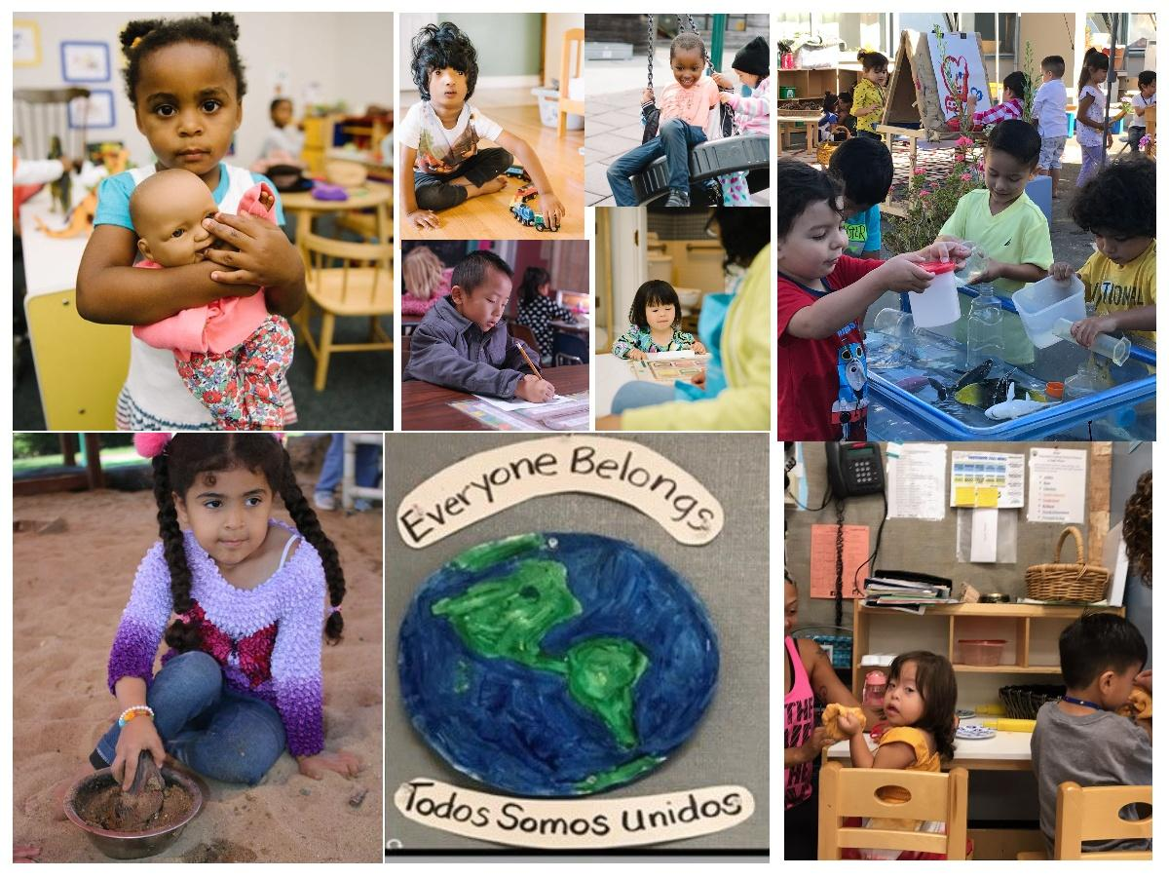
Welcome and Introductions

Slide 4
Agenda
Overview of the Policy and Purpose
Implementation of the Classroom Assessment Scoring System (CLASS) Second Edition Pre-K-3rd
Implementation of CLASS Environment
Additional CLASS Information
Achieving Success in Positive Interactions, Relationships, and Environments (ASPIRE)
ASPIRE Accomplishments
Questions and Answers

Slide 5
Policy and Purpose

Slide 6
Policy and Purpose (1)
Management Bulletin (MB) 23-10 notifies and provides guidance for California State Preschool Programs (CSPP) on new requirements to use CLASS and CLASS Environment and changes to Title 5 regulations:
  Requirements to phase in implementation of the CLASS, the CLASS Environment tool, and additional environment requirements
  Removal of current requirements for contractors to complete the Environment Rating Scale (ERS)
  As of July 1, 2024, contractors will no longer be required to complete an ERS annually
  Instead, contractors are required to implement CLASS Second Edition Pre-K-3rd, the CLASS Environment, and the additional requirements as specified

Slide 7
Policy and Purpose (2)
At this time, the CLASS tools and data will not be used by the California Department of Education (CDE) to determine a finding during monitoring, but rather to identify where additional support is needed for continuous quality improvement in the CSPP.
CLASS data should be used by CSPPs to inform professional development, coaching, and other continuous quality improvement efforts.
Contractors shall not use CLASS scores to evaluate staff competency.
If violations of state or federal law are observed during a CLASS Second Edition Pre-K-3rd or CLASS Environment observation, the person observing shall continue to follow all applicable laws.

Slide 8
Implementation of CLASS
Second Edition Pre-K-3rd

Slide 9
Implementation of CLASS - Overview
As of July 1, 2024:
All CSPP contractors are required to use the CLASS tool
CLASS will be implemented with a graduated phase-in approach that will allow time for the state and contractors to increase CLASS Observation capacity until full implementation in program year 2028–29
Beginning July 1, 2028, all contractors are required to obtain at least one CLASS Observation on each CSPP classroom per program year

Slide 10
Implementation of CLASS: Timeline
Year Number | Program Year | Percent of CSPP Classrooms Within the Agency’s Contract That Must Have Annual CLASS Observation Completed
1 | 2023–24 | No requirement; however, contractors should use 2023–24 to begin developing an agency plan for CLASS implementation
2 | 2024–25 | 15%
3 | 2025–26 | 30%
4 | 2026–27 | 60%
5 | 2027–28 | 90%
6 | 2028–29 and beyond | 100%

Slide 11
Requirements for CLASS Observers
Any Certified CLASS observer who is conducting an observation in a CSPP classroom must also have completed the CLASS Observer Support Series, including:​
  Settings with Dual Language Learners
  Settings with Children with Disabilities
  Reducing Bias​
The purpose of this additional training requirement is to ensure California is centering diversity, equity, inclusion, and belonging in CLASS implementation.

Slide 12
Implementation of
CLASS Environment

Slide 13
Implementation of CLASS Environment: Overview
As of July 1, 2024:
  CSPP contractors are no longer required to complete an ERS annually, as part of the Program Self-Evaluation and as part of a contract monitoring review
  All CSPP contractors are required to implement the CLASS Environment
  CLASS Environment has been implemented with a graduated phase-in approach, requiring any license-exempt classrooms to be phased in first
Beginning July 1, 2028, all contractors are required to obtain at least one CLASS Environment observation on each CSPP classroom per program year

Slide 14
Implementation of CLASS Environment: Timeline
Year | Program Year | Percent of CSPP Classrooms Within the Contract That Must Have an Annual CLASS Environment Observation Completed
1 | 2023–24 | No requirement; however, contractors should use 2023–24 to begin developing an agency plan for CLASS Environment implementation. (Note: Final year ERS is in effect.)
2 | 2024–25 | 15%
3 | 2025–26 | 30%
4 | 2026–27 | 60%
5 | 2027–28 | 90%
6 | 2028–29 and beyond | 100%

Slide 15
Requirements for CLASS Environment Observers
CLASS Environment Observers must have completed all the following requirements:
CLASS Certification
CLASS Support Series:
  Settings with Dual Language Learners
  Settings with Children with Disabilities
  Reducing Bias
CLASS Environment training:​
  CLASS Environment Foundations
  CLASS Environment within a CLASS Observation
The purpose of this additional training requirement is to ensure California is centering diversity, equity, inclusion, and belonging in CLASS Environment implementation
​

Slide 16
Additional Environment Requirements

Slide 17
Additional Requirements (1)
Certain requirements that were included in the ERS remain necessary to support quality improvement. Therefore, contractors must meet the following requirements, which are preserved from the ERS:
  Provide a regularly scheduled time to nap or rest for all children enrolled in CSPP for four or more hours
  Cots or mats must be at least 18 inches apart
  Napping and rest activities must be provided in a clean and sanitary manner
  Space must be conducive to resting

Slide 18
Additional Requirements (2)
Ensure schedules provide a balance of structure and flexibility. The schedule must include the following each day:
  A variety of play activities
  Both gross motor and less active play
  At least one indoor and one outdoor play period (weather permitting)

Slide 19
Additional Requirements (3)
Post written handwashing procedures in a place that is visible to children and adults
Handwashing procedures must be followed by children and adults
Provide storage spaces with security provisions where staff can store their personal belongings
Have space and/or policies in place to support staff for work-related tasks such as conferences and meetings and to support staff for personal breaks

Slide 20
Additional CLASS Implementation
Information

Slide 21
Obtaining CLASS Observations
It is the Contractor’s responsibility to plan and meet the requirements. As contractors build capacity, they have the following options to obtain CLASS Second Edition Pre-K-3rd and CLASS Environment observations:
Contractors can send program staff to certified CLASS Observer training provided through the regional leads funded with CSPP ASPIRE funding
Contractors can have CLASS Second Edition Pre-K-3rd and/or CLASS Environment completed by a certified observer from other funding
Contractors can connect with their regional leads for support in finding certified CLASS Second Edition Pre-K-3rd and CLASS Environment observers

Slide 22
CLASS Documentation (1)
Contractors are required to keep the following documentation at the contractor level to be made available to the CDE as requested:
  Current CLASS Observer certifications for all staff employed by the contractor that have completed the CLASS Second Edition Pre-K-3rd and CLASS Environment Observation training and passed the certification or recertification test
  All CLASS Second Edition Pre-K-3rd and CLASS Environment observation scoresheets for each CSPP classroom, or CSPP classroom scores on an observation or scoring summary document provided by the observer that provides some context about the observation

Slide 23
CLASS Documentation (2)
All coaching and/or training documentation associated with CLASS Second Edition Pre-K-3rd and CLASS Environment Observations
Name and agency association for all CLASS Observers that complete CLASS Second Edition Pre-K-3rd and CLASS Environment observations that are not employed by the CSPP contractor
  Note that this information can be captured informally such as on the scoresheet or scoring summary provided at the end of the observation

Slide 24
CLASS Data for Statewide and Regional Leads
CSPP contractors:
  must provide data and information requested by the Regional and Statewide Leads funded through ASPIRE
  operating in multiple counties, must provide information at the county level to the appropriate regional lead(s)
  operating an approved CSPP Family Child Care Home Education Network, will need to collect and share with their CSPP regional leads data relating to the individual providers

Slide 25
CLASS Data Guidance
The CDE is still in the process of finalizing the CLASS Second Edition Pre-K-3rd and CLASS Environment data reporting instructions
Once finalized, the data reporting instructions will be posted on the CLASS Resources page and contractors will be notified via the Early Education Division's email distribution list

Slide 26
CLASS Data and the PSE
As part of the submission of the annual PSE, CSPP contractors should be ready to report on the implementation of CLASS and CLASS Environment. This may include observation scores and any training or coaching received related to CLASS.

Slide 27
ASPIRE

Slide 28
ASPIRE Overview
The ASPIRE grant request for applications (RFA) was released in the spring of 2024
The ASPIRE leads were selected in May 2024
The ASPIRE grant was awarded to:
  One statewide lead
  Four regional leads
ASPIRE funding provides the overall coordination of CLASS implementation across the state for CLASS Second Edition Pre-K-3rd and CLASS Environment for CSPPs

Slide 29

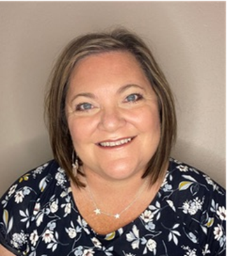
Statewide Lead
El Dorado County Office of Education
Elizabeth Blakemore
ASPIRE Statewide Lead
Melissa Wheelahan
ASPIRE Statewide Lead

Slide 30
Statewide Lead
Responsibilities of statewide lead for CLASS implementation for CSPP are the following:
  coordinate efforts across the four regions in collaboration with the regional leads,
  contract with Teachstone to support CLASS implementation,
  create equitable access to resources and training, and
  ensure coordinated data sharing and reporting.

Slide 31
Regional Leads
Responsibilities of the regional leads for CLASS implementation for CSPP are the following:
support contractors with CLASS implementation and capacity building
conduct needs assessments throughout each region
use the needs assessment data to develop a regional plan
the goal of each regional plan is to meet the needs of all CSPPs specific to the region

Slide 32
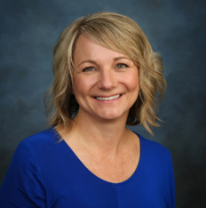
Region A Regional Lead
Region A: Northern
Butte, Del Norte, Glenn, Humboldt, Lake, Lassen, Mendocino, Modoc, Plumas, Shasta, Siskiyou, Sonoma, Tehama, and Trinity Region
Regional Lead: Shasta County Office of Education
Rea McFadden
rmcfadden@shastacoe.org

Slide 33
Region A Data
Based on the needs assessments collected in region A, the data shows:
  Current response rate: 98 percent
  Number of contractors: 51
  Number of sessions: 276
  Number of CLASS 2008 observers: 57
  Number of CLASS 2008 trainers: 13
  Number of CLASS Second Edition Pre-K-3rd observers: 42
  Number of CLASS Second Edition Pre-K-3rd trainers: 7
  Number of sessions being observed by the block grant: 114

Slide 34
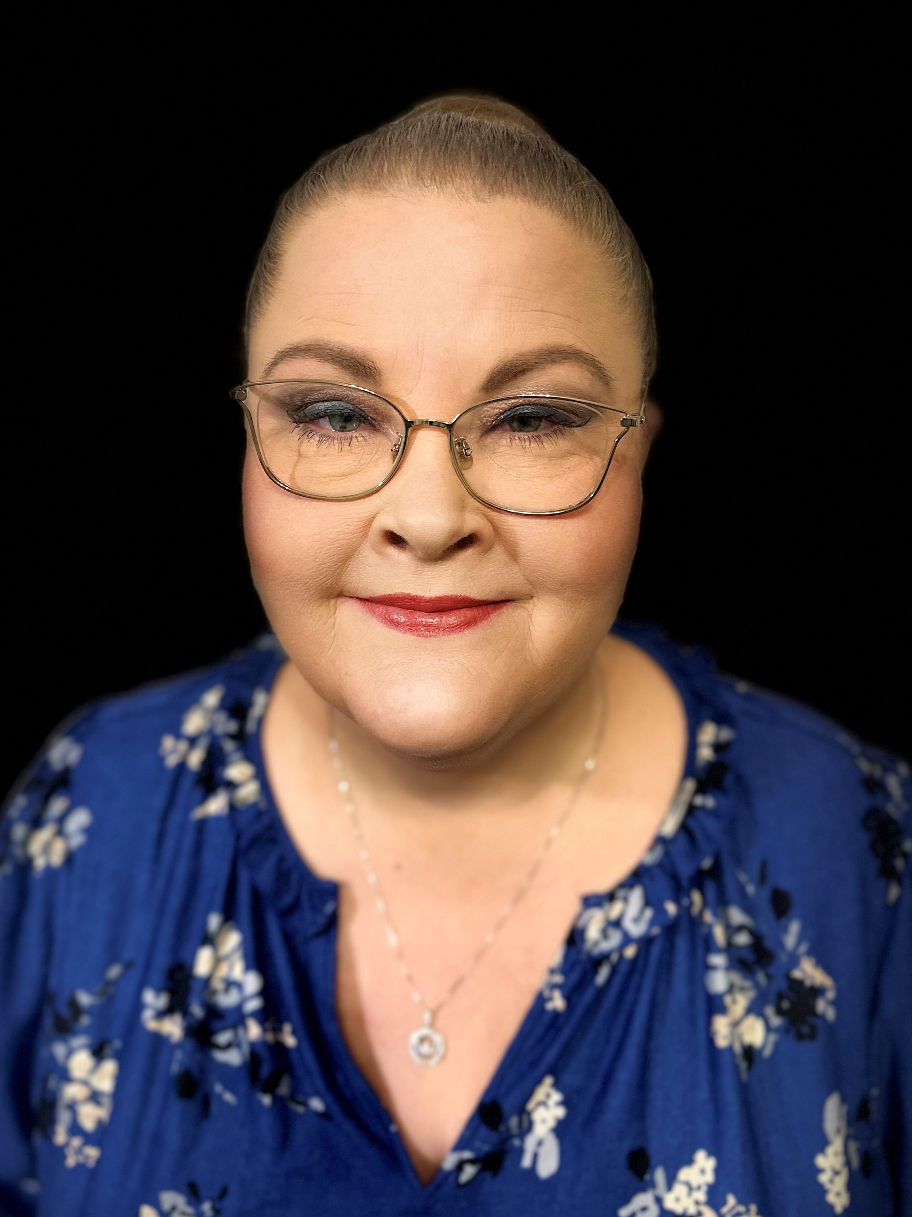
Region B Regional Lead
Region B: Greater Sacramento and Bay
Alameda, Alpine, Amador, Calaveras, Colusa, Contra Costa, El Dorado, Marin, Monterey, Napa, Nevada, Placer, Sacramento, San Benito, Santa Clara, Santa Cruz, San Francisco, San Joaquin, San Mateo, Sierra, Solano, Stanislaus, Sutter, Tuolumne, Yolo, and Yuba Region
Regional Lead: El Dorado County Office of Education (EDCOE)
Denise Gale
ASPIRERegionB@edcoe.org

Slide 35
Region B Data
Based on the needs assessments collected in region B, the data shows:
  Current response rate: 82 percent
  Number of contractors: 229
  Number of sessions: 1829
  Number of CLASS 2008 observers: 236
  Number of CLASS 2008 trainers: 40
  Number of CLASS Second Edition Pre-K-3rd observers: 112
  Number of CLASS Second Edition Pre-K-3rd trainers: 19
  Number of sessions being observed by the block grant: 312

Slide 36
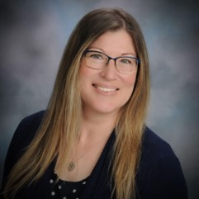
Region C Regional Lead
Region C: Central Valley and Coast
Fresno, Kern, Kings, Madera, Merced, Mariposa, San Luis Obispo, Santa Barbara, Tulare, and Ventura Region
Regional Lead: Ventura County Office of Education
Alicia McFarland
aspireregionc@vcoe.org

Slide 37
Region C Data
Based on the needs assessments collected in region C, the data shows:
  Current response rate: 90 percent
  Number of contractors: 118
  Number of sessions: 1017
  Number of CLASS 2008 observers: 170
  Number of CLASS 2008 trainers: 36
  Number of CLASS Second Edition Pre-K-3rd observers: 69
  Number of CLASS Second Edition Pre-K-3rd trainers: 6
  Number of sessions being observed by the block grant: 139

Slide 38
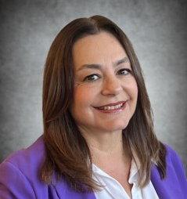
Region D Regional Lead
Region D: Southern and High Desert
Imperial, Inyo, Los Angeles, Mono, Orange, Riverside, San Bernardino, and San Diego Region
Regional Lead: San Diego County Office of Education
Eunice Munro
ASPIRE-RegionD@sdcoe.net

Slide 39
Region D Data
Based on the needs assessments collected in region D, the data shows:
  Current response rate: 83 percent
  Number of contractors: 275
  Number of sessions: 3275
  Number of CLASS 2008 observers: 210
  Number of CLASS 2008 trainers: 182
  Number of CLASS Second Edition Pre-K-3rd observers: 60
  Number of CLASS Second Edition Pre-K-3rd trainers: 199
  Number of sessions being observed by the block grant: 537

Slide 40
ASPIRE Accomplishments

Slide 41
EDCOE and Teachstone Contract
As of July 29, 2024, EDCOE executed a two-year contract with Teachstone
The goal of the contract is to support CLASS implementation statewide by:
  Increasing CLASS knowledge through trainings
  Building observer capacity
  Building trainer capacity
  Supporting data management and data quality

Slide 42
Needs Assessment
Each regional lead sent out and collected needs assessments in July from:
  CSPP Contractors
  CSPP Quality Rating Improvement System Block Grantees
The needs assessment return rate was 87 percent at the end of August
NOTE: This was a required data reporting survey for CSPP contractors; therefore, if your program has not completed the survey, you must complete it and return it to your Regional Lead

Slide 43
Capacity Building
The start of CLASS capacity building in California includes:
  Facilitating the transition of 60 current trainers from the CLASS 2008 tool to the CLASS Second Edition Pre-K-3rd tool
  Scheduling Observer Transition training
  Scheduling new Measurement Trainer training

Slide 44
What’s Next with ASPIRE
November Kick-Off Event
  This event is designed for administrators, site leaders, educators, and coaches, offering an in-depth introduction to the strengths of CLASS
  Participants will have the opportunity to join breakout sessions and learn more on CLASS and CLASS Environment

Slide 45

CLASS Resources
Scan the code above to access the
CDE CLASS Resources web page.

Slide 46
Questions and Answers

Slide 47
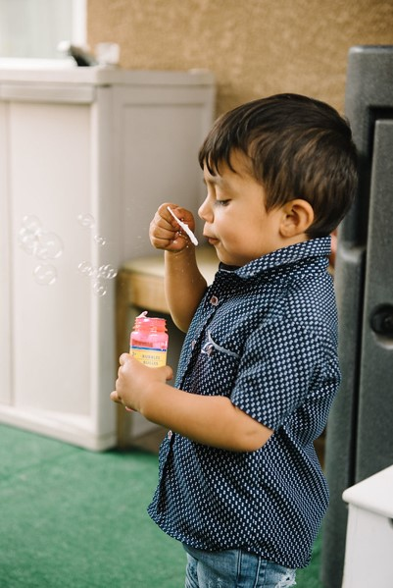
Thank You
Photo Credit: Debra Manrique Family Child Care; Oxnard, CA

