Slide 1
Child Development Management Information System (CDMIS)
Maintenance and Optimization (M&O)
Technical Assistance Webinar
Date: February 15, 2023
Time: 10-11:30 a.m.

Slide 2

Agenda
Introduction of the CDMIS Support Team
Review of Areas of Impact and Updates within CDMIS
Demonstration of Updates
Question and Answer Session
Closing Remarks
Photo Credit: Reading Harvest

Slide 3
Introduction of the CDMIS Team (1)
California Department of Education (CDE)
  Jane Liang, Ed.D – Education Administrator
  Carly Nodohara – Education Programs Assistant
  Josephine Chan –Associate Governmental Program Analyst
  Steven Granados – Associate Governmental Program Analyst
  Jordan Fairbanks – Office Technician
  Ethan Thich – Student Assistant
2

Slide 4
Introduction of the CDMIS Team (2)
California Department of Social Services (CDSS)
  Cliff Li – Research Data Manager
  Thomas Ponik - Staff Services Manager I
  Jessica Caplinger - Associate Governmental Program Analyst
3

Slide 5
What to Expect
High Level Summary of Updates & Enhancements
Enhancement to the exchange and tracking of communications between external users and CDE
Improved viewing ability for external users related to report submission statuses
How a logical navigation structure provides easier navigation through CDMIS and improved user interface elements including typography, layout, system notifications and instructions improve the experience
Near real-time notification of submission status and daily processing of the CDD-801A report

Slide 6
Update to Agency Information
Historical Perspective
  Historically, CDMIS users were not able to submit agency update documentation via the CDMIS. Instead, they were directed to email these documents to their assigned Program Quality Implementation (PQI) consultant via email.​
New Upload Feature
  In addition to the previous functionality, including the following
    Adding or Editing Family Child Care Home (FCCH) Information
      Adding or Editing Sites or Offices
      Editing Executive Director Information
      Editing Program Director Information
    Users are now able to upload corresponding files, of specified formats, to the CDMIS under the Update Agency Information function.

Slide 7
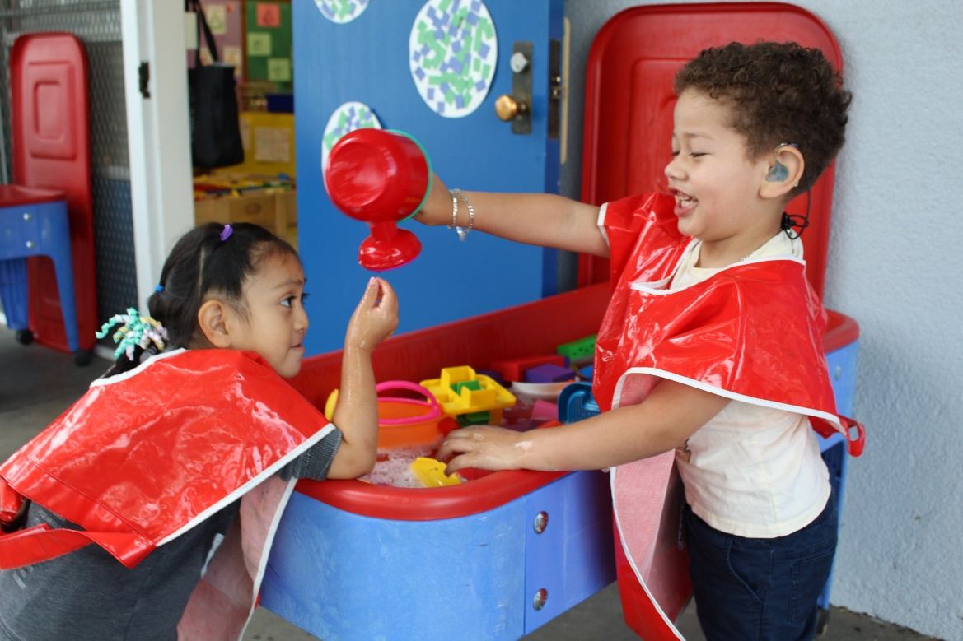
Update to Agency Information (Demo)
(Live Demonstration):
  During this portion of the webinar, a CDMIS staff member will share their web browser to showcase the steps needed to upload files to the agency information section in CDMIS.
Photo Credit: Breed St. Elementary, Deaf & Hard of Hearing Program

Slide 8
Viewing User Account History
Historical Perspective
    Historically, Super Users were only able to view the following information in the CDMIS for users from their agency:​
      Date CDMIS account last accessed​
      Date CDMIS account was registered​
      Date CDMIS account was deactivated (if applicable)​
      Account activation status and deactivation reason (if applicable)​
Proposed Enhancements
    A newly added feature allows users to view the user account history to your CDMIS account.
    CDMIS Super Users will also have the ability to view the account history of all users within your agency.

Slide 9
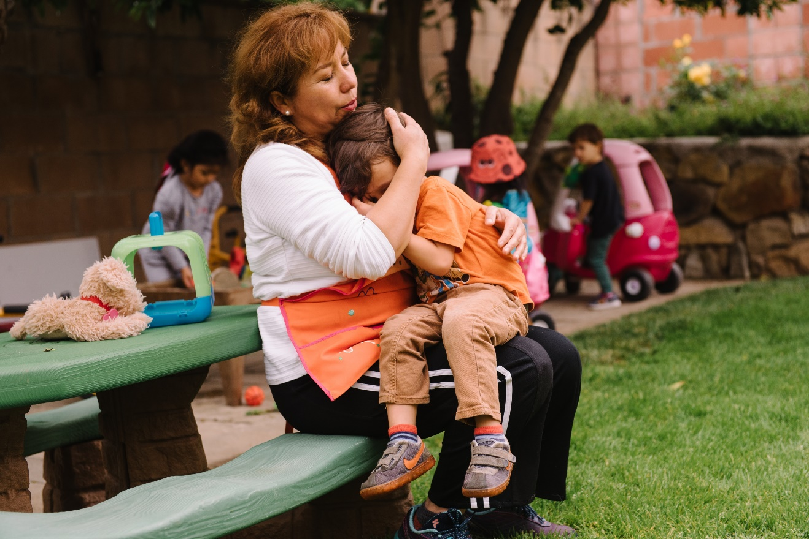
Viewing User Account History (Demo)
(Live Demonstration):
  During this portion of the webinar, a CDMIS staff member will share their web browser to showcase the steps needed to review a user’s account history.
Photo Credit: Reading Harvest

Slide 10
Viewing of Additional Information and Filtering Functions in CDD-801A
Historical Perspective
  Historically, correspondence between the CDMIS Support Team and CDMIS users would be done through email only. ​
  To send emails to all active CDMIS users or select groups (Program Directors and/or Executive Users), a spreadsheet of email addresses would need to be generated through an internal application or provided by the CDMIS Technology Services team.
​Proposed Enhancements
  Additional viewing options for CDD-801A submittal status
  Identification of CDD-801A “Late Submission” status
  Users will be able to view messages directly from the
  Early Education Division

Slide 11
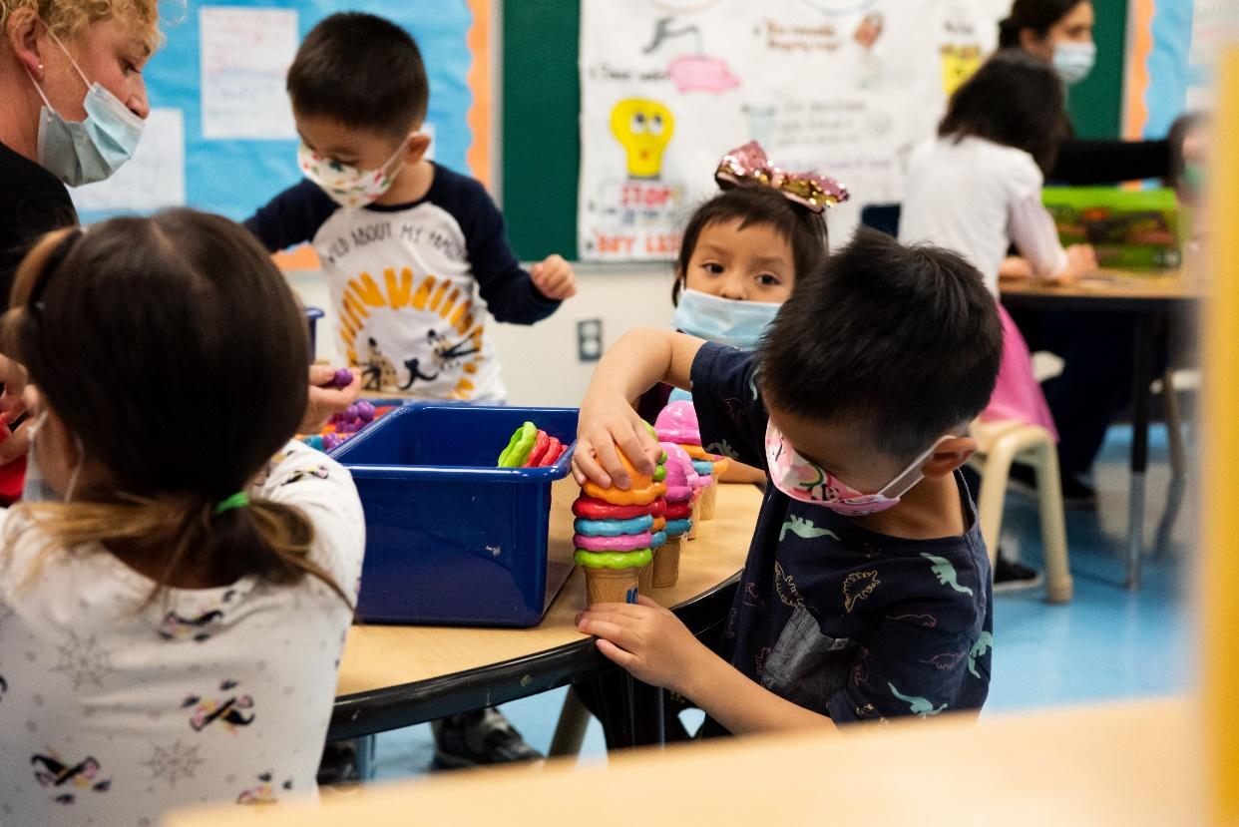
Communication Enhancements (Demo)
(Live Demonstration):
  During this portion of the webinar, a CDMIS staff member will share their web browser to showcase the steps needed to review the communication enhancements.
Photo Credit: Gates Early Education Center (Preschool DLL), Los Angeles, May 5, 2022

Slide 12
Notification of CDD-801A and Processing Status
Historical Perspective
  Previously there were two methods to process CDD-801A reports.
    Test: Within the test site, the user was able to upload the 801A file to validate the file for data or validation errors.
    Live: The upload of the electronic file for processing within the live site required an overnight batch process. A downside of this method was the fact that the users were not notified if the file was uploaded successfully until the following day.
Enhancements
    CDD-801A Electronic Transfer Files will now process instantaneously. Users can access their CDD-801A Electronic File Transfer Status right after uploading their file into the CDMIS.
    As a result, there will be no need for the CDMIS Test Environment. Users will only need to keep track of one set of credentials for data reporting.

Slide 13

CDD-801A Electronic File Transfer (ETF)
Processing Enhancements
(Live Demonstration):
  During this portion of the webinar, a CDMIS staff member will share their web browser to showcase the steps needed to review the CDD-801A ETF processing enhancements.
Photo Credit: Tree of Life International Charter School, TK, Anderson, May 10, 2022

Slide 14
Viewing CDD-801A, CDD-801B, and Subsidized Provider Report (SPR) Transaction History
Historical Perspective
    Historically, CDMIS users would have to navigate to the CDD-801A Input/Edit function to view their 801A report Or to the CDD-801A Management Reports function to view the report that was submitted.
Enhancements
    The updates to the Account Transaction History viewing now features a dashboard that allows Super and Regular CDMIS users the ability to view the report submittal status.
    The user can select parameters to view specific agency, vendor and date of transactions.
    The feature allows for the notification of an electronic submission that displays the date of the submittal.

Slide 15

Report Transaction History (Demo)
(Live Demonstration):
  During this portion of the webinar, a CDMIS staff member will share their web browser to showcase the steps needed to review the report transaction history functions.
Photo Credit: Brooklyn Early Education Center (Toddler & Preschool), Los Angeles, May 2, 2022

Slide 16
Improvements to the CDMIS User Experience
Visual & Design
  Use of full screen display layout
  Improved use of typography, in size and selection
  Shaded containers that contain instructional information
  Use of buttons to indicate an action will occur.
Functional
  Self-managed password reset, reactivation of user account and forgot username
  Improved visualization of the status of submissions, including input/edit status, submittal status, errors and successful processes.

Slide 17

User Experience Enhancements (Demo)
(Live Demonstration):
  During this portion of the webinar, a CDMIS staff member will share their web browser to showcase the updated website and navigation panel.
Photo Credit: Trauma Informed Care Module, Harvest

Slide 18
Post CDMIS M&O Updates
Debugging
Changes to Reporting Schedule
  July, August, September, October, and November 2022 801A report will be locked March 31, 2023
Data Validation/Data Cleaning
Withhold list

Slide 19
CDMIS Reporting Reminders
Setting Type Data Field
  This field indicates what type of setting the child is being served
    Center or Family Child Care Home
  For all data fields, but this one in particular, please double check this for accuracy
  Demonstration of this field in the 801A

Slide 20
CDMIS Resources and Contact Information
CDMIS technical assistance inbox:​
  cdmis@cde.ca.gov
  cdmis@dss.ca.gov
CDMIS Resources Webpage and Updates
  https://www.cde.ca.gov/sp/cd/ci/ccdata.asp​
  https://www.cde.ca.gov/sp/cd/ci/cdmisupdate30.asp
CDMIS Live Site: ​
  https://www4.cde.ca.gov/cdmis

Slide 21

Questions
Photo Credit: Kidango Decoto Center; Union City, CA

Slide 22
Thank you for joining us!

