Slide 1
Fiscal Year 2024–25
Continued Funding Application for
California State Preschool Program and Prekindergarten and Family Literacy Support Contractors
Presented by the Early Education Division ​​
Date: October 31, 2023
Time: 10:30 a.m. to 12:30 p.m.

Slide 2

Welcome and Introductions

Slide 3
Agenda
Management Bulletin (MB) 23-09
Statutory Background
Autorenewal
Application Updates: New for Fiscal Year (FY) 2024–25
2024–25 Continued Funding Application (CFA) Submission
Instructions
Electronic CFA Walkthrough
Contact Information
Questions
Closing

Slide 4
Management Bulletin 23-09: Continued Funding Application Fiscal Year 2024–25
MB 23-09 Purpose
FY 2024–25 CFA Submission Due Date, December 1st, 2023
The complete FY 2024–25 CFA Electronic Application and forms are available on the CFA web page at https://www.cde.ca.gov/sp/cd/ci/cfa2425.asp
Each contractor is to review this information as soon as possible to ensure appropriate time and resources are reserved to complete and submit the FY 2024–25 CFA in a timely manner

Slide 5
Statutory Background
The CDE administers the California State Preschool Program (CSPP) and Prekindergarten and Family Literacy Support (CPKS) Program.
California Code of Regulations, Title 5, CFA requirements.
  Responding to the CFA request in accordance with the instructions and timelines.
  Failure to respond to the CFA request.

Slide 6
Autorenewal
Any CSPP and CPKS contractors who apply for and are approved for continued funding will not need to sign a contract to provide services for 2024–2025.
CSPP and CPKS contracts approved for continued funding will be automatically renewed in accordance with all applicable federal and state laws, as well as all CSPP and CPKS Contract Terms and Conditions that will be incorporated into the subsequent contract, as applicable.

Slide 7
Application Updates for Fiscal Year 2024–25
Application Sections Reorganized
Program Narrative Change Questions Incorporated
Program Calendar 1-page PDF
Application for License Exemption Updated

Slide 8
Instructions Overview
Contractors operating a California State Preschool Program (CSPP) and/or a Prekindergarten and Family Literacy Support (CPKS) program must review the instructions prior to completing the Continued Funding Application (CFA) for fiscal year (FY) 2024–25.
Refer to the CFA Instructions and FAQs posted on the CFA web page.

Slide 9
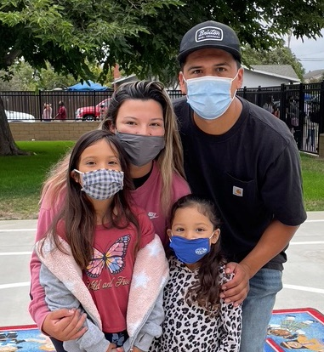
Instructions: Submission of the 2024–25 CFA
Due Date: December 1, 2023, by 5:00 p.m.
Methods of submission
  Electronically by Online Application
  Electronically by Email (Print and Scan)
    CFA@cde.ca.gov
  Hard Copy by Mail
Photo Credit: University Preparation School at CSU Channel Islands

Slide 10
Instructions (1)
Section I: Contractor Information
Complete Legal Business Name and Address
Information entered in this section must match the information on file in the Child Development Management Information System (CDMIS) database
Note that phone numbers must be entered in the format shown:
  999-999-9999

Slide 11
Instructions (2)
Section II: Part I - Contract and Program Type
Contract types: (1) CSPP (2) CPKS.
Indicate if CSPP contractor operates a Family Childcare Home Education Network.
Program Types: (1) Full-Day/Full-Year, (2) Part-Day/Part-Year, (3) Full-Day/Part-Year, and (4) Part-Day/Full-Year.

Slide 12
Instructions (3)
Section II: Part II – Projected Enrollment
Number of children expected to be enrolled in part-day and full-day CSPP in each county served.
Not required to use “Funded Enrollment Calculator”

Slide 13
Instructions (4)
Section III: Contractor’s Officers and Board of Directors
Contact information for each governing individual is required whether or not the contractor has a Board of Directors or other governance structure.
Complete the entire section regardless of your agency’s governance structure.

Slide 14
Instructions (5)
Section IV: Program Narrative
  Indicate whether any programmatic and/or minimum days of operation (MDO) changes are requested for FY 2024–25.
  Complete the program narrative change questions and provide signature.
    These questions were formerly collected on a separate form.
  All contractors must submit the FY 2024–25 Program Calendar whether or not changes are requested.
  Ensure the FY 2024–25 Program Calendar aligns with the MDO if you are requesting no MDO changes.

Slide 15
Instructions (6)
Section V: Subcontract Certification
  “Subcontractor” refers to a separate agency subcontracted to provide CSPP services in accordance with the provisions contained in the California Education Code, 5 CCR, and the Contract Terms and Conditions.
  Contractors who subcontract CSPP services must also submit a completed Subcontractor Information Form (EED-3704B).

Slide 16
Instructions (7)
Section VI: Contractor Certification
  Contains required certifications previously presented in separate CFA sections; Personnel Certifications, Certification of Information in CDMIS, and Contractor Certifications.
  The State of California requires any contractor receiving early education and care funding, disbursed by the CDE, to employ fully qualified personnel as stipulated in the California Education Code; and the California Code of Regulations, Title 5; and the Contract Terms and Conditions.

Slide 17
Instructions (8)
Section VI: Contractor Certification (continued)
CSPP contractors are required to review and update all information in the CDMIS and certify under penalty of perjury that the information in CDMIS is complete and accurate as of the date of the certification.
  The information in the CDMIS becomes part of the agency’s contract.
  Incomplete or inaccurate information in the CDMIS can result in an audit finding at the state level and a finding of noncompliance for your agency.

Slide 18
Instructions (9)
Section VII: CFA Checklist
  All required attachments must be completed and attached to the application.
  Note which documents are required for your agency type.
  Check each box to confirm the required item is included.
  Online CFA: Before uploading the completed attachments, save as zipped file.

Slide 19
Electronic CFA Walkthrough
The electronic CFA can be accessed from the CFA webpage.
We will now perform a walkthrough of the electronic CFA and demonstrate how to submit the online application.

Slide 20
Required Attachments (1)
ALL contractors must provide these documents:
  CSPP Program Calendar(s) (EED 9730)
  California Civil Rights Laws Certification (CO-005)
  Contractor Certification Clauses (CCC)
  Federal Certification (CO.8)
  CDMIS Agency Information Certification

Slide 21
Required Attachments (2)
Any contractor that uses subcontractors must also provide the Subcontractor Certification Form (EED 3704B).
Please note this must be signed by the contractor’s authorized representative on page 2.

Slide 22
Required Attachments (3)
Local Education Agencies (LEAs) must also provide:
Verification of LEA name and address
  California School Directory
  California Community College Chancellor
If the LEA is choosing to apply to be exempt from licensure pursuant to Health & Safety Code Section 1596.792(o), they must also include the completed and signed Application for License Exemption.

Slide 23
Required Attachments (4)
Non-Public agencies must also provide:
State of California Payee Data Record (STD. 204)
Secretary of State certification or search results
If the payment address differs from the mailing address provided on the STD. 204, the Payee Data Record Supplement (STD. 205) is also required.

Slide 24
Required Attachments (5)
Board Resolution:
The CFA must be signed by a person with the legal authority to contractually bind the agency, or the contractor's "authorized representative.”
A board resolution or meeting minutes may be required to demonstrate that the person signing the CFA has been delegated the legal authority to sign contractual agreements on behalf of the agency.

Slide 25
Required Attachments (6)
Board Resolution (continued):
Public Agencies
If the contractor is a county, city, district, or other local public body, the local governing body must provide one of the following documents authorizing execution of the 2024-25 CFA and identifying by name the individual(s) authorized to sign related contractual documents:
  Board Resolution; or
  Board Minutes; or
  Board Policy

Slide 26
Required Attachments (7)
Board Resolution (continued):
For County Offices of Education, a resolution is not required IF the County Superintendent signs the CFA and related contract documents.
If anyone else signs, a board resolution or minutes authorizing delegation of signature authority is required.

Slide 27
Required Attachments (8)
Board Resolution (continued):
Private Agencies should follow their agency’s bylaws.
Generally, the Executive Director, Owner, and President are authorized signers.
If an individual with a different title than above signs, provide one of the following indicating the signee has the authority to sign contractual agreements on behalf of the agency:
  Letter on company letterhead; or
  Board Resolution; or
  Board Minutes

Slide 28
Required Attachments (9)
Board Resolution (continued):
Please refer to the template resolution provided on the CFA web page as an example of the information required in the resolution.
Agencies may either complete this template or provide an equivalent resolution in their own format.

Slide 29
Program Calendar (EED 9730)
The Program Calendar has been updated to a 1-page PDF format for ease of use.
If a contractor operates both a full-day and a part-day program, separate Program Calendars must be uploaded for each.
The FY 2024–25 Program Calendar must align with the contractor’s MDO in CDMIS. Otherwise, Section IV should indicate a request for MDO change.

Slide 30
Contractor Certification Clauses (CCC)
Contractors must certify under penalty of perjury that they are duly authorized to legally bind the prospective contractor to the clauses listed.
Please note this must be signed by the contractor’s authorized representative.

Slide 31
Federal Certification (CO.8)
Prospective contractors must complete and sign the Federal Certification, to attest that they will comply with certification requirements regarding lobbying, debarment, suspension, and other workplace requirements.
Places of performance must be listed on page 2.
This must be signed by the contractor’s authorized representative.

Slide 32
Contact Information
Submit questions regarding the application process to the CFA team by email at CFA@cde.ca.gov.
Submit programmatic questions regarding the CFA to your assigned Early Education Division, Program Quality Implementation Office regional consultant.
Submit fiscal related questions regarding the CFA to your assigned Early Education Nutrition Fiscal Services apportionment analyst.

Slide 33
Quick Reminders
Agency’s Board Resolution
CDMIS Changes
Subcontractor Information Form (if Applicable)
Application for License Exemption (LEA’s only)

Slide 34
CFA Timeline
October 20, 2023: MB 23-09 released
October 31, 2023: Continued Funding Application (CFA) Webinar
December 1, 2023: Continued Funding Application Due to Early Education Division (EED)
December 2, 2023 – February 28, 2024: Review and Processing of CFAs by EED Staff
March 2024: Completed CFAs received by Contracts Office

Slide 35
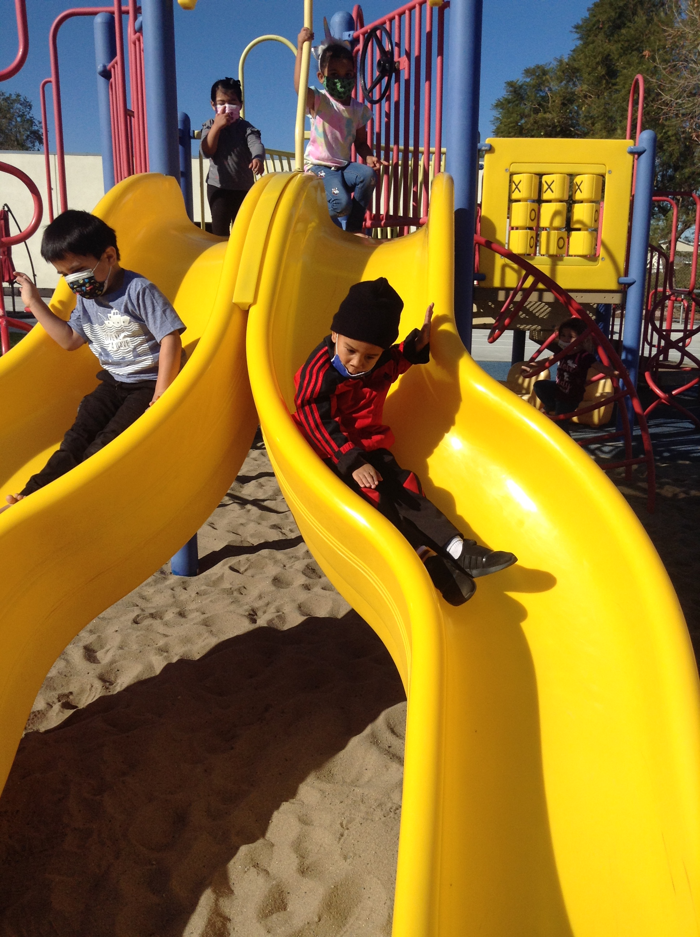
Questions
Photo Credit: University Preparation School at CSU Channel Islands

Slide 36
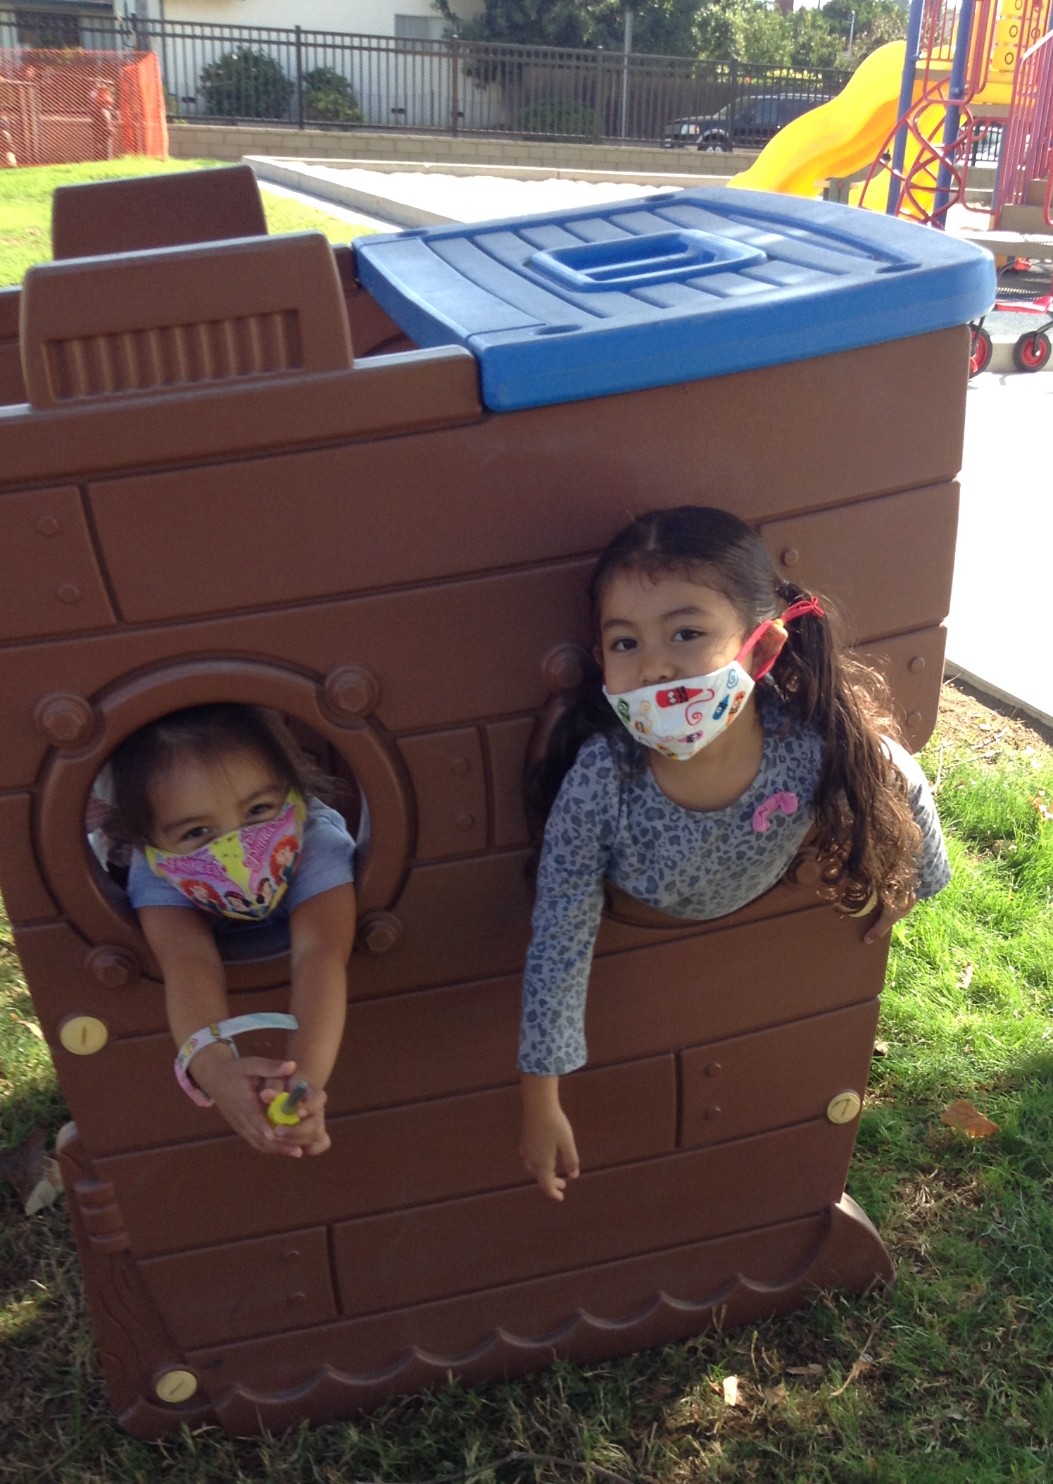
Closing
Photo Credit: University Preparation School at CSU Channel Islands

