Slide 1
Classroom Assessment Scoring System Environment
Shaping Learning Through Environments and Interactions
Early Education Division
Date: February 9, 2026
Time: 3 to 5 p.m.

Slide 2
Agenda
Opening Reflection
Elements of the Classroom Assessment Scoring System (CLASS) and CLASS Environment
Emotional Support Domain
Classroom Organization Domain
Instructional Support Domain
Closing

Slide 3
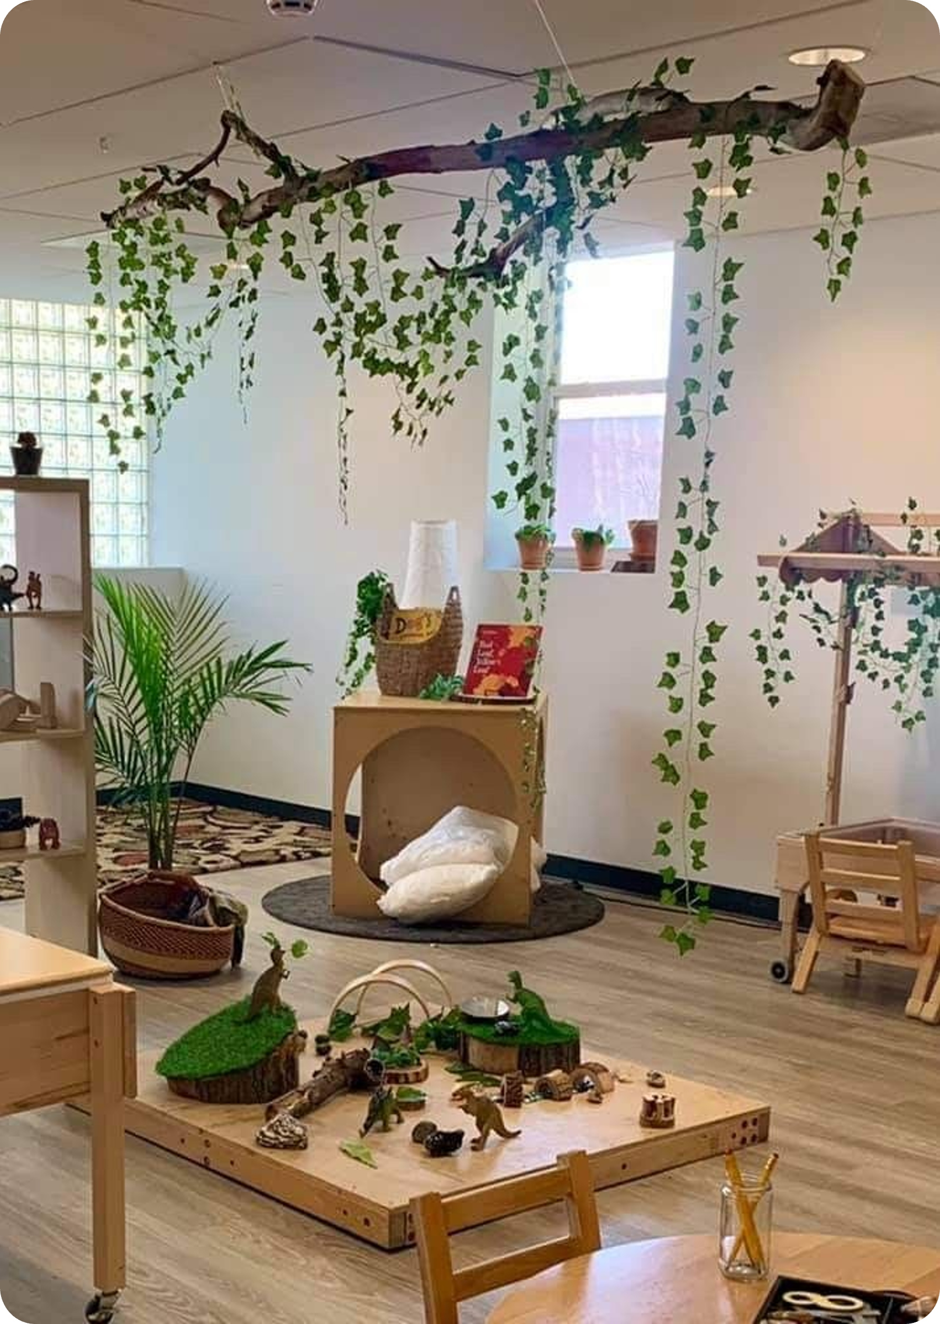
Opening Reflection
Think of a space where you felt completely comfortable and inspired to learn or create.
Share one word to describe that space in the chat.

Slide 4
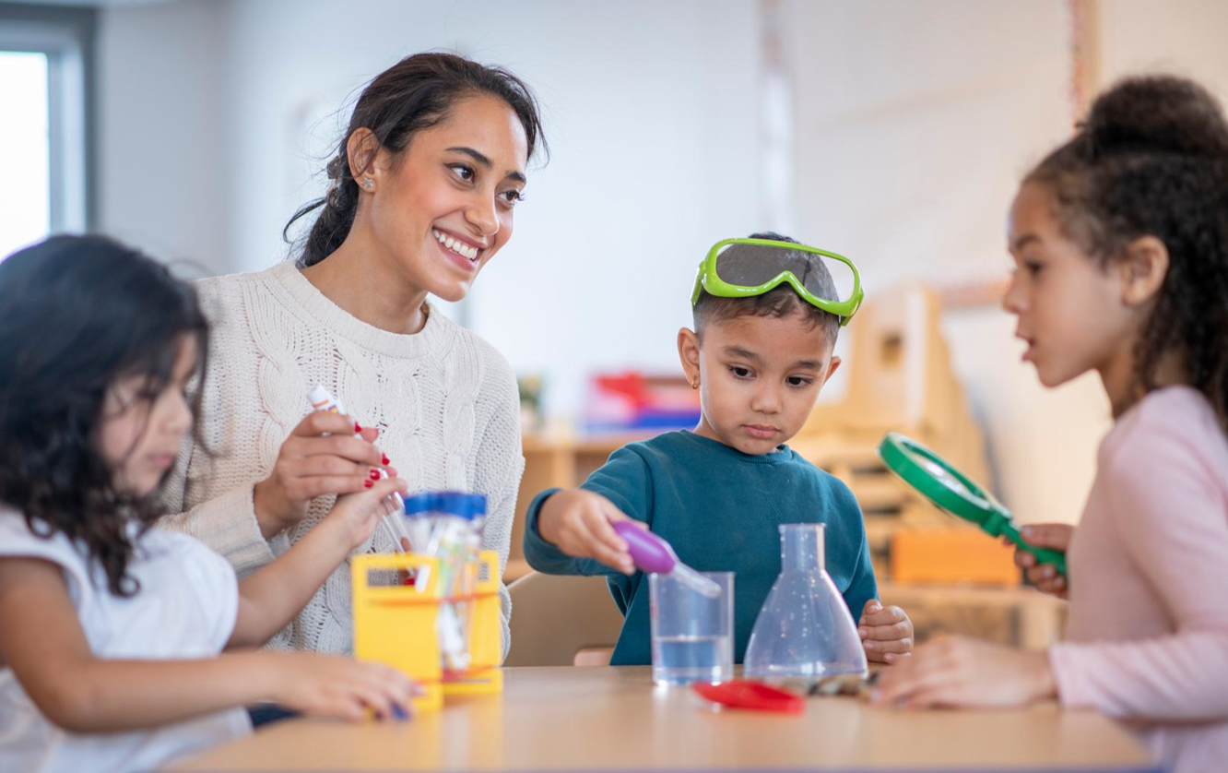
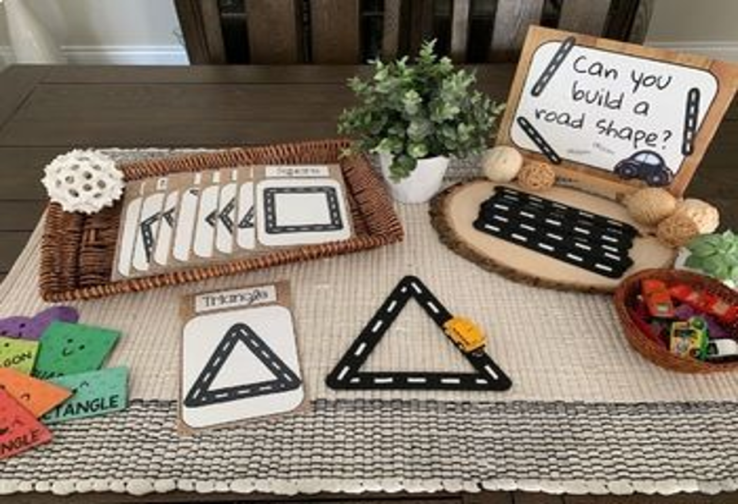
Adult/Child Interactions and Environment
CLASS → focuses on interactions
CLASS Environment → focuses on setting items that support interactions
Both together → influence quality of learning and engagement

Slide 5
CLASS Environment
CLASS Domains
Emotional Support Classroom Organization Instructional support
Environment Items
Arrangements Displays Materials

Slide 6
CLASS Domains
Emotional Support measures the quality of teacher-child interactions that promote children’s social-emotional development and well-being. It focuses on creating a warm, positive, and supportive classroom climate, fostering trusting relationships, and helping children manage their emotions, feel secure, and develop a sense of belonging.
Classroom Organization measures how educators manage time, attention, and the physical environment to maximize children’s engagement and learning. It focuses on creating a well-structured, predictable, and efficiently managed classroom that supports positive behavior, maximizes instructional time, and encourages children’s active participation.
Instructional Support focuses on how educators promote children’s thinking, understanding, and language development. It captures the ways teachers guide learning through meaningful feedback, encourage problem-solving and reasoning, and use rich language to expand children’s vocabulary and comprehension.

Slide 7
CLASS Environment - Emotional Support
Emotional Support

Slide 8
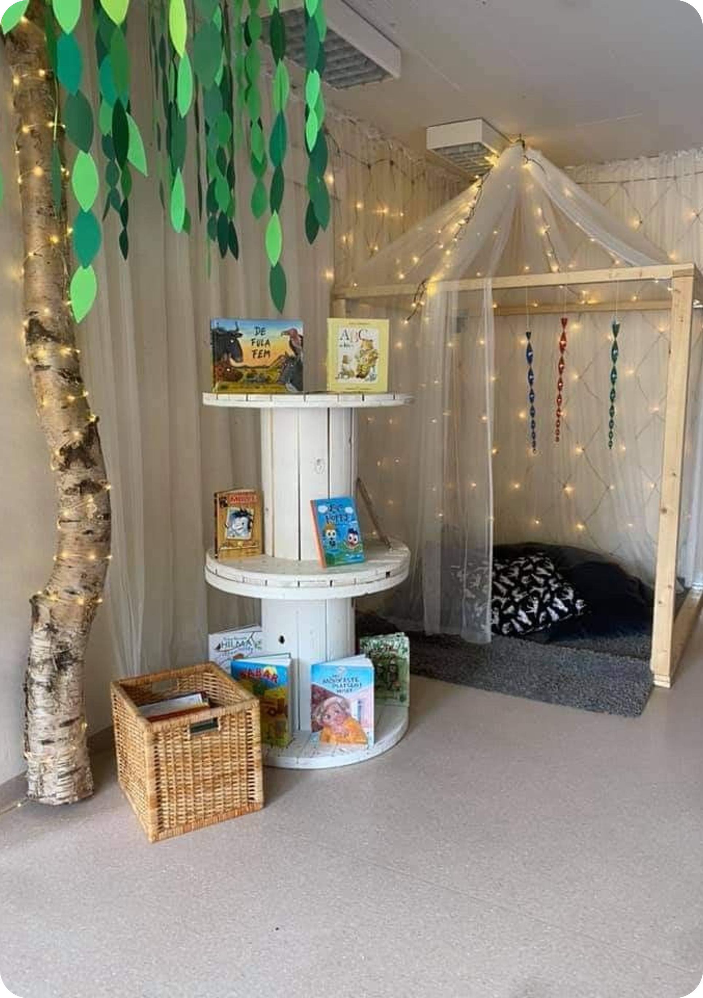
Emotional Support Items:
  Arrangements
  1. Space for cooperation
  2. Sightlines
  3. Adult furniture
  4. Space for child privacy
  Displays
  5. Child-level displays
  6. Displays of children or their work
  Materials
  7. Child-accessible materials
  Multi-category
  8. Adaptations for all children’s participation
  9. Representation of diversity
  10. Materials for all children’s communication

Slide 9
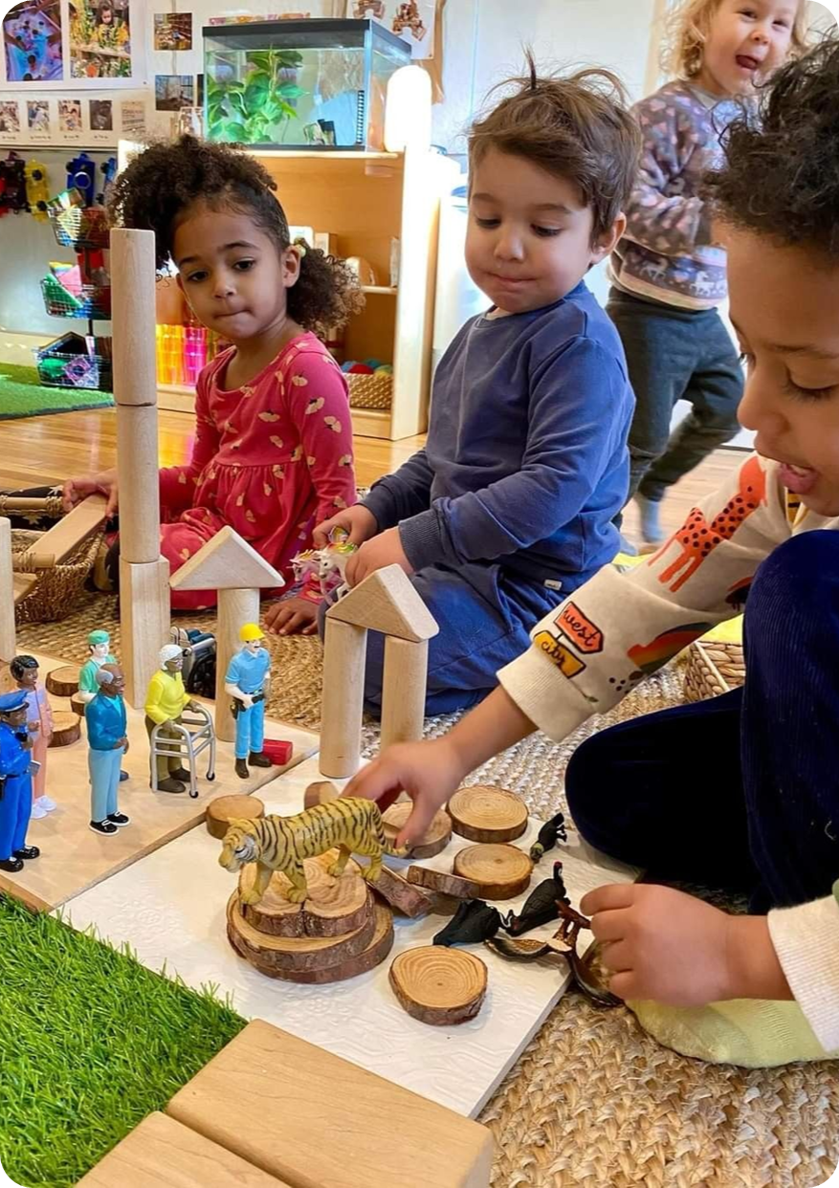
1. Space for Cooperation
Arrangements within the learning setting allow children to
cooperate in close proximity with educators and each other.
The classroom provides ample space for children to move freely and comfortably.
Children and educators are positioned close enough to support warm, responsive interactions.
Learning areas are arranged so children can play and explore without disrupting one another.
The room setup allows educators to easily join children at their level, whether at tables or on the floor.

Slide 10
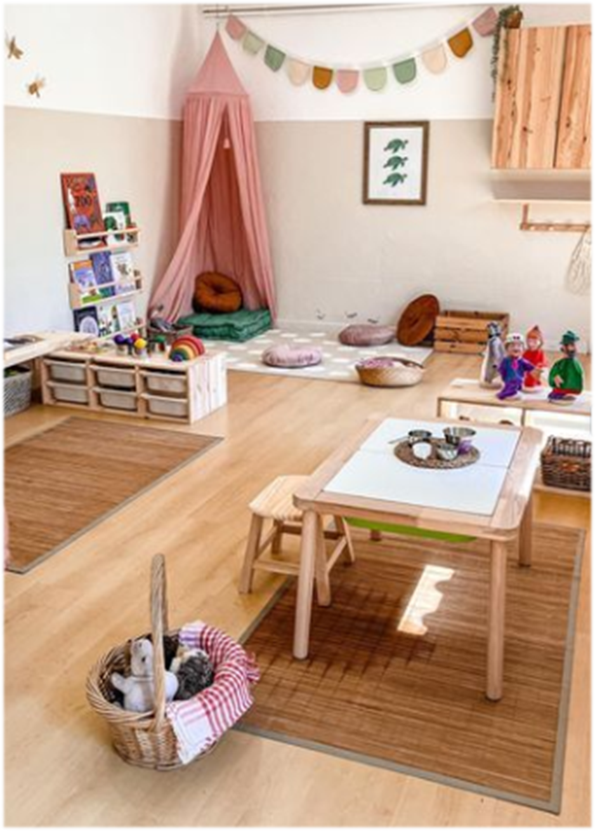
2. Sightlines
Arrangements allow educators to position themselves for clear sightlines to observe children’s cues (verbal and non-verbal) from all the areas of the learning setting.
The classroom layout allows educators to easily observe all children throughout the learning environment.
Educators are able to maintain visual supervision of every child at all times —even while engaging in routines or working with small groups.
The environment is free of blind spots or equipped with mirrors or monitors that ensure full visibility of all areas.

Slide 11
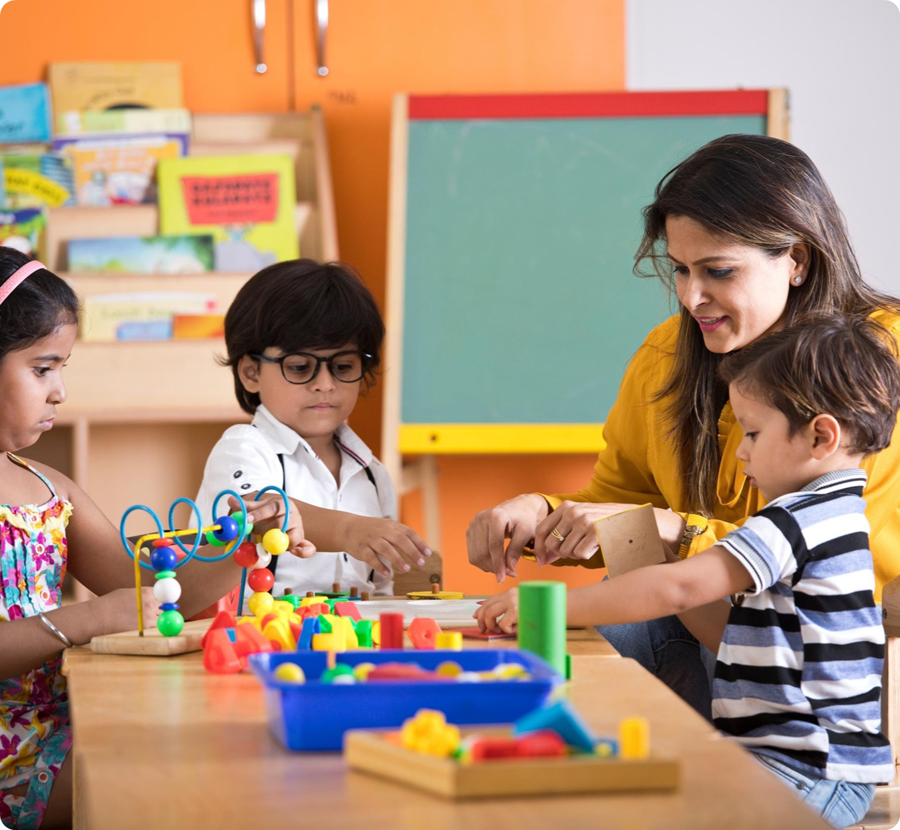
3. Adult Furniture
Adult-size furniture allows educators to participate comfortably alongside children at their physical level.

Slide 12
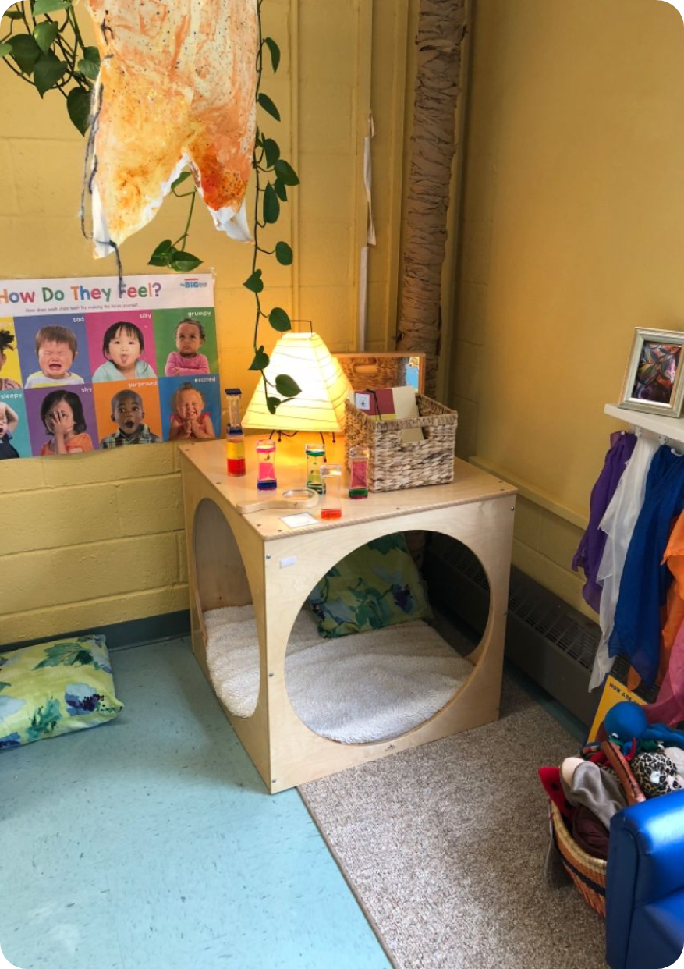
4. Space for Child Privacy
Children have access to a designated area for individual play, learning, refocusing, silence, or relaxation. A private space is one that is physically separated from busier, noisier parts of the classroom.
The environment includes a designated area where children can engage in independent play or learning, separated from the rest of the setting by low shelves, dividers, or other boundaries.
Quiet or private spaces are intentionally located away from busier, more active areas to provide children with a calm and focused environment.

Slide 13
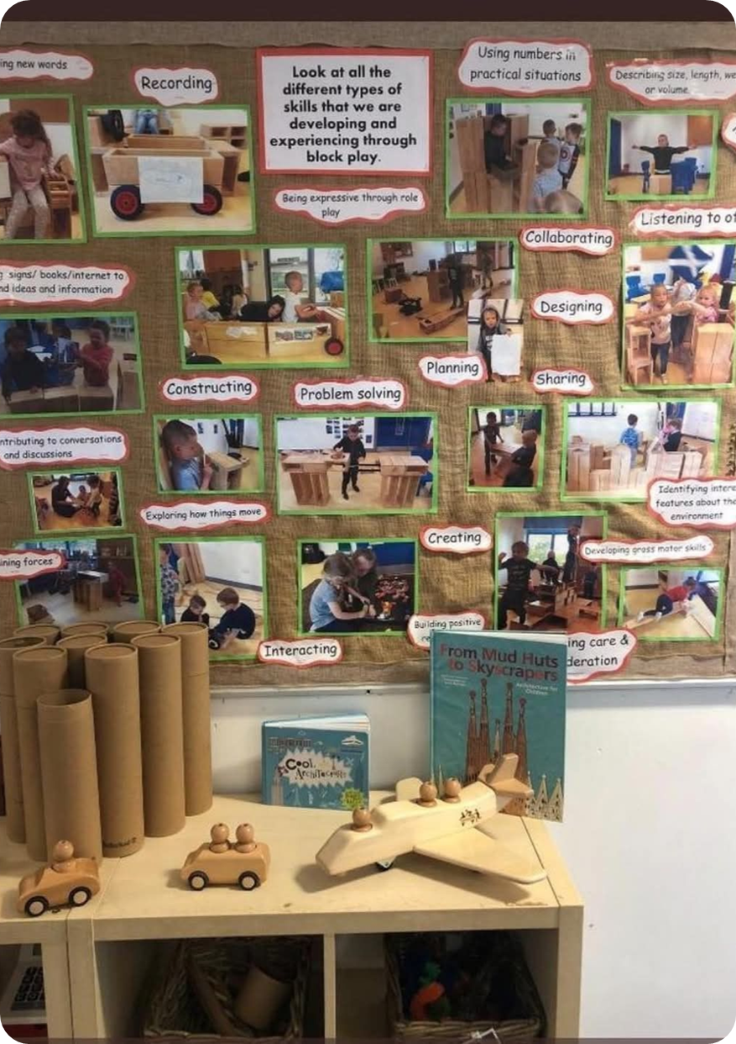
5. Child – Level Displays
Visual displays are at eye level for children. Children can easily see and touch displays
Most or all of the displays intended for children can easily see and approach them.

Slide 14
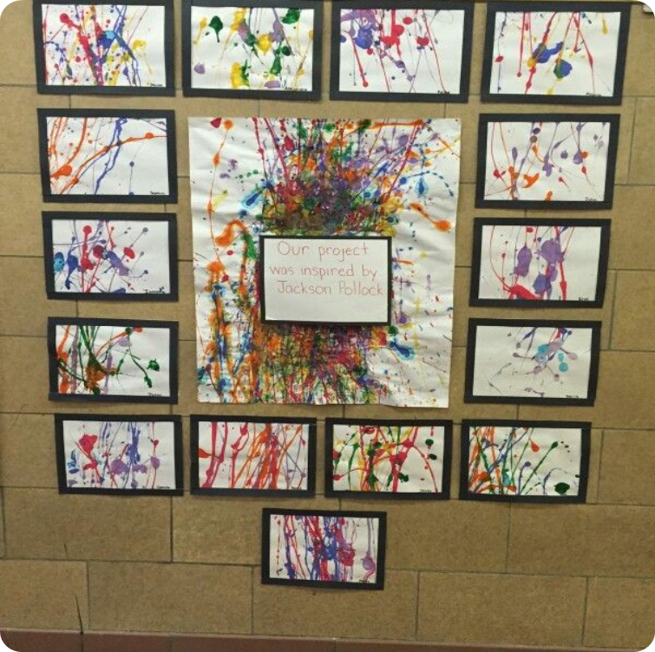
6. Displays of Children or Their Work
Displays include images of children currently in the learning setting, their work or representations they find meaningful.

Slide 15
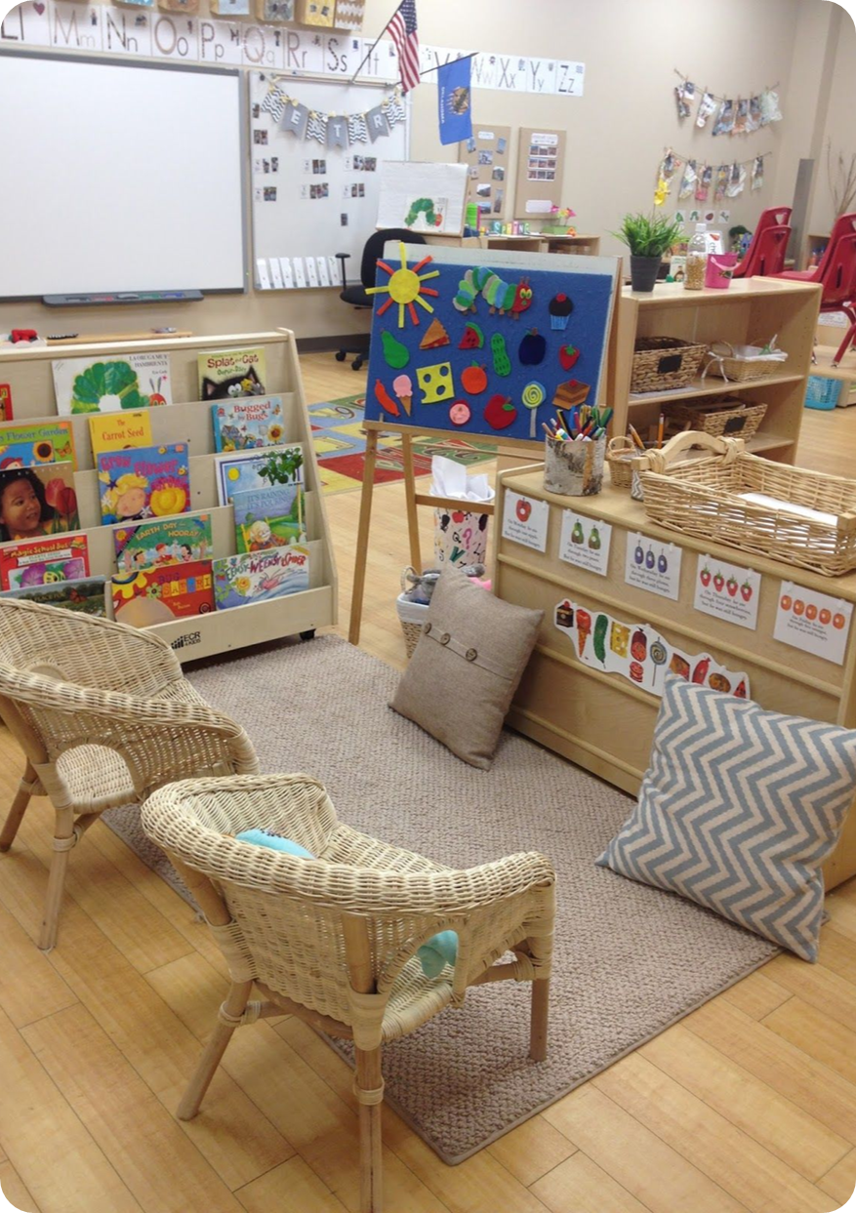
7. Child-Accessible Materials
A variety of materials are available and accessible to all children.
  Most materials are organized and available for children to access and use independently.
  Materials are stored in ways that allow children to reach and choose them without needing adult assistance or permission.

Slide 16
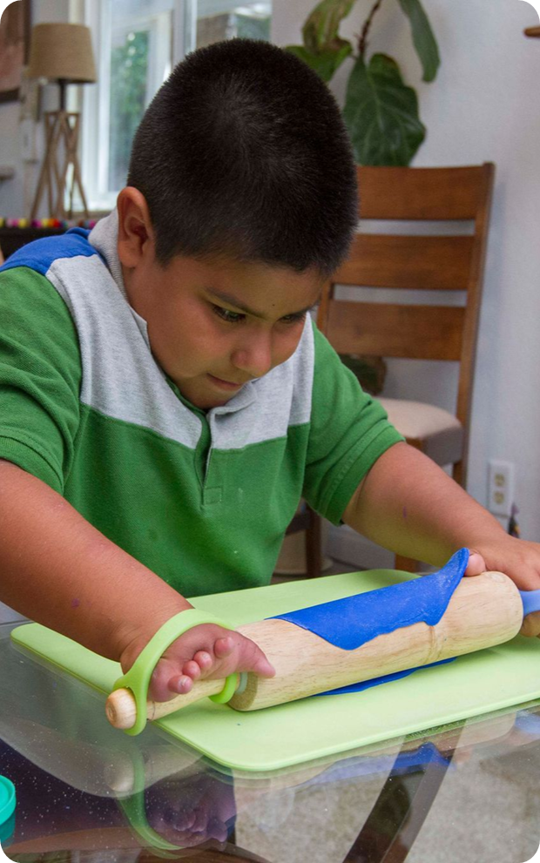
8. Adaptations for All Children’s Participation (1)
Furniture and materials are adaptive as necessary to support all children’s participation.
  All children, regardless of ability, are able to participate fully in all activities with appropriate adaptations, materials, and support.

Slide 17
8. Adaptations for All Children’s Participation (2)
Materials:
  Adaptive furniture (e.g., wheelchair-accessible tables, supportive seating)
  Fidget tools and bouncy chairs for sensory and attention support
  Fine motor tools: built-up spoons, large crayons, large-knob puzzles, adaptive pens and scissors
  Augmentative and alternative communication (AAC) devices or visual communication boards
  Specialized adaptive equipment: Tumble Forms chairs, wedges, bolsters, special cushions, and switch-activated toys

Slide 18
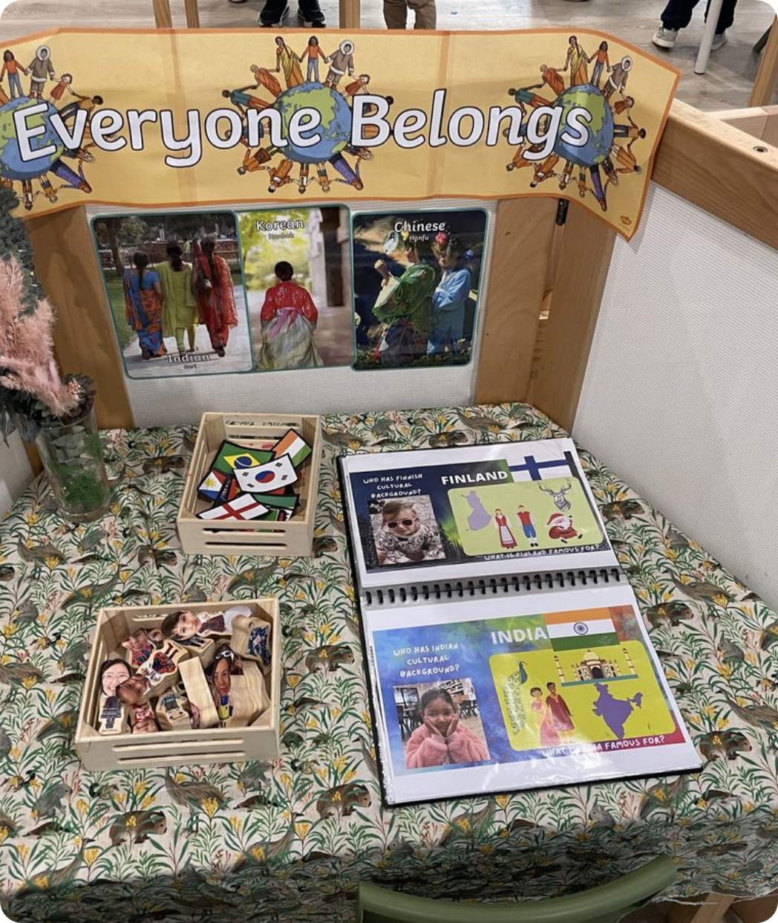
9. Representation of Diversity
Materials and displays represent diverse abilities, ages, cultures, gender roles, languages, and races.
  Materials reflect diversity in abilities, ages, cultures, gender roles, languages, and races
  Functional print and real-life objects in children’s home languages and cultures are included throughout the environment

Slide 19
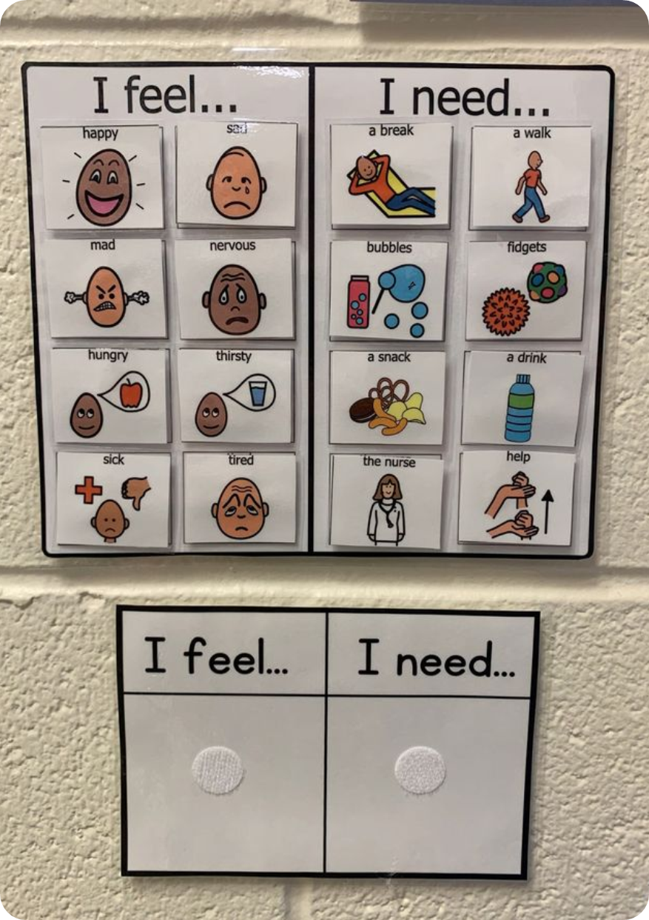
10. Materials for All Children’s Communication (1)
Materials and displays that support children’s communication are available in the setting.
  There are materials or displays throughout the setting that educators and children can use to facilitate expression or communication.

Slide 20
10. Materials for All Children’s Communication (2)
Materials:
  Communication boards
  Labels and print in home languages
  Picture cards
  Play telephones
  Puppets
  Real-life objects from home cultures
  Pictures of children engaged in everyday activities

Slide 21
Small Group Reflection
  What interactions do these items invite?
  How do they support relationships and/or emotional regulation?

Slide 22
CLASS Environment - Classroom Organization
Classroom Organization

Slide 23
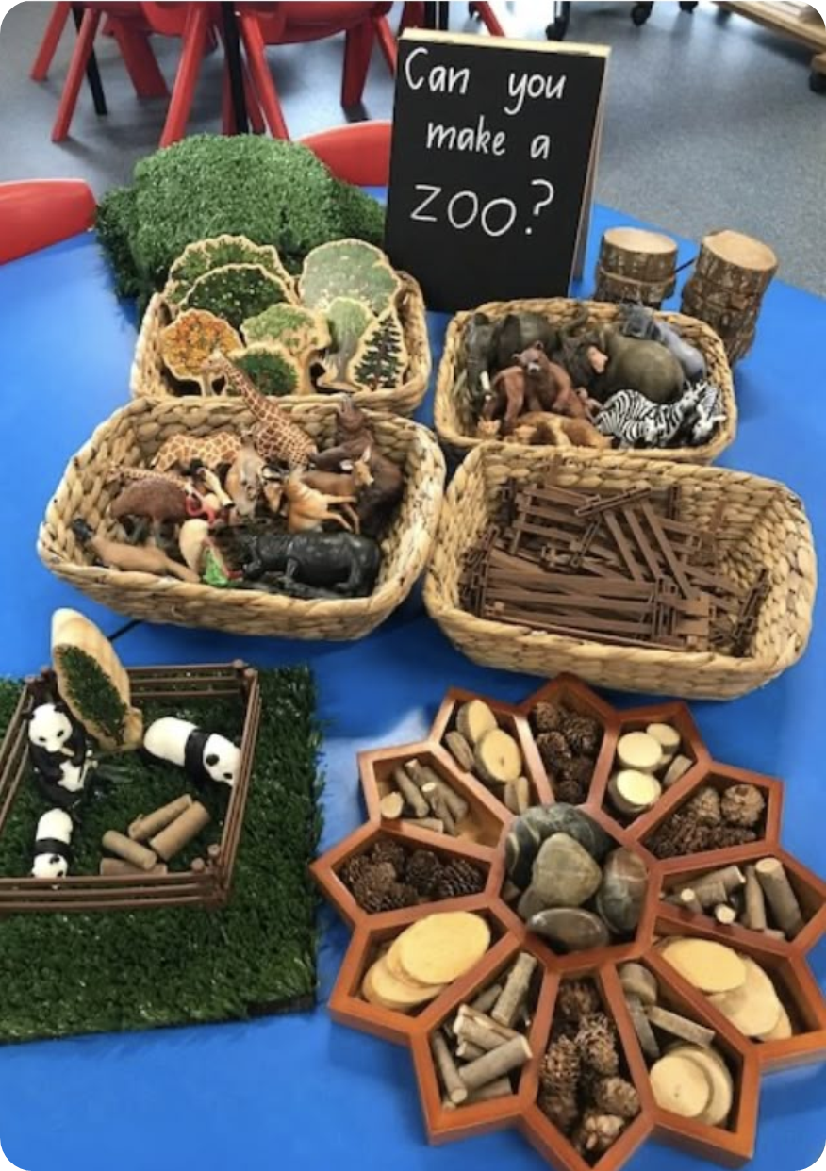
Classroom Organization Items:
  Arrangements
  11. Purposeful spaces
  12. Tidiness
  13. Freedom from background noise
  Displays
  14. Visual community expectations
  15. Displays of routines and transitions
  Materials
  16. Condition of materials
  17. Quantity of materials
  18. Sensory materials

Slide 24
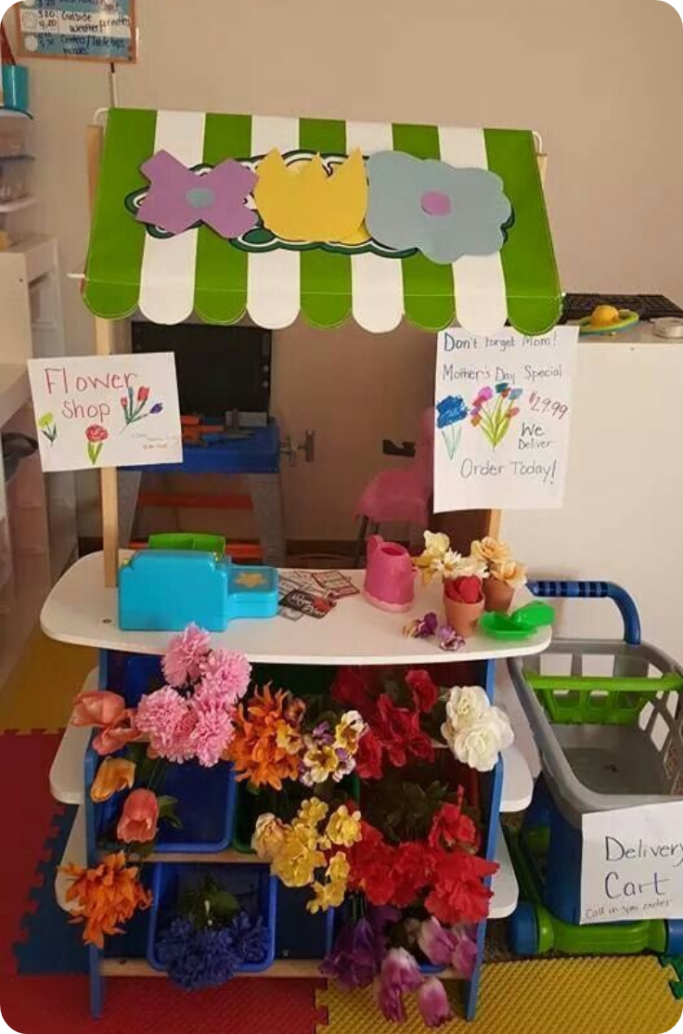
11. Purposeful Space (1)
All areas of the learning setting are arranged so that children know how to focus their time and attention.
All areas of the setting have clearly designated purposes for play or learning. Materials are available and organized in a way that guides children’s time and attention

Slide 25
11. Purposeful Space (2)
Consider the Following Areas:
  Art area
  Block area
  Imaginary or real-world play area
  Reading or book area
  Soft or quiet area
  Music area
  Sand and water area

Slide 26
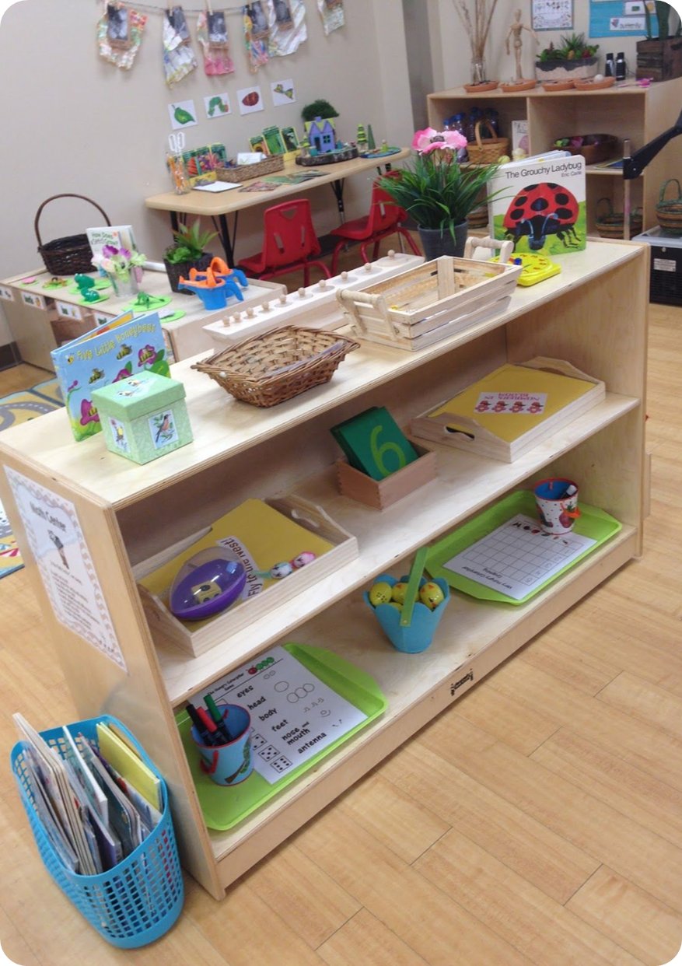
12. Tidiness
The setting is generally orderly and free from physical clutter.
  Unused materials are stored out of the way.
  Play and learning surfaces remain clear.
  Storage systems keep areas uncluttered and easy to use.
  All areas of the setting are tidy and organized.

Slide 27
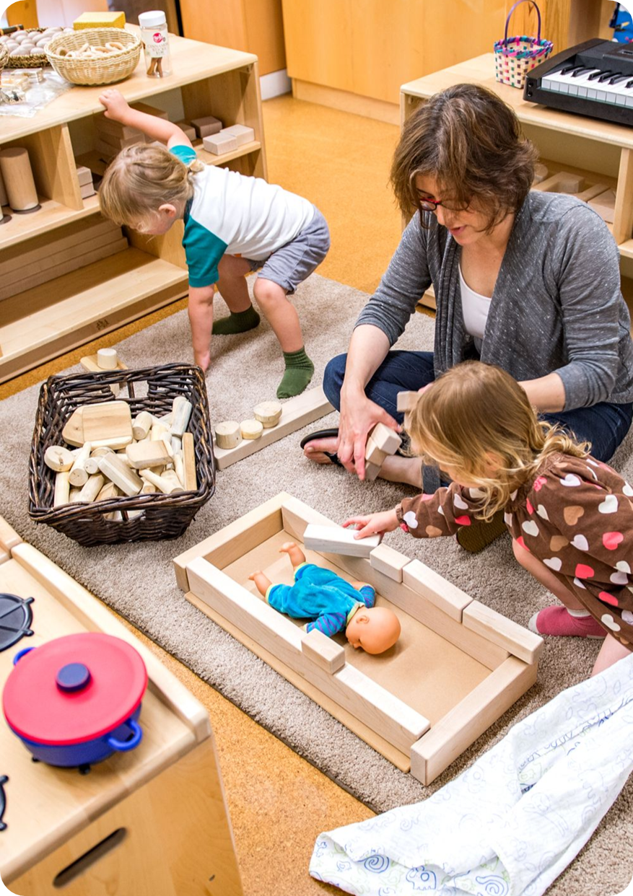
13. Freedom From Background Noise
The setting is free of excessive background noise.
  There is no background noise that competes with educators’ and children’s abilities to communicate.
  Educators and children can easily hear each other.
  Sources in the learning setting are unsupportive of children’s engaged play and learning (constant background music, noisy toys).

Slide 28
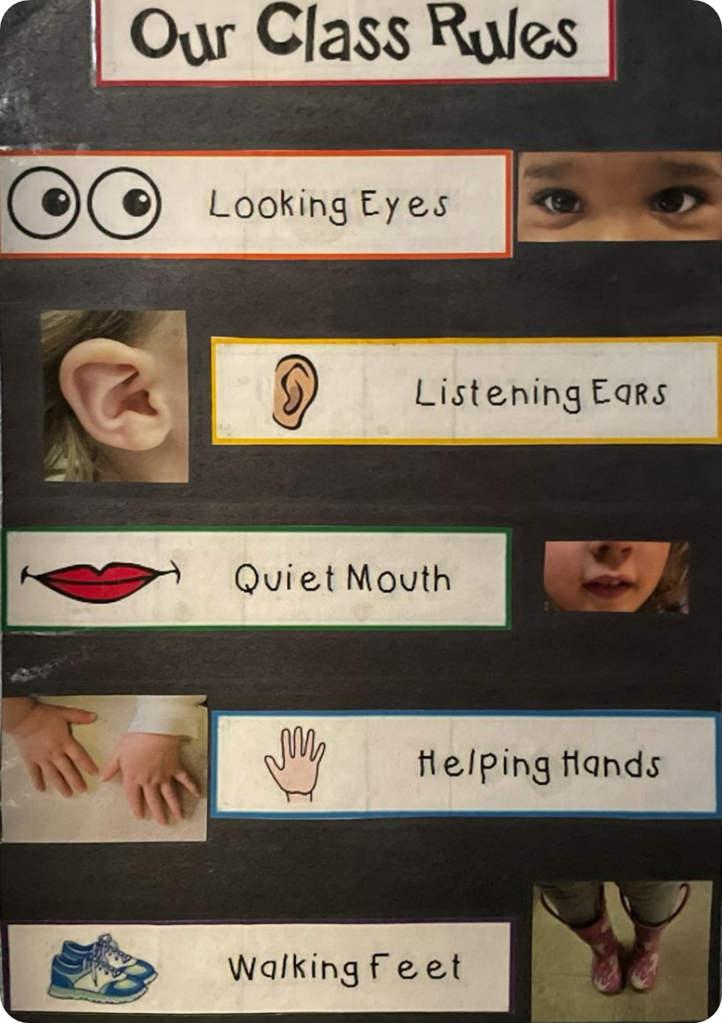
14. Visual Community Expectations
Displays show positive community expectations and those community expectations are displayed at children’s height and include visuals that pre-literate children can understand.
  Displays of community expectations are clear and accessible to children.
  Written text includes visuals to support understanding.
Positive Expectations Encourage Behaviors Such as:
  Gentle touches and listening
  Keeping hands and feet to oneself
  Using respectful language
  Helping friends

Slide 29
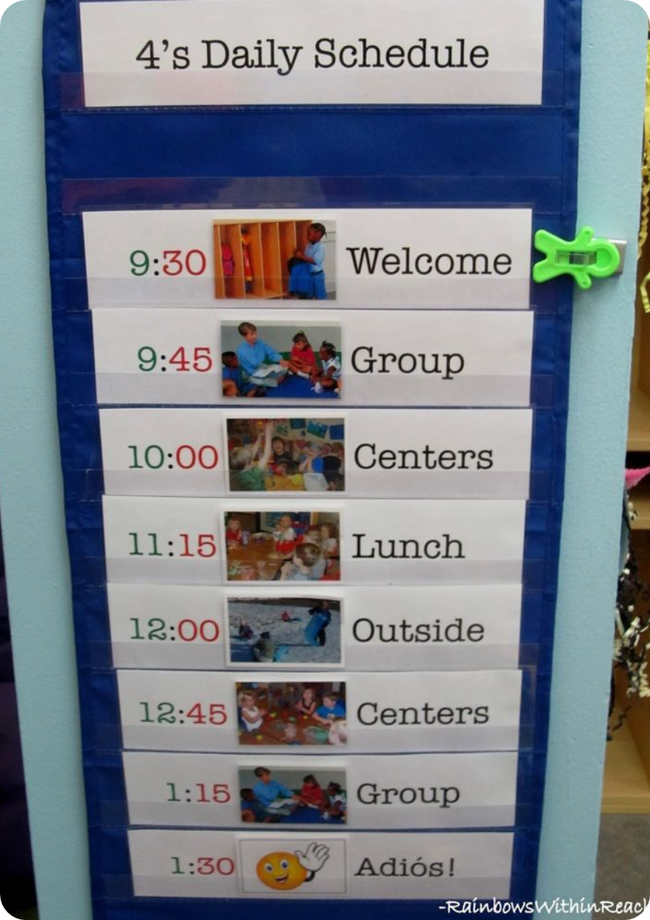
15. Displays of Routines and Transitions
Displays show routines and transitions of the learning setting. Transitions are the changes between activities such as when children are switching from play time to mealtime or preparing to go outside.
  Displays of daily routines and transitions are placed at children’s eye level.
  Visuals accompany any written text to help children understand and follow routines easily.
  The visuals used are positive, clear, and effectively support smooth transitions.

Slide 30
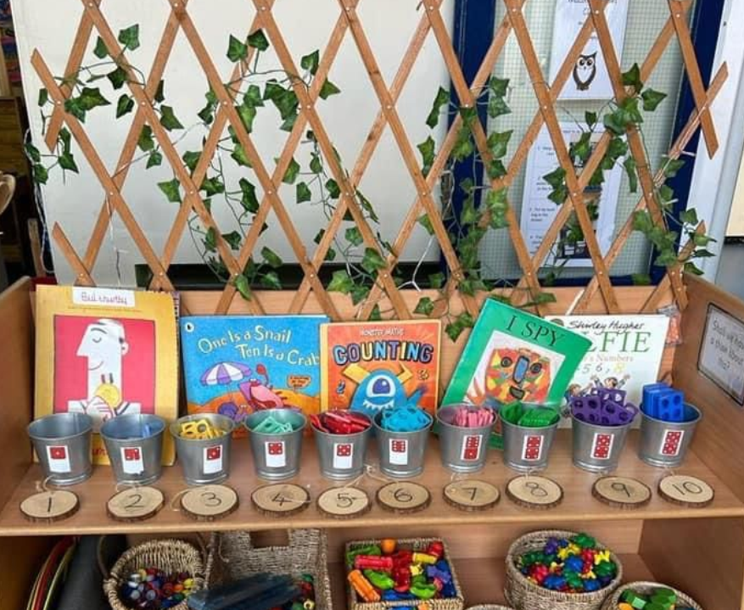
16. Condition of Materials
Materials available in the setting are in good condition and allow children to plan and learn.
  Materials are clean, complete, and in good working order.
  All materials are well-maintained, allowing to play and learn safely and effectively.

Slide 31
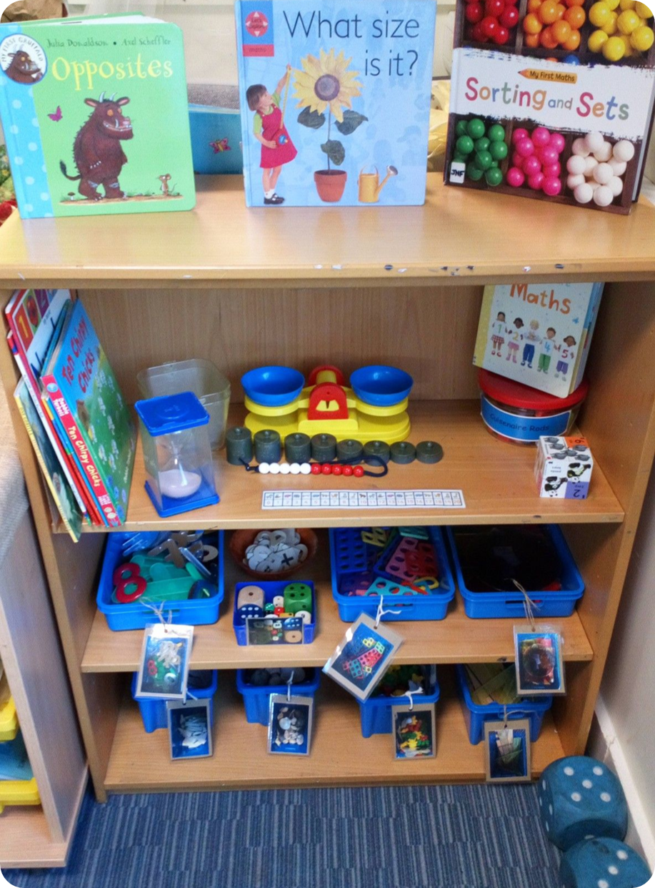
17. Quantity of Materials
The quantity of materials allows for consistent child engagement. Children do not have to wait long periods of time to use materials.
  There are enough materials and activities available for all children to engage meaningfully.
  Materials support sustained participation and minimize waiting or idle time.

Slide 32
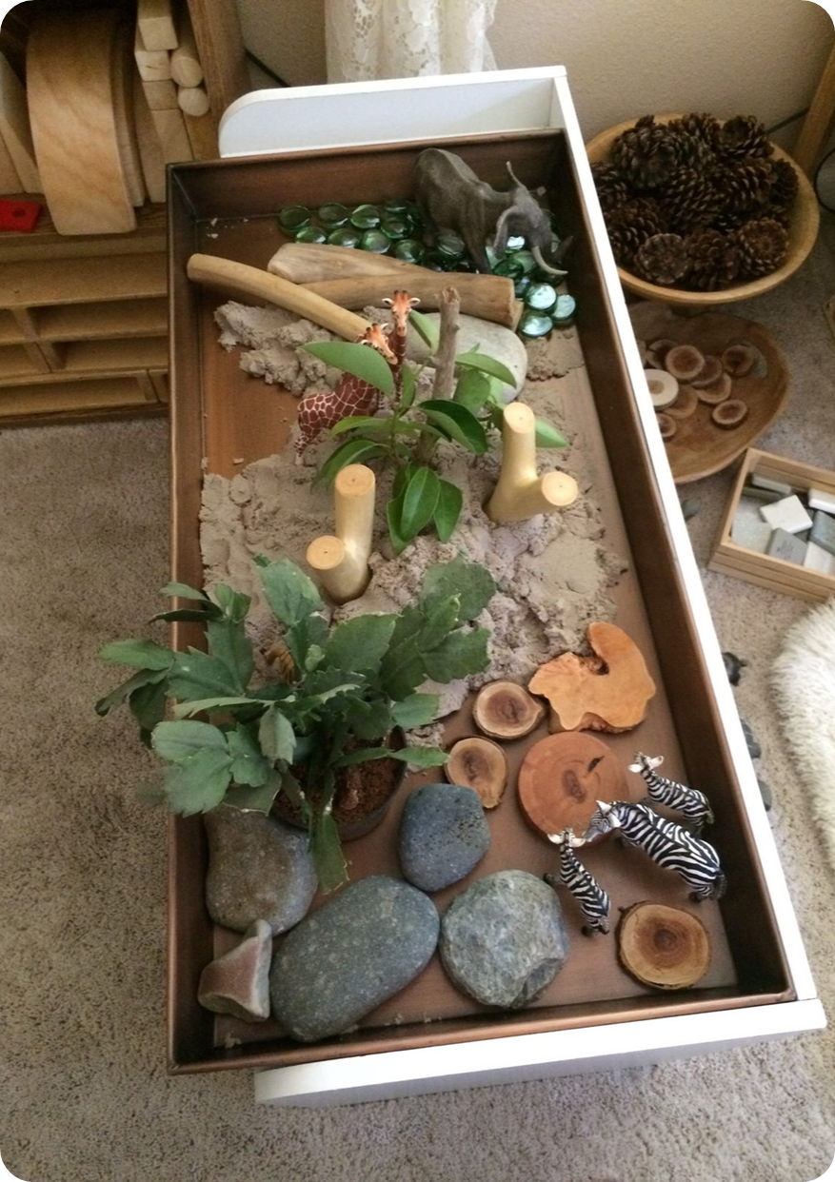
18. Sensory Materials
Tactile and messy materials are available in the setting.
The setting has many materials for children’s tactile and messy exploration.
Materials Include:
  Paints
  Playdough
  Sand
  Sensory balls
  Sensory bins filled with textured materials (e.g., dirt, beads, kinetic sand, and slime)

Slide 33
Pause and Reflect
11. Purposeful spaces 15. Displays of routines and transitions
12. Tidiness 16. Condition of materials
13. Freedom from background noise 17. Quantity of materials
14. Visual community expectations 18. Sensory materials
Supporting Well:
Which CLASS Environment items are currently in practice and helping children stay engaged, focused, and productive in your learning space?
Call to Action:
Choose one CLASS Environment item you are ready to improve. What is one small, realistic change you can make to better support children’s engagement and productivity?

Slide 34
CLASS Environment – Instructional Support
Instructional Support

Slide 35
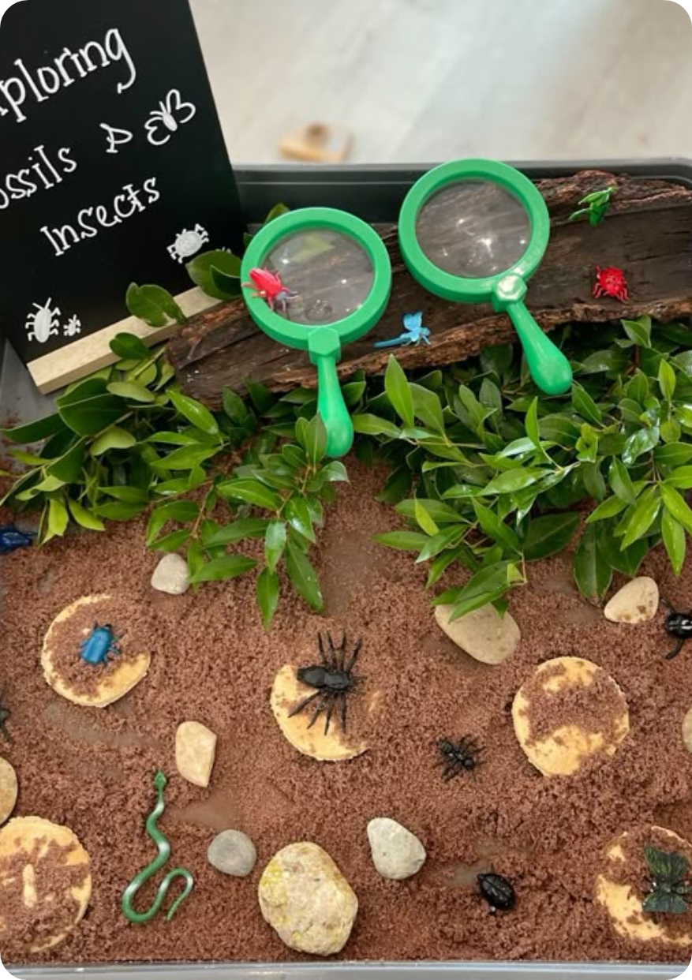
Instructional Support Items:
  Displays
    19. Display of children’s writing and dictation
  Materials
    20. Effectiveness of screen time
    21. Open-ended materials
    22. Materials for imaginary real-world play
    23. Art, music, or dance materials
    24. Real-world multicultural materials
    25. Recycled materials
  Displays/Materials
    26. Materials from nature
    27. Literacy materials
    28. Math materials
    29. Social and emotional learning materials

Slide 36
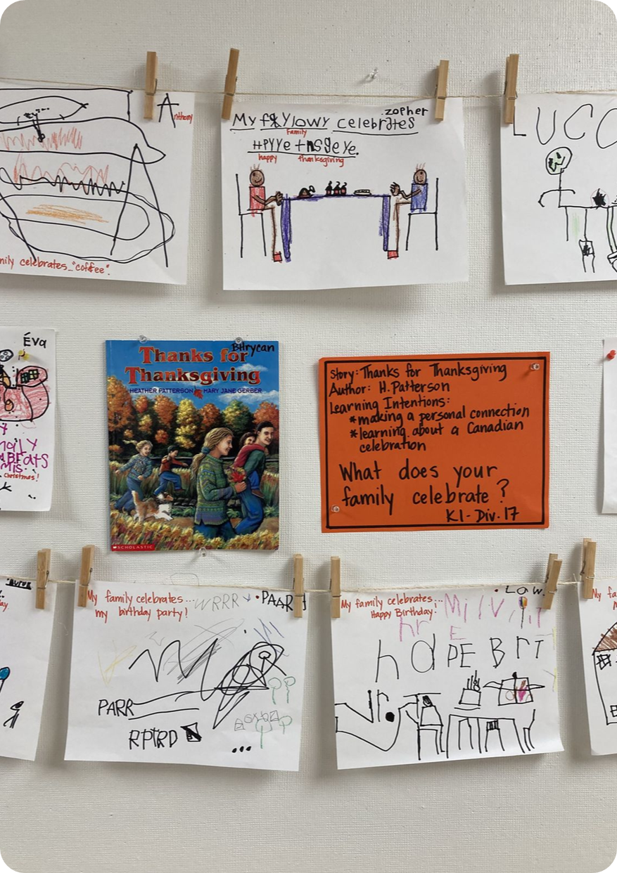
19. Displays of Children’s Writing and Dictation
  Displays present children’s unique writing (including pre-writing) attempts and dictations in any language.
    There are displays of children’s pre-writing in the classroom.
    There are children’s work with dictation.

Slide 37
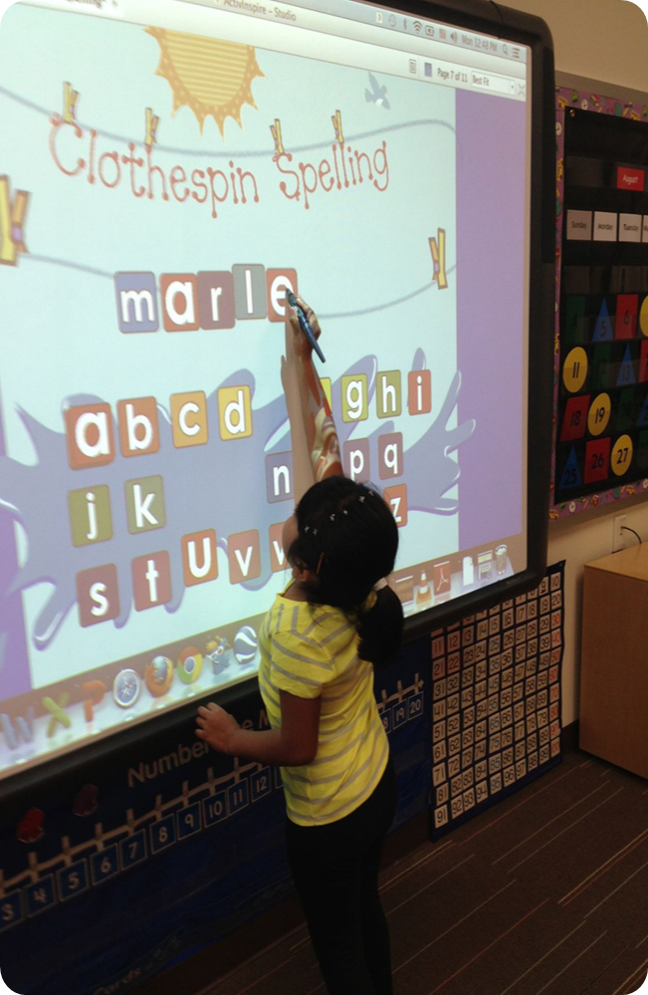
20. Effectiveness of Screen Time
  Screen time is interactive, requiring children’s engagement through clicking, tapping, dragging, or interactions with educators. Educators facilitate screen time to enhance play and learning.
    When screen time is included, educators intentionally use screen-based technology to enhance children’s play and learning experiences.
    For children two years and older, educators may facilitate the use of screen-based technology that involves active engagement, such as clicking, or interacting with the screen.
    Screen-based technology refers to devices such as cell phones, tablets, computers, televisions, smart boards, and other digital tools with screens.
    Assistive screen-based technology specifically designed for children with disabilities is not included in this definition

Slide 38
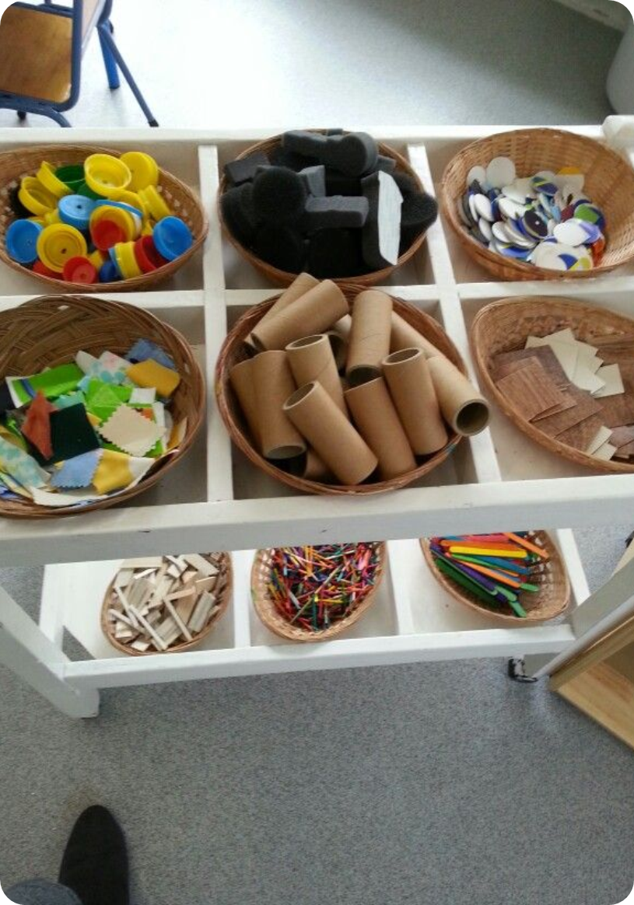
21. Open-Ended Materials
  Materials that encourage open-ended exploration are available in the setting
  The variety of materials encourage creativity and there is no correct or “right” way of using them
  Materials Include:
  Blank paper Collage materials
  Markers Paints
  Popsicle sticks Glue
  Buttons Cotton balls
  Yarn String
  Boxes Objects found in the outdoors (rocks, twigs, leaves etc.)

Slide 39
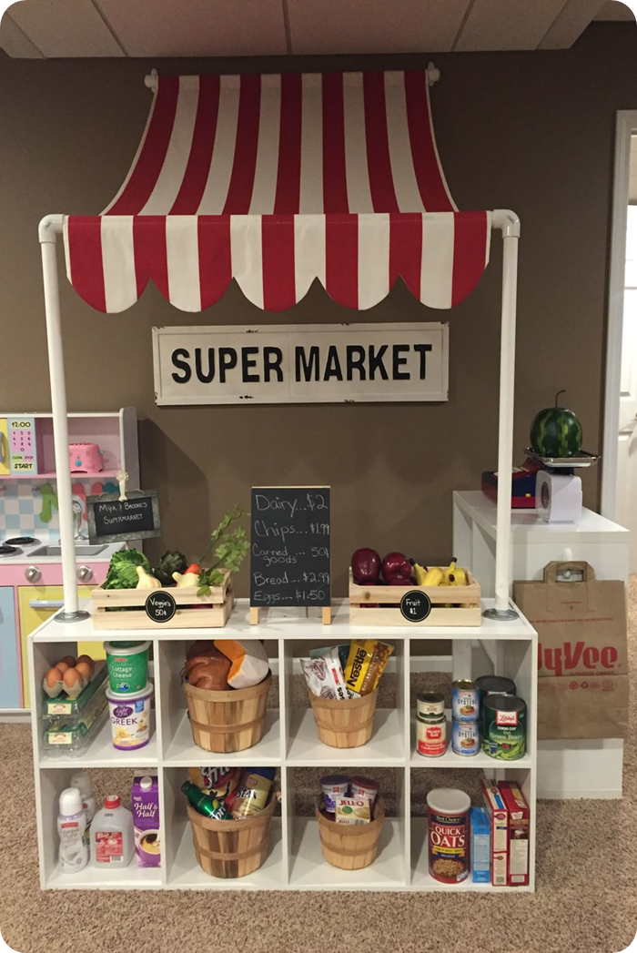
22. Materials for Imaginary Real-World Play
  Materials allow children to take on roles from the real world and to create scenes from their own experiences and imaginations.
  Materials for imaginary real-world play such as costumes and props or materials
  Materials Include:
    Cash registers
    Cookware and dishes
    Empty food boxes and containers
    Tools
    Flowers and vases (Flower Shop)
    Uniforms or costumes to create lived experiences (e.g. firefighter, doctor etc.)

Slide 40
23. Art, Music, and Dance Materials
  Art Materials:
  Books representing artwork or artists
  Colored pencils
  Crayons
  Easels
  Glitter
  Glue
  Markers
  Paper
  Pencils
  Paper punchers
  Scraps
  Watercolors
Music Materials:
Drums, egg shakers, and bells
Scarves to dance with
Yoga and tumbling mats
Images or books representing musicians
Musical instruments

Slide 41

24. Real-World Multicultural Materials
  Real-world objects from a variety of cultures and traditions available.
  Materials Include:
    Kitchen objects (kettles, pots, etc.)
    Musical instruments
    Tools
    Traditional baskets
    Traditional clothing
    Traditional dolls
    Woven textiles

Slide 42
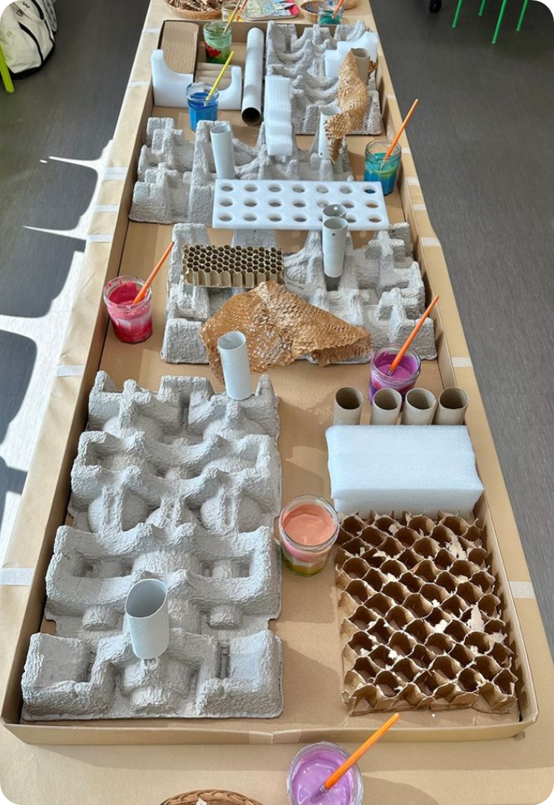
25. Recycled Materials
  Recycled materials that are used in children’s home lives are available in the learning setting for educators and children to repurpose
  Materials Include:
    Buttons
    Cardboard boxes
    Cotton balls
    Egg cartons
    Jars and containers
    Magazines and newspapers
    Paper towel rolls
    Wrapping paper
    Yarn and string

Slide 43
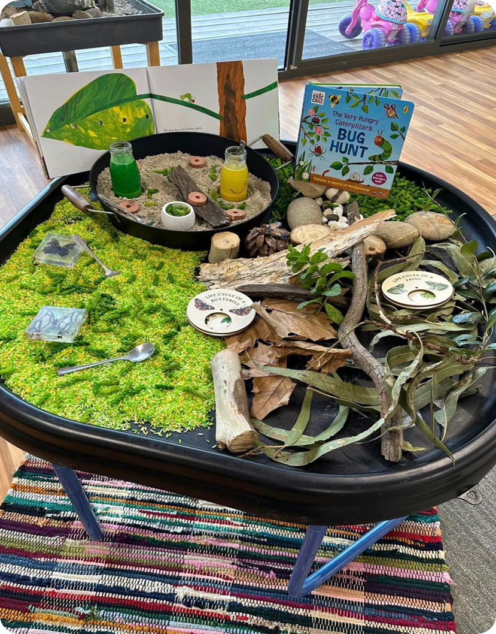
26. Materials From Nature
  Materials from the natural world are available in the setting
  Materials Include:
    Animals (for example, fish, crickets, and turtles)
    Buds and flowers
    Feathers
    Fossils
    Leaves
    Pinecones
    Plants
    Rocks
    Seeds
    Sticks
    Shells

Slide 44
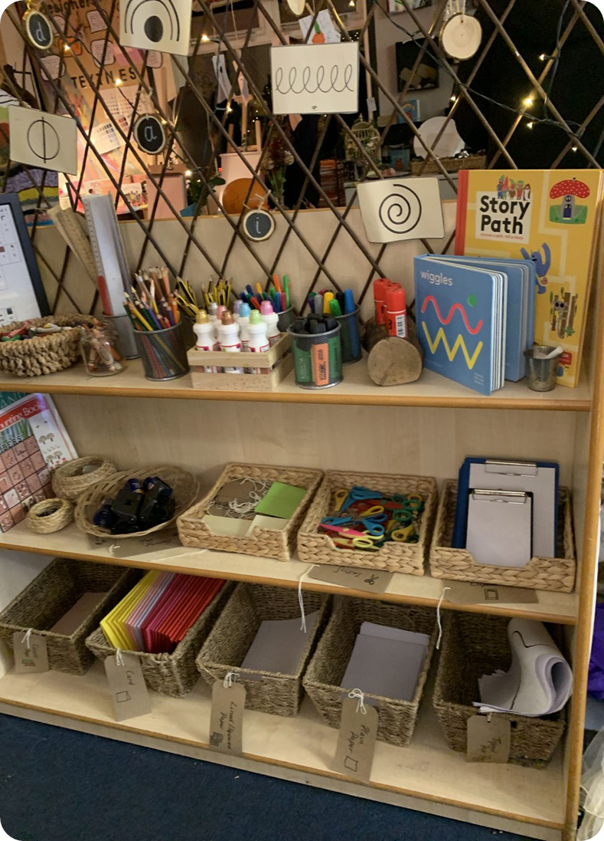
27. Literacy Materials (1)
  Materials or displays that promote literacy skills are available in the learning setting.
  The learning setting has a wide variety of books, low alphabet poster, and print labels with pictures for different materials and throughout the space.

Slide 45
27. Literacy Materials (2)
  Materials Include:
    Alphabet materials; including cards, charts, games, letter puzzles, stencils
    Alphabet Books
    Letter Bingo, letter matching games
    Flannel boards
    Sequencing cards to retell the story
    Labels for children’s cubbies and labeled centers
    Menus in the dramatic play area
    Writing materials (pencils, markers, highlighters etc.)
    Pads of paper to make a grocery list
    Cards and envelopes to write letters

Slide 46
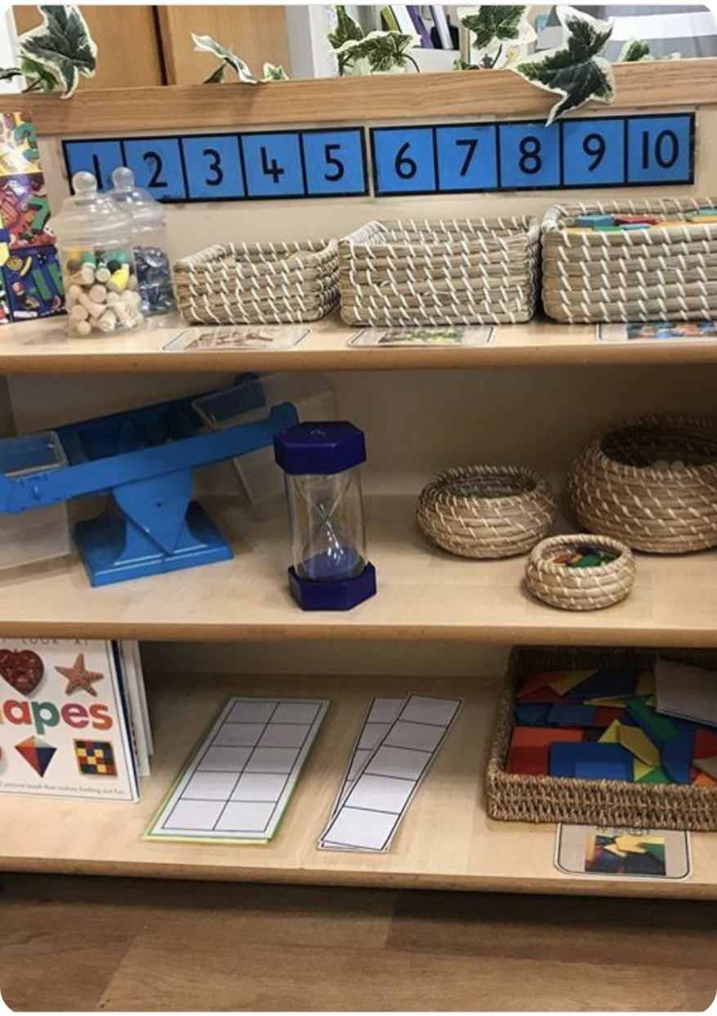
28. Math Materials (1)
  Math materials or displays are available in the setting.
  Materials Include:
    Balance scales and variety of materials to weigh
    Books about numbers and counting
    Books about shapes
    Blocks of different sizes and shapes
    Clocks, calendars, and stopwatches
    Different sized containers for comparing quantities
    Shape bingo, dominoes, and dice
    Materials for patterning

Slide 47
28. Math Materials (2)
  Materials Include:
    Magnetic numbers
    Number puzzles
    Number lines
    Number tiles
    Number blocks
    Picture cards that show different positions
    Play money
    Rulers
    Shape puzzles

Slide 48
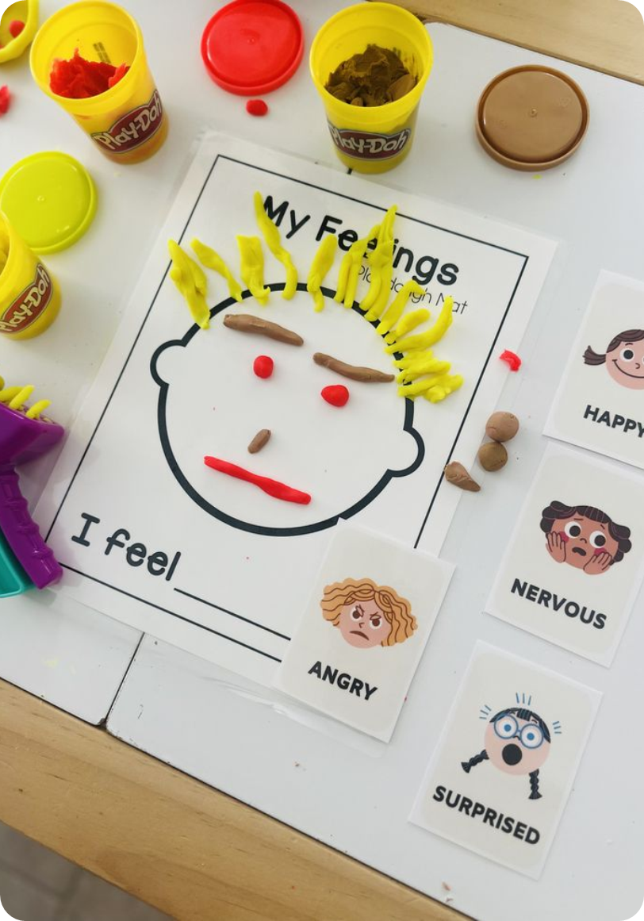
29. Social and Emotional Learning Materials (1)
  Social and emotional learning materials or displays available
  Materials Include:
    Books that show children experiencing different emotions
    Books that show ways to deal with strong emotions
    Books about friendship, caring and empathy
    Books about conflict resolution

Slide 49
29. Social and Emotional Learning Materials (2)
  Materials Include:
    Fidget toys
    Posters that show different ways to calm down
    Posted schedule to help children know what is next
    Posters that display problem-solving
    Puppets for role-play or acting out feelings
    Stress-balls

Slide 50
29. Social and Emotional Learning Materials (3)
  Materials Include:
    Fidget toys
    Posters that show different ways to calm down
    Posted schedule to help children know what is next
    Posters that display problem-solving
    Puppets for role-play or acting out feelings
    Stress-balls

Slide 51
The CLASS Environment tool is not just about materials it is about shaping experiences that support interactions.

Slide 52
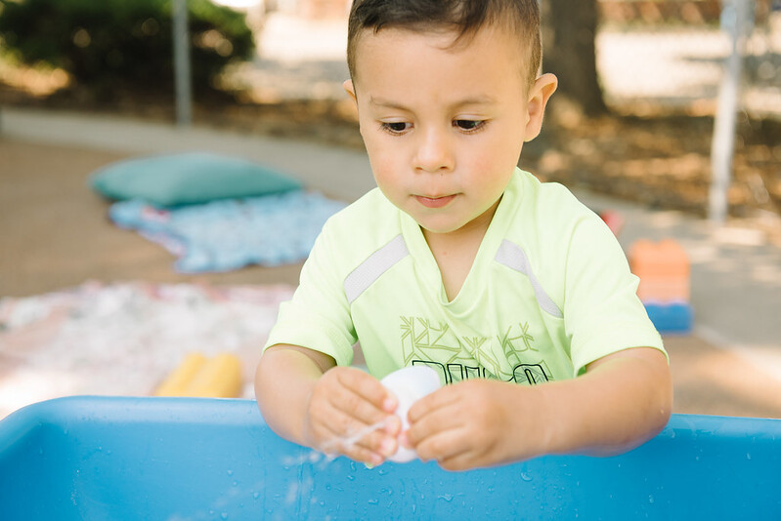
Thank you!
Photo Credit: Kidango Decoto Center; Union City, CA

