Slide 1
Classroom Assessment Scoring System Environment
Shaping Learning Through Environments and Interactions
Early Education Division
Date: February 19, 2026
Time: 3 to 5 p.m.

Slide 2
Before We Get Started
Participation in this training does not fulfill the two-part CLASS Environment certification requirement necessary to become a certified CLASS Environment observer, as offered by Teachstone.
The CLASS Environment Workbook shared during this training is not the CLASS Environment Manual.
The CLASS Environment Workbook is designed specifically for this training and is not intended to be used to conduct CLASS Environment observations.
The CLASS Environment tool and manual are copyrighted by Teachstone. The official CLASS Environment Manual is the required resource for conducting CLASS Environment observations and must be obtained directly through Teachstone.
These materials are provided solely to support learning within this training and may not be reproduced or used as a substitute for the official CLASS Environment Manual.

Slide 3
Agenda
Opening Reflection
Elements of the Classroom Assessment Scoring System (CLASS) and CLASS Environment
Emotional Support Domain
Classroom Organization Domain
Instructional Support Domain
Continuous Quality Improvement
Resources and Contact Information

Slide 4

Opening Reflection
Let us start with a quick reflection. Think of a time when someone gave you feedback at work or in a learning setting.
How did that feedback make you feel in the moment?
Share one word in the chat that captures that feeling.

Slide 5

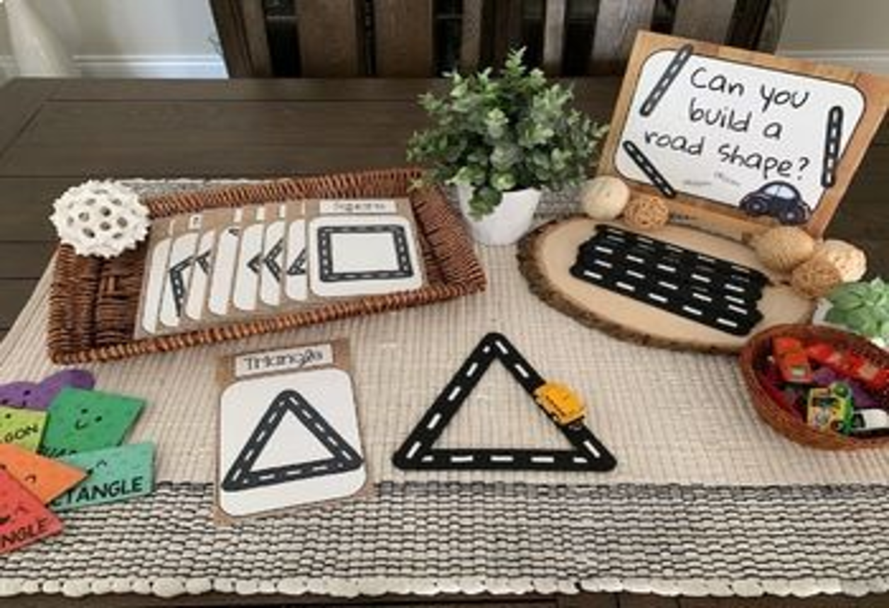
Adult/Child Interactions and Environment
CLASS → focuses on interactions
CLASS Environment → focuses on setting items that support interactions
Both together → influence quality of learning and engagement

Slide 6
CLASS Environment
CLASS Domains
Emotional Support Classroom Organization Instructional support
Environment Items
Arrangements Displays Materials

Slide 7
CLASS Domains
Emotional Support measures the quality of teacher-child interactions that promote children’s social-emotional development and well-being. It focuses on creating a warm, positive, and supportive classroom climate, fostering trusting relationships, and helping children manage their emotions, feel secure, and develop a sense of belonging.
Classroom Organization measures how educators manage time, attention, and the physical environment to maximize children’s engagement and learning. It focuses on creating a well-structured, predictable, and efficiently managed classroom that supports positive behavior, maximizes instructional time, and encourages children’s active participation.
Instructional Support focuses on how educators promote children’s thinking, understanding, and language development. It captures the ways teachers guide learning through meaningful feedback, encourage problem-solving and reasoning, and use rich language to expand children’s vocabulary and comprehension.

Slide 8
CLASS Environment - Emotional Support
Emotional Support

Slide 9

Emotional Support Domain:
  Arrangements
  1. Space for cooperation
  2. Sightlines
  3. Adult furniture
  4. Space for child privacy
  Displays
  5. Child-level displays
  6. Displays of children or their work
  Materials
  7. Child-accessible materials
  Multi-category
  8. Adaptations for all children’s participation
  9. Representation of diversity
  10. Materials for all children’s communication
Focus:
Belonging, relationships, emotional safety
Key items:
Cooperation, privacy, displays, adaptations
Strong emotional support builds readiness to learn

Slide 10
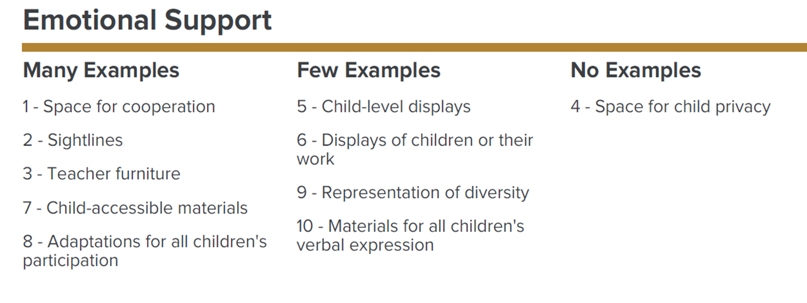
Understanding Your Emotional Support Scores
  What does my Emotional Support score mean?
  Each item gets a score of either a one (1), two (2), or three (3)
  Score 1: No or minimal evidence observed
  Score 2: Some or inconsistent evidence
  Score 3: Many, consistent, or varied evidence
  Scores guide improvement, not evaluation

Slide 11

Emotional Support Scenario (1)
Context: It is mid‑morning circle time. Seventeen children (mixed ages three to five) gather on the carpet for a music-and-movement activity. The classroom has a cozy “peace corner” with soft seating and a feelings chart, but it is positioned adjacent to the circle area with limited visual separation. Visuals for routines are posted near the door. Two educators are present.
What Occurred: The group transitions quickly from a lively song to a teacher-led read‑aloud. Ari, age four, who is sensitive to noise and transitions, begins fidgeting and covers his ears.
Initial Support: The lead educator notices and gestures toward the peace corner, saying, “You can take a break if you need.” Ari moves to the corner, but the space is within earshot and sightline of the group.

Slide 12
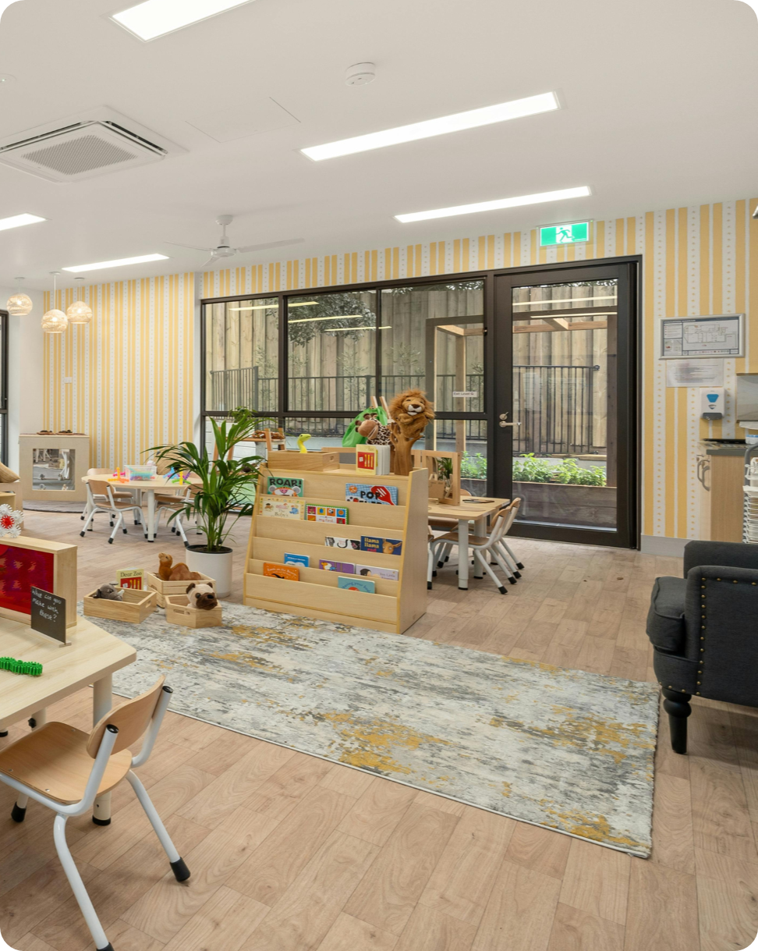
Emotional Support Scenario (2)
Context: It is mid‑morning circle time. Seventeen children (mixed ages three to five) gather on the carpet for a music-and-movement activity. The classroom has a cozy “peace corner” with soft seating and a feelings chart, but it is positioned adjacent to the circle area with limited visual separation. Visuals for routines are posted near the door. Two educators are present.
What Score did this educator get in multiple Emotional Support items: 2
Things to notice:
Educator notices distress and offers Ari a break
Peace corner exists but lacks full separation
Support is reactive, but there is limited follow-up
What can we do to help the educator?

Slide 13
Developing a Plan (1)
Example strategies for a three (3) score
Enhance Environment
Add visual or physical separation for peace corner
Include calming tools (headphones, sensory items)
Post self-regulation visuals inside the space
Proactive Emotional Support
Preview transitions and offer choices
Use emotional coaching language (“What can help you feel calm?”)
Foster Independence
Teach children to use peace corner without prompting
Practice during calm times
Follow-Up & Connection
Brief check-in after break
Reinforce positive self-regulation

Slide 14
CLASS Environment - Classroom Organization
Classroom Organization

Slide 15
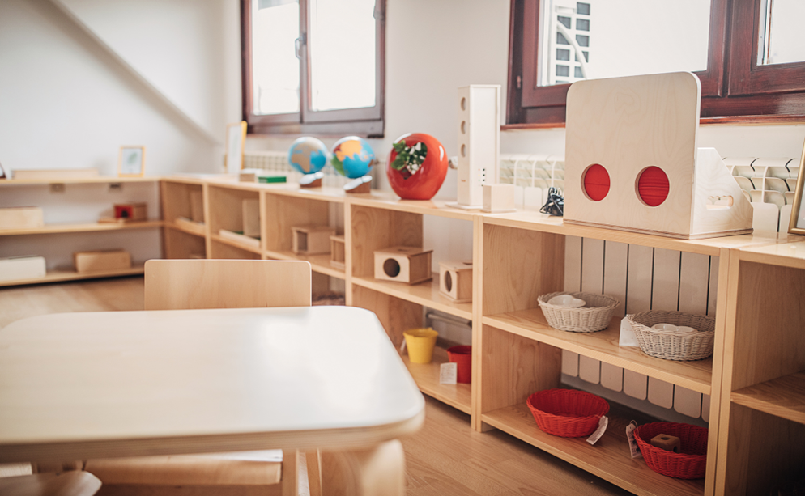
Classroom Organization Items:
  Arrangements
  11. Purposeful spaces
  12. Tidiness
  13. Freedom from background noise
  Displays
  14. Visual community expectations
  15. Displays of routines and transitions
  Materials
  16. Condition of materials
  17. Quantity of materials
  18. Sensory materials
Focus:
Routines, engagement, self-regulation
Key items:
Purposeful spaces, routines, materials
Organization supports positive behavior

Slide 16
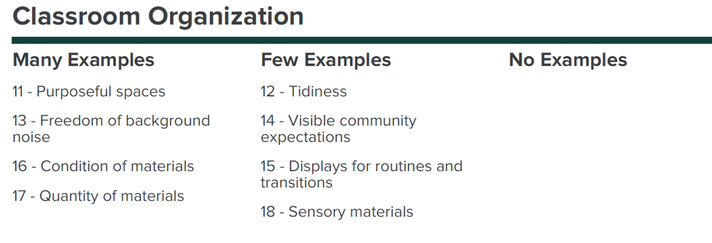
Understanding your Classroom Organization Scores
  What does my Classroom Organization score mean?
  Each item gets a score of either a one (1), two (2), or three (3)
  Score 1: No or minimal evidence observed
  Score 2: Some or inconsistent evidence
  Score 3: Many, consistent, or varied evidence
  Scores guide improvement, not evaluation

Slide 17
Classroom Organization Scenario (1)
Context: During center time, the classroom has only one sensory bin available. Several children gather around it, but only two can use it at a time. The remaining children wait with no alternative activities nearby. There are no visual supports such as center signs, turn-taking charts, or choice boards to guide children on what to do next.
What Occurred: Children waiting for the sensory bin start wandering around the classroom. Some interrupt others at the sensory bin, leading to minor conflicts.
Initial Support: The teacher acknowledges the issue and begins redirecting waiting children to other centers verbally. He attempts to manage turn-taking by telling children to wait patiently. No additional materials or visual aids are introduced at this point.

Slide 18
Classroom Organization Scenario (2)
Context: During center time, the classroom has only one sensory bin available. Several children gather around it, but only two can use it at a time. The remaining children wait with no alternative activities nearby. There are no visual supports such as center signs, turn-taking charts, or choice boards to guide children on what to do next.
What Score did this educator get in multiple Classroom Organization items: 1
Things to notice:
The educator provided a sensory experience.
Children were allowed to interact with the sensory bin, promoting hands-on learning.
The educator stayed near the sensory bin to monitor use and manage turn-taking verbally.
  Attempted to manage fairness by asking children to wait patiently.
  What can we do to help the educator?

Slide 19
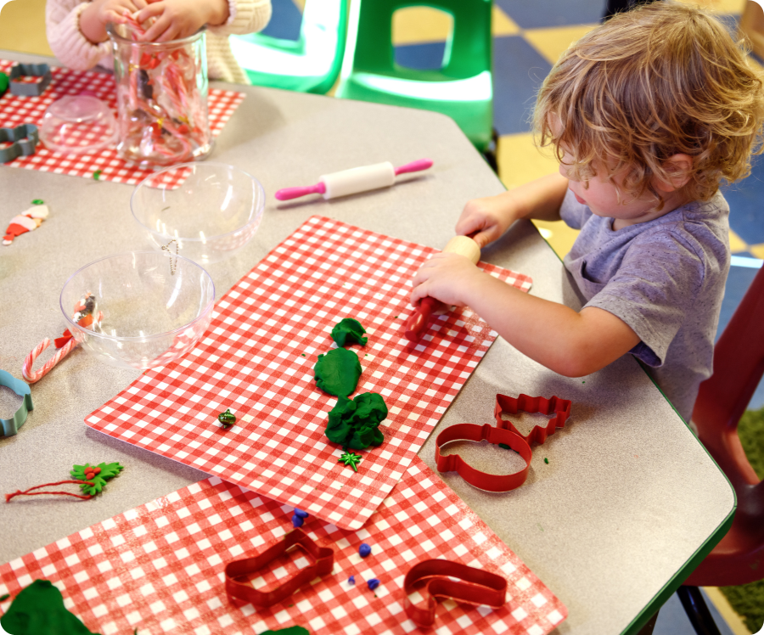
Developing a Plan (2)
Example strategies for a three (3) score
Enhance Environment
Add multiple sensory options (e.g., water table, playdough, textured materials).
Rotate sensory materials weekly to maintain engagement.
Ensure materials are accessible and organized for easy use.
Proactive Classroom Organization
Provide alternative activities for waiting children (puzzles, art trays, quiet reading).
Use timers or name cards for turn-taking at the sensory bin.
Arrange centers to reduce congestion and promote smooth transitions.

Slide 20
Developing a Plan (3)
Example strategies for a three (3) score
Foster Independence
Introduce visual supports:
  Center choice boards with pictures.
  Turn-taking charts or name cards.
Visual schedules for transitions.
  Follow-Up & Connection
Model and practice routines for moving to activities.
Engage children actively by circulating and guiding them to other centers.
Reflect on what worked and adjust materials or supports based on children’s interests.

Slide 21
CLASS Environment – Instructional Support
Instructional Support

Slide 22

Instructional Support Items:
  Displays
    19. Display of children’s writing and dictation
  Materials
    20. Effectiveness of screen time
    21. Open-ended materials
    22. Materials for imaginary real-world play
    23. Art, music, or dance materials
    24. Real-world multicultural materials
    25. Recycled materials
  Displays/Materials
    26. Materials from nature
    27. Literacy materials
    28. Math materials
    29. Social and emotional learning materials
Focus:
Language, thinking, problem-solving
Key items:
Open-ended, literacy, math, real-world materials
Environment invites deeper learning

Slide 23
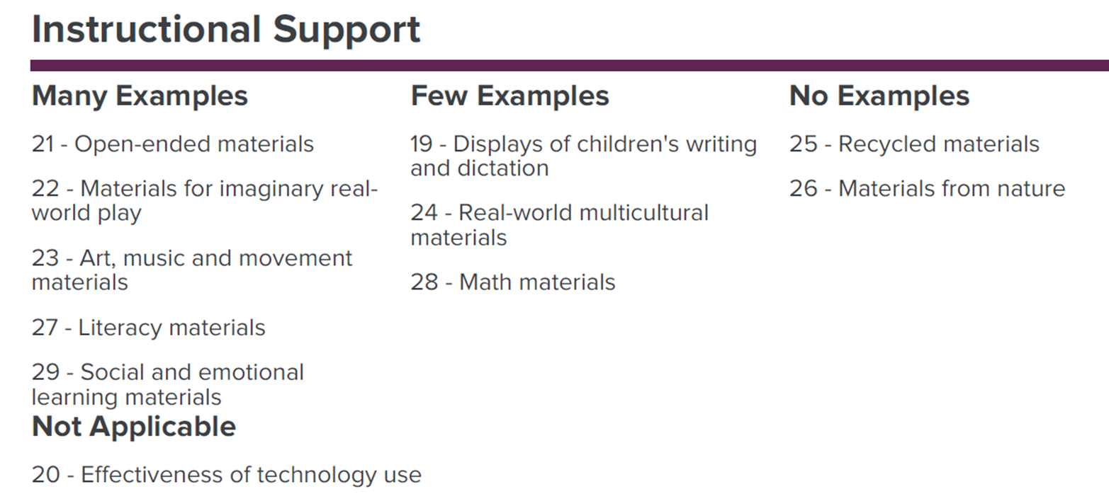
Understanding your Instructional Support Scores
  What does my Classroom Organization score mean?
  Each item gets a score of either a one (1), two (2), or three (3)
  Score 1: No or minimal evidence observed
  Score 2: Some or inconsistent evidence
  Score 3: Many, consistent, or varied evidence
  Scores guide improvement, not evaluation

Slide 24
Instructional Support Scenario (1)
Context: During free play time, the educator sets up a small table with loose parts (bottle caps, sticks, shells, and cardboard pieces) for children to explore. The intention is to encourage creativity and problem-solving. The educator places the materials on the table and says: “Here are some things you can use. What do you think you could make?”
What Occurred: Children begin to explore, stacking and arranging the loose parts. The educator observes and asks a few questions such as: “What happens if you put the stick on top of the shell?” “Can you make it stand up?” The children experiment briefly but there is no extended conversation or deeper engagement.
Initial Support: The educator provides access to materials that allow for basic exploration. There were some questions asked, but children respond with a yes or a no.

Slide 25
Instructional Support Scenario (2)
Context: During free play time, the educator sets up a small table with loose parts (bottle caps, sticks, shells, and cardboard pieces) for children to explore. The intention is to encourage creativity and problem-solving. The educator places the materials on the table and says: “Here are some things you can use. What do you think you could make?”
What Score did this educator get in multiple Instructional Support items: 2
Things to notice:
The educator provided access to loose parts that encourage exploration and creativity.
Asked open-ended questions like “What happens if you put the stick on top of the
shell?” to spark curiosity.
Created an opportunity for problem-solving through materials that allow stacking and
  balancing.
Allowed child-led exploration, giving children autonomy rather than directing the
activity.
What can we do to help the educator?

Slide 26
Developing a Plan (4)
Example strategies for a three (3) score
Enhance Environment
Add variety and complexity to loose parts (e.g., different textures, sizes, connectors)
Include related props or tools (like small containers, ramps, or clips) that encourage experimentation and problem-solving.
Arrange materials in a way that sparks curiosity (e.g., grouping items by shape or color to prompt sorting or pattern-making).
Proactive Instructional Support
Begin with intentional prompts:
“What could you build that moves?” or “How can you make it taller without falling?”
Use language that introduces concepts (balance, stability, size, weight) during play.
Offer gentle hints or challenges:
“What happens if you use a heavier piece at the bottom?”

Slide 27
Developing a Plan (5)
Example strategies for a three (3) score
Foster Independence
  Encourage children to plan before building:
  “What is your idea? How will you start?”
  Give choices and ownership:
  “Which pieces do you think will work best?”
  Follow-Up & Connection
  After the activity, reflect together:
  “What worked well? What was tricky?”
  Connect to real-world examples:
  “Buildings need strong bases too why do you think that is?”

Slide 28
Continuous Quality Improvement

Slide 29

Using Results for Continuous Quality Improvement (1)
Analyze Data Trends
Review CLASS scores across dimensions
Emotional Support
Classroom Organization
Instructional Support
Identify patterns:
Are certain domains consistently lower?
Are there classroom specific trends?

Slide 30

Using Results for Continuous Quality Improvement (2)
Set SMART Goals
Specific: Target one or two dimensions for improvement.
Measurable: Define what success looks like (e.g., increase Instructional Support score by 0.5 points).
Achievable: Align goals with available resources.
Relevant: Connect goals to program priorities and child
outcomes.
Time-bound: Establish timelines for progress checks.

Slide 31

Using Results for Continuous Quality Improvement (3)
Monitor & Adjust
Schedule regular check-ins to review progress.
Adjust strategies based on data and teacher feedback.
Celebrate Success
Recognize improvements
Share success stories

Slide 32
Resources and Contact Information
Management Bulletin 23-10 - Child Development (CA Dept of Education)
Classroom Assessment Resources - Child Development (CA Dept of Education)
CLASS® in California
ASPIRE Home
Technical assistance inbox for California State Preschool Program requirements: eedtitle5@cde.ca.gov
CLASS inbox: EEDCLASS@cde.ca.gov

Slide 33
The CLASS Environment tool is not just about materials it is about shaping experiences that support interactions.

Slide 34

Thank you!
Photo Credit: Kidango Decoto Center; Union City, CA

