Slide 1
Management Bulletin 23-10:
Classroom Assessment Scoring System (CLASS) in California State
Preschool Programs
Early Education Division (EED)
Date: March 7, 2024
Time: 3 – 4:30 p.m.

Slide 2
CLASS Webinar Series
Webinar 1: Today
Overview of Management Bulletin (MB) 23-10: Walking Through the Requirements
Webinar 2: April 18, 2024
What is CLASS 2.0 and CLASS Environment? How can it help?

Slide 3
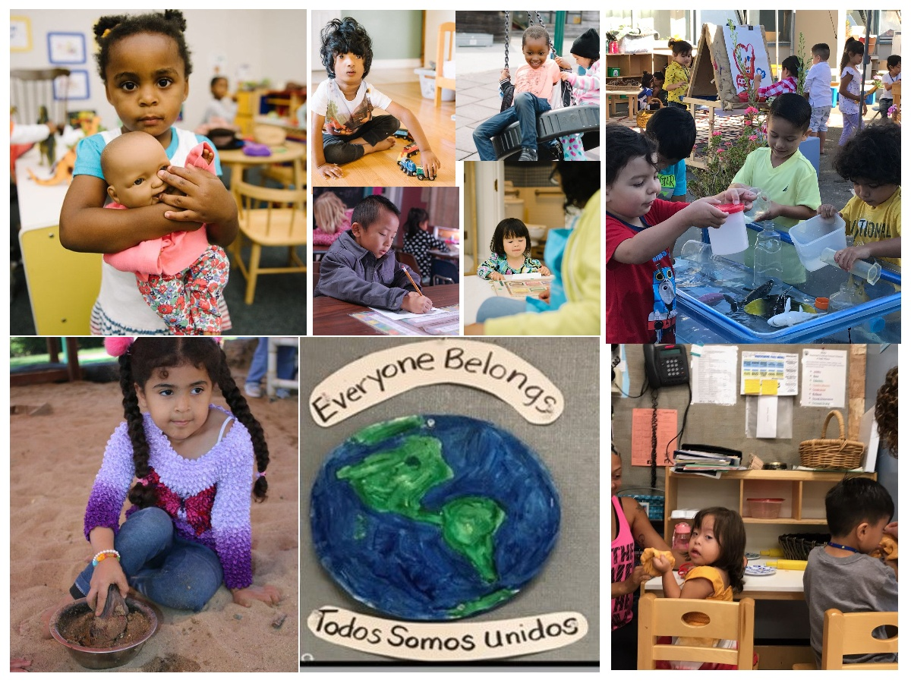
Welcome and Introductions

Slide 4
Agenda (1)
Overview of the Policy and Purpose
Why the Classroom Assessment Scoring System (CLASS) and CLASS Environment
Implementation of CLASS
Implementation of the CLASS Environment
  Changes Related to the Environment Rating Scale (ERS)
  Additional Requirements

Slide 5
Agenda (2)
Implementation Support
Timelines
Obtaining Observations and Trainings
CLASS Scores
Documentation
Data Requirements
We will hold a Question and Answer (Q&A) session at the end of the webinar. Please use the Q&A feature to send your questions, not the chat box.

Slide 6
Policy and Purpose (1)
Management Bulletin (MB) 23-10 notifies and provides guidance on:
  Requirements to phase in implementation of the CLASS, the CLASS Environment tool, and additional requirements
  Removal of current requirements for contractors to complete the ERS
Changes to Title 5 regulations in order to implement Section 106 of Senate Bill (SB) 114 (Chapter 48, Statutes of 2023):
  As of July 1, 2024, contractors will no longer be required to complete an ERS annually, as a part of their Program Self Evaluation (PSE) and as part of a contract monitoring review.
  Instead, contractors will be required to implement CLASS Second Edition Pre-K-3rd, the CLASS Environment, and additional requirements as specified

Slide 7
Policy and Purpose (2)
At this time, the CLASS tools and data will not be used by the California Department of Education (CDE) to determine a finding, but rather to help identify where additional support is needed for continuous quality improvement in California State Preschool Programs (CSPP).
CLASS data should be used by CSPP programs to inform professional development, coaching, and other continuous quality improvement efforts.
Contractors shall not use CLASS scores to evaluate staff competency.

Slide 8
Why CLASS and CLASS Environment?
The 2023–24 Budget required CDE to issue guidance on use of a tool to strengthen teacher-child interactions and support quality improvement in CSPP
To build an educator-first system of improving adult-child interactions and enhancing equity, CDE is implementing the Classroom Assessment Scoring System (CLASS) Second Edition® and the CLASS Environment tool across all CSPPs
CLASS Second Edition was updated with the specific intention of centering equity to ensure CLASS reflects and supports the diverse communities it serves and provides actionable insights for educators to make improvements in the areas that matter most for children
CDE looks to build on California's existing CLASS capacity throughout the implementation

Slide 9
Implementation of CLASS

Slide 10
Implementation of CLASS: Overview
Beginning on July 1, 2024, for the 2024–25 program year, all CSPP contractors are required to use the CLASS tool.
CLASS will be implemented with a graduated phase-in approach beginning in 2024–25, that will allow time for the state and contractors to increase CLASS Observation capacity until full implementation in program year 2028–29.
Beginning July 1, 2028, all contractors are required to obtain at least one CLASS Observation on each California State Preschool Program (CSPP) classroom per program year.

Slide 11
Implementation of CLASS: Timeline
Year Number | Program Year | % of CSPP classrooms within the agency's contract that must have annual CLASS Observation completed
1 | 2023–24 | No requirement; however, contractors should use 2023–24 to begin developing an agency plan for CLASS implementation
2 | 2024–25 | 15%
3 | 2025–26 | 30%
4 | 2026–27 | 60%
5 | 2027–28 | 90%
6 | 2028–29 and beyond | 100%

Slide 12
Requirements for CLASS Observers
Certified CLASS Observers are required to complete additional training beyond CLASS Certification.
Except as specified in “Allowances for Head Start Grantees and Contractors Participating in QRIS”, any Certified CLASS Observer who is conducting an observation in a CSPP classroom must also have completed the CLASS Observer Support Series, including:​
​
  Settings with Dual Language Learners,​
  Settings with Children with Disabilities, and​
  Reducing Bias.​
  ​
The purpose of this additional training requirement is to ensure California is centering diversity, equity, inclusion, and belonging in CLASS implementation.​

Slide 13
Commingling and CLASS Observations
Each classroom that includes one or more children enrolled in CSPP must conduct CLASS observations with respect to all children in the classroom, regardless of funding source.
When conducting a CLASS Observation in a mixed-age setting or classroom, including in family childcare homes operating as part of a family childcare home education network (FCCHEN), contractors must observe using the CLASS Second Edition Pre-K-3rd.
When contractors commingle CSPP children (certified children) with children being served through different funding sources (non-certified children), contractors must observe using the CLASS Second Edition Pre-K-3rd.
In all commingling situations, the Observers must observe teacher-child interactions with all children in the classroom, not just children enrolled in CSPP.

Slide 14
Allowances for Head Start Grantees and Contractors Participating in the Quality Rating Improvement System (1)
  For program years 2024–25 and 2025–26, contractors that are also Head Start grantees serving preschool-age children or that are participating in their local CSPP quality rating improvement system (QRIS) may utilize observations made using the CLASS 2008 version if the following requirements are met:
    The observations were conducted during the corresponding program year and,
    Any data and information from such observations required pursuant to the Data Collection Requirements must be reported using the processes specified in MB 23-10

Slide 15
Allowances for Head Start Grantees and Contractors
Participating in the Quality Rating Improvement System (2)
At this time, CLASS observations conducted on CSPP classrooms during federal Head Start grantee monitoring may be utilized to meet the requirements of MB 23-10 (even if those observations only include two cycles) so long as the CSPP contractor has received, at minimum, site-level data with CLASS scores from the observation.
If a Head Start grantee is conducting the CLASS through their annual self-assessment (for example, to prepare for federal monitoring or to support continuous quality improvement), that CLASS observation must be a minimum of three cycles in order to meet the requirements of MB 23-10.

Slide 16
Allowances for Head Start Grantees and Contractors
Participating in the Quality Rating Improvement System (3)
If the percentage of classrooms observed using CLASS 2008 is insufficient to meet the required percentage threshold for the applicable year, then the contractor must obtain observations on additional classrooms using the CLASS 2nd Edition.
Beginning in program year 2026–27, all CSPP classroom observations must be conducted using the CLASS 2nd Edition and include a minimum of three cycles of observation.

Slide 17
Implementation of CLASS Environment

Slide 18
Implementation of CLASS Environment: Overview
Beginning July 1, 2024:
  CSPP contractors will no longer be required to complete an ERS annually, as part of the PSE and as part of a contract monitoring review.
  All CSPP contractors will be required to implement CLASS® Second Edition Pre-K-3rd and the CLASS Environment.
  CLASS Environment will be implemented with a graduated phase-in approach for the 2024–25 program year.
Beginning July 1, 2028, all contractors are required to obtain at least one CLASS Environment Observation on each CSPP classroom per program year.

Slide 19
Implementation of CLASS Environment: Timeline
Year | Program Year | % of CSPP classrooms within the contract that must have an annual CLASS Environment Observation completed
1 | 2023–24 | No requirement; however, contractors should use 2023–24 to begin developing an agency plan for CLASS Environment implementation. (Note: Final year ERS is in effect.)
2 | 2024–25 | 15%
3 | 2025–26 | 30%
4 | 2026–27 | 60%
5 | 2027–28 | 90%
6 | 2028–29 and beyond | 100%

Slide 20
Requirements for Individuals Conducting CLASS Environment Observations
CLASS Environment Observations must be completed by a Certified CLASS Observer who has also completed training on CLASS Environment.
Additionally, any Certified CLASS Observer who is conducting a CLASS Environment Observation in a CSPP classroom must also have completed the CLASS Observer Support Series.
The purpose of this additional training requirement is to ensure California is centering diversity, equity, inclusion, and belonging in CLASS Environment implementation.

Slide 21
Commingling and CLASS Environment Observations
Each classroom that includes one or more children enrolled in CSPP must conduct CLASS Environment with respect to all children in the classroom, regardless of funding source.
When conducting a CLASS Environment Observation in a mixed-age setting or classroom, including in family childcare homes operating as part of a FCCHEN, contractors must observe using CLASS Environment.
When contractors commingle CSPP children (certified children) with children being served through different funding sources (non-certified children), contractors must observe using CLASS Environment.
In all commingling situations, the observers must make environmental observations for all children in the classroom, not just children enrolled in CSPP.

Slide 22
Local Educational Agencies (LEAs)
With License Exempt Classrooms
Prior to full implementation of the CLASS Environment in program year 2028–29, CSPP contractors must:
  Prioritize all CSPP license-exempt classrooms for CLASS Environment observations.
  Ensure CLASS Environment observations are completed for all license-exempt classrooms before CLASS Environment Observations for licensed classrooms are started.

Slide 23
Additional Environment Requirements

Slide 24
Additional Requirements (1)
Certain requirements that were included in the ERS remain necessary to support quality improvement. Therefore, contractors must meet the following requirements, which are preserved from the ERS:
  Provide children enrolled in full-day CSPP for over four hours with regularly scheduled time to nap or rest
  Cots or mats must be at least 18 inches apart
  Napping and rest activities must be provided in a clean and sanitary manner
  Space must be conducive to resting

Slide 25
Additional Requirements (2)
Ensure schedules provide a balance of structure and flexibility. The schedule must include the following each day:
  A variety of play activities
  Both gross motor and less active play
  At least one indoor and one outdoor play period (weather permitting)

Slide 26
Additional Requirements (3)
  Post written handwashing procedures in a place that is visible to children and adults
  Handwashing procedures must be followed by children and adults
  Provide storage spaces with security provisions where staff can store their personal belongings
  Have space and/or policies in place to support staff for work-related tasks such as conferences and meetings and to support staff for personal breaks

Slide 27
Support for Contractors and Timeline

Slide 28
Implementation Support
Achieving Success in Positive Interactions, Relationships, and Environments (ASPIRE) program request for applications was released on February 28, 2024.
  Supporting one Statewide CLASS Lead
    Coordinating efforts across leads in collaboration with CDE and Teachstone
    Statewide access to resources, training, and data reporting
  Supporting four Regional Leads
    Conducting regional needs assessment to identify capacity for observations and coaching
    Developing regional coordination plan
ASPIRE leads will begin grant duties by June 2024

Slide 29
Timeline (1)
2023–24 Program Year:
Introductory training on CLASS and CLASS Environment
Determining how observations will be obtained
Attending webinars or office hours hosted by the CDE
Viewing the CLASS resource page
Connecting with ASPIRE grant leads, once identified
By May 15, 2024, all contractors must provide data to their Regional CLASS leads, per the Data Collection Requirements section in MB 23-10.

Slide 30
Timeline (2)
2024–25 Program Year and Beyond:
October 1, 2024, all contractors must develop an agency plan, send a copy to ASPIRE grant leads, and share that plan with their staff
Beginning with 2024–25 PSE, contractors will be required to report data on CLASS and CLASS Environment Observations completed in their programs

Slide 31
Obtaining CLASS Observations
Contractors have the following opportunities for CLASS observations:
  If the Regional CLASS Lead offers and the contractor prefers, the contractor may obtain a CLASS and/or CLASS Environment observation from the Regional CLASS Lead
  Contractors can send program staff to certified CLASS Observer training provided through the CSPP Regional CLASS Leads funded with CSPP ASPIRE funding
  Contractors can have CLASS and/or CLASS Environment Observations completed by a Certified Observer under another auspice

Slide 32
Obtaining CLASS Training
The Statewide CLASS Lead will hold Leader and Educator Launch Events to increase knowledge of:
  The importance of teacher-child interactions and classroom settings/environments
  How CLASS can inform continuous quality improvement
The Regional CLASS Leads, in partnership with the Statewide CLASS Lead, will:
  Hold in-person regional events to share information with leaders, program administrators and educators
  Facilitate regional and local communication about CLASS in the field

Slide 33
CLASS Scores (1)
At this time, the CDE is not setting a required minimum threshold score per domain for the CLASS or the CLASS Environment.
While there is not a minimum score that contractors need to meet at this time, the CLASS and CLASS Environment scores will still be reported to CDE as part of the annual PSE.
The CLASS tools, including data generated by the implementation of the CLASS tools, will not be used by CDE to determine a finding during contract monitoring.
  CLASS scores will be used to help identify where additional support is needed for continuous quality improvement in CSPP.

Slide 34
CLASS Scores (2)
Beginning in program year 2024–25, the CDE will:
  Review CLASS and CLASS Environment scores as part of the annual PSE
  Connect with contractors whose scores indicate a need for more intensive training, support, and technical assistance and/or coaching for program staff.
The CDE will be closely reviewing data collected on CLASS and CLASS Environment implementation to determine minimum threshold scores that will be implemented through the regulations process.

Slide 35
CLASS Documentation (1)
Contractors are required to keep the following documentation at the contractor level to be made available to the CDE as requested:
  Current CLASS Observer certifications for all staff employed by the contractor that have completed the CLASS and CLASS Environment Observation Training and passed the certification or recertification test.
  All CLASS and CLASS Environment Observation scoresheets for each CSPP classroom, or CSPP classroom scores on an Observation or scoring summary document provided by the Observer that provides some context about the observation.

Slide 36
CLASS Documentation (2)
  All coaching and/or training documentation associated with CLASS and CLASS Environment Observations.
  Name and agency association for all CLASS Observers that complete CLASS and CLASS Environment observations that are not employed by the CSPP contractor.
    Note that this information can be captured informally such as on the scoresheet or scoring summary provided at the end of the observation.

Slide 37
CLASS Data (1)
CSPP contractors must provide data and information requested by the Regional and Statewide CLASS Leads funded through ASPIRE
CSPP contractors must provide the following data to their CSPP Regional CLASS Leads by May 15:
  Data on the number and location(s) of the CSPP classrooms
  The date(s) of the last CLASS Observation for each CSPP classroom
  The date(s) of the last CLASS Environment Observation for each CSPP classroom

Slide 38
CLASS Data (2)
For contractors operating in multiple counties, information at the county level must be provided to the appropriate Regional Lead(s).
For contractors operating an approved CSPP FCCHEN, the contractor will need to collect and share with their CSPP Regional CLASS Leads data relating to the individual providers, including:
    The number of providers
    The location of those providers, and
    Information on the date of last CLASS and CLASS Environment Observation for each provider

Slide 39
CLASS Data (3)
  CSPP contractors will also be required to report more specific data on CLASS and CLASS Environment scores
    The CDE is still in the process of finalizing the CLASS and CLASS Environment Data Reporting Instructions
    Once finalized, the data reporting instructions will be posted on the CLASS Resources page

Slide 40
CLASS Data and the Program Self Evaluation
As part of the submission of the annual PSE, CSPP contractors will be required to review all data and provide information related to:
  CLASS and CLASS environment scores
  Coaching or training provided as a result of those scores
The annual PSE will include a section where contractors will be asked to reflect on their scores and identify a plan for how they will use the information from their scores to improve their practice as they work on continuous quality improvement.

Slide 41
Using CLASS Data at the Contractor Level
CLASS data should be used by CSPP contractors to inform professional development, coaching, and other continuous quality improvement efforts.
Contractors shall not use CLASS scores to evaluate staff competency. If violations of state or federal law are observed during a CLASS or CLASS Environment Observation, the person observing shall continue to follow all applicable laws.

Slide 42

CLASS Resources
Scan the code above to access the
CDE CLASS Resources web page: https://www.cde.ca.gov/sp/cd/ci/classrmassessmtresource.asp

Slide 43
Questions and Answers

Slide 44
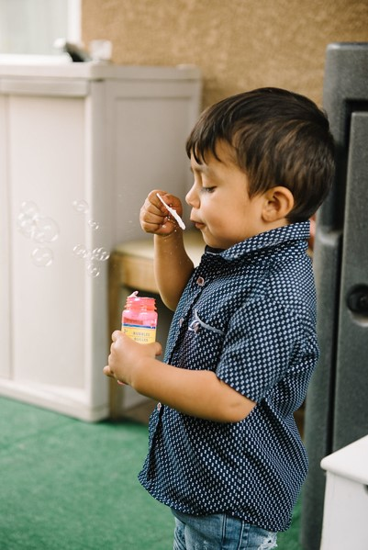
Closing
Photo Credit: Debra Manrique Family Child Care; Oxnard, CA

