Slide 1
Supporting Dual Language Learners in California State Preschool Programs (CSPP)
Early Education Division (EED)
Date: June 13, 2023
Time: 3:00 – 4:30 p.m.

Slide 2
Webinar Overview
Highlights from Dual Language Learner (DLL) Series
DLLs in CA
Policy Background
Guest Speakers
  Classroom Strategies
  Family Engagement
DLL Support Webpage
Resources and Support

Slide 3
Highlights from DLL Webinar Series
Parts One and Two
Video from Early Edge Co-Sponsors of Assembly Bill (AB) 1363
Policy and Procedures
Practitioner Perspective
Preschool Language Information System (PLIS)
DLL identification and PLIS frequently asked questions (FAQs)

Slide 4
Dual Language Learners in California
According to the Migration Policy Institute (MPI) analysis from the U.S. Census Bureau's 2015–19 data, California is home to 1.7 million Dual Language Learners, who comprise 59% of all young children ages 0–5 in California.

Slide 5
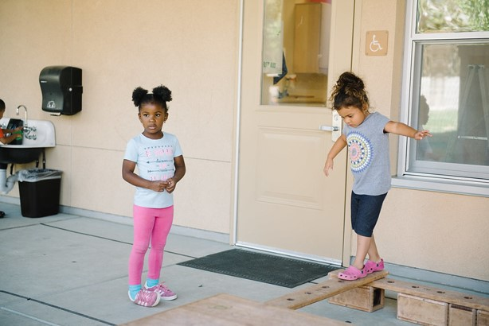
Top Non-English Languages Spoke in DLLs' Households in California, 2015–19
These languages include:
Spanish: 66%
Chinese: 5%
Tagalog: 3%
Vietnamese: 2%
Korean: 1%
Hindi: 1%
Arabic: 1%
Russian: 1%
Farsi or Persian: 1%
Armenian: 1%
Photo Credit: Lighthouse for Children CDC, Fresno, CA

Slide 6
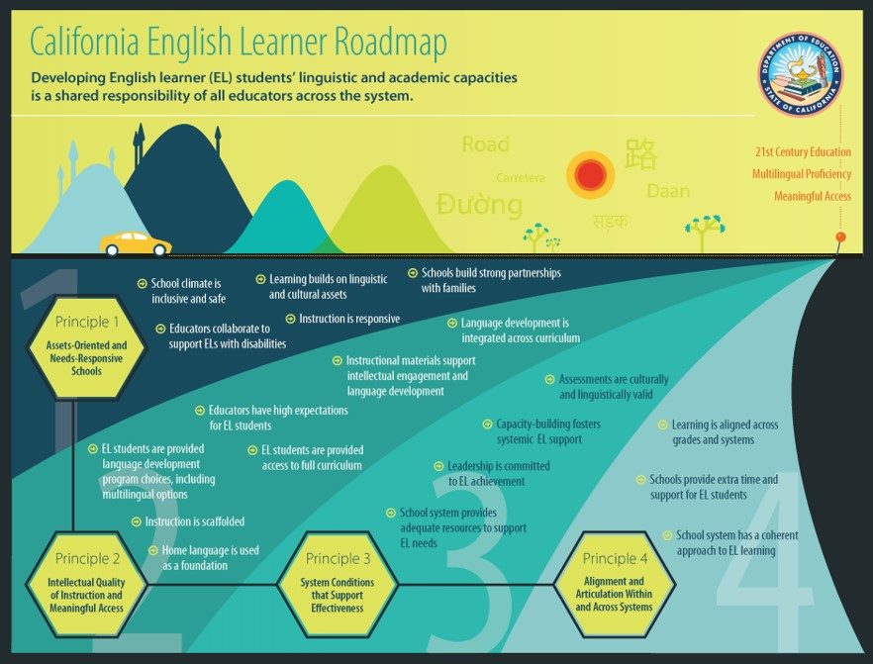
California English Learner Roadmap Policy
Multilingual learners will “fully and meaningfully access and participate in a twenty-first century education from early childhood through grade twelve that results in their attaining high levels of English proficiency, mastery of grade level standards, and opportunities to develop proficiency in multiple languages.”
Long description for English Learner Roadmap

Slide 7
Dual Language Learner Policy in CSPP
AB 1363 and Management Bulletin (MB) 23-03 can help to provide the following:
  Access to data on Dual Language Learners in the California State Preschool Program
  Proper identification to provide students with the support they need
  Allocate funding to provide programs with the support they need
  Provide data to make informed policy decisions on DLLs

Slide 8
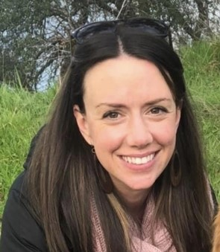
Classroom Strategies for Supporting DLLs
Katie Hardy, Early Childhood Education Specialist, Sacramento County Office of Education (SCOE)

Slide 9
Introduction: The Importance of Bilingualism
Benefits of bilingualism in early childhood are well-documented
Increased cognitive flexibility, improved ability to plan and solve problems, and self-regulatory skills
Prioritize remaining culturally sensitive, aware, and curious
A strong foundation in home language supports the acquisition of a second language
Remember, all young children are English language learners
The strategies shared today are examples of practices that support all young children

Slide 10
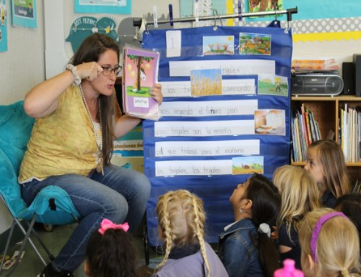
Desired Results Developmental Profile (DRDP)
Measuring Starting Points and Growth
Bilingual Instructional Aides (BIAs)
Large group activities offered again in smaller groups
Gather data from families
Invite families to volunteer in the classroom
Observe all children across a variety of times, settings, and circumstances
Incorporate visuals and gestures
Sending home key vocabulary words translated into home languages paired with images
Photo Credit: Tree of Life International Charter School, Transitional Kindergarten, Anderson, CA

Slide 11
Classroom Strategies: Visual Supports (1)
Visuals are powerful teaching tools for all young learners
Interactive visual schedules, picture icons accessible to teachers throughout the day, interest area photos
Utilize photos of your students in establishing classroom expectations
Your body language, facial expressions, and gestures are visuals too

Slide 12
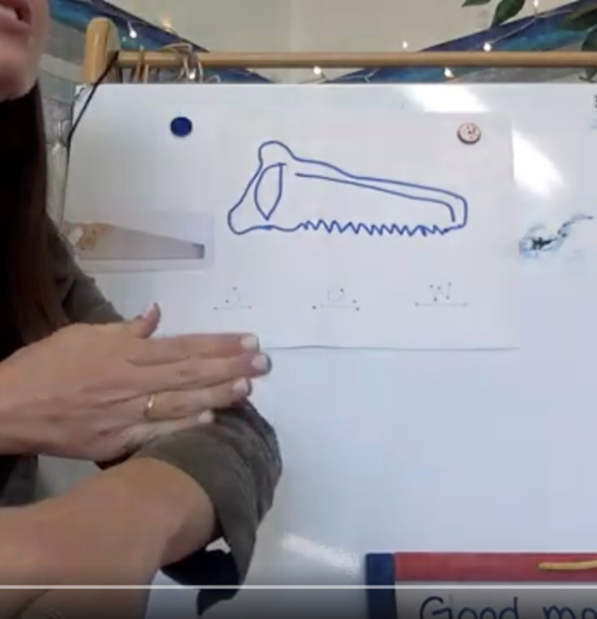
Classroom Strategies: Visual Supports (2)
There are a variety of excellent instructional models that support young children’s language acquisition:
  Sobrato Early Academic Language (SEAL), Personalized Oral Language Learning (POLL), Preschool Guided Language Acquisition Design (GLAD) are a few
Select a text to read multiple times per week
Identify important vocabulary – mix of common and more challenging
Nouns – draw a picture in front of the students, show a photo of the noun, and pair the word with an action
Keep these posted in the classroom
Photo Credit: Distance Learning, Sacramento, CA

Slide 13
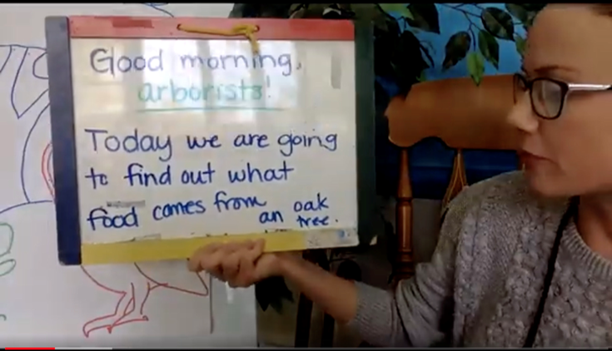
Lesson Planning to Increase Student Engagement (1)
Relationships, relationships, relationships! Positive emotional climate impacts students’ willingness to engage, trust, participate, and take risks in the classroom.
Learn key words and phrases in the home languages of your students.
GLAD strategies:
  Visuals, pairing actions with words and concepts, creating books, songs and chants. Send lyrics home to families!
  Intentional message
  Center enhancements
  Turn and talks
Photo Credit: Distance Learning, Sacramento, CA

Slide 14
Lesson Planning to Increase Student Engagement (2)
Explicitly teach and reinforce important vocabulary and concepts in a variety of ways:
Engage students in multisensory, interactive lessons
Storyboard retelling for simple stories – make those stories come alive
Include books and elements of your print-rich classroom environment in children’s home languages
Using a variety of strategies when lesson planning supports a more individualized approach to serving young learners

Slide 15

Family Engagement for Supporting DLLs
Kelly Sowle, Mentoring Supervisor, Educare Los Angeles at Long Beach

Slide 16
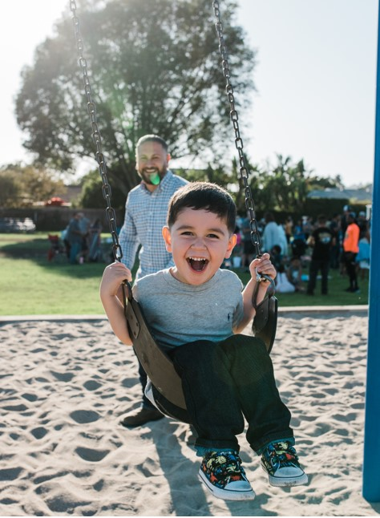
Defining Family Engagement
Partnering with Families: Interactive Collaborative Process
Goal oriented relationships that support:
Strong parent-child relationships
Family well-being
Ongoing learning and development for parents and children
Positive outcomes
Shared Responsibility
Empowerment of adults and strength-based attitudes
Collaborative goal setting
Photo Credit: University of Preparation Charter School Preschool, Camarillo, CA

Slide 17
Benefits of Family Engagement
Families are children’s first and life-long teachers.
Quality of parent-child relationships and interactions create the foundational skills that children need to be successful in school and in life.
Parallel process: when staff and parents build positive relationships, it supports parents’ capacity to build and sustain positive parent-child relationships.
Children with engaged adults in their lives exhibit greater emotional security, connection with others and curiosity toward learning.

Slide 18
Practical Strategies to Encourage Family Engagement
Creating a welcoming and inclusive environment of families’ cultures
Learn and use parents’ names
Create opportunities to share common words in home language
Display photos of families and use as conversation starters
Ask parents to share songs, music, stories, poems
Invitations to donate empty food containers for pretend play
Connect or introduce returning families to new families
Label children’s cubbies with parent name and child’s name

Slide 19
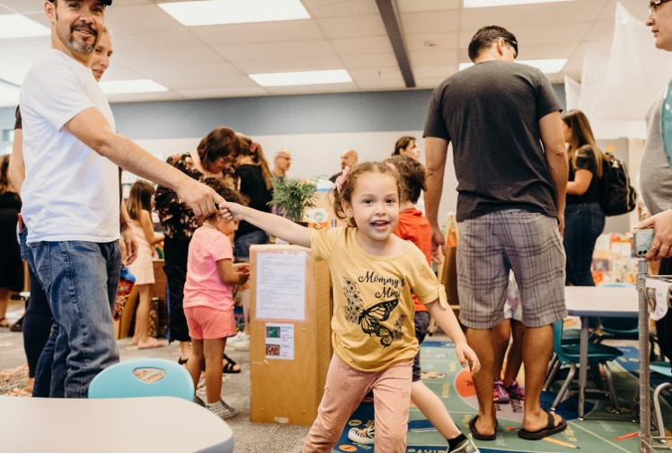
Building Competency in Parents that Supports the Learning and Development of Their Children
Home visits, parent-teacher conferences, formal and informal conversations
Classroom parent meetings
Google classroom and resources
First 15 minutes at arrival time
Collaborative goal setting
Photo Credit: University of Preparation Charter School Preschool, Camarillo, CA

Slide 20
Parent or Partner: What's the Difference?
YOU “r”
Relationships that you invest in with parents make all the difference.
Relationship-based approach to engaging families involves:
Adopting a strengths-based attitude about parents
Using the behavior of the child as your language with parents
Reflecting on your own perspectives and biases

Slide 21
DLL Support Webpage
This webpage will provide technical support, guidance, and resources for the identification, reporting, and support of dual language learners in California State Preschool Programs. Our goal is that the webpage will be one location for easy access and reference.
We will continue to update and add additional resources and support materials in the future.

Slide 22
Panel Discussion

Slide 23

Moderator Introduction
Dr. Matilda Soria, Senior Director of Early Care and Education, Office of the Fresno County Superintendent of Schools

Slide 24

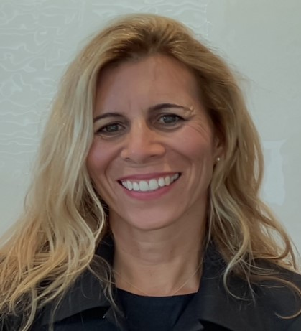

Panelist Introductions
Anna Arambula
Child Development Instructor/Coordinator, Madera Community College
Dr. Carola Oliva-Olson
Vice President of Early Childhood Studies at EDvance College
Raema Avalos
Mentoring Supervisor, Educare Los Angeles at Long Beach

Slide 25
Discussion Panel Questions (1)
What do you do to welcome and engage families of dual language learners as active partners in their child’s learning?
How do you help a child feel safe in your classroom on the first day of school or while they get adjusted if you do not speak the same language as they do?
What do you do to set up your classroom environment to support the learning of dual language learners and create a welcoming environment?

Slide 26
Discussion Panel Questions (2)
How do you build a positive relationship with dual language learner parents when you don’t speak the same language?
What do you do to encourage home language development if you don’t speak the home language of all the dual language learners in your classroom?

Slide 27
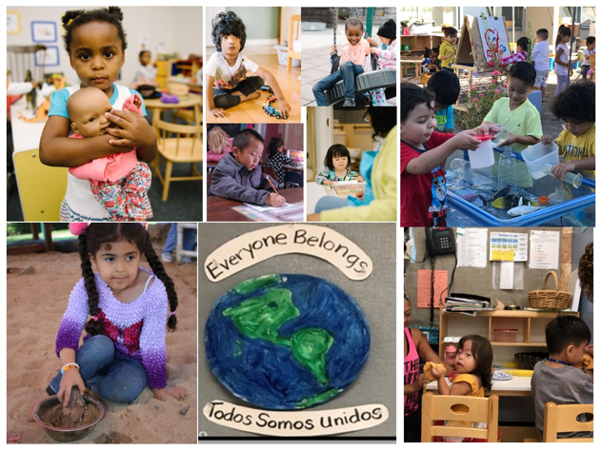
Thank You
“Language is the roadmap of a culture. It tells you where its people come from and where they are going.”
Rita Mae Brown

Slide 28
Resources to Support Dual Language Learners (1)
Multilingual Learning Toolkit: https://www.multilinguallearningtoolkit.org/
CA’s DLL Identification Process Helps Teachers Support Young Children & their Families Video: https://www.youtube.com/watch?v=SN9TGK0PvQE
Three-part webinar series for teachers on Family Engagement, Oral Language Development, and Home Language Development: https://www.multilinguallearningtoolkit.org/blog/webinar-resources-from-seal-and-early-edge/

Slide 29
Resources to Support Dual Language Learners (2)
Effective Classroom Practices for Equitably Serving Preschool-Age Dual Language Learners: https://www.youtube.com/watch?v=TJZnjqmrBhY
  In Spanish: Prácticas efectivas para apoyar equitativamente a los estudiantes preescolares que aprenden en dos idiomas: https://www.youtube.com/watch?v=MROubnCTCN0
POLL Strategies for DLLs: https://www.pollstrategies.org/
Dual Language Learners Initiative Quality Start Los Angeles: https://qualitystartla.org/dual-language-learners-initiative/

Slide 30
California English Learner Roadmap (1)
Long Description: A graphic depicting the four principles of the CDE California English Learner Roadmap Policy and the steps required to achieve each principle. The top of the graphic shows the title, California English Learner Roadmap; subtitle, Developing English Learner (EL) students’ linguistic and academic capacities is a shared responsibility of all educators across the system; and CDE seal. There are images of mountains and a yellow car driving on a road with the word road written in various languages, and a red sun. Each principle is depicted in a honeycomb shape on the left of the graphic with lanes that extend from each principle towards a pin on the far side of the graphic, which is connected by a dotted line to three roadmap goals, 21st Century Education, Multilingual Proficiency, and Meaningful Access. Each lane includes components that are associated with each of the principles. The principles and associated components are listed on the following slides.

Slide 31
California English Learner Roadmap (2)
Principle 1: Assets-Oriented and Needs-Responsive Schools
  School climate is inclusive and safe
  Educators collaborate to support ELs with disabilities
  Learning builds on linguistic and cultural assets
  Instruction is responsive
  Schools build strong partnerships with families
Principle 2: Intellectual Quality of Instruction and Meaningful Access
  EL students are provided language development program choices, including multilingual options
  Instruction is scaffolded
  Home language is used as a foundation
  Educators have high expectations for EL students
  EL students are provided access to full curriculum
  Instructional materials support intellectual engagement and language development
  Language development is integrated across curriculum

Slide 32
California English Learner Roadmap (3)
Principle 3: System Conditions that Support Effectiveness
  School system provides adequate resources to support EL needs
  Leadership is committed to EL achievement
  Capacity-building fosters system EL support
  Assessments are culturally and linguistically valid
Principle 4: Alignment and Articulation Within and Across Systems
  School system has a coherent approach to EL learning
  Schools provide extra time and support for EL students
  Learning is aligned across grades and systems
Back to figure.

