Slide 1
Webinar on COVID-19 Guidance for Early Learning and Care Contractors
Early Learning and Care Division and
Fiscal and Administrative Services Division
Date: October 16, 2020
Time: 10:00 AM–11:00 AM

Slide 2
Welcome and Introductions

Slide 3
Meeting Agenda
Introduction and Director's Welcome
Ongoing CDE Guidance Work–What's New and What's Ahead
Program Quality Implementation Updates
Questions

Slide 4
Upcoming CDE Guidance
Guidance on Program Quality
Guidance for Resource and Referral (R&R) Agencies
Guidance on Non-COVID-19 Emergency Closures
Guidance on Transitional Kindergarten (TK) and Kindergarten Eligible Children in the California State Preschool Program (CSPP)

Slide 5
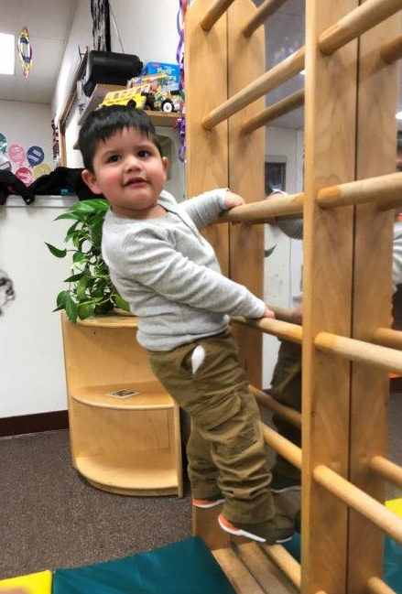
Program Quality Implementation Update
Trainings being developed:
Overview of Remote Monitoring
How to Get Ready for a Review
Certification and Recertification in a Remote Environment
Maintaining Program Quality during COVID
New Contractor Orientation
Photo Credit: CAPE, Inc.

Slide 6
Program Quality Implementation Update (2)
Continued Funding Application (CFA)
Contractors that intend to accept the offer to continue services in the subsequent contract period shall respond to a CFA request from CDE in accordance with the instructions and timelines specified in the request (California Code of Regulations, Title 5 [5 CCR] 18010[d])
Failure to respond within the timelines specified in the CFA shall constitute the contractor's intent to discontinue services at the end of the current contract period (5 CCR 18010[e])

Slide 7
Continued Funding Applications (CFA)
The CFA for Fiscal Year (FY) 2021–22 is now available at:
https://www.cde.ca.gov/sp/cd/ci/cfaforms2122.asp.
The due date is November 10, 2020.
The informational webinar is now available.
Please contact us at CFA@cde.ca.gov if you have questions.

Slide 8
Continued Funding Applications (CFA) (2)
Please ensure the following:
The CFA for 2021–22 is submitted.
The Contractor Information (Page 2) is consistent with the CDMIS form.
All boxes are checked on the Board of Directors form (page 4).
The Subcontract Certification form (Page 7) is included.
Calendars are included and header information is populated.

Slide 9
Continued Funding Applications (CFA) (3)
Please ensure the following (continued):
The form ELCD 3704A: Program Narrative Change is included when there is a program or Minimum Days of Operation (MDO) change.
The form ELCD 3704B Subcontractor Certification is included when your agency has a subcontract.
All forms and documents requiring a signature are signed.

Slide 10
Continued Funding Applications (CFA) (4)
Thank you so much!
Please contact us at CFA@cde.ca.gov.

Slide 11
Frequently Asked Questions
The ELCD Frequently Asked Questions (FAQ) webpage can be found at:
https://www.cde.ca.gov/sp/cd/re/covid19elcdfaq.asp
Steps to upload:
Question received
Response developed
Response vetted
Response is posted

Slide 12
Frequently Asked Questions (2)
Some newly uploaded FAQS:
Under the subcategory of: Closures/Reopening -
Q: Is the 14 additional closure days due to COVID-19 only for licensed AP providers?
A: No, the 14 non-operational days COVID-19 related are for both licensed and licensed-exempt AP providers.

Slide 13
Frequently Asked Questions (3)
Under the subcategory of: Reimbursement-
Q: If an attendance sheet is submitted for reimbursement without the parent's signature, but the reason for no signature is not COVID-19 related, does the AP program still reimburse the provider?
A: No. Contractors must only reimburse providers who submit an attendance record or invoice without a parent signature when the absence of a parent signature is due to the COVID-19 pandemic and there is documentation of the provider's attempts to collect the signature. Please see MB 20-15a.

Slide 14
Frequently Asked Questions (4)
Under the subcategory of: Reimbursement -
Q: How were the allocations determined for the most recent CAPP amendment?
A: The Child Development and Nutrition Fiscal Services (CDNFS) Fiscal analysts sent emails to contractors during the week of September 15 regarding CAPP amendments. This email provides the allocation amounts by purpose and the methodology for each allocation. The CDNFS fiscal analysts would have sent the email to their agency's fiscal contact (i.e. probably the agency representative to submits fiscal reports). You may reach out to your agency's representative to obtain a copy of that email or your fiscal analyst.

Slide 15
Frequently Asked Questions (5)
Other ideas you have for getting information out?

Slide 16
Questions
Photo Credit:
University Preparation School at CSU Channel Islands

Slide 17
Resources
Webinar slides, MBs, Frequently Asked Questions (FAQs), can be found on the ELCD COVID-19 Guidance web page at:
https://www.cde.ca.gov/sp/cd/re/elcdcovid19.asp
You may submit additional questions to the ELCD Emergency email inbox at:
ELCDEmergency@cde.ca.gov
To contact your assigned PQI Office Regional Consultant, a list of consultants can be found on the ELCD Consultant Regional Assignments web page at:
https://www.cde.ca.gov/sp/cd/ci/assignments.asp
Consultants are most easily reached by email
or by phone at 916-322-6233

Slide 18
Closing
Photo Credit: American River College Child Development Center

