Slide 1
IEP Implementation Data Collection
Special Education Division
California Department of Education

Slide 2
Agenda/Topics
Description/Requirements
Timeline
Procedure/Methodology
Data Collection Website
Data Validation Requirements

Slide 3
Description/Requirements
Objectives:
To fulfill its monitoring and enforcement responsibilities under the federal IDEA (Individuals with Disabilities Education Act) in 34 Code of Federal Regulations sections 300.600 and 300.323.
Identify systemic issues with LEAs (Local Education Agencies) and help the State identify LEAs that are not providing the services promised in Individualized Education Programs (IEPs).
Identify and categorize IEPs surveyed by three designated percentage of completion ranges.

Slide 4
Timeline
For the upcoming AY, we are implementing a change of dates in the data review/collection cycle.
Date Range for IEP review
January 1 – February 27, 2026
Training Webinar
November 13, 2025
Data collection window
March 2 – May 15, 2026
Data collection final due date
May 15, 2026

Slide 5
Procedure/Methodology
On March 2, 2026, California Department of Education (CDE) will provide a random sample of students with disabilities (SWDs) to each LEA based upon the following criteria:
Number of SWD | Number of IEPs LEA Must Review | Percentage of IEPs Required for Review
1 – 100 | All/Max of 20 | 20% - 100%
101 – 199 | 20 | 10.05% - 19.8%
200 – 4,999 | 20 – 500 | 10%
5,000 + | 500 | 0.74% - 9.97%
Link to Long Description of Table A: Methodology
NOTE: Small LEAs (LEAs with 100 or fewer SWDs) that were selected for monitoring in Cycles A, B, or C will only be required to submit IEP Implementation data during their next monitoring cycle, which will include Cycle C in 2026.

Slide 6
Student Sample (1)
Student samples should:
  (for large LEAs) not include any students from charter schools identified as “small LEAs” being monitored in Cycles A or B, or C
    Small LEAs in Cycle C will receive their own student samples
  Include students on IEPs only, including any students enrolled in Nonpublic Nonsectarian Certified schools (NPS)

Slide 7
Student Sample (2)
  Only include students enrolled for the entire duration of the evaluation period (January 1 through February 27, 2026)
    If LEAs receive a Statewide Student Identifier (SSID) for a student that transferred out of the LEA prior to or during the evaluation period, the LEA should:
      Ensure the student’s exit is updated in California Longitudinal Pupil Achievement Data System (CALPADS)
      Ensure that the reason for not providing results for that student in the IEP Implementation Data Collection is documented and shared with the special education local plan area (SELPA)

Slide 8
Procedure/Methodology (2)
LEAs will collect and analyze local-level service implementation data.
Measurements will be based upon total number of service minutes provided for all services in the IEP (numerator), and the total number of service minutes prescribed (denominator). Each IEP ratio will then be summarized into one of three categories:
  A. 100 to 95% of IEP services implemented
  B. 94.9 to 90% of IEP services implemented
  C. Less than 90% of IEP services implemented

Slide 9
Procedure/Methodology (3)
Numerator should include:
  The total count of actual service minutes received for all services provided during the evaluation period
Denominator should:
  Include:
    Total count of prescribed service minutes included in the special education plan to which the parent/guardian has agreed/signed, including:
      Service minutes the student received
      Student absences due to illness (familial or student), truancy, or other excused or unexcused absences
      Staff absences due to illness or staff shortages
  Exclude service minutes prescribed during:
      Field trips
      Scheduled school breaks such as intersession or Spring Break
      Statewide testing periods
      Student benchmark testing
      Special programming at the school site (e.g., school assemblies)
      School-related emergencies

Slide 10
Why must student absences be included in the denominator calculation?
Although student absences may have an impact on a particular student's implementation percentage, when evaluating IEP Implementation at a local educational agency-level, the CDE is examining the overall percentage of students in the randomly selected sample that are falling into the 90% and below range.
A significant percentage of students falling into the 90% and below range may identify systemic issues that may offer an opportunity for CDE to provide programmatic and technical assistance to LEAs.

Slide 11
Procedure/Methodology (4)
Example:
Sample LEA ABCUSD
  Large LEA, 5000+ SWDs, n size of sample: 500 IEPs
Calculation for single student IEP:
  Time Period for analysis: January 1, 2026, and February 27, 2026
  2000 service minutes provided/2160 service minutes prescribed = 93% implementation. This student is added to the bucket for category B
  94.9 to 90% of IEP services implemented
Summary Data by ABCUSD for submission:
Category | Total | Percentage
A. 100 to 95% of IEP services implemented | 410 | 82%
B. 94.9 to 90% of IEP services implemented | 70 | 14%
C. Less than 90% of IEP services implemented | 20 | 4%

Slide 12
Things to consider when evaluating IEP Implementation…
LEAs should:
  Have a clear, documented process for tracking the implementation of IEP services throughout the year in preparation for any audits
  Have a clear understanding of how your special education data system tracks services
  Ensure all service providers are clear on their obligation to provide services consistent with the IEP
When determining IEP implementation rates, staff should consider the following:
  Electronic or paper service logs
  Transition Services prescribed and received
  Push-in or pull-out aide services and who documents those services
  Specialized Academic Instruction (SAI)
  Student absences
  Service provider/staff absences

Slide 13
How are Specialized Academic Instruction Minutes Calculated?
If a student is in attendance, SAI minutes may be counted as received.
This includes days when an appropriately authorized (certificated or licensed) staff member or contracted provider is substituting for the teacher or staff person of record.

Slide 14
Compensatory Services
Students may, but are not required to receive compensatory services
If provided, the compensatory service minutes provided must fall within the prescribed evaluation period (January 1 through February 27, 2026)

Slide 15
IEP Implementation and Annual Determinations
In the Annual Determination Letter for the 2026 monitoring year, which will be issued the first week of February 2026, From the 2024-25 Implementation Data Collection, LEAs that reported more than 50% of their student sample as receiving less than 90% of their prescribed services will be flagged as “Target Not Met”.

Slide 16
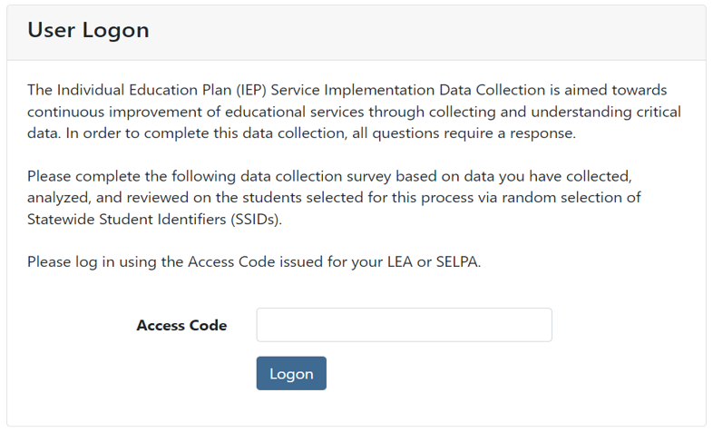
Data Collection Website
IEP Implementation Website: https://www3.cde.ca.gov/iepimpsys/

Slide 17
How do I get my access code for the website?
SELPA access
  On March 2, 2026, CDE will email access codes to SELPA level users.
LEA access
  Once SELPA level users log into the system, they are expected to download access codes for their LEA-level users (available in the application) and then distribute these access codes to their respective LEA representatives.

Slide 18
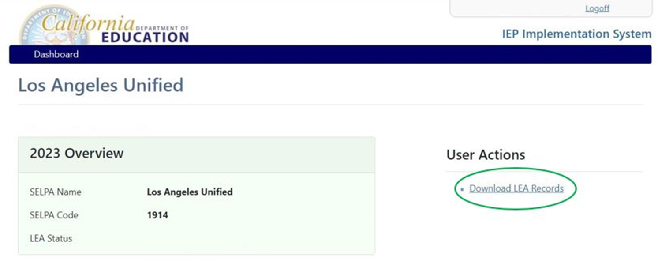
Data Collection Website (SELPA View 1)

Slide 19
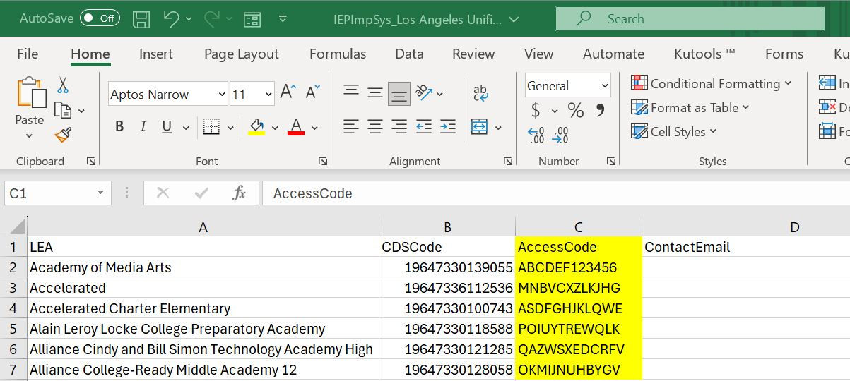
SELPA View of LEA Access Codes
It will be the responsibility of each SELPA director to distribute the LEA access codes to the associated and responsible LEA representatives.

Slide 20
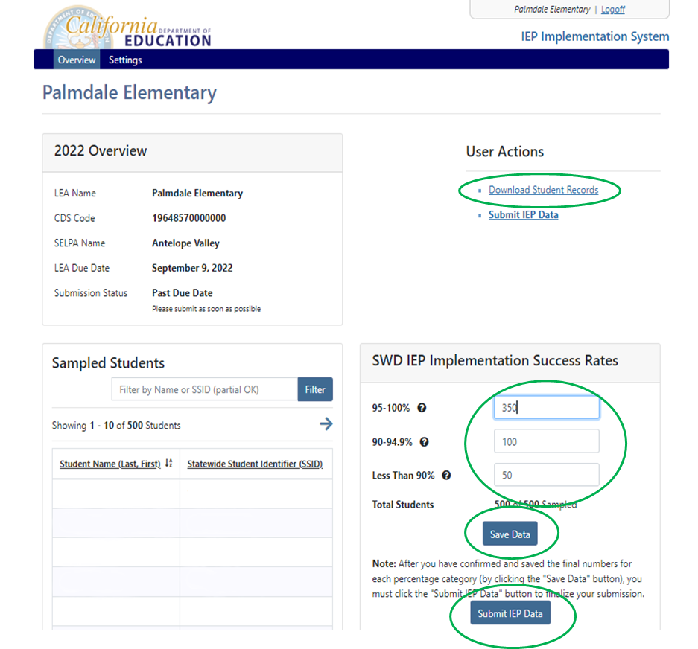
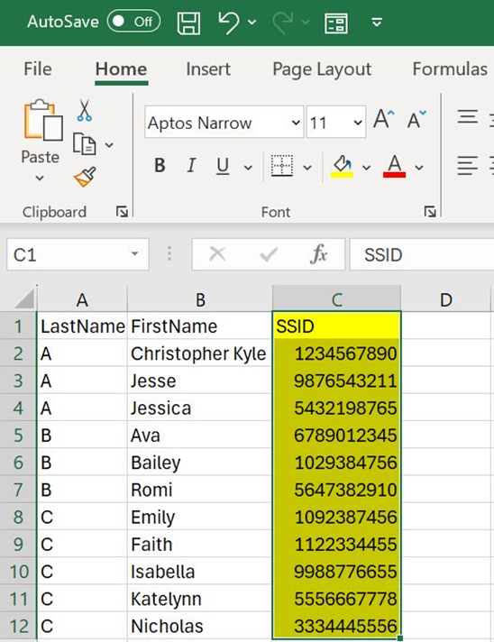

Data Collection Website (LEA View)

Slide 21
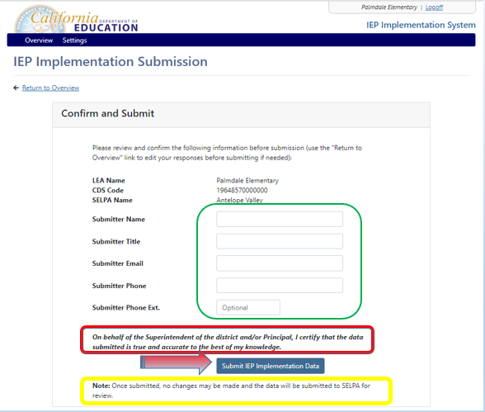
Data Collection Website (LEA Certification Page)
Link to Long Description of Image A: LEA Certification

Slide 22
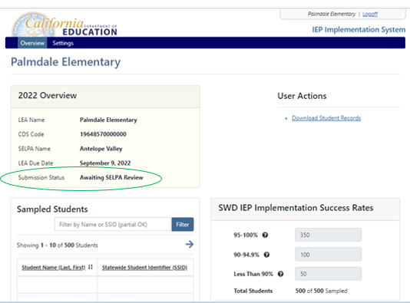
Data Collection Website (LEA, Confirmation)

Slide 23
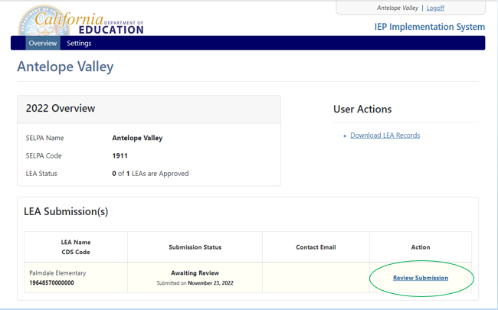
Data Collection Website (SELPA View 2)

Slide 24
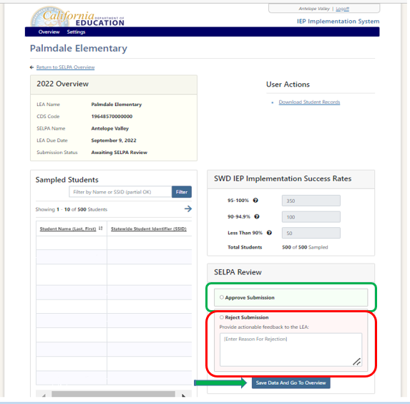
Data Collection Website (SELPA Review, Approval)

Slide 25
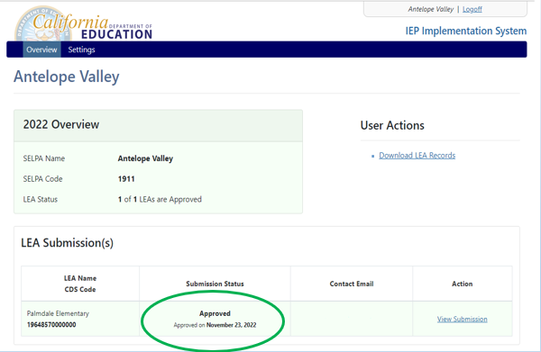
Data Collection Website (SELPA, Confirmation)

Slide 26
Data Validation Requirements
CDE will require that each Superintendent (or designee) of each LEA certify to the State that the data submitted regarding an LEA's implementation of IEP services are accurate and that school principals have certified to the LEA's Superintendent that such submitted data are accurate; and
To assess the validity and reliability of data submitted in response to the State’s annual statewide data collection regarding an LEA's implementation of IEP services, for those LEAs who submit such data, the State will randomly select 10% of those LEAs and audit the data submitted by those LEAs regarding the LEA's implementation of IEP services
If selected for review, the follow up survey response by LEAs is mandatory

Slide 27
Resources
CDE Web Page for IEP Implementation Data Collection:
https://www.cde.ca.gov/sp/se/ds/iepimplementation.asp
IEP Implementation Website:
https://www3.cde.ca.gov/iepimpsys/

Slide 28
Goals/Summary
Statewide data collection to help the State identify LEAs that are not implementing the services promised in IEPs
Help improve LEA’s program efficiency and effectiveness through monitoring special education services to students across California.
Questions? Please send an email to IEPimplementation@cde.ca.gov

Slide 29
Long Description of Table A
Table A: Methodology
Table showing how many IEPs an LEA must review based on number of SWDs. The first column is number of SWD, the second column is number of IEPs LEA must review, the third column is percentage of IEPs required for review. For 1-100 SWDs, the LEA must review all IEPs, or a maximum of 20, which is 20%-100%. For 101-199 SWDs, 20 IEPs need review, 10.05%- 19.8% For 200-4,999, 20-500 IEPs need review, or 10%. For 5,000 or more SWDs, 500 IEPs need review, which is 0.74% - 9.97%.

Slide 30
Long Description of Image A
Image A: LEA Certification
Screenshot of IEP Implementation Data Submission page. The page shows a box labeled "Confirm and Submit", with LEA name, CDS code, and SELPA name listed. There is a circle around contact information fields for the individual who is submitting data. Listed fields are "Submitter Name". "Submitter Title", "Submitter Email", "Submitter Phone", and "Submitter Phone Ext". There is a circle around the disclaimer "On behalf of the Superintendent of the district and/or Principal, I certify that the data submitted is true and accurate to the best of my knowledge." There is another circle at the bottom of the screen reading "Note: Once submitted, no changes may be made and the data will be submitted to SELPA for review."

