Slide 1
A Site Administrator’s Guide:
Talking to Parents
About the California Alternate Assessments (CAAs)
Notes:
Note: Slide Notes are used throughout this presentation

Slide 2
The Intent of This Deck
  This slide deck is intended for use by site administrators to provide information to parents and guardians about the CAAs for English language arts/literacy (ELA), mathematics, and science. It includes:
    A description of why the CAAs are given
    An overview of test administration
    Information on who takes the CAAs
    When the tests are administered
    Information on how test results are reported
    Available resources for parents related to the CAAs

Slide 3
Recommended Handouts
Parent Guide to Understanding the CAAs
Available in seven languages
Take a Practice or Training Test with Your Child
https://www.caaspp.org/practice-and-training/index.html
How to Take a Practice Test Quick Reference Guide

Slide 4
How to Use This Deck (1)
This deck has been created for you to customize and edit as needed:
  Choose the slides you want to use.
    Select the “View” tab, and then select “Normal.”
    In the slide list on left, select on the slide you do not want and select “Hide Slide” at the bottom of the menu.
  Add your school’s logo and change colors.
  Change wording for your audience—you know your audience best!
  Talking points are provided in the "Slide Notes" throughout this document that can be customized to your audience.

Slide 5
How to Use This Deck (2)
Change color scheme.
  Select “View” tab, and then “Slide Master.”
    For titles, select slide—highlight header text—select “Home”—choose text color—return to “View” tab.
    For the body, select slide—highlight body text—select “Home” tab—choose text color—return to “View” tab.
    For the green line, select slide—highlight line—select “Home” tab— select “Shape Outline”—choose color—return to “View” tab.
    When all changes are made—select “Slide Master” tab—select “Close Master View.”
The changes should apply to all slides in the deck.

Slide 6
Understanding the California Alternate Assessments (CAAs)
[Add school logo here, if desired.]
[Add school motto here, if desired.]
Notes:
Hello Families!
My name is [insert name] and I’m very excited about all the learning that will take place this year here at [insert school name].
Tonight, I’d like to share with you information about the California Alternate Assessments for English language arts/literacy, also called ELA, mathematics, and science.
I’ll also talk to you about important ways that you can work in partnership with your child’s teacher to ensure their success.
Let’s get started!

Slide 7
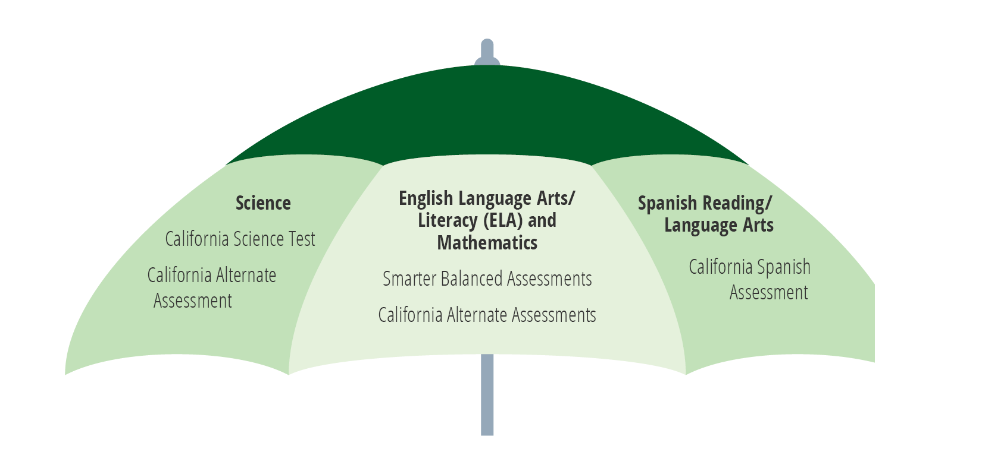
CAASPP System
Notes:
At the end of a typical school year, students in grade 3 and higher take statewide assessments, also known as summative assessments. They are called summative because they test the sum of what your child learned during the school year.
[Insert relevant information about how the CAASPP assessments were handled locally in 2020-2021.]
The umbrella term we use to talk about the summative assessments our students take is CAASPP which stands for the California Assessment of Student Performance and Progress.
The CAASPP system has three main parts:
ELA and mathematics assessments
Science assessments
and the Spanish reading/language arts assessment, which is optional.
Today we will focus on the California Alternate Assessments.

Slide 8
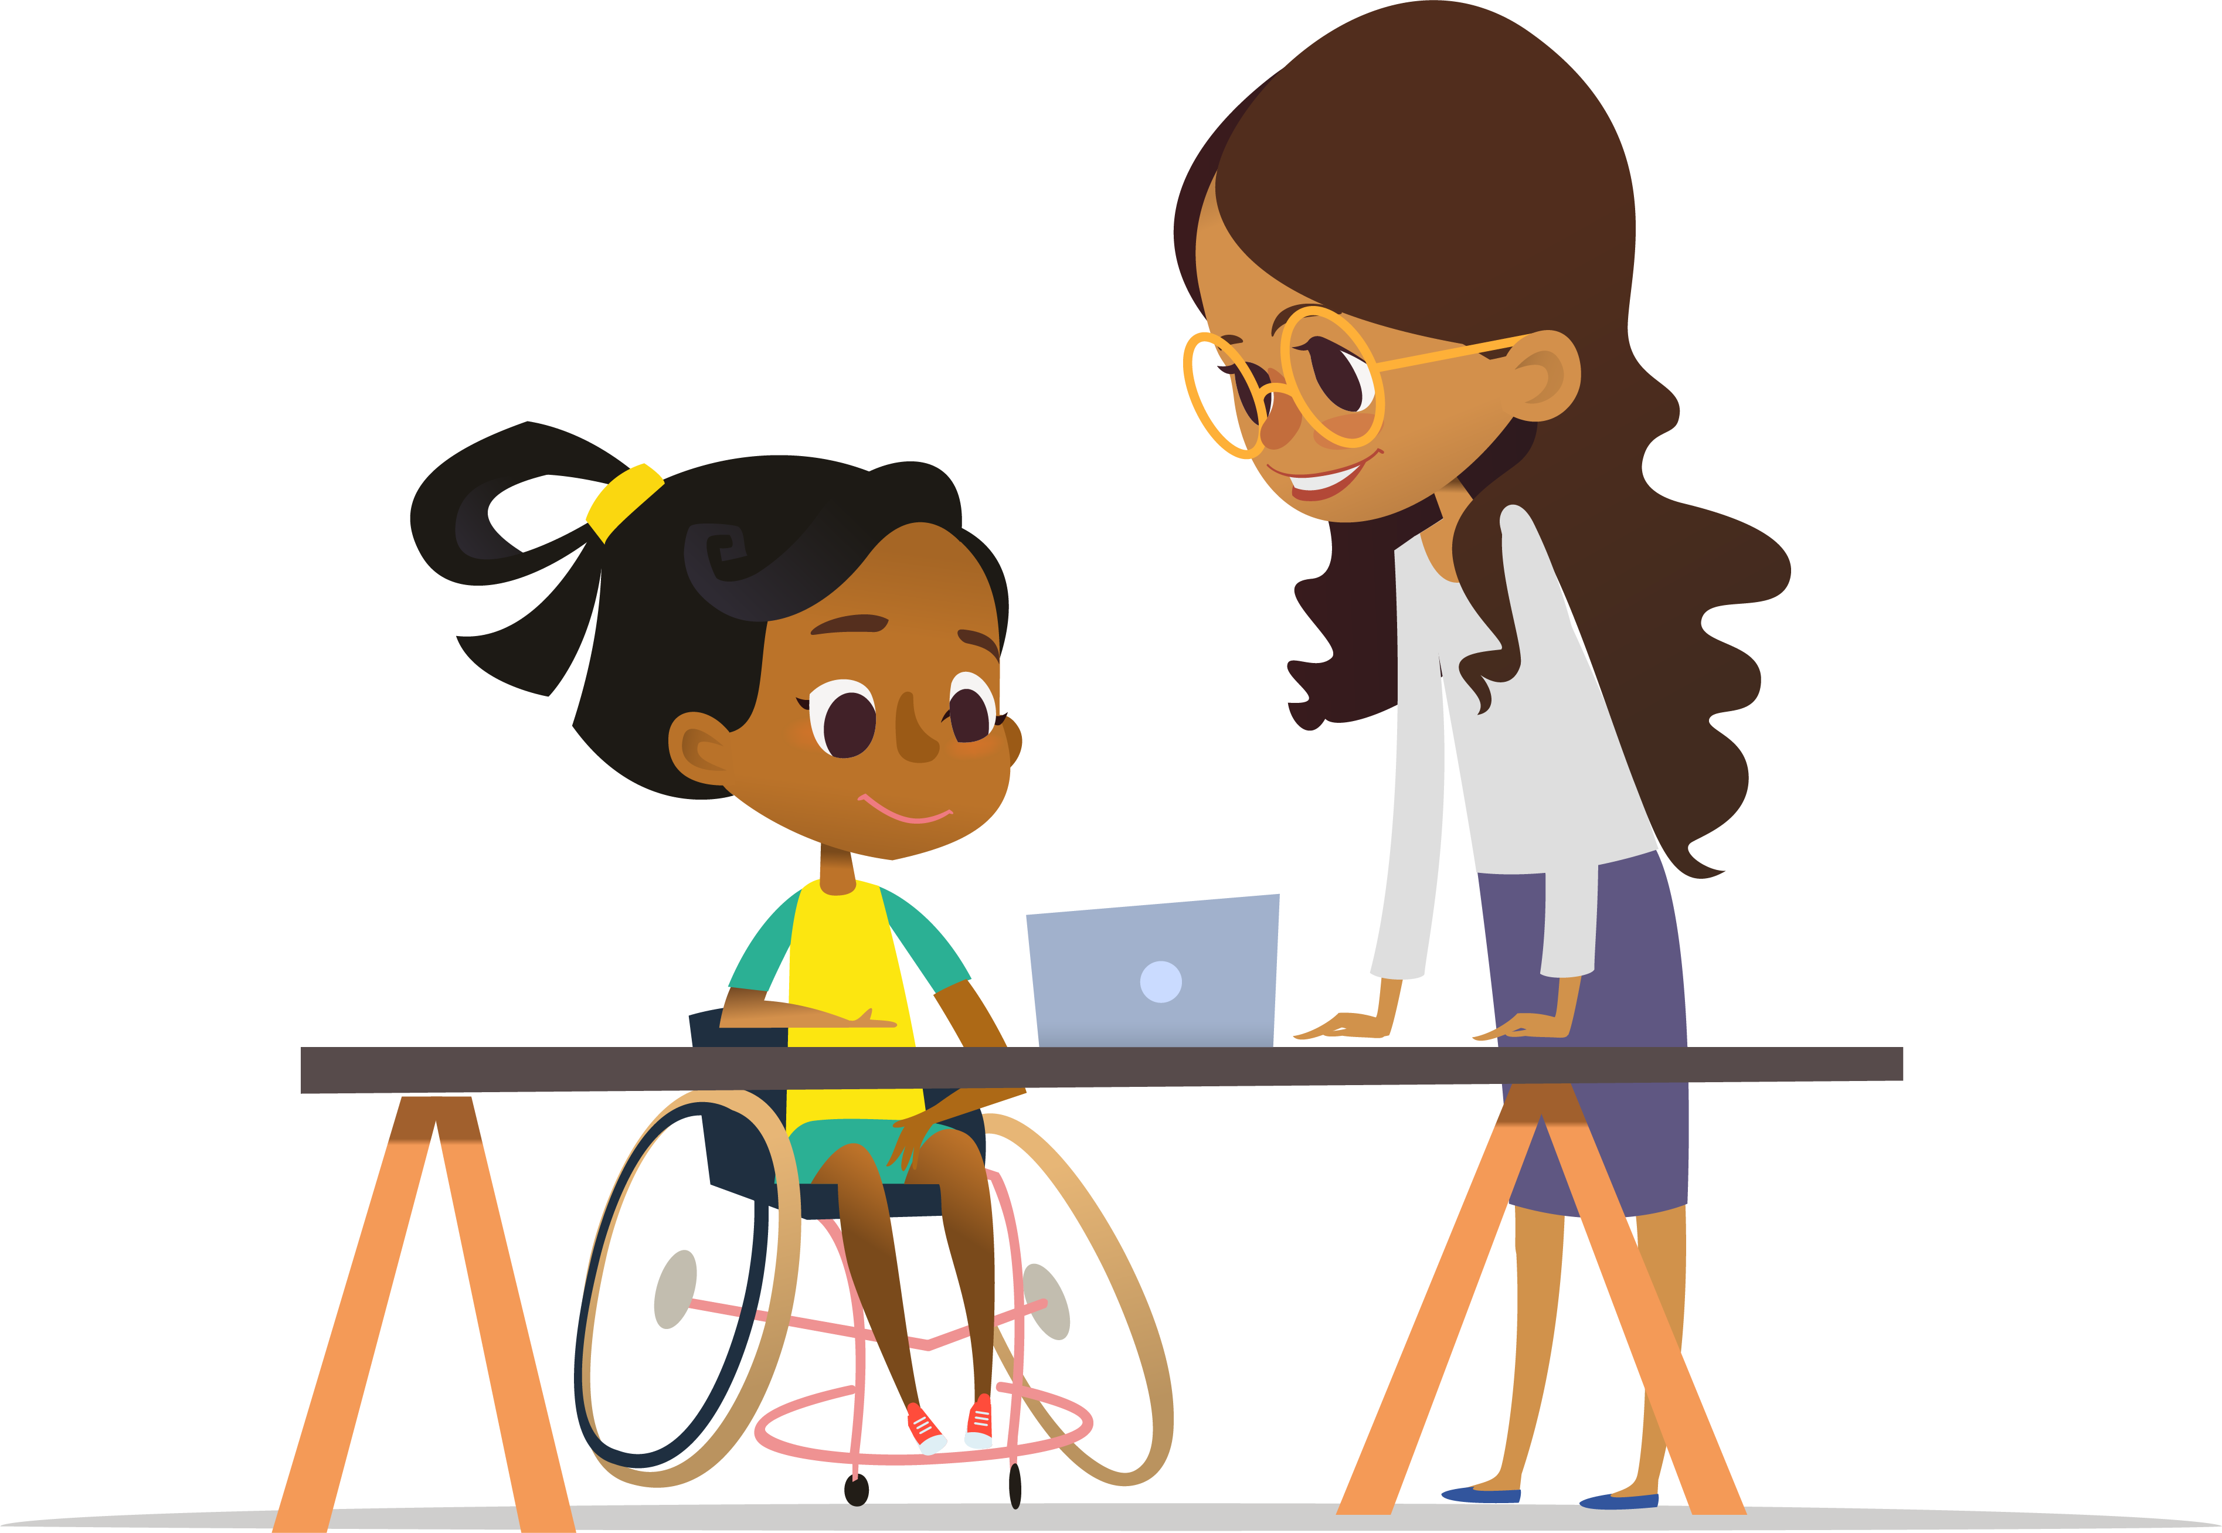
Why:
To allow students with the most significant cognitive disabilities to show what they know and can do.
Notes:
The Alternate Assessments are given to students with the most significant cognitive disabilities as indicated in their individualized Education program (IEP).
Students identified for alternate assessment take the alternate version of ALL tests: ELA, Mathematics, Science, and Alt ELPAC.
Why do we give these assessments?
The purpose of the California Alternate Assessments is measure what students with the most significant cognitive disabilities know and can do.
These measures help identify gaps in knowledge or skills early on, so students get the support they need.
The information from these tests will be used by teachers to support students by providing them the help they need to be successful in ELA, mathematics, and science.

Slide 9

What:
English language arts/literacy (ELA)
Mathematics
Science
Notes:
There are alternate assessments in three areas:
English language arts/literacy or ELA
Mathematics, and
Science.

Slide 10

How:
On a computer
With a trained
test examiner
One-on-one setting
Notes:
The CAAs for ELA, mathematics, and science are administered one-on-one by a trained test examiner who is familiar with the student and the student’s specific needs.
The assessments are done on the computer.
We will go through the elements of ELA and mathematics first and then talk about science in more detail.

Slide 11
CAA for ELA and Mathematics
Notes:
The CAAs for ELA and mathematics are tests that were designed specifically for students with the most significant cognitive disabilities.
The alternate assessments are aligned with the California Common Core State Standards in ELA and mathematics.

Slide 12
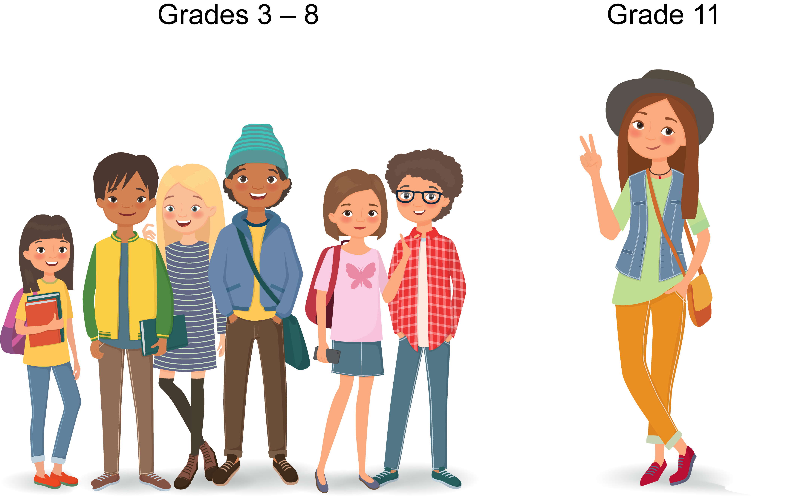
Who: ELA and Mathematics
Grade 11
Grades 3–8
Notes:
Students are eligible to take the CAA for ELA and mathematics only if it is indicated in their active individualized education program (IEP) by the IEP Team.
The CAA for ELA and mathematics is administered to all eligible students in grades three through eight and grade eleven.

Slide 13

When: ELA and Mathematics
January through the last day of school
Notes:
Now let’s talk about the timing of the CAAs in ELA and mathematics. We mentioned before that these tests are taken by students at the end of the school year. What does that mean exactly?
Students take the CAAs in ELA and mathematics during what’s called the “testing window”. Each school selects its own testing window in the spring of each school year.
Testing can begin as early as January and continue through the last day of school.
[Insert more specific information about days and times of testing for your school.]

Slide 14
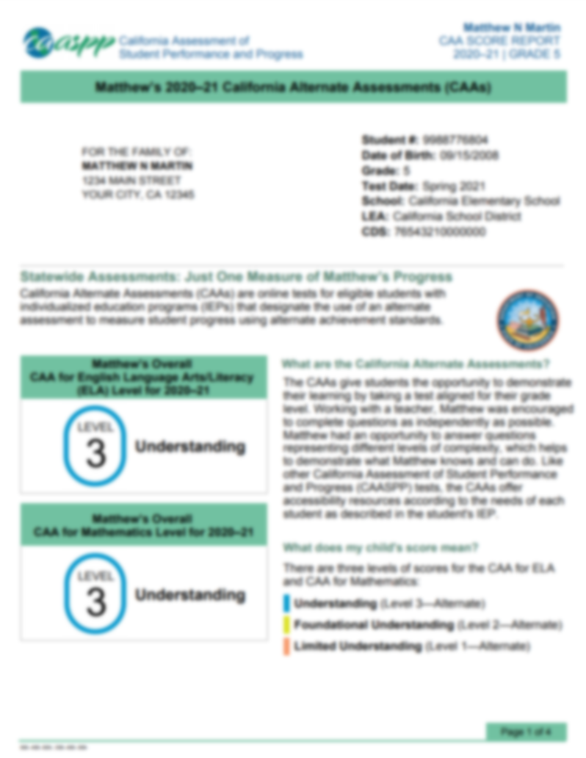
Scores:
ELA and Mathematics
Notes:
Results from the CAA for ELA and mathematics will be sent on a score report.
The score report will show your child’s overall achievement score as a three-digit number and what is called a performance level.
The performance level is one of three levels – Level 1, Level 2, or Level 3.
Level 1 corresponds to limited understanding.
Level 2 corresponds to functional understanding, and
Level 3 corresponds to understanding.
These reports are usually provided to you after the start of the next school year.

Slide 15
CAA for Science
Notes:
Now let's focus on the alternate science test, called the California Alternate Assessment for Science, also known as the CAA for Science.
While this test is also designed for students with the most significant cognitive disabilities, it has a few key differences.

Slide 16
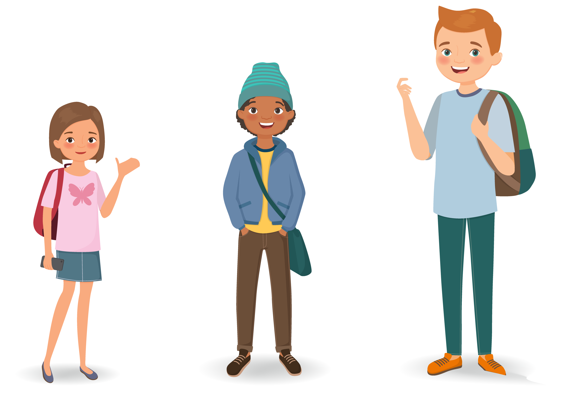
Who: Science
High School
Grade 8
Grade 5
Notes:
Remember that students are eligible to take the CAA for Science only if an alternate assessment is indicated in their active individualized education program (IEP) by the IEP team.
The CAA for Science is given to all eligible students in grades 5 and 8.
High school students, that is students in grades 10, 11, or 12, will take the CAA for Science one time only.
It is recommended that high school students take the science assessment after taking their last science class.

Slide 17

Areas of Study: Science
Earth and Space Sciences
Life Sciences
Physical Sciences
Notes:
The CAA for Science measures knowledge in three areas of study: ​
- Earth and Space Sciences,
- Life Sciences,​
- Physical Sciences, ​
Students are given test questions that reflect knowledge and skills in each of these three areas.​
​

Slide 18
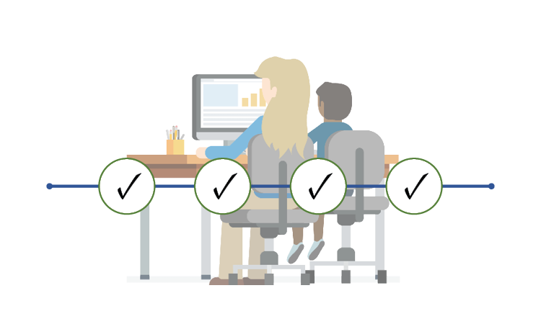
When: Science
End of School
September
Notes:
The CAA for Science can be given at any time starting in September and continuing through the end of the school year or July 15th, whichever comes first.
The teachers can choose the best time to administer the four performance tasks based on when concepts are taught to the student. These tasks are a collection of activities and questions related to one science area that your child just learned in the classroom.

Slide 19
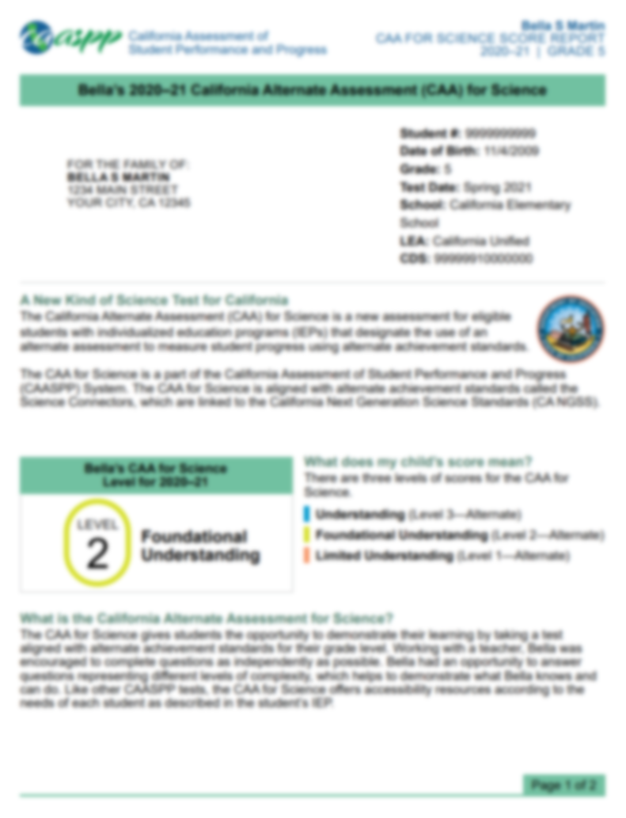
Scores: Science
Notes:
Student scores from the CAA for science assessment will be provided in the form of scale scores and achievement levels.
The performance level is one of three levels – Level 1, Level 2, or Level 3.
Level 1 corresponds to limited understanding.
Level 2 corresponds to functional understanding, and
Level 3 corresponds to understanding.
These scores will be provided on student score reports that will be shared with families at the end of the school year.

Slide 20

How Parents Can Help
Notes:
Next let’s talk about how parents can help their students.

Slide 21

Ask Your Child’s Teacher:
In what areas is my child doing well?
In what areas might my child need some extra support?
Who will provide that extra support?
How can I help support my child at home?
Notes:
Here at [insert school], we take our job of teaching your child very seriously.
If you have any concerns about your child’s education and what they are learning, the best place to start is with your child’s teacher. The teacher can work in partnership with you to make sure that your child receives the support they need to be successful.
When you talk to your child’s teacher ask specific questions about your child:
In what areas is my child doing well?
In what areas might my child need some extra support?
Who will provide that extra support?
How can I help support my child at home?
These are just a few examples of how to start a conversation with your child’s teacher.

Slide 22

Help Your Child Succeed
Discuss the test with your child.
Set expectations.
Take a practice test with your child.
Make sure your child gets a good night’s sleep and a nutritious breakfast before testing.
Notes:
Additionally, here are a few other ways that parents can help their child be successful:
[For elementary schools]
Read with and to your child.
[For middle and high schools]
Your child will likely have homework every day. You can help them be successful by making sure that they have a quiet place at home to do that work that is free from distractions.
Be sure to review your child's homework with them.
[For all students]
Additionally, here are a few other ways that you can help your child be successful:
When it’s time for testing, talk to your child about the test. Make sure your child knows that the tests are important, but they are just one measure of learning. The teacher uses that information along with other information to make sure your child is getting the support they need.
Make sure your child knows that you and their teacher want you to do your best and are there to help every step of the way.
If you’re interested, the California Department of Education has also developed Practice and Training Tests that you can access from home on the computer. You can look at sample test questions and get familiar with the way questions are presented on the computer. More information about the Practice and Training Tests are on the flyer that you received today/tonight.
Additionally, make sure that your child is well rested and has a good nutritious breakfast before testing so that they are set up for success on the day of testing.

Slide 23

Starting Smarter
https://ca.startingsmarter.org/
Notes:
The California Department of Education has created a website for families who want additional information about student score reports; ca.startingsmarter.org.
This website has sample student score reports as well as resources for families to use. Those resources include a link to Learning Heroes website, a flyer on how to have an effective parent/teacher conference, as well as links to the practice tests. Among these valuable resources, you will also find a document created in collaboration with the Parent Teacher Association (PTA) that gives parents additional guidance on what questions to ask teachers in order to create the most supportive environment for your children.
Currently available on this website are the ELA, mathematics. Science and Spanish web pages.

Slide 24
Starting Smarter Video
https://youtu.be/HS8cVQin_fc
Notes:
[ BEFORE PRESENTING, YOU MAY CHOOSE TO EMBED THIS VIDEO ON THE SLIDE. IN THE “INSERT” TAB ON THE TOP MENU, SELECT THE “VIDEO” BUTTON, FOLLOWED BY “ONLINE VIDEO” FROM THE DROP-DOWN MENU. PASTE THE FOLLOWING URL INTO THE YOUTUBE SEARCH BOX: https://youtu.be/HS8cVQin_fc (THE SAME URL THAT APPEARS ON THE SLIDE) WHICH WILL LEAD TO THE CALIFORNIA STARTING SMARTER OVERVIEW VIDEO ]
There is a video available that helps explain the starting smarter website to families.

Slide 25
Learn More
Parent/Guardian’s Guide to the CAA
  https://www.cde.ca.gov/ta/tg/ca/caaparentguide.asp
Parent Guide to Understanding the CAAs
Available Resources for the CAA for Science
  https://www.caaspp.org/ta-resources/available-resources-caasci.html
Take a Practice or Training Test with Your Child
  https://www.caaspp.org/practice-and-training/index.html
Starting Smarter Website
  https://ca.startingsmarter.org/
Notes:
Here is a list of CAA for ELA, mathematics and science resources that are available to you.
You can visit the Parent/Guardian Guide to the CAAs on the California Department of Education’s Web page. This web page reviews the criteria for your child to take one of these tests.
There is also a “Parent Guide to Understanding” for each statewide assessment. They are a great resource, and they answer the key questions about each assessment – much like this presentation. [Suggestion: You received a copy of the Parent Guide to Understanding the CAAs when you walked in tonight.]
There are also practice tests available that will help you and your child understand the type of test questions that they might receive. You can take the practice tests from home with your child to help them prepare. [Suggestion: You also received a flyer tonight with a Web site address for the practice tests.]
And finally, we have included the link to the website for families who want additional information about student score reports.

Slide 26

Questions
Notes:
We have reached the end of this presentation. I hope it has helped you understand the features of the CAAs for ELA, mathematics, and science, which students take it, and how and when it is administered.
Are there any questions I can answer?
Thank you!

Slide 27
Posted by the California Department of Education | May 2024

