Slide 1
A Site Administrator’s Guide:
Talking to Parents
About the California Assessment of Student Performance and Progress (CAASPP)
The slide notes will be present throughout the presentation.

Slide 2
The Intent of This Deck
  This slide deck is intended for use by site administrators to provide information to parents and guardians about the CAASPP. It includes:
    A description of the CAASPP
    An overview of how the CAASPP is given
    Information on who takes the CAASPP
    An overview of test administration for the CAASPP
    Information on how test results are reported
    Available resources for parents related to the CAASPP

Slide 3
Recommended Handouts
Parent Guide to Understanding the Summative Assessments
https://www.cde.ca.gov/ta/tg/ca/documents/sbsummativepgtu.pdf
Parent Guide to Understanding the CAST
https://www.cde.ca.gov/ta/tg/ca/documents/castpgtu.pdf
Parent Guide to Understanding the CSA
https://www.cde.ca.gov/ta/tg/ca/documents/csapgtu.pdf

Slide 4
How to Use This Deck (1)
This deck has been created for you to customize and edit as needed:
  Choose the slides you want to use.
    Select the “View” tab, and then select “Normal.”
    In the slide list on left, select on the slide you do not want and select “Hide Slide” at the bottom of the menu.
  Add your school’s logo and change colors.
  Change wording for your audience—you know your audience best!
  Talking points are provided in the “Notes” section that can be customized to your audience.

Slide 5
How to Use This Deck (2)
Change color scheme.
  Select “View” tab, and then “Slide Master.”
    For titles, select slide—highlight header text—select “Home”—choose text color—return to “View” tab.
    For the body, select slide—highlight body text—select “Home” tab—choose text color—return to “View” tab.
    For the green line, select slide—highlight line—select “Home” tab— select “Shape Outline”—choose color—return to “View” tab.
    When all changes are made—select “Slide Master” tab—select “Close Master View.”
The changes should apply to all slides in the deck.

Slide 6
Understanding the California Assessment of Student Performance and Progress (CAASPP)
[Add School Logo Here if Desired]
[Add School Motto Here if Desired]
Notes:
Good Evening Families!
My name is [insert name] and I’m very excited about all the learning that will take place this year here at [insert school name].
Tonight, I’d like to share with you a few of the ways that we measure how our students here at [insert school name] are learning and what we do with that information.
I’ll also talk to you about important ways that you can work in partnership with your child’s teacher to help your child succeed.
Let’s get started!

Slide 7
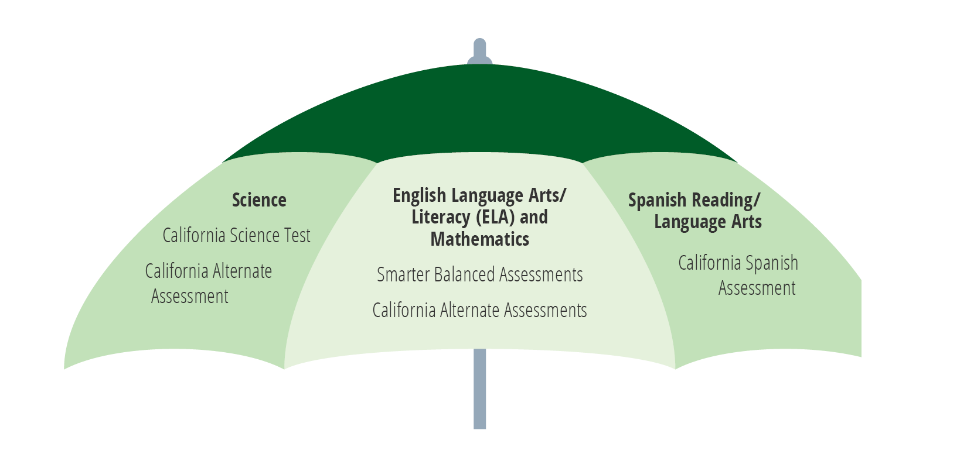
CAASPP System
Notes:
At the end of each school year, students in grade 3 and higher take statewide assessments, also known as summative assessments. They are called summative because they test the sum of what your child learned during the school year.
The umbrella term we use to talk about the summative assessments our students take is CAASPP which stands for the California Assessment of Student Performance and Progress.
The CAASPP system has three main parts:
Science assessments
English language arts/literacy, or ELA, and mathematics assessments
and the Spanish reading/language arts assessment, which is optional.
Today we will focus on the assessments of ELA, mathematics, and science, because most students will take those tests. The only exception is for those students who take the California Alternate Assessments based on their unique needs.

Slide 8

What:
Smarter Balanced Summative Assessments in English language arts/literacy (ELA) and Mathematics
California Science Test (CAST)
California Spanish Assessment (CSA)—optional
Notes:
First, let’s take a moment to talk about the Smarter Balanced assessments in English language arts/literacy (ELA) and mathematics.
Why are these tests called the Smarter Balanced tests? Or maybe you’ve heard them referred to as the SBAC.
These tests were developed by educators in multiple states, and the name of that group is the Smarter Balanced Assessment Consortium.
As you saw in the umbrella graphic on the previous slide, they are part of the CAASPP system.
These tests are designed to measure or check what students know and can do – in other words the knowledge and skills they gained during the school year.
The California Science Assessment, also known as CAST, was designed to test the students’ ability to think critically and solve problems, which are important skills for all students to have.
The CAST focuses on questions that cover more than one scientific area at a time, such as life science, earth and space science, and physical science.
The California Spanish test is an optional test designed to measure student competency in Spanish language arts.

Slide 9

Why:
To provide teachers, students and parents with information about how students are doing in school
Notes:
You may be wondering why students need to take the CAASPP tests.
Test results are an important piece of information about how your child is doing in school.
Together with report cards, classroom work, homework, etc., test results tell us if your child is on track to succeed in higher grades and is ready for college and career.
Most importantly, the CAASPP system gives information to teachers, students, and their families about what students know and are able to do. This information can also be used by administrators to evaluate and improve education programs.
As a parent or guardian, you can use these test results and other information to know if your child is on track or perhaps needs support in certain areas of English language arts, mathematics, or science.

Slide 10

Why: High School
Readiness for college-level classes
Notes:
For students in grade eleven, there is another reason these tests are important.
The results of statewide assessments for English language arts and math are also used by some colleges in California to decide how ready students are for college-level classes.
When your child takes the CAASPP tests in grade 11, you will be able to see information about their readiness for college-level classes on their Student Score Report, which we will talk about in more detail in just a few minutes.

Slide 11
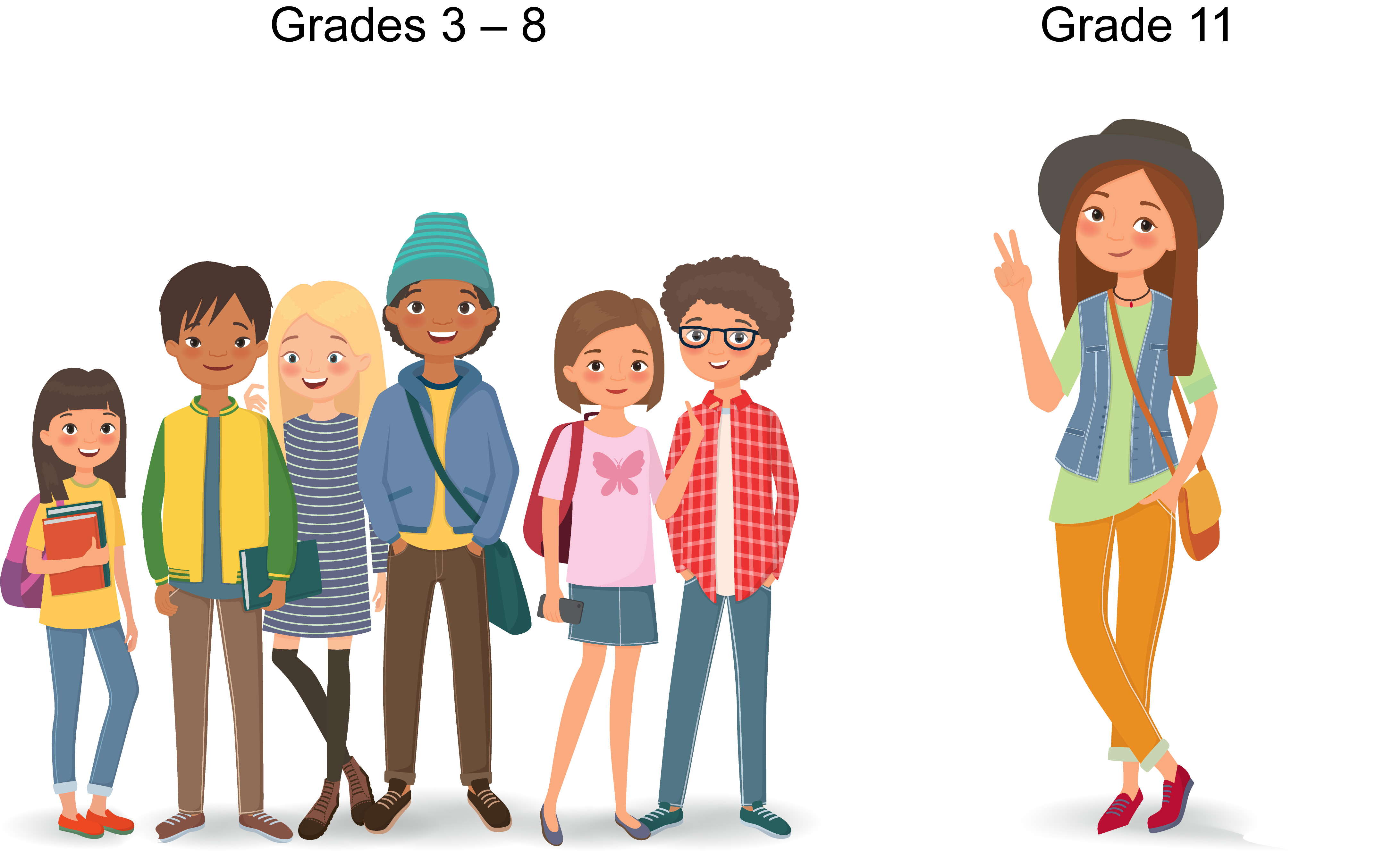
Who: ELA and Mathematics
High School
Grades 3–8
Notes:
You might be wondering at this point which of these tests your child will take. Let’s talk about that!
All students in grades 3 through 8, and grade 11 take the Smarter Balanced Summative Assessments in English language arts/literacy and mathematics.
In other words, if your child is in grade 3, 4, 5, 6, 7, 8 or 11, they will take these tests at the end of the school year.
The only exceptions to this are students who take the California Alternate Assessments based on their unique needs.

Slide 12
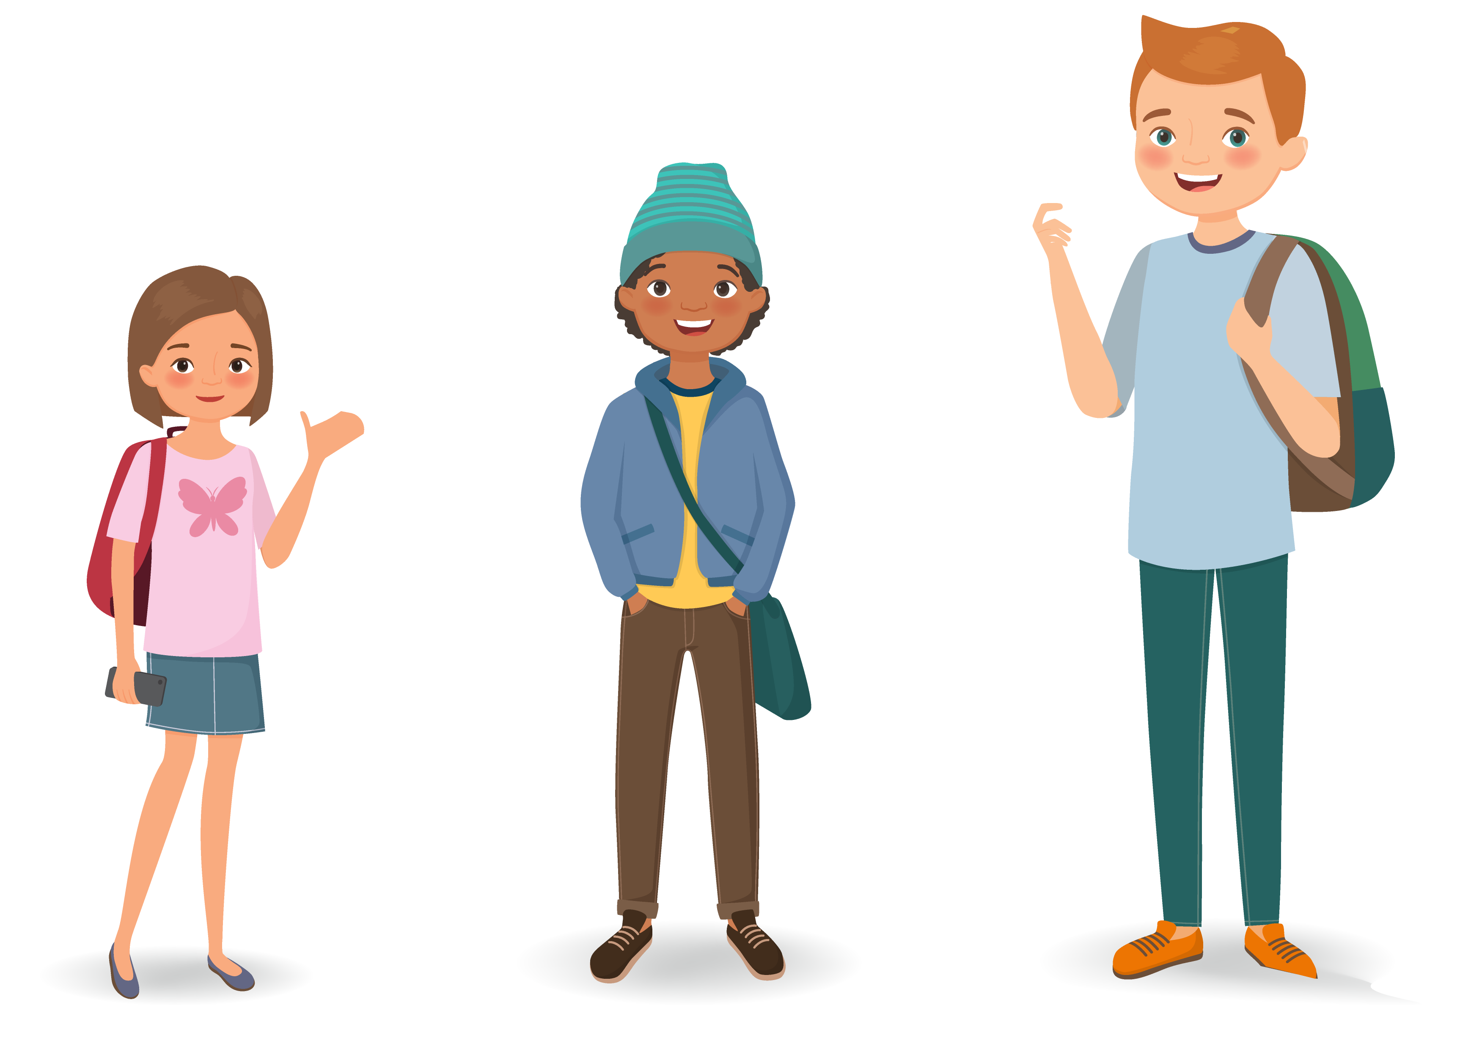
Who: Science
High School
Grade 8
Grade 5
Notes:
As far as the California Science Test or CAST is concerned, all students in grades 5 and 8 take it at the end of the school year.
They will also take this test once in high school, depending on when they take their last science class.

Slide 13

How:
On the computer
Adjusts difficulty
Varied question types
  Multiple choice
  Read and respond
  Drag and drop
  Constructed response
  Performance Task
Notes:
Now that we know what these tests are, why students take them, and in which grades, let’s spend a few minutes on what the tests look like.
The CAASPP assessments are all taken on a computer.
The Smarter Balanced Summative Assessments in ELA and mathematics are computer adaptive. That means that students take the test on a computer and the computer gives students questions that are easier, the same, or more difficult based on their answers to the previous questions. As students answer questions correctly, they receive more challenging questions. Incorrect answers trigger easier questions. This helps keep the test short for many students and makes sure the scores are very accurate, especially for students who score very low or very high.
The assessments use multiple ways of asking questions to allow students to show what they know and can do.
The CAST is taken on a computer but is not computer adaptive.
These online tests give students many different types of questions. For some of the math questions, for example, your child might be asked to drag and drop things from one place on the screen to another or draw a graph to solve a problem.

Slide 14

When:
January through the last day of school
Notes:
Now let’s talk about the timing of the CAASPP in ELA and mathematics. We mentioned before that these tests are taken by students at the end of the school year. What does that mean exactly?
Students take the Summative Assessments during what’s called the “testing window”.
Each school selects its own testing window in the spring of each school year.
Testing can begin as early as January and continue through the last day of school.
[Insert more specific information about days and times of testing for your school.]

Slide 15
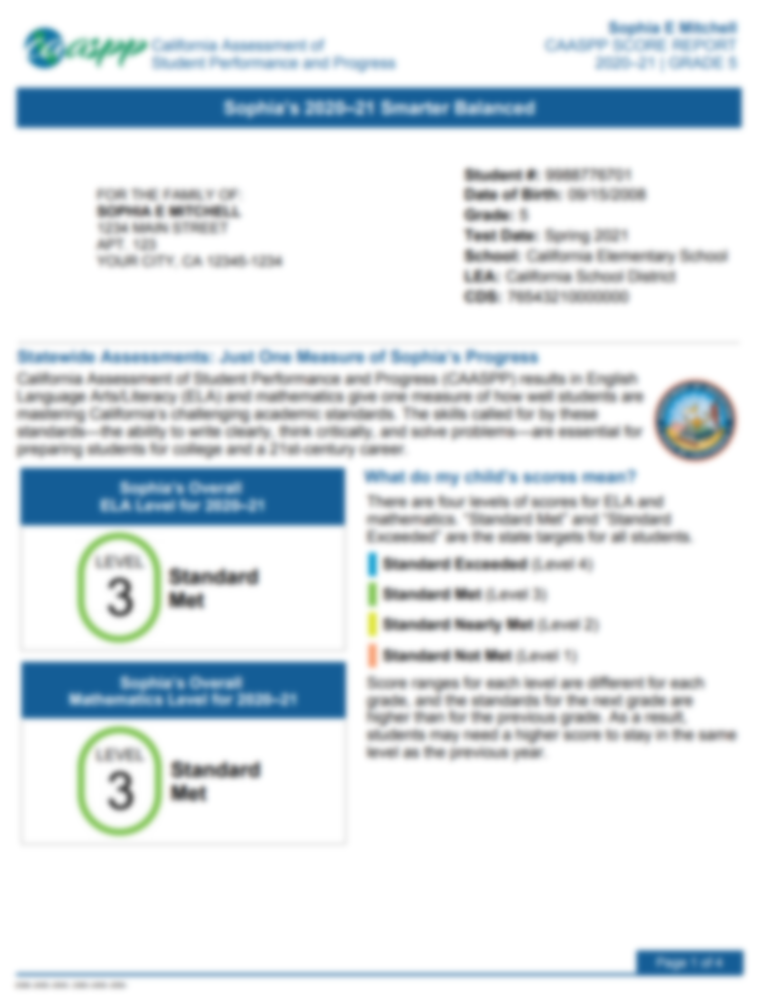
Scores: CAASPP
Notes:
Students who take the CAASPP tests will receive scores in the late summer or early fall. [Insert more specific information about the timing of this report for your school.]
When you receive your child’s student score report, take a moment to review it with your child and understand what it shows.
On the front of the report, you will see your child’s test scores for ELA (top half of the page) and mathematics (bottom half of the page). It will show your child’s score and well as one of four achievement levels:
Standard Not Met or Level 1
Standard Nearly Met or Level 2
Standard Met or Level 3 or
Standard Exceeded or Level 4
When you’re reviewing this information remember that the goal for each child is to meet or exceed the standard, which means Level 3 or better.
You will also see information about how your child’s score from this year’s test compares to last year’s test.
And finally information about the four areas of ELA and three areas of mathematics knowledge your child was tested on and how they did.

Slide 16
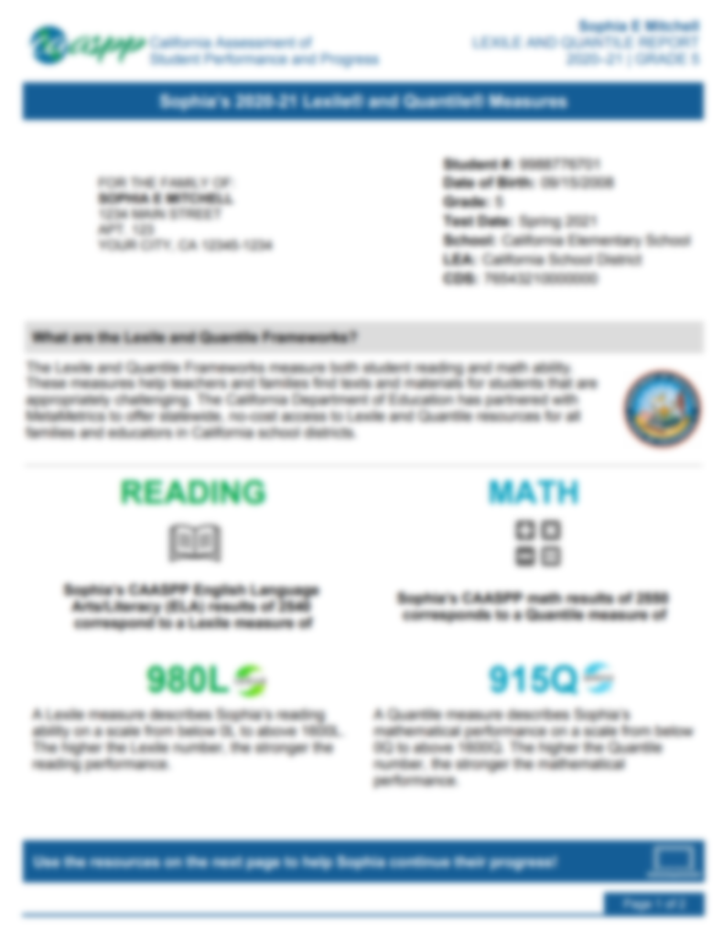
Scores: Lexile and Quantile
Notes:
This year, your child will receive a separate report of their reading and math abilities called the Lexile and Quantile Measures Report.
These new measures, Lexile and Quantile measures, are not the result of additional tests but rather a byproduct of your child’s score on the Smarter Balanced assessments in English language arts and math.
A Lexile measure indicates the difficulty of materials your child can read and understand.
A Quantile measure shows what math skills your child has mastered and which skills they need additional instruction in.

Slide 17
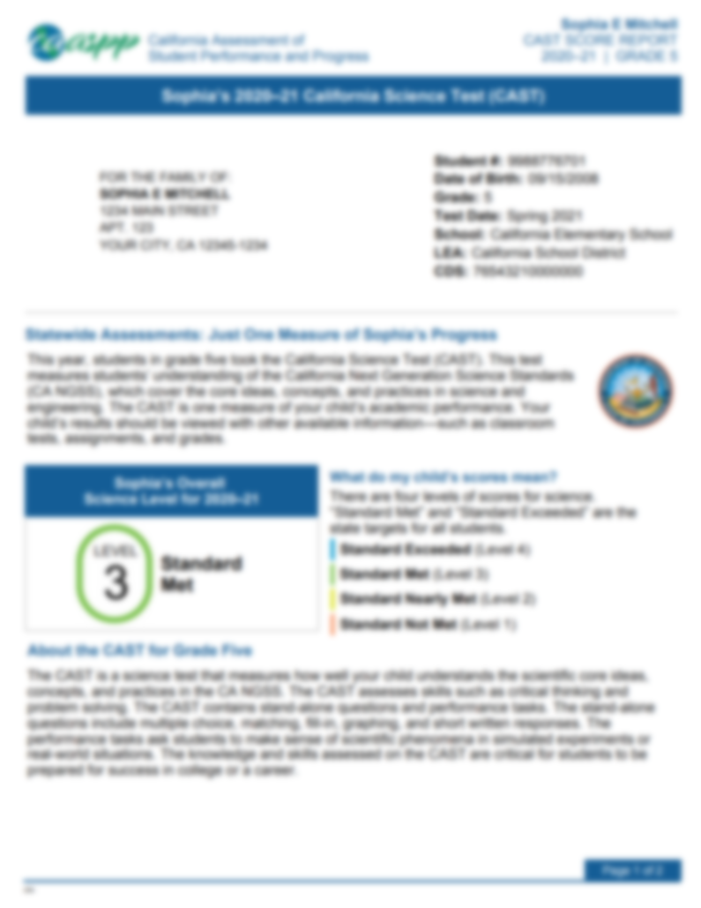
Scores: CAST
Notes:
Other reports you might receive for your child are:
The CAST Student Score Report if your child is in grades 5, 8 or high school and took the CAST.

Slide 18
Scores: College Readiness
EAP
EARLY ASSESSMENT PROGRAM
Notes:
You may remember that a few minutes ago we briefly mentioned additional information about readiness for college-level courses your grade 11 student will receive on their Student Score Report.
The section you see on the screen will be included on the back page of the report.
It explains what your child’s achievement level on the ELA and mathematics tests – Standard Not Met, Standard Nearly Met, Standard Met or Standard Exceeded – means in terms of their readiness for college level classes.
For example, if your child’s score fell into the Standard Met category for mathematics, that means that your child is conditionally Ready for college-level coursework. Additionally, your child can be exempt from the California State University’s placement test and Early Start Program by taking an approved course and earning a grade of C or better.
On the other hand, if your child scored in the Standard Not Met category, it means that they are not yet ready for college-level coursework.
These scores are only used for course placement and are not used for admissions.

Slide 19
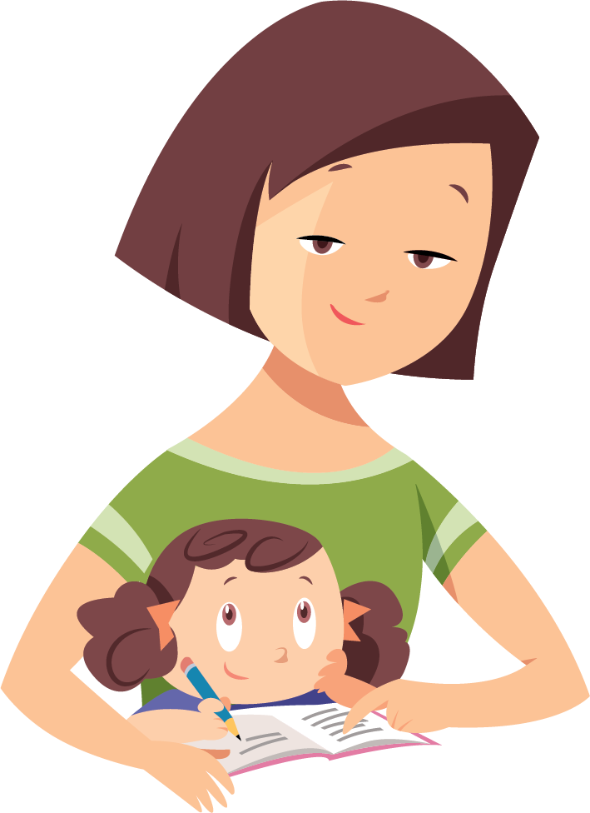
How Parents Can Help

Slide 20

Ask Your Child’s Teacher:
In what areas is my child doing well?
In what areas might my child need some extra support?
Who will provide that extra support?
How can I help support my child at home?
Notes:
We have covered a lot of important information about the tests your child takes, but we haven’t talked about the most important thing yet, which is how you can help your child succeed.
First, and foremost, talk to your child about what they are learning. Make sure you review his or her homework to see what they are learning and to help them the best you can.
Your child’s teacher is your #1 resource. The best time to contact your child’s teacher is either before or after school. Ask your child’s teacher about how they like to be contacted – either by phone or via e-mail.
When you talk to your child’s teacher ask them specific questions about your child, such as:
In what areas is my child doing well?
In what areas might my child need some extra support?
Who will provide that extra support?
How can I help support my child at home?
These are just a few examples of how to start a conversation with your child’s teacher.

Slide 21

Help Your Child Succeed
  Discuss the test with your child.
  Set expectations.
  Take a practice or training test with your child.
  Make sure your child gets a good night’s sleep and a nutritious breakfast before testing.
Notes:
Additionally, here are a few other ways that you can help your child be successful:
When it’s time for testing, talk to your child about the test. Make sure your child knows that the tests are important, but they are just one measure of learning. The teacher uses that information along with other information to make sure your child is getting the support they need.
Make sure your child knows that you and their teacher have high expectations and that you are both there to help them every step of the way.
If you’re interested, the California Department of Education has also developed Practice and Training Tests that you can access from home on the computer. You can look at sample test questions and get familiar with the way questions are presented on the computer. More information about the Practice and Training Tests are on the Parent Resources flyer that you received today/tonight.
Additionally, make sure that your child is well rested and has a good nutritious breakfast before testing so that they are set up for success on the day of testing.

Slide 22

Starting Smarter
https://ca.startingsmarter.org/
Notes:
The California Department of Education has created a website for families who want additional information about student score reports; ca.startingsmarter.org.
This website has sample student score reports as well as resources for families to use. Those resources include a link to the Learning Heroes website and a links to the practice and training tests. Among these valuable resources, you will also find a document created in collaboration with the Parent Teacher Association (PTA) that gives parents additional guidance on what questions to ask teachers in order to create the most supportive environment for your children.
Currently available on this website are the ELA, mathematics, science, and Spanish web pages.

Slide 23
Starting Smarter Video
https://youtu.be/HS8cVQin_fc
Notes:
[ BEFORE PRESENTING, YOU MAY CHOOSE TO EMBED THIS VIDEO ON THE SLIDE. IN THE “INSERT” TAB ON THE TOP MENU, SELECT THE “VIDEO” BUTTON, FOLLOWED BY “ONLINE VIDEO” FROM THE DROP-DOWN MENU. PASTE THE FOLLOWING URL INTO THE YOUTUBE SEARCH BOX: https://youtu.be/HS8cVQin_fc (THE SAME URL THAT APPEARS ON THE SLIDE) WHICH WILL LEAD TO THE CALIFORNIA STARTING SMARTER OVERVIEW VIDEO ]
There is a video available that helps explain the starting smarter website to families.

Slide 24
Learn More
Parent Guides to Understanding
Available in seven languages
https://www.cde.ca.gov/ta/tg/ca/parentguidetounderstand.asp
Take a Practice or Training Test with Your Child
https://www.caaspp.org/practice-and-training/index.html
Starting Smarter Website
https://ca.startingsmarter.org/
Notes:
Here are some additional resources for you to learn more about the summative assessments and support you student’s success.
The California Department of Education has developed a series called the Parent Guide to Understanding. These are designed to be simple overview that answer the critical questions of what, why, who, how, and when about each assessment.
[NOTE: Suggest providing parents a printed copy of the Parent Guide to Understanding the CAST and the Smarter Balanced Summative Assessments.]
You can find these on the Web site listed on this slide.
There are also practice tests available that will help you and your child understand the type of test questions that they might receive. You can take the practice tests from home with your child.
And finally you can visit the Starting Smarter website listed on the slide to learn more about your child’s score and see sample test questions.

Slide 25

Questions
Notes:
That brings us to the end of today/tonight’s presentation.
We’ll take a moment to answer some of your questions now.
Thank you for coming today/tonight!

Slide 26
Posted by the California Department of Education | July 2021

