Slide 1
Information Item Related to California’s State and Federal Accountability System: Review of the 2023 California School Dashboard and the 2024 Accountability Workplan
February 9, 2024

Slide 2
Topics
Overview of the 2023 California School Dashboard (Dashboard)
2024 Accountability Workplan

Slide 3
Overview of the
2023 Dashboard

Slide 4
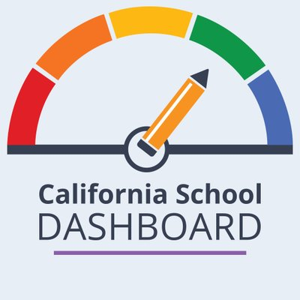
Purpose
The California School Dashboard provides parents and educators with meaningful information on school and district progress so they can participate in decisions to improve student learning.

Slide 5
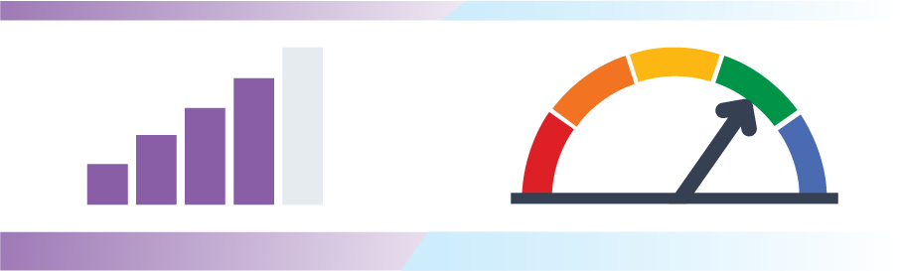
All Indicators Are Back! And in Color!
All state measures will have a color, except for the College/Career Indicator (CCI) which will be Status Only.

Slide 6
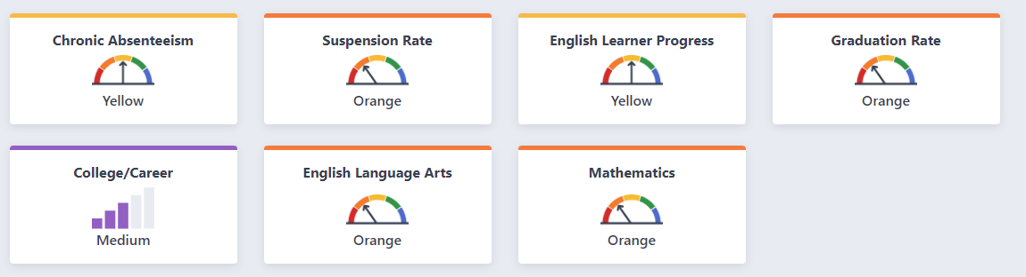
2023 Dashboard State Summary

Slide 7
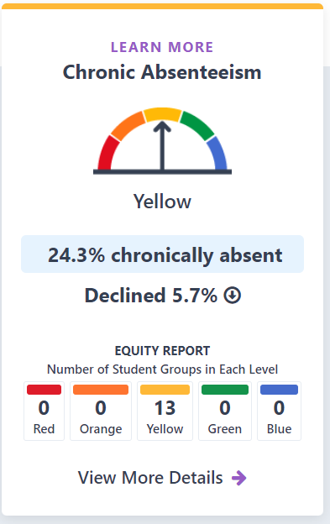
Chronic Absenteeism Statewide Results
Represents local educational agencies (LEAs) and schools that serve kindergarten through grade eight students whose students were absent 10 percent or more of the school year.
For most state indicators, the desired outcome is to have a high percentage of performance in the current year. This indicator has a reverse goal of having the lowest percentage of students chronically absent in the current year.

Slide 8
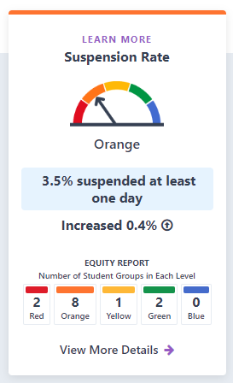
Suspension Rate Indicator Statewide Results
This indicator represents the percentage of students who were suspended for an aggregate total of one full day anytime during the school year.
For most of the other state indicators, the desired outcome is to have a high percentage in the current year and an increase in percentage from the prior year. However, for this indicator, the desired outcome is reversed, and the goal is to achieve a low suspension rate.

Slide 9
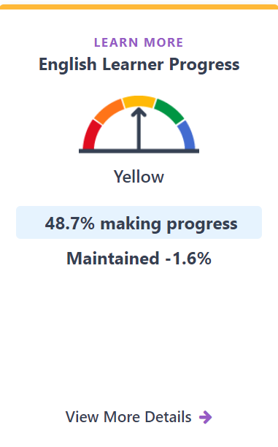
English Learner Progress Indicator Statewide Results
This indicator represents the percentage of English learner students who are progressing towards English language proficiency.
It measures progress toward English language proficiency by comparing English Learner students’ results from the current Summative English Language Proficiency Assessments for California (ELPAC) and Summative Alternate ELPAC to the prior year Summative ELPAC and Summative Alternate ELPAC results.

Slide 10
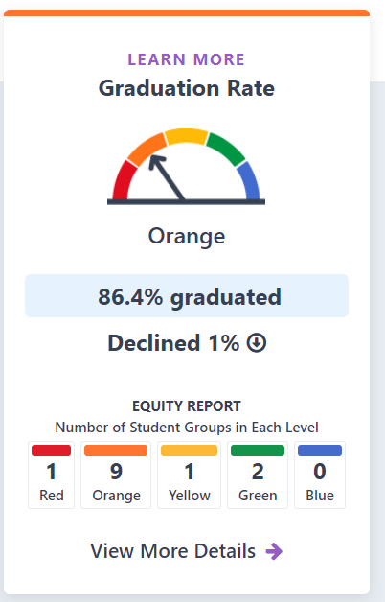
Graduation Rate Indicator Statewide Results
Represents the percentage of students who received a high school diploma within four or five years of entering ninth grade or complete their graduation requirements at an alternative school.

Slide 11
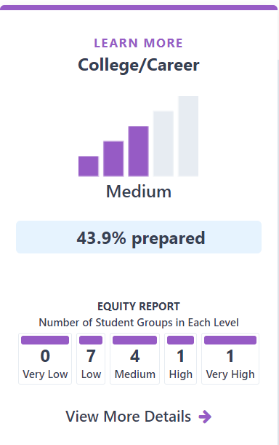
College/Career Indicator Statewide Results
This indicator represents the percentage of high school graduates who are prepared by their school/LEA for college or a career.
The indicator was designed to encourage high schools to provide all students with a rigorous broad course of study that prepares them for postsecondary success. For the 2023 Dashboard, the CCI represents one year of data, or status only.

Slide 12
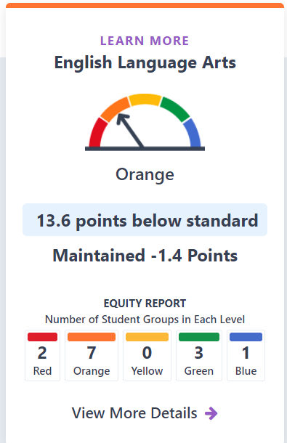
English Language Arts Indicator Statewide Results
This indicator applies to districts and schools that serve students in grades
three through eight and grade eleven and is based on Student performance on the Smarter Balanced Summative Assessments and the California Alternate Assessments. Each Academic Indicator is calculated using two components:
Distance from Standard (DFS)
  The average distance (in points) away from Level 3/Standard Met
Participation rate

Slide 13
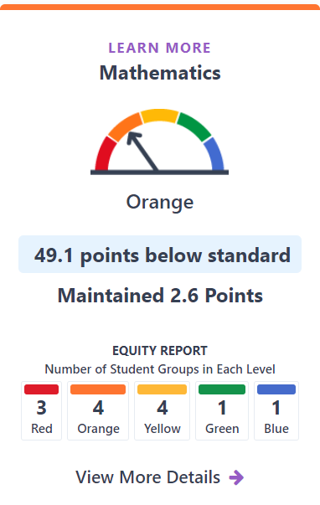
Mathematics Indicator Statewide Results
This indicator applies to districts and schools that serve students in grades
three through eight and grade eleven and is based on Student performance on the Smarter Balanced Summative Assessments and the California Alternate Assessments. Each Academic Indicator is calculated using two components:
Distance from Standard (DFS)
  The average distance (in points) away from Level 3/Standard Met
Participation rate

Slide 14
Local Educational Agencies Eligible for Differentiated Assistance

Slide 15
Local Control Funding Formula Assistance Categories
California’s accountability and continuous improvement system is based on a three-tiered system:
General Assistance—resources and assistance that are made available to all local educational agencies (LEAs) (i.e., districts, charter schools, and COEs)
Differentiated Assistance—LEAs that meet certain eligibility criteria for additional support
Intensive Intervention—LEAs with persistent performance issues over a period of time

Slide 16
2023 Differentiated Assistance
The Dashboard is used to determine which districts/COEs and charter schools are eligible for differentiated assistance.
This is the first time since 2019 that charter schools are eligible for differentiated assistance.
Beginning in 2023, while differentiated assistance determinations for districts and COEs are made annually, those districts and COEs that are eligible for differentiated assistance will receive support for two years.

Slide 17
Differentiated Assistance Eligibility Methods
Eligibility for differentiated assistance is based on either:
  Student group performance in two or more LCFF state priority areas (Method 1),
  Performance on local indicators in two or more priority areas (Method 2), or,
  A combination of student group and local indicator performance in two or more priority areas (Method 3).
  Note: Two years of data is required to evaluate charter school eligibility.

Slide 18
SBE Adopted Differentiated Assistance Eligibility Criteria for Priorities 1-3
Priority Number | Priority Area | Criteria
1 | Basics | Not Met for Two or More Years on Local Performance
2 | Implementation of State Academic Standards | Not Met for Two or More Years on Local Performance
3 | Parent and Family Engagement | Not Met for Two or More Years on Local Performance

Slide 19
SBE Adopted Eligibility Criteria for Priorities 4-5
Priority Number | Priority Area | Criteria
4 | Pupil Achievement | Red on both English language arts and math tests, or Red on English language arts or math test and Orange on the other test, or Red on the English Learner Progress Indicator (ELPI) (English Learner student group only)
5 | Pupil Engagement | Red on Graduation Rate Indicator, or Red on Chronic Absence Indicator

Slide 20
SBE Adopted Differentiated Assistance Eligibility Criteria for Priorities 6-10
Priority Number | Priority Area | Criteria
6 | School Climate | Red on Suspension Rate Indicator, or Not Met for Two or More Years on Local Performance
7 | Access to a Board Course of Study | Not Met for Two or More Years on Local Performance
8 | Outcomes in a Broad Course of Study | Red on College/Career Indicator (CCI)
9 | Coordination of Services for Expelled Pupils – COEs ONLY | Not Met for Two or More Years on Local Performance
10 | Coordination of Services for Foster Youth – COEs Only | Not Met for Two or More Years on Local Performance

Slide 21
Multi-Year COE/District
Differentiated Assistance Eligibility
Category | 2019 | 2022 | 2023
Districts/COEs | 333 | 617 | 455

Slide 22
2023 COE/District
Differentiated Assistance Eligibility
Category | 2023
Districts/COEs no longer eligible | 220
Newly eligible Districts/COEs | 58

Slide 23
2023 COE/District
Differentiated Assistance Key Points
In 2022, approximately 617 or 62.1 percent of all COEs/Districts were eligible for differentiated assistance
In 2023, 220 or 36 percent of the COEs/Districts eligible for differentiated assistance in 2022 made improvements and are no longer eligible for differentiated assistance
In 2023, approximately 455 or 45.9 percent of all COEs/Districts are eligible for differentiated assistance
Improvement in performance on the Chronic Absenteeism Indicator led to a decrease in the overall number of COEs/Districts eligible for differentiated assistance in 2023

Slide 24
COE/District
Eligibility by Student Group
Based on the 2023 Dashboard, the three student groups in greatest need of support are:
  Students with Disabilities
  Homeless students
  English Learners

Slide 25
Charter School Eligibility Criteria
The eligibility criteria for charters is identical to districts/COEs eligibility criteria, except charter schools are required to meet the criteria in two or more years.
2023:
State Indicators Only (Method 1)
Local Indicators Only (Method 2)
A Combination of State and Local Indicators (Method 3)
2022:
State Indicators Only (Method 1)

Slide 26
Charter Schools
Differentiated Assistance Key Points
Charter schools are returning to differentiated assistance determinations for the first time since 2019 and their eligibility criteria have changed in accordance with new statutory requirements
Due to the change in criteria, it is not valid to compare these data to the charter schools eligible based on the 2019 criteria
In 2023, 197 or 15.4 percent of all charter schools are eligible for differentiated assistance
Of the 197 charters schools eligible for differentiated assistance, 49 or 25 percent are alternative schools participating in the Dashboard Alternative School Status (DASS) program

Slide 27
Charter School
Eligibility by Student Group
Based on the 2023 Dashboard, the three student groups in greatest need of support are:
  Students with Disabilities
  Socioeconomically Disadvantaged
  English Learners

Slide 28
Every Student Succeeds Act Schools Eligible for Assistance

Slide 29
ESSA School Eligibility
A verbal update will be provided on the status on this release at the CPAG meeting.

Slide 30
Dashboard Resources

Slide 31
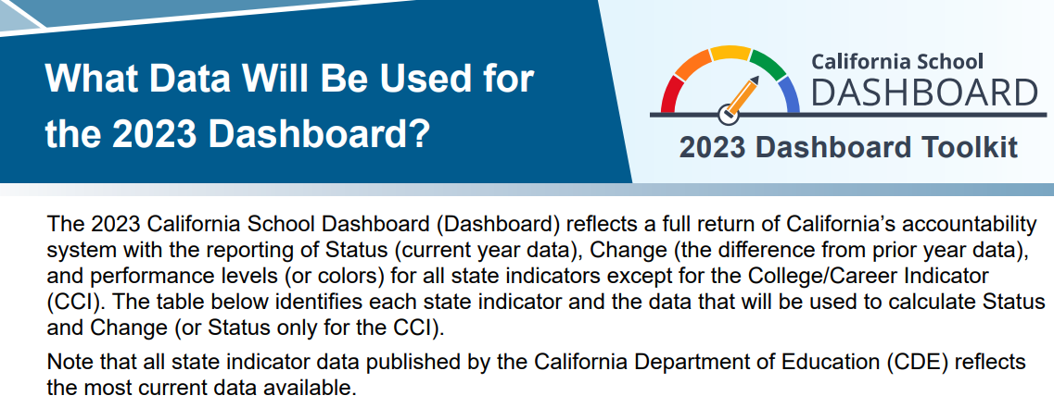
2023 Dashboard Toolkit​ Resources
Flyers for Educators and Parents (translations available!)
On-Demand Recordings and Notetaking Guide
Additional Resources

Slide 32
School Dashboard Additional Reports and Data
State Indicator 5x5 Placement Reports
College/Career Placement Report
College/Career Measures Report
A-G/CTE Completion
Graduation Rate Additional Report
Academic Participation Rate Report
Summative ELPAC and Summative Alternative ELPAC Participation Rate Report
Student Group Report
District Performance by County
Charter Performance by County

Slide 33

California School Dashboard Publication Deadlines
Assembly Bill 114 (Chapter 194, Statutes 2023), requires the annual publication of the Dashboard on the following dates:
  2023—December 15, 2023
  2024—December 1, 2024
  2025—November 15, 2025
  2026—October 15, 2026

Slide 34
2024 Accountability Workplan

Slide 35
California School Dashboard 2024
The CDE is committed to continuous improvement within the accountability system and Dashboard.
CDE's annual work plan reviews the state and local indicators and performance standards and addresses suggested revisions or updates in the work plan each March.
  This work plan is presented annually at the March SBE Meeting.

Slide 36
Update to Dashboard Schedules
SB 141 (Chapter 194, Statutes of 2023) moves up the publication date of the 2024 Dashboard to December 1, 2024.
The State Board of Education (SBE) adoption of items from the Workplan are being moved up from September to July
  Normal timeline provided six months for policy and technical work and educational partner feedback
  The 2024 workplan has 50 percent less time for development work (mid-March to mid-June)

Slide 37
Consolidated 2024 Accountability Workplan
Incorporate Science Assessment Results onto the Dashboard
New Student Populations: Transitional Kindergarteners (TK) and Long-Term English Learners (LTEL)
College/Career Indicator (CCI) Reflection
Student-Level Growth Model Data Release
Priority 1: State-Level Data

Slide 38
Incorporate Science Assessment Results onto the Dashboard

Slide 39
Background on Science (1 of 3)
2018
  First operational California Science Test was administered to student in grades five, eight, and once in high school.
2020
  At the March SBE meeting, CDE discussed the timeline for potential incorporation of the Science test results into the Dashboard.

Slide 40
Background on Science (2 of 3)
March 2022 SBE Meeting
  CDE provided an update on the feasibility of when the science results could be incorporated into the Dashboard considering the revised blueprints.
September 2022 SBE Meeting
  SBE approved the insertion of a link on the Dashboard Additional Reports to the California Science Test results on the CAASPP website.

Slide 41
Background on Science (3 of 3)
December 2022
  2022 Dashboard Additional Reports links to the California Science Test (CAST) results on the CAASPP website.
December 2023
  2023 Dashboard Additional Reports links to the California Science Test (CAST) results on the CAASPP website.

Slide 42
Science Workplan for 2024
With access to two years of results from the 2021–22 and 2022–23 CAST and California Alternate Assessment (CAA)-Science assessments, the CDE will work to develop options toward inclusion of these test results on the Dashboard in 2024.

Slide 43
Science Workplan and Dashboard Principles
Principle 5: Values high performance and growth equally.
Principle 8: Reflects technical quality through measures that are valid and reliable.
Principle 11: Is subject to continuous revision and improvement.

Slide 44
SBE Decision Points for Science Workplan
To move forward with this process, the SBE will need to take action on the following six individual decision points:
Approval of a Metric to Measure Science Assessment Performance for Use on the Dashboard
Approval of Status Cut Points
Approval of Change Cut Points
Approval of a Color Scheme for the Five-by-Five Color Grid
Inclusion of the Indicator within the State Accountability System through Differentiated Assistance Criteria (DA)
Inclusion of the Indicator within the Federal Accountability System through Every Student Succeeds Act (ESSA) Eligibility Identification

Slide 45
Approval of a Metric to Measure Science Assessment Performance for Use on the Dashboard
Adding Science to the Dashboard will require a full technical evaluation of the results from the 2021–22 and 2022–23 CAST and CAA-Science administrations to ensure the creation of a new Accountability Indicator is valid and reliable.
  While the science assessments have similar characteristics to both the ELA and Mathematics assessments, they have many unique features that must be evaluated to ensure fair and valid results for Accountability determinations.

Slide 46
Decision Points 2-4:
Creation of a Color on the Dashboard
Following the metric's approval, the CDE would need evaluate the results and distribution of results for the Science Assessment metric to establish cut points for status and change and choose a color scheme for the five-by-five color grid.

Slide 47
Decision Points 5 and 6:
Support Eligibility Determinations
The final decision points for the SBE would be to evaluate whether results on the metric would be added to the criteria to identify LEAs under the LCFF eligibility criteria and/or schools ESSA criteria.

Slide 48
New Student Populations:
TK and LTEL

Slide 49
Background on TK and LTEL
In 2024, the Dashboard will have two additional student populations to address across its state indicators: Transitional Kindergarteners (TK) and Long-Term English Learners (LTELs).

Slide 50
TK and LTEL Workplan and Dashboard Principles
The work on this state indicator aligns with the following Dashboard Principles:
  Principle 5: Values high performance and growth equally.
  Principle 8: Reflects technical quality through measures that are valid and reliable.
  Principle 11: Is subject to continuous revision and improvement.

Slide 51
Collection of TK Data
Beginning this school year (2023–24), the California Longitudinal Pupil Achievement Data System (CALPADS) is collecting TK data as a separate grade level from kindergarten to facilitate the reporting of TK student data and to meet the intent of California Education Code Section 60900(d)(4)(A).
This is the first opportunity for the CDE to recognize and identify which students are enrolled in TK versus Kindergarten.

Slide 52
Where TK is Included/Excluded on the Dashboard
On the current Dashboard, TK students are included in the following ways:
  Suspension Rate Indicator
  Chronic Absenteeism Indicator
On the current Dashboard, TK students are excluded in the following ways:
  The English Learner Progress Indicator (ELPI) excludes TK students from the measurement of progress toward English language proficiency.
  The directory details for districts and schools on the Dashboard excludes TK.

Slide 53
TK Dashboard Workplan
Following the close of the 2023–24 data collection cycle, the CDE will analyze the TK population across the Suspension Rate and Chronic Absenteeism Indicators, and ELPI across schools/districts/state. This information will be used to inform decisions within the 2025 Accountability Workplan.

Slide 54
LTEL Definition
Senate Bill 141 added LTELs, defined as a pupil who has not attained English language proficiency within 7 years of initial classification as an English learner, as the fourteenth student group on the Dashboard.
LTELs will have the same n-size rules that govern Foster Youth and Homeless student groups:
  15 or more students will be held accountable at the district level and receive a color
  30 or more students will be held accountable at the school level.

Slide 55
LTELs and the 2024 Dashboard
Beginning with the 2024 Dashboard, the LTEL student group will be added to all state Indicators:
    Suspension Rate Indicator
    Graduation Rate Indicator
    College/Career Indicator
    Chronic Absenteeism Indicator
    Academic Indicators
    English Learner Progress Indicator
      This indicator will now have an overall performance for English Learners and a single student group: LTELs

Slide 56
Student Groups Included in the 2024 Dashboard
With the addition of LTELs, the number of student groups on the 2024 Dashboard will increase from 13 to 14.
Race/Ethnicity Student Groups | Program Student Groups
African American | Foster Youth
American Indian | Homeless
Asian | Socioeconomically Disadvantaged
Filipino | Students with Disabilities
Hispanic | English Learners
Two or More Races | Long-Term English Learners
Pacific Islander | n/a
White | n/a

Slide 57
LTELs Dashboard Workplan
CDE will conduct technical work to operationalize the inclusion of the LTEL student group on the Dashboard within:
  Cumulative Enrollment,
  Cohort Calculations, and
  Assessment demographics.
The CDE will engage with educational partners obtain feedback on resources to advertise the addition of the new student group on the Dashboard.

Slide 58
College/Career on the Dashboard

Slide 59
What is the College/Career Indicator?
Measures how well districts and schools are preparing its graduates for college/career.

Slide 60
Which Students Are Included in the CCI?
Includes the same set of students as in the Graduation Rate Indicator (i.e., combined four- and five-year graduation rate).
The following is an example of how the CCI is calculated using students who were prepared:
Class of 2022 Grads + Fifth-Year Graduates from Class of 2021
Divided
Class of 2022 + Fifth-Year Graduates from Class of 2021

Slide 61
Background on CCI
The CCI returned to 2023 Dashboard for the first time since 2019, but as a "status only" Indicator
On the 2024 Dashboard, the CCI will return to reporting colors for schools, districts and student groups.

Slide 62
College/Career Workplan and Dashboard Principles
The work on this state indicator aligns with the following Dashboard Principles:
  Principle 2: Reports opportunity and performance gaps among student groups through the Equity Report that is available for each state indicator.
  Principle 3: Reports each indicator separately.
  Principle 4: Values each indicator equally.
  Principle 8: Reflects technical quality through measures that are valid and reliable.
  Principle 11: Is subject to continuous revision and improvement.

Slide 63
CCI Dashboard Workplan
Prior to the release of the 2024 CCI, the CDE will:
  Seek guidance from the SBE on continuing review of the data for the four new career measures (Internships, Student-led enterprise, Simulated work-based learning, ASVAB),
  Update the SBE on the data collection for the Seal of Civic Engagement, and
  Discuss exploration of industry certifications.

Slide 64
Development of the CCI
The CCI was developed to emphasize that a high school diploma represents the completion of a broad and rigorous course of study that prepares students for success after high school.
It was originally adopted by the State Board of Education (SBE) in July 2016 and performance levels (colors) were reported for the first time on the 2018 Dashboard.
It is based on students in each four-year graduation cohort and uses specific criteria that are reliant on assessments and course completion data to determine if students are “Prepared,” “Approaching Prepared,” or “Not Prepared” for college and/or career.

Slide 65
Continuing to Review Data for the Four New Career Measures
The CDE began collecting data on four new career measures in 2020-21:
  Internships
  Student-led enterprise
  Simulated work-based learning
  Armed Services Vocational Aptitude Battery (ASVAB)
CDE analyzed the two years of data collected from 2020–21 and 2021–22 during the 2023 Accountability Workplan.
If directed, CDE could analyze the additional data collected from 2022–23 in the scope of the 2024 Accountability Workplan.
  SBE will need to provide additional guidance to CDE on the data required to add these components to the CCI.

Slide 66
Update on Data Collection for the
Seal of Civic Engagement
CDE will be adding an additional ad-hoc data collection to the 2023–24 End of Year (EOY) process for LEAs to collect student-level information on the students who have earned the Seal of Civic Engagement.
This will allow CDE to analyze the data and learn more about the students who are earning the seal for future consideration by the SBE.

Slide 67
Exploration of Industry Certifications
In 2024, the CDE will also continue to solicit feedback on how Industry Certifications have incorporated into CTE Pathways around the state, and to further define and identify what and how data can be collected from LEAs.

Slide 68
Student Level Growth Model Data Release

Slide 69
Background on Student Level Growth Model
The SBE adopted a growth model calculation and model in May 2021.
In December 2024, the CDE will release the initial set of English Language Arts (ELA) and mathematics growth data using three years of assessment data from 2021–22, 2022–23 and 2023–24.
The release of these results will allow the SBE to begin conversations about how growth data will be incorporated into the Dashboard and support determinations for the State and Federal Accountability systems.

Slide 70
Student Level Growth Model Workplan and Dashboard Principles
This work aligns with the following Dashboard Principles:
  Principle 2: Reports opportunity and performance gaps among student groups through the Equity Report that is available for each state indicator.
  Principle 4: Values each indicator equally.
  Principle 5: Values high performance and growth equally.
  Principle 8: Reflects technical quality through measures that are valid and reliable.
  Principle 11: Is subject to continuous revision and improvement.

Slide 71
Growth Model Workplan
Following the release of the 2024 Dashboard, CDE will release the initial set of individual student level growth data using the three years of the California Assessment of Student Performance and Progress (CAASPP) summative assessment scores from the 2021–22, 2022–23, and 2023–24 school years.
The data release will include:
  Downloadable data files, with aggregated growth scores at the school, district and student group levels, and
  A graphic display of the results on the “Details” page of the Dashboard.

Slide 72
Priority 1: State Level Data

Slide 73

Priority 1—Teacher Data Background
In 2023, the SBE adopted displaying information from the 2021–22 Teacher Assignment Monitoring Outcomes (TAMO) reports within Local Measure Priority 1
The SBE also updated the self-reflection tool for Priority 1 consistent with the addition of statewide data related to the assignment of teachers

Slide 74
Priority 1: Teacher Outcomes Reporting on the Dashboard Display
Name | Total Teaching FTE | Clear (% of teaching FTE) | Comparison to Statewide Average
Sacramento City Unified | 1,688.4 | 87.3% | Above
Sacramento | 9,887.7 | 88.3% | Above
Statewide | 246,966.4 | 85.8% | n/a
Optional Narrative (Limited to 1,500 characters): Provide any additional information that the local educational agency believes is relevant to understanding its progress on meeting the requirements for this measure. For additional information about schools within this local educational agency, please visit the Dataquest Teaching Assignment with School Data report at (unique link for each LEA provided here).

Slide 75
Priority 1–Teacher Data Workplan and Dashboard Principles
This work aligns with the following Dashboard Principles:
  Principle 8: Reflects technical quality through measures that are valid and reliable.
  Principal 9: Leverages the expertise and perspectives of a broad set of educational partners and community members.
  Principle 10: Promotes coherence between data reporting and support/improvement programs.
  Principal 11: Is subject to continuous revision and improvement.

Slide 76
Priority 1–Teacher Data Workplan
With the first reporting of these data with objective criteria in Priority 1 beginning with the 2023 Dashboard, the CDE has responded to an increased need for technical and policy support from LEAs for these new reports and similar reports on the School Accountability Report Card (SARC)
In 2024, the CDE will continue to support and monitor the impact of these data in the field and focus on preparing for the release of these related reports on DataQuest: New Staff Demographic, Experience, and Education Data (multiple years) AND Year 3 of TAMO data

Slide 77
Next Steps for the State Board

Slide 78
March SBE Meeting
SBE will provide feedback on the 2024 Accountability work plan

Slide 79
Public Comment

Slide 80
Public Comment Call-in Number
Phone number: 667-770-1523
Participant Access Code: 651905
Notes: Turn down the volume of your computer or live webcast to avoid background echoes.
When it is your turn, an operator will announce, “Please say your name and affiliation and begin public comment. Your time begins now.”

