Slide 1
Item 2: Related to California’s State and Federal Accountability System: Review of the 2026 Accountability Work Plan California Practitioners Advisory Group March 27, 2026

Slide 2
March 2026 Meeting Agenda (1)
2026 Accountability Workplan
College Career Indicator (CCI)
Work-Based Learning (WBL) Career Measures: Internships, Student-Led Enterprise, and Simulated Work-Based Learning
State Seal of Civic Engagement
Adding Courses:
International Baccalaureate (IB) Courses
Adding Assessments:
Armed Services Vocational Aptitude Battery (ASVAB)
Adding Courses/Assessments:
Cambridge International (Cambridge) Courses and Exams

Slide 3
March 2026 Meeting Agenda (2)
Long-Term English Learners (LTELs)
Adding Reclassified Fluent English Proficient (RFEP) LTELs to the English Learner Progress Indicator (ELPI)
Priority 1: Teacher Data
Growth Data Dashboard Display Card
Growth as a Full State Indicator
Science as a Full State Indicator
Modification of English Language Arts (ELA) and Mathematics Indicator Display and Information
California Assessment of Student Performance and Progress (CAASPP) Performance Levels on the Dashboard
Public Comment

Slide 4
2026 Accountability Workplan

Slide 5
2026 Workplan Items
Student-Level Growth Model for Grades 4 through 8 in ELA and Mathematics as full indicators
Science Indicator as full indicator
College/Career Indicator
Application Based Dashboard Alternative School Status
Priority 1 Teacher Assignment Data
Long-Term English Learner Student Group
Participation Rate for ELA, Mathematics and Science Indicators-March SBE Meeting
Modification of ELA and Mathematics Indicator language and information-New Work Added During January SBE Meeting
Release Plan for the 2026 Dashboard-Information only

Slide 6
2026 Workplan: CCI
Work-Based Learning Measures:
Internships
Student-Led Enterprise
Simulated Work-Based Learning
State Seal of Civic Engagement
International Baccalaureate (IB) Courses
Cambridge International Courses & Exams
Armed Services Vocational Aptitude Battery (ASVAB)

Slide 7
2026 Workplan: Remaining LTEL
RFEP in the LTEL ELPI:
Augment the ELPI calculation to include LTEL students who have recently reclassified to fluent English proficient status.

Slide 8
Addition to Workplan: Modification of ELA and Mathematic Indicator Language and Information
Modify language and information around ELA and Mathematic Indicators to address concerns with the continued use of the word "Standard"
January 2026 SBE Motion:
Ensuring the October 2026 Dashboard displays trends in student performance at all four performance levels, and a link to the local educational agency (LEA)/school's CAASPP page
Ensuring that the October 2026 Dashboard uses the term Distance from Proficiency Standard rather than Distance from Standard
Examining how we might move to a clearer metric than Distance from Standard using a positive point scale on the 2027 Dashboard
Evaluating and, as needed, undertaking potential changes to California’s Every Student Succeeds Act State Plan.

Slide 9
College/Career Indicator

Slide 10
College/Career Dashboard Principles
The work on this state indicator aligns with the following Dashboard Principles:
Principle 2: Reports opportunity and performance gaps among student groups through the Equity Report that is available for each state indicator.
Principle 3: Reports each indicator separately.
Principle 4: Values each indicator equally.
Principle 8: Reflects technical quality through measures that are valid and reliable.
Principle 11: Is subject to continuous revision and improvement.

Slide 11
Timeline for the College/Career Indicator in the 2026 Accountability Workplan
Subject | March 2026 SBE Meeting | March 2026 CPAG Meeting | May 2026 SBE Meeting
Review of currently adopted College/Career Indicator components | SBE reviewed inclusion of State Seal of Civic Engagement and Additional Career Measures in CCI. | CPAG will provide feedback on the inclusion of IB courses, Cambridge courses/exams and ASVAB in CCI. CPAG will also review March SBE CCI Items. | SBE will consider the inclusion of IB courses, Cambridge courses/exams and ASVAB in CCI and items held over from the March SBE meeting.

Slide 12
Currently Adopted CCI Measures
Assessment Measures
Smarter Balanced Summative Assessments (SBAC) in English Language Arts/Literacy and Mathematics (Grade 11)
International Baccalaureate (IB)
Course Measures
College Credit Course
Registered Pre-Apprenticeships
Transition Classroom and Work-Based Learning Experience
Combination of Assessments/Course Measures
Advanced Placement (AP)
Met University of California/California State University (UC/CSU) Requirements
State Seal of Biliteracy
Career Technical Education (CTE) Pathway Completion
Leadership/Military Science
State and Federal Job Programs

Slide 13
Career Measures: Internships, Student-led Enterprise, and Simulated Work-Based Learning

Slide 14
Work-Based Learning and the CCI
In 2019–20, based on feedback from interest groups, the following new career measures were developed to be considered for inclusion in the CCI:
Work-Based Learning: Internships
Work-Based Learning: Student-Led Enterprises
Work-Based Learning: Simulated Work-Based Learning
ASVAB

Slide 15
Development of High Quality WBL Measures
Analyzed work-based learning data received from local educational agencies (LEAs) between the 2020–21 and 2024–25 school years
Worked with the CDE’s College and Career Transition Division (CCTD) and educational partners to define what data points lead to "High Quality" work-based learning
Evaluated impact that these CCI measures would have on 2025 CCI cohort and the students that were either "approaching prepared" or "not prepared" by their LEA for college or career.

Slide 16
Students in the Cohort with Work-Based Learning Data Submitted
Year | Students in the Cohort with Internship Data Submitted | Students in the Cohort with Student-Led Enterprise Data Submitted | Students in the Cohort with Simulated Work-Based Learning Data Submitted
2024–25 | 19,124 | 8,554 | 33,211

Slide 17
Work-Based Learning: Internship
An internship is a work-based learning activity which allows students to apply classroom learning in a work-place setting.
Can be paid or unpaid.
Must be tied to a course.
High-Quality Criteria:
50 hours or more
Sponsored by the LEA
Supervised by a Certificated Staff
3 or higher on Evaluation
Completed as part of a Career Technical Education (CTE) Concentrator or Capstone Course, or through CTE Work Experience Education (CTWEE)

Slide 18
How did the 19,124 students in the 2025 cohort who completed an Internship place on the established 2025 CCI criteria?
CCI Level | Students with Internship Data Submitted | Students with Internship Data Submitted that Met the High-Quality Standard | 2025 CCI
Prepared | 13,433 (70.2%) | 4,716 (76.0%) | 257,567 (51.7%)
Approaching Prepared | 3,220 (16.9%) | 1,008 (16.2%) | 71,381 (14.3%)
Not Prepared | 2,471 (12.9%) | 482 (7.8%) | 168,866 (33.9%)

Slide 19
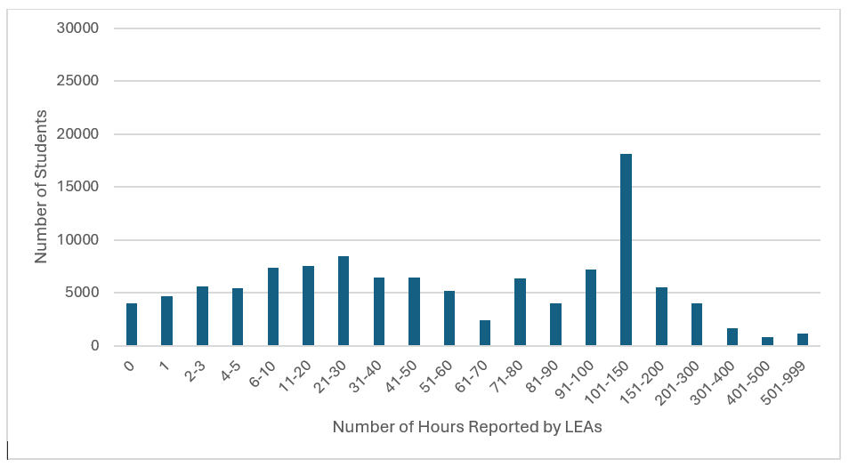
Number of Hours Reported by LEAs for Students Completing Internships from 2020–21 through 2024–25 School Years
Reference Appendix 1 for the alternate text version.

Slide 20
Work-Based Learning: Student-Led Enterprise
A student-led enterprise involves the development and operation of a revenue-generating business (regardless of profit or loss), operating outside the classroom.
It must be:
operated by the student
be ongoing and not a one-day event, and
tied to a course in which students develop a business and marketing plan.
High-Quality Criteria:
50 hours or more
Completed as part of a CTE Concentrator or Capstone Course

Slide 21
How did the 8,554 students in the 2025 cohort who completed a Student-Led Enterprise place on the established 2025 CCI criteria?
CCI Level | Students with Student-Led Enterprise Data Submitted | Students with Student-Led Enterprise Data Submitted that Met the High-Quality Standard | 2025 CCI
Prepared | 5,340 (62.4%) | 2,305 (70.0%) | 257,567 (51.7%)
Approaching Prepared | 1,812 (21.2%) | 711 (21.6%) | 71,381 (14.3%)
Not Prepared | 1,402 (16.4%) | 277 (8.4%) | 168,866 (33.9%)

Slide 22
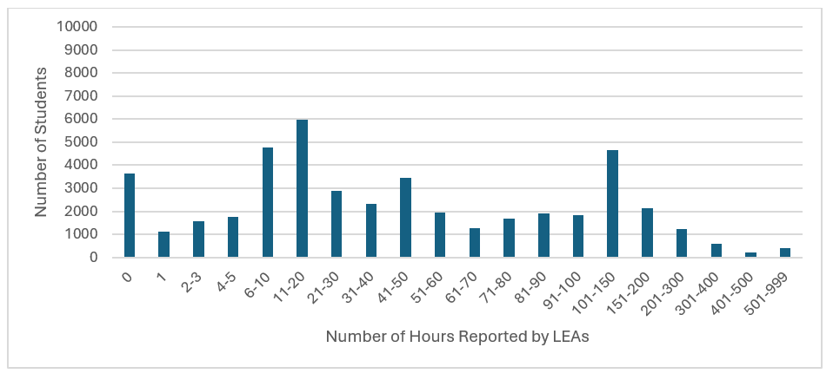
Number of Hours Reported by LEAs for Students Completing Student-Led Enterprises from 2020–21 through 2024–25 school years
Reference Appendix 2 for the alternate text version.

Slide 23
Work-Based Learning: Simulated Work-Based Learning
Simulated Work-Based Learning (SWBL) is where students gain career experience while at school through an emulated workplace environment that is aligned to the classroom curriculum.
It must be:
tied to both a course and instructor
be a workplace experience within a school environment in conjunction with business or industry, and
needs to involve work-related and/or technical skill development.
High-Quality Criteria:
50 hours or more
Completed as part of a CTE Concentrator or Capstone Course

Slide 24
How did the 33,211 students in the 2025 cohort who completed SWBL place on the established 2025 CCI criteria?
CCI Level | Students with SWBL Data Submitted | Students with SWBL Data Submitted that Met the High-Quality Standard | 2025 CCI
Prepared | 20,987 (63.2%) | 5,947 (69.1%) | 257,567 (51.7%)
Approaching Prepared | 6,381 (19.2%) | 1,653 (19.2%) | 71,381 (14.3%)
Not Prepared | 5,843 (17.6%) | 1,001 (11.6%) | 168,866 (33.9%)

Slide 25
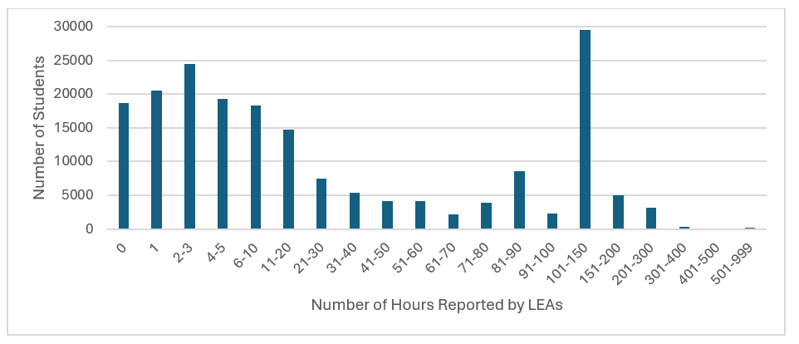
Number of Hours Reported by LEAs for Students Completing SWBL Experiences from 2020–21 through 2024–25
Reference Appendix 3 for the alternate text version.

Slide 26
Summary of WBL Impact on 2025 CCI
Based on the proposed “Prepared” criteria from CDE for the three new career measures:
796 additional students (0.16 percent) would be prepared by completing a CTE Pathway plus a High-Quality Internship
586 additional students (0.12 percent) would be prepared by completing a CTE Pathway plus a High-Quality Student-Led Enterprise
1,158 additional students (0.23 percent) would be prepared by completing a CTE Pathway plus a High-Quality Simulated Work-Based Learning Experience
If all three career measures are included on the CCI, the percentage of students who were prepared by their LEA/school would increase to 52.2 percent from 51.7 percent.

Slide 27
SBE March Meeting: Work-Based Learning
At the March SBE meeting, the SBE reviewed the proposed criteria and provided feedback that Work-Based Learning opportunities in non-CTE courses were not appropriately recognized within the criteria.
No action was taken on the high quality definitions, or to incorporate "CTE Pathway Plus High Quality WBL“ in the CCI
SBE indicated an interest in revisiting the options for how to add/incorporate work-based learning in non-CTE courses at their May 2026 meeting.

Slide 28
Completion of WBL + ?
Completion of High-Quality WBL Internship
Completion of High-Quality Student-Led Enterprise
Completion of High-Quality Simulated Work-Based Learning
CCI Plus Measures
CTE Pathway
Met UC/CSU Requirements
1 College Credit Course
1 AP Course/Exam
1 IB Course/Exam
SBAC score of Level 3 or higher in one subject area (ELA or mathematics) and a score of Level 2 in the other area
Leadership/Military Science

Slide 29
CPAG Feedback on WBL
Turn & Talk (15 minutes and Share)
Which combinations of existing CCI metrics would you combine with High-Quality WBL to signal that an LEA/school has prepared a student for college/career?

Slide 30
State Seal of Civic Engagement

Slide 31
SSCE Overview
In September 2020, the SBE adopted criteria and guidance to award a SSCE to California public school students who demonstrate excellence in civics education and participation, and an understanding of the United States Constitution, the California Constitution, and the democratic system of government.
Each LEA should develop local requirements, procedures, and optional local criteria considering its own local context for the SSCE based on the adopted criteria and guidance.

Slide 32
SSCE Completers on the 2025 CCI
CCI Level | State Seal of Civic Engagement Recipients | 2025 CCI
Prepared | 16,445 (80.5%) | 257,567 (51.7%)
Approaching Prepared | 2,140 (10.5%) | 71,381 (14.3%)
Not Prepared | 1,840 (9.0%) | 168,866 (33.9%)

Slide 33
Completion of SSCE + ?
Completion of SSCE
CCI Plus Measures
CTE Pathway
Met UC/CSU Requirements
1 College Credit Course
1 AP Course/Exam
1 IB Course/Exam
SBAC score of Level 3 or higher in one subject area (ELA or mathematics) and a score of Level 2 in the other area
Leadership/Military Science

Slide 34
CPAG Feedback on SSCE
Turn & Talk (7 minutes and Share)
Do you agree with adding the State Seal of Civic Engagement into the CCI?
If so, which combinations of existing CCI metrics would you combine with SSCE to signal that an LEA/school has prepared a student for college/career?
If not, why?

Slide 35
International Baccalaureate Courses

Slide 36
International Baccalaureate
The International Baccalaureate (IB) curriculum sets out the requirements for study that is composed of three core elements that aim to broaden students' educational experience and challenge them to apply their knowledge and skills.
There is an application process for schools wishing to become an authorized IB school.
In 2025, there were 97 high schools (~4 percent of high schools) in the State of California that offered IB coursework.

Slide 37
Adding Courses to IB Measure
For the 2026 workplan, the SBE would like to consider including IB courses on the CCI:
For a student to earn prepared via the IB measure they must:
Score 4 or higher on at least two IB Exams, or
Successfully complete at least two IB courses with a grade of C- or better, or
Achieve a combined total of two or more qualifying IB course completions and IB examinations.

Slide 38
IB Schools and Districts
Number of Students:
CCI IB Prepared students via Exams Only (2 Exams or UC/CSU Requirements Met+1 Exam) vs. CCI IB Prepared students via Courses (2 Courses/1 Course+1 Exam/UC-CSU Requirements Met+1 Course)

Slide 39
How Would The 2024 and 2025 CCI Look?
Dashboard Year | Total Students in CCI Denominator | Passed Two IB Exams | Passed Two IB Courses | Passed One IB Course and One IB Exam | Total IB Prepared
2024 | 507,621 | 3,610 (0.7%) | N/A | N/A | 3,610 (0.7%)
2025 | 497,816 | 3,719 (0.75%) | 4,626 (0.9%) | 4,471 (0.9%) | 7,472 (1.5%)

Slide 40
Simulation of 2024 and 2025 CCI Results for Met UC/CSU Requirements + IB Course
Dashboard Year | Total Students in Denominator | Met UC/CSU Requirements | One IB Exam | One IB Course | Total UC/CSU with IB | Total UC/CSU Requirements Plus
2024 | 507,621 | 228,029 (44.9%) | 6,229 (1.2%) | N/A | 6,229 (1.2%) | 190,799 (37.6%)
2025 | 497,816 | 235,028 (47.3%) | 6,420 (1.3%) | 10,682 (2.1%) | 10,543 (2.1%) | 212,396 (42.6%)

Slide 41
How did the students in the 2025 cohort who completed the modified IB Course Measure place within established 2025 criteria?
CCI Level | Students That Completed the IB Measure (n=3,753) | Students That Completed UC/CSU with IB (n =414) | 2025 CCI (n=497,814)
Prepared | 3,272 (87.2%) | 29 (7.0%) | 257,567 (51.8%)
Approaching Prepared | 289 (7.7%) | 385 (93.0%) | 71,381 (14.3%)
Not Prepared | 192 (5.1%) | 0 (0.0%) | 168,866 (33.9%)

Slide 42
Students Approaching Prepared/Not Prepared by their School/LEA on the 2025 Dashboard that Completed a Combination of IB Courses, IB Exams, or UC/CSU with IB
Total | Total IB Prepared | Total UC/CSU with IB | Total Prepared with Either Method
Number of Students | 414 | 385 | 735
Number of Schools | 74 | 78 | 104
Number of Districts | 57 | 62 | 74
Number of Counties | 22 | 22 | 23

Slide 43
Cambridge International Courses and Exams

Slide 44
Cambridge International
Cambridge International Education is a global provider educational programs. It is part of Cambridge University Press and Assessment.
Cambridge has a strong international recognition for their “Advanced Level” (A-courses), which are known for their rigor and allow students to specialize deeply in a few subjects.

Slide 45
Cambridge Advanced Course Information
Cambridge International offers 55 Course Subjects
Two Types of Courses:
AS Level (1 year): course with exam (graded A to E) is equivalent to 3-4 college credits
A Level (2 years): course with exam (graded A* to E) is equivalent to 6-8 college credits-recommended for use in the CCI by Cambridge
College Credit
UC grants credit for Cambridge A Level exams on which a student earns a grade of A, B, or C.

Slide 46
Prevalence of Cambridge International Programs in California
LEA Name | School Name | Number of Students with Cambridge Courses | Number of Cambridge Course Sections Completed | Cambridge Authorized School?
Placentia-Yorba Linda Unified | Valencia High | 42 | 130 | Yes
Fullerton Joint Union High | Troy High | 187 | 480 | Yes

Slide 47
How did the students in the 2025 cohort who completed two Cambridge International A Level Courses place within established 2025 criteria?
CCI Level | Students That Completed Two Cambridge International A Level Courses (n=68) | 2025 CCI (n=497,814)
Prepared | 68 (100%) | 257,567 (51.7%)
Approaching Prepared | 0 (0.0%) | 71,381 (14.3%)
Not Prepared | 0 (0.0%) | 168,866 (33.9%)

Slide 48
Prevalence of Cambridge International A Level Exams in California
LEA Name | School Name | Number of Students with A Level Cambridge Exams | Number of Cambridge A Level Exams Taken | Number of Cambridge A Level Exams Passed | Cambridge Authorized School?
Placentia-Yorba Linda Unified | Valencia High | 9 | 12 | 6 | Yes
Fullerton Joint Union High | Troy High | 143 | 298 | 167 | Yes

Slide 49
How did the students in the 2025 cohort who completed two Cambridge International A Level exams place within established 2025 criteria?
CCI Level | Students That Completed Two Cambridge International A Level exams (n=18) | 2025 CCI (n=497,814)
Prepared | 17 (94.4%) | 257,567 (51.7%)
Approaching Prepared | 0 (0.0%) | 71,381 (14.3%)
Not Prepared | 1 (6.6%) | 168,866 (33.9%)

Slide 50
CPAG Feedback on IB/Cambridge
Turn & Talk (5 minutes and Share)
Do you agree with adding IB Courses to the CCI?
Do you agree with adding Cambridge International courses/exams to the CCI?
Are there any additional questions/information that CDE needs to share with SBE?

Slide 51
Armed Services Vocational Aptitude Battery Armed Forces Qualification Test Scores

Slide 52
ASVAB AFQT Background
ASVAB Armed Forces Qualification Test (AFQT) is used to determine qualification for enlistment into the US military.
The AFQT score consists of 4 of the 10 subtests on the ASVAB:
Arithmetic Reasoning
Mathematics Knowledge
Paragraph Comprehension
Word Knowledge
The AFQT is measured by the percentile of a tested student total score to other tested students. For example, a score of 31 means that this student scored in the 31st percentile.
The SBE has asked the CDE to review the ASVAB for inclusion in the CCI for multiple years.

Slide 53
AFQT Categories
Category | Percentile
Category I | 93-99
Category II | 65-92
Category III A | 50-64
Category III B | 31-49
Category IV A | 21-30
Category IV B | 16-20
Category IV C | 10-15
Category V | 0-9

Slide 54
ASVAB AFQT in Other States
State | AFQT Score
Arizona | 31
Delaware | 50
Florida | 65
Georgia | 31
Maryland | 31
Montana | Attempt-88 (index)
New Hampshire | 31
State | AFQT Score
New Mexico | 31
Nevada | 31
South Carolina | 31
Tennessee | 31
Virginia | 31-65 (index)
Wyoming | 45
* Students in Montana and Virginia receive a weighted score based on their AFQT score.

Slide 55
Number of Students who Participated in the ASVAB by Year
Cohort Year | Number of students in the cohort whose LEA submitted ASVAB anytime during high school
2020–21 | 192
2021–22 | 1,877
2022–23 | 7,967
2023–24 | 10,750
2024–25 | 11,878

Slide 56

ASVAB CEP Testing Data 2021-2026 Prepared by: Tim Westley, Ph.D. Western Sector Education Services Specialist
#STUDENTS | #PLANNING | #OPTIONS | #FUTURE | #CHOICES | #KNOWLEDGE | #TOOLS

Slide 57
Los Angeles & Regional Schools (1)
Student Testing
2021 - 2026
Month | Total 11th | Total 12th | Total Jr/Sr | Total Students | Total Schools | Total Sessions
OCT | 3,278 | 5,085 | 8,363 | 9,342 | 262 | 282
NOV | 2,524 | 3,196 | 5,270 | 7,210 | 245 | 259
MAR | 1,777 | 1,726 | 3,503 | 4,240 | 197 | 210
FEB | 1,398 | 1,364 | 2,762 | 3,733 | 178 | 185
DEC | 1,152 | 1,298 | 2,450 | 2,727 | 125 | 132
SEP | 1,308 | 1,284 | 2,592 | 2,830 | 78 | 89

Slide 58
Los Angeles & Regional Schools (2)
Student Testing
2021 - 2026
Month | Total 11th | Total 12th | Total Jr/Sr | Total Students | Total Schools | Total Sessions
SEP | 1,308 | 1,284 | 2,592 | 2,830 | 78 | 89
JAN | 962 | 1,177 | 2,139 | 2,827 | 97 | 105
AUG | 189 | 1,066 | 1,255 | 1,285 | 11 | 14
APR | 1,500 | 1,059 | 2,559 | 3,002 | 163 | 176
MAY | 521 | 285 | 806 | 1,092 | 66 | 71
JUL | 8 | 24 | 32 | 52 | 4 | 4
JUN | 76 | 6 | 82 | 83 | 3 | 4
Total | 14,693 | 17,570 | 32,263 | 38,423 | 1,429 | 1,531

Slide 59
Sacramento & Regional Schools (1)
Student Testing
2021 - 2026
Month | Total 11th | Total 12th | Total Jr/Sr | Total Students | Total Schools | Total Sessions
OCT | 3,789 | 3,871 | 7,660 | 9,128 | 339 | 375
NOV | 3,739 | 2,934 | 6,673 | 8,124 | 316 | 342
DEC | 1,947 | 1,635 | 3,582 | 4,602 | 200 | 216
SEP | 1,431 | 1,449 | 2,880 | 3,657 | 122 | 155
MAR | 2,059 | 1,412 | 3,471 | 4,896 | 290 | 317
FEB | 2,230 | 1,251 | 3,481 | 4,885 | 239 | 261

Slide 60
Sacramento & Regional Schools (2)
Student Testing
2021 - 2026
Month | Total 11th | Total 12th | Total Jr/Sr | Total Students | Total Schools | Total Sessions
JAN | 1,612 | 1,060 | 2,672 | 4,080 | 170 | 196
APR | 1,485 | 928 | 2,413 | 3,604 | 207 | 234
MAY | 749 | 375 | 1,124 | 1,897 | 81 | 106
AUG | 481 | 87 | 568 | 1,059 | 23 | 41
JUN | 50 | 56 | 106 | 616 | 17 | 42
JUL | 16 | 42 | 58 | 539 | 18 | 40
Total | 19,588 | 15,100 | 34,688 | 47,087 | 2,022 | 2,325

Slide 61
San Jose & Regional Schools (1)
Student Testing
2021 - 2026
Month | Total 11th | Total 12th | Total Jr/Sr | Total Students | Total Schools | Total Sessions
OCT | 1,665 | 1,966 | 3,631 | 4,128 | 160 | 169
NOV | 1,532 | 1,907 | 3,439 | 4,378 | 170 | 186
FEB | 1,562 | 1,227 | 2,789 | 3,260 | 138 | 141
SEP | 789 | 1,189 | 1,978 | 2,139 | 60 | 72
MAR | 1,625 | 1,094 | 2,719 | 3,175 | 154 | 160
DEC | 487 | 615 | 1,102 | 1,420 | 72 | 78

Slide 62
San Jose & Regional Schools (2)
Student Testing
2021 - 2026
Month | Total 11th | Total 12th | Total Jr/Sr | Total Students | Total Schools | Total Sessions
APR | 1,552 | 531 | 2,083 | 2,581 | 82 | 113
JAN | 989 | 400 | 1,389 | 1,982 | 60 | 74
JUL | 128 | 214 | 342 | 496 | 7 | 24
MAY | 192 | 136 | 328 | 404 | 31 | 37
JUN | 12 | 88 | 100 | 167 | 9 | 12
AUG | 9 | 61 | 70 | 101 | 5 | 8
Total | 10,542 | 9,428 | 19,970 | 24,231 | 948 | 1,074

Slide 63
San Diego & Regional Schools (1)
Student Testing
2021 - 2026
Month | Total 11th | Total 12th | Total Jr/Sr | Total Students | Total Schools | Total Sessions
OCT | 6,891 | 5,060 | 11,951 | 15,066 | 227 | 234
NOV | 5,635 | 3,552 | 9,187 | 11,197 | 196 | 211
SEP | 615 | 1,875 | 2,490 | 3,161 | 83 | 90
MAR | 1,987 | 1,720 | 3,707 | 4,698 | 169 | 175
JAN | 955 | 1,314 | 2,269 | 3,498 | 82 | 88
DEC | 1,453 | 1,197 | 2,650 | 3,509 | 91 | 96

Slide 64
San Diego & Regional Schools
Student Testing
2021 - 2026
Month | Total 11th | Total 12th | Total Jr/Sr | Total Students | Total Schools | Total Sessions
FEB | 1,612 | 1,002 | 2,614 | 2,996 | 120 | 121
APR | 1,039 | 772 | 1,811 | 2,314 | 130 | 131
AUG | 21 | 426 | 447 | 458 | 6 | 8
MAY | 417 | 399 | 816 | 947 | 63 | 68
JUL | 6 | 35 | 41 | 48 | 5 | 6
JUN | 19 | 34 | 53 | 73 | 7 | 8
Total | 20,650 | 17,386 | 38,036 | 47,965 | 1,179 | 1,236

Slide 65
How do students who take the ASVAB place on the CCI?
CCI Level | ASVAB Testers | ASVAB AFQT Score of 31 or Higher | 2025 CCI
Prepared | 6,697 (56.4%) | 4,725 (75.8%) | 257,567 (51.7%)
Approaching Prepared | 2,292 (19.3%) | 835 (13.4%) | 71,381 (14.3%)
Not Prepared | 2,889 (24.3%) | 671 (10.8%) | 168,866 (33.9%)

Slide 66
Students Approaching Prepared/Not Prepared by their School/LEA on the 2025 Dashboard that took the ASVAB
Total | Total ASVAB Testers | ASVAB AFQT Score of 31 or Higher
Number of Students | 5,181 | 1,506
Number of Schools | 586 | 393
Number of Districts | 222 | 173
Number of Counties | 46 | 43

Slide 67
CPAG Feedback on ASVAB
Turn & Talk (5 minutes and Share)
Do you agree with adding ASVAB AFQT to the CCI?
If so, do you agree with having a minimum score of 31?
If so, should it be a standalone measure or a plus measure? If so, what should the plus measure be?
Any additional data or discussion regarding the inclusion of ASVAB AFQT on the CCI?

Slide 68
Long Term English Learners Reclassification and English Learner Progress Indicator

Slide 69
Long Term English Learners Principles
The work on this state indicator aligns with the following Dashboard Principles:
Principle 8: Reflects technical quality through measures that are valid and reliable.
Principle 9: Leverages the expertise and perspectives of a broad set of educational partners and community members.
Principle 11: Is subject to continuous revision and improvement.

Slide 70
2026 Workplan for Long Term English Learners
Subject | March 2026 SBE Meeting | May 2026 CPAG Meeting | May 2026 SBE Meeting
Continued analysis of the Long-Term English learner (LTEL) student group | SBE approved the proposed changes to the Suspension Rate five-by-fives for LTELs | CPAG will provide feedback on data around adding reclassification as an additional level to the ELPI for LTELs | SBE will consider adding reclassified students as an additional level to the ELPI for LTELs

Slide 71
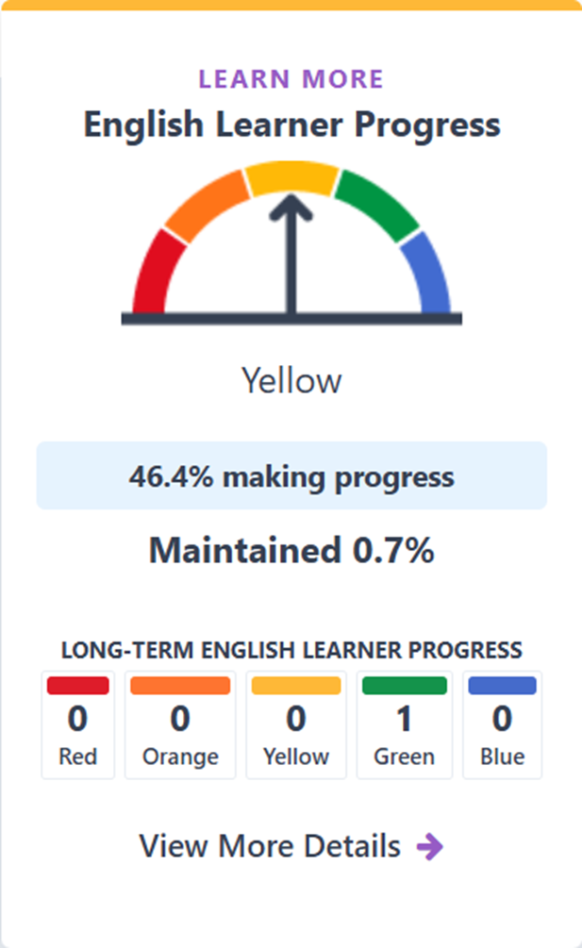
English Learner Progress Indicator Overview
Grades 1-12
The ELPI shows the percentage of current English learners making progress towards English language proficiency or maintaining the highest performance level on the Summative English Language Proficiency Assessments for California (ELPAC) or Summative Alternate ELPAC.

Slide 72
LTEL/ELPI Request from SBE
The SBE requested that schools and districts be given credit on the ELPI for LTEL students who are reclassified fluent English proficient (RFEP) during the academic year.
RFEPs were included in the ELPI calculation for ELs on the first Dashboard in 2017.
However, on October 9, 2018, the U.S. Department of Education (ED) denied the CDE’s waiver to include the RFEPs in the ELPI.

Slide 73
How LTEL RFEPs Would Be Added to ELPI
Who is included:
LTEL students who reclassify during the current academic year but do not take the current year Summative ELPAC.
What is the impact:
The number of LTEL students reclassified will be added to both the numerator and denominator of the ELPI Status calculation.
This methodology can only raise the school/district Status rate.
This addition of the RFEPs to the LTEL student group will not be applied to the overall ELPI.

Slide 74
Proposed ELPI Status Formula for LTELs
LTEL Students that Increased an ELPI Level or maintained the Highest ELPI Level or reclassified during the current academic year (but did not taking the current year Summative ELPAC)
Divided by
All LTEL Students with Prior Year and Current Year Summative ELPAC Results plus LTEL students reclassified in the current academic year

Slide 75
Example: Methodology for Reclassified Fluent English Proficient Students Inclusion
Example, Gershon High School had 74 LTEL students with current year and prior year Summative ELPAC results.
Methodology | Increase an ELPI Level | Maintain the Highest Level | Decrease an ELPI Level | Maintain a Level Other than the Highest Level | RFEP | ELPI Status Rate
RFEP included | 27 | 18 | 13 | 16 | 11 | 65.9%
Current | 27 | 18 | 13 | 16 | N/A | 60.8%

Slide 76
Change in N-Size Criteria
Adding in RFEPs had an impact on the number of schools and districts meeting the n-size to receive a performance color.
Entity | 2025 ELPI - Entities Meeting N-Size | Simulation- Entities Meeting N-Size Districts | Difference with the Addition of RFEPs
Districts | 564 | 579 | +15
Schools | 1,960 | 2,165 | +205
Charters | 315 | 361 | +46
Non-Charters | 1,645 | 1,804 | +159
DASS | 175 | 190 | +15
Non-DASS | 1,785 | 1,975 | +190

Slide 77
2025 Performance Color Results for LTELs on ELPI with the Addition of RFEPs
Performance Color | Schools | Schools (+ RFEP) | Districts | Districts (+ RFEP) | State | State (+RFEP)
Blue | 437 | 664 | 103 | 156 | n/a | n/a
Green | 473 | 537 | 182 | 108 | 1 | 1
Yellow | 305 | 302 | 98 | 96 | n/a | n/a
Orange | 456 | 482 | 134 | 107 | n/a | n/a
Red | 289 | 180 | 47 | 32 | n/a | n/a
Total | 1,960 | 2,165 | 564 | 579 | 1 | 1

Slide 78
Overview of RFEP Simulation Results
The number of schools (+205) and districts (+15) included in the ELPI increased.
Despite the increase in the number of schools and districts in the ELPI, there was a decrease in schools (-109) and districts (-15) in the Red performance level.
Additionally, there was an increase in the schools (+227) and districts (+53) in the Blue performance level.

Slide 79
CPAG Feedback on LTEL/ELPI
•Turn & Talk (5 minutes and Share)
Do you agree with adding RFEP students to the ELPI calculation for the LTEL student group?
Are there any additional questions, clarifications, and concerns needed?

Slide 80
Priority 1: Teacher Data

Slide 81
Priority 1: Teacher Data Background (1)
The 2022, 2023, and 2024 Dashboards include information about teacher assignments in compliance with California Education Code (EC) Section 52064.5(e)(2) which requires that:
"The standards for local indicators for which the department collects or otherwise has access to relevant and reliable school-level data for all schools statewide shall, to the extent practicable, be based on objective criteria, which may include, but are not necessarily limited to, the extent of any disparities across school sites within a school district or county office of education or performance relative to statewide data.”

Slide 82
Priority 1: Teacher Data Background (2)
In 2023, the SBE adopted displaying information from the 2021–22 Teacher Assignment Monitoring Outcomes (TAMO) reports within Local Measure Priority 1.
The SBE updated the self-reflection tool for Priority 1 to be consistent with the addition of statewide data related to the assignment of teachers.
In 2024, the CDE continued to provide technical and policy support to LEAs for these reports and similar reports on the School Accountability Report Card (SARC).
The 2025 and 2026 Accountability Workplans provide the SBE an opportunity to further refine prior work on adding teacher assignment data to the Dashboard at the school level. Specifically, SBE members requested that the CDE review options for expanding these data to make them more accessible from the homepage of the Dashboard and provide further disaggregated information at the school level.

Slide 83
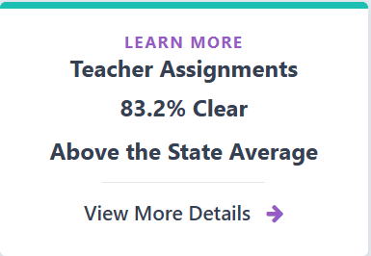
Current Teacher Assignment Display on Main Dashboard Page

Slide 84
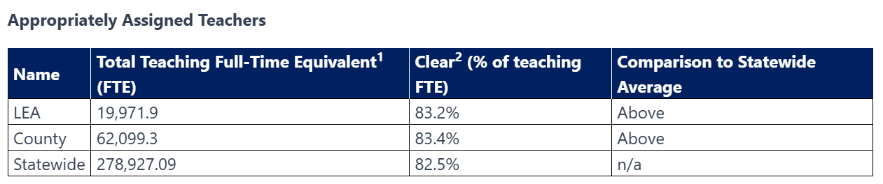
Current Appropriately Assigned Teachers Display Within Local Indicators (1)
¹The data in this table is based on full-time equivalent (FTE) status. One FTE equals one staff member working full-time; one FTE could also represent two staff members who each work 50 percent of full-time.
²"Clear" refers to the percentage of full-time equivalent teachers who are Fully Credentialed (Preliminary or Clear) for Subject and Student Placement (properly assigned). An assignment describes a position based on its setting, subject, and grade level.

Slide 85
Current Appropriately Assigned Teachers Display Within Local Indicators (2)
The Dashboard also includes a direct link to the school and/or district report on DataQuest as follows:
For additional information about appropriately assigned teachers at schools within this local educational agency, please visit the Dataquest Teaching Assignment with School Data report at (links to specific school or district report).

Slide 86
Educational Partner Engagement
Representatives from educational management organizations, civil rights and equity groups were brought together in early 2026 to obtain feedback on teacher data on the Dashboard. The topics for this discussion included the following:
Feedback on the new Teacher Assignments card on the LEA and school Dashboard pages
Ideas for realizing statutory direction around the extent of any disparities in teacher assignments between schools within an LEA
Suggestions on how teacher data terminology might be aligned, specifically across the SARC, TAMO and the Dashboard

Slide 87
Educational Partner Feedback (1)
The new Teacher Assignments card and accompanying LEA details are being used to support teacher quality conversations among equity groups and community-based organizations.
It is important to consider rural LEAs and their schools, as well as county office of education-run court and community schools, as these settings can face unique staffing challenges.
The term “Clear” on the Dashboard is somewhat confusing, given that it does not indicate teachers that hold a clear credential.
The Every Student Succeeds Act term “Ineffective” on the Teacher Assignment Monitoring Outcomes on DataQuest is unpopular among many interest holders, as it is seen as pejorative to temporary permit holders and misassigned educators serving in California classrooms.

Slide 88
Options for Consideration (1)
In order for the SBE to provide direction to align terminology and display intra-district/county teacher credentialing and assignment data on the Dashboard, the following options were developed in response to educational partner feedback:
Align Terminology: Change “Clear” on the Dashboard to “Fully Credentialed and Properly Assigned” on the Teacher Assignments card as well as on the Local Indicators Dashboard page. Request that the CDE consider terminology updates to the TAMO reports to align with the Dashboard terms, as it deems appropriate considering TAMO’s use of federally required terminology.
There was broad support at the SBE meeting for this change in terminology.

Slide 89
Options for Consideration (2)
Intradistrict Comparison: Add a second teacher assignment data table to the LEA local indicators page to meet the statutory requirements.
Note: Single school LEAs (e.g., charters, single school districts) would not have a second table as there are no comparisons possible

Slide 90
Sample Table: Intra-district Comparison of Fully Credentialed and Properly Assigned Teachers
School Type | Count of Schools | Highest Percentage Fully Credentialed and Properly Assigned | Lowest Percentage Fully Credentialed and Properly Assigned
Elementary | 43 | 100% | 65%
High | 8 | 97% | 69%
Middle | 12 | 95% | 55%

Slide 91
Educational Partner Feedback (2)
Various interest holders provided additional feedback to the SBE at its March 2026 meeting, specific to the table:
The proposed data table is duplicative of information already provided on DataQuest
Add a row to the data table for alternative or Dashboard Alternative School Status schools
Add a column to the table to present the statewide average for elementary, middle, high and alternative schools.

Slide 92
CPAG Feedback on Priority 1
How else could we look at disparities across school sites?
When does it make sense to compare within an LEA, and when does a statewide comparison feel more appropriate?
Do you have thoughts around considering elementary, high, continuation and charter school contexts?
What would be reasonable parameters on displaying data?
If only 1 school per type – do you display it?
Is there any additional feedback you'd like to share on the change in terminology?

Slide 93
Science as Full State Indicator

Slide 94
Science Indicator Dashboard Principles
Principle 5: Values high performance and growth equally.
Principle 8: Reflects technical quality through measures that are valid and reliable.
Principle 11: Is subject to continuous revision and improvement.

Slide 95
2026 Workplan for Science Indicator
Subject | March 2026 CPAG Meeting | May 2026 SBE Meeting | July 2026 SBE Meeting
Consideration of the Science Indicator as a full indicator | CPAG provides feedback on full state indicator status for Science | SBE will consider full state indicator status for Science | SBE will incorporate any decisions into revised criteria for state assistance determinations

Slide 96
Background of Science on the Dashboard
July 2024 SBE meeting
SBE adopted the criteria for the Science Indicator and the addition of Science to the Dashboard Distance from Standard (DFS) Methodology
Include a participation rate within the metric starting with the 2025 Dashboard
March 2025 SBE Meeting
SBE modified the measurement of the Science Indicator to Science Points
SBE adopted cut scores for status and change and the five-by-five performance color grid
November 2025
The Dashboard published the Science Indicator with full colors

Slide 97
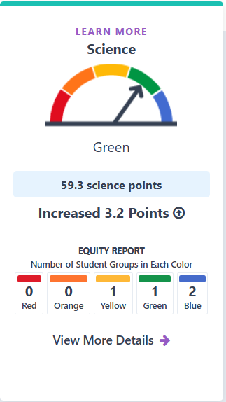
Science on the Dashboard
Measurement of achievement on the California Science Test (CAST) and the California Alternate Assessment (CAA)
2025 Dashboard had performance colors for the first time
SBE adopted Science Points, a distinct metric for the Science Indicator, that sets the reference point to the lowest point value of Level 1. Scores range from 0-100.

Slide 98
Considering Science as a Full State Indicator
At the May 2025 SBE meeting, the following options were considered for the Science Indicator and inclusion in the Local Control Funding Formula (LCFF) Eligibility Criteria:
Option 1: Add the Science Indicator as a State Indicator for one of the eight state Priority Areas
Option 2: Add the Science Indicator as a Local Indicator for one of the eight state Priority Areas
Option 3: The Science Indicator is used for information purposes only and does not impact LCFF Eligibility Determinations
Option 4 (Introduced by the SBE in May): Add Science as a Local Indicator that eventually transitions into a State Indicator after a certain amount of time.
The SBE delayed action until 2026.

Slide 99
Science as a Full State Indicator
Front Page of the Dashboard
No longer for informational purposes
Implications for State Support Determinations
Differentiated Assistance
Implications for Federal Support Determinations
Comprehensive Support and Improvement (CSI)
Additional Targeted Support and Improvement (ATSI)
Targeted Support and Improvement (TSI)

Slide 100
Science and March CPAG Meeting
CPAG will provide discussion and feedback on adding the Science Indicator as a full state indicator beginning with the 2026 Dashboard.
Full state indicator status adds the Indicator to state and/or federal support determination criteria.

Slide 101
Growth as Full State Indicator

Slide 102
Student Growth Dashboard Principles
This work aligns with the following Dashboard Principles:
Principle 2: Reports opportunity and performance gaps among student groups through the Equity Report that is available for each state indicator.
Principle 4: Values each indicator equally.
Principle 5: Values high performance and growth equally.
Principle 8: Reflects technical quality through measures that are valid and reliable.
Principle 11: Is subject to continuous revision and improvement.

Slide 103
2026 Workplan for Growth
Subject | March 2026 CPAG Meeting | May 2026 SBE Meeting | July 2026 SBE Meeting
Consideration of the student-level growth model for grades 4 through 8 in ELA and Mathematics as a full indicator | CPAG feedback about full state indicator status for ELA Growth and Math Growth | SBE will consider full state indicator status for ELA Growth and Math Growth | SBE will incorporate any decisions into revised criteria for state assistance determinations

Slide 104
Timeline for Growth on the Dashboard
December 2016
Began development of Student Level Growth Model.
May 2021
SBE adopted the current growth model.
January 2025
CDE released the initial set of ELA and Mathematics growth data using three years of assessment data from 2021–22, 2022–23 and 2023–24.
July 2025
SBE adopted the Growth Performance Categories for the 2025 Dashboard.

Slide 105
What is Growth
Growth data measures the year-to-year improvement in students' assessment scores in ELA and mathematics.
Aggregate student growth scores show average growth for students within a school, local educational agency, or student groups.
Components of Dashboard Growth:
Growth Score (numerical score above/below average)
Growth Performance Category

Slide 106
Growth Performance Categories
Category | Cut Score
Minimal Growth | 20.1 points below or fewer
Moderate Growth | 20 points below to 5.1 points below or fewer
Average Growth | 5.0 points below to 4.9 points above or fewer
Accelerated Growth | 5.0 points above to 19.9 points above or fewer
Exceptional Growth | More than or equal to 20 points above

Slide 107
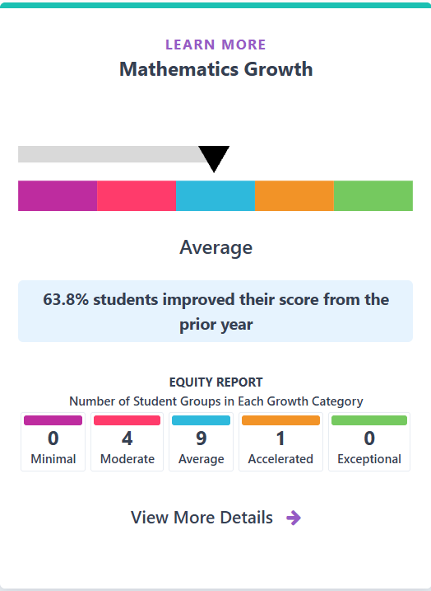
Growth on the 2025 Dashboard
Performance Category
Based on the growth score
Equity Report
Extra information
Percent of students who improved their score from the prior year

Slide 108
Growth as a Full State Indicator
Front Page of the Dashboard
No longer for informational purposes
Implications for State Support Determinations
Differentiated Assistance
Implications for Federal Support Determinations
Comprehensive Support and Improvement (CSI)
Additional Targeted Support and Improvement (ATSI)
Targeted Support and Improvement (TSI)

Slide 109
Growth and March CPAG Meeting
CPAG will provide discussion and feedback on adding the ELA and Math Growth as a full state indicator beginning with the 2026 Dashboard.
Full state indicator status adds the Indicator to state and/or federal support determination criteria.

Slide 110
CPAG Feedback on Science/Growth
Use the handouts to brainstorm feedback (20 minutes)
Provide feedback on adding Science and Growth data as a full indicators:
Pros of adding Science as a full indicator (4 minutes)
Cons of adding Science as a full indicator (4 minutes)
Pros of adding Growth as a full indicator (4 minutes)
Cons of adding Growth as a full indicator (4 minutes)
Reconvene to share highlights from the exercise (5 minutes)

Slide 111
Growth Data Dashboard Display Card

Slide 112
Growth Data Display Card
SBE asked the CDE to revisit the design of the Dashboard Growth Data Card following public feedback at the January 2026 SBE meeting
Requests for the Dashboard card to include the average growth score
The percentage of students increasing their scale score from the prior year is poorly understood without context
Requests for the data on the Dashboard card to align with the growth performance category

Slide 113
Development of the Growth Dashboard Card
The CDE gathered and incorporated public feedback on the best and most effective way to display growth on the Dashboard between 2022–2024.

Slide 114
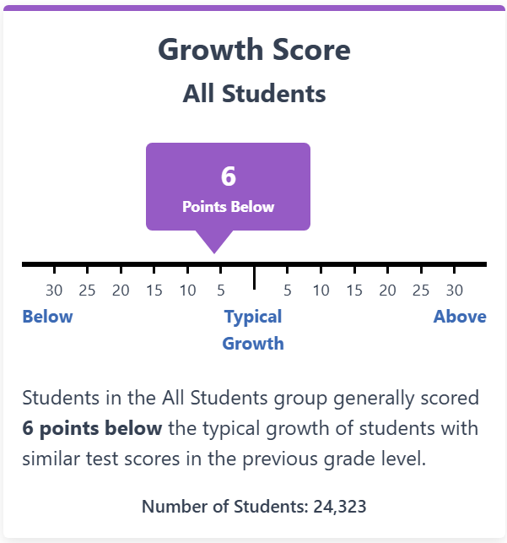
2024 Growth Dashboard Card: Growth Score
The 2024 Dashboard had a Growth Data Card that included
Average growth score
For example, 6 points below
Category of growth
For example, below typical growth
Sentence describing growth

Slide 115
2025 Growth Dashboard Card
In July 2025, the SBE modified the Growth Data Card to exclude the growth score and instead include
SBE adopted growth performance category
Percentage of students with improved scale scores from the prior year

Slide 116
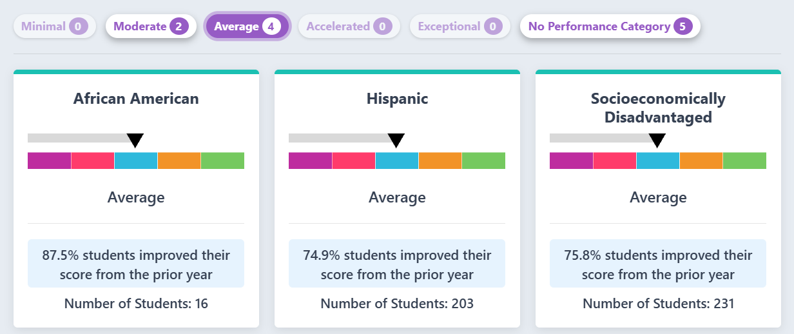
2025 Growth By Student Group

Slide 117
Differences Between 2024 and 2025 Dashboard Card
2024 Dashboard | 2025 Dashboard
Growth Score Displayed | Growth Score Not Displayed
Possible Range of Growth Score Displayed | Percentage of Students with Improved Scale Scores From the Prior Year Displayed
Growth Level Descriptors | SBE Adopted Growth Performance Levels
Not Displayed on Front Page & No Equity Report | Displayed on Front Page with Equity Report

Slide 118
CPAG Feedback on Growth Display
Growth Display Handout and Design (10 minutes)
Choose your own pieces of content to design your preferred Dashboard growth display
Reconvene to share design ideas

Slide 119
Modification of English Language Arts and Mathematic Indicator Display and Information

Slide 120
ELA and Mathematic Indicator Dashboard Principles
The work on this state indicator aligns with the following Dashboard Principles:
Principle 1: Focuses on elements that express the commitment to a well-rounded, well-supported education and makes space for what is valued locally
Principle 8: Reflects technical quality through measures that are valid and reliable
Principle 11: Is subject to continuous revision and improvement

Slide 121
2026 Workplan for ELA and Mathematic Indicator
Subject | March 2026 CPAG Meeting | May 2026 SBE Meeting
Modification of ELA and Mathematic Indicator Language and Information | CPAG provides feedback on requests to make additional modifications to the ELA and Mathematic Indicator Language and Information | SBE will consider additional modifications to the ELA and Mathematic Indicator Language and Information

Slide 122
Modification of ELA and Mathematic Indicator Language and Information
As a part of the 2026 Dashboard Workplan, the SBE tasked the CDE with investigating modifying the ELA and Mathematic achievement language and the addition of information of CAASPP performance levels.

Slide 123
Distance from Proficiency Standard

Slide 124
Update on the Impact of the SBE’s Modification of the Distance from Standard
The SBE has directed the CDE to:
Ensure that the October 2026 Dashboard uses the term Distance from Proficiency Standard rather than Distance from Standard.

Slide 125
Background on Distance from Standard
The Academic ELA and Math Indicators used “Distance from Standard” (DFS) to measure CAASPP results on the Dashboard for accountability purposes.
DFS represents the “distance” between a student’s score on the Smarter Balanced Summative Assessments (SBAC) and the Standard Met Achievement Level threshold (that is, the lowest threshold scale score for Level 3).

Slide 126
Achievement Level Descriptors
Achievement Level | Prior ALD Labels | Newly Adopted ALD Labels
Level 1 | Standard Not Met | Minimal
Level 2 | Standard Nearly Met | Developing
Level 3 | Standard Met | Proficient
Level 4 | Standard Exceeded | Advanced
At the March 2025 SBE meeting, the SBE approved a revision to the reporting achievement level descriptors (ALD) and labels for the CAST and the CAASPP Smarter Balanced Summative Assessments for ELA and Math.

Slide 127
CPAG Feedback on "Distance from Proficiency Standard"
Are there any questions/feedback about updating the term "Distance from Standard" (DFS) to "Distance from Proficiency Standard" on the 2026 Dashboard?

Slide 128
Displaying California Assessment of Student Performance and Progress Performance Levels on the Dashboard

Slide 129
Modifying the ELA and Mathematics Indicator Dashboard Display
The SBE has directed the CDE to:
Ensure the 2026 Dashboard displays trends in student performance at all four performance levels, and a link to the LEA/school's California Assessment of Student Performance and Progress (CAASPP) page

Slide 130
Differences Between CAASPP Reporting and the Dashboard
There are multiple differences between the reporting on the CAASPP website and the California School Dashboard. Some of them include:
CAASPP includes all students who completed the assessment; Dashboard reports students who are valid test takers.
Dashboard applies special rules for Students with Disabilities referred to as District of Residence (or District of Special Education Accountability [DSEA])
Dashboard combines the performance of English Language Arts /Mathematics Smarter Balanced Summative Assessments (SBAC) and California Alternate Assessment (CAA)
Dashboard uses different inclusion criteria for accountability

Slide 131
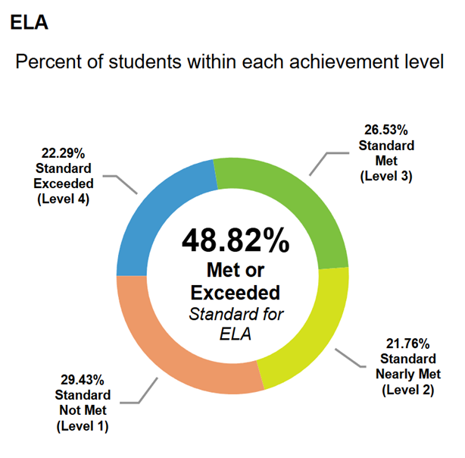
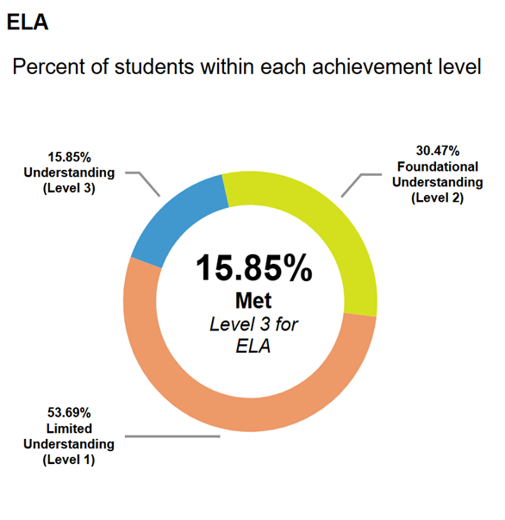
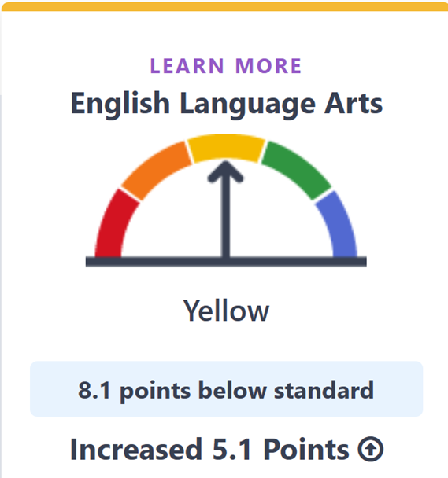
CAASPP and Dashboard Displays
SBAC: ELA
CAA: ELA
Dashboard: ELA

Slide 132
Potential Displays of CAASPP Data on the Dashboard
In order to "ensure the October 2026 Dashboard displays trends in student performance at all four performance levels," a new data reporting section will need to be created for the Dashboard
Graphics: line graph, stacked bar graph, donut display, horizontal bar graph, vertical bar graph
Table of Values: Data table

Slide 133
Location of CAASPP Data
The CAASPP trend data display does not have a specific location within the ELA and Math Indicators or within the Dashboard. The following are potential locations for the CAASPP trend data display:
Before or after the DFS trend graph within in the ELA and Math Indicators
Before or after the English Learner subgroup data comparisons within the ELA and Math Indicators
In the Informational Purposes section of the Dashboard

Slide 134
CPAG Feedback on Adding CAASPP Levels to the Dashboard
Provide feedback for displaying CAASPP levels on the Dashboard and select a preferred display
Pros of displaying CAASPP levels
Cons of displaying CAASPP levels
Location of the CAASPP displays
Display types
Reconvene to share feedback from the activity

Slide 135
Appendix 1
Slide 19:
The frequency bar graph shows the number of hours reported by LEAs for students completing internships between 2020–21 and 2024–25.
The X-axis is represented by the number of hours reported by LEAs in pre-set hour intervals. The Y-axis is represented by the number of students within each interval of hours.
The hour intervals of 0, 1, 61-70, 81-90, and 201+ have less than 5,000 students each.
The hours intervals of 2-3, 4-5, 6-10, 11-20, 21-30, 31-40, 41-50, 51-60, 71-80, 91-100, and 151-200 have between 5,000 to 10,000 students each.
The hour interval of 101-150 has more than 15,000 students.

Slide 136
Appendix 2
Slide 22:
The frequency bar graph shows the number of hours reported by LEAs for students completing Student-Led Enterprises between 2020–21 and 2024–25.
The X-axis is represented by the number of hours reported by LEAs in pre-set hour intervals. The Y-axis is represented by the number of students within each interval of hours.
The hour intervals of 1, 2-3, 4-5, 21-30, 31-40, 51-60, 61-70, 71-80, 81-90, 91-100, and 151+ have less than 3,000 students each.
The hours intervals of 0, 6-10, 41-50, and 101-150 have between 3,000 to 5,000 students each.
The hour interval of 11-20 has more than 5,000 students

Slide 137
Appendix 3
Slide 25:
The frequency bar graph shows the number of hours reported by LEAs for students completing SWBL between 2020–21 and 2024–25.
The X-axis is represented by the number of hours reported by LEAs in pre-set hour intervals. The Y-axis is represented by the number of students within each interval of hours.
The hour intervals of 21-30, 31-40, 41-50, 51-60, 61-70, 71-80, 81-90, 91-100, and 151+ have less than 10,000 students each.
The hours intervals of 0, 1, 2-3, 4-5, 6-10, and 11-20 have between 10,000 to 25,000 students each.
The hour interval of 101-150 has more than 25,000 students

Slide 138
Public Comment

Slide 139
Public Comment Call-in Number
Phone number: 717-908-1926
Participant Access Code: 1166083#
Notes: Turn down the volume of your computer or live webcast to avoid background echoes.
When it is your turn, an operator will announce, “Please say your name and affiliation and begin public comment. Your time begins now.”

