Slide 1
Item 3-Absenteeism by Reason
DataQuest Report
December 11, 2020

Slide 2
Overview of Today’s Presentation
Reasons for another absence report
Development process
Report description
2018-19 data
Live DataQuest demonstration

Slide 3
2019 State Superintendent of Public Instruction Data Collection Workgroup
Recommended the development of a DataQuest report to:
  Better understand how much students miss school
  Better understand reasons students miss school

Slide 4
CDE Absenteeism Report Workgroup:
Focus and Goals
Identify potential issues/challenges
Clear and meaningful data
Interactive DataQuest report
Additional downloadable data files

Slide 5
CDE Absenteeism Report Workgroup:
Development and Engagement
Cross-division staff involved representing data collection and reporting
January to July
  Report content
  Reliability, clarity, accessibility
August to November
  Stakeholder preview and engagement
    Expertise in the field
    Cross-division feedback and input
  Local educational agency private preview

Slide 6
Chronic Absenteeism Reports
Chronically
Absent
Yes
All
Students
Chronically
Absent
No

Slide 7
Absenteeism by Reason Reports
Total
Days
Absent
All
Students
1+
Days Absent

Slide 8
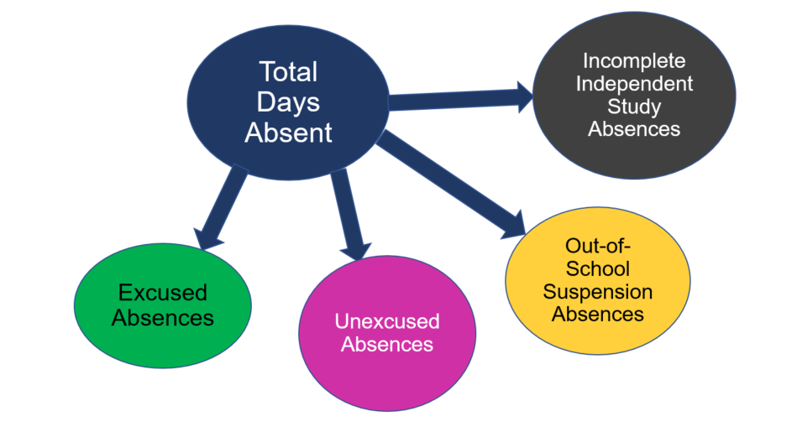
Absenteeism by Reason Reports (2)

Slide 9
Report Summary
Start with chronic absence eligible students
How many missed one or more days of school
Average number of days absent
Percent of the total days absent by type of absence
  Excused
  Unexcused
  Out of school suspension
  Incomplete independent study

Slide 10
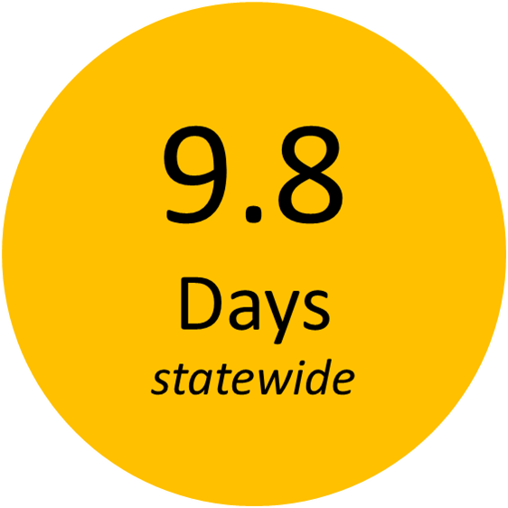
Average Days Absent
2018-19
Average
Days
Absent

Slide 11
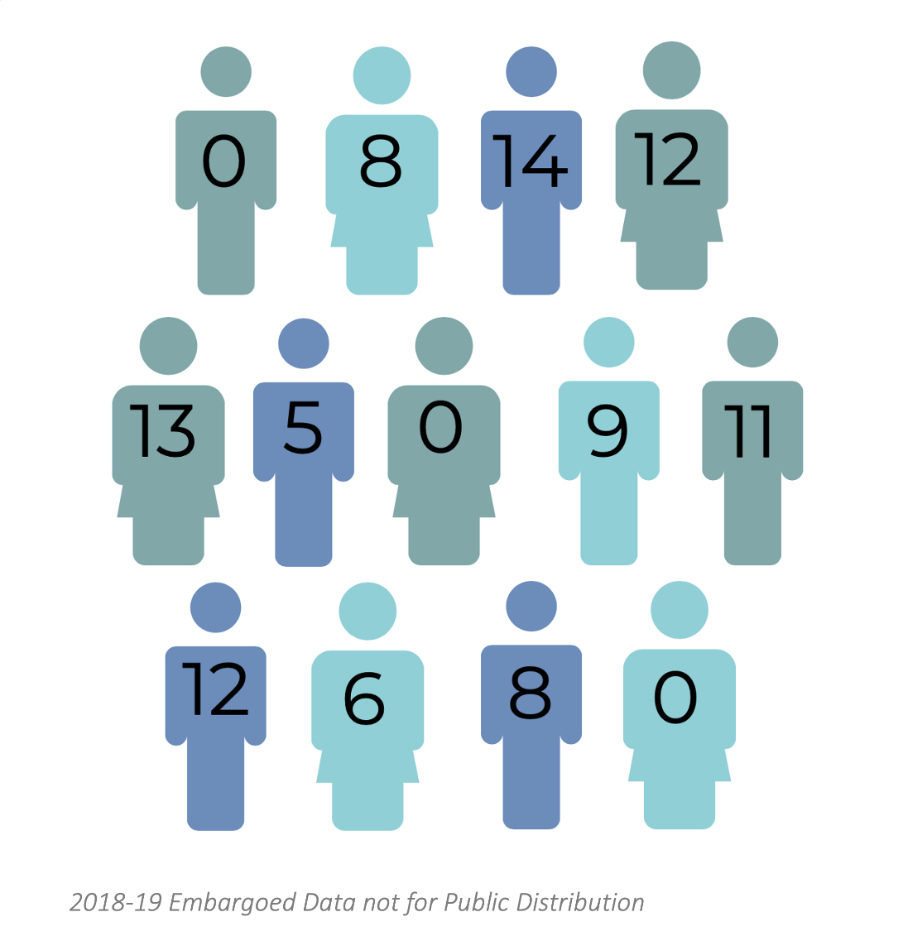
Absences for All Students
13
students

Slide 12
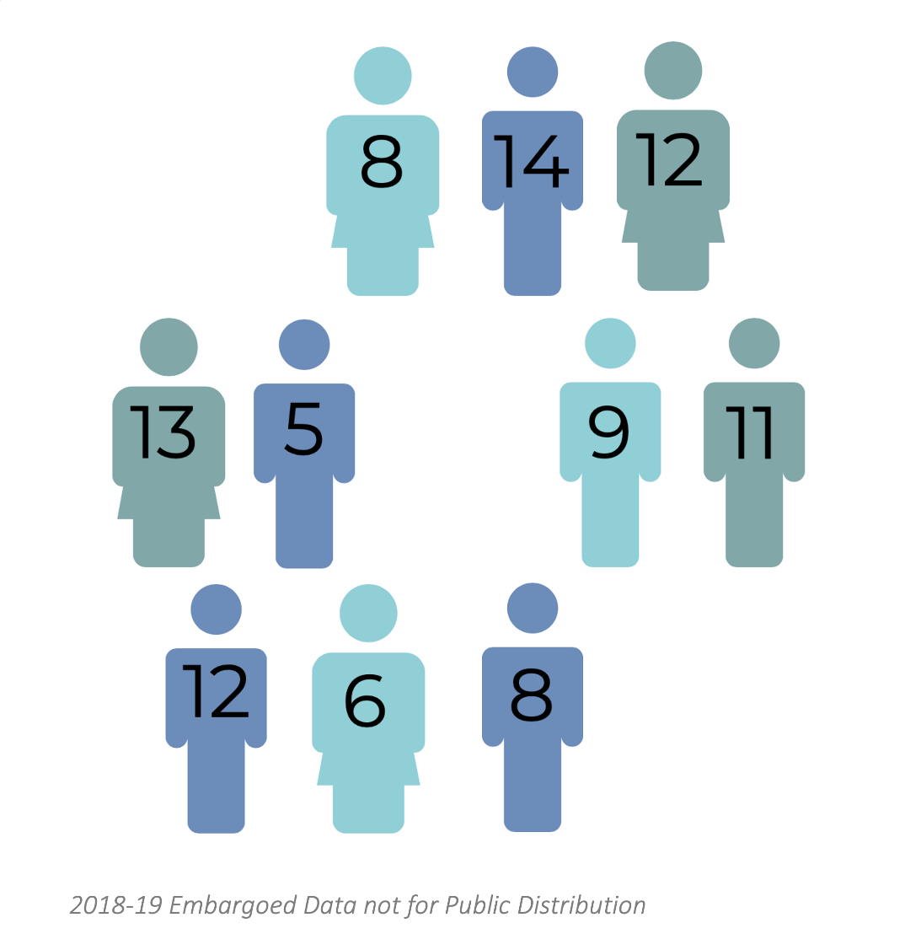
Students with One or More Absences
10
students

Slide 13

Total Days Absent
98
total
days
absent

Slide 14

Days and Students Absent
98
Days
__________
10
Students
=

Slide 15

Average Days Statewide
9.8
Average
Days
Statewide

Slide 16
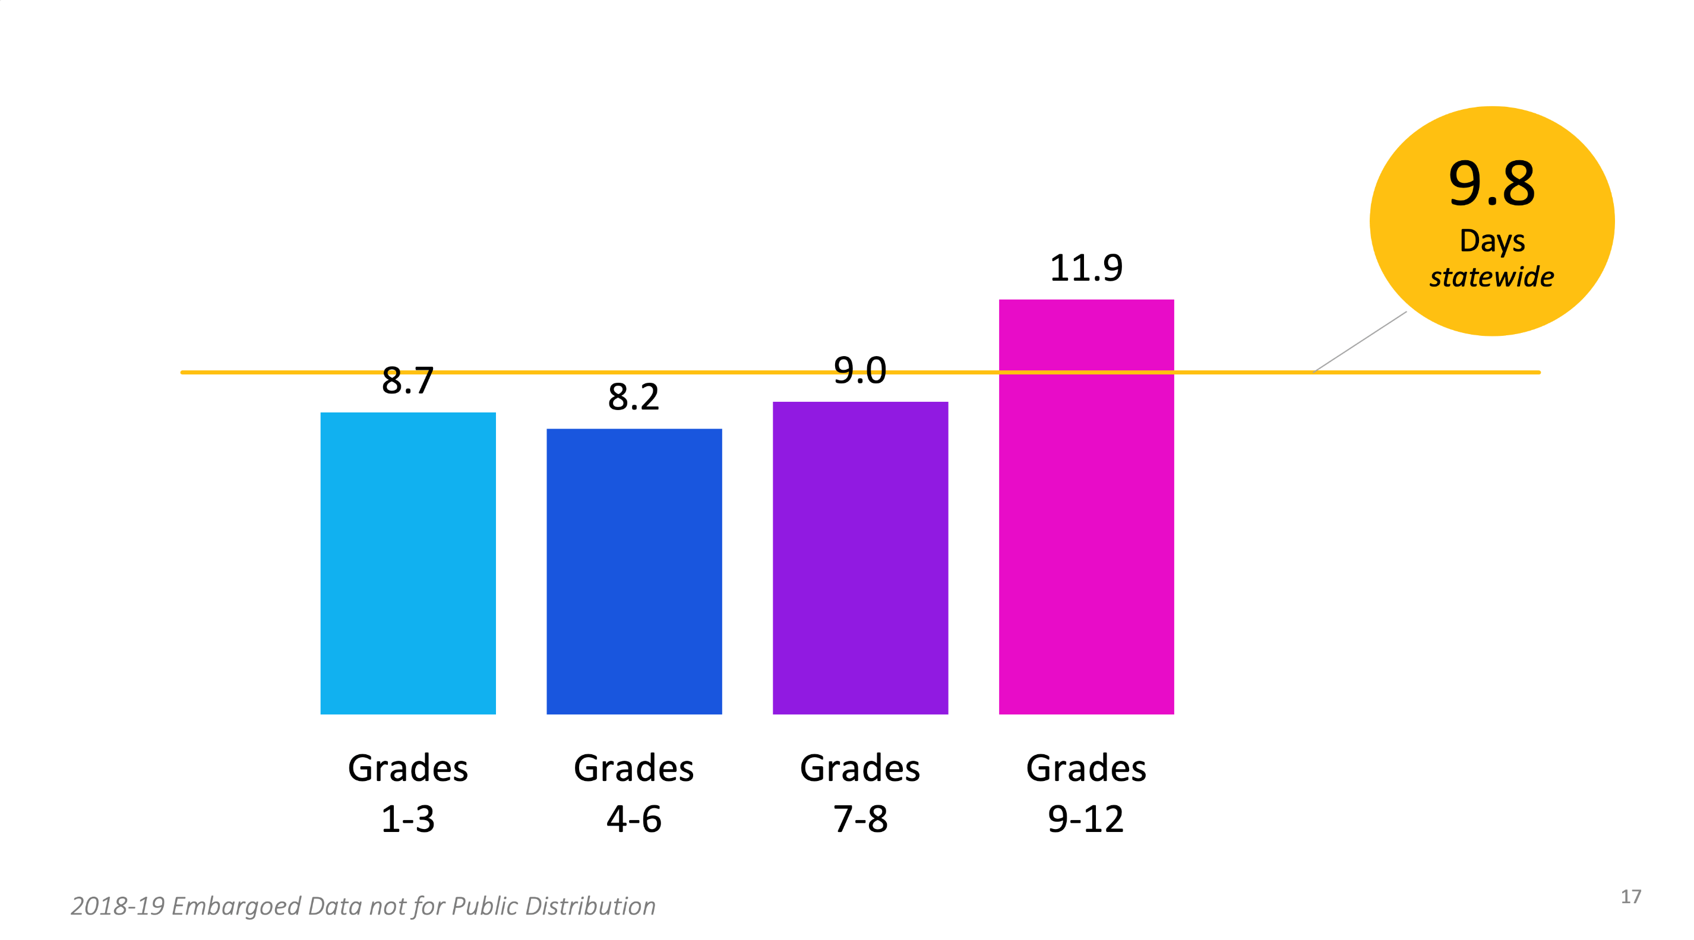
Average Days Absent 2018-19 by Grade Span

Slide 17
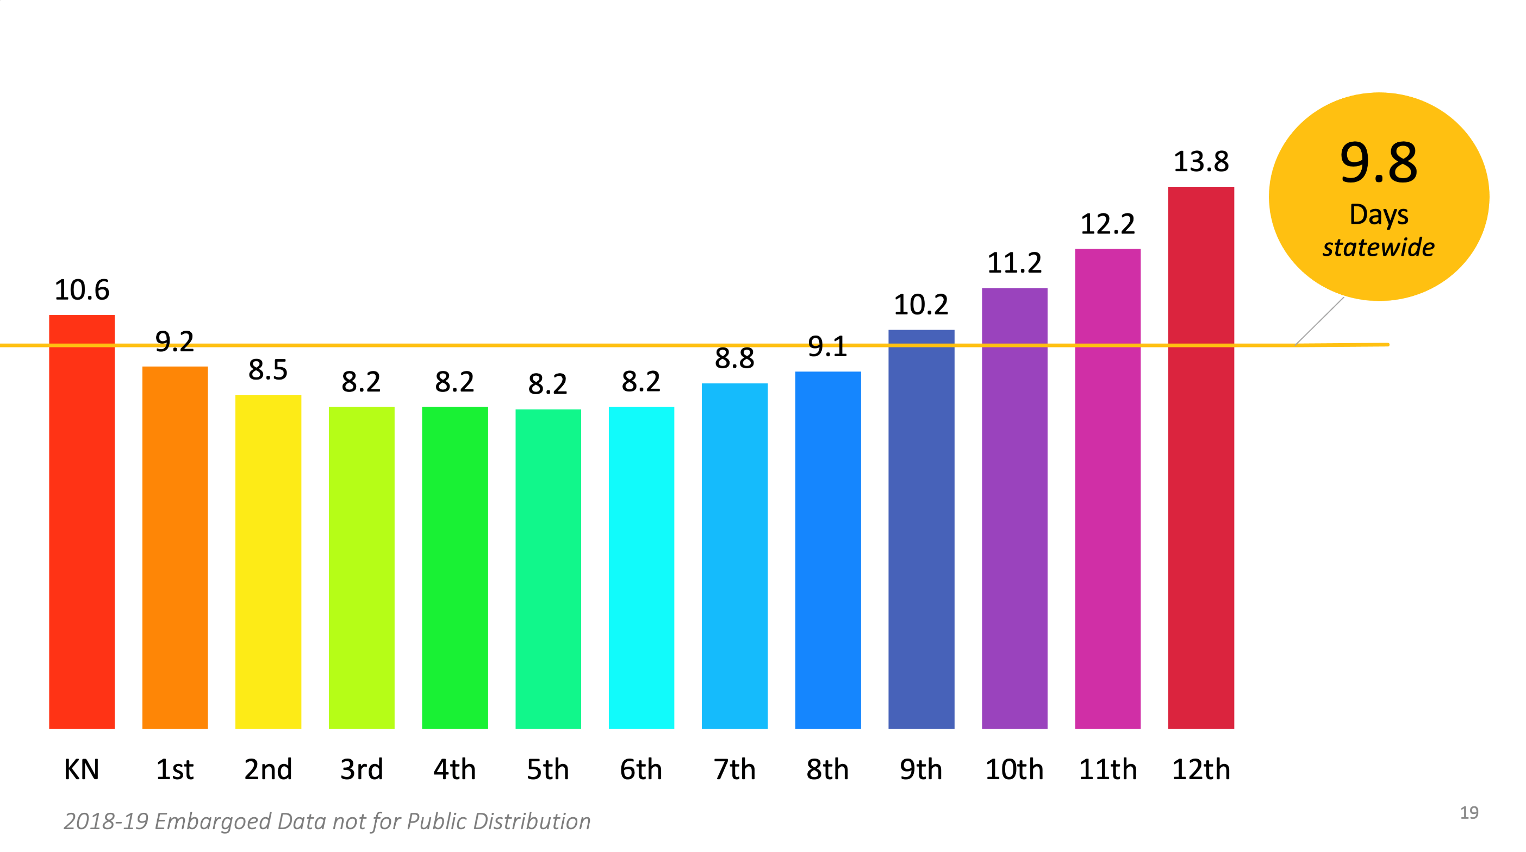
Average Days Absent 2018-19 by Grade

Slide 18
Descriptive Text for Average Days Absent 2018-19 by Grade
The image above is a graph representing average days absent statewide of 9.8 days and the following days for each grade: Kindergarten 10.6, 1st 9.2, 2nd 8.5, 3rd 8.2, 4th 8.2, 5th 8.2, 6th 8.2, 7th 8.8, 8th 9.1, 9th 10.2, 10th 11.2, 11th 12.2, 12th 13.8.

Slide 19
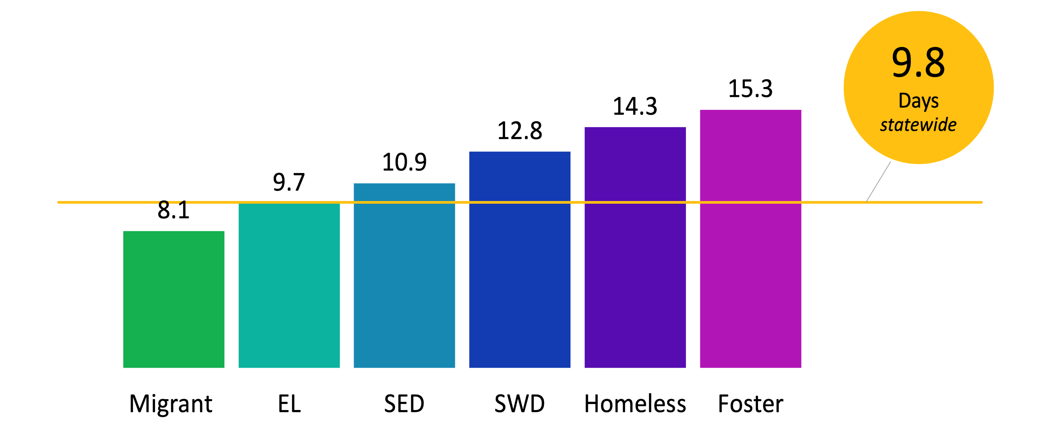
Average Days Absent 2018-19 by Student Group

Slide 20
Descriptive Text Average Days Absent 2018-19 by Student Group
The image above is of a graph representing average days absent statewide of 9.8 days and by student group with Migrant 8.1, English Learners, 9.7, Socioeconomically disadvantaged 10.9, Students with disabilities 12.8, Homeless 14.3, and Foster 15.3.

Slide 21
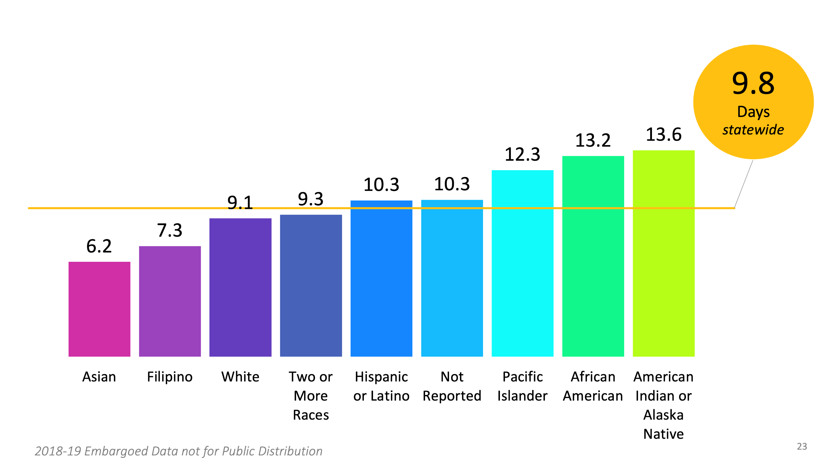
Average Days Absent 2018-19 by Race/Ethnicity

Slide 22
Descriptive Text for Average Days Absent 2018-19 by Race/Ethnicity
Image of a graph representing average days absent statewide of 9.8 days and as follows by race/ethnicity: Asian 6.2, Filipino 7.3, White 9.1, Two or More Races 9.3, Hispanic or Latino 10.3, Not Reported 10.3, Pacific Islander 12.3, African American 13.2, and American Indian or Alaska Native 13.6.

Slide 23
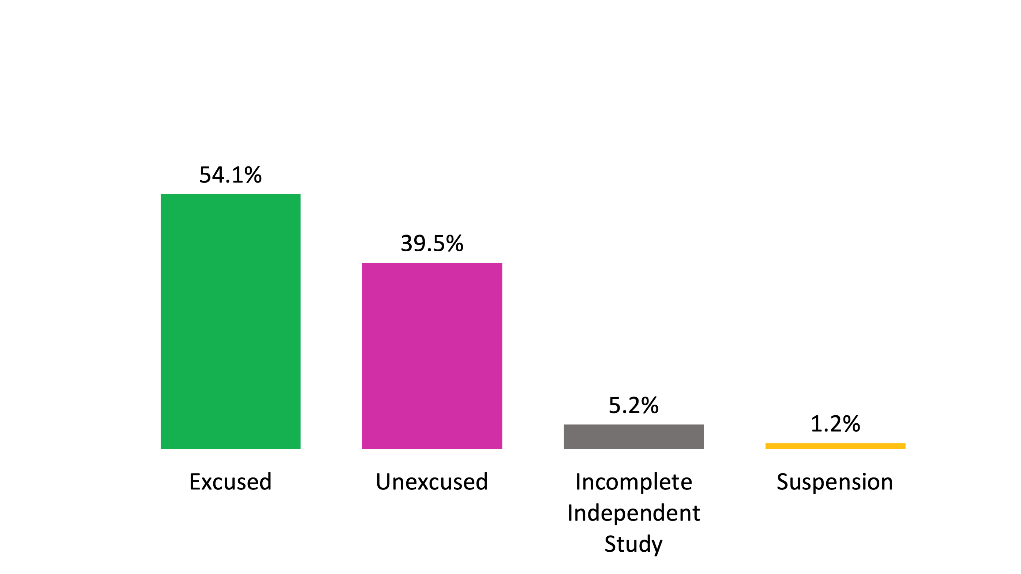
Absenteeism by Reason 2018-19

Slide 24
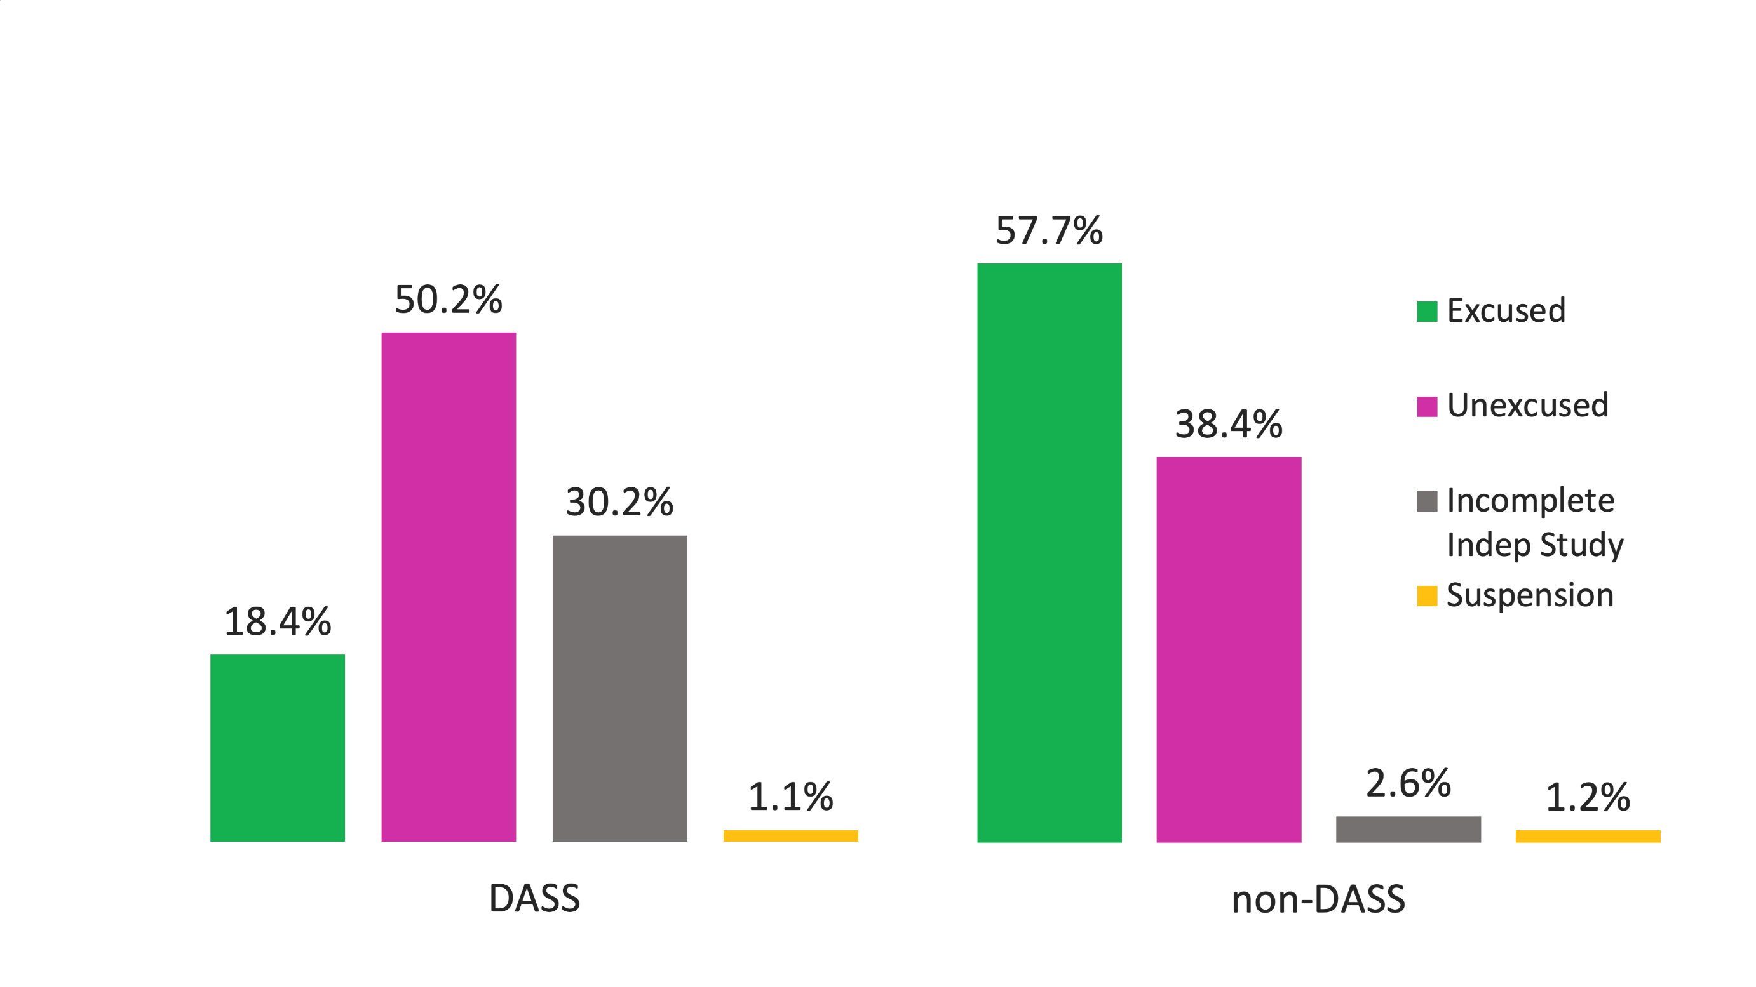
Absenteeism by Reason 2018-19
DASS and non-DASS Schools

Slide 25
Descriptive Text for Absenteeism by Reason 2018-19 DASS and non-DASS Schools
The image above is of two graphs comparing the percent of total absences statewide between DASS and non-DASS schools. For DASS Schools the percents are 18.4 excused, 50.2 unexcused, 30.2 Incomplete Independent Study, and 1.1 Suspension. For non-DASS schools the percents are 57.7 excused, 38.4 unexcused, 2.6 Incomplete Independent Study, and 1.2 Suspension.

Slide 26
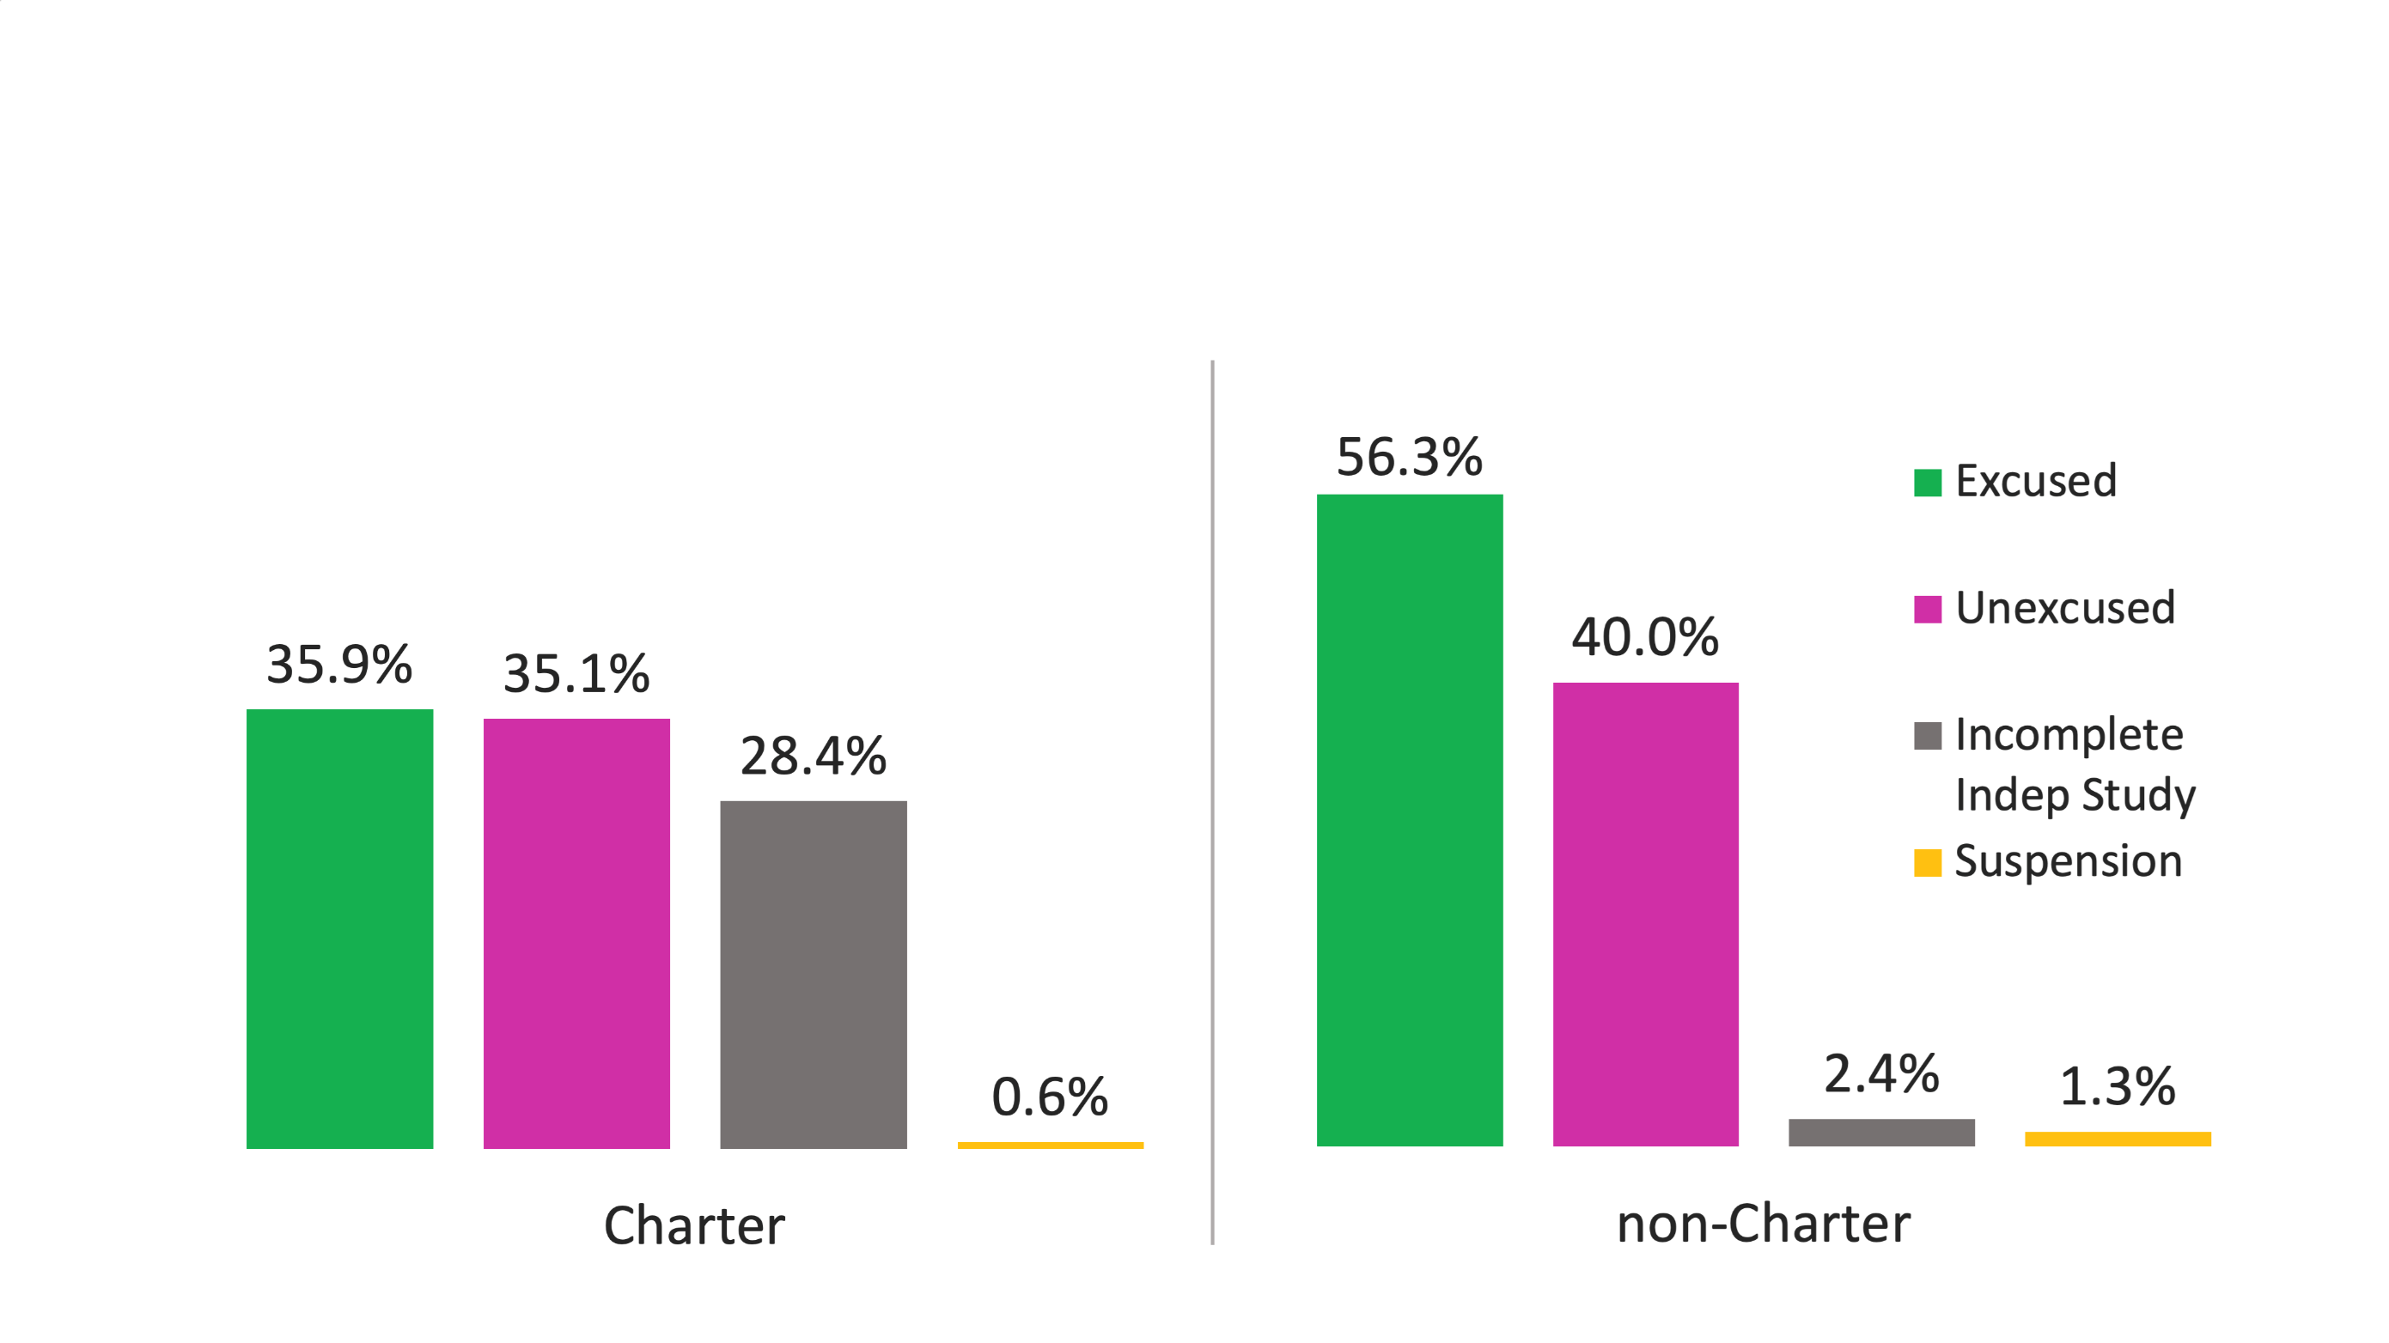
Absenteeism by Reason 2018-19
Charter and non-Charter Schools

Slide 27
Descriptive Text for Absenteeism by Reason 2018-19 Charter and non-Charter Schools
The image above is of two graphs comparing the percent of total absences statewide between Charter and non-Charter schools. For Charter Schools the percents are 35.9 excused, 35.1 unexcused, 28.4 Incomplete Independent Study, and 0.6 Suspension. For non-Charter schools the percents are 56.3 excused, 40 unexcused, 2.4 Incomplete Independent Study, and 1.3 Suspension.

Slide 28
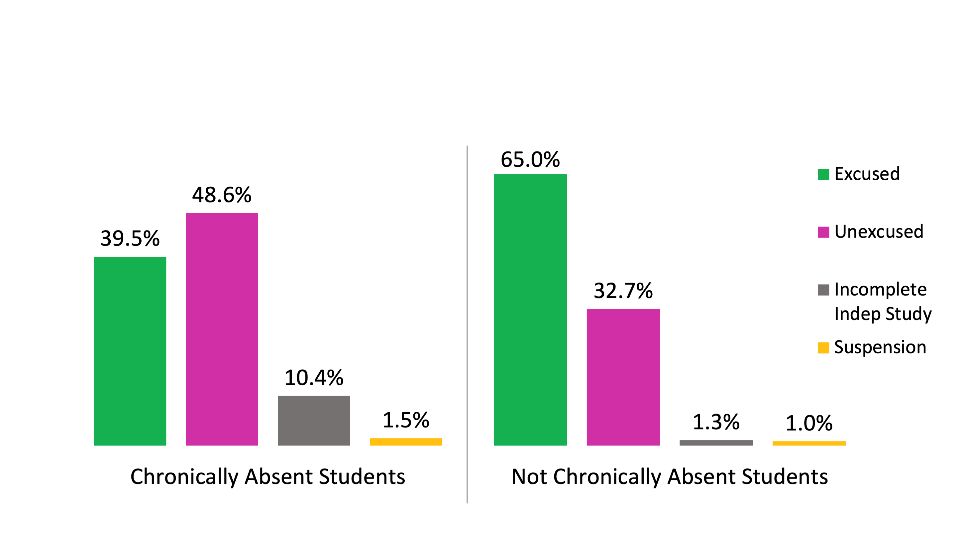
Absenteeism by Reason 2018-19
Chronically Absent and Not Chronically Absent Students

Slide 29
Descriptive Text for Absenteeism by Reason 2018-19 Chronically Absent and Not Chronically Absent Students
The image above is of two graphs comparing the percent of total absences statewide between Chronically Absent and not-Chronically Absent students. For Chronically Absent students the percents are 39.5 excused, 48.6 unexcused, 10.4 Incomplete Independent Study, and 1.5 Suspension. For not-Chronically Absent students the percents are 65 excused, 32.7 unexcused, 1.3 Incomplete Independent Study, and 1 Suspension.

Slide 30
DataQuest Report
  Eligible Cumulative Enrollment (#)
  Count of Students with one or more absences (#)
  Average days absent (#)
  Excused absences (%)
  Unexcused absences (%)
  Out of School Suspension absences (%)
  Incomplete Independent Study absences (%)
  Excused absences (#)
  Unexcused absences (#)
  Out of School Suspension absences (#)
  Incomplete Independent Study absences (#)

Slide 31
Downloadable Data Files
Additional Data
  Eligible Cumulative Enrollment (#)
  Count of Students with one or more absences (#)
  Average days absent (#)
  Excused absences (%)
  Unexcused absences (%)
  Out of School Suspension absences (%)
  Incomplete Independent Study absences (%)
  Total Days Absent (#)
  Excused absences (#)
  Unexcused absences (#)
  Out of School Suspension absences (#)
  Incomplete Independent Study absences (#)

Slide 32

DataQuest Demonstration

Slide 33

DataQuest Exploration
https://dq.cde.ca.gov/dataquest/
As a teacher, parent, administrator, or advocate, what is one thing that stands out to you or that you would like to explore more?

Slide 34
Appendix
Slide 16 Alternate Text Version
Image of a graph representing average days absent statewide of 9.8 days and by grade span with grades 1-3 of 8.7 days, grades 4-6 of 8.2 days, grades 7-8 of 9 days, and grades 9-12 of 11.9 days.

