Slide 1
California Practitioners Advisory Group
Item 2: California’s Integrated Local, State, and Federal Accountability and Continuous Improvement System: An Overview
Analysis, Measurement, and Accountability Reporting Division
February 19, 2020

Slide 2
Topics
Overview of the California School Dashboard (Dashboard) and Accountability System
Navigating the 2019 Dashboard
Resources on the Dashboard

Slide 3
Overview of the California School Dashboard and Accountability System

Slide 4
Dashboard Purpose
Supports local educational agencies (LEAs) and schools by providing information on specific indicators to identify strengths, weaknesses, and areas needing improvement.
  In-depth analyses on specific areas can be conducted using local data
Reports data for all student groups to ensure that each student group is provided the attention and services they need.
Promotes continuous improvement
  Standards established to help schools make significant progress

Slide 5
Dashboard Indicators
Six State Indicators:
  Data collected statewide from local educational agencies (LEAs) through CALPADS or outside vendors (e.g. Educational Testing Service, College Board, etc.).
  California Department of Education (CDE) uploads the data into the Dashboard
Five Local Indicators for Districts and Charter Schools; Seven Local Indicators for County Offices of Education (COEs):
  Data collected by LEAs
  LEAs upload the data into the Dashboard

Slide 6
Use of Dashboard Data
LEAs are required to use the data to inform their local control and accountability plans (LCAPs).
Schools are encouraged to use the data to inform their School Plan for Student Achievement (SPSA). However, schools eligible for support under ESSA must use the data to inform their SPSA.
The state uses both local and state indicators to identify LEAs that are eligible for support and uses state indicators to identify schools that are eligible for support. The goal is to focus on how to improve outcomes for students.

Slide 7
Local Indicators
Local Indicators
Basics: Teachers, Instructional Materials, Facilities
Implementation of Academic Standards
Parent and Family Engagement
Local Climate Survey
Access to a Broad Course of Study
Coordination of Services for Expelled Pupils—COEs Only
Coordination of Services for Foster Youth—COEs Only
LEAs (Dashboard Coordinators) are responsible for uploading information on local indicators in the Dashboard. Note: Charter schools are considered LEAs under the local control funding formula (LCFF) and are also required to upload local indicators.
Notes:
There are six state indicators
And five local indicators

Slide 8
Local Indicators: How Do You Get a Rating?
Once indicators are uploaded, the status for LEAs are automatically populated in the Dashboard:
  Met
  Not Met
  Not Met for More than Two Years
Based on whether LEAs met the following requirements:
  Annually measure progress on local performance indicators based on locally available data
  Report results at a regularly scheduled public meeting of the local governing board
  Report results to the public through the Dashboard

Slide 9
State Indicators by Grade Span
State Indicator | Grade Span
Chronic Absenteeism Indicator | K–8
Suspension Rate Indicator | K–12
Graduation Rate Indicator | 9–12
College/Career Indicator (CCI) | 9–12
Academic Indicator | 3–8 and 11
English Learner Progress Indicator Not reported in 2018 Dashboard Status only reported in 2019 Dashboard | 1–12
Notes:
Unlike the local indicators, which apply only at the LEA level and whose data are reported by the LEAs themselves, the state indicators apply to both LEAs and schools, and data are reported by the department.

Slide 10
Performance Levels (Colors)
Two years of data (Status and Change) are required to receive a performance level (color):
  Status: Current year data
  Change: Difference between current- and prior-year data
Notes:
To get a color, you need two years of data for that indicator:
The most current year of data (which is used to report the Status for that indicator)
The prior year’s data (which is used to determine whether improvement was made over the two year period)

Slide 11
N-Size Requirements
LEAs, schools, and student groups receive performance levels (or colors) for each state indicator with at least 30 students in the current and prior year.
  “30 or more” determination differs for each state indicator
Exception: LEAs receive a color for homeless and foster youth if they have at least 15 students in the current and prior year.
  Note: Charter schools are treated as schools for N-size determinations
Notes:
In order to receive a performance level, or color, for an indicator, at the LEA-, school-, or student-group level, there must be at least 30 students in both the current and prior years for that indicator.
The “30 or more” determination is different for each state indicator.
(See Table 5, page 28 of Guide)
Exception: Foster Youth and Homeless
The number of students needed in the Foster Youth and Homeless student groups to receive a performance level (color) differs at the LEA-level.
School-level: The N size for both student groups is 30 or more students. Therefore, if the school has 30 or more Foster Youth students or Homeless students, each student group will receive a performance level (or color).
LEA-level: The N size for both student groups is 15 students (not 30). Therefore, if the LEA has 15 or more Foster Youth students or Homeless students, each student group will receive a performance level (or color).
Note: Charter Schools are treated as schools (not LEAs) when it comes to reporting these two student groups. Charter schools will need at least 30 or more Foster Youth, or 30 or more Homeless students, to receive a performance level (or color) for each student group.
Less than 30 Students
The following business rules are used to report data on the Dashboard:
Between 11 to 29 Students: LEAs, schools, and students groups that have between 11 and 29 students in the denominator, in either the current or prior years, will only have Status and Change data displayed. In these instances, a performance level (or color) will not be displayed.
Less than 11 Students: Data for less than 11 students are not displayed on the Dashboard to protect the anonymity of the students.

Slide 12
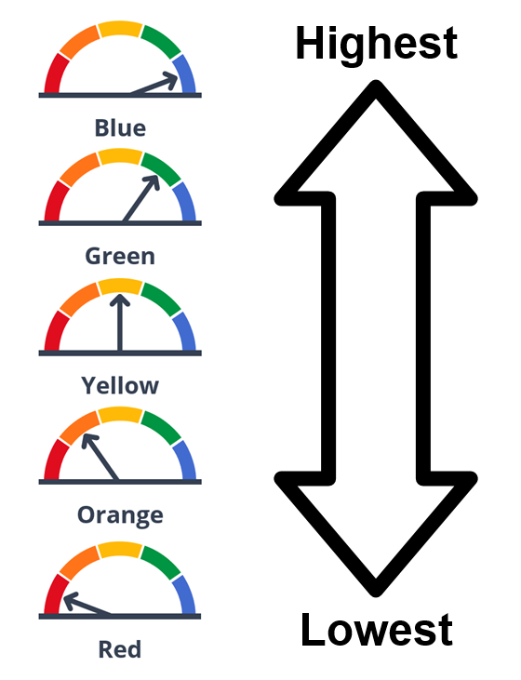
Five Performance Levels (Colors)
The image on the left is an example of the Gauge Indicators from the Highest to the Lowest.
First Gauge pointing to Blue
Second Gauge pointing to Green
Third Gauge pointing to Yellow
Fourth Gauge pointing to Orange
Fifth Gauge pointing to Red
Notes:
The Dashboard reports performance levels (or colors) for each of the state indicators at the LEA, school, and student group levels. Blue is the highest performing and red signifies the lowest performing.
But how is a color generated?

Slide 13
How Do You Get a Color?
Level | Declined Significantly from Prior Year | Declined from Prior Year | Maintained from Prior Year | Increased from Prior Year | Increased Significantly from Prior Year
Very High In Current Year | Yellow | Green | Blue | Blue | Blue
High in Current Year | Orange | Yellow | Green | Green | Blue
Medium in Current Year | Orange | Orange | Yellow | Green | Green
Low in Current Year | Red | Orange | Orange | Yellow | Yellow
Very Low in Current Year | Red | Red | Red | Orange | Yellow
The image on the left is a 5x5 table showing an example of how to get a color
Get a color (Green) by combining:
  Current year results (High), and
  Difference from prior year results (Increased)
Notes:
As we mentioned, you need two years of data for an indicator to receive a color:
The most current year of data (or Status), which is represented by the top to bottom rows on this table
The prior year’s data, which is used to show Change. This is represented in the left to right columns)
So in this example, we have a high Status level (meaning that in the current year and that performance increased from the prior year. These two levels intersect to get a Green performance level. If it had increased significantly from the prior year, or if the current year’s Status was “Very High,” the performance color would have been Blue.

Slide 14
Small Student Populations
Small student populations are more susceptible to large swings in results from year to year.
Therefore, a three-by-five table (condensed from a five-by-five table) is applied when N size is 149 or fewer at the LEA, school, and student group levels.
N size is based on different denominators, depending on the state indicator.
Notes:
To prevent large swings in results on the Dashboard from year to year, the 3 x 5 table is used for small student populations.

Slide 15
Which Indicators Are Eligible for the 3x5?
Graduation Rate: N= number of students in the combined four-and five-year graduation rate and/or the DASS graduation rate
Suspension Rate: N= number of students cumulative enrolled
Chronic Absenteeism Rate: N= number of students who meet the enrollment eligibility
CCI: N = number of students in the combined four-and five-year graduation rate and/or the DASS graduation rate

Slide 16
Grids
3x5 Grids N-Size <150
(Graduation, Suspension, Chronic, CCI)
5x5 Grids
N-Size 150 or Greater
*The 2nd columns (Increased Significantly) and 6th columns (Declined Significantly) are highlighted and grayed out to show that they have been removed from the traditional 5x5 grid to form a new 3x5 grid.
Performance Level | Increased Significantly from Prior Year | Increased from Prior Year | Maintained from Prior Year | Declined from Prior Year | Declined Significantly from Prior Year
Very Low Current Year | N/A | Green | Blue | Blue | Blue
Low Current Year | Orange | Yellow | Green | Green | Blue
Medium Current Year | Orange | Orange | Yellow | Green | Green
High Current Year | Red | Orange | Orange | Yellow | Yellow
Very High Year | Red | Red | Red | Orange | Yellow
Performance Level | *Increased Significantly from Prior Year | Increased from Prior Year | Maintained from Prior Year | Declined from Prior Year | *Declined Significantly from Prior Year
Very Low Current Year | *N/A | Green | Blue | Blue | *Blue
Low Current Year | *Orange | Yellow | Green | Green | *Blue
Medium Current Year | *Orange | Orange | Yellow | Green | *Green
High in Current Year | *Red | Orange | Orange | Yellow | *Yellow
Very High in Current Year | *Red | Red | Red | Orange | *Yellow

Slide 17
Dashboard Alternative School Status (DASS)
All DASS schools receive a Dashboard report.
Data from DASS schools are included in their LEA Dashboard report.
  Exception: Because charter schools are treated as LEAs under the LCFF, DASS charter schools are not included in their authorizers’ reports.
    All charter schools (both DASS and non-DASS) are not included in their authorizers’ reports.
  County offices of education (COEs) that serve only DASS schools receive Dashboard reports based on their DASS schools’ data.

Slide 18
Modified Methods for DASS Schools
DASS schools are held accountable for all state indicators reported in the Dashboard.
However, “modified methods” are used to fairly evaluate the success and progress of alternative schools that serve high-risk students.
  Modified graduation rate
  Modified Status level cut scores for the Academic Indicator

Slide 19
Navigating the 2019 Dashboard

Slide 20

Homepage
Image below is the example of the 2019 Dashboard Homepage. The top of the page has an image of a gauge with the arrow pointing to green. Tabs from left to right as follows:
Home
About
State Summary
Search
More Information
En Espanol
Explore information about your local school and district with a search tab.

Slide 21
Live Demonstration
The CDE California Accountability Model & School Dashboard web page has a new layout and new tabs for easier access.
  https://www.cde.ca.gov/ta/ac/cm/
    From this web page, you can access:
      Dashboard
      School Dashboard Additional Reports
Notes:
Focus on tabs
Show statewide report and additional reports.

Slide 22
Resources

Slide 23
California School Dashboard and System of Support Webpage
Parent Guide
Flyers for Parents (translated in seven languages)
Videos for Parents (English and Spanish)
Flyers for Educators
Webinar PowerPoints
Data Files for Each Indicator
https://www.cde.ca.gov/ta/ac/cm/

Slide 24
Additional Reports and Data Webpage
5x5s for Each Indicator
CCI Measures Report
Participation Rate Report
Student Group Report
District Performance by County
https://www6.cde.ca.gov/californiamodel/

Slide 25
DASS Webpage
Current list, Background, Eligibility Criteria, Application Instructions
Flyer: What is the DASS?
DASS Graduation Rate PowerPoint
DASS FAQs
https://www.cde.ca.gov/ta/ac/dass.asp

Slide 26
Whom Do I Contact?
Local Indicators:
  Dashboard Coordinators have access to the Dashboard to update local indicator data.
    Questions on local indicators and Dashboard Coordinators should be addressed to the Local Agency Systems Support Office at lcff@cde.ca.gov
State Indicators:
  Questions on state indicators and signing up to be an Accountability Coordinator should be addressed to the Academic Accountability Unit at aau@cde.ca.gov
    Accountability Coordinator listserv sign up: http://www.accountabilityinfo.org/ [The preceding link is no longer available.]

