Slide 1
Item 3: Update on the Development of a Student Growth Model for the Integrated Local, State, and Federal Accountability and Continuous Improvement System
Analysis, Measurement, and Accountability Reporting Division
February 19, 2021

Slide 2
California Has Invested Significant Time & Effort in Researching Student Growth for Accountability
2015
March
Accountability System Work begins
September
Begin technical work on growth models
2016
March
Collaboration with Education Testing Service (ETS) begins
2017
January:
SBE Meeting: Discuss criteria for selection a growth model
April:
CDE contracts with ETS for evaluation study

Slide 3
CDE Explored
Three Different Growth Models
2018
February: ETS Study Part I
https://www.cde.ca.gov/be/pn/im/documents/memo-pptb-amard-feb18item01.docx
May: SBE Approved Further Exploration Residual Gain Model
June: ETS Study Part II
https://www.cde.ca.gov/be/pn/im/documents/memo-pptb-amard-jun18item01a1.docx
ETS explored three models in Study Part I:
  Residual Gain
  Change in “Distance to Met” (Our Academic Measure)
  Conditional Percentile Ranking
Further technical evaluation
  Led to ETS Study Part II

Slide 4
SBE Pause on Growth Model
Results of studies and technical feedback led the SBE to pause the adoption of a growth model
The student-level growth model that CDE and SBE worked to develop DID NOT:
  Fit the requirements our established multiple measures accountability system
  Provide the answers/information that our various stakeholders wanted
2018
July:
State Board pauses work on growth model

Slide 5
Explored Technical Adjustments for the Residual Gain Model
2019
A Growth Model Stakeholder Group was convened for four meetings in 2019
Work from these meetings influenced CDE and SBE decisions to continue to pursue a residual gain Student Growth Model
2020
Worked on technical modifications with ETS and the Technical Design Group (TDG)
  Revised the highest obtainable scale score
  Developed new regression formula to increase accuracy and stability

Slide 6
Growth Model Work
The California Department of Education (CDE) has worked closely with the Educational Testing Service (ETS) to improve the validity and cross-time stability of the Residual Gain (RG) model, which is based on simple averages of growth measures.
ETS has developed the Empirical Best Linear Prediction (EBLP), which creates an approximate weighted average of student growth measures from multiple school years.

Slide 7
Growth Model Decisions in 2020
At the March 2020 SBE Meeting the Board approved:
  To move forward with the Residual Gain (RG) model
    Investigate how additional modifications to RG model could enhance validity and cross-time stability
At the November 2020 SBE meeting the Board affirmed:
  That the EBLP will only use the same subject area when modeling student growth (i.e., only prior ELA results will be used for ELA growth scores), and
  The maintenance of the current student-level methodology (i.e., not including additional variables), which holds the same expectations for growth for all student groups and allows comparisons of student group data.

Slide 8
Weighted Averages Under the EBLP
Gives greater weight to data from the most recent year and less weight to data from previous school years.
Weights are specific to each school and district and are dependent on the number of growth scores for that school or district.

Slide 9
Strengths and Limitations of the
EBLP Method
The EBLP increases accuracy and stability in the growth scores for schools and small student group populations.
However, it does not always increase the accuracy at the district level when larger numbers of scores are involved.
  Here, the simple average works well.

Slide 10
Recommended Hybrid Method
CDE recommends that the EBLP be applied to:
  Schools
  Student groups in a school
  The “All” student group in a district
  Student groups in a district:
    If 500 or fewer students make up the student group
For race/ethnicity and program participation student groups in a district that has more than 500 scores, will have the simple average applied.

Slide 11
LEA and School Level Growth Data by Student Group

Slide 12
Reading and Interpreting Growth Score Distributions: Data
We normally share Accountability data results in vertical percentile charts:
  0 = Minimum score observed in the data
  100 = Maximum score observed in the data
  10-90 = Score observed at each respective percentile break
Percentile | Growth Score
0 | 42.1
10 | 87.8
20 | 92.8
30 | 96.2
40 | 99.0
50 | 101.4
60 | 103.9
70 | 106.5
80 | 109.6
90 | 113.6
100 | 150.5

Slide 13
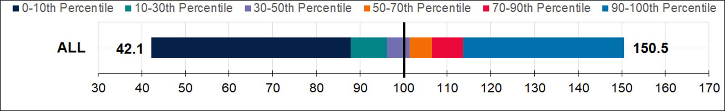
Reading and Interpreting Growth Score Distributions: Visual Charts
Today, we are sharing the same data but in a bar chart
  Each color corresponds to a range of the distribution
    i.e. Navy blue represents the zero to 10th percentile, teal the 10-30th percentile, purple the 30-50th percentile, orange the 50-70th percentile, red the 70-90th percentile, and bright blue the 90-100th percentile results
  The dark black line at 100 represents the growth score achieved if students, on average, met their expected growth

Slide 14
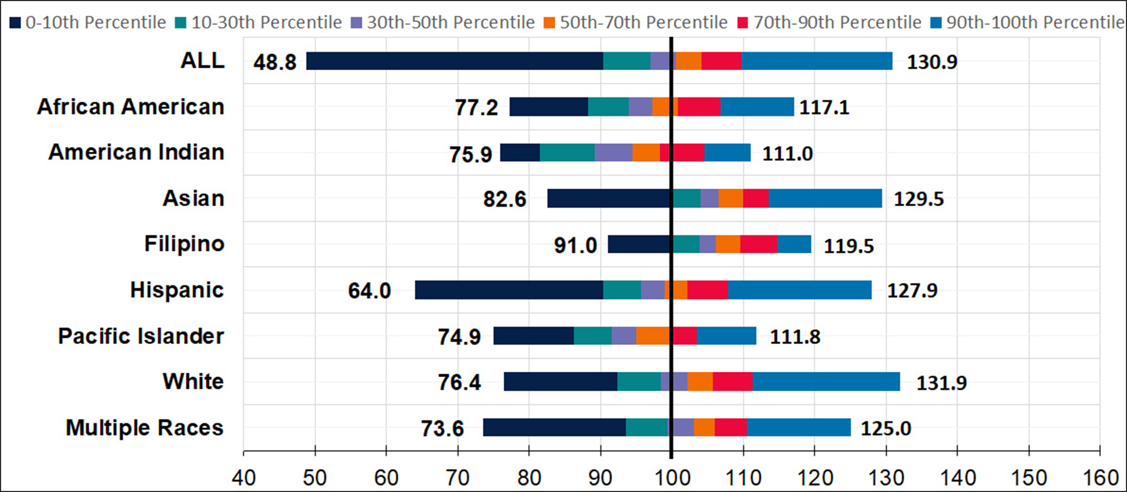
Distribution of ELA Growth Scores (LEA): Race/Ethnicity Groups

Slide 15
Distribution of ELA Growth Scores (LEA): Race/Ethnicity Groups in Table Form
Student Group | Minimum (Zero Percentile) | 10th Percentile | 30th Percentile | 50th Percentile | 70th Percentile | 90th Percentile | Maximum (100th Percentile)
ALL | 48.8 | 90.3 | 97.0 | 100.6 | 104.1 | 109.7 | 130.9
African American | 77.2 | 88.2 | 93.9 | 97.2 | 100.8 | 106.8 | 117.1
American Indian | 75.9 | 81.5 | 89.1 | 94.5 | 98.3 | 104.5 | 111.0
Asian | 82.6 | 99.7 | 103.9 | 106.5 | 110.0 | 113.5 | 129.5
Filipino | 91.0 | 99.7 | 103.9 | 106.1 | 109.5 | 114.7 | 119.5
Hispanic | 64.0 | 90.3 | 95.6 | 98.9 | 102.1 | 107.9 | 127.5
Pacific Islander | 74.9 | 86.2 | 91.5 | 94.9 | 100.0 | 103.5 | 111.8
White | 76.4 | 92.4 | 98.4 | 102.1 | 105.6 | 111.3 | 131.9
Multiple Races | 73.6 | 93.5 | 99.3 | 103.0 | 106.0 | 110.5 | 125.0

Slide 16
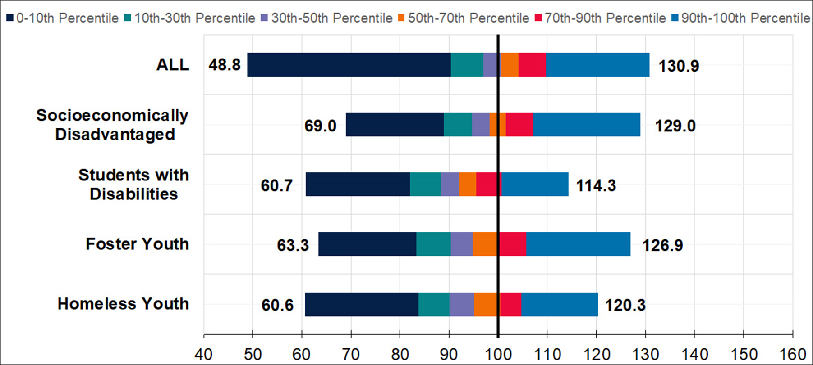
Distribution of ELA Growth Scores (LEA): Program Groups

Slide 17
Distribution of ELA Growth Scores (LEA): Program Groups in Table Form
Student Group | Minimum (Zero Percentile) | 10th Percentile | 30th Percentile | 50th Percentile | 70th Percentile | 90th Percentile | Maximum (100th Percentile)
ALL | 48.8 | 90.3 | 97.0 | 100.6 | 104.1 | 109.7 | 130.9
Socioeconomically Disadvantaged | 62.0 | 89.9 | 95.1 | 98.5 | 101.8 | 107.2 | 123.1
Students with Disabilities | 70.1 | 90.8 | 97.3 | 100.8 | 104.6 | 110.6 | 130.4
Foster Youth | 67.5 | 93.7 | 99.5 | 103.3 | 106.3 | 111.7 | 126.8
Homeless Youth | 55.4 | 85.6 | 90.7 | 94.4 | 97.6 | 102.8 | 128.8

Slide 18
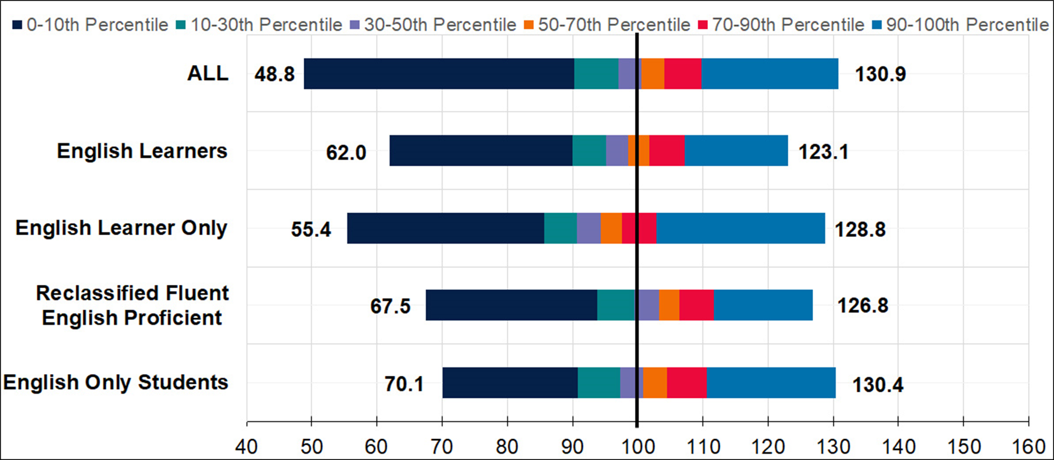
Distribution of ELA Growth Scores (LEA): English Learners

Slide 19
Distribution of ELA Growth Scores (LEA): English Learners in Table Form
Student Group | Minimum (Zero Percentile) | 10th Percentile | 30th Percentile | 50th Percentile | 70th Percentile | 90th Percentile | Maximum (100th Percentile)
ALL | 48.8 | 90.3 | 97.0 | 100.6 | 104.1 | 109.7 | 130.9
English Learners | 62.0 | 89.9 | 95.1 | 98.5 | 101.8 | 107.2 | 123.1
English Only Students | 70.1 | 90.8 | 97.3 | 100.8 | 104.6 | 110.6 | 130.4
Reclassified Fluent English Proficient | 67.5 | 93.7 | 99.5 | 103.3 | 106.3 | 111.7 | 126.8
English Language Only | 55.4 | 85.6 | 90.7 | 94.4 | 97.6 | 102.8 | 128.8

Slide 20
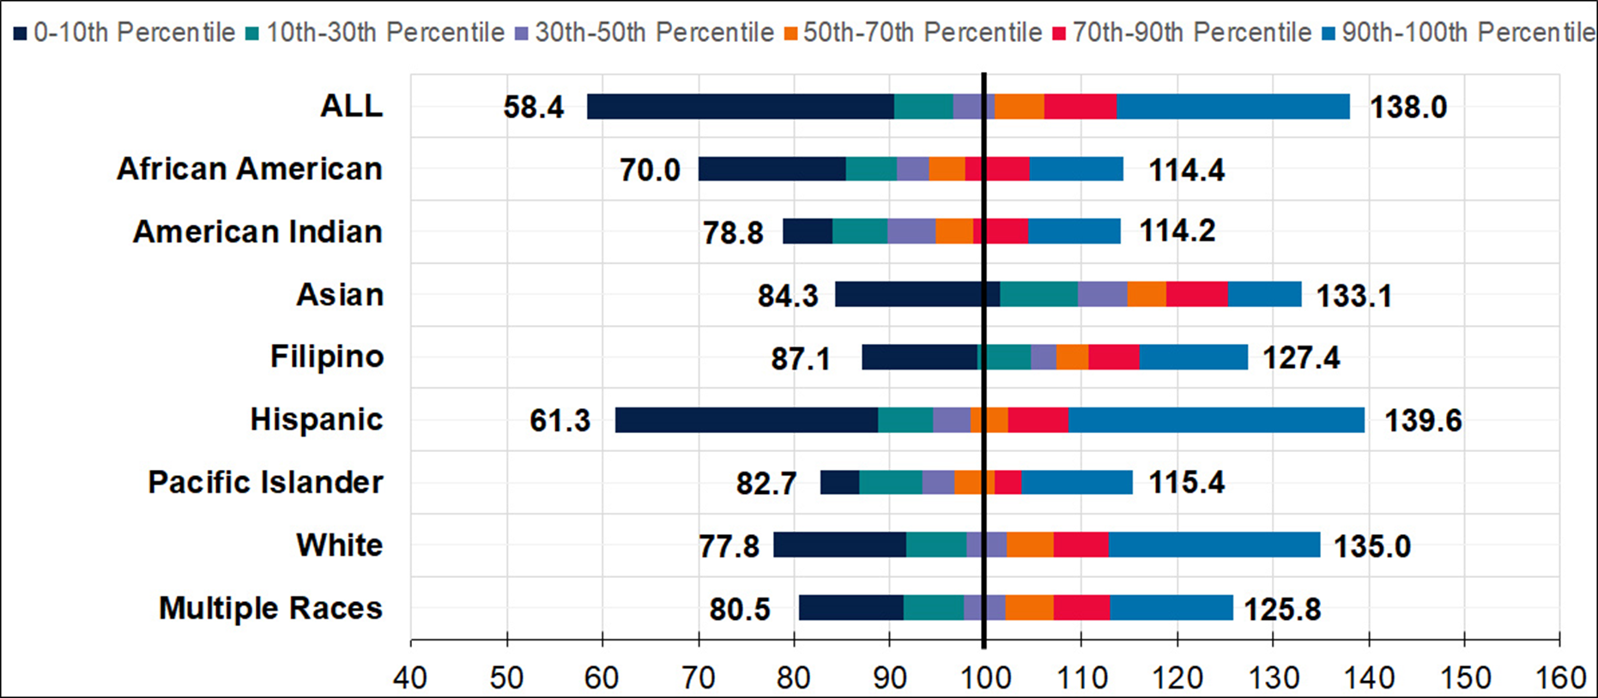
Distribution of MATH Growth Scores (LEA): Race/Ethnicity Groups

Slide 21
Distribution of MATH Growth Scores (LEA): Race/Ethnicity Groups in Table Form
Student Group | Minimum (Zero Percentile) | 10th Percentile | 30th Percentile | 50th Percentile | 70th Percentile | 90th Percentile | Maximum (100th Percentile)
ALL | 58.4 | 90.4 | 96.6 | 101.0 | 106.1 | 113.7 | 138.0
African American | 70.0 | 85.4 | 90.7 | 94.1 | 97.8 | 104.6 | 114.4
American Indian | 78.8 | 84.0 | 89.8 | 94.8 | 98.8 | 104.5 | 114.2
Asian | 84.3 | 101.4 | 109.6 | 114.8 | 118.9 | 125.3 | 133.1
Filipino | 87.1 | 99.1 | 104.7 | 107.3 | 110.7 | 116.1 | 127.4
Hispanic | 61.3 | 88.8 | 94.5 | 98.3 | 102.3 | 108.6 | 139.6
Pacific Islander | 82.7 | 86.8 | 93.4 | 96.7 | 101.0 | 103.8 | 115.4
White | 77.8 | 91.7 | 97.9 | 102.2 | 107.0 | 112.8 | 135.0
Multiple Races | 80.5 | 91.5 | 97.8 | 102.1 | 107.0 | 113.0 | 125.8

Slide 22
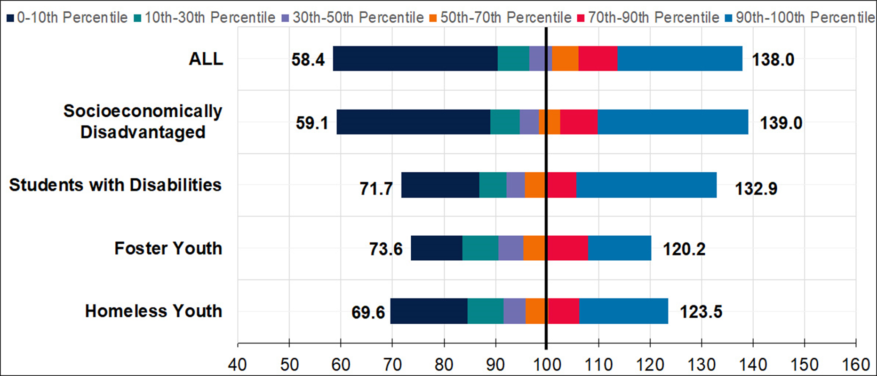
Distribution of MATH Growth Scores (LEA): Program Groups

Slide 23
Distribution of MATH Growth Scores (LEA): Program Groups in Table Form
Student Group | Minimum (Zero Percentile) | 10th Percentile | 30th Percentile | 50th Percentile | 70th Percentile | 90th Percentile | Maximum (100th Percentile)
ALL | 58.4 | 90.4 | 96.6 | 101.0 | 106.1 | 113.7 | 138.0
Socioeconomically Disadvantaged | 59.1 | 89.0 | 94.7 | 98.4 | 102.6 | 109.8 | 139.0
Students with Disabilities | 71.7 | 86.9 | 92.1 | 95.7 | 99.9 | 105.8 | 132.9
Foster Youth | 73.6 | 83.6 | 90.5 | 95.4 | 100.1 | 108.0 | 120.2
Homeless Youth | 69.6 | 84.5 | 91.5 | 95.8 | 100.3 | 106.3 | 123.5

Slide 24
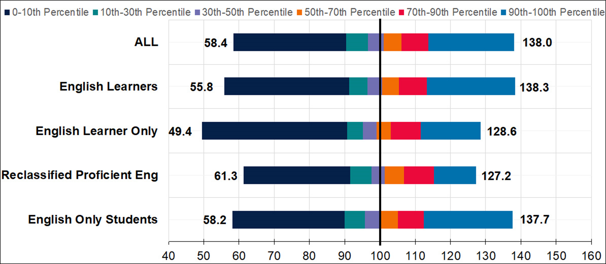
Distribution of MATH Growth Scores (LEA): English Learners

Slide 25
Distribution of MATH Growth Scores (LEA): English Learners in Table Form
Student Group | Minimum (Zero Percentile) | 10th Percentile | 30th Percentile | 50th Percentile | 70th Percentile | 90th Percentile | Maximum (100th Percentile)
ALL | 58.4 | 90.4 | 96.6 | 101.0 | 106.1 | 113.7 | 138.0
English Learners | 55.8 | 91.3 | 96.5 | 100.6 | 105.3 | 113.3 | 138.3
English Learners Only | 49.4 | 90.6 | 95.1 | 99.1 | 103.1 | 111.6 | 128.6
Reclassified Fluent English Proficient | 61.3 | 91.6 | 97.6 | 101.4 | 106.9 | 115.2 | 127.2
English Only Students | 58.2 | 90.0 | 95.7 | 99.9 | 105.1 | 112.5 | 137.7

Slide 26
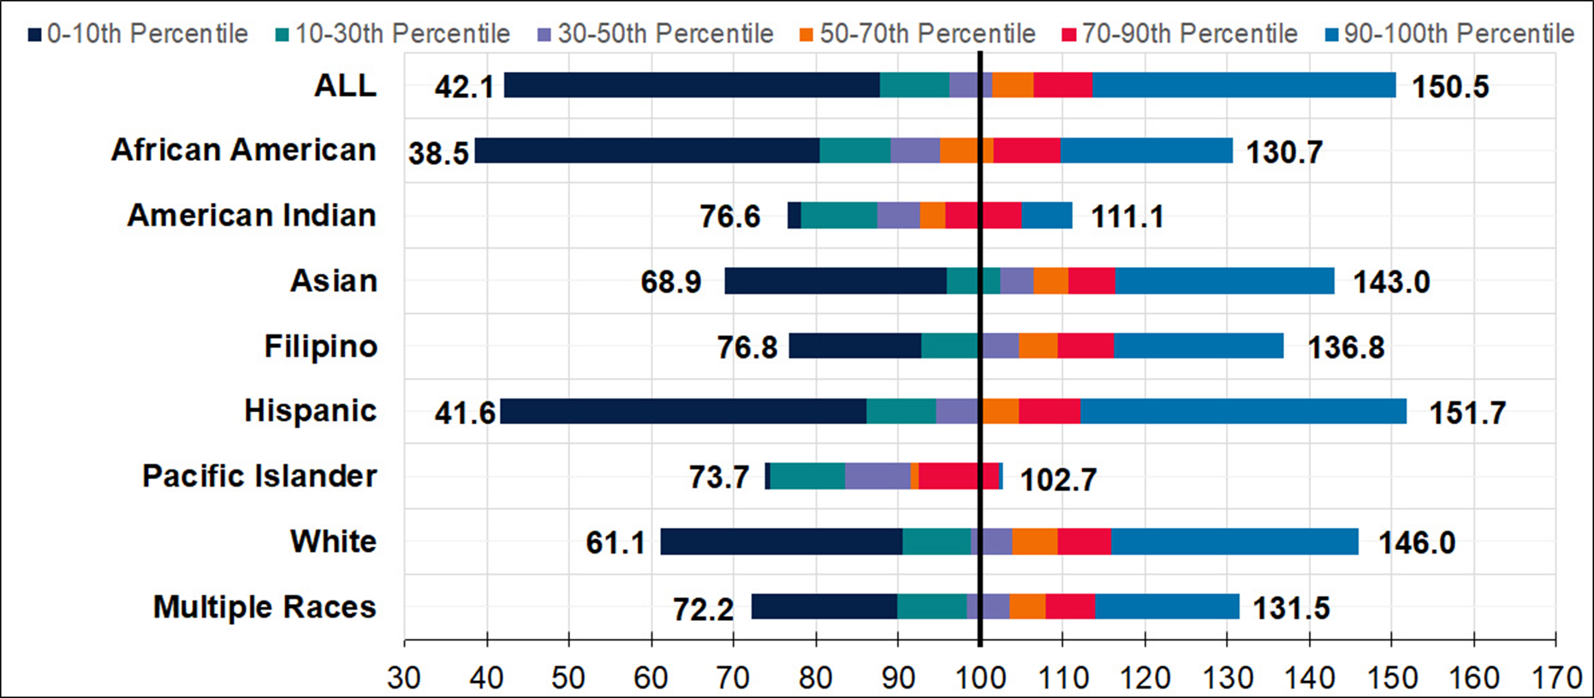
Distribution of ELA Growth Scores (School): Race/Ethnicity Groups

Slide 27
Distribution of ELA Growth Scores (School):
Race/Ethnicity Groups in Table Form
Student Group | Minimum (Zero Percentile) | 10th Percentile | 30th Percentile | 50th Percentile | 70th Percentile | 90th Percentile | Maximum (100th Percentile)
ALL | 42.1 | 87.8 | 96.2 | 101.4 | 106.5 | 113.6 | 150.5
African American | 38.5 | 80.4 | 89.0 | 95.0 | 101.6 | 109.7 | 130.7
American Indian | 76.6 | 78.1 | 87.4 | 92.6 | 95.8 | 104.9 | 111.1
Asian | 68.9 | 95.8 | 102.4 | 106.5 | 110.7 | 116.4 | 143.0
Filipino | 76.8 | 92.9 | 100.3 | 104.7 | 109.4 | 116.2 | 136.8
Hispanic | 41.6 | 86.1 | 94.5 | 99.9 | 104.6 | 112.1 | 151.7
Pacific Islander | 73.7 | 74.3 | 83.6 | 91.5 | 92.4 | 102.3 | 102.7
White | 61.1 | 90.5 | 98.8 | 103.9 | 109.3 | 115.9 | 146.0
Multiple Races | 72.2 | 89.9 | 98.3 | 103.5 | 107.8 | 113.9 | 131.5

Slide 28
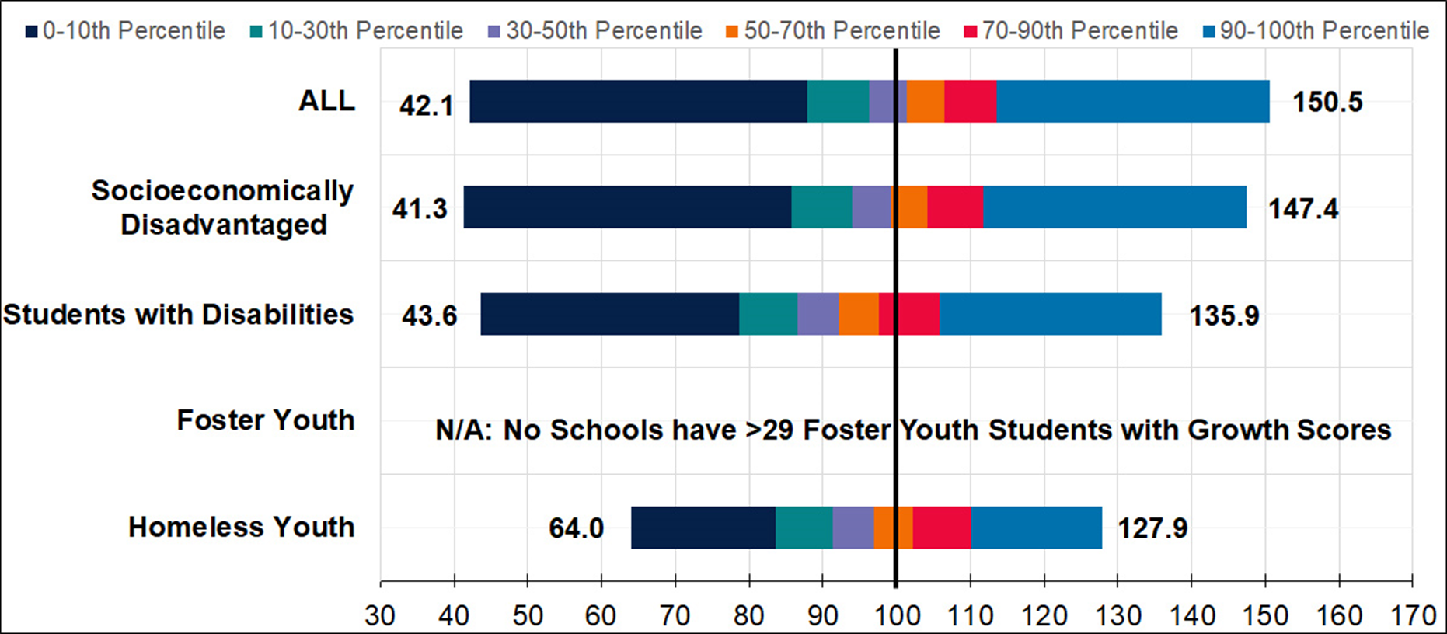
Distribution of ELA Growth Scores (School): Program Groups

Slide 29
Distribution of ELA Growth Scores (School): Program Groups in Table Form
Student Group | Minimum (Zero Percentile) | 10th Percentile | 30th Percentile | 50th Percentile | 70th Percentile | 90th Percentile | Maximum (100th Percentile)
ALL | 42.1 | 87.8 | 96.2 | 101.4 | 106.5 | 113.6 | 150.5
Socioeconomically Disadvantaged | 41.3 | 85.7 | 94.0 | 99.2 | 104.2 | 111.8 | 147.4
Students with Disabilities | 43.6 | 78.6 | 86.6 | 92.2 | 97.7 | 105.7 | 135.9
Foster Youth | n/a | n/a | n/a | n/a | n/a | n/a | n/a
Homeless Youth | 64.0 | 83.6 | 91.3 | 96.9 | 102.3 | 110.1 | 127.9

Slide 30
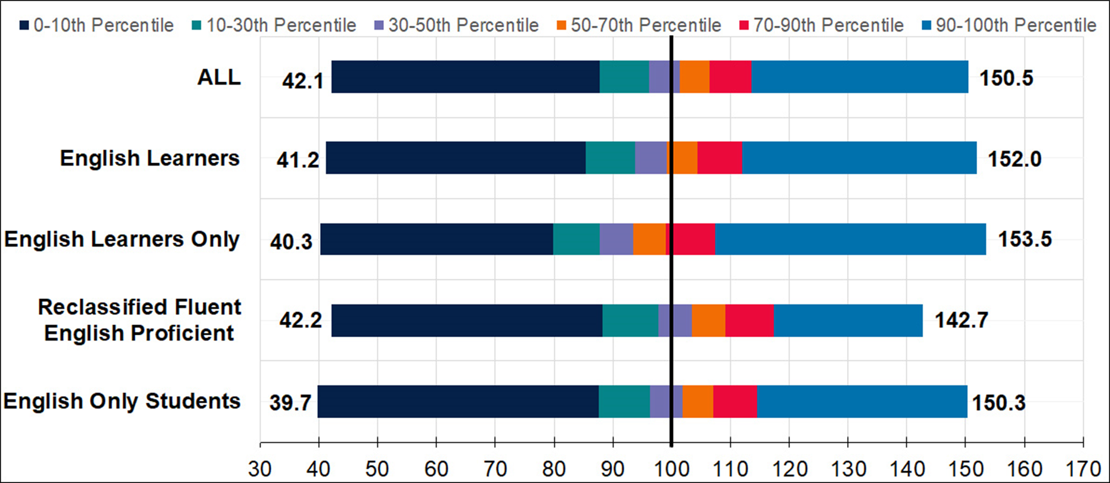
Distribution of ELA Growth Scores (School): English Learners

Slide 31
Distribution of ELA Growth Scores (School): English Learners in Table Form
Student Group | Minimum (Zero Percentile) | 10th Percentile | 30th Percentile | 50th Percentile | 70th Percentile | 90th Percentile | Maximum (100th Percentile)
ALL | 42.1 | 87.8 | 96.2 | 101.4 | 106.5 | 113.6 | 150.5
English Learners | 41.2 | 85.3 | 93.8 | 99.1 | 104.3 | 112.0 | 152.0
English Learners Only | 40.3 | 79.8 | 87.8 | 93.4 | 99.0 | 107.4 | 153.5
Reclassified Fluent English Proficient | 42.2 | 88.2 | 97.7 | 103.4 | 109.2 | 117.4 | 142.7
English Only Students | 39.7 | 87.5 | 96.3 | 101.8 | 107.1 | 114.5 | 150.3

Slide 32
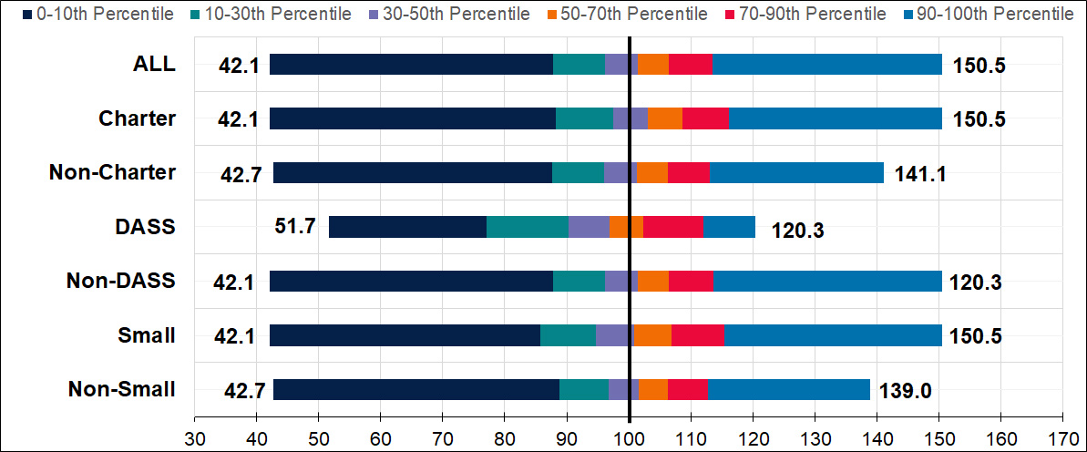
Distribution of ELA Growth Scores (School): School Types
Note: There are only 33 DASS schools represented in this category

Slide 33
Distribution of ELA Growth Scores (School): School Types in Table Form
Student Group | Minimum (Zero Percentile) | 10th Percentile | 30th Percentile | 50th Percentile | 70th Percentile | 90th Percentile | Maximum (100th Percentile)
ALL | 42.1 | 87.8 | 96.2 | 101.4 | 106.5 | 113.6 | 150.5
Charter | 42.1 | 88.2 | 97.5 | 103.1 | 108.6 | 116.1 | 150.5
Non-Charter | 42.7 | 87.7 | 96.0 | 101.2 | 106.3 | 113.1 | 141.1
DASS | 51.7 | 77.1 | 90.2 | 96.9 | 102.3 | 112.0 | 120.3
Non-DASS | 42.1 | 87.8 | 96.2 | 101.4 | 106.5 | 113.6 | 150.5
Small | 42.1 | 85.8 | 94.7 | 100.9 | 106.8 | 115.5 | 150.5
Non-Small | 42.7 | 88.8 | 96.7 | 101.6 | 106.3 | 112.7 | 139.0

Slide 34
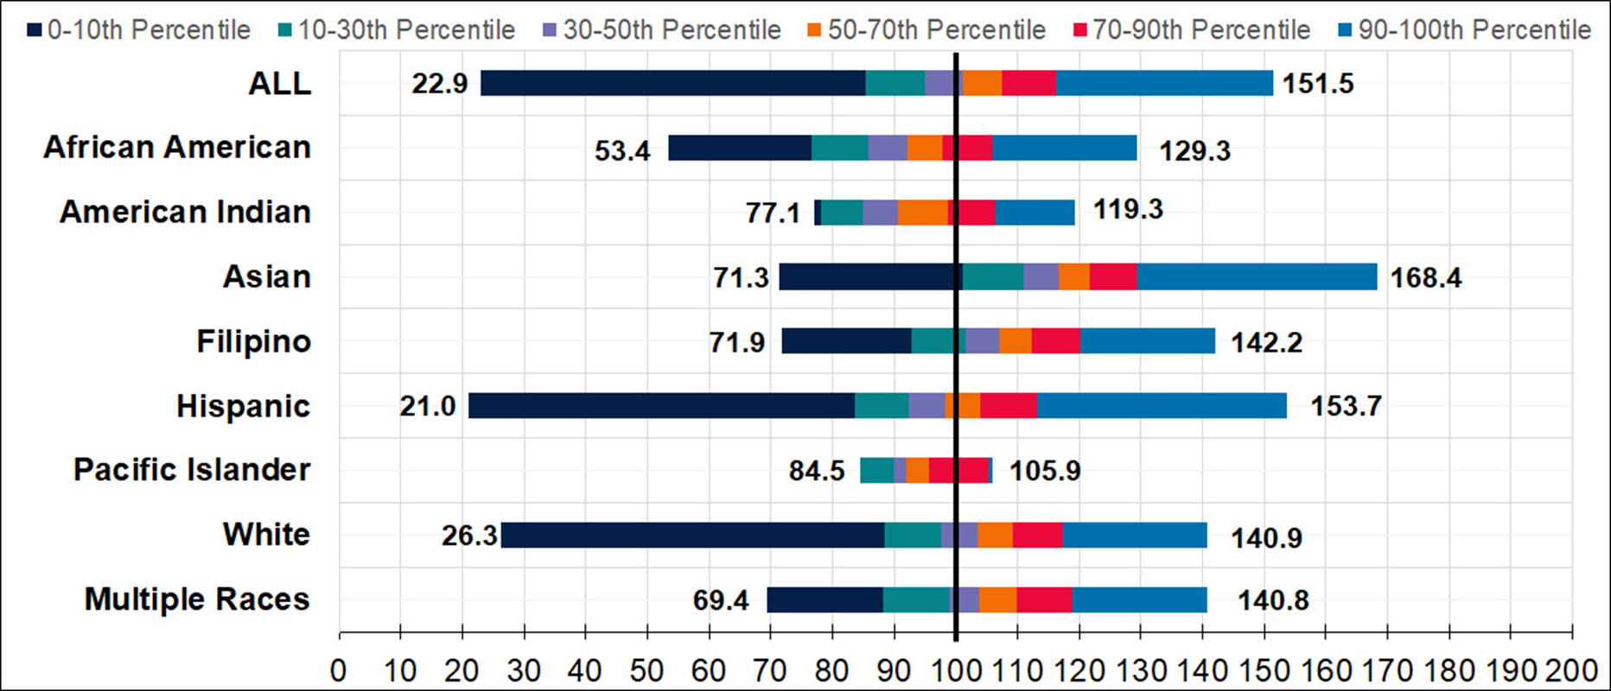
Distribution of MATH Growth Scores (School): Race/Ethnicity Groups

Slide 35
Distribution of MATH Growth Scores (School): Race/Ethnicity Groups in Table Form
Student Group | Minimum (Zero Percentile) | 10th Percentile | 30th Percentile | 50th Percentile | 70th Percentile | 90th Percentile | Maximum (100th Percentile)
ALL | 22.9 | 85.4 | 94.9 | 101.1 | 107.4 | 116.3 | 151.5
African American | 53.4 | 76.6 | 85.7 | 92.1 | 97.9 | 106.0 | 129.3
American Indian | 77.1 | 78.1 | 85.0 | 90.6 | 98.7 | 106.5 | 119.3
Asian | 71.3 | 101.1 | 111.0 | 116.8 | 121.8 | 129.4 | 168.4
Filipino | 71.9 | 92.7 | 101.7 | 107.0 | 112.4 | 120.2 | 142.2
Hispanic | 21.0 | 83.7 | 92.4 | 98.3 | 103.9 | 113.1 | 153.7
Pacific Islander | 84.5 | 84.5 | 89.9 | 91.9 | 95.6 | 105.3 | 105.9
White | 26.3 | 88.4 | 97.6 | 103.5 | 109.4 | 117.3 | 140.9
Multiple Races | 69.4 | 88.3 | 98.9 | 103.7 | 110.0 | 118.9 | 140.8

Slide 36
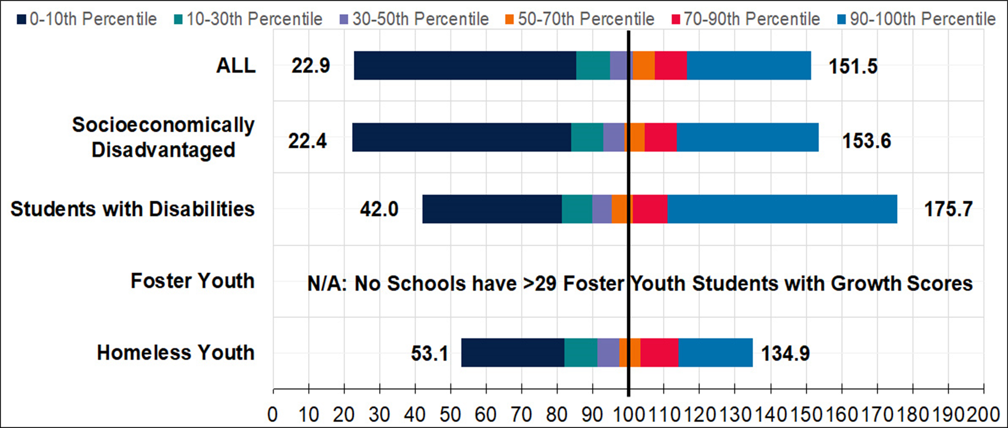
Distribution of MATH Growth Scores (School): Program Groups

Slide 37
Distribution of MATH Growth Scores (School): Program Groups in Table Form
Student Group | Minimum (Zero Percentile) | 10th Percentile | 30th Percentile | 50th Percentile | 70th Percentile | 90th Percentile | Maximum (100th Percentile)
ALL | 22.9 | 85.4 | 94.9 | 101.1 | 107.4 | 116.3 | 151.5
Socioeconomically Disadvantaged | 22.4 | 83.9 | 92.8 | 98.8 | 104.7 | 113.7 | 153.6
Students with Disabilities | 42.0 | 81.3 | 89.8 | 95.3 | 101.3 | 111.0 | 175.7
Foster Youth | n/a | n/a | n/a | n/a | n/a | n/a | n/a
Homeless Youth | 53.1 | 81.9 | 91.2 | 97.4 | 103.4 | 114.0 | 134.9

Slide 38
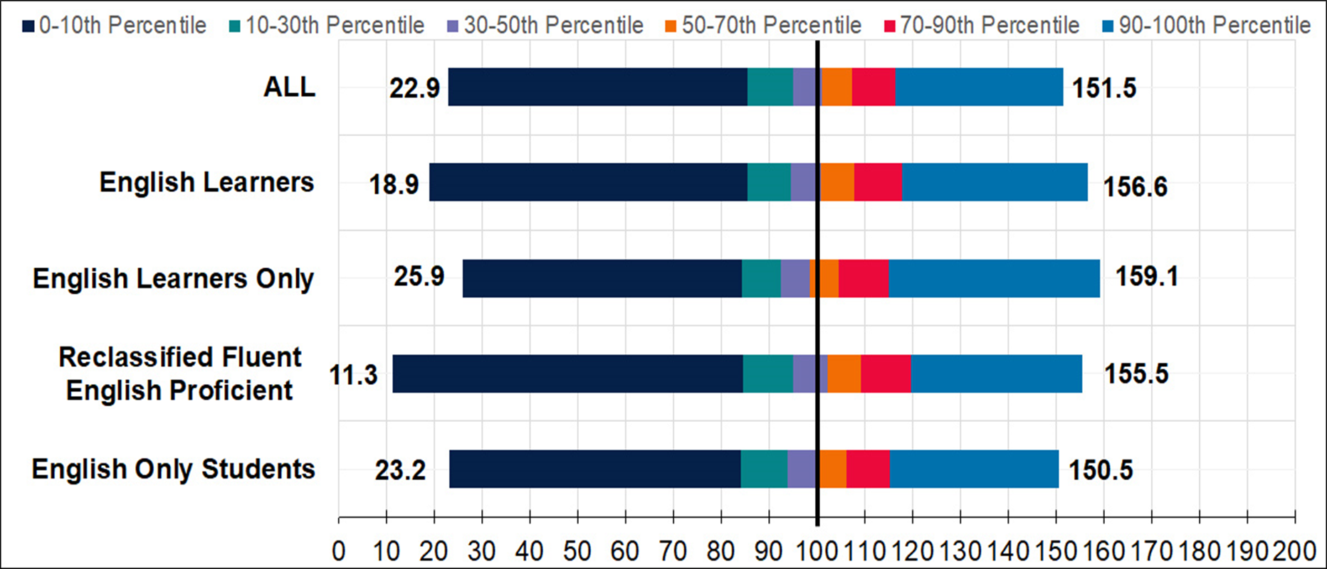
Distribution of MATH Growth Scores (School): English Learners

Slide 39
Distribution of MATH Growth Scores (School): English Learners in Table Form
Student Group | Minimum (Zero Percentile) | 10th Percentile | 30th Percentile | 50th Percentile | 70th Percentile | 90th Percentile | Maximum (100th Percentile)
ALL | 22.9 | 85.4 | 94.9 | 101.1 | 107.4 | 116.3 | 151.5
English Learners | 18.9 | 85.6 | 94.5 | 100.8 | 107.8 | 117.7 | 156.6
English Learners Only | 25.9 | 84.4 | 92.5 | 98.5 | 104.6 | 114.9 | 159.1
Reclassified Fluent English Proficient | 11.3 | 84.7 | 95.1 | 102.3 | 109.3 | 119.6 | 155.5
English Only Students | 23.2 | 84.2 | 93.9 | 100.2 | 106.2 | 115.2 | 150.5

Slide 40
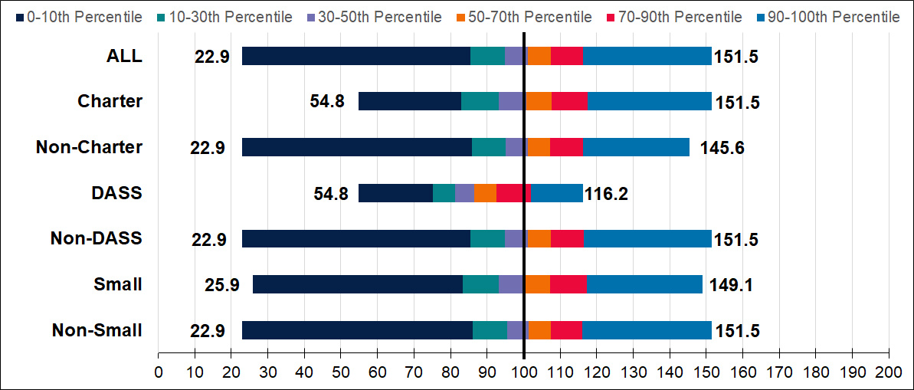
Distribution of MATH Growth Scores (School): School Types
Note: There are only 34 DASS schools represented in this category

Slide 41
Distribution of MATH Growth Scores (School): School Types in Table Form
Student Group | Minimum (Zero Percentile) | 10th Percentile | 30th Percentile | 50th Percentile | 70th Percentile | 90th Percentile | Maximum (100th Percentile)
ALL | 22.9 | 85.4 | 94.9 | 101.1 | 107.4 | 116.3 | 151.5
Charter | 54.8 | 83.0 | 93.3 | 100.7 | 107.6 | 117.6 | 151.1
Non-Charter | 22.9 | 85.8 | 95.0 | 101.2 | 107.4 | 116.2 | 145.6
DASS | 54.8 | 75.2 | 81.2 | 90.2 | 92.7 | 101.9 | 116.2
Non-DASS | 22.9 | 85.5 | 95.0 | 104.1 | 107.4 | 116.4 | 151.5
Small | 25.9 | 83.4 | 93.2 | 103.5 | 107.3 | 117.4 | 149.1
Non-Small | 22.9 | 86.2 | 95.5 | 104.3 | 107.4 | 116.0 | 151.5

Slide 42
Reflecting on the Growth Data
What are your initial takeaways on the growth data distributions?

Slide 43
Next Steps
March 2021: The Growth Model will be recommended for approval at the SBE Meeting for informational purposes.
April 2021 through November 2022: Work with LEAs and stakeholders on developing and implementing a communications plan, data use cases, etc.​
December 2021: Data to calculate a growth score is unavailable (due to suspension of assessments in 2019–20 school year), continue use of current Academic Indicator methodology​.
December 2022: Release growth scores for informational purposes (using CAASPP data from 2021–2022)​. Continue use of current Academic Indicator methodology​.
March 2023 through August 2023: Discussions with SBE and stakeholders on how to incorporate the Growth Model into the California School Dashboard.

Slide 44
Growth Model Communication Timeline
April 2021: Release student-level data files to LEAs via the Test Operations Management System. Additionally, publicly release downloadable district, school, and student group aggregate data files. Conduct statewide webinar on how to read the publicly available downloadable data files.
May through September 2021: Conduct focus groups to develop communication and data use strategies for:
  LEA and school administrators
  School staff
  Parents and the general public
  Develop a report that displays English Language Proficiency Assessment for California levels with growth scores

Slide 45

Questions

Slide 46
Public Comment Line
Phone Number: (669) 900-6833
Meeting ID: 898 4974 9360#
Passcode: 193608

