Slide 1
Screening Multilingual Learners for Risk of Reading Difficulties
Statewide Literacy Office
March 4, 2025

Slide 2
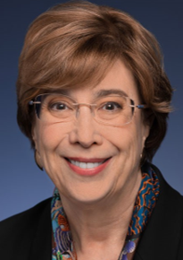


Webinar Presenters
Nancy Brynelson
Statewide Literacy
Co-Director
Dr. Bonnie Garcia
Statewide Literacy
Co-Director
Geqigula Dlamini
Administrator, Language Policy & Leadership Office

Slide 3

Welcome!
Alesha Moreno-Ramirez
Director, Multilingual Support Division

Slide 4
Agenda
Welcome & Introductions
Overview of Screening Requirements
Considerations & Questions for Screening Multilingual Learners
Next Steps: Local Educational Agency (LEA) Responsibilities & Flexibilities
Resources
Q and A

Slide 5
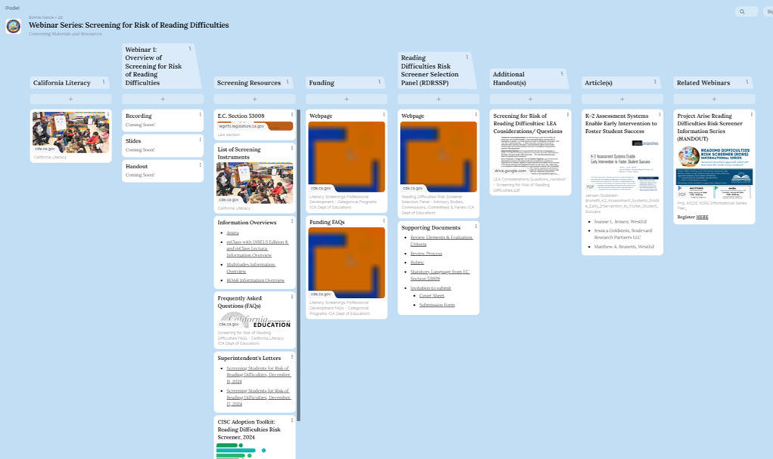
Webinar Padlet
Webinar Padlet
https://tinyurl.com/cdescreenerwebseries

Slide 6
Webinar Objectives
Refresh knowledge of screening requirements
  Education Code (EC) Section 53008
Understand specific requirements for screening multilingual learners
Understand LEA responsibilities and flexibilities
Become familiar with available resources

Slide 7
“California for All Kids”
“All kindergarten through second grade students will be screened for risk of reading difficulties, increasing early identification and support.”
Quoted from the Governor’s Budget Summary ― 2025‒26, pp. 13‒14

Slide 8
Overview of Screening Requirements

Slide 9
Key Provisions of EC Section 53008 for LEAs (1)
(a) Legislative intent
(d) Board adoption
(e) Timeline to assess
(f) New students
(g)(2) Not a diagnosis for special education or 504
(h) Multilingual learners ‒ “Pupils who do not speak sufficient English to be screened with an English-language instrument…”
(i) Exemptions; (e), (f), & (j) Opt-outs
(j), (k) Notifications to parents & guardians
Supports & services for students identified at risk
Unacceptable uses of results
Translation of notifications
(o) Definitions

Slide 10
Examining EC Sec. 53008 (h) (1)
Pupils who do not speak sufficient English to be screened with an English-language instrument shall be screened … in their primary language …
If a screening instrument is not available in at least one language in which a pupil is proficient, … the pupil … shall be evaluated through an analysis of the pupil’s developmental history, educational history, & literacy progress, taking into account the pupil’s home background & evolving English language abilities, including speaking, listening, reading, spelling, & writing, consistent with the CA Dyslexia Guidelines.

Slide 11
Examining EC Sec. 53008 (h) (2)
Components of screening instruments that do not require English language proficiency may be used in this evaluation.
When a pupil acquires sufficient English language knowledge and fluency to be able to be assessed using … [an English-language] instrument … or if a screening instrument in their primary language becomes available, the LEA shall assess that pupil using the appropriate screening instrument.

Slide 12
Required in California
“Beginning in 2025‒26, and annually thereafter, an LEA … shall assess each pupil in kindergarten and grades one and two for risk of reading difficulties,” … “including possible neurological disorders such as dyslexia ...” (e), (b)

Slide 13

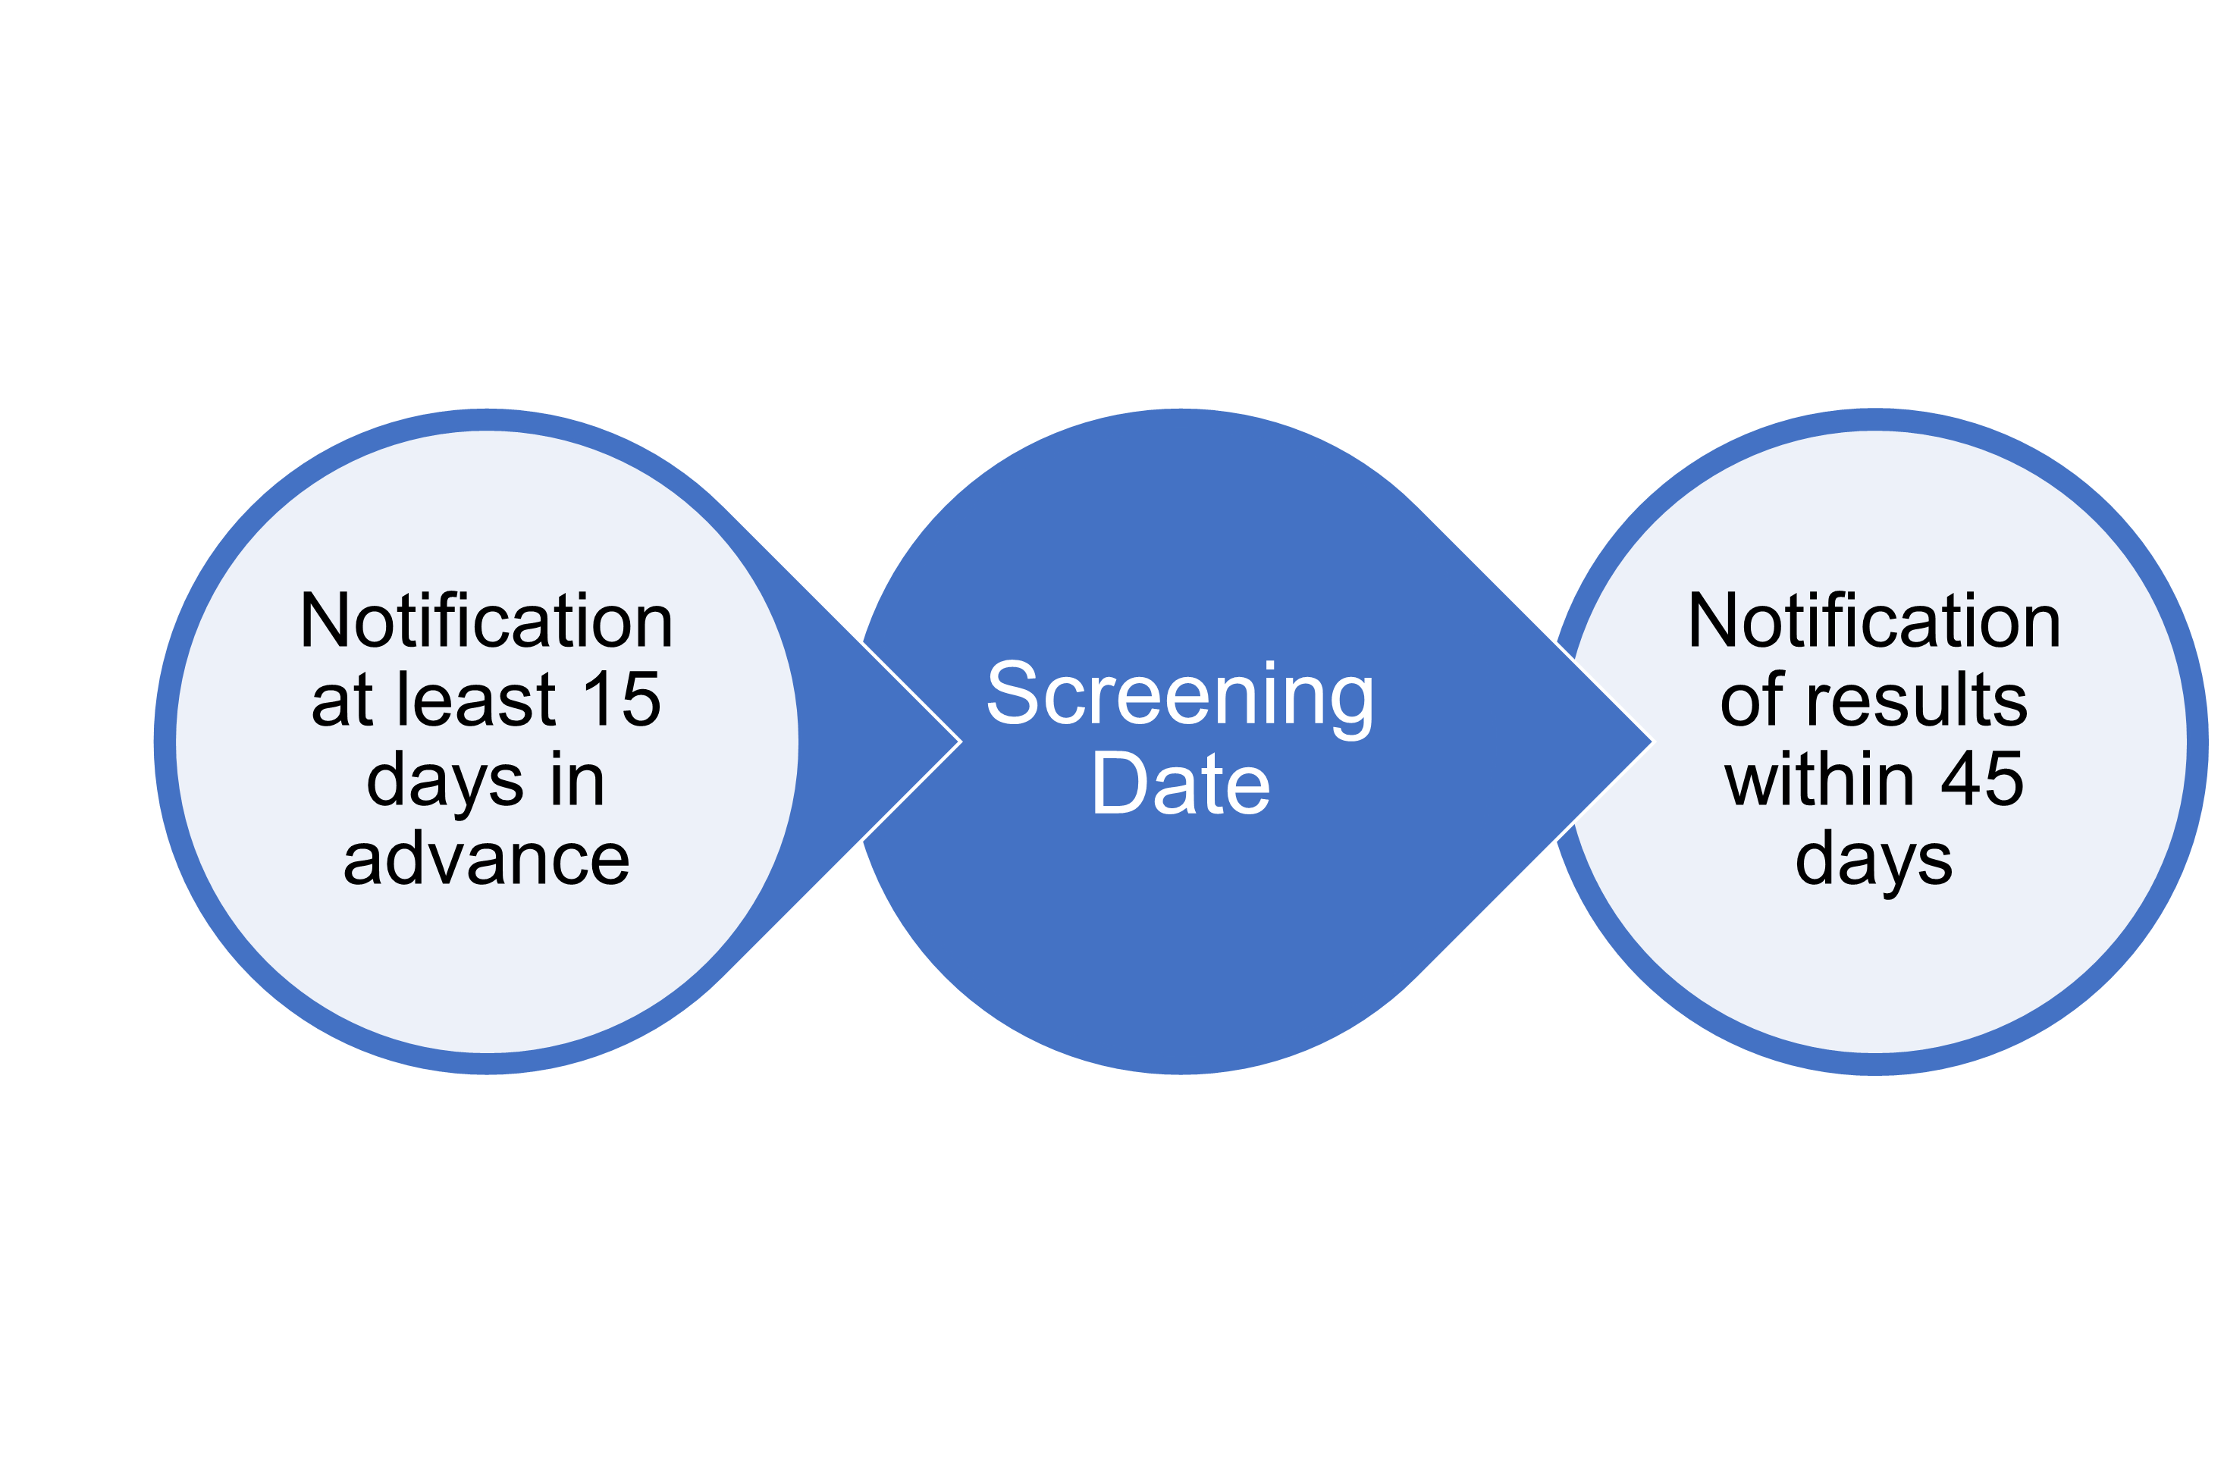
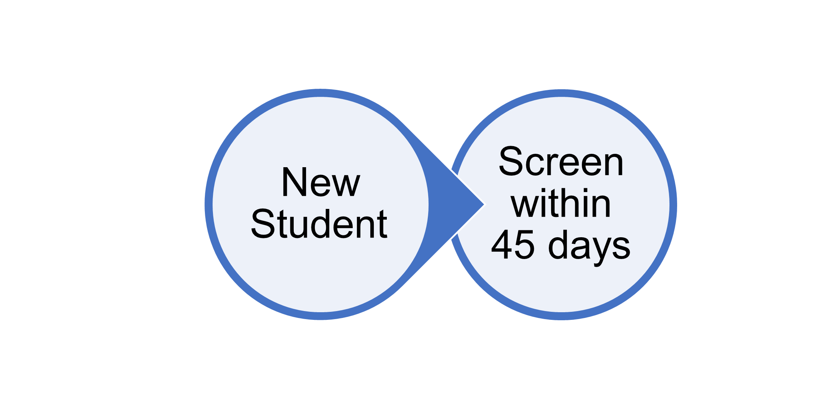
WHEN should SCREENING occur?
Beginning of year?
Middle of year?
End of year?
Timeline Considerations:
Conducted annually
Sufficient instruction for a valid assessment
By grade level
In English, Spanish, or both
Frequency within year
Tasks administered

Slide 14
Considerations & Questions for Screening Multilingual Learners

Slide 15
Considerations & Questions for Screening Multilingual Learners (1)
How do we avoid the over- or under-identification of multilingual learners as being at risk for reading difficulties?
How do we determine if a student has “sufficient English to be screened with an English-language instrument”?
Is screening different for students in dual immersion programs?

Slide 16
Considerations & Questions for Screening Multilingual Learners (2)
May we assess multilingual learners in Spanish even if they have “sufficient” English?
How do we evaluate risk if no instrument is available in a student’s language?
How do we screen students who use American Sign Language (ASL)?

Slide 17
Considerations & Questions for Screening Multilingual Learners (3)
What are components that do not require English language proficiency?
Do we provide follow-up support & services for multilingual learners in English or Spanish or both?
May we use the results of the screening to satisfy Reclassification Criterion 4?

Slide 18
Avoiding Over- & Under-Identification of Multilingual Learners as Being at Risk for Reading Difficulties

Slide 19
Avoiding Over- & Under-Identification (1)
Selection criteria for screening instruments
  Evidence-based, culturally, linguistically, & developmentally appropriate screening instruments in primary languages of CA students (b), (c)
  Normed & validated on populations that include multilingual students (g)(1)(C)
  Guidance for educators and family members on results and services (g)(1)(E)

Slide 20
Avoiding Over- & Under-Identification (2)
Administration of screening instruments and processes
  Screening in primary language if students do not speak sufficient English to be screened with an English-language instrument (h)
  Use of alternate process if no instrument is available in primary language (h)

Slide 21
Avoiding Over- & Under-Identification (3)
Purposes of screening
  “Screening results shall be used as a flag for potential risk for reading difficulties, not as a diagnosis of a disability.” (l)
  “Results … shall be used as a part of a broader process that further evaluates pupil needs and progress, identifies supports for classroom instruction, enables targeted individual intervention as needed, & allows for further diagnosis if concerns do not resolve.” (l)

Slide 22
Avoiding Over- & Under-Identification (4)
Approved screening instruments are to include “guidance & resources … informed by
  ELA/ELD Framework
  CA Dyslexia Guidelines
  Knowledge of effective interventions for the specific needs of individual students
…and reflect a tiered interventions model aligned with the Multi-Tiered Systems of Support.” (g)(1)(E)

Slide 23
Avoiding Over- & Under-Identification (5)
Unacceptable uses of screening results (m)
  Screening results “shall not to be used for any high-stakes purpose, including but not limited to
    Teacher evaluation
    Accountability
    Grade promotion or retention
    Identification for gifted or talented education
    Reclassification of English learners
    Identification as an individual with exceptional needs.”

Slide 24
Determining if a Student Speaks Sufficient English to be Screened with an English-Language Instrument (1)

Slide 25
Determining if a Student Speaks Sufficient English to Be Screened with an English-Language Instrument (2)
Consult information provided with approved screening instruments for guidance on making this determination.
  Start by reviewing the Information Overview for each instrument posted on CDE’s California Literacy web page.
Students who do not speak sufficient English must be screened in their primary language (if an approved instrument is available).

Slide 26
Information Overview – Skills Measured
Include
  Skills measured per 53008
  Name of task
  Grade level
Screening instruments and categories of skills measured
  Amira: Universal Screening
  mCLASS – DIBELS 8 & mCLASS Lectura: Required, additional/optional
  Multitudes: Initial universal screening, follow-up screening, additional/optional
  ROAR – Required, recommended, additional/optional

Slide 27
Screening Multilingual Learners in Both English & Spanish (1)

Slide 28
Screening Multilingual Learners in Both English & Spanish (2)
If a student speaks sufficient English to be screening with an English-language instrument, the students must be screened in English (h)
LEAs may also choose to administer screenings in Spanish. “Nothing in this section restricts LEAs from providing additional pupil screenings or diagnostic evaluations, as appropriate.” (e)

Slide 29
Screening Students in Dual Immersion Programs (1)

Slide 30
Screening Students in Dual Immersion Programs (2)
Requirements for screening apply to all students in kindergarten through grade two regardless of program type.
LEAs may choose to conduct additional screenings to reflect students’ language of instruction.

Slide 31
Evaluating Risk if No Instrument Is Available in a Student’s Language (1)

Slide 32
Evaluating Risk if No Instrument Is Available in a Student’s Language (2)
LEA must develop & implement a process for evaluating risk:
  Through an analysis of the student’s…
    Developmental history
    Educational history
    Literacy progress
  Taking into account the student’s…
    Home background
    Evolving English language abilities
  Including speaking, listening, reading, spelling, & writing, consistent with the CA Dyslexia Guidelines.

Slide 33
Possible Types & Sources of Information for Evaluating Risk
Areas | What to collect? | From whom or where? | Information Form? | Who will collect & how?
Developmental History
Educational History
Literacy Progress
Home Background
Evolving English Language Abilities

Slide 34
Considering the Information Collected
Taking all information into consideration, what is the child’s literacy profile? (ELA/ELD Framework, Ch. 9, pp. 888-891)
What profile might indicate risk for reading difficulties?
  By grade
  By previous schooling experience
  Other factors
What are next steps?
LEAs have flexibility to design a process that is responsive to community characteristics.

Slide 35
Screening Students Who Use ASL (1)

Slide 36
Screening Students Who Use ASL (2)
None of the approved screening instruments were specifically designed to assess students who use ASL.
Consult information provided with approved screening instruments for accommodations for deaf students.
Develop a process for evaluating risk when no instrument is available in a student’s language, considering suggestions just presented.

Slide 37
Components of Screening Instruments that Do Not Require English Language Proficiency (1)

Slide 38
Components of Screening Instruments Do Not Require English Language Proficiency (2)
“Components of screening instruments that do not require English language proficiency may be used in this evaluation.” (h)
Consult with vendors of approved screening instruments to determine the components or tasks that do not require English language proficiency.

Slide 39
Determining Supports & Services for Students Identified as Being at Risk (1)

Slide 40
Determining Supports & Services for Students Identified as Being at Risk (2)
If a student is identified as being at risk, LEAs “shall provide … supports & services, appropriate to the specific challenges identified …, which may include, among other[s], any of the following:
  Evidence-based literacy instruction focused on specific needs.
  Progress monitoring.
  Early intervention in the regular general education program.
  One-on-one or small group tutoring.
  Further evaluation or diagnostic assessment.” (l)

Slide 41
Determining Supports & Services for Students Identified as Being at Risk (3)
Possible considerations for multilingual learners identified as being at risk for reading difficulties:
Language of screening (English &/or Spanish, other)
Screening results by task & language
Guidance provided by screening instrument(s)
Program type & language(s) of core literacy instruction

Slide 42
Use of Screening Results for Reclassification (1)

Slide 43
Use of Screening Results for Reclassification (2)
  Screening results “shall not to be used for any high-stakes purpose, including, but not limited to, … reclassification of English learners …” (m)
  Screening instruments are normed & validated to predict risk of reading difficulties.
  They cannot be used for reclassification.

Slide 44

Reclassification Overview
  Reclassification is the process whereby a student is reclassified from English learner (EL) status to Reclassified Fluent English Proficient status.
  Reclassification can take place at any time during the academic year, immediately upon the student meeting all the criteria.
  Each LEA establishes a locally-approved
  reclassification process

Slide 45

Reclassification Criteria Overview
  Assessment of English Language Proficiency with Summative English Language Proficiency Assessments for California (ELPAC) or Summative Alternate ELPAC
  Teacher evaluation
  Parent Opinion and Consultation
  Basic Skills Relative to English Proficient Students

Slide 46
Criterion 4: Basic Skills Relative to English Proficient Students
Comparison of EL student performance to the performance of native English speakers of the same age in basic skills is locally determined.
  Demonstrates whether the pupil is sufficiently proficient in English to participate effectively in a curriculum designed for pupils of the same age whose native language is English.
The LEA establishes the empirical range of performance in basic skills when setting the criteria for reclassification and considers the overall achievement goals set for all students.

Slide 47
Helpful Related Terms for Criterion 4
  Performance in basic skills: The score and/or performance level resulting from a recent administration of an objective assessment of basic skills in English (e.g., Smarter Balanced assessments, district benchmarks).
  Range of performance in basic skills: A range of scores on the assessment of basic skills in English that corresponds to a performance level or a range within a performance level.
  Students of the same age: English-proficient students who are enrolled in the same grade as the student who is being considered for reclassification.

Slide 48
Next Steps: LEA Responsibilities & Flexibilities

Slide 49
LEA Responsibilities (1)
Adopt an approved screening instrument by June 30, 2025
Administer screenings beginning in 2025-2026
Determine if students speak sufficient English to be screened in English (based on instrument guidelines)
Conduct screening in English or student’s primary language
Evaluate risk if no instrument is available in student’s language
Follow timelines for screening of newly enrolled students & notifications to parents & guardians

Slide 50
LEA Responsibilities (2)
Develop & translate notification letters (before & after screenings, including all required elements, scheduling, opt-outs, exemptions, results, supports & services)
Determine supports & services for students identified as at risk, including resources for families and educators
Refrain from using screening results for unacceptable purposes

Slide 51
LEA Flexibilities to Determine (1)
Multi-Tiered System of Support, including assessment, core instruction, intervention, family engagement, professional learning
Process for selecting screening instrument(s) to adopt
When, where, how often, & in what mode to screen (within instrument guidelines)
Screening schedule (month & time) & location
Assessment tasks to administer, if any, beyond required tasks

Slide 52
LEA Flexibilities to Determine (2)
Personnel to conduct screenings & professional learning
  “appropriately trained school employee, including, but not limited to, a certificated teacher …” (o)
How to evaluate risk if no instrument is available in a student’s language
Specific form of communication with parents & guardians
Specific supports and services for students identified as being at risk of reading difficulties

Slide 53
Resources

Slide 54
CDE Website > California Literacy Web Page
Screening Tab https://www.cde.ca.gov/ci/cl/
Screening Instruments & Information Overviews
Communication & Resources
  Frequently Asked Questions
  Letters to the Field
  “Adoption Toolkit” (Curricular & Improvement Support Committee,
  CA County Superintendents)
  Literacy Screening Professional Development Funding 2024–25
Policy
  Education Code Section 53008
  Reading Difficulties Risk Screener Selection Panel
  California Dyslexia Guidelines
Other
  Announcements & Webinars tabs will include future and archived webinars.
  See Padlet for all resources

Slide 55
Screening for Risk of Reading Difficulties
Webinars Series 2025
January 21, 2025 – Overview of Screening Requirements
February 12, 2025 – Role of Screening in a Multi-Tiered System of
Support
March 4, 2025 – Screening Multilingual Students
March 25, 2025 – Addressing Reading Difficulties

Slide 56
Funding to Support Screening
  2024‒25
  $25 million one-time Prop 98 General Funds to support training for educators to administer screenings
  Funds apportioned January 2025 @ $21.16 per K-2 pupil
2025‒26 as proposed by the Governor
  $40 million one-time Prop 98 General Funds to support the purchase of screening materials and training for educators to administer literacy screenings

Slide 57
Contacts
Dr. Bonnie Garcia
  Statewide Literacy Co-Director
  bogarcia@cde.ca.gov
  916-445-7098
Nancy Brynelson
  Statewide Literacy Co-Director
  nbrynelson@cde.ca.gov
  916-445-2426

Slide 58
Questions and Answers

