Slide 1
Universal PreKindergarten (UPK) Implementation: Community Engagement and Partnerships Webinar Early Education Division (EED) February 24, 2022

Slide 2
Welcome and Introductions

Slide 3
Why Early Learning Matters
Brain science shows that 90% of a child’s brain growth happens by 5 years old
Early intervention is more effective in terms of cost and health than later remediation
Preschool Prepares Children for School and Kindergarten
Preschool has long term Impacts on school progress, graduation, and future life outcomes
Preschool has enduring benefits that do not fade

Slide 4
Early Education is Most Effective When it is High Quality
Programs should:
Have well-qualified educators paid a livable wage
Use a developmentally-informed program with domain-specific curricula that includes intentional teaching
Have adequate learning time for students
Provide scaffolded, intentional instruction embedded into playful activities
Design environments to sustain and nourish children’s natural curiosity and passion for learning.
Provide educators with support and foster mechanisms for ongoing program improvement.
Ensure Preschool through Third Grade (P-3) alignment across curriculum, instruction, assessments, and professional learning

Slide 5
Benefits of Implementing Inclusive Settings
Helps reduce the need for future special education services
Decrease long-term special education costs
Increase student academic achievement
Children with disabilities can make significant developmental and learning progress
Same-age peers without disabilities show positive development, social, and attitudinal outcomes

Slide 6
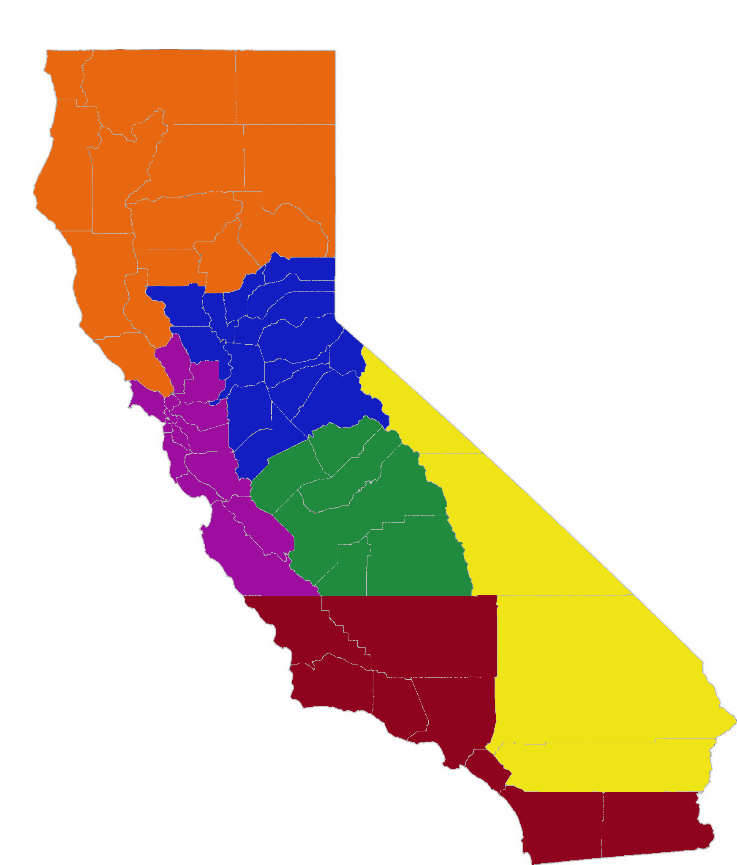
Who is in the ‘room’ with us today?
California County Superintendents Educational Services Association (CCSESA) regions:
Northern CA: Regions 1 and 2 (orange)
Greater Sacramento: Regions 3 and 6 (blue)
Bay Area/Coastal: Regions 4 and 5 (purple)
Central Valley: Region 7 (green)
Inland Empire: Region 10 (yellow)
Southern CA: Regions 8, 9 and 11 (red)
CCSESA: http://CCSESA.org/regions/

Slide 7
Review of Universal PreKindergarten Implementation
Photo Credit: UPS Preschool; Camarillo, CA

Slide 8
What is UPK?
UPK will bring together programs across early learning and K-12, relying heavily on Universal Transitional Kindergarten (UTK) and California State Preschool Program (CSPP), as well as Head Start, community-based organizations (CBOs), and private preschool.
Universal means that by 2025–26, regardless of background, race, zip code, immigration status, or income level – every child– has access to a quality learning experience the year before Kindergarten.

Slide 9
How Do Transitional Kindergarten (TK), UPK, and P-3 Alignment Work Together?
TK is an integral program in the mixed delivery system for achieving UPK. It will be the only program that must serve any four-year-old child that wants to enroll by 2025–26.
UPK is a mixed-delivery system of UTK, CSPP, Head Start, expanded learning, private providers, and more. It provides every four-year-old child access to high quality learning the year before Kindergarten.
P-3 Connects UPK with Kindergarten, 1st, 2nd, and 3rd grade. It aligns developmentally informed best practices, UPK– 3rd grade.

Slide 10
UPK Implementation Schedule: TK and Early Admittance TK (ETK)
Birthdays | 2021–22 | 2022–23 | 2023–24 | 2024–25 | 2025–26
Sep. 2 – Dec. 2 | TK | TK | TK | TK | TK
Dec. 3 – Feb. 2 | ETK | TK | TK | TK | TK
Feb. 3 – Apr. 2 | ETK | ETK | TK | TK | TK
Apr. 3 – Jun. 2 | ETK | ETK | ETK | TK | TK
Jun. 3 – Jun. 30 | ETK | ETK | ETK | ETK | TK
July 1 – Sep. 1 | Other | Other | Other | Other | TK

Slide 11
UPK Implementation Schedule: CSPP Expansion
Request for Applications (RFA) will be released today
$130 million in CSPP Expansion funds available to local educational agencies (LEAs) to provide both part-day and full-day CSPP
LEAs may apply to provide direct, center-based CSPP services, subcontract services with another entity, including CBOs, or provide services through a family child care home education network (FCCHEN)
An instructional webinar will be offered shortly following the release of the RFA

Slide 12
UPK Implementation Schedule: Supports for Planning and Implementation (P&I)
$200 million UPK P&I Grant Allocations Will Be Updated Soon
$175.5 million UPK P&I Grant
$24.5 million UPK P&I Countywide and Capacity Grant
The Early Education Teacher Development Grant
Did you or an LEA you know submit an eligible letter of intent (LOI) by February 2nd at 5 p.m.?
RFA to be released shortly
Questions? Email UPKWorkforceRFA@cde.ca.gov

Slide 13
UPK Guidance
On February 14, the California Department of Education (CDE) uploaded guidance to our website that corresponds to the template for LEAs to implement UPK.
It can be found at https://www.cde.ca.gov/ci/gs/em/
The UPK Planning and Implementation Guidance Volume 1 includes information on the following:
Guidance Introduction and General Information
Projected Enrollment and Needs Assessment
Focus Area A: Vision and Coherence Program Models and Funding
Focus Area B: Community Engagement and Partnerships Opportunities to engage the community
Focus Area E: Facilities Requirements and Resources

Slide 14
Projected Needs and Assessment
The CDE has enrollment projections for some local education agencies (LEAs) and sent those emails directly to each LEA on Wednesday, February 23
These figures are provided as one tool LEAs can consider when developing their TK and kindergarten enrollment projections
More information can be found in the UPK Planning and Implementation Guidance

Slide 15
Full-Day Programs That Meet Family Needs
Statute requires LEAs to plan how all four-year-old children in their attendance area will have full-day programs the year before Kindergarten that meet family needs
These needs can be met through a variety of programs providing rich early learning and care, including TK, CSPP, Head Start, other early learning and care programs, expanded learning, private preschool, and more
Having different UPK models builds capacity to provide high-quality programs to support child outcomes, and allows families meaningful choice while also providing equitable opportunities

Slide 16
Role of Community Agencies/Partners
Photo Credit: Thermalito Preschool; Poplar, CA

Slide 17
County Office of Education Role
County Offices of Education (COEs) are receiving funding to support countywide UPK Planning.
As part of this, COEs should be helping LEAs in their county with planning and supporting countywide planning and capacity building of UPK. This includes, but is not limited to:
Helping LEAs think through which community partners to engage and how
Convening LEAs and CBOs to support conversations around how full-day PreK opportunities can be provided to all children the year before kindergarten
Potentially supporting county conversations around serving three-year-old children

Slide 18
School Site and LEA Level Community Engagement
School Site level
Parent Teacher Association (PTA) Meetings
English Learner Advisory Committee (ELAC)
School Site Council (SSC)
LEA Level
Special Education Local Plan Area (SELPA)
Community Advisory Committee (CAC)
Local Control Accountability Plan (LCAP) Input Sessions
Tribal Community Input Sessions

Slide 19
Community-Level Community Engagement
Community-Level partners for Early Education planning include, but are not limited to:
Resource and Referral Agencies (R&Rs)
Local Child Care and Development Planning Councils (LPCs)
First 5 County Commissions
Quality Counts California (QCC)
Family Empowerment Centers (FECs)
Head Start Policy Council

Slide 20
Child Care Resource and Referral (R&Rs) Programs
R&Rs are mandated by both federal and state laws (Child Care and Development Block Grant [CCDBG] and Welfare & Institution Code [WIC])
There are 69 locally-based R&Rs throughout the state of California and one (1) Child Care Resource and Referral Network
Major responsibilities include:
Providing families with child care information based on their needs, along with other support services
Recruit, train, and support child care providers
Collect data from parents and child care providers

Slide 21
Local Planning Councils (LPCs)
LPCs are required by WIC and their major responsibilities are:
Provide a forum for the identification of local priorities for child care and the development of policies to meet the needs identified within those priorities
By May 30 of each year, submit to the California Department of Social Services and the State Department of Education the local priorities
Conduct a needs assessment of child care needs in the county no less frequently than once every five years

Slide 22
COEs Already Play Key Roles Around Early Learning
Out of 58 County Offices of Education, currently:
41 provide TK
38 have CSPP contracts
50 operate the Local Planning Councils
15 operate Resource and Referral Agencies
30+ are the lead for Quality Counts California consortia

Slide 23
Leveraging Programs Providing Direct Services to Children
Photo Credit: Kidango Decoto Center; Union City, CA

Slide 24
Select State Funded Early Learning and Care Programs
Name | Acronym | Funding | Brief Description
California State Preschool Program | CSPP | Direct contract | Provides PreK to 3-4 year old children, and expanded learning to TK and K students.
General Child Care | CCTR | Direct contract | Provides child care to children aged 0-12.
CA Migrant Center Program | CMIG | Direct Contract | Provides child care to children aged 0-12 from migrant families.
CalWORKs Child Care Program | Varies | Voucher | Provides child care to children aged 0-12 from CalWORKs families.
CA Alternative Payment Program | CAPP | Voucher | Provides child care to children aged 0-12.
CA Migrant Alternative Payment Program | CMAP | Voucher | Provides child care to children aged 0-12 from migrant families.

Slide 25
Head Start Programs
A federally administered program that provides grants directly to organizations in local communities
Services are provided in a variety of settings
Provides comprehensive services such as developmental and health screenings that are included in the Performance Standards.

Slide 26
CSPP Eligibility Criteria (Current Law)
Three and four-year old children—as well as TK and kindergarten-age children are eligible for part- and full-day CSPP if the child's family is:
A cash aid recipient
Income eligible (income below 85% of state median income)
Homeless
One whose children receive child protective services or identified or at risk
Lives within and attends a CSPP program within the attendance boundaries of a school where 80 percent or more of pupils are eligible for free- or reduced-price meals
For Part-Day CSPP only:
Children from families with incomes slightly above the income threshold
Children with exceptional needs with income above eligibility threshold

Slide 27
Expanded Learning and Care
Expanded Learning includes before-school, after-school, summer, or intersession learning programs that focus on developing the academic, social, emotional, and physical needs and interests of pupils through hands-on, engaging learning experiences.
Expanded Learning Opportunities Program (ELO-P) provides funding for after-school and summer school enrichment programs for TK through sixth grade. A full day is defined as in-person before- or after-school expanded learning opportunities that, when added to daily instructional minutes, are no fewer than nine hours of combined instructional time.
After-School Education and Safety (ASES)
21st Century Community Learning Centers
Head Start, CSPP, and Early Learning and Care providers described above also contribute to this fabric of extended learning and care.

Slide 28
Models for Layering Programs to Meet Family Needs
Photo Credit: Lighthouse for Children CDC, Fresno CA

Slide 29
Funding Sources to Support UPK Implementation
TK
CSPP Expansion Funding and Existing CSPP Contracts
Expanded Learning
Every Students Succeeds Act (ESSA) funds
Community Schools
Universal Meals Program
Subsidized Child Care Funding

Slide 30
Part-Day and Full-Day TK
Part-Day
A minimum of three hours, and no more than four hours, of instruction per day, including recess and excluding lunch, for a total of 36,000 instructional minutes total over a school year
Provides ability to stack classes with two sessions per day to serve more children
Full-Day
More than four hours a day if they are operating as part of an early primary program
Supportive of working families
Maximizes student learning opportunities

Slide 31
Choosing Models of Service Delivery
CSPP
Additional funding
Income-based qualifications
CSPP requirements such as Early Childhood Environment Rating Scale (ECERS) and Desired Results Developmental Profile (DRDP)
Head Start
Additional funding
Very low-income communities
Additional Head Start Performance Standards (requirements) such as Classroom Assessment Scoring System (CLASS) assessment

Slide 32
Facilities
California Preschool, Transitional, Kindergarten, and Full-Day Kindergarten Facilities Grant Program
School districts and county offices of education may apply
School districts can also apply for the facility funding on behalf of charter schools who operate on district property
Funding may be used to construct or modify existing facilities
Applicants may apply for grant funds in advance of having a CSPP contract in place, indicating in the application for grant funding as a "future contractor."

Slide 33
Live Questions and Answers (Q&A)
Photo Credit: Patricia Angulo's Family Child Care; Thousand Palms, CA

Slide 34
Upcoming Webinars
March 4 from 10:00 a.m. - 11:00 a.m. Early Education Division will host their monthly webinar with an updated Governor's Budget summary and specific CSPP focus in certain areas
March 8 at 3:00 p.m. or March 10 at 3:00 p.m. Coffee with Patty: Using the DRDP with Specialized Populations
We are planning to hold more webinars; the dates are yet to be determined:
P-3 Webinar: Supporting Children with Disabilities in Inclusive P-3 Settings
UPK Webinar Tentatively on Facilities, Services, and Operations

Slide 35
In what area(s) might you need more information or assistance?
Photo Credit: Debra Manrique Family Child Care; Oxnard, CA

Slide 36
Closing and Next Steps
Inbox for questions and comments: UPK@cde.ca.gov
We will post this webinar: https://www.cde.ca.gov/ci/gs/em/
We look forward to more opportunities to discuss
the implementation of UPK!
Thank you!

