Slide 1
Universal PreKindergarten (UPK) Implementation Office Hour Early Education Division (EED) September 14, 2022

Slide 2
Welcome and Introductions

Slide 3
CDE Recent Webinars
Fiscal Year (FY) 2022–23 Attendance Accounting and Instructional Time Requirements Webinar
Early Education Division September Webinar

Slide 4
UPK Planning and Implementation Key Dates
Local educational agencies (LEAs) and county offices of education (COEs) that received UPK Planning and Implementation grant funds must meet all deadlines for reporting as a condition of grant apportionment.
August 19, 2022: UPK programmatic surveys was distributed
September 30, 2022: Final due date for survey submission

Slide 5
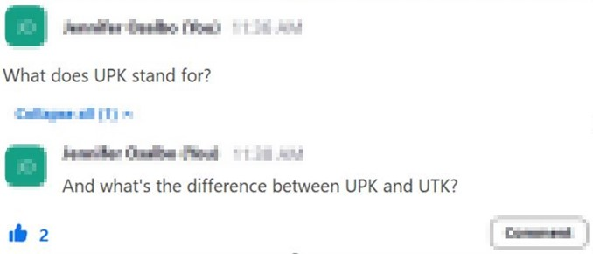
Asking Questions

Slide 6
Questions & Answers
Photo Credit: Kidango Decoto Center; Union City, CA

Slide 7
Closing and Next Steps
Inbox for questions and comments: UPK@cde.ca.gov
We will post this week's slides on: https://www.cde.ca.gov/ci/gs/em/
We look forward to more opportunities to discuss
the implementation of UPK!
Thank you!

Slide 8
Resources
Program Quality Implementation (PQI) Office Regional Consultants
https://www.cde.ca.gov/sp/cd/ci/assignments.asp
Consultants are most easily reached by email
or by phone at 916-322-6233
Early Education and Nutrition Fiscal Services (EENFS), Fiscal Apportionment Analyst Directory
https://www.cde.ca.gov/fg/aa/cd/faad.asp
Regulation Related Questions
EEDTitle5@cde.ca.gov

Slide 9
UPK Resources
California Educators Together:
https://www.caeducatorstogether.org/groups/e0cfjrjf/upk-p-3
UPK Resources:
https://www.cde.ca.gov/ci/gs/em/
UPK FAQs:
https://www.cde.ca.gov/ci/gs/em/kinderfaq.asp
UPK Office Hour:
https://www.cde.ca.gov/ci/gs/em/upkofficehours.asp
System of Support for Expanded Learning:
https://www.cde.ca.gov/ls/ex/sosexplearncontacts.asp
Kindergarten through Grade 12 (K-12) Omnibus Trailer Bill:
https://esd.dof.ca.gov/trailer-bill/public/trailerBill/pdf/527 [Link no longer available]

Slide 10
Budget Resources
Final Budget Summary
https://www.ebudget.ca.gov/FullBudgetSummary.pdf
Senate Bill (SB) 154
https://leginfo.legislature.ca.gov/faces/billNavClient.xhtml?bill_id=202120220SB154
Assembly Bill (AB) 210
https://leginfo.legislature.ca.gov/faces/billNavClient.xhtml?bill_id=202120220AB210
AB 181
Bill Text - AB-181 Education finance: education omnibus budget trailer bill.

Slide 11
Expanded Learning Opportunities Program (ELO-P) Resources
ELO-P Main Page:
https://www.cde.ca.gov/ls/ex/elopinfo.asp#elopfaqs
ELO-P Program Plan Guide:
https://www.cde.ca.gov/ls/ex/documents/elopprogplanguide.pdf
ELO-P FAQs:
https://www.cde.ca.gov/ls/ex/elofaq.asp
ELO-P Fireside Chats:
https://www.afterschoolnetwork.org/elo-program
ELO-P Email Box:
ExpandedLearning@cde.ca.gov

Slide 12
Facilities Resources
Access California Preschool, Transitional, Kindergarten and Full-Day Kindergarten Facilities Grant Program Funding (FDK grant program)
https://www.dgs.ca.gov/OPSC/Services/Page-Content/Office-of-Public-School-Construction-Services-List-Folder/Access-Full-Day-Kindergarten-Facilities-Grant-Program-Funding
Facilities Contacts:
Joshua Potter
Phone: 279-946-8454
E-mail: Joshua.Potter@dgs.ca.gov
Lindsey Gordon
Phone: 279-946-8458
E-mail: Lindsey.Gordon@dgs.ca.gov

