Slide 1
Welcome and Introductions

Slide 2
P-3 Upcoming Webinars
P-3 Webinar: Transition to Elementary School Toolkit
May 23, 2023 at 3:30pm
P-3 Webinar: The Importance of Play
August (Date to be determine [TBD]), 2023 at 3:30pm

Slide 3
Upcoming Dual Language Learner Support Webinar Series
Part One: Identifying Dual Language Learners (DLLs) in California State Preschool Programs (CSPPs)
Part Two May 16, 2023, 3:00-4:30pm: Data Reporting DLLs in CSPPs
Part Three June 13, 2023, 3:00-4:30pm: Supporting DLLs in CSPPs

Slide 4
Elephants and Rumors
Rumor: All local educational agencies (LEAs) need to develop a plan for the 2022–23 Universal PreKindergarten Planning & Implementation (UPK P&I) Grant.
Truth: Only LEAs that did not develop the plan required for the 2021–22 UPK P&I Grant, are required to develop a plan for the 2022–23 UPK P&I Grant. This plan should have been presented for consideration to the governing board or body at a public meeting by March 30, 2023.
Rumor: There are no changes to allowable fund usage for the 2022–23 UPK P&I grant?
Truth: The 2022–23 UPK P&I Grant now includes classroom operating costs as an allowable expense. These funds now cover costs associated with expanding Transitional Kindergarten (TK) age eligibility faster than required by law.

Slide 5
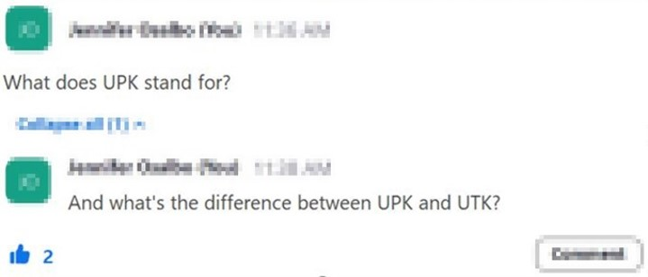
Asking Questions

Slide 6
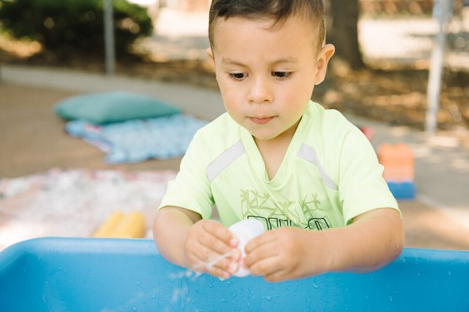
Questions​ &​ Answers
Photo Credit: Kidango Decoto Center; Union City, CA

Slide 7
Closing and Next Steps
Inbox for questions and comments:
UPK@cde.ca.gov
Inbox for UPK P&I Grant questions:
UPKPlanningGrant@cde.ca.gov
We will post this week's slides soon:
https://www.cde.ca.gov/ci/gs/em/upkofficehours.asp

Slide 8
UPK Resources
California Educators Together:
https://www.caeducatorstogether.org/groups/e0cfjrjf/upk-p-3
UPK Resources:
https://www.cde.ca.gov/ci/gs/em/
UPK frequently asked questions (FAQs):
https://www.cde.ca.gov/ci/gs/em/kinderfaq.asp
UPK Office Hour:
https://www.cde.ca.gov/ci/gs/em/upkofficehours.asp
System of Support for Expanded Learning:
https://www.cde.ca.gov/ls/ex/sosexplearncontacts.asp

Slide 9
Expanded Learning Opportunities Program (ELO-P) Resources
ELO-P Main Page:
https://www.cde.ca.gov/ls/ex/elopinfo.asp#elopfaqs
ELO-P Program Plan Guide:
https://www.cde.ca.gov/ls/ex/documents/elopprogplanguide.pdf
ELO-P FAQs:
https://www.cde.ca.gov/ls/ex/elofaq.asp
ELO-P Fireside Chats:
https://www.afterschoolnetwork.org/elo-program
ELO-P Email Box:
ExpandedLearning@cde.ca.gov

Slide 10
Facilities Resources
Access California Preschool, Transitional, Kindergarten and Full-Day Kindergarten (FDK) Facilities Grant Program Funding
https://www.dgs.ca.gov/OPSC/Services/Page-Content/Office-of-Public-School-Construction-Services-List-Folder/Access-Full-Day-Kindergarten-Facilities-Grant-Program-Funding
Facilities Contacts:
Joshua Potter
Phone: 279-946-8454
E-mail: Joshua.Potter@dgs.ca.gov
Lindsey Gordon
Phone: 279-946-8458
E-mail: Lindsey.Gordon@dgs.ca.gov

Slide 11
Other Resources
Program Quality Implementation (PQI) Office Regional Consultants​
https://www.cde.ca.gov/sp/cd/ci/assignments.asp​
Consultants are most easily reached by email
or by phone at 916-322-6233​
Early Education and Nutrition Fiscal Services (EENFS), Fiscal Apportionment Analyst Directory​
https://www.cde.ca.gov/fg/aa/cd/faad.asp
Regulation Related Questions​
EEDTitle5@cde.ca.gov​

Slide 12
We look forward to more opportunities to discuss ​ the implementation of UPK! Thank you!​
California Department of Education
April 2023

