Slide 1
Williams Case
Schools Identified for Monitoring
Office Hours
March 16, 2022

Slide 2
Update to the Williams Legislation
The prior Williams school list was based on the Academic Performance Index (API) decile rankings.
In October 2021, Assembly Bill (AB) 599 was signed into law and became effective on January 1, 2022.
AB 599 updates the criteria for schools eligible for monitoring under the Williams settlement legislation.

Slide 3
New Legislative Requirements for Williams Eligibility
As outlined in AB 599, schools that meet the criteria listed below are eligible for monitoring under the Williams settlement legislation:
  Schools eligible for Comprehensive Support and Improvement (CSI) and Additional Targeted Support and Improvement (ATSI) in 2019-20; and
  Schools with fifteen percent or more of the school’s teachers that do not possess a valid and clear or preliminary teaching credential.

Slide 4
Alternative Schools in Williams Legislation
Per AB 599, schools that have a Dashboard Alternative School Status (DASS) are excluded from the Williams list.
  For example, a school that is in CSI – Graduation Rate but are also a DASS school will be excluded from the Williams list.

Slide 5
School Identified for Williams Monitoring
On March 14, 2022, the list of schools identified for Williams monitoring was released.
  The list can be found on the Schools Identified for Monitoring webpage at https://www.cde.ca.gov/eo/ce/wc/willamsmonitoring.asp.
Based on the criteria outlined in AB 599 the list identifies 1,832 schools for Williams monitoring.
Additionally, there is a list of frequently asked questions regarding the list of schools identified for Williams monitoring requirements.
  The FAQs can be found on the Williams Case – Monitoring FAQ webpage at https://www.cde.ca.gov/eo/ce/wc/wcmonitorfaq.asp.

Slide 6
Eligibility Criteria for CSI – Low Graduation Rate
Using data from the 2019 California School Dashboard (Dashboard), the selection criteria for CSI – Low Graduation Rate are:
Any public high school whose average graduation rate is below 68 percent for three consecutive years are automatically eligible for CSI – Graduation Rate, regardless of its Title I status.
This calculation uses the combined four- and five-year graduation rate.
For the 2019–2020 eligibility cycle, the average of two years of data was used for these criteria. Note: three consecutive years of data were not available for CSI – Low Graduation Rate determinations in 2019–20.
AB 599 does not permit exiting schools from the list due to no longer being in the CSI – Low Graduation Rate category or other criteria.

Slide 7

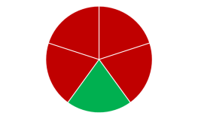
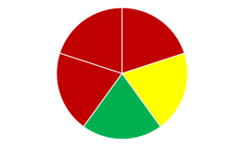
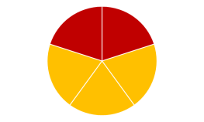
Eligibility Criteria for CSI – Low Performing
Using data from the 2019 Dashboard, the selection criteria for CSI – Low Performing are:
  All red (or ‘Very Low’ ELPI status) indicators
  All red (or ‘Very Low’ ELPI status) but one indicator of any other color
  Five or more indicators where majority are red (or ‘Very Low’ ELPI status)
  All red (or ‘Very Low’ ELPI status) and orange indicators
Notes:
JI

Slide 8
Eligibility Criteria for ATSI
ATSI uses the same criteria listed in slide 6.
ATSI is at the student group level (e.g., race/ethnicity, English learner).
Requires two years of Dashboard data (i.e., 2018 and 2019 Dashboards)
The same student group has to meet the criteria in slide 6 in consecutive years (i.e., 2018 and 2019 Dashboards).
Notes:
JI

Slide 9
Eligibility Criteria for Teacher Credentialing
Any school with 15 percent or more of the school’s teachers that do not possess a valid and clear or preliminary teaching credential
The formula used to calculate the teacher credentialing rate:
  Number of teachers that have a teaching assignment and possess a valid and clear or preliminary teaching credential at the school on Census Day (i.e., October 2020)
  Divided by
Number of teachers that have a teaching assignment at the school on Census Day (i.e., October 2020)
Multiplied by 100
Notes:
JI

Slide 10
Questions
Please submit all questions in the Q&A box.
The Chat box will not be monitored.
After this webinar, for questions regarding the schools identified for Williams monitoring, please email LCFFESSAdata@cde.ca.gov.

Slide 11


Thank you

