Slide 1
Expanded Learning Opportunities (ELO) Grant
CALIFORNIA DEPARTMENT OF EDUCATION
April 15, 2021
Notes:
Jen-play music

Slide 2
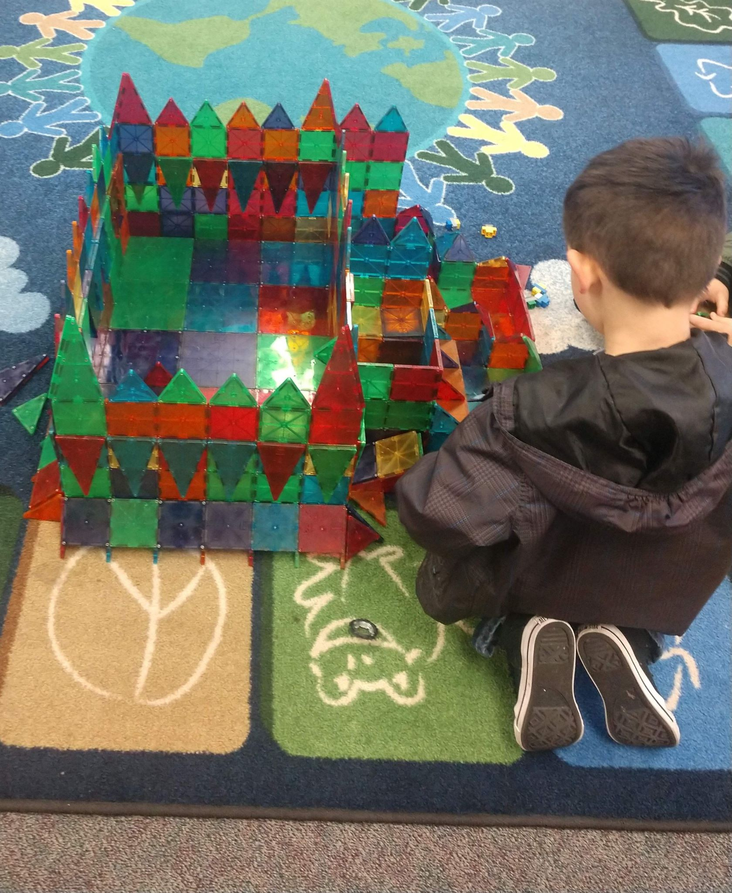
Welcome!
Notes:
Michael

Slide 3
Today’s Session
Intent of Expanded Learning Opportunities (ELO) Grant
Review ELO Grant Plan Template and Instructions
ELO Frequently Asked Questions
Fireside Chat: How leaders in the field are envisioning support for students
Notes:
Michael

Slide 4
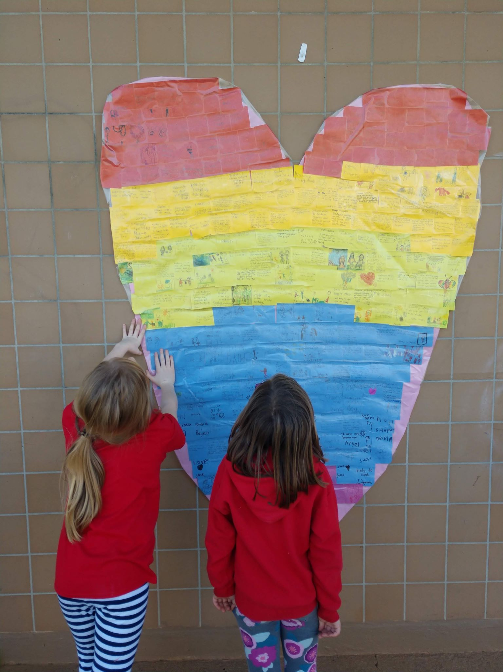
Intent of the
Expanded Learning Opportunities Grant
Dr. Stephanie Gregson
Chief Deputy Superintendent of Public Instruction
California Department of Education
Notes:
Stephanie

Slide 5
Assembly Bill 86
Joshua Strong, Education Administrator
Local Agency Systems Support Office
California Department of Education
Notes:
Josh

Slide 6
Assembly Bill (AB) 86 (1)
Approved on March 5th, 2021
Among other things, AB 86 provides In-Person Instruction and Expanded Learning Opportunities Grants for local educational agencies (LEAs)
LEAs eligible for the ELO Grant include school districts, county offices of education (COEs), charter schools, and state special schools.

Slide 7
Assembly Bill 86 (2)
As opposed to a typical grant process, there is not an application process for ELO Grants.
As a condition of receiving funding, a plan must be adopted by the local governing board or body of the LEA at a public meeting on or before June 1, 2021, and must be submitted to the COE, the California Department of Education (CDE), or the chartering authority within five days of adoption, as applicable

Slide 8
Expanded Learning Opportunity Grant Template and Instructions

Slide 9
Where to Find the Template
The Expanded Learning Opportunities Plan template and instructions can be found on the CDE’s COVID-19 Relief and School Reopening Grants page here: https://www.cde.ca.gov/ls/he/hn/covidreliefgrants.asp

Slide 10
Plan Requirements (1)
The Plan must be:
Completed by any LEA receiving ELO Grant funds under California Education Code (EC) Section 43521(b).
Adopted by the local governing board or body of the LEA at a public meeting on or before June 1, 2021.
Submitted to the county office of education, the California Department of Education, or the chartering authority within five days of adoption, as applicable.
Updated to include the actual expenditures by December 1, 2022.

Slide 11
Plan Requirements (2)
An LEA that receives ELO Grant funds is required to implement a learning recovery program that provides:
Supplemental instruction,
Support for social and emotional well being, and
Meals and snacks.

Slide 12
Plan Requirements (3)
The learning recovery program is to be provided to students who are included in one or more of the following groups:
low-income,
English learners,
foster youth,
homeless students,
students with disabilities,
students at risk of abuse, neglect, or exploitation,
disengaged students, and
students who are below grade level, and
other students identified by certificated staff.

Slide 13
Plan Template
The Plan Template consists of two components:
Plan Descriptions
Expenditure Plan
Specific requirements for completing the prompts in the template, as well as programmatic and fiscal requirements of the plan, are provided in the instructions.

Slide 14
Plan Descriptions
A description of how parents, teachers and school staff were involved in the development of the plan.
A description of how students will be identified and the needs of students will be assessed.
A description of how parents and guardians will be informed of the opportunities for supplemental instruction and support.
A description of the LEA’s plan to provide supplemental support and instruction.

Slide 15
Expenditure Plan (1)
There are seven supplemental instruction and support strategies that may be supported with ELO Grant funds.
Extending instructional learning time
Accelerating progress to close learning gaps through the implementation, expansion, or enhancement of learning supports
Integrated student supports to address other barriers to learning
Community learning hubs
Supports for credit deficient students
Additional academic services
Training for staff
Notes:
LEAs are to work collaboratively with their community partners to identify the supplemental instruction and support strategies that will be implemented.
LEAs are encouraged to engage, plan, and collaborate on program operation with community partners and expanded learning programs, and to leverage existing behavioral health partnerships and Medi-Cal billing options in the design and implementation of the supplemental instruction and support strategies being provided

Slide 16
Expenditure Plan (2)
Expanded Learning Opportunity (ELO) Grant funds may only be spent to support implementation of the seven identified supplemental instruction and support strategies
LEAs complete the Expenditure Plan data entry tables by specifying the amount of ELO Grant funds being budgeted to support each strategy being implemented and the total of all ELO Grant funds being budgeted
LEAs must also provide a description of how ELO Grant funds are being coordinated with Elementary and Secondary Schools Emergency Relief II funds

Slide 17
Reviewing the Template and Instructions
We will now display the template and walk through the template and instructions located here: https://www.cde.ca.gov/ls/he/hn/covidreliefgrants.asp

Slide 18
Frequently Asked Questions (FAQs)
Related to the template and instructions
Notes:
Josh

Slide 19
ELO Grant FAQs
The following are FAQs related to the ELO Grant and its implementation.
These FAQs are posted on the CDE’s IPI and ELO Grants Frequently Asked Questions web page at https://www.cde.ca.gov/ls/he/hn/covidgrantsfaqs.asp.

Slide 20
May local educational agencies (LEAs) use their local control and accountability plan (LCAP) stakeholder engagement process to meet the stakeholder engagement requirements for developing the Expanded Learning Opportunities Grant Plan?
California Education Code (EC) Section 43522(e)(2)(iii) requires that parents and school site staff, including classified and certificated staff be involved in the development of the Expanded Learning Opportunities Grant Plan; in addition, EC Section 43522(h) encourages LEAs to engage, plan and collaborate with community partners, expanded learning programs, and existing behavioral health partnerships in the design of the plan.
Therefore, LEAs may integrate stakeholder engagement related to the development of the Expanded Learning Opportunities Grant Plan into their ongoing LCAP stakeholder engagement process to the extent that it is appropriate and practicable to do so.

Slide 21
Are LEAs required to hold a public hearing to solicit stakeholder input prior to adopting the Expanded Learning Opportunities Grant Plan?
EC Section 43522(e) requires that the Expanded Learning Opportunities Grant Plan be adopted at a public meeting of the governing board or governing body of the LEA on or before June 1, 2021. Statute does not require an additional public hearing to be held prior to the adoption of the plan.
However, LEAs must include a description of how the LEA involved parents and school site staff, including classified and certificated staff, in the development of the plan pursuant to EC Section 43522(e)(2)(A)(iii).

Slide 22
Are LEAs required to submit the Expanded Learning Opportunities Grant Plan once it has been adopted by the local governing board or body of the LEA?
Yes; EC Section 43522(e) requires the plan to be adopted on or before June 1, 2021 and the plan must be submitted within five days of adoption by the governing board or body of the LEA.
School districts must submit the plan to their COE; charter schools must submit their plans to their chartering authority; COEs and school districts in a single-district county must submit their plans to the California Department of Education (CDE) by email at LCAPReview@cde.ca.gov.

Slide 23
Are COEs, chartering authorities, and the CDE required to review and/or approve Expanded Learning Opportunities Grant Plans?
No; while EC Section 43522(e) requires plans to be submitted as described in the previous FAQ, statute does not include a requirement for COEs, chartering authorities, or the CDE to review or approve Expanded Learning Opportunities Grant Plans adopted by a governing board or governing body.
As noted in the Annual Audit FAQ, EC Section 43523 requires that compliance be monitored through the annual audit process for the 2021–22 fiscal year.

Slide 24
Are LEAs required to post the Expanded Learning Opportunities Grant Plan on their web site?
Statute does not include a requirement for LEAs to post the Expanded Learning Opportunities Grant Plan on their web sites; however, in the interest of informing the local community, LEAs are strongly encouraged to post the adopted Expanded Learning Opportunities Grant Plan to the same web page as their LCAP.

Slide 25
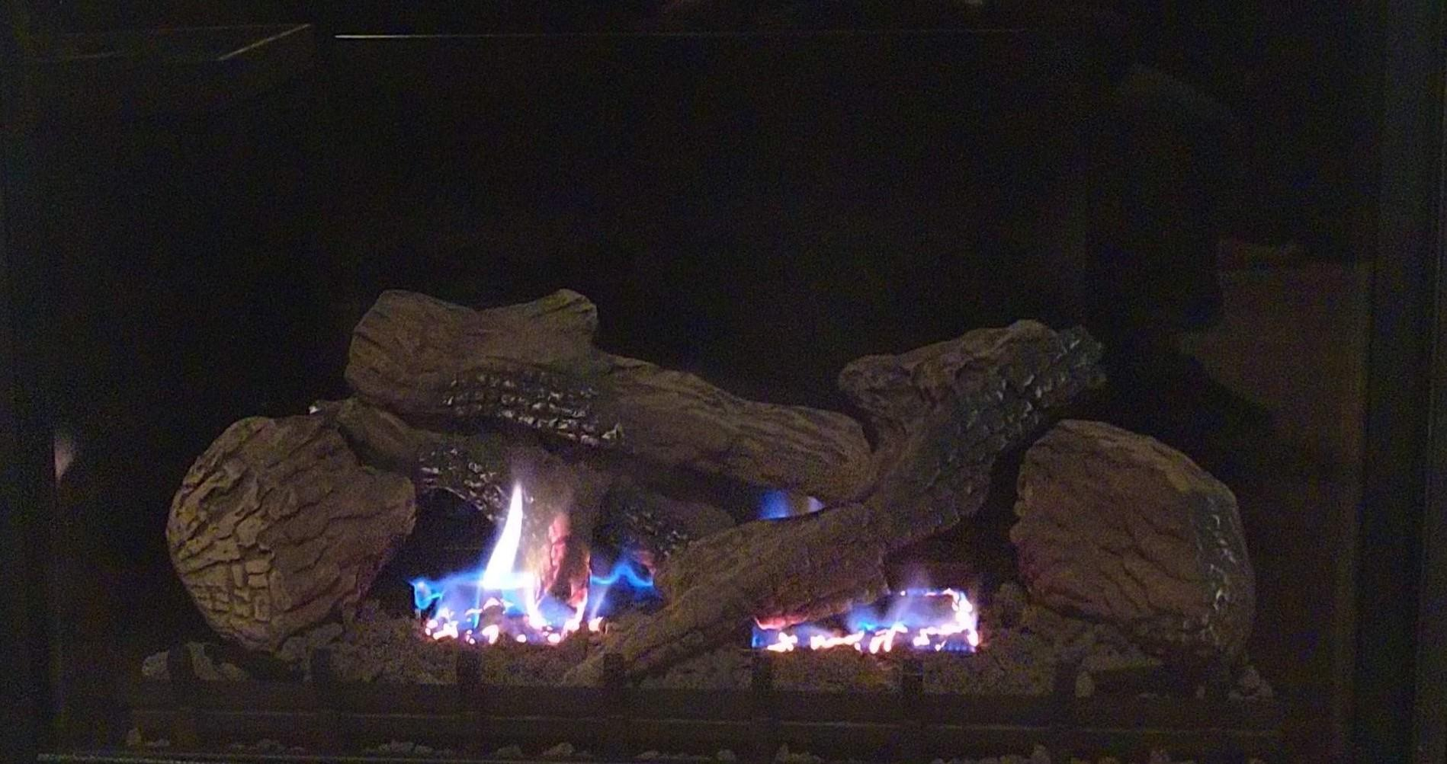
Fireside Chat
Michael Funk, Director, Expanded Learning Division, CDE
Dr. Paul Gothold, Superintendent, San Diego County Office of Education
Dr. Joe Johnson, Retired Dean and Professor at San Diego State University. Founder and Lead for the National Center for Urban Schools Transformation
Notes:
Michael

Slide 26
How can we design learning settings so that all students thrive? Pamela Cantor, M.D., Linda Darling-Hammond, Merita Irby, and Karen Pittman
“Education has long been central to the promise of the United States of America. But our current education system has never been designed to promote the equitable opportunities or outcomes that our children and families deserve, and that our democracy, society and economy need. Our system was designed for a different world — to support mass education preparing students for their presumed “places in life.” That world believed that talent and skills were scarce, it trusted averages as a measure of individuals and it was a world where racist beliefs and stereotypes shaped the system so that only some children were deemed worthy of opportunity. These beliefs influenced the learning and development ecosystem beyond school walls as well – such that access to high quality exploration and enrichment opportunities were more often a reflection of wealth and zip code than need or interest”.
Source: The SoLD Alliance, www.soldalliance.org

Slide 27
Webinar for A Whole Child Approach to the AB86 Expanded Learning Opportunities (ELO) Grant
You’re invited to a free virtual convening for all California Educators, featuring speakers, workshops, resources, innovative ideas, and peer learning.
Plan to attend as a team!
Wednesday, May 5, 2021
9 am – 3 pm
Additional details coming soon!
In partnership with:
Register at https://www.afterschoolnetwork.org/ab86-elo-convening

Slide 28
Closing
Lindsay Tornatore, Division Director
Student Achievement and Support Division
California Department of Education

Slide 29
ELO Resources
Main Page: https://www.cde.ca.gov/ls/he/hn/covidreliefgrants.asp
Frequently Asked Questions: https://www.cde.ca.gov/ls/he/hn/covidgrantsfaqs.asp
Funding Results: https://www.cde.ca.gov/fg/fo/r14/ipielo20result.asp

Slide 30
Questions
For questions about ELO Grants, please contact ELOGrants@cde.ca.gov.
For questions about the fiscal requirements of the ELO Grant, please contact Categorical Allocations and Audit Resolution Office, email: CAAR@cde.ca.gov.
For questions about the In-Person Instruction (IPI) Grant, please contact InPersonGrants@cde.ca.gov.

